Slide 3
Mass and Age Determination
CMD Fitting

Slide 4
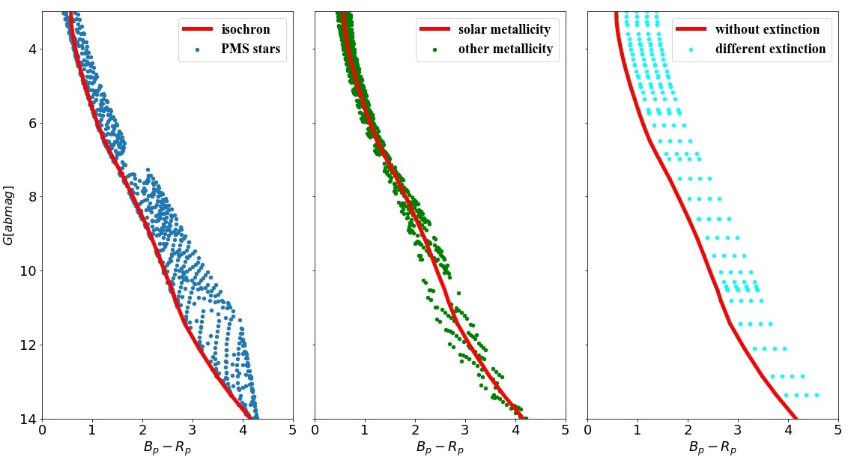
The limitation of CMD fitting

Slide 5
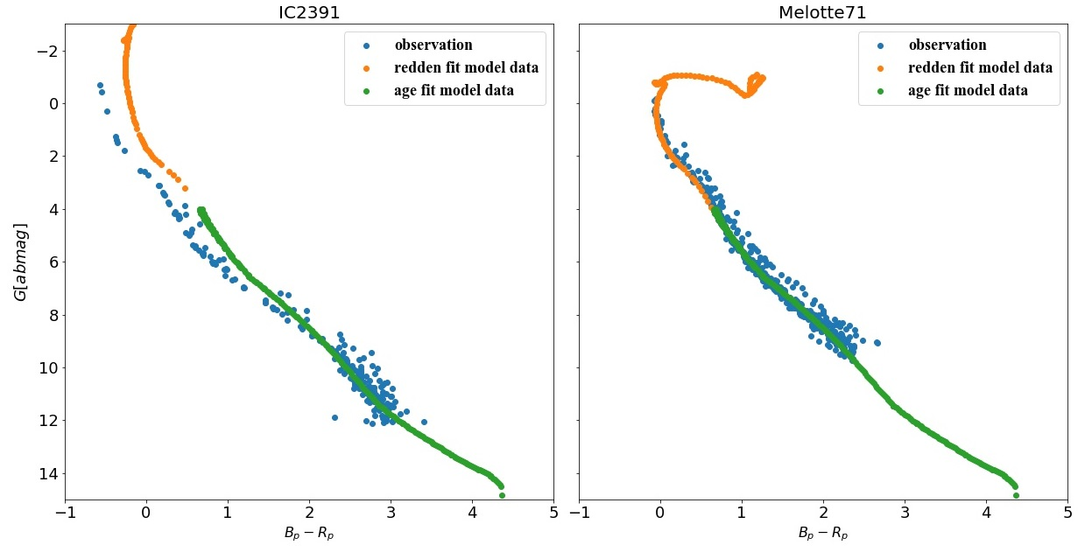
Linear redden model

Slide 6
Data Lists
Gaia data
Gaudin 2018
Bossini 2019
Bailer-Jones 2018
Extinction
Members of 1229 OCs
269 OCs, nearly half have metallicity
Distance of Gaia stars

Slide 7
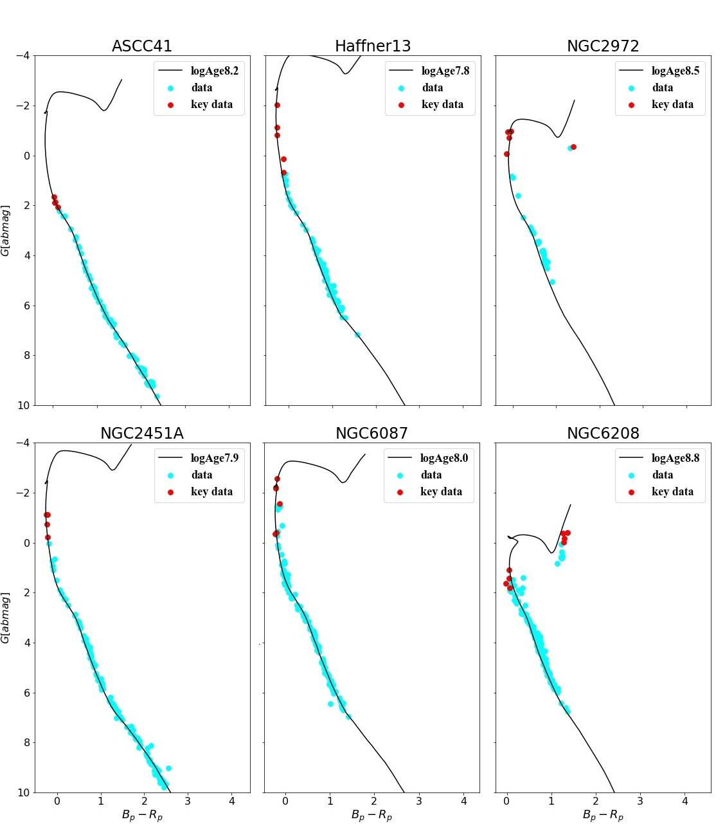
Final Fitting Result
Key data
Red Giant branch

Slide 8
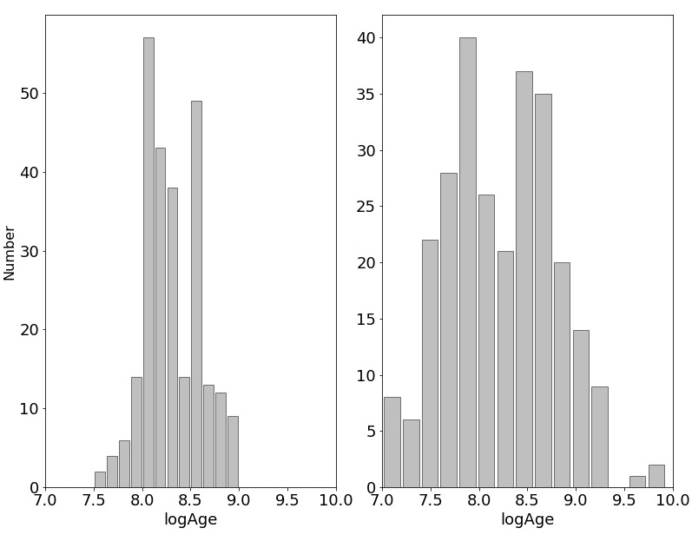
Age Distribution of 200+ OCs

Slide 9
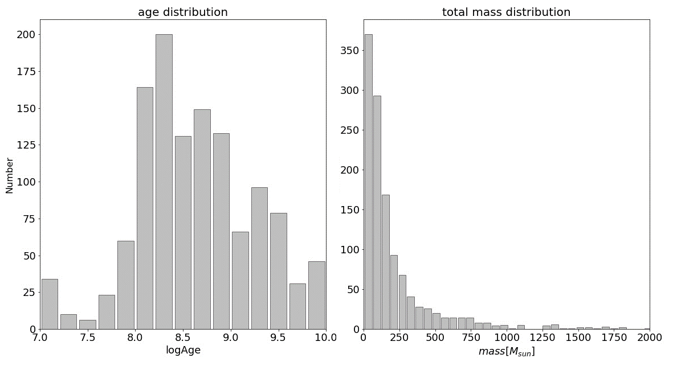
Final Age and Mass Distribution

Slide 10
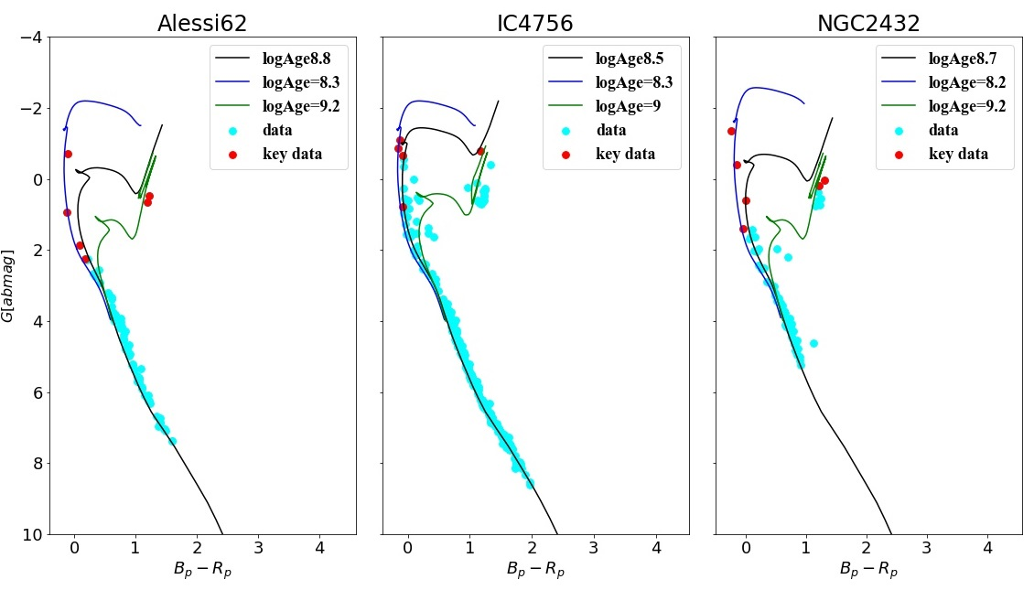
Discussion-Strange OCs

Slide 11
Further work
Fitting model (D. Bossini et al. 2019)
CMD + stellar bolometric corrections model (YBC)
(Yang Chen et al. 2019)

Slide 13
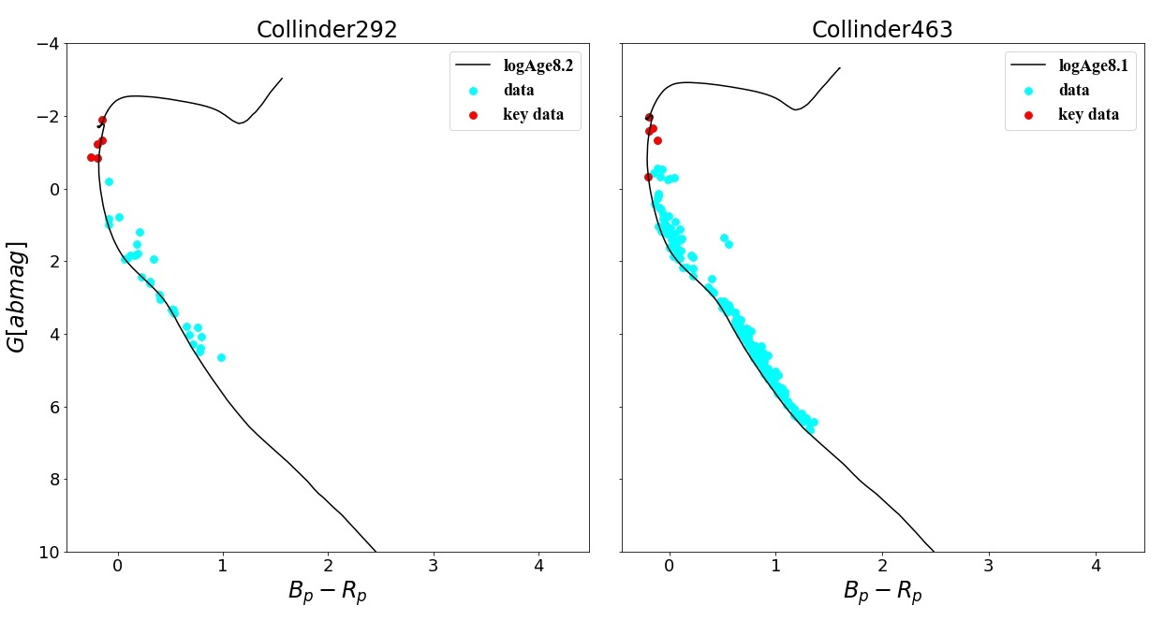
Discussion-Key Data Selection

