Slide 1
Evolution of Open Cluster
Zhiwei Pan: Scheme
Yu Qiu: Summary
Yuxuan Pang: PPT
2019.12.3

Slide 2
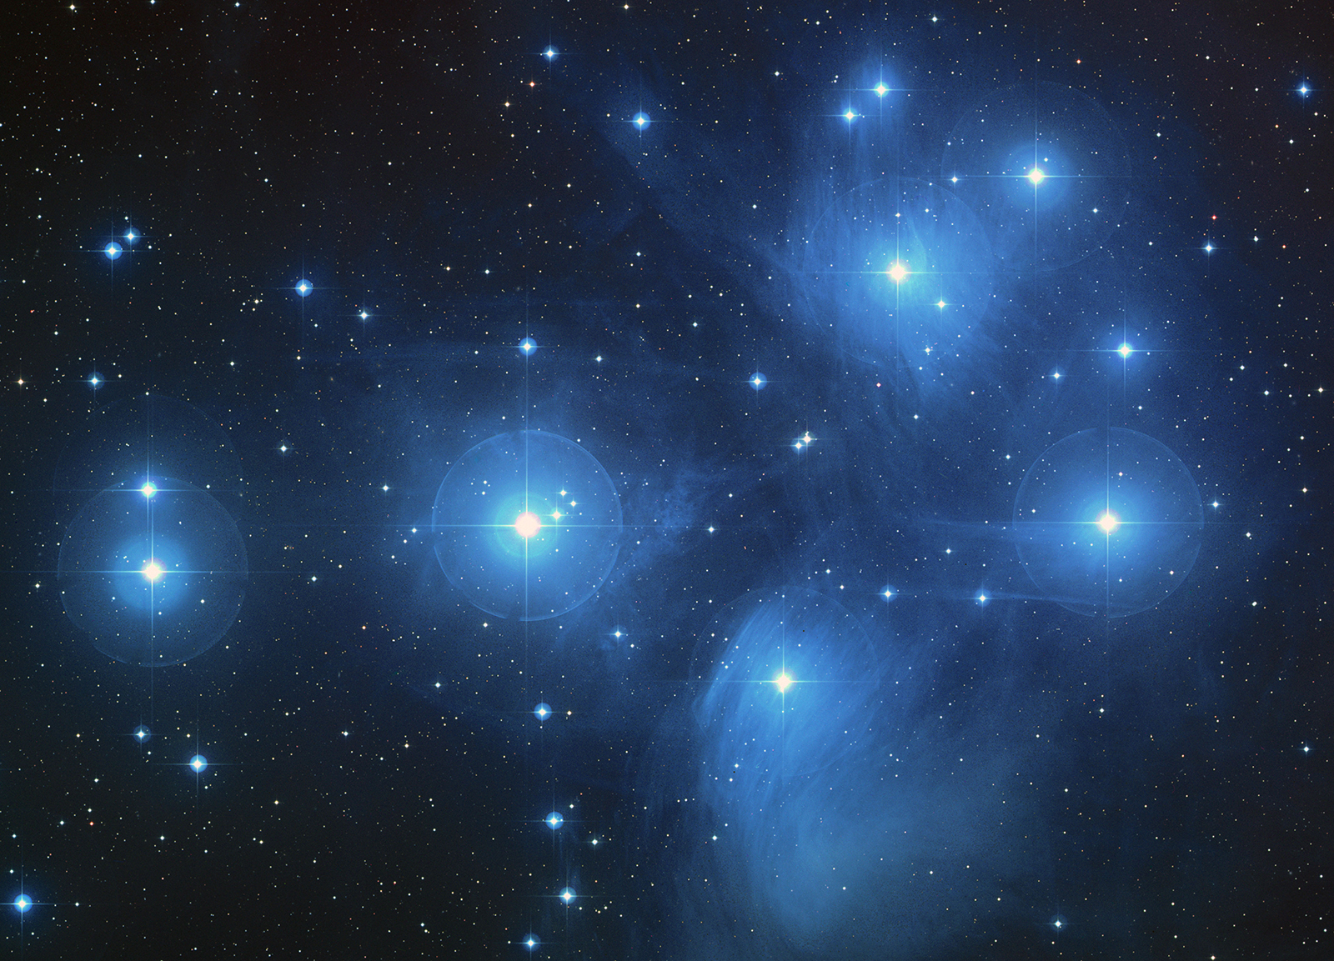
Background
Star clusters are very large groups of stars.
Two types of star clusters can be distinguished:
Globular cluster and open cluster
Open cluster widely used to trace the histroy of the Galactic disk and stellar evolution
Known stellar clusters comprise about 160 globular clusters and about 3000 open clusters
From Encyclopedia Britannica
Notes:
globular clusters are tight groups of hundreds to millions of old stars which are gravitationally bound, while open clusters, more loosely clustered groups of stars, generally contain fewer than a few hundred members, and are often very young

Slide 3
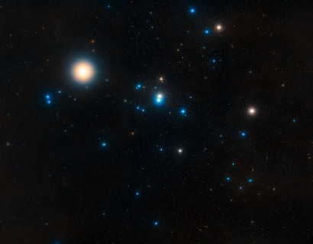
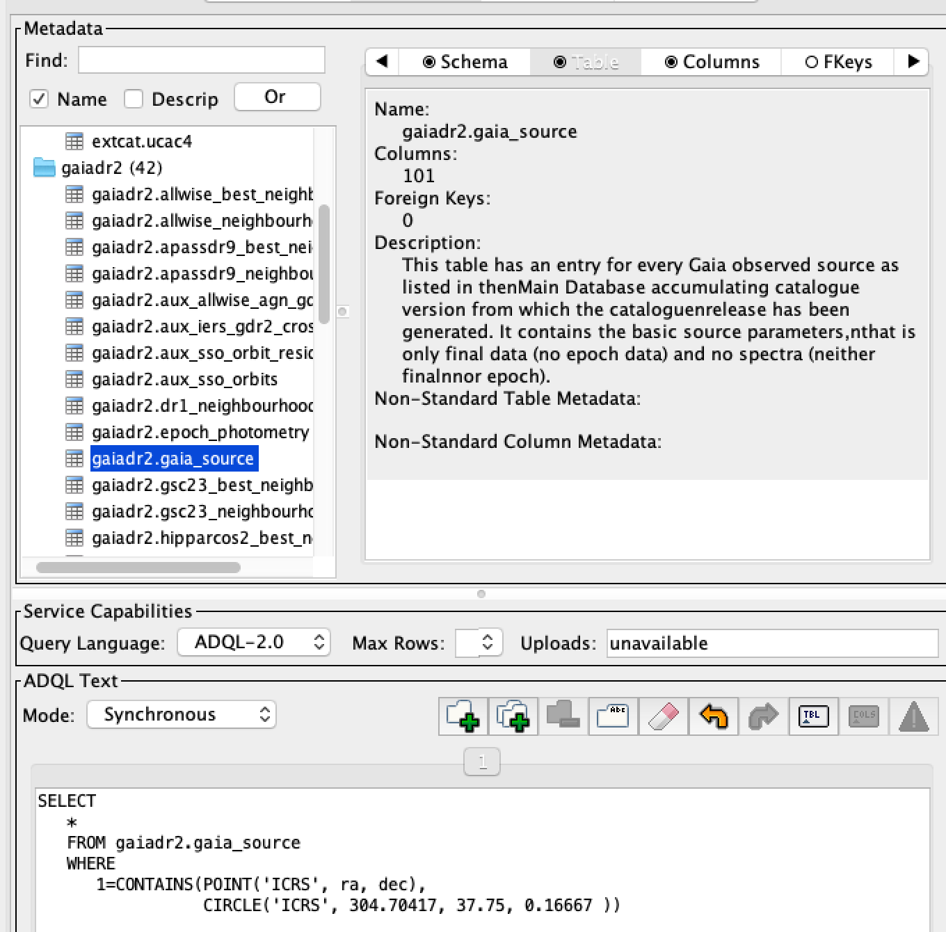

Scheme
Reproduce Tadross 2018 work
Gaia DR2 data (ADQL)
Crossmatch with 2MASS (Topcat)
Calculate basic parameters
“Pipeline”
Batch processing
Statistics
From sci.esa

Slide 4
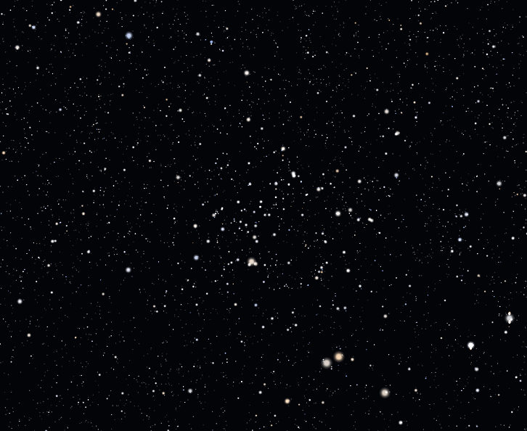
Expected Result
Parameters of 3000 open clusters
Distance, location, age
Mass
HR diagram
Metal abundance
Repose time
……
The evolution of clusters
Star numbers
Radius
……
From wiki NGC752

Slide 5
Thanks

