Slide 1
Artificial Neural Nets on CUDA
ECE 5720 Introduction to Parallel Computing
Project Presentation
Zhixin Lai(zl768) Jingwen Ye(jy879) Sizhe Zhang(sz592)

Slide 2
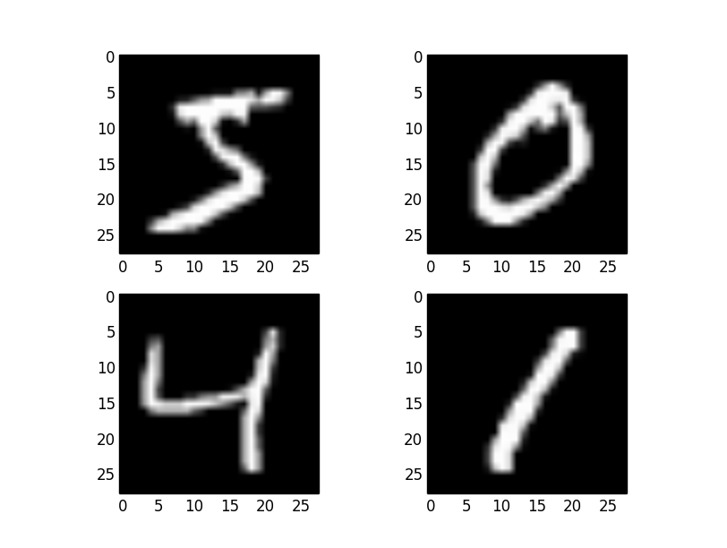
Introduction of Project
Goal:
Image classification with ANN
Speed up with GPU
Dataset:
Handwritten digits dataset (MNIST)
Model:
Artificial Neural Networks
Language:
C/C++ (CUDA)

Slide 3
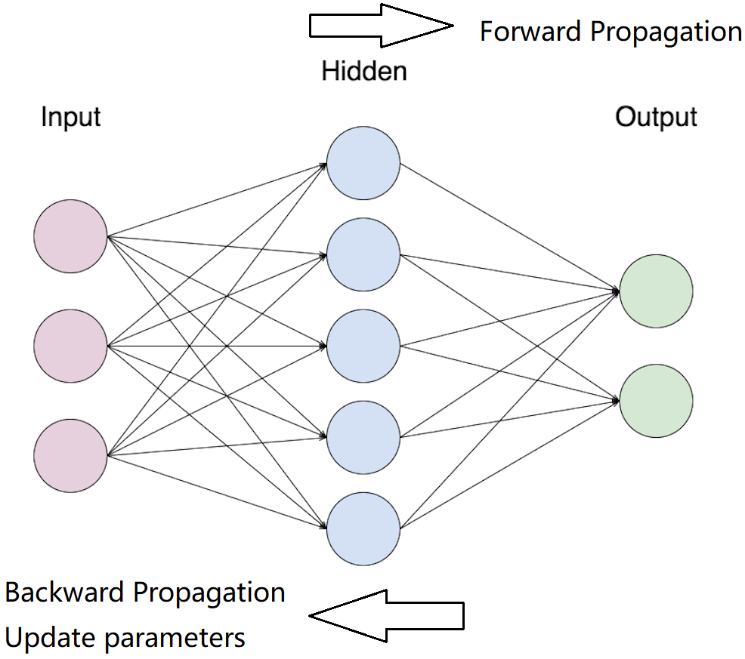
Model of Artificial Neural Networks
Input layer:
image(14 * 14 * 964) for train
image(14 * 14 * 414) for test
Hidden layer:
20 Nodes + Activation function (ReLU / Sigmoid)
Output layer:
2 Nodes + Softmax
Loss:
Cross-Entropy Loss

Slide 4
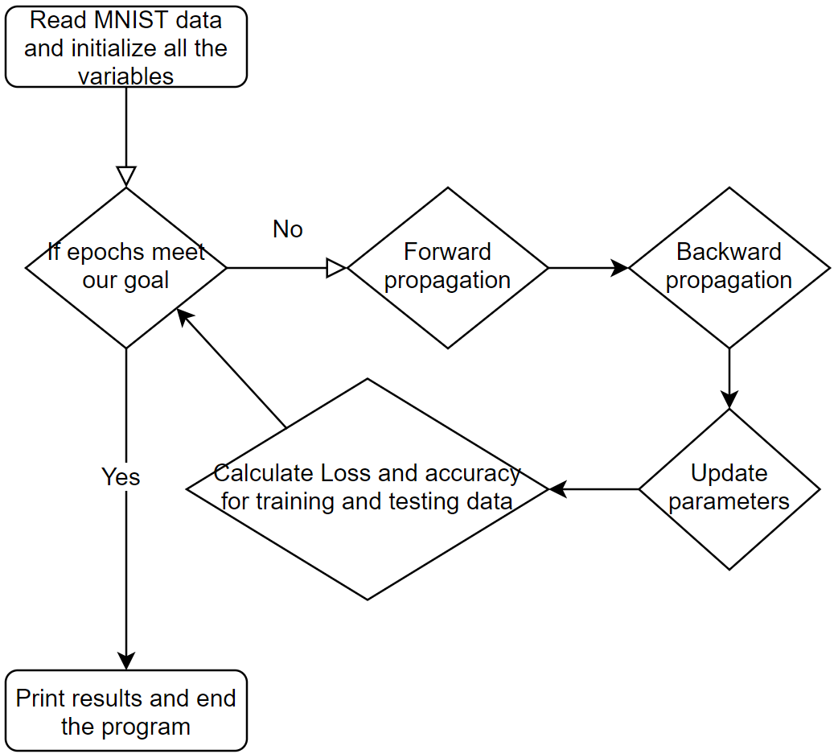
Logic of ANN
Simple version of MNIST
14*14 per image
964 images for training
414 images for testing

Slide 5

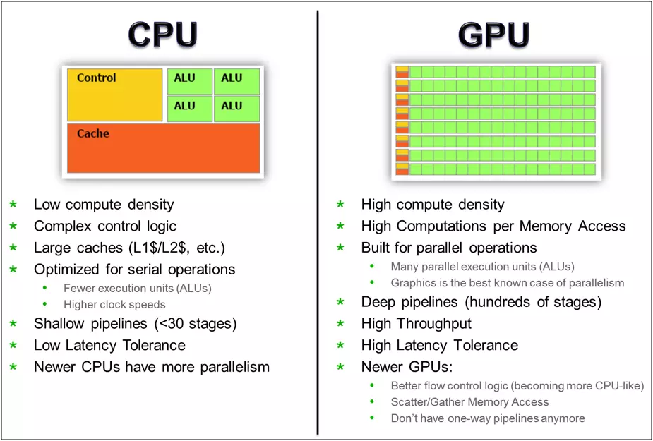
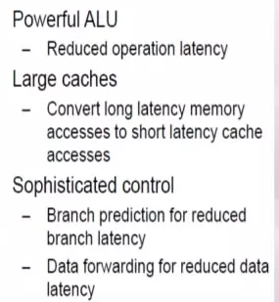
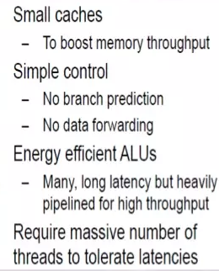
Introduction of CUDA
Compute Unified Device Architecture
Use GeForce series of Video Card GPU for computing.
In this project, GeForce GTX980 and Tesla K40C are provided
GPU is good for repeated tasks, such as Matrix Computation.

Slide 6
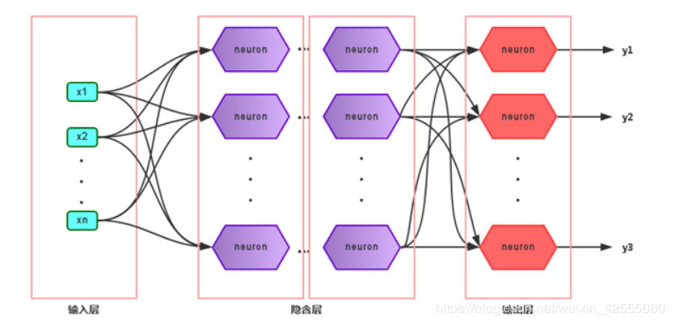
Parallel Computing Design
Forward （sequential）
Input Layer Hidden Layer Output layer Loss
No parallel Parallel Computing Parallel Computing No parallel
Backward （sequential）

Slide 7
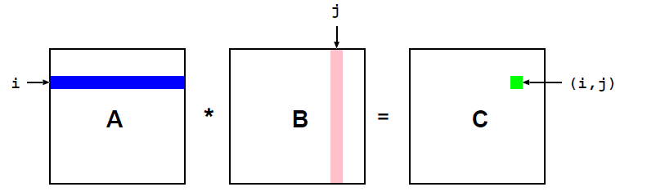
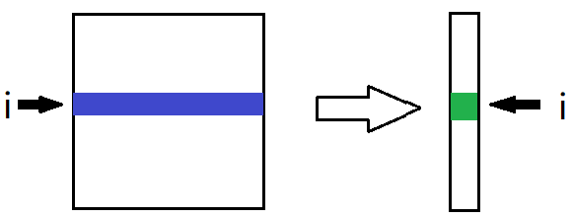
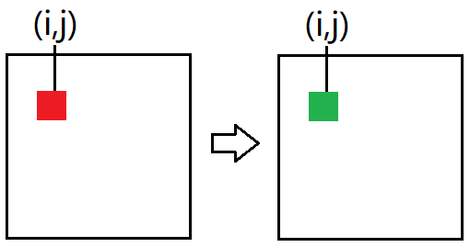
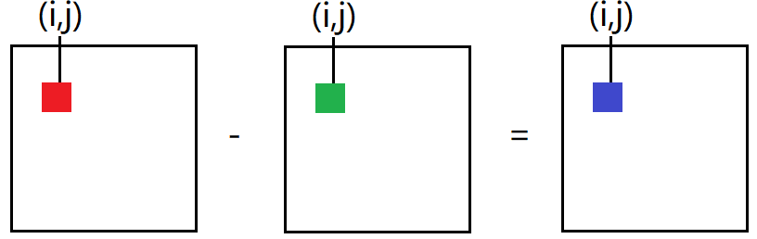
Parallel Computing Design
(1) Forward
Matrix-matrix multiply: W*X
Softmax: Matrix elements add
Activation function:
Sigmoid / ReLU
(2) Backward
Matrix-matrix multiply: W*X
Activation function: Sigmoid / ReLU
(3) Update parameter
Matrix-matrix add: W-dW*rate
i= blockIdx.y * blockDim.y + threadIdx.y
j= blockIdx.x * blockDim.x + threadIdx.x

Slide 8
Experiment Design
(1) Different versions
Sequential computing version
Code without CUDA
V1: Basic version of parallel computing
Parallel compute for each part of ANN (Forward, backward....)
V2: Reduce times of memory copy and allocation and use shared memory
Some duplicate memory copy between CPU and GPU are removed
Some duplicate memory allocation for each epoch can be removed
Introduce the shared memory(cost more time)
V3: Remove the if-else
Remove if-else of __global__ code ran on device to avoid warp divergence
V4: Use stream
Use stream to allows overlapping between CPU(Memory copy) and GPU
cudaMemcpyAsync(), cudaStreamSynchronize()
(2) Each parallel computing experiment
Block size is 1*1, 2*2, 4*4, 8*8, 16*16, 32*32

Slide 9
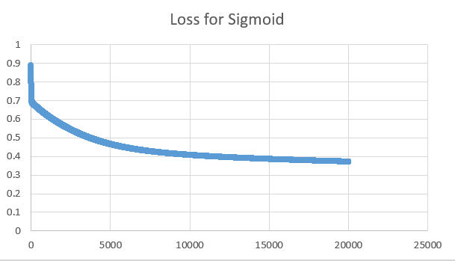
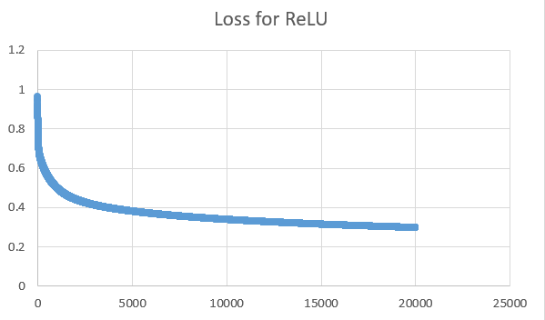
Result and Analysis
(1) Sequential computing
Loss:
Sigmoid: ReLU:
Accuracy:
Sigmoid:
Training set: 0.852697, testing set: 0.842995
ReLU:
Training set: 0.870332, testing set: 0.840580
Convergence speed: ReLU > Sigmoid

Slide 10
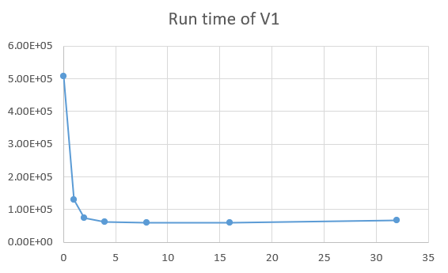
Result and Analysis
(1) V1: Basic version of parallel computing
Parallel vs Sequential
Speed up by 10x with CUDA
Influence of block size
Run time decreases first and increases then with the increase of the block size
x - block size ( 0 means series computing without CUDA)
y - run time (ms)

Slide 11
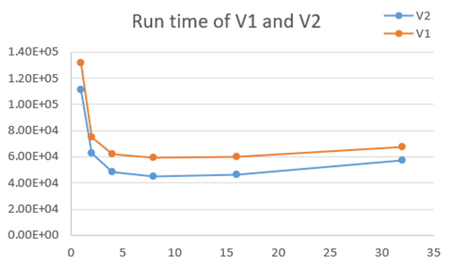
Result and Analysis
(2) V2: Remove duplicate memory copy and allocation + shared memory
Compared with V1
Reducing the times of memory copy and allocation can save running time
x - block size; y - run time (ms)

Slide 12
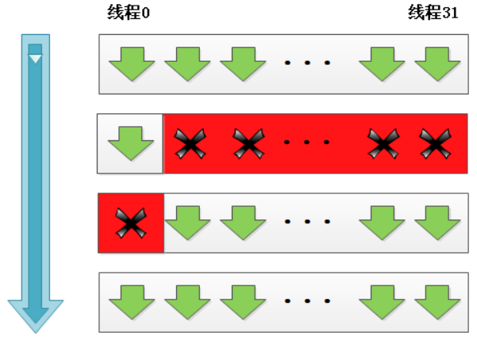
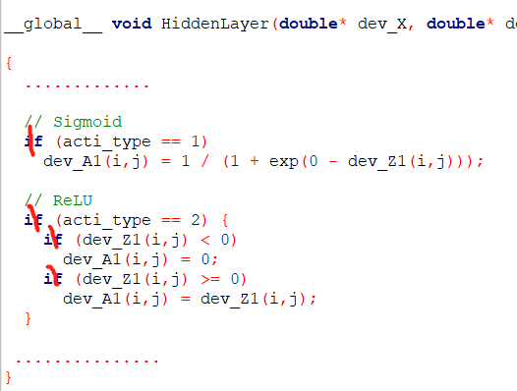
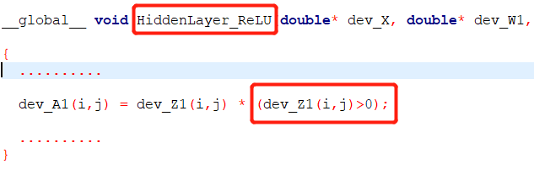
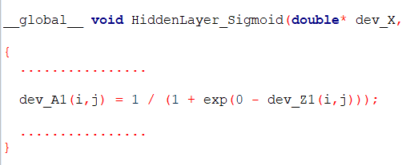
Result and Analysis
(3) V3: Remove the if-else
warp divergence
divide

Slide 13
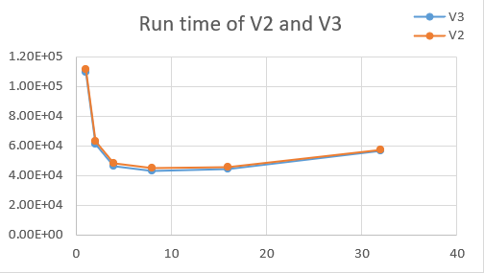
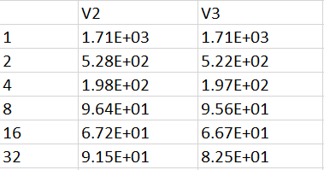
Result and Analysis
(3) V3: Remove the if-else
Compared with V2
Remove if-else of code ran on device to avoid warp divergence. It helps save time.
The local run time of V4 is less than the local run time of V3. Therefore, avoid warp divergence helps save time.
Run time for the whole code
Run time for the local code of if-else

Slide 14
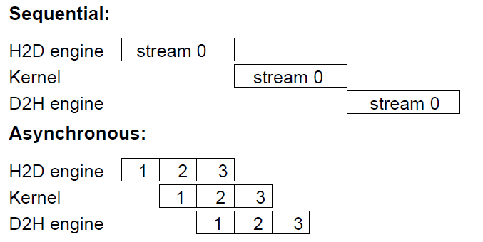
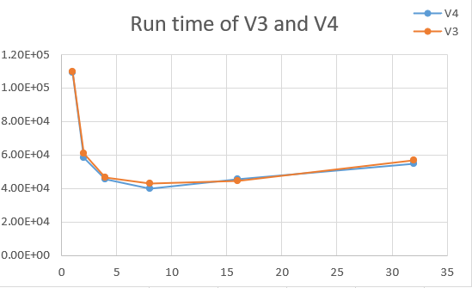
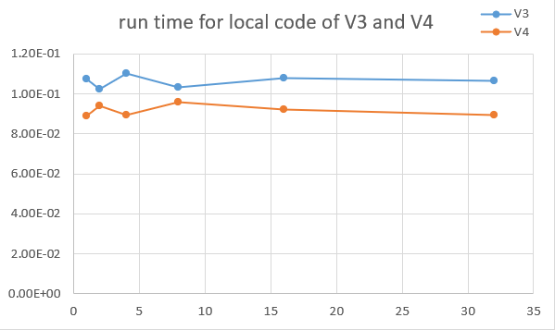
Result and Analysis
(4) V4: Use stream
cudaStreamSynchronize
Compared with V3
Use stream to allows overlapping between CPU(Memory copy) and GPU.
The local run time of V4 is less than the local run time of V3. Therefore, stream helps save time.

Slide 15
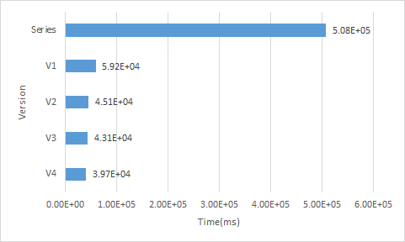

Conclusion
sequential
Series no CUDA: 5.08E+05 ms
V1 block size = 8: 5.92E+04 ms
V2 block size = 8: 4.51E+04 ms
V3 block size = 8: 4.31E+04 ms
V4 block size = 8: 3.97E+04 ms
Run time decreases!
Efficiency improved!
Parallel computing improves the efficiency by more than 12 times to Sequential computing;
Block size influence the efficiency and find the best size is also important;
Remove if-else code on device to avoid warp divergence and improve efficiency;
Using stream to allow overlapping between CPU and GPU improves the efficiency.
Much more can do to improve efficiency: optimize the memory access, dynamic parallelism…………

Slide 16
Thank You
Q & A

