Slide 1

Graduate
Project
Zhixiu Kang

Slide 2
Introduction
Research and Implementation of Text Content Clustering Method for Breaking News
Zhixiu Kang
Advisor: Dongqi Wang
Reviewer: Yi Ma

Slide 3
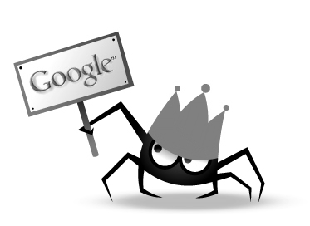
Background
Information Explosion
People have requirements to use data

Slide 4
Main Work
Chinese Segmentation
Web Crawling
TF-IDF
K-means Clustering

Slide 5
Technologies
1
2
3
4
Web crawling
Chinese Segmentation
TF-IDF
K-means Clustering
Pyquery
Regular Expression
chardect
jieba
CountVectorizer
Lloyd Algorithm

Slide 6
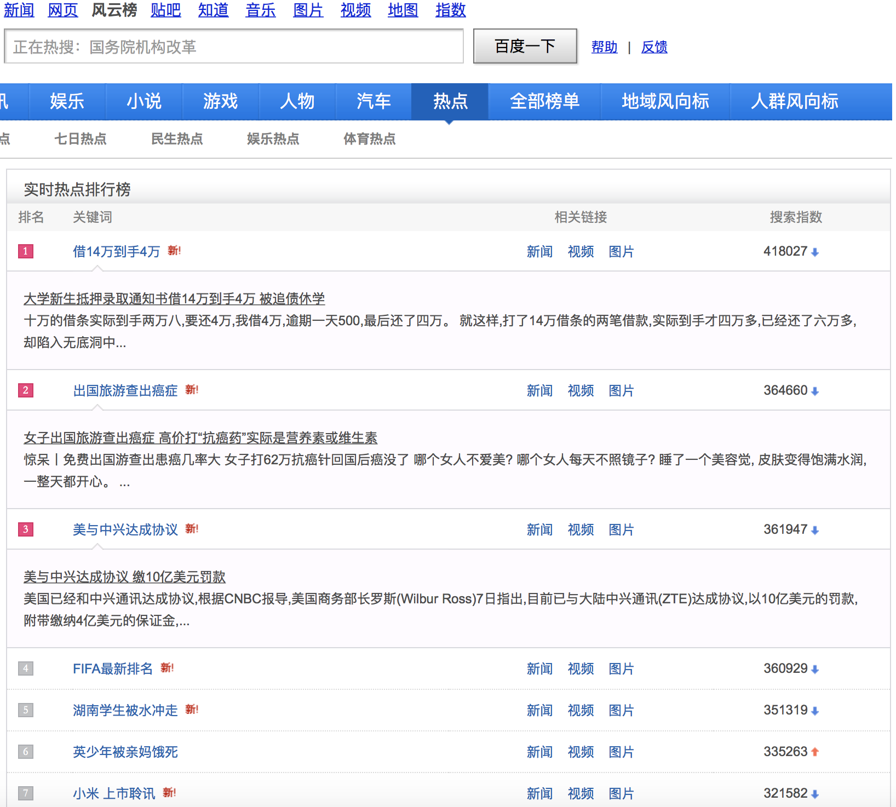
http://top.baidu.com/buzz?b=1
Web Crawling

Slide 7
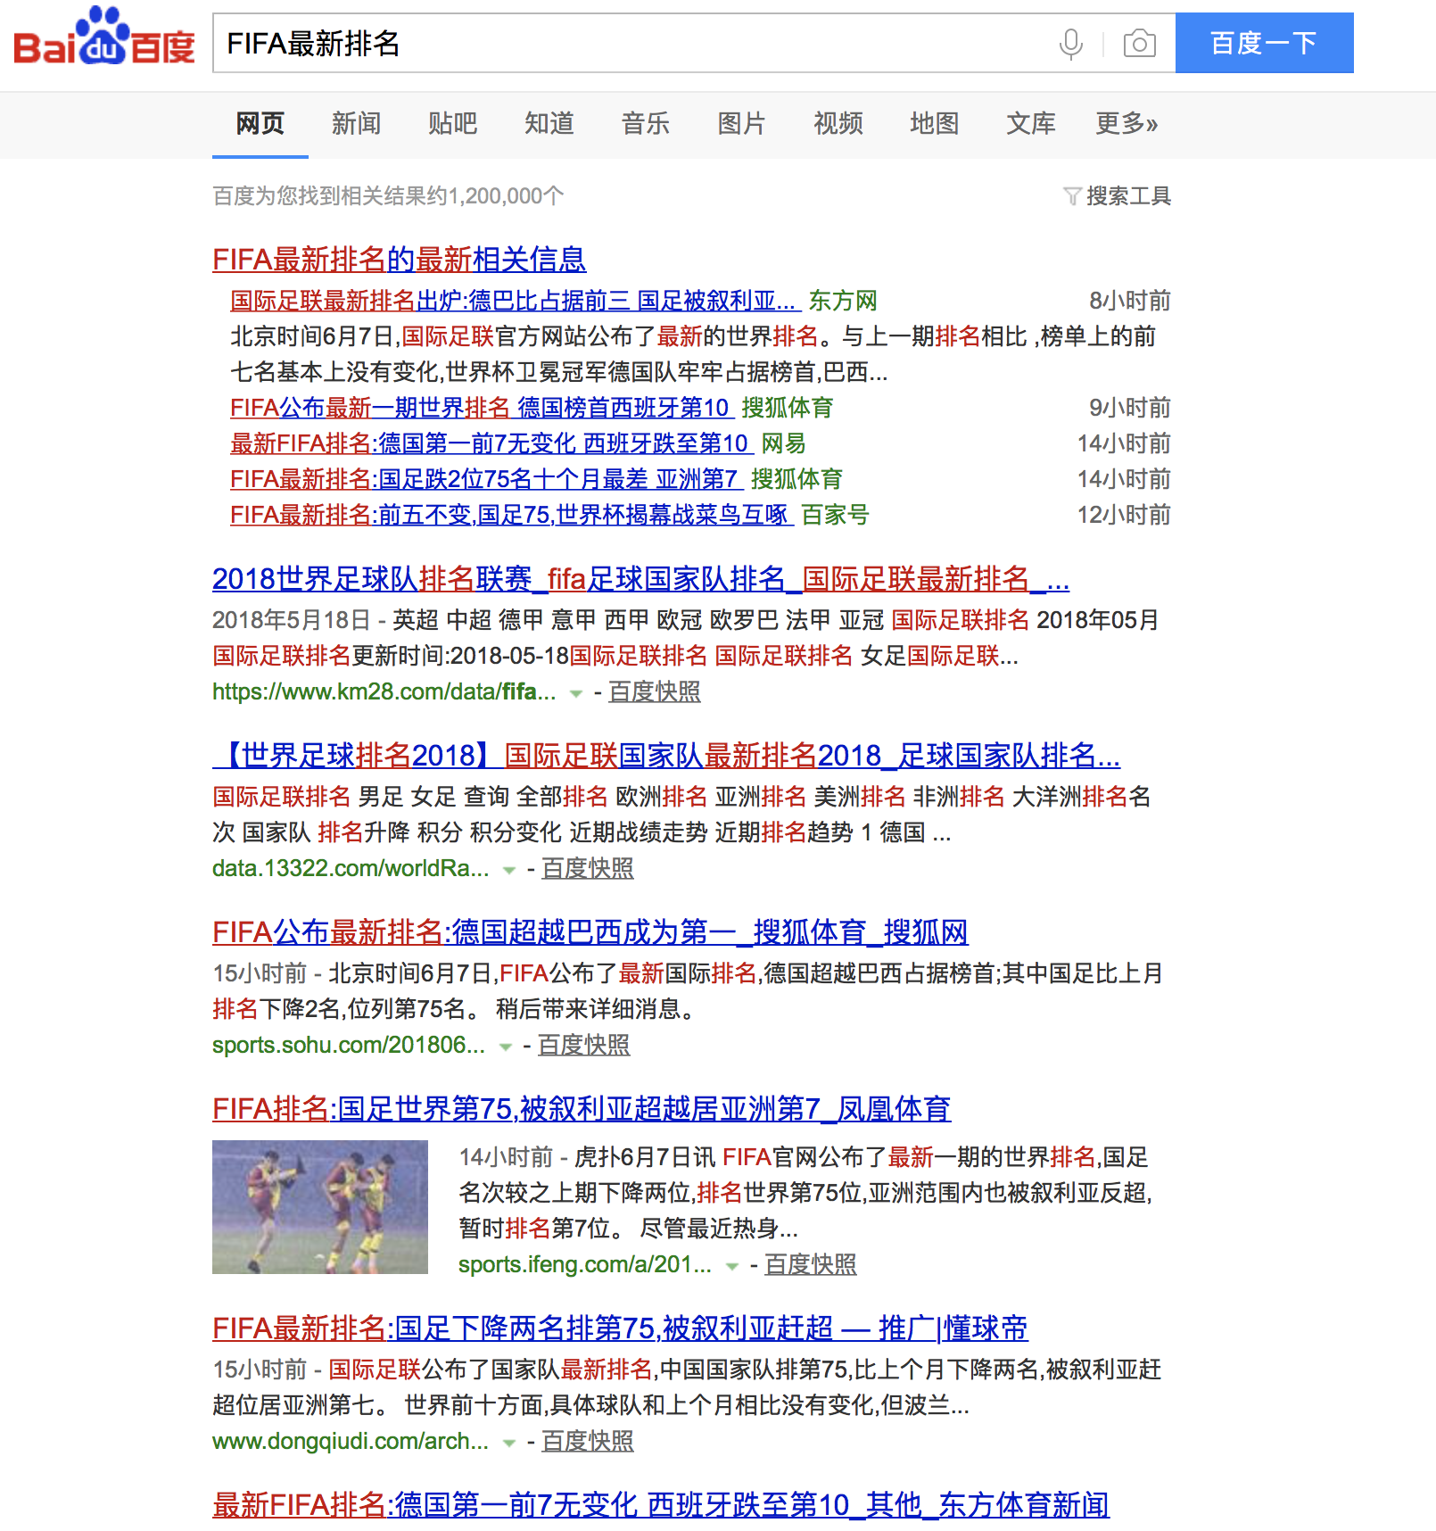

Slide 8
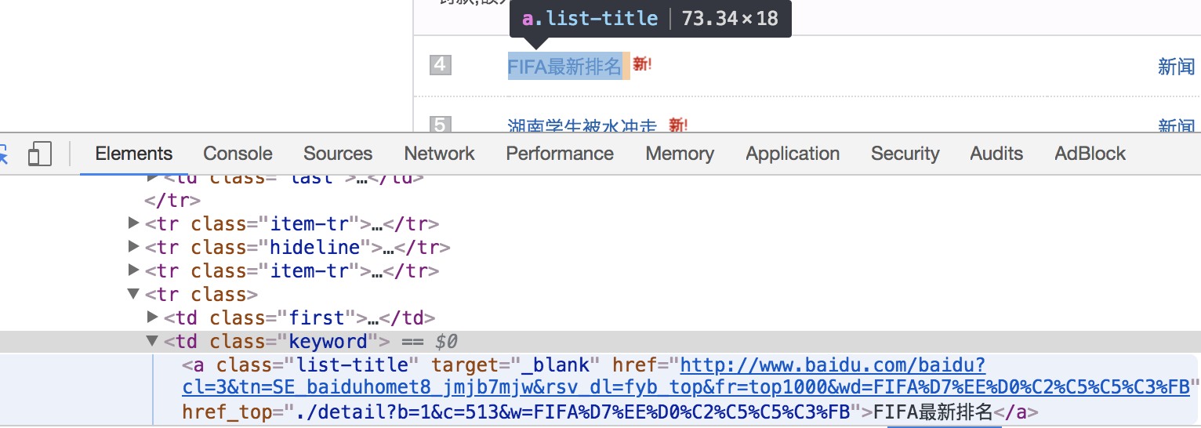
pyquery

Slide 9
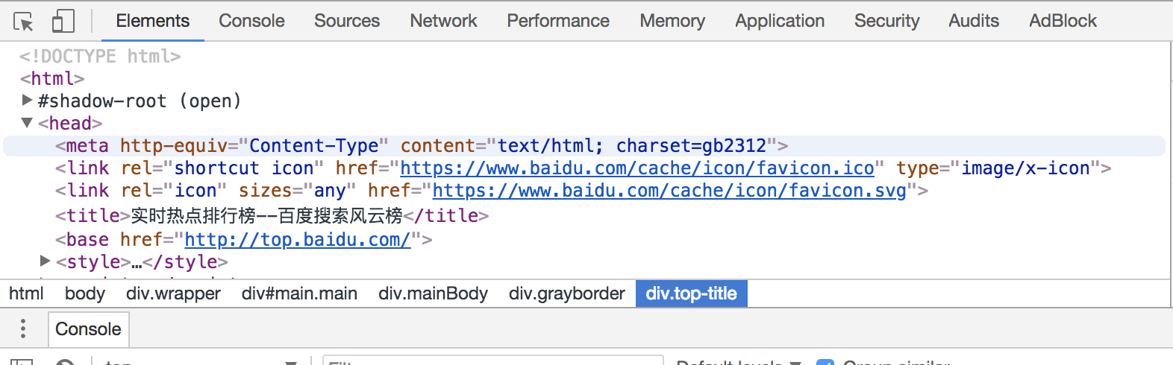
chardect

Slide 10
Regular Expression

Slide 11
Part of Crawled Data
Keyword | News_content
情侣遭敲门威胁 | 情侣遭敲门威胁原标题细思极恐住酒店半夜有人敲门月日晚长沙火车站附近的橙果酒店罗小姐化
暴漫创始陵园道歉 | 暴漫创始陵园道歉为什么道歉道歉说了什么具体什么情况合肥网暴漫创始陵园道歉月日暴走漫画
重庆面馆天价面条 | 重庆面馆天价面条重庆面馆天价面条元一碗是什么面中国历史网重庆面馆天价面条重庆面馆天价
一学习就流鼻血 | 学习用脑流鼻血近日山东济南岁男孩小田一学习用脑就流鼻血一天多达次无奈只得休学多家医院
借宝马当婚车被烧 | 新人结婚借来宝马当婚车不料豪车起火烧成空壳或赔百万万家热线安徽门户网站新人结婚借来宝
王毅回应美撤邀请 | 王毅回应美撤邀请热点法律法规网王毅王毅回应美撤邀请热点实时热点原标题美取消邀请中国参
张艺谋吐槽低头族 | 张艺谋吐槽低头族菜上来就拍你吃还是手机吃张艺谋手机低头族对话寓言新浪娱乐新浪网张艺谋
陈法蓉霸气斥谣言 | 陈法蓉霸气斥谣言是怎么回事陈法蓉霸气斥什么谣言海峡网此处须引用头条此处可以改背景色背

Slide 12
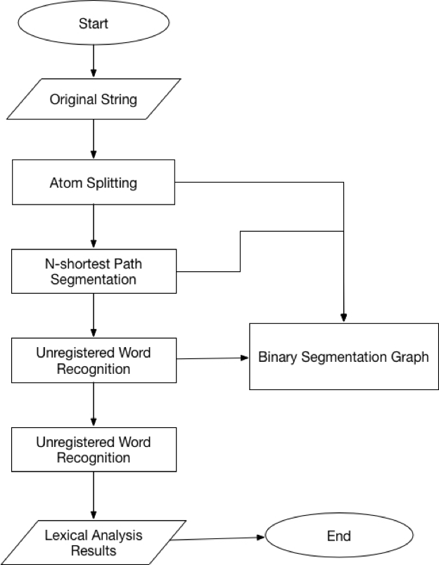
Word Segmentation

Slide 13
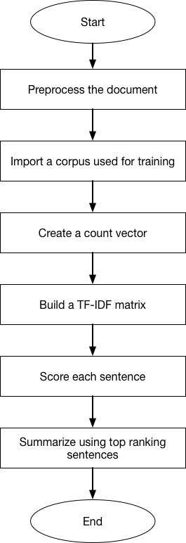
TF-IDF Model

Slide 14
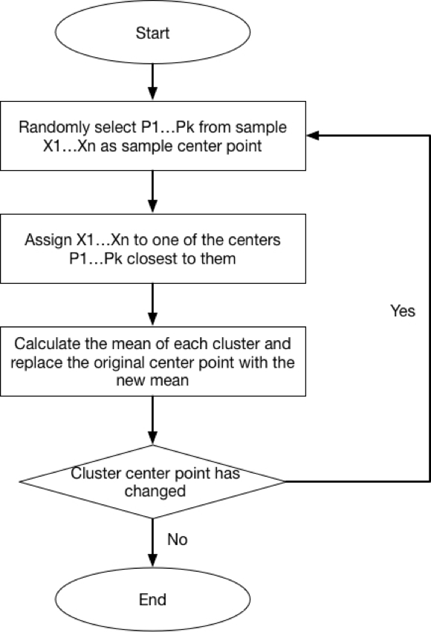
K-means Clustering

Slide 15
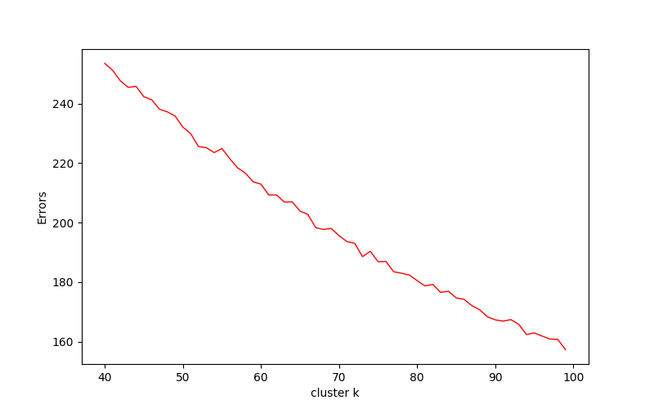
Find the best k

Slide 16
Part of Clustered Data
Real Label | id | Cluster
情侣遭敲门威胁 | 1-10 | 47, 27, 8, 27, 27, 6, 37, 27, 8
暴漫创始陵园道歉 | 11-19 | 34, 34, 34, 34, 34, 34, 34, 37
重庆面馆天价面条 | 20-29 | 6, 6, 6, 6, 37, 6, 6, 1, 37, 24
一学习就流鼻血 | 30-40 | 40, 12, 25, 2, 8, 40, 1, 20, 1, 1, 17
借宝马当婚车被烧 | 41-48 | 13, 42, 25, 42, 42, 42,17, 25
王毅回应美撤邀请 | 49-57 | 40, 40, 39, 21, 40, 40, 0, 40, 40
张艺谋吐槽低头族 | 58-66 | 29, 21, 8, 47, 6, 24, 2, 6, 7

Slide 17
Innovation
Using chardect to format messy html code
First person to cluster Baidu breaking news

Slide 18
Deficiency
1
Still some redundant data in crawled data, this will reduce the accuracy of later result.
2
Clustering results could be visualized and be displayed in a more vivid way.

Slide 19
THANKS

