Slide 1
Chapter 2
Simple Linear Regression
2.4 Least-Squares Regression
2.5 Cautions about Correlation and Regression
2.7 The Question of Causation

Slide 2
2.4 Least-Squares Linear Regression
Linear regression
Least-squares linear regression
Predictions
Facts about least-squares linear regression
Correlation and regression

Slide 3
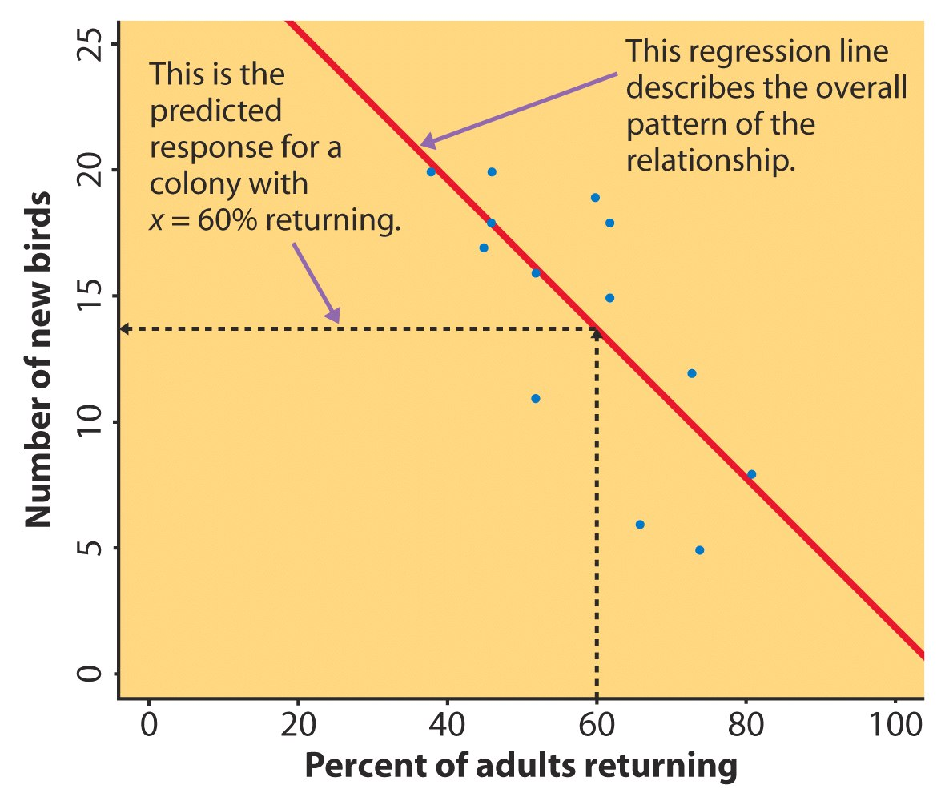
Linear Regression 1
The linear regression to create a straight line (regression line) to describe the relationship between explanatory variable x and the predicted value of response variable y.
We can use a regression line to predict the value of y for a given value of x.
Example: Predict the number of new adult birds that join the colony based on the percent of adult birds that return to the colony from the previous year.
If 60% of adults return, how many new birds are predicted?
Notes:
When a scatterplot displays a linear pattern, we can describe the over all pattern by drawing a straightline through the points.
Fitting a line to data means drawing a line that comes as close as possible to the points

Slide 4

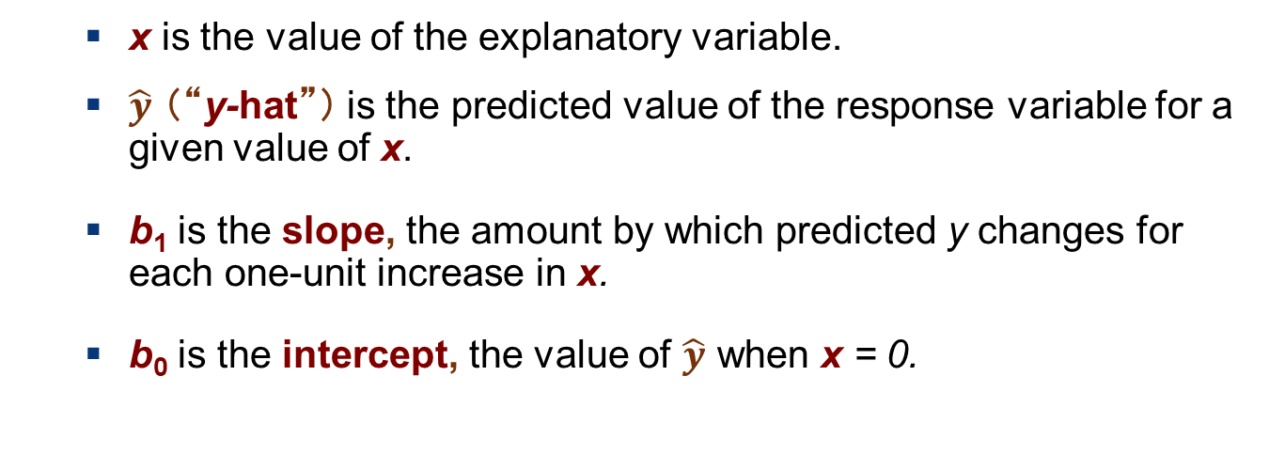
Linear Regression 2
When a scatterplot displays a linear pattern, we can describe the overall pattern by fitting a straight line to the data points. To fit such a line, the first step is to assume that
$$\hat{y}=b_{0}+b_{1}x$$
  x is the value of the explanatory variable.
  $\hat{y}$ （“y-hat”） is the predicted value of the response variable for a given value of x.
  b₁ is the slope, the amount by which predicted y changes for each one-unit increase in x.
  b₀ is the intercept, the value of $\hat{y}$ when x = 0.
Notes:
Or regression model

Slide 5
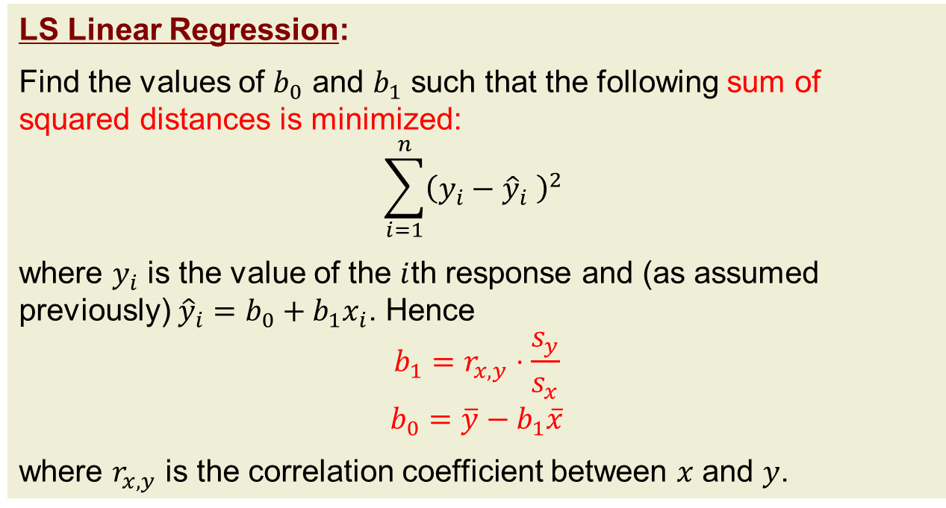
Linear Regression 3
The remaining issue is to obtain values of $b_{0}$ and $b_{1}$. A classical way is to follow the (ordinary) least squares (abbr. OLS or LS) method.
LS Linear Regression:
Find the values of $b_{0}$ and $b_{1}$ such that the following sum of squared distances is minimized:
$$\sum_{i=1}^{n}{{\left(y_{i}−{\hat{y}}_{i} \right)}^{2} }$$
where $y_{i}$ is the value of the $i$th response and (as assumed previously) ${\hat{y}}_{i}=b_{0}+b_{1}x_{i}$. Hence
$$b_{1}=r_{x,y}⋅\frac{s_{y}}{s_{x}}$$
$$b_{0}=\overline{y}−b_{1}\overline{x}$$
where $r_{x,y}$ is the correlation coefficient between $x$ and $y$.

Slide 6
Predictions Via Regression Line
For the returning birds example, the fitted linear regression is
y-hat = 31.9343 − 0.3040x
y-hat is the predicted number of new birds for colonies with x percent of adults returning.
Suppose we know that an individual colony has 60% returning. What would we predict the number of new birds to be for just that colony?
For a colony with 60% returning adults, the predicted number of new birds is
31.9343 − (0.3040)(60) = 13.69

Slide 7
Extrapolation 1
Sarah’s height was plotted against her age.
Can you guess (predict) her height at age 42 months?
Can you predict her height at age 30 years (360 months)?
Notes:
Extrapolation is not applicable; COVID-19 confirm cases over time

Slide 8
Extrapolation 2
Regression line:
y-hat = 71.95 + .383 x
Height at age 42 months? y-hat = 88
Height at age 30 years? y-hat = 209.8 (The linear relationship observed for young children should not be extrapolated to sth. outside the range of training data).

Slide 9
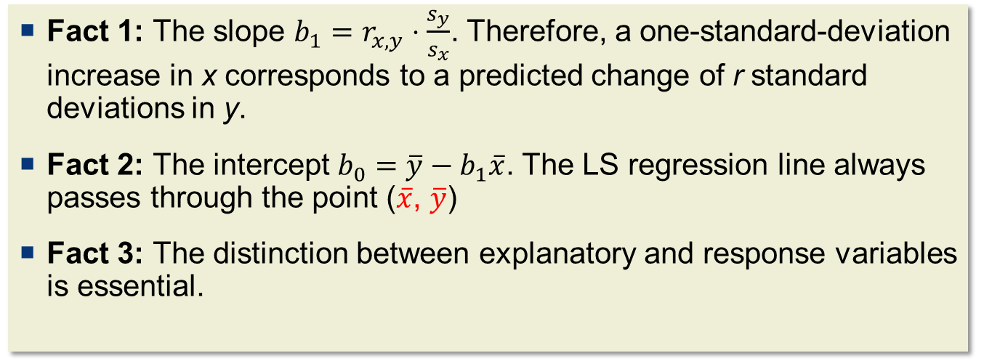
Facts About Least-Squares Linear Regression
LS is the most common method for fitting a regression line to data. Here are some facts about LS linear regression.
Fact 1: The slope $b_{1}=r_{x,y}⋅\frac{s_{y}}{s_{x}}$. Therefore, a one-standard-deviation increase in x corresponds to a predicted change of r standard deviations in y.
Fact 2: The intercept $b_{0}=\overline{y}−b_{1}\overline{x}$. The LS regression line always passes through the point ($\overline{x}$, $\overline{y}$)
Fact 3: The distinction between explanatory and response variables is essential.
Notes:
Give example for the relationship between b1 and r --- change of unit for X or Y will change slope, but not r --- give a plot from R example --- scale down the X

Slide 10
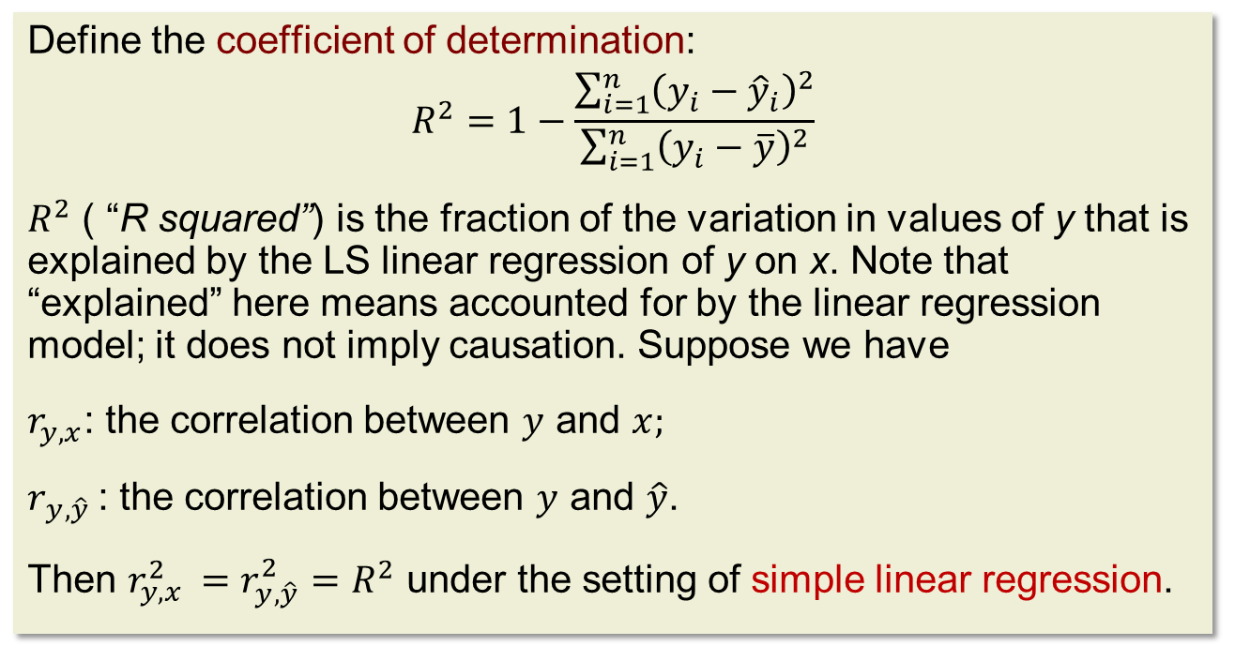
Correlation and Simple Linear Regression
Under the setting of simple linear regression, there is a close connection between the correlation and regression.
Define the coefficient of determination:
$$R^{2}=1−\frac{\sum_{i=1}^{n}{{\left(y_{i}−{\hat{y}}_{i}\right)}^{2}}}{\sum_{i=1}^{n}{{\left(y_{i}−\overline{y}\right)}^{2}}}$$
$R^{2}$ ( “R squared”) is the fraction of the variation in values of y that is explained by the LS linear regression of y on x. Note that “explained” here means accounted for by the linear regression model; it does not imply causation. Suppose we have
$r_{y,x}$: the correlation between $y$ and $x;$
$r_{y,\hat{y} }$: the correlation between $y$ and $\hat{y}$.
Then $r_{y,x }^{2}=r_{y,\hat{y}}^{2}=R^{2}$ under the setting of simple linear regression.
Notes:
ANOVA

Slide 11
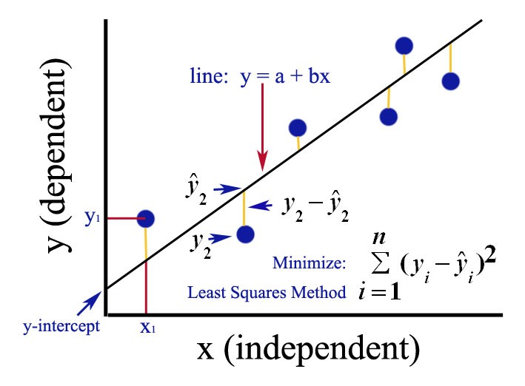
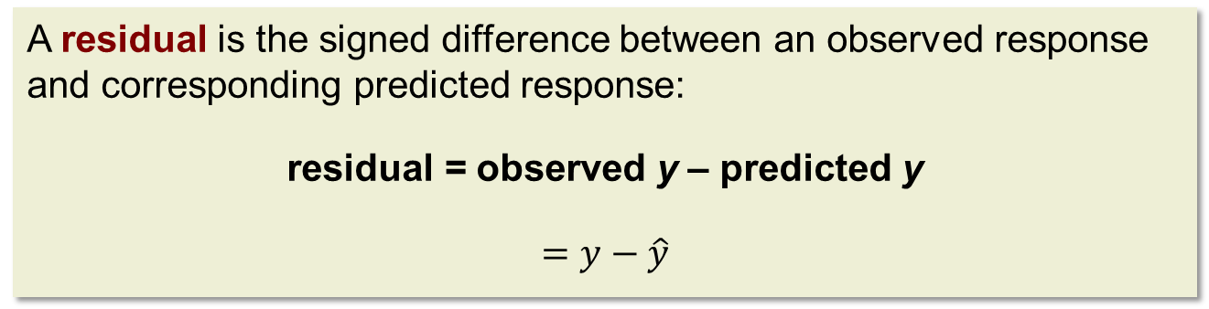
Residuals
A residual is the signed difference between an observed response and corresponding predicted response:
residual = observed y – predicted y
$$=y−\hat{y}$$

Slide 12
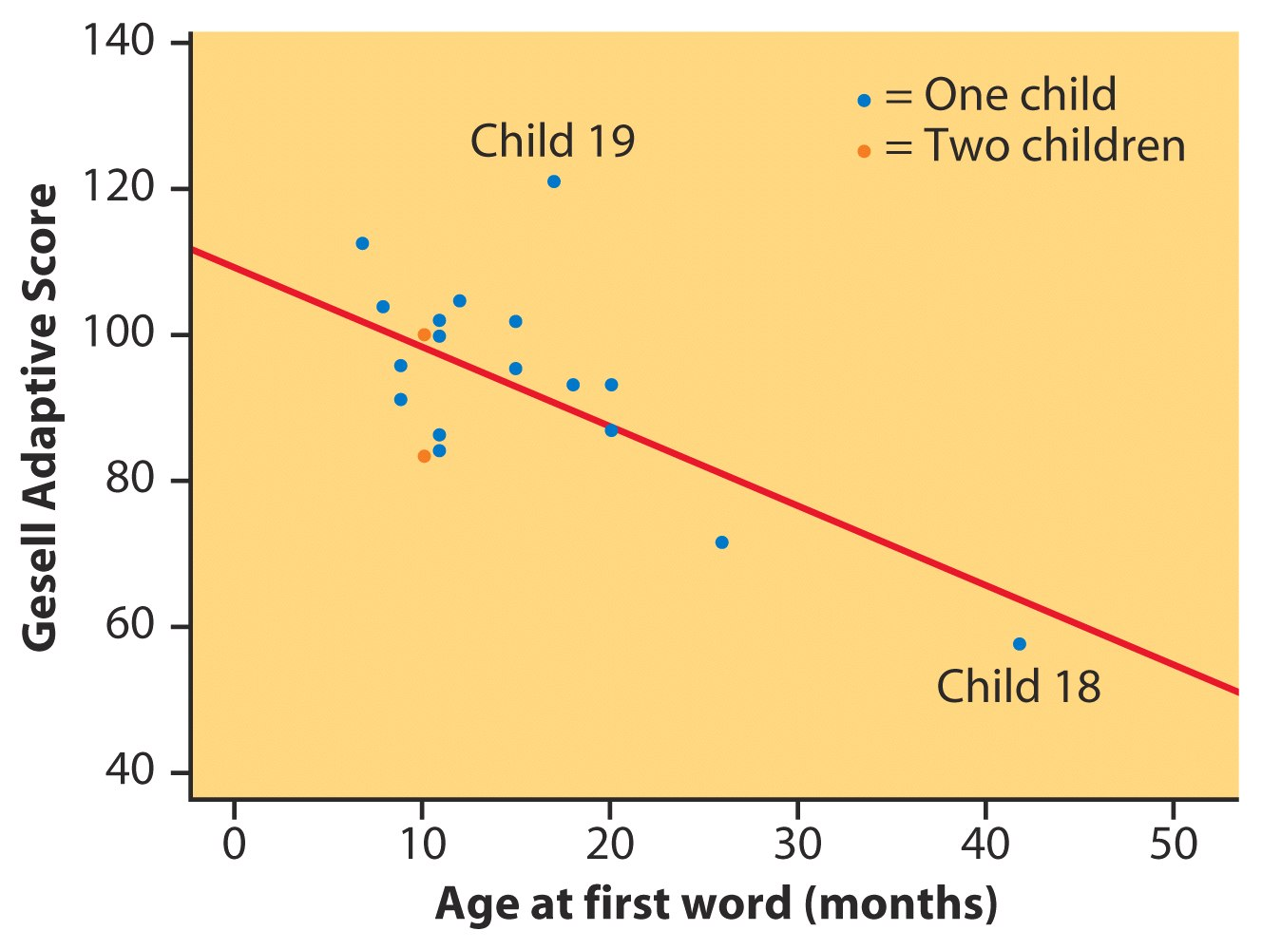
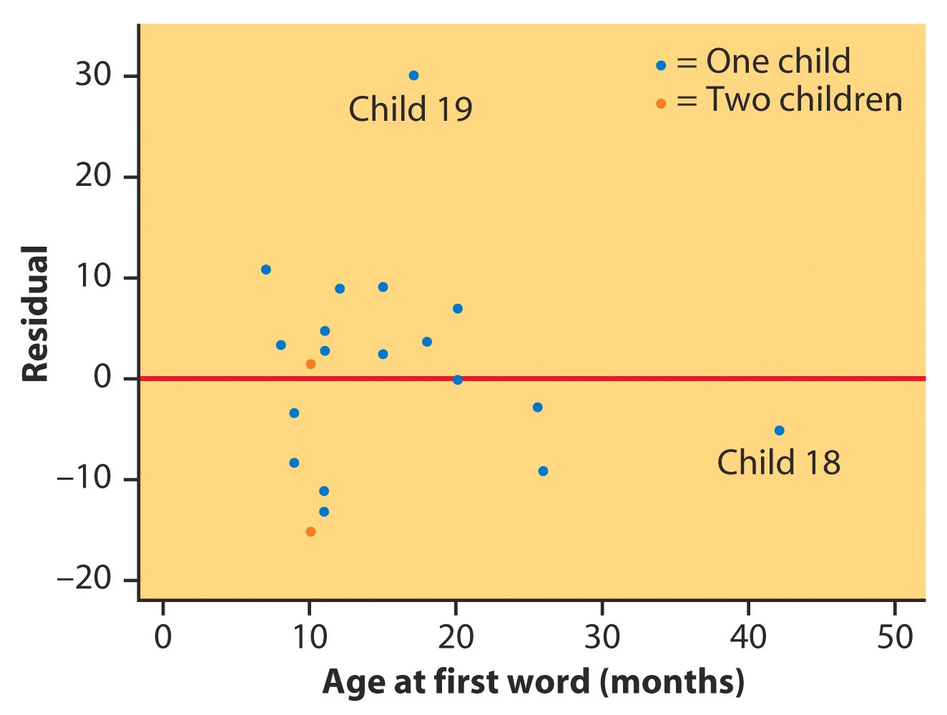
Residual Plots
A residual plot is a scatterplot of the regression residuals against the explanatory variable. Residual plots help us assess the fit of a regression line.
  Ideally there should be a “random” scatter around zero.
  Residual patterns suggest deviations from a linear relationship.
Gesell Adaptive Score and Age at First Word
Notes:
An aptitude test known as the Gesell adaptive scoretest is given to children to measure their level of cognitive development
Is child 18 an outlier? (follow the overall trend?) How about child 19? What if we change child 18 and 19?

Slide 13
Outliers and Influential Points 1
An outlier is an observation that lies outside the overall pattern of the other observations.
  Outliers in the y direction have large residuals.
  Outliers in the x direction are often influential.
  But Influential ≠ outlier. Influence is determined by how much the regression results change when an observation is removed.

Slide 14


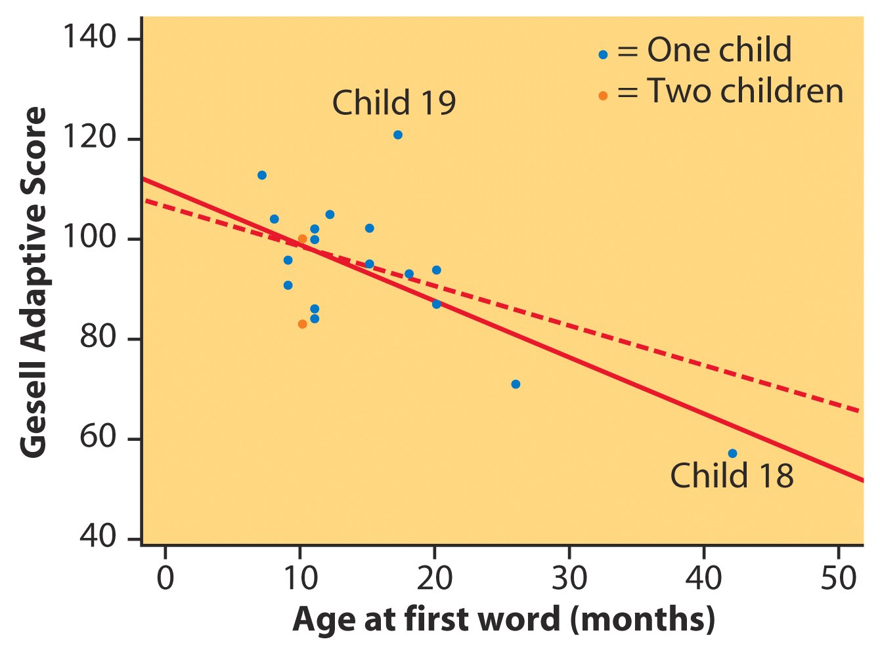
Outliers and Influential Points 2
Gesell Adaptive Score and Age at First Word
After removing child 18
R² = 11%
From all of the data
R² = 41%
Notes:
How can R squared change so much after removing child 18? Without child 18, the negative association pattern is not that strong. Give another example using R. (simulation) – be careful – don’t just read the r value – plot is important !!

Slide 15
Lurking Variables
A lurking variable is a variable that is not among the explanatory or response variables and yet may influence the interpretation of relationships among those variables.
Winter Months
Gas expense seems to be negatively associated with Electricity expense, but “season” may be a lurking variable.
SummerMonths
Notes:
Check this slide???? A lurking variable can falsely identify a strong relationship between variables or it can hide the true relationship. For example, a research scientist studies the effect of diet and exercise on a person's blood pressure. Lurking variables that also affect blood pressure are whether a person smokes and stress levels

Slide 16
Cautions About Correlation and Regression
Both describe linear relationships.
Both can be strongly affected by outliers..
Always plot the data before interpreting.
Beware of extrapolation.
    Use caution in predicting y when x is outside the range of observed x values.
Beware of lurking variables.
    A lurking variable is not among the explanatory or response variables but may influence the interpretation of their relationship.
Correlation does not imply causation!

Slide 17
2.7 The Question of Causation
Explaining association
Causation
Common response
Confounding
Establishing causation

Slide 18
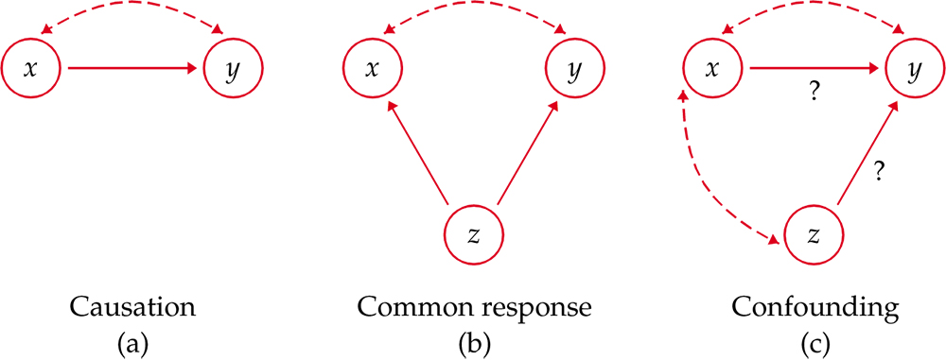
Explaining Association: Causation
Association, however strong, does NOT imply causation.
Some possible explanations for an observed association
The dashed lines show an association. The solid arrows show a cause- and-effect link. x is explanatory, y is response, and z is a lurking variable.

Slide 19
Explaining Association: Common Response
“Beware the lurking variable” is good advice when thinking about an association between two variables. The observed relationship between the variables can be explained by a lurking variable. Both x and y may change in response to changes in z.
Most students who have high SAT scores (x) in high school have high GPAs (y) in their first year of college.
This positive correlation may be explained as a common response to students’ ability and knowledge.
The observed association between x and y could be explained by a third lurking variable z. In this example, “ability and knowledge” is the lurking variable.
Both x and y change in response to changes in z. This could create an association without a direct causal link.
Notes:
X: number of walk step
Y: clinical visit time per month
Z: age

Slide 20
Explaining Association: Confounding
Two variables are confounded when their effects on a response variable cannot be distinguished from each other. The confounded variables may be either explanatory variables or lurking variables.
Example: People who drink more coffee (x) may also be more likely to smoke (z). Smoking itself is associated with cardiovascular disease (y). Therefore, the observed association between coffee consumption and cardiovascular disease may be partly due to confounding by smoking.
An observed association between x and y does not necessarily represent the effect of x on y. A third variable associated with both may confound the relationship.
Notes:
Loma Linda, Seven-Day Adventist: blue zones
The Seventh-day Adventist Church is an Adventist Protestant Christian denomination
Example:
Researchers are investigating the relationship between red meat consumption (independent variable) and the risk of developing cardiovascular disease (dependent variable). They find that people who consume more red meat tend to have a higher risk of cardiovascular disease.
However, a potential confounding variable could be physical activity:
People who consume a lot of red meat may also engage in less physical activity compared to those who consume less red meat.
Low physical activity is a known risk factor for cardiovascular disease.
In this case, physical activity is the confounder, as it influences both red meat consumption (less active people might have poorer dietary habits) and cardiovascular disease risk (less physical activity increases the risk). If physical activity is not controlled for, the study might incorrectly suggest that red meat consumption alone is the primary cause of the increased cardiovascular risk, when the true relationship could also be influenced by lifestyle factors like physical activity.
To account for confounding, researchers would need to adjust for physical activity levels in their analysis.

Slide 21
Causation from Observational Data
It appears that lung cancer is associated with smoking.
How do we know that both of these variables are not being affected by an unobserved third (lurking) variable?
For instance, what if there is a genetic predisposition that causes people to both get lung cancer and become addicted to smoking, but the smoking itself does not CAUSE lung cancer?
An association, even a strong one, does not by itself establish causation. A well-designed randomized experiment can provide strong evidence for a causal effect. When randomized experiments are not possible, determining whether an association is causal requires careful consideration of alternative explanations, particularly confounding and bias. The textbook discusses five considerations that may provide supporting evidence: strength, consistency, dose-response, temporality, and plausibility. These considerations do not constitute a definitive test for causation. See causal inference courses and references.

Slide 22
Chapter 2
Looking at Data—Relationships (Review)
2.1 Relationships
2.2 Scatterplots
2.3 Correlation
2.4 Least-Squares Linear Regression
2.5 Cautions about Correlation and Simple Linear Regression
2.6 Two-Way Tables
2.7 The Question of Causation

