Slide 1
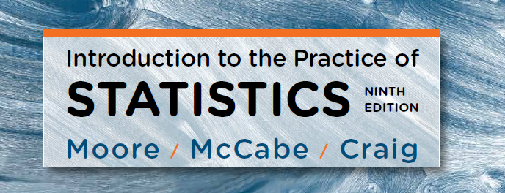
Chapter 5:
Sampling Distributions
Lecture Presentation Slides
Macmillan Learning © 2017

Slide 2
Chapter 5
Sampling Distributions
5.1 Toward Statistical Inference
5.2 The Sampling Distribution of a Sample Mean
5.3 Sampling Distributions for Counts and Proportions

Slide 3
5.1 Toward Statistical Inference
Parameters and statistics
Sampling variability
Sampling distributions
Bias and variability
Sampling from large populations

Slide 4

Parameters and Statistics
A parameter is a number that describes a particular characteristic of a population. In frequentist statistics, a parameter is fixed but unknown.
A statistic is a function of a sample. So, the value of a statistic may change from sample to sample.
Remember s and p: statistics come from samples and
parameters come from populations.
We write µ (the Greek letter mu) for the population mean and σ for the population standard deviation. We write $\overline{x}$ (x-bar) for the sample mean and s for the sample standard deviation.

Slide 5
Estimation
Estimation is the process of using sample data to estimate the (unknown) parameters. In plain language, estimation means making a “guess” about values of parameters. This guess is typically data-driven rather than arbitrary judgment.
An estimator is a statistic used to estimate (unknown) parameters. In plain language, an estimator is an “guess” for values of parameters.
Estimation is an important part of statistical inference, but statistical inference encompasses more than estimation. Statistical inference also includes hypothesis testing (to be covered in the remaining chapters).

Slide 6
Statistical Inference
The process of statistical inference involves using a sample to draw conclusions about the population.
Different random samples yield different values of statistics. We need to be able to describe the sampling distribution of a statistic in order to perform statistical inference.
The sampling distribution of a statistic (e.g., mean) consists of all possible values of the statistic and the relative frequency with which each value occurs.
Population
Sample
Collect data from a representative Sample...
Make an inference about the Population.
Notes:
Remember a statistic is a summary of a data (from a sample), it is not individual data (point). Take sample mean as an example

Slide 7
Sampling Variability
Sampling variability is a term used for the fact that the value of a statistic varies in repeated random sampling.
To make sense of sampling variability, we ask, “What would happen if we took many samples?”
Population
Sample
Sample
Sample
?
Sample
Sample
Sample
Sample
Sample
Larger random samples reduce sampling variability, making a statistic more likely to be less variable.

Slide 8
Sampling Distributions
The sampling distribution of a statistic is the distribution of values taken by the statistic in all possible samples of the same size from the same population.
In practice, it is difficult to take all possible samples of size n to obtain the actual sampling distribution of a statistic. Instead, we can simulate the process of sample generation and take many, many samples.
Notes:
It would be more accurate for an estimate (i.e mean) from a larger sample size– measure average height in a class.

Slide 9
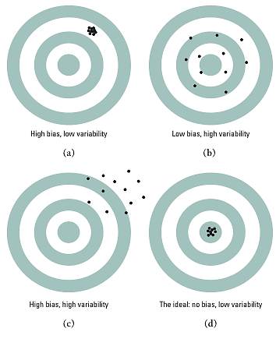
Bias and Variability
We can think of the true value of the population parameter as the bull’s-eye on a target and of the sample statistic as an arrow fired at the target. Bias and variability describe what happens when we take many shots at the target.
Bias concerns the center of the sampling distribution. A statistic used to estimate a parameter is unbiased if the mean of its sampling distribution is equal to the true value of the parameter being estimated.
The variability of a statistic is described by the spread of its sampling distribution. This spread is determined by the sampling design and the sample size n. Statistics from larger random samples have smaller spreads.
Notes:
Very important !! Sampling design – average height – sampling individuals from the same ethnic population vs different ethnic groups – homogeneous population, adult vs children

Slide 10
Managing Bias and Variability
A good sampling scheme must have both small bias and small variability.
To reduce bias, use random sampling. Random sampling helps control selection bias, but it does not protect against undercoverage, nonresponse, response bias, or measurement error.
To reduce variability of a statistic from an SRS, use a larger sample.
For an SRS with the population size (N) is much larger than the sample size (n), the variability of a statistic is driven mainly by n, not N.

Slide 11
Why Random Sampling?
The purpose of a sample is to give us information about the population. The process of drawing conclusions about a population on the basis of sample data is called (statistical) inference.
Why should we rely on random sampling?
Reduce selection bias. Random sampling gives individuals a chance of being selected according to a known sampling mechanism and helps prevent systematic selection of particular types of individuals.
Quantify sampling variability. Because selection is governed by chance, probability can be used to describe how a statistic would vary across repeated random samples. This allows us to quantify sampling variability.
  Results from random samples come with a margin of error that sets bounds on the size of the likely error.
  Larger random samples are likely to give more information about the population than smaller samples.

Slide 12
5.2 The Sampling Distribution of a Sample Mean
Population distribution
The mean and standard deviation of the sample mean
Sampling distribution of a sample mean
Central limit theorem

Slide 13
Population Distribution
The population distribution of a variable is the distribution of values of the variable among all individuals in the population. The population distribution is also the probability distribution of the variable when we choose one individual at random from the population.

Slide 14
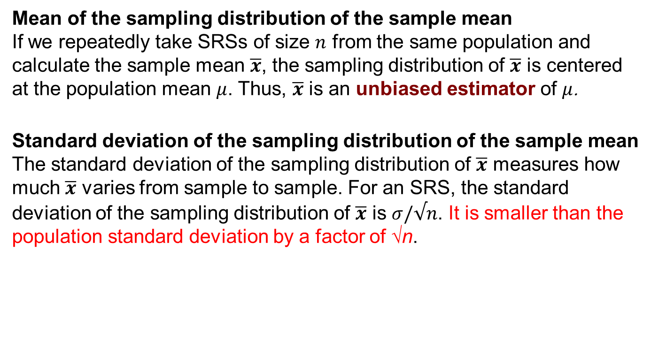
Mean and Standard Deviation of the Sampling Distribution of the Sample Mean
Mean of the sampling distribution of the sample mean
If we repeatedly take SRSs of size $n$ from the same population and calculate the sample mean $\overline{x}$, the sampling distribution of $\overline{x}$ is centered at the population mean $μ$. Thus, $\overline{x}$ is an unbiased estimator of $μ$.
Standard deviation of the sampling distribution of the sample mean
The standard deviation of the sampling distribution of $\overline{x}$ measures how much $\overline{x}$ varies from sample to sample. For an SRS, the standard deviation of the sampling distribution of $\overline{x}$ is $σ/√n$. It is smaller than the population standard deviation by a factor of √n.

Slide 15


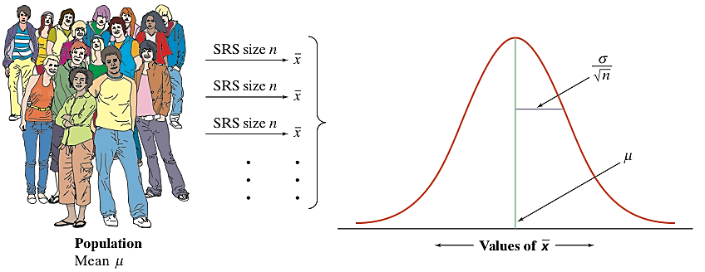
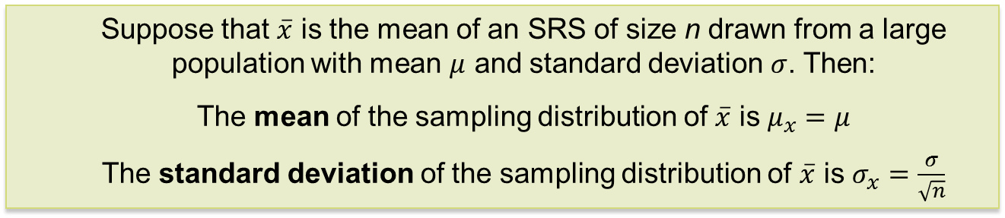
The Sampling Distribution of the Sample Mean
15
When we choose many SRSs from a population, the sampling distribution of the sample mean is centered at the population mean µ and is less spread out than the population distribution. Here are the facts.
The Sampling Distribution of Sample Means
Suppose that $\overline{x}$ is the mean of an SRS of size n drawn from a large population with mean $μ$ and standard deviation $σ$. Then:
The mean of the sampling distribution of $\overline{x}$ is $μ_{x}=μ$
The standard deviation of the sampling distribution of $\overline{x}$ is $σ_{x}=\frac{σ}{\sqrt{n}}$
If individual observations have the N(µ,σ) distribution, then the sample mean of an SRS of size n has the N(µ, σ/√n) distribution, regardless of the sample size n.

Slide 16
The Central Limit Theorem
Most population distributions are not normal. What is the shape of the sampling distribution of sample means when the population distribution is not normal?
It is a remarkable fact that, as the sample size increases, the distribution of a sample mean begins to look more and more like a normal distribution!
When the sample size is large enough, the (sampling) distribution of sample mean is very close to normal, no matter what shape the population distribution has, as long as the population has a finite standard deviation.

Slide 17
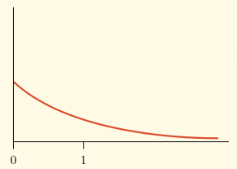
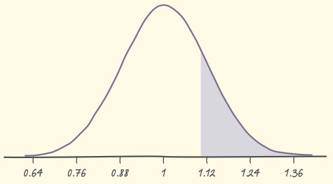
Illustrative Example of CLT
Based on service records from the past year, the time (in hours) that a technician requires to complete preventive maintenance on an air conditioner follows a distribution that is strongly right-skewed and whose most likely outcomes are close to 0. The mean time is µ = 1 hour and the standard deviation is σ = 1.
Your company will service an SRS of 70 air conditioners. You have budgeted 1.1 hours per unit. Will this be enough?
The mean and standard deviation of the sampling distribution of the average time spent working on the 70 units are
CLT says that the sampling distribution of the mean time spent working is approximately N(1, 0.12).
If you budget 1.1 hours per unit, there is a 20% chance the technicians will not complete the work within the budgeted time.

Slide 18
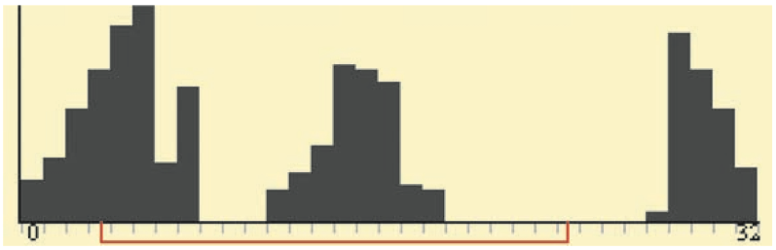
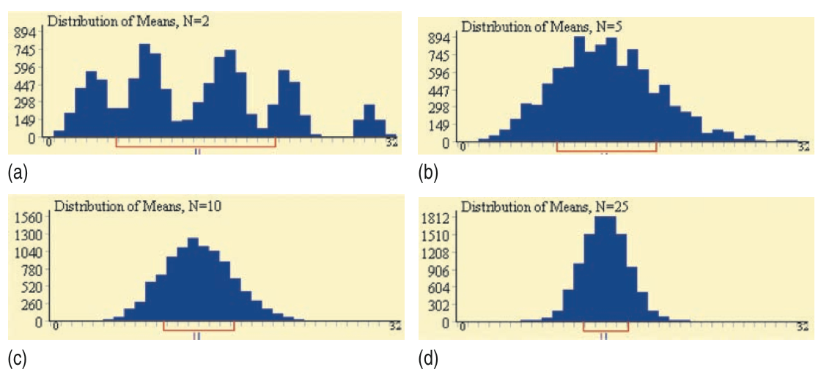
A Few More Facts
Any linear combination of independent Normal random variables is also normally distributed.
More generally, CLT notes that the distribution of a sum or average of many small random quantities is close to Normal.
Finally, CLT also applies to discrete random variables. An average of discrete random variables will never result in a continuous sampling distribution, but the normal distribution still serves as an approximation.
Notes:
The first two points are less relevant.

Slide 19
5.3 Sampling Distributions for Counts and Proportions
Binomial distributions for sample counts
Binomial distributions in statistical sampling
Finding binomial probabilities
Binomial mean and standard deviation
Sample proportions
Normal approximation for counts and proportions
Binomial formula
Poisson distributions

Slide 20
The Binomial Setting
When the same chance process is repeated several times, we are often interested in whether a particular outcome does or does not happen on each repetition. In some cases, the number of repeated trials is fixed in advance, and we are interested in the number of times a particular event (called a “success”) occurs.
A binomial setting arises when we perform several independent trials of the same chance process and record the number of times that a particular outcome occurs. The four conditions (called BINS) for a binomial setting are
• Binary? The possible outcomes of each trial can be classified as “success” or “failure.”
• Independent? Trials must be independent; that is, knowing the result of one trial must not have any effect on the result of any other trial.
• Number? The number of trials n of the chance process must be fixed in advance.
• Success? On each trial, the probability p of success must be the same.
Notes:
Clinical trial for treatment efficacy (yes, no); cancer patient survival

Slide 21
Binomial Distribution
Consider tossing a coin n times. Each toss gives either heads or tails. Knowing the outcome of one toss does not change the probability of an outcome on any other toss. If we define heads as a success, then p is the probability of a head and is 0.5 on any toss.
The number of heads in n tosses is a binomial random variable X. The probability distribution of X is called a binomial distribution.
Binomial Distribution
The count X of successes in a binomial setting has the binomial distribution with parameters n and p, where n is the number of trials of the chance process and p is the probability of a success on any one trial. The possible values of X are the whole numbers from 0 to n.
Note: Not all counts have binomial distributions; be sure to check the conditions for a binomial setting and make sure you are being asked to count the number of successes in a certain number of trials.
Notes:
Tamaxifen vs Aramatase for breast cancer

Slide 22
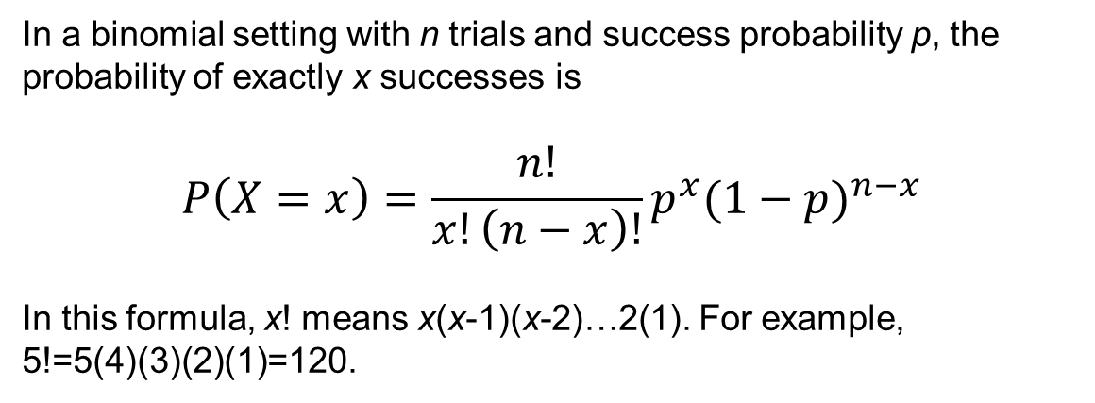
Form of the Binomial Distribution
In a binomial setting with n trials and success probability p, the probability of exactly x successes is
$$P\left(X=x\right)=\frac{n!}{x!\left(n−x\right)!}p^{x}{(1−p)}^{n−x}$$
In this formula, x! means x(x-1)(x-2)…2(1). For example, 5!=5(4)(3)(2)(1)=120.
Notes:
Steph Curry – free throw 90% (make or miss) – make three two free throws; or 3 free throws

Slide 23
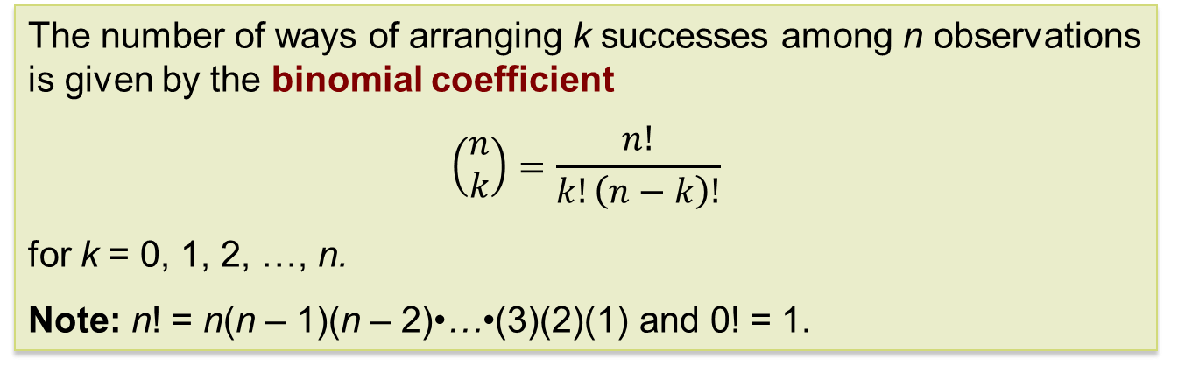
Binomial Formula
Here, we justify the expression given previously for the binomial distribution. First, we can find the chance that a binomial random variable takes any value by adding probabilities for the different ways of getting exactly that many successes in n observations.
The number of ways of arranging k successes among n observations is given by the binomial coefficient
$$\left(\begin{matrix}n \\ k\end{matrix}\right)=\frac{n!}{k!\left(n−k\right)!}$$
for k = 0, 1, 2, …, n.
Note: n! = n(n – 1)(n – 2)•…•(3)(2)(1) and 0! = 1.

Slide 24
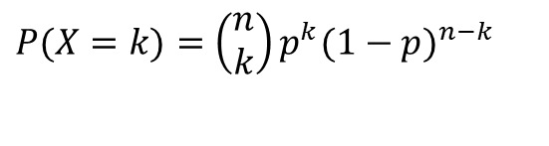
Binomial Probability
The binomial coefficient counts the number of different ways in which k successes can be arranged among n trials. The binomial probability P(X = k) is this count multiplied by the probability of any one specific arrangement of the k successes.
Binomial Probability
If X has the binomial distribution with n trials and probability p of success on each trial, the possible values of X are 0, 1, 2, …, n. If k is any one of these values:
$$P(X=k)=\left(\begin{matrix}n \\ k\end{matrix}\right)p^{k}(1−p)^{n−k}$$
Number of arrangements of k successes
Probability of n−k failures
Probability of k successes

Slide 25
Binomial Probability Example
Suppose each child of a particular couple has probability 0.25 of having blood type O and this couple have five children.
(a) Find the probability that exactly three of the children have type O blood.
Let X = the number of children with type O blood. We know X has a binomial distribution with n = 5 and p = 0.25.
(b) What is the probability for them to have more than three children with type O blood?
Notes:
BO + OO – 3 kids – O/O, B/O, B/O

Slide 26
Binomial Distributions in Statistical Sampling
The binomial distributions are important in statistics when we want to make inferences about the proportion p of successes in a population.
Suppose 10% of CDs have defective copy-protection schemes that can harm computers. A music distributor inspects an SRS of 10 CDs from a shipment of 10,000. Let X = number of defective CDs in the SRS of size 10.
What is P(X = 0)? Note: This is not quite a binomial setting. Why?
The actual probability is
Sampling Distribution of a Count
Choose an SRS of size n from a population with proportion p of successes. When the population is much larger than the sample, the count X of successes in the sample has approximately the binomial distribution with parameters n and p.
Using the binomial distribution,
Notes:
Skip this slide !

Slide 27
Binomial Mean and Standard Deviation
If a count X has the binomial distribution based on n observations with probability p of success, what is its mean µ? In general, the mean of a binomial distribution is µ = np. Here are the facts.
Mean and Standard Deviation of a Binomial Random Variable
If a count X has the binomial distribution with number of trials n and probability of success p, the mean and standard deviation of X are
Note: These formulas work ONLY for binomial distributions. They cannot be used for other distributions!

Slide 28
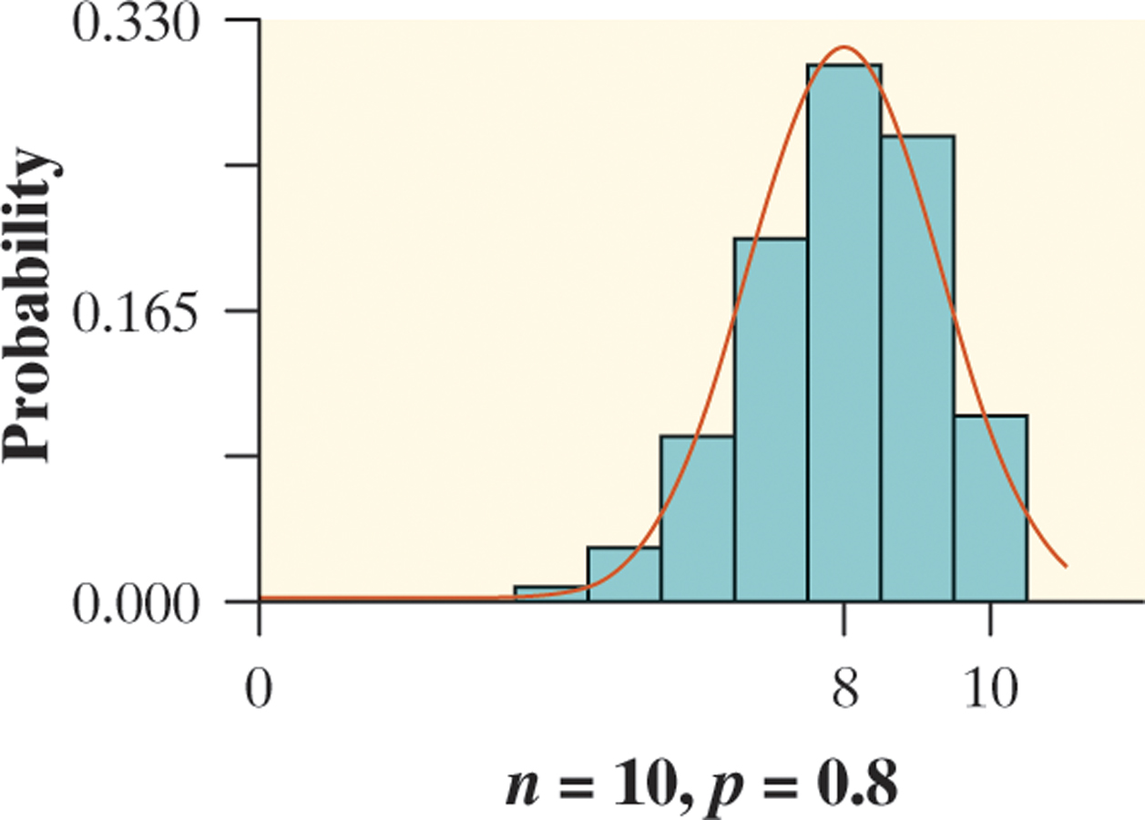
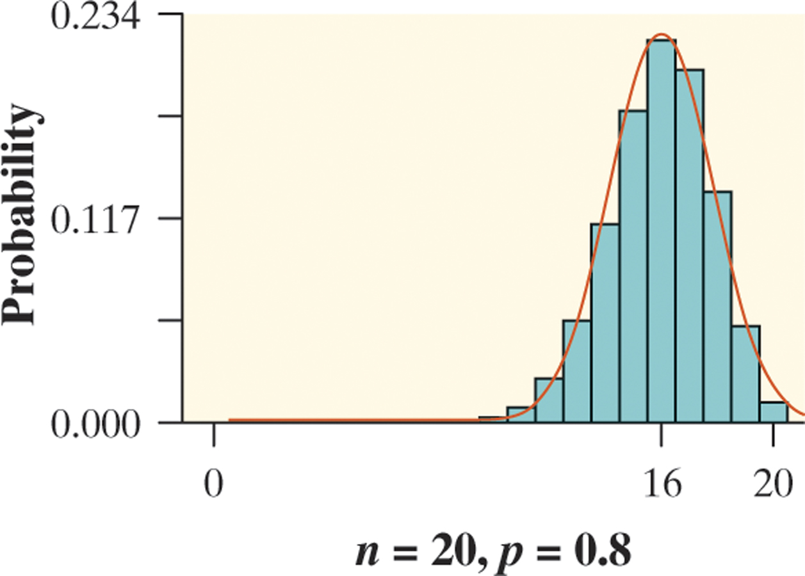
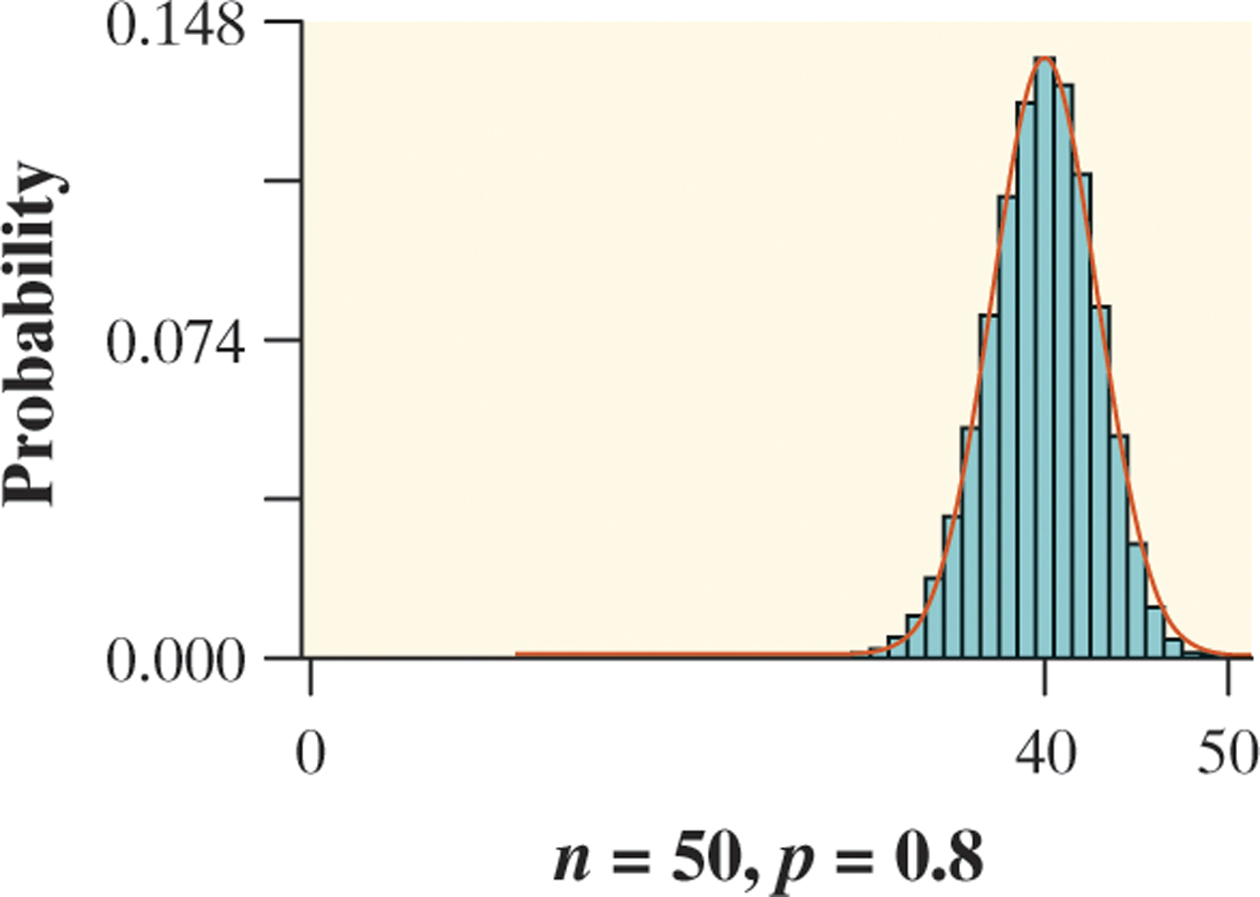
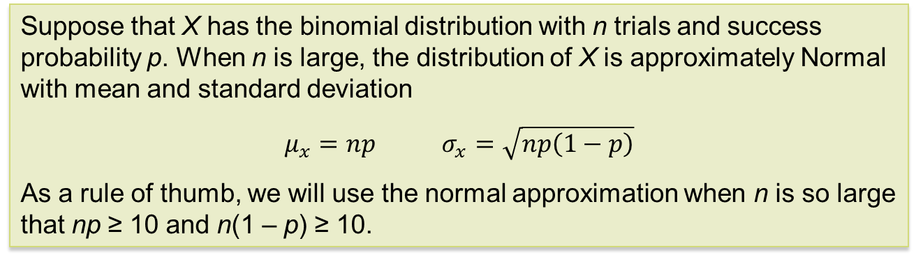
Normal Approximation for
Binomial Distributions
As n gets larger, something interesting happens to the shape of a binomial distribution.
Normal Approximation for Binomial Distributions
Suppose that X has the binomial distribution with n trials and success probability p. When n is large, the distribution of X is approximately Normal with mean and standard deviation
$μ_{x}=np$ $σ_{x}=\sqrt{np\left(1−p\right)}$
As a rule of thumb, we will use the normal approximation when n is so large that np ≥ 10 and n(1 – p) ≥ 10.

Slide 29
Normal Approximation Example
Sample surveys show that fewer people enjoy shopping than in the past. A survey asked a nationwide random sample of 2500 adults if they agreed or disagreed that “I like buying new clothes, but shopping is often frustrating and time-consuming.” Suppose that exactly 60% of all adult U.S. residents would say “Agree” if asked the same question. Let X = the number in the sample who agree. Estimate the probability that 1520 or more of the sample agree.
1) Verify that X is approximately a binomial random variable.
B: Success = agree; Failure = do not agree
I: Because the population of U.S. adults is over one hundred million, it is reasonable to assume that the 2500 trials are independent of each other.
N: n = 2500 trials of the chance process.
S: The probability of selecting an adult who agrees is p = 0.60.
2) Check the conditions for using a Normal approximation.
Because np = 2500(0.60) = 1500 and n(1 – p) = 2500(0.40) = 1000 are both at least 10, we may use the Normal approximation.
3) Calculate P(X ≥ 1520) using a Normal approximation.

Slide 30
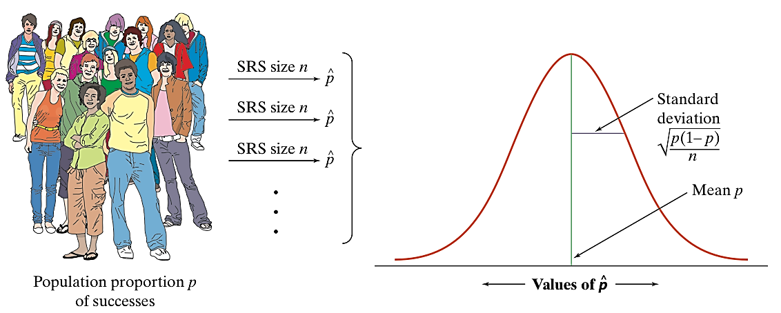
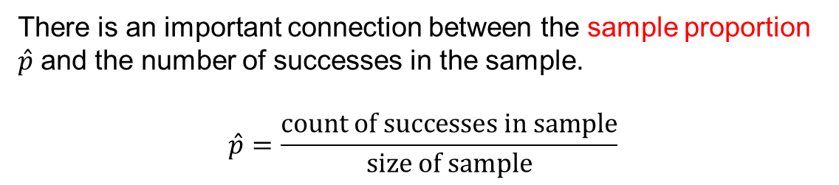
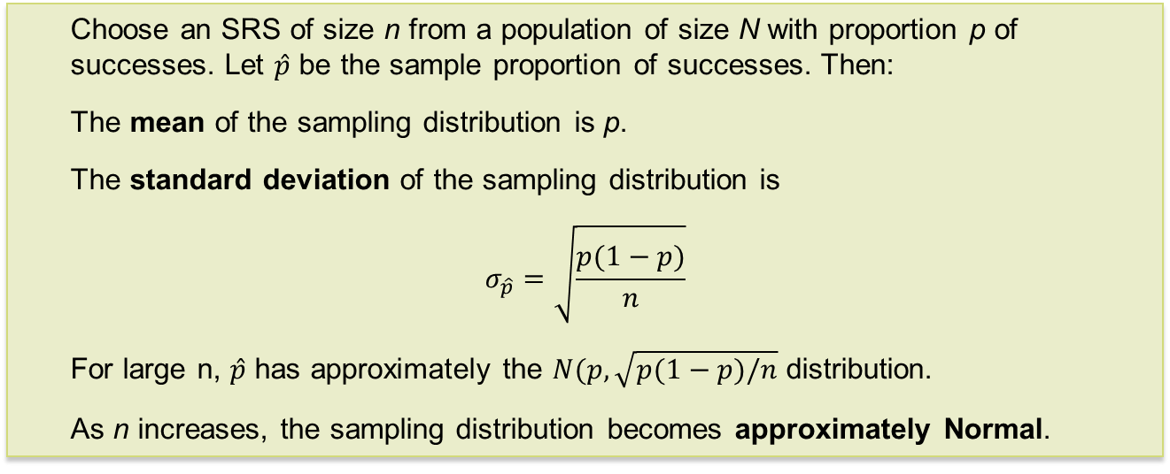
Sampling Distribution of a Sample Proportion
There is an important connection between the sample proportion $\hat{p}$ and the number of successes in the sample.
$$\hat{p}=\frac{\text{count of successes in sample}}{\text{size of sample}}$$
Sampling Distribution of a Sample Proportion
Choose an SRS of size n from a population of size N with proportion p of successes. Let $\hat{p}$ be the sample proportion of successes. Then:
The mean of the sampling distribution is p.
The standard deviation of the sampling distribution is
$$σ_{\hat{p}}=\sqrt{\frac{p(1−p)}{n}}$$
For large n, $\hat{p}$ has approximately the $N(p,\sqrt{p(1−p)/n}$ distribution.
As n increases, the sampling distribution becomes approximately Normal.

Slide 31
Poisson Setting
Frequently, we meet counts that are open-ended:
  The number of customers at a café between noon and 1:00 p.m.
  The number of patients coming to the ER between 10 p.m. and 11 p.m.
  The number of reported pedestrian/bicyclist collisions on campus during an academic year
A Poisson setting arises when we consider the number of successes that occur in a fixed unit of measure, such as a period of time or a region of space.
Conditions for the Poisson Distribution
The number of successes that occur in two nonoverlapping units of measure are independent.
The probability that a success will occur in a unit of measure is the same for all units of equal size and is proportional to the size of the unit.
The probability that more than one event occurs in a unit of measure is negligible for very small-sized units. In other words, the events occur one at a time.

Slide 32
Poisson Distribution
Poisson Probability
If X has the Poisson distribution with mean μ, the possible values of X are 0, 1, 2, 3, … If k is any whole number,
The standard deviation of the distribution is √μ.
Example
Suppose the number of dropped calls on your cell phone varies, with an average of 2.1 calls per day. If we assume the Poisson setting is reasonable, we can model the daily count of dropped calls X using the Poisson distribution with μ = 2.1. What is the probability of having no more than two dropped calls tomorrow?
There is roughly a 65% chance that you will have no more than two dropped calls tomorrow.

Slide 33
Chapter 5
Sampling Distributions (Review)
5.1 Toward Statistical Inference
5.2 The Sampling Distribution of a Sample Mean
5.3 Sampling Distributions for Counts and Proportions

