Slide 1
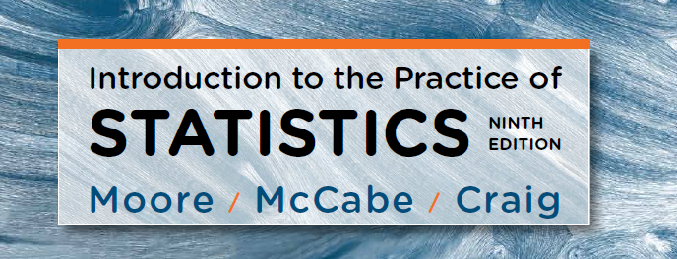
Chapter 6:
Introduction to Inference
Lecture Presentation Slides
Macmillan Learning © 2017

Slide 2
Chapter 6
Introduction to Inference
6.1 Confidence Intervals
6.2 Hypothesis Tests
6.3 Use and Abuse of Tests
6.4 Power

Slide 3
6.1 Estimating with Confidence
Overview of Inference
Confidence intervals
Confidence interval for a population mean
How confidence intervals behave
Choosing the sample size
Some Cautions

Slide 4
Statistical Inference
After we have selected a sample, we know the responses of the individuals in the sample. However, the reason for taking the sample is to infer from that data some conclusion about the wider population represented by the sample.
Statistical inference uses a sample to draw conclusions about a population.
Population
Sample
Collect data from a representative sample...
Make an inference about the population.

Slide 5
Overview of Inference
Confidence intervals and hypothesis tests are two closely related methods of statistical inference.
A confidence interval provides a range of plausible values for a population parameter based on sample data.
A hypothesis test evaluates sample data to make a decision between two competing hypotheses.

Slide 6
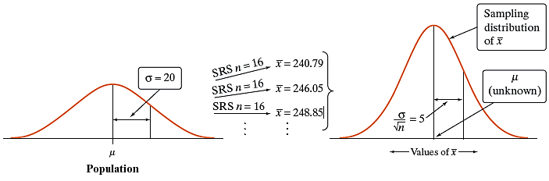
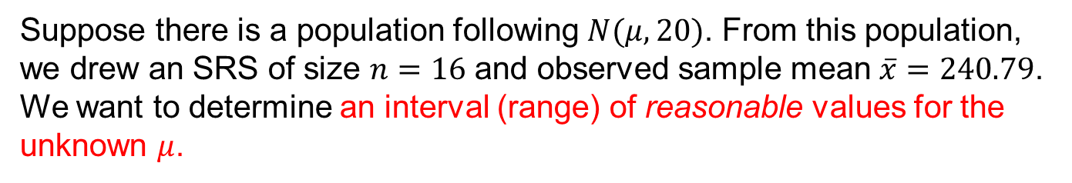


Estimation: a Normal Example
Suppose there is a population following $N(μ,20)$. From this population, we drew an SRS of size $n=16$ and observed sample mean $\overline{x}=240.79$. We want to determine an interval (range) of reasonable values for the unknown $μ$.
Because the sample mean is 240.79, we could guess that µ is “somewhere” around 240.79. How close to 240.79 is $μ$ likely to be?
To answer this question, we must ask another: how would $\overline{x}$ vary if we took SRSs from this population repeatedly and independently?

Slide 7
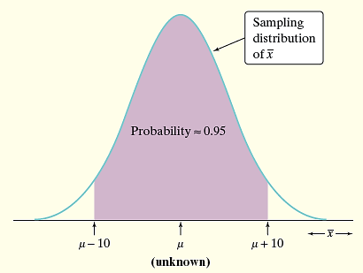
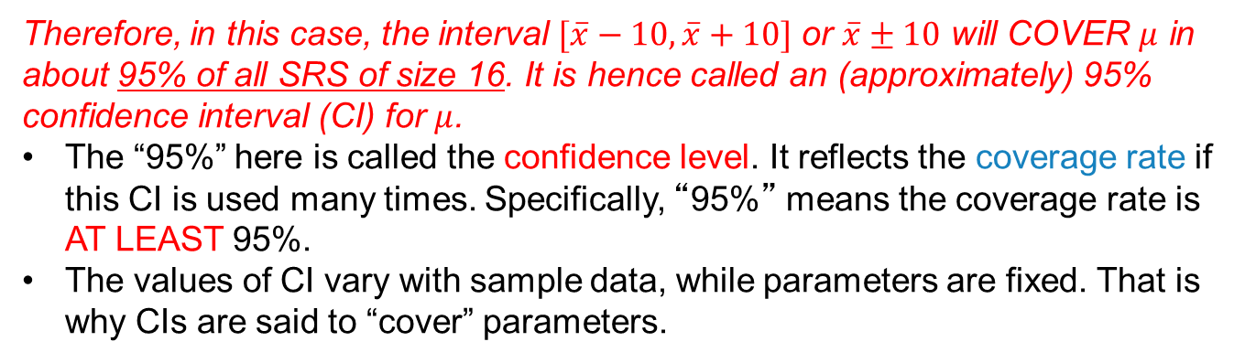
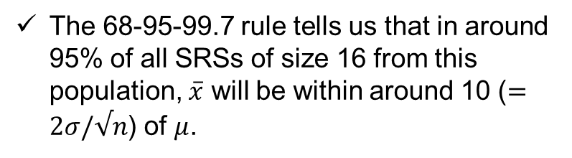
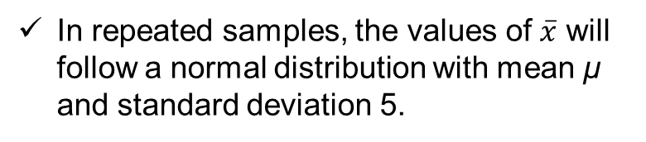
Estimation: a Normal Example
In repeated samples, the values of $\overline{x}$ will follow a normal distribution with mean µ and standard deviation 5.
The 68-95-99.7 rule tells us that in around 95% of all SRSs of size 16 from this population, $\overline{x}$ will be within around 10 ($=2σ/√n$) of $μ$.
If $\overline{x}$ is within 10 of µ, then µ is within 10 of $\overline{x}$.
Therefore, in this case, the interval $[\overline{x}−10,\overline{x}+10]$ or $\overline{x}±10$ will COVER $μ$ in about 95% of all SRS of size 16. It is hence called an (approximately) 95% confidence interval (CI) for $μ$.
The “95%” here is called the confidence level. It reflects the coverage rate if this CI is used many times. Specifically, “95%” means the coverage rate is AT LEAST 95%.
The values of CI vary with sample data, while parameters are fixed. That is why CIs are said to “cover” parameters.
Notes:
This is why the interpretation of 95% CI is tricky! Because mu is a fixed unknown value, mu doesn’t have 95% CI. Instead, if we “repeat” this procedure, 95% of those CIs will cover/capture the true mu.

Slide 8
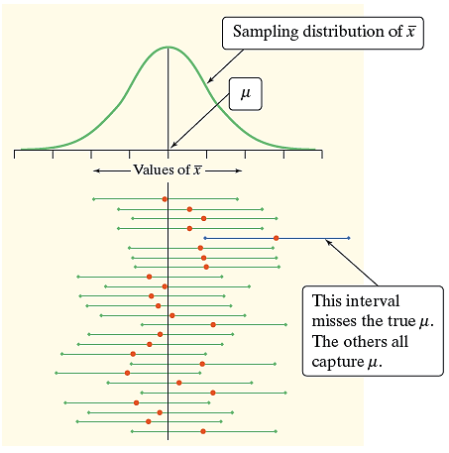
(Wald) Confidence Interval
Fixing the sample size and the construction method, a 95% CI means that at least 95% of CIs constructed from repeated SRSs of that size will cover the true parameter.
/* Monte Carlo coverage of a 95% confidence interval */
/* Normal population, known population SD */
%let mu = 250; /* True population mean */
%let sigma = 20; /* Known population SD */
%let n = 16; /* Sample size */
%let B = 1000; /* Number of replication */
%let alpha = 0.05;
data simulation;
call streaminit(702);
zcrit = quantile("NORMAL", 1 - &alpha/2);
se = &sigma / sqrt(&n);
do replicate = 1 to &B;
/* Generate one random sample and compute its mean */
sum_x = 0;
do i = 1 to &n;
x = rand("NORMAL", &mu, &sigma);
sum_x + x;
end;
xbar = sum_x / &n;
/* Construct the confidence interval */
lower = xbar - zcrit * se;
upper = xbar + zcrit * se;
/* Does this interval contain the true mean? */
covered = (lower <= &mu <= upper);
output;
end;
keep replicate xbar lower upper covered;
run;
/* Estimate the coverage probability */
proc means data=simulation n mean stderr;
var covered;
title "Coverage of a 95% Confidence Interval";
run;

Slide 9
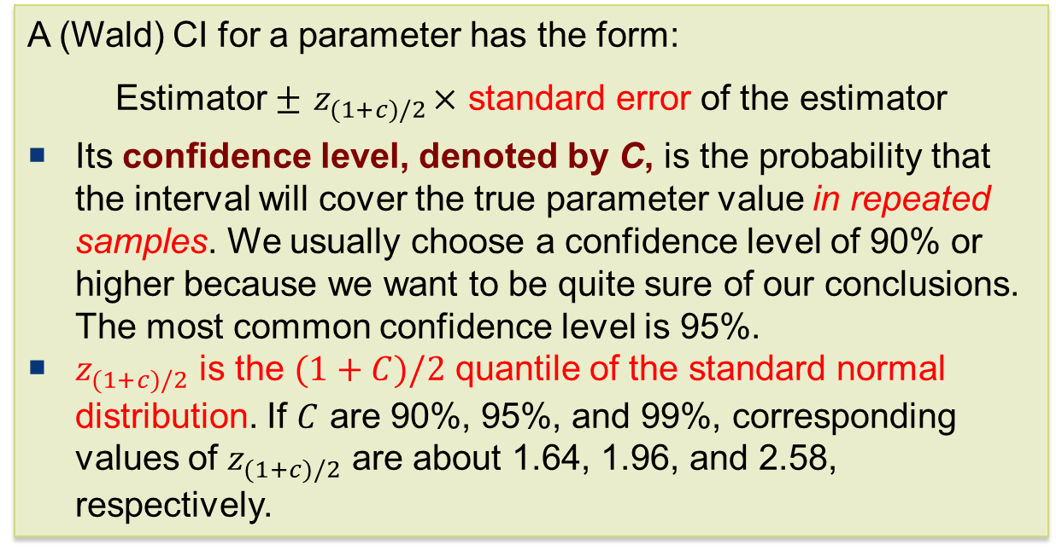
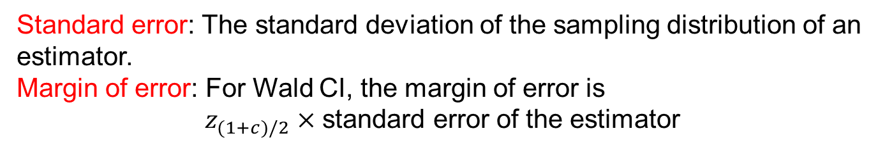
(Wald) Confidence Interval
A (Wald) CI for a parameter has the form:
Estimator $±{ z}_{(1+c)/2}×$ standard error of the estimator
Its confidence level, denoted by C, is the probability that the interval will cover the true parameter value in repeated samples. We usually choose a confidence level of 90% or higher because we want to be quite sure of our conclusions. The most common confidence level is 95%.
$z_{(1+c)/2}$ is the $(1+C)/2$ quantile of the standard normal distribution. If $C$ are 90%, 95%, and 99%, corresponding values of $z_{(1+c)/2}$ are about 1.64, 1.96, and 2.58, respectively.
Standard error: The standard deviation of the sampling distribution of an estimator.
Margin of error: For Wald CI, the margin of error is
$z_{(1+c)/2}×$ standard error of the estimator
Notes:
Is a 95% CI wider or a 90% CI ? Why?

Slide 10


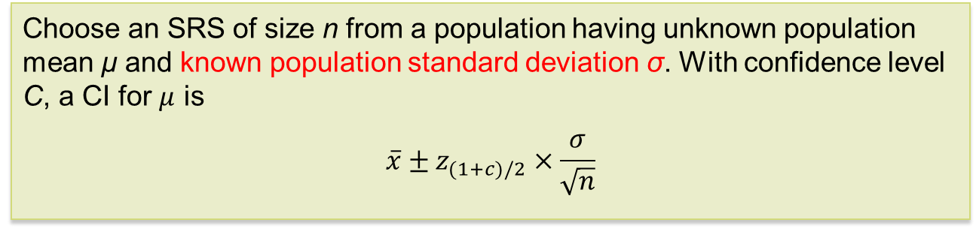

Confidence Interval for $μ$ with Known $σ$
Recall the normal example. A 95% CI for $μ$ is given by:
$\overline{x}±2×$ (standard error of $\overline{x}$)
which may be further genderized.
CI for the Mean of a Normal Population with Known Standard Deviation
Choose an SRS of size n from a population having unknown population mean µ and known population standard deviation σ. With confidence level C, a CI for $μ$ is
$$\overline{x}±z_{(1+c)/2}×\frac{σ}{\sqrt{n}}$$
For this setting,
standard error of $\overline{x}$ is $\frac{σ}{\sqrt{n}}$, and
the margin of error is $z_{(1+c)/2}×\frac{σ}{\sqrt{n}}$.

Slide 11
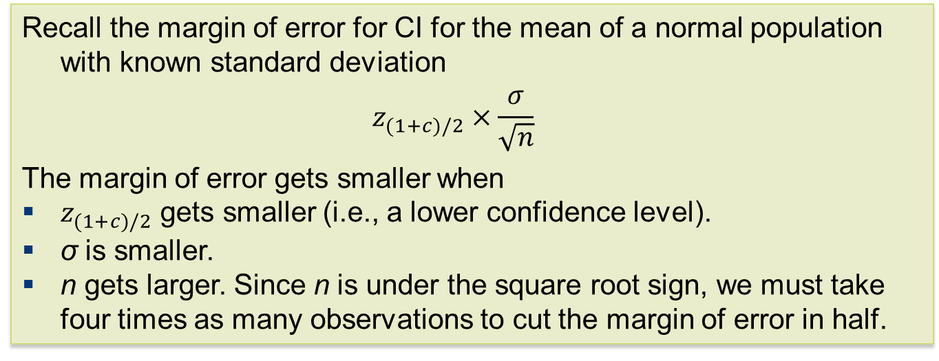
How Confidence Intervals Behave
Users may choose the confidence level and the margin of error follows.
Would like high confidence level and a small margin of error.
  High confidence suggests our method almost always gives correct answers.
  A small margin of error suggests we have pinned down the parameter precisely.
Recall the margin of error for CI for the mean of a normal population with known standard deviation
$$z_{(1+c)/2}×\frac{σ}{\sqrt{n}}$$
The margin of error gets smaller when
$z_{(1+c)/2}$ gets smaller (i.e., a lower confidence level).
σ is smaller.
n gets larger. Since n is under the square root sign, we must take four times as many observations to cut the margin of error in half.

Slide 12
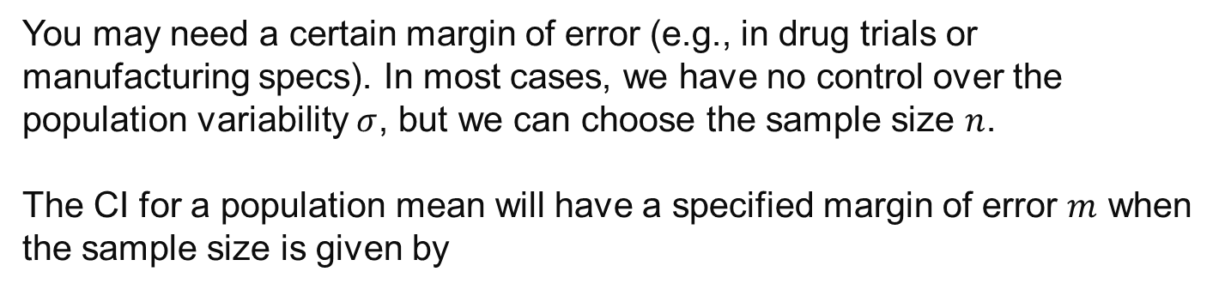

Sample Size
You may need a certain margin of error (e.g., in drug trials or manufacturing specs). In most cases, we have no control over the population variability $σ$, but we can choose the sample size $n$.
The CI for a population mean will have a specified margin of error $m$ when the sample size is given by
$$n={\left(\frac{z_{(1+c)/2}×σ}{m}\right)}^{2}$$
A larger sample size is better, but there are typically costs and constraints associated with large samples. The best approach is to use the smallest sample size that can give you useful results.

Slide 13
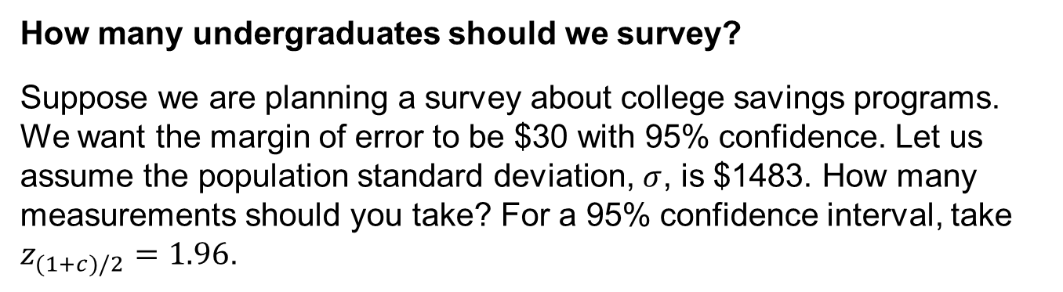
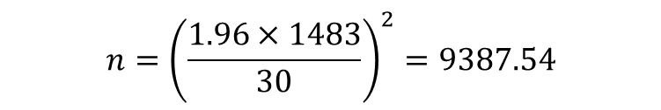
Sample Size: an Example
How many undergraduates should we survey?
Suppose we are planning a survey about college savings programs. We want the margin of error to be $30 with 95% confidence. Let us assume the population standard deviation, $σ$, is $1483. How many measurements should you take? For a 95% confidence interval, take $z_{(1+c)/2}=1.96$.
$$n={\left(\frac{1.96×1483}{30}\right)}^{2}=9387.54$$
Therefore, we need at least 9388 measurements.

Slide 14
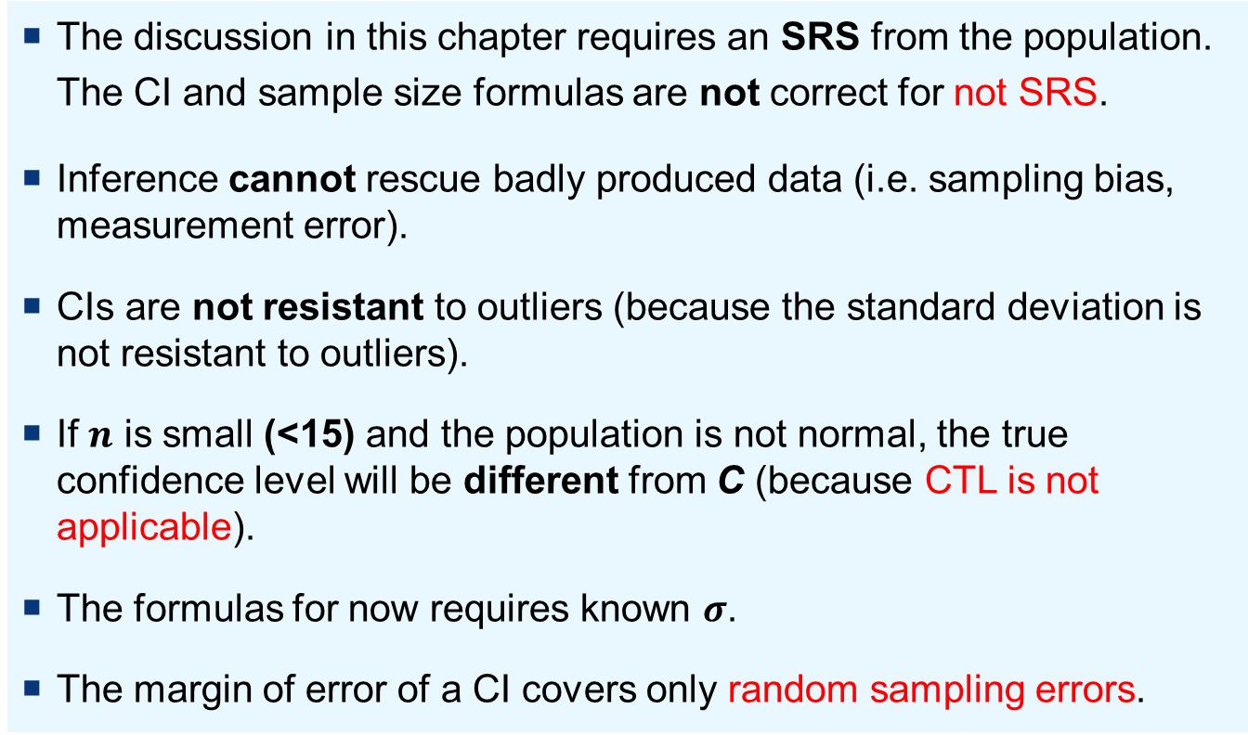
Some Cautions
The discussion in this chapter requires an SRS from the population. The CI and sample size formulas are not correct for not SRS.
Inference cannot rescue badly produced data (i.e. sampling bias, measurement error).
CIs are not resistant to outliers (because the standard deviation is not resistant to outliers).
If $n$ is small (<15) and the population is not normal, the true confidence level will be different from C (because CTL is not applicable).
The formulas for now requires known $σ$.
The margin of error of a CI covers only random sampling errors.
Notes:
Random sampling errors – not measurement error

Slide 15
6.2 Hypothesis Test
Reasoning of tests of significance
Stating hypotheses
Test statistics and P-values
Significance levels
Tests for a population mean

Slide 16
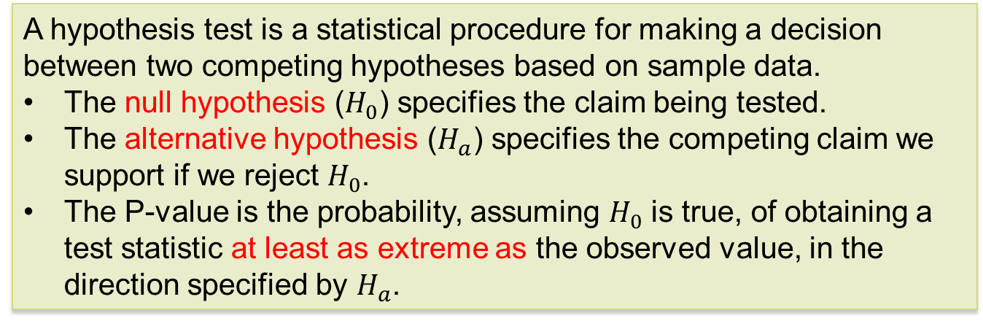
Hypothesis Tests
A hypothesis test is a statistical procedure for making a decision between two competing hypotheses based on sample data.
The null hypothesis ($H_{0}$) specifies the claim being tested.
The alternative hypothesis ($H_{a}$) specifies the competing claim we support if we reject $H_{0}$.
The P-value is the probability, assuming $H_{0}$ is true, of obtaining a test statistic at least as extreme as the observed value, in the direction specified by $H_{a}$.
Notes:
How likely the observed data will be collected if the null hypothesis is true.

Slide 17
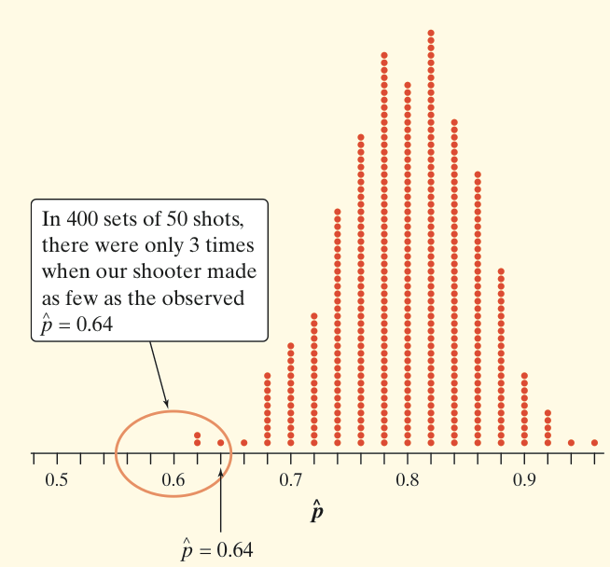
Free-throw Shooter Example
Suppose a basketball player claimed to be an 80% free-throw shooter. To test this claim, we have him attempt 50 free throws. He makes 32 of them. His sample proportion of making shots is 32/50 = 0.64.
What can we conclude about the claim based on this sample data?
The plot on the right is from a simulation of 400 sets of 50 shots, each on the assumption that the player is an 80% free-throw shooter.
You can say how strong the evidence against the player’s claim is by giving the probability that he would make as few as 32 out of 50 free throws if he really makes 80% in the long run.
Assuming that the actual parameter value is p = 0.80, the observed statistic is so unlikely that it gives convincing evidence that the player’s claim is not true.

Slide 18
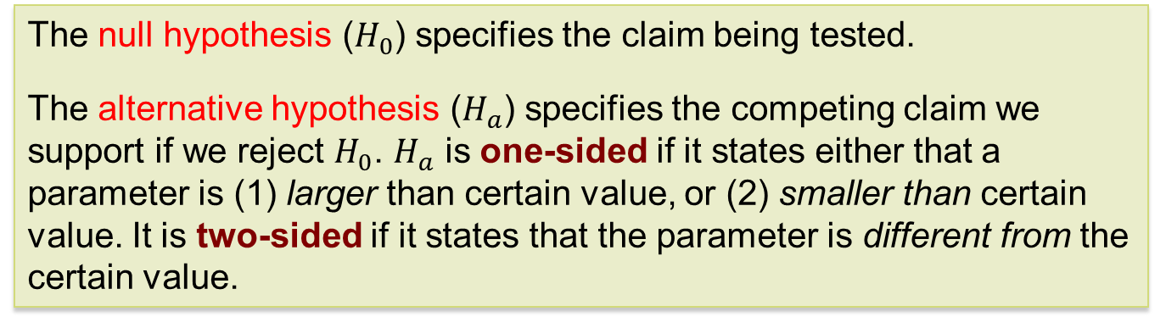
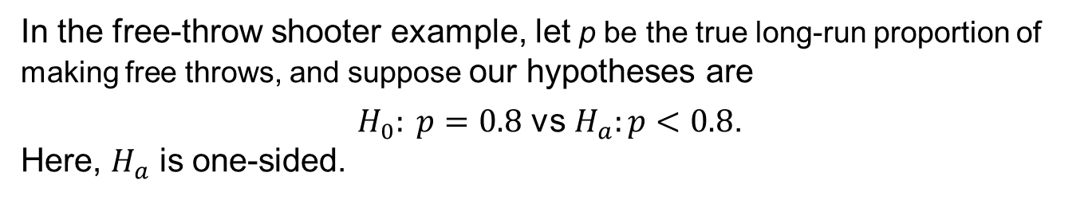
Hypotheses
A hypothesis test starts with a careful statement of the hypotheses we want to compare.
The null hypothesis ($H_{0}$) specifies the claim being tested.
The alternative hypothesis ($H_{a}$) specifies the competing claim we support if we reject $H_{0}$. $H_{a}$ is one-sided if it states either that a parameter is (1) larger than certain value, or (2) smaller than certain value. It is two-sided if it states that the parameter is different from the certain value.
In the free-throw shooter example, let p be the true long-run proportion of making free throws, and suppose our hypotheses are
$H_{0}: p=0.8$ vs $H_{a}:p<0.8$.
Here, $H_{a}$ is one-sided.
Notes:
Supplement: Red yeast rice to reduce cholesterol

Slide 19
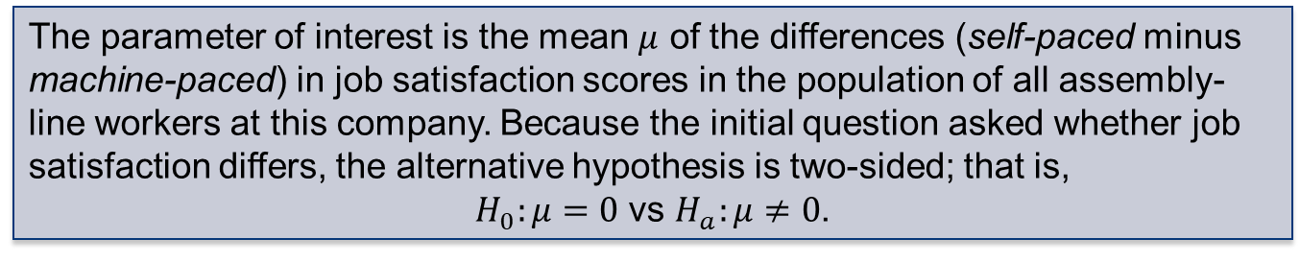
Hypotheses: Job Satisfaction Example
Does the job satisfaction of assembly-line workers differ when their work is machine-paced rather than self-paced? One study chose 18 subjects at random from a company with over 200 workers who assembled electronic devices. Half of the workers were assigned at random to each of two groups. Both groups did similar assembly work, but one group was allowed to pace itself while the other group used an assembly line that moved at a fixed pace. After two weeks, all the workers took a test of job satisfaction. Then, they switched work setups and took the test again after two more weeks. The response variable is the difference in satisfaction scores, self-paced minus machine-paced.
The parameter of interest is the mean $μ$ of the differences (self-paced minus machine-paced) in job satisfaction scores in the population of all assembly-line workers at this company. Because the initial question asked whether job satisfaction differs, the alternative hypothesis is two-sided; that is,
$H_{0}:μ=0$ vs $H_{a}:μ≠0$.
Notes:
What is this study design? Cross-over design

Slide 20

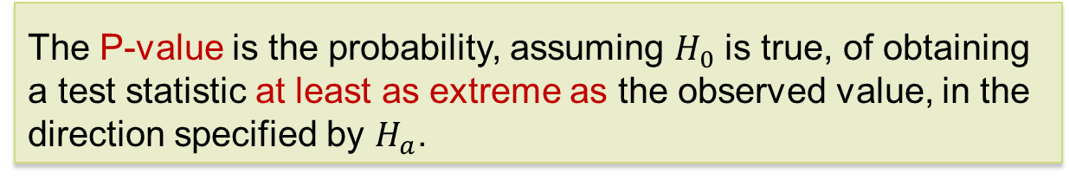
Test Statistics and P-Values
A test statistic is a quantity calculated from sample data used to conduct a hypothesis test.
The test statistic is used to calculate the P-value, taking into account $H_{a}$.
The P-value is the probability, assuming $H_{0}$ is true, of obtaining a test statistic at least as extreme as the observed value, in the direction specified by $H_{a}$.
Small P-values are evidence against H₀ because they say that the observed result is unlikely to occur when H₀ is true.
Large P-values fail to give convincing evidence against H₀ because they say that the observed result is likely to occur by chance when H₀ is true.

Slide 21
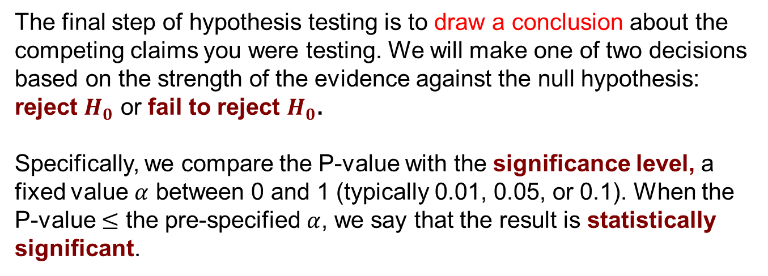
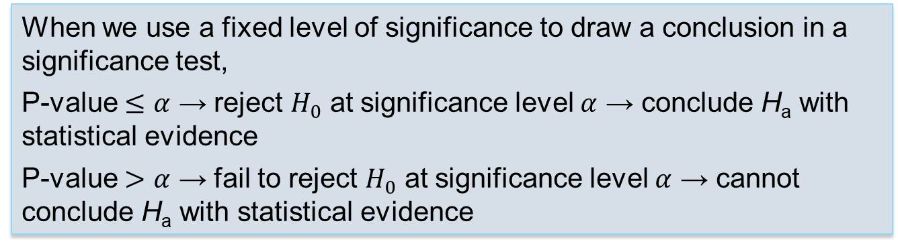
Significance Levels
The final step of hypothesis testing is to draw a conclusion about the competing claims you were testing. We will make one of two decisions based on the strength of the evidence against the null hypothesis: reject $H_{0}$ or fail to reject $H_{0}$.
Specifically, we compare the P-value with the significance level, a fixed value $α$ between 0 and 1 (typically 0.01, 0.05, or 0.1). When the P-value $≤$ the pre-specified $α$, we say that the result is statistically significant.
When we use a fixed level of significance to draw a conclusion in a significance test,
P-value $≤α$ → reject $H_{0}$ at significance level $α$ → conclude H_{a} with statistical evidence
P-value $>α$ → fail to reject $H_{0}$ at significance level $α$ → cannot conclude H_{a} with statistical evidence
Note: A fail-to-reject H₀ decision does not mean that H₀ is true. For that reason, you should never “accept” or use language implying that you believe H₀ is true.

Slide 22
Hypothesis Tests
Hypothesis Tests: Four Steps
1. State the null and alternative hypotheses.
2. Calculate the value of test statistic.
3. Calculate the P-value.
4. Draw a conclusion.
We will learn the details of many hypothesis tests in the following chapters. The appropriate test statistic vary with the hypotheses and how the data were collected.

Slide 23
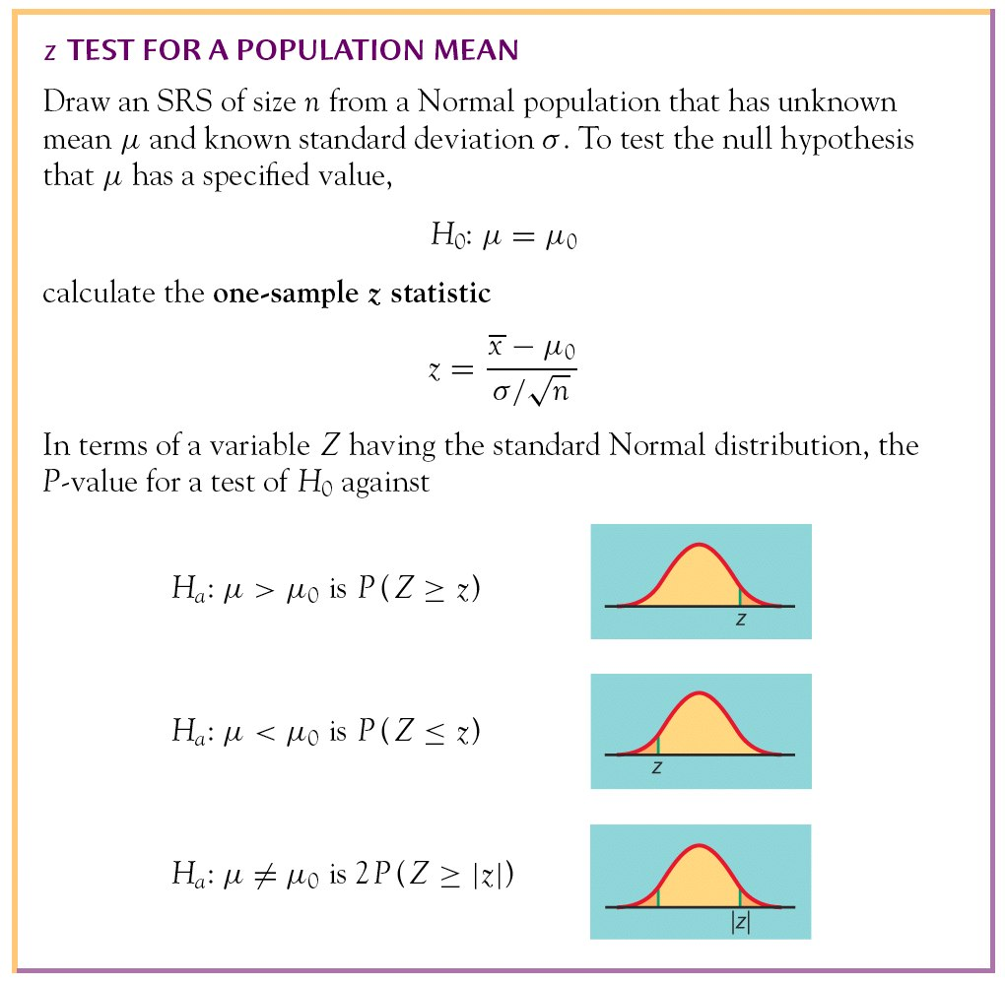
Tests for a Population Mean

Slide 24
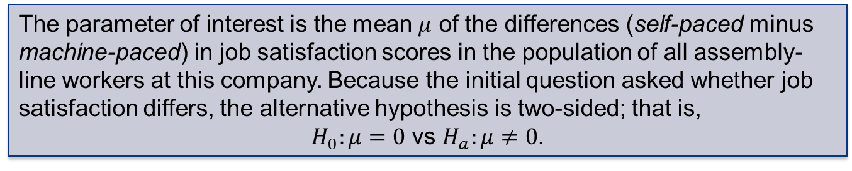
Hypothesis Test: Job Satisfaction Example
Does the job satisfaction of assembly-line workers differ when their work is machine-paced rather than self-paced? One study chose 18 subjects at random from a company with over 200 workers who assembled electronic devices. Half of the workers were assigned at random to each of two groups. Both groups did similar assembly work, but one group was allowed to pace itself while the other group used an assembly line that moved at a fixed pace. After two weeks, all the workers took a test of job satisfaction. Then, they switched work setups and took the test again after two more weeks. The response variable is the difference in satisfaction scores, self-paced minus machine-paced.
The parameter of interest is the mean $μ$ of the differences (self-paced minus machine-paced) in job satisfaction scores in the population of all assembly-line workers at this company. Because the initial question asked whether job satisfaction differs, the alternative hypothesis is two-sided; that is,
$H_{0}:μ=0$ vs $H_{a}:μ≠0$.

Slide 25
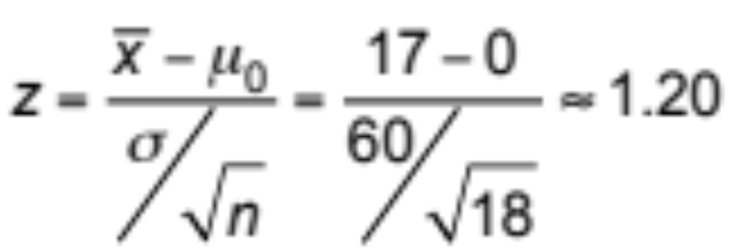
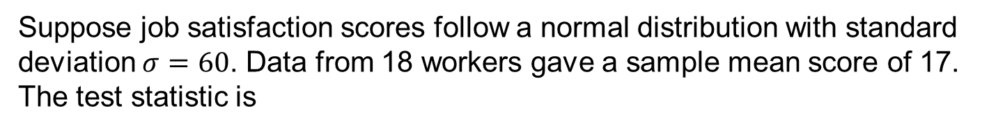
Hypothesis Test: Job Satisfaction Example
Suppose job satisfaction scores follow a normal distribution with standard deviation $σ=60$. Data from 18 workers gave a sample mean score of 17. The test statistic is

Slide 26
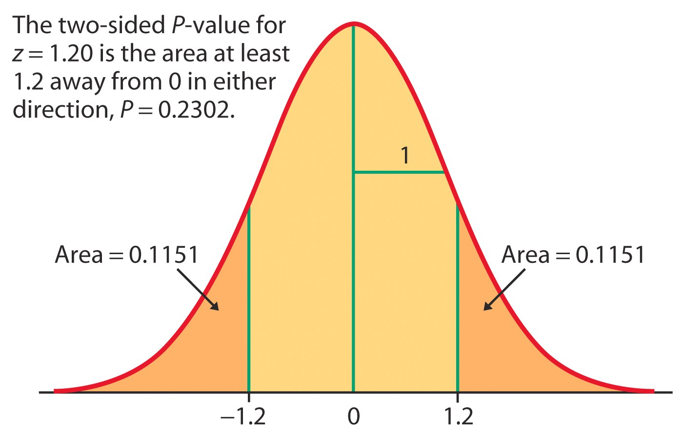
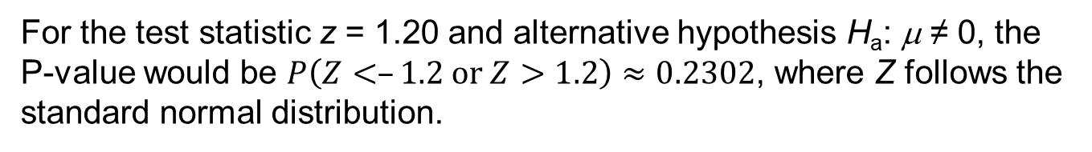
Hypothesis Test: Job Satisfaction Example
For the test statistic z = 1.20 and alternative hypothesis H_{a}: μ ≠ 0, the P-value would be $P\left(Z<–1.2 or Z>1.2\right)≈0.2302$, where Z follows the standard normal distribution.
data normal;
prob = cdf('NORMAL’, -1.2, 0, 1) + 1 - cdf('NORMAL’, 1.2, 0, 1);
proc print;
run;
The P-value is 0.2302. At the significance level 0.05, we cannot reject H₀. That is, there is no strong statistical evidence against that the job satisfaction is identical across the two groups of workers.

Slide 27
More About P-Values
P-value is summary of a test. When reporting the result of a test, better to also include the hypotheses, testing method, significance level, and conclusions.
P-values do not provide specific information about the magnitude of estimates. In many case, CIs are also expected to reflect a likely range of values for the parameter.

Slide 28
6.3 Use and Abuse of Tests
What statistical significance does not mean
Do not ignore lack of significance
Beware of searching for significance

Slide 29
Cautions About Hypothesis Tests
What statistical significance does not mean:
Statistical significance is not synonymous with clinical importance. That’s because statistical significance does not tell you about the magnitude of the effect.
An effect could be too small to be relevant. And, with a large enough sample size, a significant result can be reached even for the tiniest effect.
  A drug is found to lower patient temperature an average of 0.4 Celsius (P-value < 0.01). But clinical benefits of temperature reduction only appear for a 1 Celsius or larger decrease.

Slide 30
Cautions About Hypothesis Tests
Do not ignore lack of significance
  Consider this provocative title from the British Medical Journal: “Absence of evidence is not evidence of absence.”
  Having no proof that a particular suspect committed a murder does not imply that the suspect did not commit the murder.
Indeed, failing to find statistical significance in results means that “the null hypothesis is not rejected.” This is very different from actually accepting the null hypothesis. The sample size, for instance, could be too small to overcome large variability in the population.
When comparing two populations, lack of significance does not imply that the two populations are the same. The populations might be different but have similar statistical properties – same mean/sd, but different distribution.
Notes:
Microarray – heterogeneity – perform subset analysis, subpopulation, Simpson paradox, -- it’s not just one test, one model…

Slide 31
Cautions About Hypothesis Tests
Beware of searching for significance
If a hypothesis is developed after examining the data, testing it on the same data may produce misleading P-values because the hypothesis-selection process is not accounted for.
When testing a large number of null hypotheses simultaneously, it can be expected that several of the tests will show significance, even when all the null hypotheses are true.
The previous two points do not imply that exploratory data analysis is a bad thing. Exploratory analysis often leads to interesting discoveries. However, if the data at hand suggest an interesting theory, then test that theory on a new set of data.

Slide 32
6.4 Power and Inference as a Decision
Power
Increasing the power

Slide 33
Power
When we draw a conclusion from a significance test, we hope our conclusion will be correct. But sometimes it will be wrong. There are two types of mistakes we can make.
If we reject H₀ when H₀ is true, we have committed a Type I error.
If we fail to reject H₀ when H₀ is false, we have committed a Type II error.
 |  | Truth about the population
 |  | H₀ is true | H₀ is false (H_{a} is true)
Conclusion based on sample | Reject H₀ | Type I error | Correct conclusion
 | Fail to reject H₀ | Correct conclusion | Type II error

Slide 34
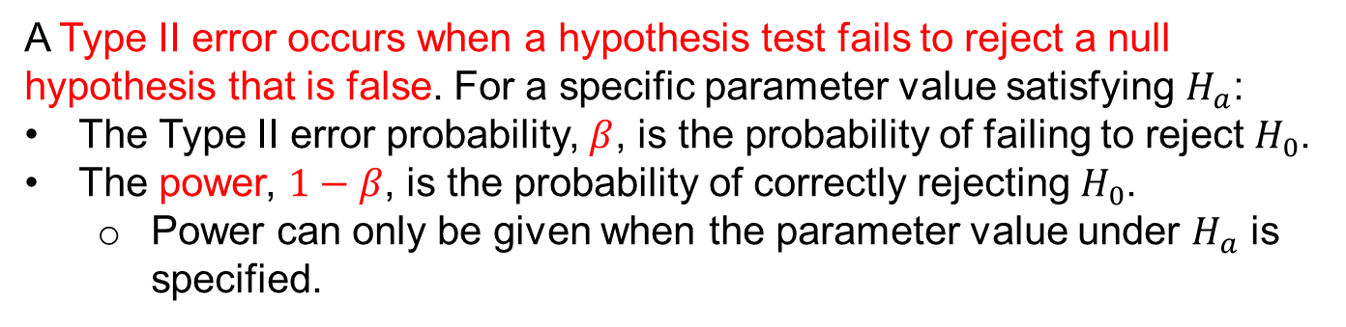
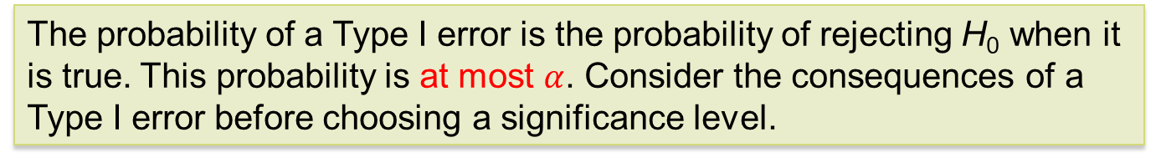
Power
The probability of a Type I error is the probability of rejecting H₀ when it is true. This probability is at most $α$. Consider the consequences of a Type I error before choosing a significance level.
A Type II error occurs when a hypothesis test fails to reject a null hypothesis that is false. For a specific parameter value satisfying $H_{a}$:
The Type II error probability, $β$, is the probability of failing to reject $H_{0}$.
The power, $1−β$, is the probability of correctly rejecting $H_{0}$.
  Power can only be given when the parameter value under $H_{a}$ is specified.

Slide 35
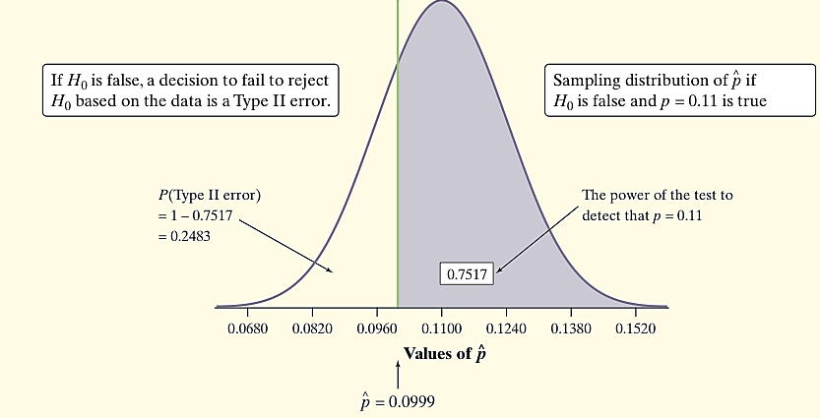
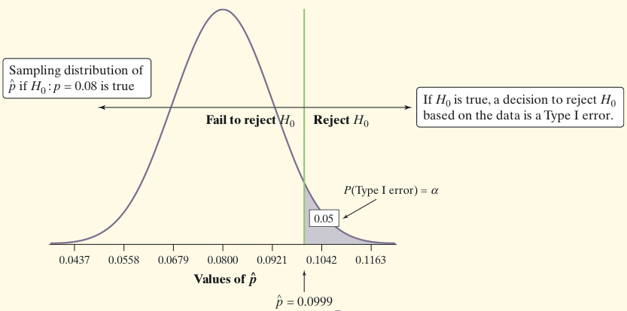
Power Calculation: An Example
A potato chip producer wonders whether the significance test of H₀: p = 0.08 versus H_{a}: p > 0.08 based on a random sample of 500 potatoes has enough power to detect a shipment with, say, 11% blemished potatoes.
What if the parameter is p = 0.11?
We would reject H₀ at α = 0.05 if our sample yielded a sample proportion to the right of the green line.
Power and Type II Error
Because we reject H₀ at α = 0.05 if our sample yields a proportion > 0.0999, we’d correctly reject the shipment about 75% of the time.
The power of a test against any alternative is 1 minus the probability of a Type II error for that alternative; that is, power = 1 – β.
Notes:
Z <- (0.0999-0.08)/(sqrt(0.08*0.92/500); pnorm(Z) =0.05
Excellent youtube: https://www.youtube.com/watch?v=QBONLUp7i28 and https://www.youtube.com/watch?v=VX_M3tIyiYk
P=0.11 is unknown, this is a hypothetic value (for alternative hypothesis). Under Ha: p=0.11
0.0999 corresponds to the critical value for 5% type I error.

Slide 36
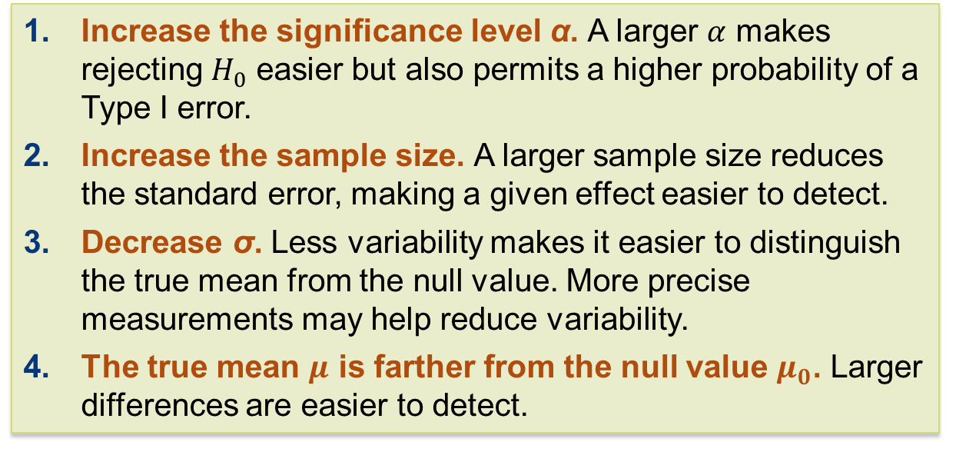
Increasing the Power
Suppose we have performed a power calculation and found that the power is too small. Several ways to increase power are
Increase the significance level α. A larger $α$ makes rejecting $H_{0}$ easier but also permits a higher probability of a Type I error.
Increase the sample size. A larger sample size reduces the standard error, making a given effect easier to detect.
Decrease σ. Less variability makes it easier to distinguish the true mean from the null value. More precise measurements may help reduce variability.
The true mean $μ$ is farther from the null value $μ_{0}$. Larger differences are easier to detect.

Slide 37
Chapter 6
Introduction to Inference (Review)
6.1 Confidence Intervals
6.2 Hypothesis Tests
6.3 Use and Abuse of Tests
6.4 Power

