Slide 1
Chapter 2 (part I)
Bivariate Relationship and Two-way Table
2.1 Relationships
2.2 Scatterplots
2.3 Correlation
2.6 Data Analysis for Two-Way Tables

Slide 2
Associations Between Variables
Two variables measured on the same cases are associated if knowing the value of one of the variables tells you something that you would not otherwise know about the value of the other variable.
When you examine the relationship between two variables, a new question becomes important: Is your purpose simply to explore the nature of the relationship, or do you wish to show that one of the variables can explain variation in the other? E.g. physical activity level and weight.
A response variable measures an outcome of a study. An explanatory variable may help explain or predict variation in the response variable.
Notes:
Give some examples: for kids: age (X) vs height (Y); In cross sectional data, sometimes it’s hard to distinct X and Ys – causal relationship

Slide 3
Scatterplot 1
The most useful graph for displaying the relationship between two quantitative variables is a scatterplot.
A scatterplot shows the relationship between two quantitative variables measured on the same cases. The values of one variable appear on the horizontal axis, and the values of the other variable appear on the vertical axis. Each case corresponds to one point on the graph.
How to Make a Scatterplot
Decide which variable should go on each axis. If a distinction exists, plot the explanatory variable on the x axis and the response variable on the y axis.
Label and scale your axes.
Plot individual data values.
Notes:
Covic-19 daily confirmed cases (in log-scale)

Slide 4
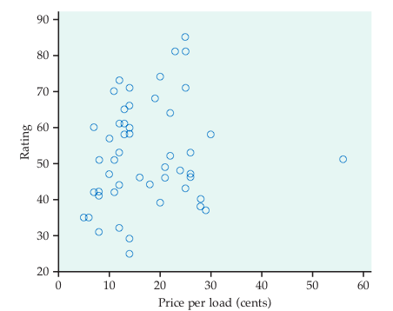
Scatterplot 2
  Example: Make a scatterplot of the relationship between price and rating for laundry detergents.
Price per load (cents) | 14 | 14 | 14 | 12 | 10 | 8 | … | 12
Rating | 60 | 58 | 60 | 53 | 57 | 41 | … | 32

Slide 5
Interpreting Scatterplots 1
How to Examine a Scatterplot
As in any graph of data, look for the overall pattern and for striking deviations from that pattern.
You can describe the overall pattern of a scatterplot by the form, direction, and strength of the relationship.
An important kind of departure is an outlier, an observation that falls outside the overall pattern of the relationship.

Slide 6
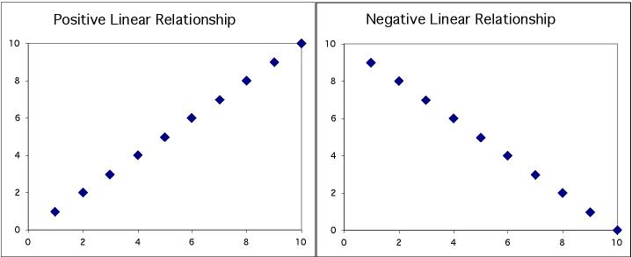
Interpreting Scatterplots 2
Two variables are positively associated when above-average values of one tend to accompany above-average values of the other and when below-average values also tend to occur together.
Two variables are negatively associated when above-average values of one tend to accompany below-average values of the other and vice versa.
Notes:
Age and blood pressure
Age and bone density
What about BP and Bone density? This may be a linear relation, but it is just association, not casuality

Slide 7
Interpreting Scatterplots 3
Notes:
What do see from this scatterplot in terms of form, strength, and direction ?

Slide 8
Interpreting Scatterplots 4
Outlier
There is one possible unusual observation―the detergent with the price per load of 56 cents seems to have a lower rating than one might expect if higher price means a higher rated detergent.
Strength
Direction
Form
There is a moderately weak, positive, linear relationship between price per load and detergent rating.
It appears that more expensive detergents are rated slightly higher, with possibly one exception.

Slide 9
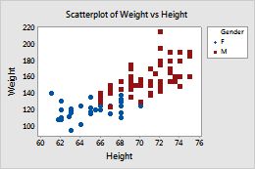
Adding Categorical Variables
Consider the relationship between height and weight.
To add a categorical variable, use a different plot color or symbol for each category.
Notes:
Do you think the overall pattern for southern states differ from other states? The relationship is very weak for states that have more than 50% of grads taking SAT. Why? This is an example of heterogeneity – meaning the relationship is different among subgroups

Slide 10
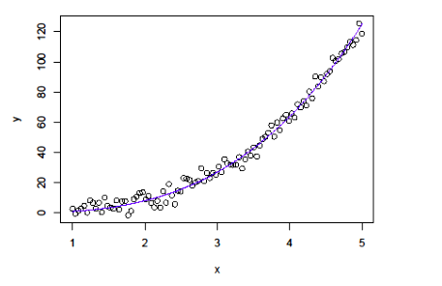
Nonlinear Relationships
There are other forms of relationships besides linear. The scatterplot below is an example of a nonlinear form.
Note the curvature in the relationship between x and y.

Slide 11
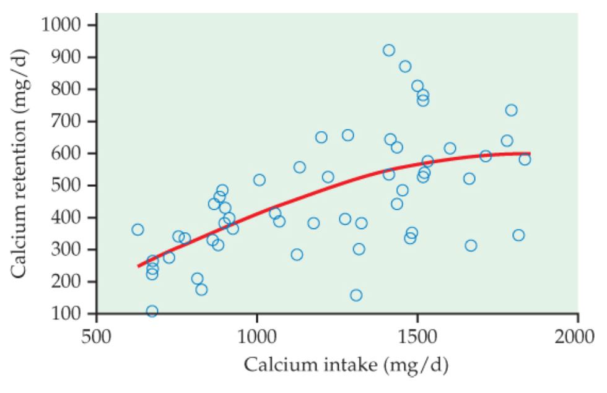
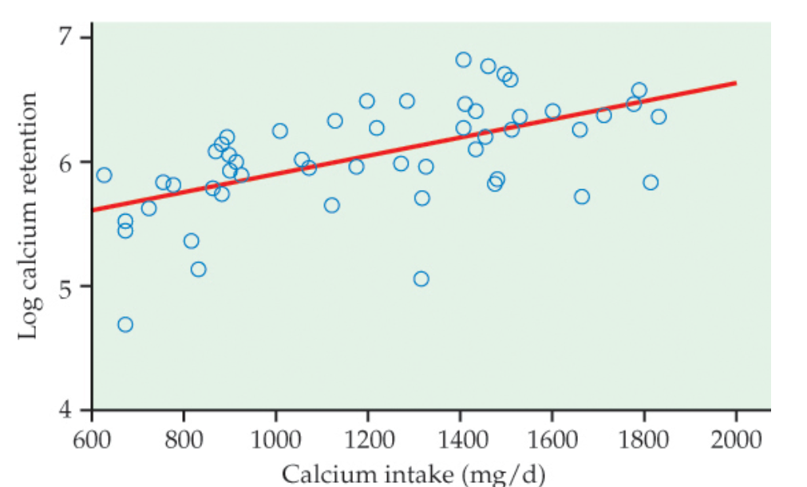
Log Transformation
Sometimes, the pattern that best describes data in a scatterplot is a curve other than a line. In this case, it is often useful to apply a transformation to the data that renders the relationship approximately linear.
The log transformation:
can be used only for variables whose values are positive.
A common choice is the natural logarithm.
Example: Consider the following two scatterplots concerning calcium intake versus calcium retention.
Original Scatterplot
Log Transformation Scatterplot

Slide 12
2.3 Correlation
Correlation coefficient r
Properties of r

Slide 13
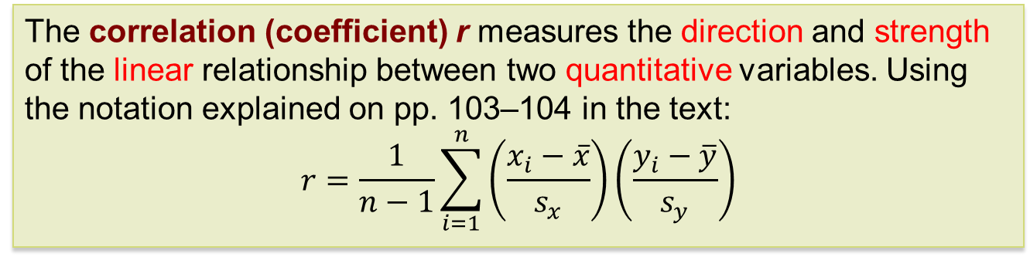
Measuring Linear Association 1
A scatterplot displays the strength, direction, and form of the relationship between two quantitative variables. Linear relationships are important because a straight line is a simple pattern that is quite common.
Our eyes are not always good judges of how strong a relationship is. Therefore, we use a numerical measure to supplement our scatterplot and help us quantify the strength of the linear relationship.
The correlation (coefficient) r measures the direction and strength of the linear relationship between two quantitative variables. Using the notation explained on pp. 103–104 in the text:
$$r=\frac{1}{n−1}\sum_{i=1}^{n}{\left(\frac{x_{i}−\overline{x}}{s_{x}}\right)\left(\frac{y_{i}−\overline{y}}{s_{y}}\right)}$$
Notes:
Correlation should not be used for categorical variables

Slide 14
Measuring Linear Association 2
We say a linear relationship is strong if the points lie close to a straight line and weak if they are widely scattered about a line. The following facts about r help us further interpret the strength of the linear relationship.
Properties of Correlation
  r is always a number between –1 and 1.
  r > 0 indicates a positive linear association.
  r < 0 indicates a negative linear association.
  Values of r near 0 indicate little or even no linear association.
  The strength of the linear relationship increases as r moves away from 0 toward –1 or 1.
  The extreme values r = –1 and r = 1 occur only in the case of a perfect linear relationship.

Slide 15
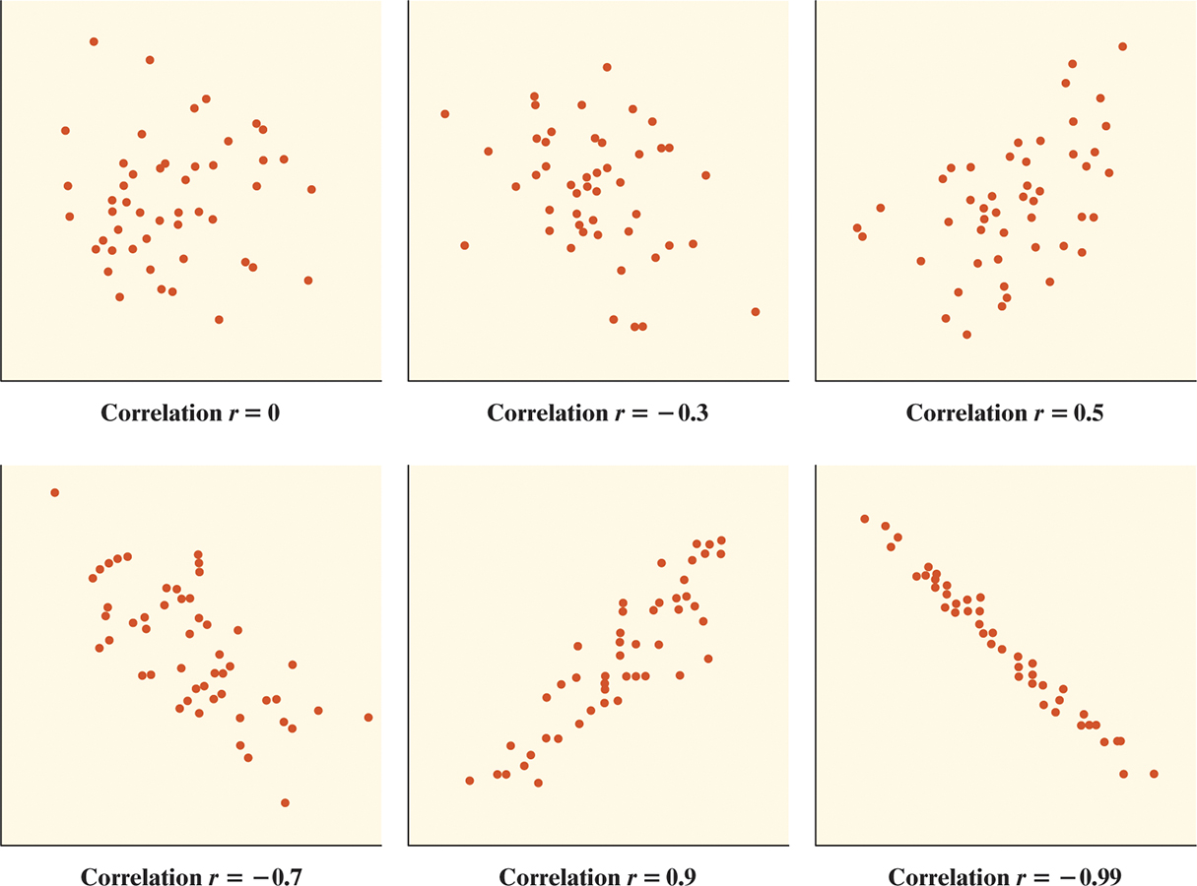
Correlation
Notes:
CRP and IL6? Inflammatory markers, sample size matters ! Very difficult to get high correlation as sample size increases.

Slide 16
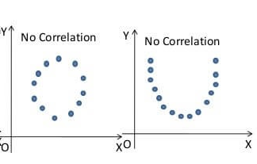
Correlation
?
?
Notes:
CRP and IL6? Inflammatory markers, sample size matters ! Very difficult to get high correlation as sample size increases.

Slide 17
Properties of Correlation
Correlation makes no distinction between explanatory and response variables.
r has no units and does not change when we change the units of measurement of x, y, or both (why?).
Positive r indicates positive association between the variables, and negative r indicates negative association.
The correlation r is always a number between –1 and 1.
Cautions:
Correlation requires that both variables be quantitative.
Correlation does not describe curved relationships between variables, no matter how strong the relationship is.
The correlation r is not resistant; it can be strongly affected by a few outlying observations.
Correlation is not a complete summary of two-variable data.
Notes:
For example, change the unit for height from inch to centimeter, and pound to kilograms for weight.

Slide 18
2.6 Data Analysis for
Two-Way Tables
The two-way table
Marginal distributions
Conditional distributions
Simpson’s paradox

Slide 19
Categorical Variables
Recall that categorical variables place individuals into one of several groups or categories.
The values of a categorical variable are labels for the different categories (i.e., male and female for “sex” variable).
The distribution of a categorical variable lists the count or percent of individuals who fall into each category.
A two-way table describes two categorical variables, organizing counts according to a row variable and a column variable. Each combination of values for these two variables is called a cell.

Slide 20
The Two-Way Table
Young adults by gender and chance of getting rich by age 30
 | Female | Male | Total
Almost no chance | 96 | 98 | 194
Some chance, but probably not | 426 | 286 | 712
A 50–50 chance | 696 | 720 | 1416
A good chance | 663 | 758 | 1421
Almost certain | 486 | 597 | 1083
Total | 2367 | 2459 | 4826
What are the variables described by this two-way table?
How many young adults were surveyed?
Notes:
R code:

Slide 21
Marginal Distribution 1
The marginal distribution of one variable in a two-way is the distribution of that variable ignoring the other variable.
Note: Percentages are often more informative than counts, especially when comparing groups of different sizes.
To examine a marginal distribution:
Divide each row (or column) total by the grand total to obtain the marginal distribution in percentages.
Make a graph to display the marginal distribution.

Slide 22
Marginal Distribution 2
Young adults by gender and chance of getting rich
 | Female | Male | Total
Almost no chance | 96 | 98 | 194
Some chance, but probably not | 426 | 286 | 712
A 50–50 chance | 696 | 720 | 1416
A good chance | 663 | 758 | 1421
Almost certain | 486 | 597 | 1083
Total | 2367 | 2459 | 4826
Examine the marginal distribution of chance of getting rich.
Response | Percent
Almost no chance | 194/4826 = 4.0%
Some chance | 712/4826 = 14.8%
A 50–50 chance | 1416/4826 = 29.3%
A good chance | 1421/4826 = 29.4%
Almost certain | 1083/4826 = 22.4%

Slide 23
Conditional Distribution 1
Marginal distributions tell us nothing about the relationship between two variables. For that, we need to explore the conditional distributions of the variables.
A conditional distribution of a variable describes the distribution of that variable among individuals who have a specific value of another variable.
To examine or compare conditional distributions:
Select the row(s) or column(s) of interest.
Use the data in the table to calculate the conditional distribution (in percent) of the row(s) or column(s). Note that the denominator is the total for the group being conditioned on, not the grand total.
Make a graph to display the conditional distribution.
  Use a side-by-side bar graph or segmented bar graph to compare distributions.
Notes:
But, marginal distribution tells us a baseline distribution if the two categorical variables are not related.

Slide 24
Conditional Distribution 2
Young adults by gender and chance of getting rich
 | Female | Male | Total
Almost no chance | 96 | 98 | 194
Some chance, but probably not | 426 | 286 | 712
A 50–50 chance | 696 | 720 | 1416
A good chance | 663 | 758 | 1421
Almost certain | 486 | 597 | 1083
Total | 2367 | 2459 | 4826
Calculate the conditional distribution of opinion among males.
Examine the relationship between gender and opinion.
Response | Male
Almost no chance | 98/2459 = 4.0%
Some chance | 286/2459 = 11.6%
A 50–50 chance | 720/2459 = 29.3%
A good chance | 758/2459 = 30.8%
Almost certain | 597/2459 = 24.3%
Female
96/2367 = 4.1%
426/2367 = 18.0%
696/2367 = 29.4%
663/2367 = 28.0%
486/2367 = 20.5%

Slide 25
Conditional Distribution 2
Young adults by gender and chance of getting rich
 | Female | Male | Total
Almost no chance | 96 | 98 | 194
Some chance, but probably not | 426 | 286 | 712
A 50–50 chance | 696 | 720 | 1416
A good chance | 663 | 758 | 1421
Almost certain | 486 | 597 | 1083
Total | 2367 | 2459 | 4826
Calculate the conditional distribution of opinion among males.
Examine the relationship between gender and opinion.
Response | Male
Almost no chance | 98/2459 = 4.0%
Some chance | 286/2459 = 11.6%
A 50–50 chance | 720/2459 = 29.3%
A good chance | 758/2459 = 30.8%
Almost certain | 597/2459 = 24.3%
Female
96/2367 = 4.1%
426/2367 = 18.0%
696/2367 = 29.4%
663/2367 = 28.0%
486/2367 = 20.5%

Slide 26
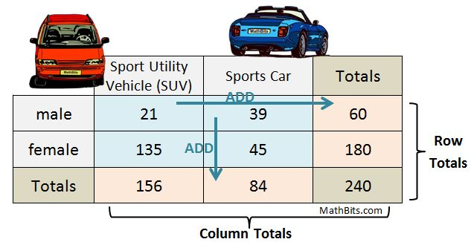
Another example
Notes:
College acceptance rate

Slide 27
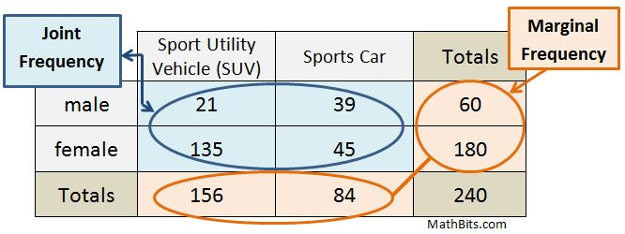
Another example
Notes:
College acceptance rate

Slide 28
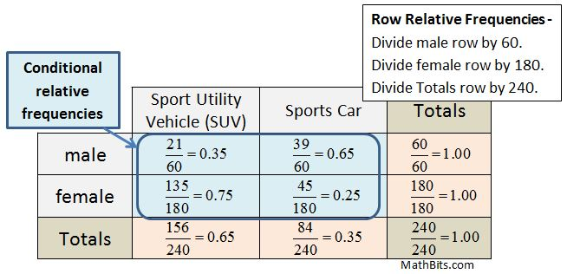
Another example
Notes:
College acceptance rate

Slide 29
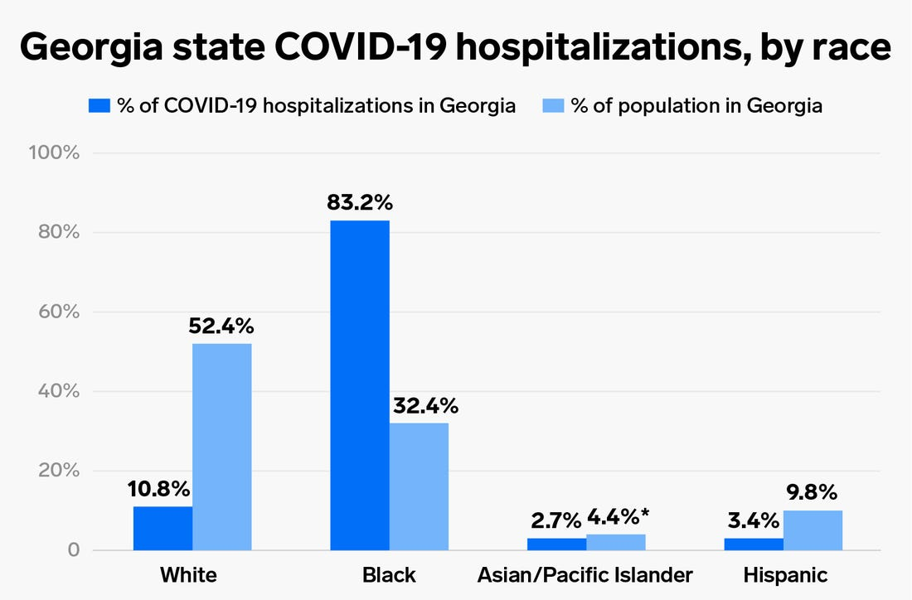
Notes:
One is marginal distribution; the other is conditional distribution. (This is not a good demo; the marginal distribution should be those with COVID, so we can compare those with and without hospitalization by race)

Slide 30
Simpson’s Paradox 1
Consider the acceptance rates for the following groups of men and women who applied to a college.
Counts | Accepted | Not accepted | Total
Men | 198 | 162 | 360
Women | 88 | 112 | 200
Total | 286 | 274 | 560
Percents | Accepted | Not accepted
Men | 55% | 45%
Women | 44% | 56%
A higher percentage of men were accepted.
Discussion: Is there evidence of discrimination?
Notes:
College acceptance rate

Slide 31
Simpson’s Paradox 2
Consider the acceptance rates when broken down by type of school.
BUSINESS SCHOOL
Counts | Accepted | Not accepted | Total
Men | 18 | 102 | 120
Women | 24 | 96 | 120
Total | 42 | 198 | 240
Percents | Accepted | Not accepted
Men | 15% | 85%
Women | 20% | 80%
ART SCHOOL
Counts | Accepted | Not accepted | Total
Men | 180 | 60 | 240
Women | 64 | 16 | 80
Total | 244 | 76 | 320
Percents | Accepted | Not accepted
Men | 75% | 25%
Women | 80% | 20%
Notes:
Why? Look at the number of male applicants in the art school (240) vs business school applicants (120). Versus the female applicants in art school (80) vs business school (120). If total female applicants to Art school is 240, then the overall acceptance rate would still be higher for women.

Slide 32
Simpson’s Paradox 3
An association or comparison that holds for several groups can reverse direction when the data are merged to a single group. This reversal is called Simpson’s paradox.
Potential cause: When studying the relationship between two variables, there might exist a lurking variable that creates a reversal in the direction of the relationship when the lurking variable is ignored as opposed to the direction of the relationship when the lurking variable is considered.
The lurking variable creates subgroups, and failure to take these subgroups into consideration can lead to misleading conclusions regarding the association between the two variables.
Notes:
SAT and % taking SAT is an example (two group). Consider “lurking” vs “confounding”
A lurking variable is a variable that is unknown and not controlled for; It has an important, significant effect on the variables of interest. They are extraneous variables, but may make the relationship between dependent variables and independent variables seem other than it actually is. In other words, the variables will cause your results to be biased. In addition, any correlation or regression analysis you perform will be misleading.

Slide 33
Simpson’s Paradox 4
Lurking variable: Applications were split between the Business School (240) and the Art School (320).
Within each school a higher percentage of women were accepted than men.
This is an example of Simpson’s paradox.
When the lurking variable (Type of School: Business or Art) is ignored, the data seem to suggest lower acceptance rate of women.
However, when the type of school is considered, the association is reversed.

