Slide 1














$$ℒ_{1}$$
$$ℒ_{2}$$
$$ℒ_{ℓ}$$
MLP
MLP
MLP
node features
$$HNN(z^{0},H^{0})$$
$$HNN(z^{1},H^{1})$$
$$HNN(z^{ℓ−1},H^{ℓ−1})$$
$$z^{0}$$
$$z^{1}$$
$$z^{2}$$
$$z^{ℓ}$$
…
$$H^{0}$$
hyperedge expansion
$$H^{1}$$
hyperedge expansion
$$H^{2}$$
$$H^{ℓ −1}$$
…
Notes:
A heterogeneous hypergraph in general online social forums
超边
紫色边：同一个用户的C和P
蓝色边：同一个post及其它的coment
红色超边：同一个group下的所有post和comment
G-P
P-C
P
Post
Comment
Group
User

Slide 3
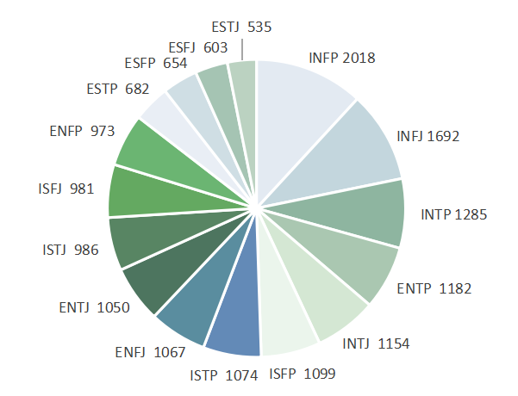
""" Your task is to analyze user descriptions from user profiles, presented in the following JSON format:
{
"1": "example description 1",
"2": "example description 2",
"3": "example description 3",
...
}
Based on the content of each description, determine the most probable MBTI personality type for the corresponding user. Employ your knowledge of MBTI typology to guide your analysis, aiming to match each description with the appropriate MBTI type.If you are unsure about a particular user based on the description, or you don't have an accurate prediction, you still have to give one assumption of the MBTI type that you think is the most likely.
It is very important to only provide the predicted MBTI type for each. No other texts, explanations or commentary are included even without a solid basis! Your analysis should be based solely on the provided descriptions, applying your understanding of the MBTI framework to make informed guesses. """
""" Your task is to analyze user descriptions from user profiles, presented in the following JSON format:
{
"1": "example description 1",
"2": "example description 2",
"3": "example description 3",
...
}
Based on the content of each description, determine the most probable MBTI personality type for the corresponding user. Employ your knowledge of MBTI typology to guide your analysis, aiming to match each description with the appropriate MBTI type.If you are unsure about a particular user based on the description, or you don't have an accurate prediction, you still have to give one assumption of the MBTI type that you think is the most likely.
It is very important to only provide the predicted MBTI type for each. No other texts, explanations or commentary are included even without a solid basis! Your analysis should be based solely on the provided descriptions, applying your understanding of the MBTI framework to make informed guesses. """
"""
Please provide the summarized one concise paragraph to describe each user based on the following details: relationship status, {Gender}, {EnneagramType}, occupation, {About}, {Location}, participated {Groups}, and {Sexual}.
if {Gender} == 'Male':
{pronouns} = ('he', 'his', 'him')
elif gender == 'Female':
{pronouns} = ('she', 'her', 'her')
else:
{pronouns} = ('they', 'their', 'them')
Ensure the result is formatted as a JSON object, like the following example: {Username} is a unique individual who identifies as {Gender}, living in {Location}. Embracing {Sexual}, {pronouns[0]} is characterized by {EnneagramType}. {pronouns[0]} participated in {Groups}
"""
Ablysmal is a female living in New Jersey, who identifies as Female yet embraces Male characteristics. She is a Type 5w6 Enneagram, and she is passionate about researching various subjects online in her spare time. Her ultimate goal is to define and reach her own personal enlightenment and to decipher life's mysteries, believing that life is only meaningful if you give it a meaning.
Input information
prompt
generated description
Embeddings to node features
Input information
Prompt
Output description

Slide 4
{
"Username": "Maki",
"Follower": [],
"About": "Hello. You can call me Maki. I go around the internet with other names, too, so you can also call me Mew or Kikichirin, which I commonly go around by. Nicknames are also fine.\nI'm brazilian, so no, English isn't my first language. I apologize for possible grammar errors. \nI'm afraid I'm not very good at writing biographies. Nevertheless, I believe this will suffice.",
"Location": "Somewhere.",
"PageURL": " https://www.personalitycafe.com/members/maki.html",
"MBTI": "ISTP",
"Sexual": "Asexual",
"EnneagramType": "Type 5",
"Gender": "Female",
"Groups": []
}
Prompt
"Maki is a unique individual who identifies as female and embraces asexual identity. She is characterized by an Enneagram type 5 and is from Brazil. She may also go by the names Mew or Kikichirin and is not fluent in English. Despite any language barriers, she is comfortable with the nicknames and is open to conversation and connection."
gpt-3.5-turbo
"Maki: An introspective and creative soul from Brazil, Maki embraces her individuality and expresses herself through a variety of online personas. Despite her professed shyness, she exudes a quiet confidence and a deep appreciation for language and culture."
gemini
"Maki - This user is a female who is Brazilian and has a different name in other online communities. She is asexual and has a humorous tone in her bio, indicating a light-hearted personality. She is part of the group "infp-haven.""
llama-7b

Slide 5
Motivation
Link prediction only based on pair-wise relations
learning multi-level hyperedges for link prediction
Link prediction using a hyperedge but has no hierarchical structures
weakly correlated
from pair-wise edges to hyperedges
from toneless hyperedges to multi-level hyperedges
unobserved link
sparsely observed network
unobserved link
unobserved link
tighten up
tighten up
under-smooth expressiveness
better expressiveness
over-smooth expressiveness
Notes:
Pair-wise methods can not deal with isolated nodes, hyperedge can.

Slide 6






$$e_{2}$$
succeed
$$e_{1}$$
$$e_{1}$$
expand $e_{1}$
$$e_{1}$$
$$e_{2}$$
depth-first expansion
overlapping as one hyperedge
$$e_{2}$$
$$e_{3}$$
expand $e_{2}$
$$e_{1}$$
$$e_{1}$$
succeed
$$e_{2}$$
$$e_{2}$$
$$e_{1}$$
$$e_{1}$$
succeed
breath-first expansion
expand $e_{1}$
$$e_{1}$$
$$e_{2}$$
$$e_{1}$$
$$e_{3}$$
$$e_{1}$$
$$e_{2}$$
$$e_{1}$$
$$e_{2}$$
$$e_{1}$$
expand $e_{2}$
result
$$e_{1}$$
fail
$$e_{2}$$
hybrid expansion
$$e_{2}$$
$$e_{3}$$
$$e_{1}$$
$$e_{1}$$
$$e_{1}$$
$$e_{4}$$
Notes:
A heterogeneous hypergraph in general online social forums
超边
紫色边：同一个用户的C和P
蓝色边：同一个post及其它的coment
红色超边：同一个group下的所有post和comment
G-P
P-C
P
Post
Comment
Group
User

Slide 7






























2-node graphlet
3-node graphlets
4-node graphlets
$$G_{0}$$
$$G_{1}$$
$$G_{2}$$
$$G_{3}$$
$$G_{4}$$
$$G_{5}$$
$$G_{6}$$
$$G_{7}$$
$$G_{8}$$
5-node graphlets
$$G_{9}$$
$$G_{10}$$
$$G_{11}$$
$$G_{12}$$
$$G_{13}$$
$$G_{14}$$
$$G_{15}$$
$$G_{16}$$
$$G_{17}$$
$$G_{18}$$
$$G_{19}$$
$$G_{20}$$
$$G_{21}$$
$$G_{22}$$
$$G_{23}$$
$$G_{24}$$
$$G_{25}$$
$$G_{26}$$
$$G_{27}$$
$$G_{28}$$
$$G_{29}$$
Notes:
A heterogeneous hypergraph in general online social forums
超边
紫色边：同一个用户的C和P
蓝色边：同一个post及其它的coment
红色超边：同一个group下的所有post和comment
G-P
P-C
P
Post
Comment
Group
User

Slide 8
Estimate a hypergraph on HINs
Attention Network fused with Hypergraphs
Multi-level Reconstruction
Query Strategies
Semantic Reconstruction
Hypergraph Aware Information Entropy
U-U
U-U
Link prediction
Node Embeddings
U-A
Cosine Similarity
Z
Hypergraph Reconstruction
meta-path:
U-U:
U-A:
U-A
Expected Error Reduction
Original
Nodes pairs selection and graphs update
Notes:
A heterogeneous hypergraph in general online social forums
超边
紫色边：同一个用户的C和P
蓝色边：同一个post及其它的coment
红色超边：同一个group下的所有post和comment
G-P
P-C
P
Post
Comment
Group
User

