Slide 1
ConU: Conformal Uncertainty in Large Language Models
with Correctness Coverage Guarantees
Zhiyuan Wang¹, Jinhao Duan², Lu Cheng³, Yue Zhang², Qingni Wang¹,
Xiaoshuang Shi^{1*}, Kaidi Xu², Hengtao Shen¹, Xiaofeng Zhu¹
¹ School of Computer Science and Engineering, University of Electronic Science and Technology of China
² Department of Computer Science, Drexel University
³ Department of Computer Science, University of Illinois Chicago
Presented by: Zhiyuan Wang

Slide 2
Background
Large language models (LLMs) are increasingly being employed for human-in-the-loop decision making and human-AI teams.
LLMs are proven to generate information that is not grounded in reality or deviates from user instructions.
Uncertainty quantification (UQ) can provide valuable insights into the reliability of model responses, facilitating risk control and assessment.
Conformal prediction (CP) is a distribution-free and model-agnostic approach to UQ, which transforms any heuristic notion of uncertainty into a statistically rigorous one by calibrating prediction sets.
Motivation
Prior studies adapt CP to the multiple-choice question-answering (MCQA) setting, where the acceptable response is selected from a fixed set of options, limiting its deployment in real-world open-ended applications.
In open-ended context, existing work either relies on the model logits or fails to achieve strict risk control at various user-specified error rates.

Slide 3
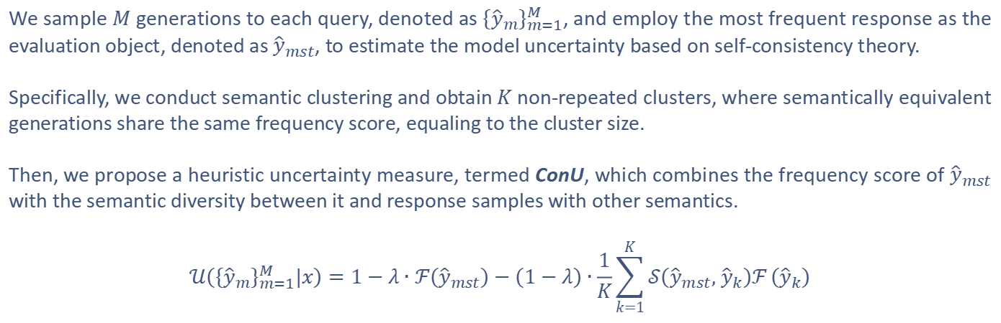
Step one: ConU
We sample $M$ generations to each query, denoted as ${\left\{{\hat{y}}_{m}\right\}}_{m=1}^{M}$, and employ the most frequent response as the evaluation object, denoted as ${\hat{y}}_{mst}$, to estimate the model uncertainty based on self-consistency theory.
Specifically, we conduct semantic clustering and obtain $K$ non-repeated clusters, where semantically equivalent generations share the same frequency score, equaling to the cluster size.
Then, we propose a heuristic uncertainty measure, termed ConU, which combines the frequency score of ${\hat{y}}_{mst}$ with the semantic diversity between it and response samples with other semantics.
$$𝒰\left({\left\{{\hat{y}}_{m}\right\}}_{m=1}^{M}|x\right)=1−λ∙ℱ\left({\hat{y}}_{mst}\right)−\left(1−λ\right)∙\frac{1}{K}\sum_{k=1}^{K}{𝒮\left({\hat{y}}_{mst}, {\hat{y}}_{k}\right)ℱ}\left({\hat{y}}_{k}\right)$$

Slide 4
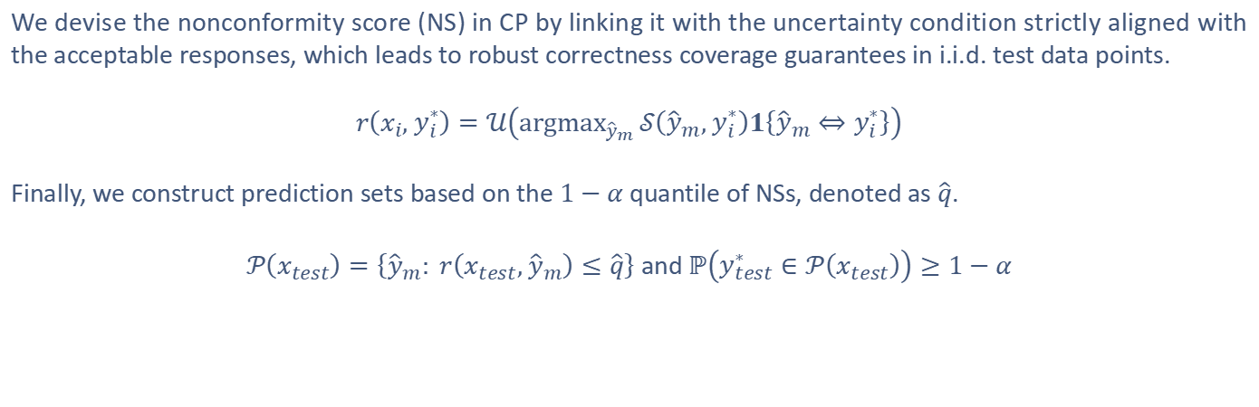
Step two: Conformal Uncertainty Criterion
We devise the nonconformity score (NS) in CP by linking it with the uncertainty condition strictly aligned with the acceptable responses, which leads to robust correctness coverage guarantees in i.i.d. test data points.
$$r\left(x_{i}, y_{i}^{∗}\right)=𝒰\left({argmax}_{{\hat{y}}_{m}}{𝒮\left({\hat{y}}_{m}, y_{i}^{∗}\right)1\left\{{\hat{y}}_{m}⇔y_{i}^{∗}\right\}}\right)$$
Finally, we construct prediction sets based on the $1−α$ quantile of NSs, denoted as $\hat{q}$.
$𝒫\left(x_{test}\right)=\left\{{\hat{y}}_{m}: r\left(x_{test}, {\hat{y}}_{m}\right)≤\hat{q}\right\}$ and $ℙ\left(y_{test}^{∗}∈𝒫\left(x_{test}\right)\right)≥1−α$

Slide 5
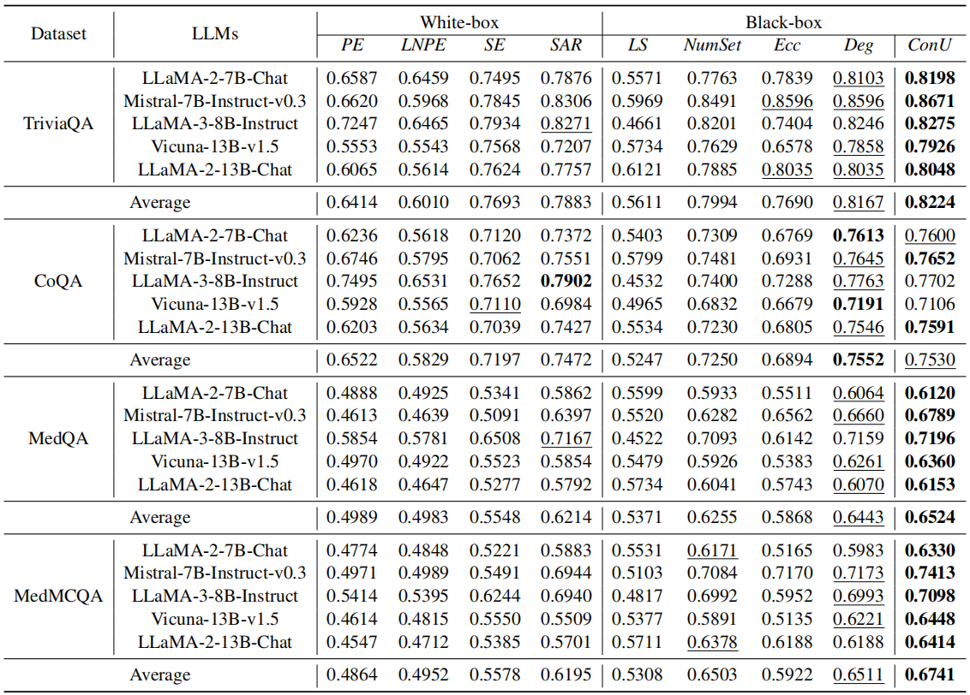
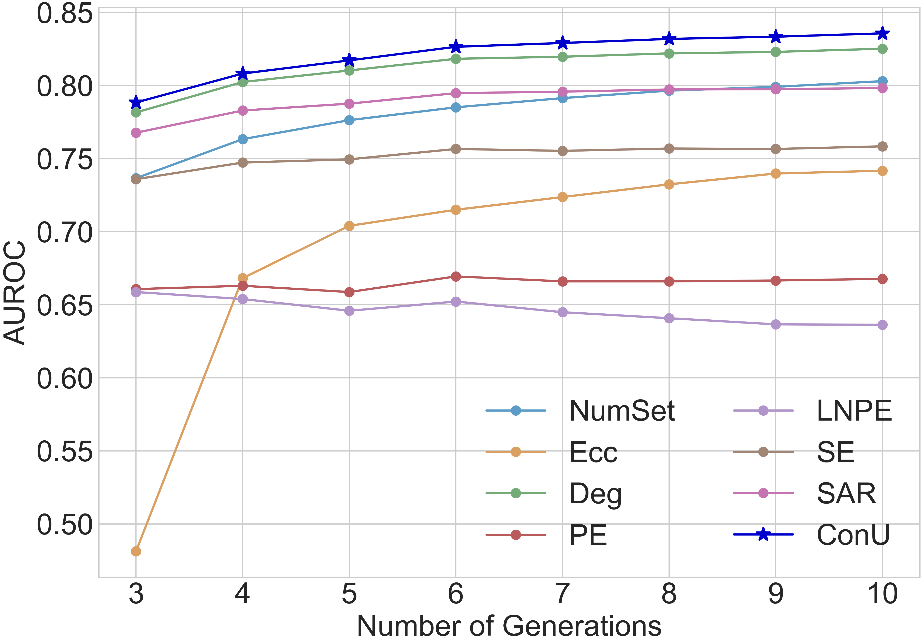
The performance of ConU in distinguishing between
correct and incorrect responses (AUROC)
ConU consistently outperforms 7 baselines, and its performance can be further boosted by incorporating more generations, showing its generation-efficient nature.
ConU generally outperforms 8 baseline methods on 4 datasets.

Slide 6
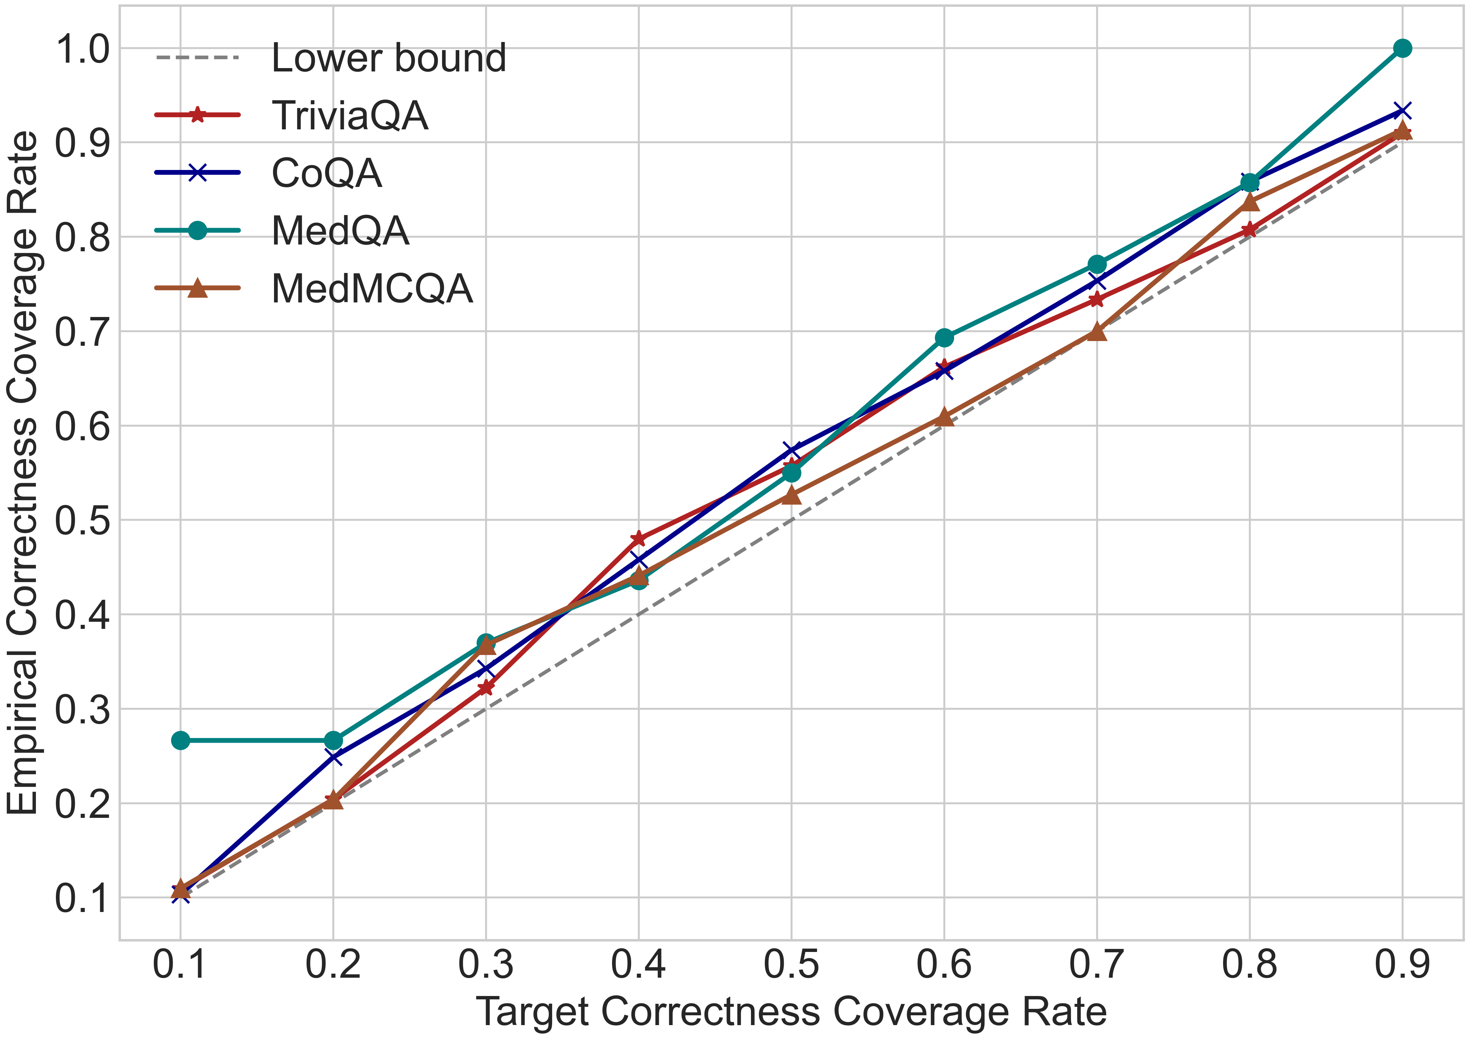
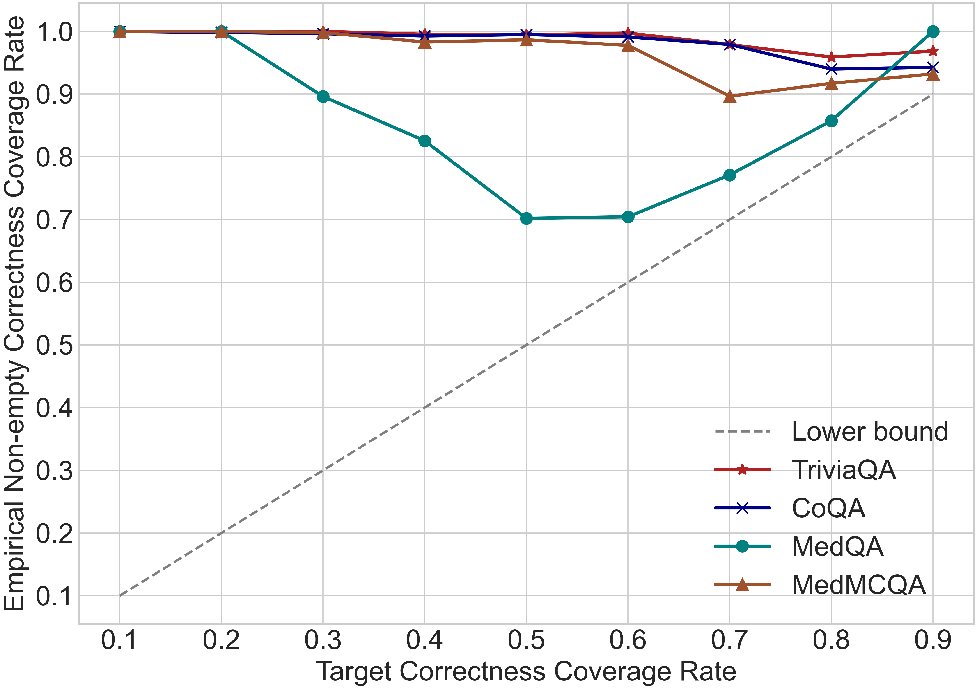
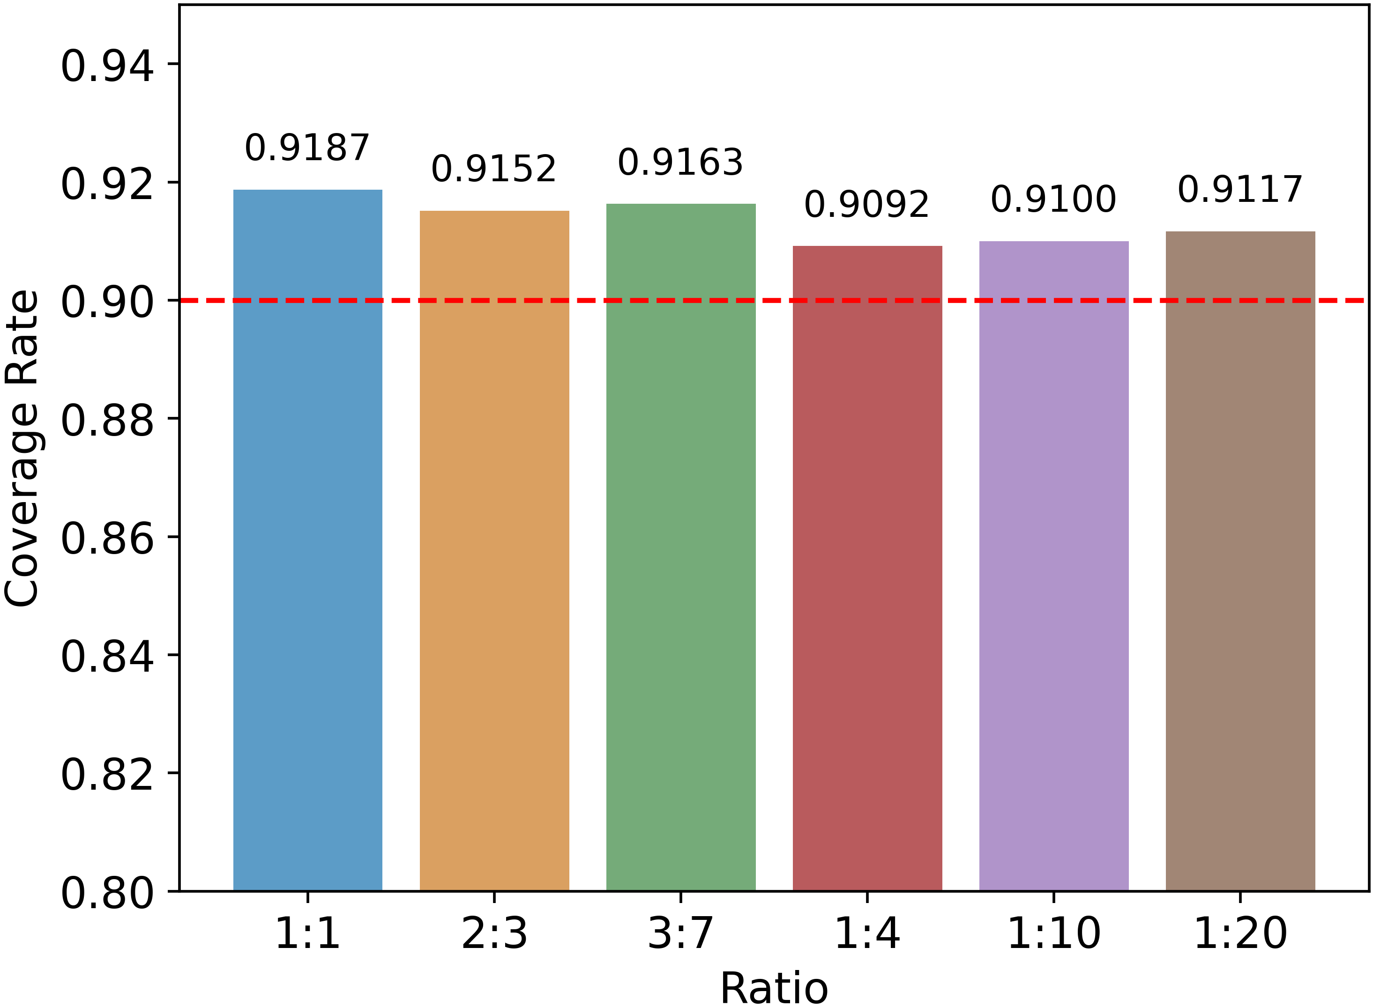
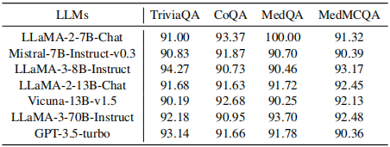
The validity of conformal uncertainty criterion
Empirical correctness coverage rate at various user-specified error rates
Empirical coverage rate on 7 LLMs across 4 open-ended NLG datasets. The user-specified error rate is set to 0.1
Empirical coverage rate at various splitting ratios

Slide 7
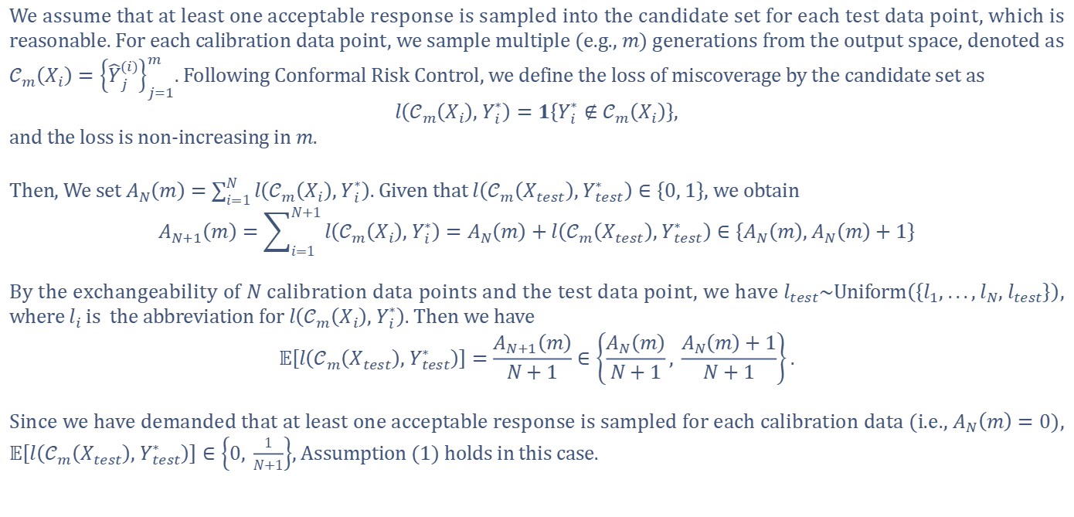
Assumption (1)
We assume that at least one acceptable response is sampled into the candidate set for each test data point, which is reasonable. For each calibration data point, we sample multiple (e.g., $m$) generations from the output space, denoted as $𝒞_{m}\left(X_{i}\right)={\left\{{\hat{Y}}_{j}^{(i)}\right\}}_{j=1}^{m}$. Following Conformal Risk Control, we define the loss of miscoverage by the candidate set as
$$l\left(𝒞_{m}\left(X_{i}\right), Y_{i}^{∗}\right)=1\left\{Y_{i}^{∗}∉𝒞_{m}\left(X_{i}\right)\right\},$$
and the loss is non-increasing in $m$.
Then, We set $A_{N}\left(m\right)=\sum_{i=1}^{N}{l\left(𝒞_{m}\left(X_{i}\right), Y_{i}^{∗}\right)}$. Given that $l\left(𝒞_{m}\left(X_{test}\right), Y_{test}^{∗}\right)∈\left\{0, 1\right\}$, we obtain
$$A_{N+1}\left(m\right)=\sum_{i=1}^{N+1}{l\left(𝒞_{m}\left(X_{i}\right), Y_{i}^{∗}\right)}=A_{N}\left(m\right)+l\left(𝒞_{m}\left(X_{test}\right), Y_{test}^{∗}\right)∈\left\{A_{N}\left(m\right), A_{N}\left(m\right)+1\right\}$$
By the exchangeability of $N$ calibration data points and the test data point, we have $l_{test}\sim Uniform\left(\left\{l_{1}, ..., l_{N}, l_{test}\right\}\right)$, where $l_{i}$ is the abbreviation for $l\left(𝒞_{m}\left(X_{i}\right), Y_{i}^{∗}\right)$. Then we have
$$𝔼\left[l\left(𝒞_{m}\left(X_{test}\right), Y_{test}^{∗}\right)\right]=\frac{A_{N+1}\left(m\right)}{N+1}∈\left\{\frac{A_{N}\left(m\right)}{N+1}, \frac{A_{N}\left(m\right)+1}{N+1}\right\}.$$
Since we have demanded that at least one acceptable response is sampled for each calibration data (i.e., $A_{N}\left(m\right)=0$), $𝔼\left[l\left(𝒞_{m}\left(X_{test}\right), Y_{test}^{∗}\right)\right]∈\left\{0, \frac{1}{N+1}\right\}$, Assumption (1) holds in this case.

