Slide 1
DAC modeling using MATLAB Simscape
Zhiyuan Fan 2024-11-11

Slide 2
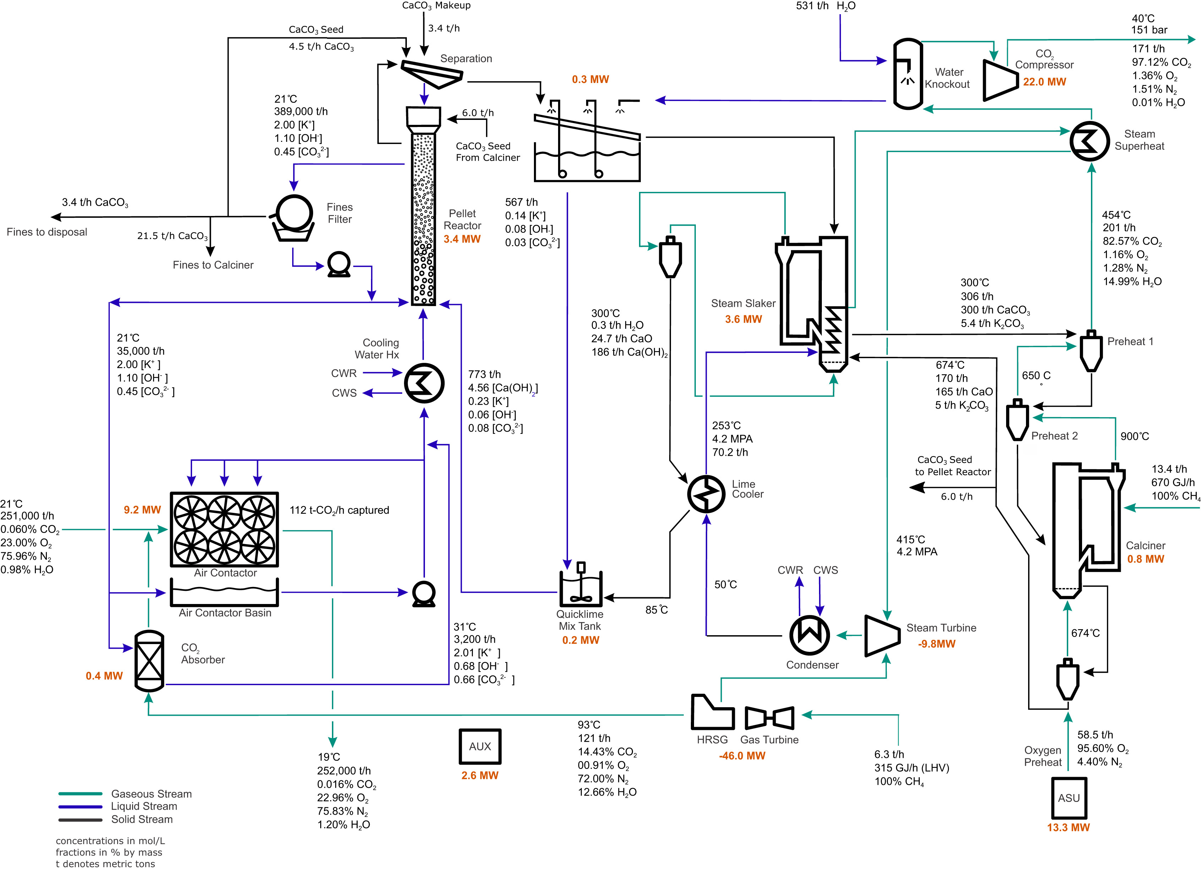
Liquid solvent DAC (continuous)
Notes:
https://www.cell.com/joule/fulltext/S2542-43511830225-3

Slide 3
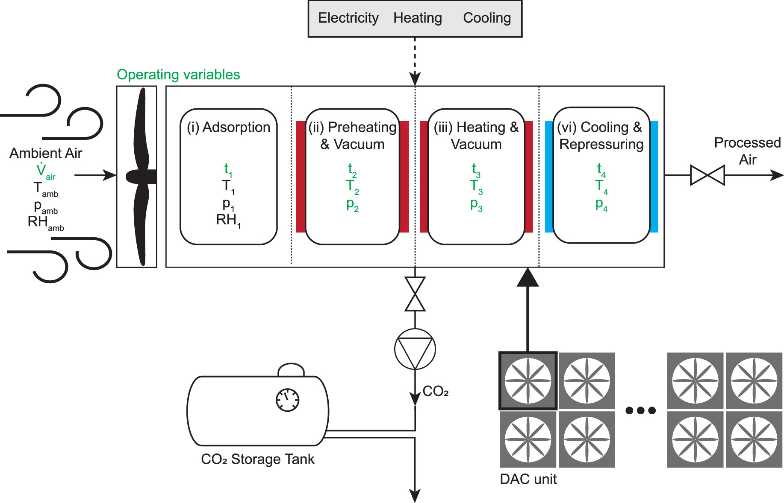
Solid sorbents DAC (cyclic)
Notes:
https://www.cell.com/joule/fulltext/S2542-43511830225-3

Slide 4
Centrifugal Fan

