Slide 1


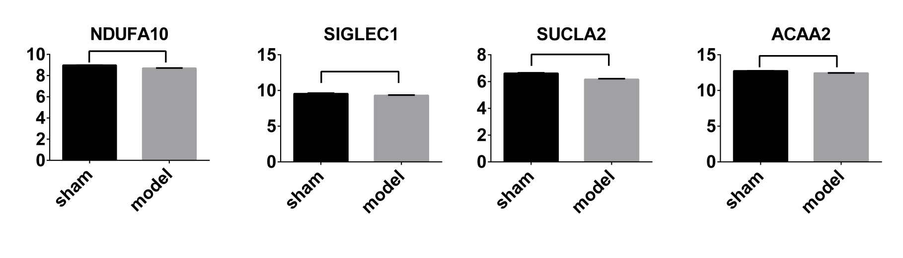

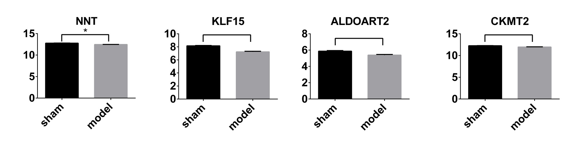
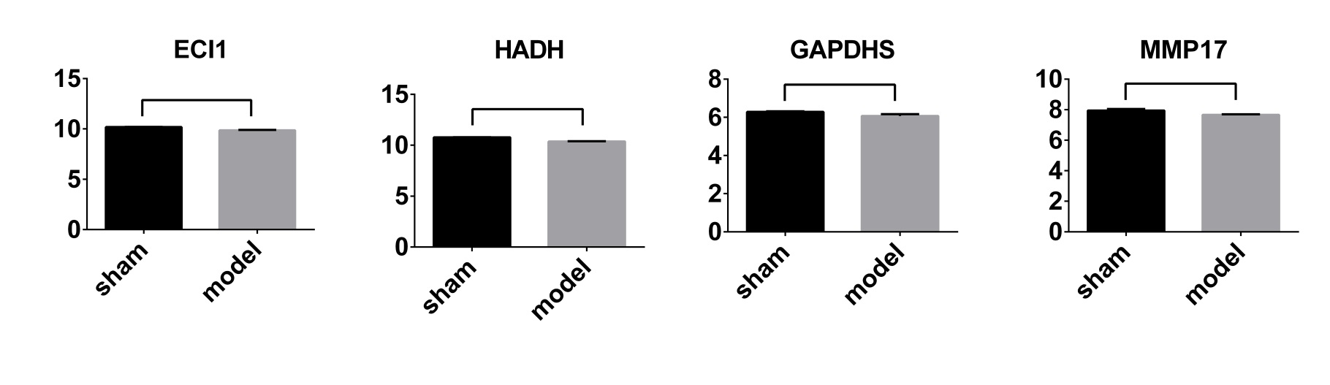
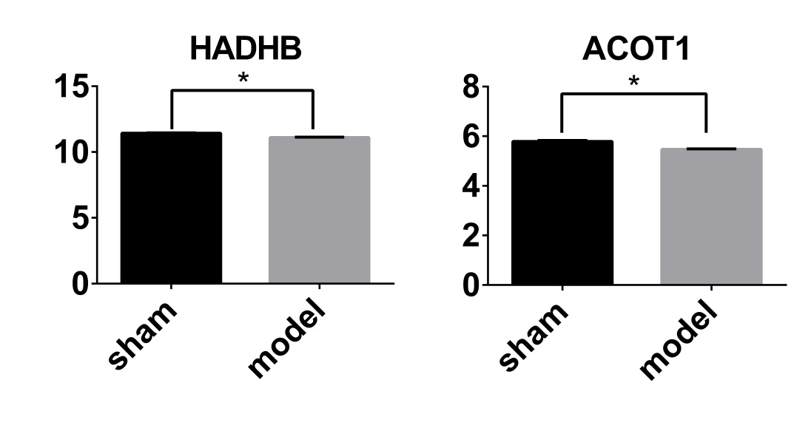



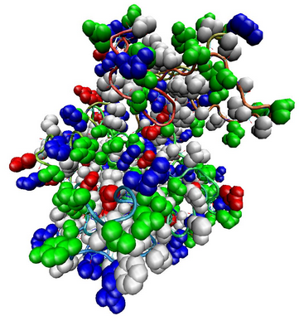
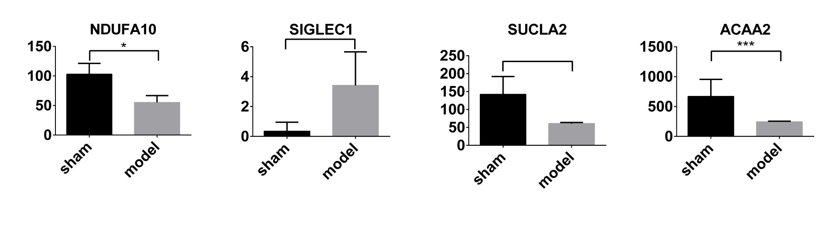
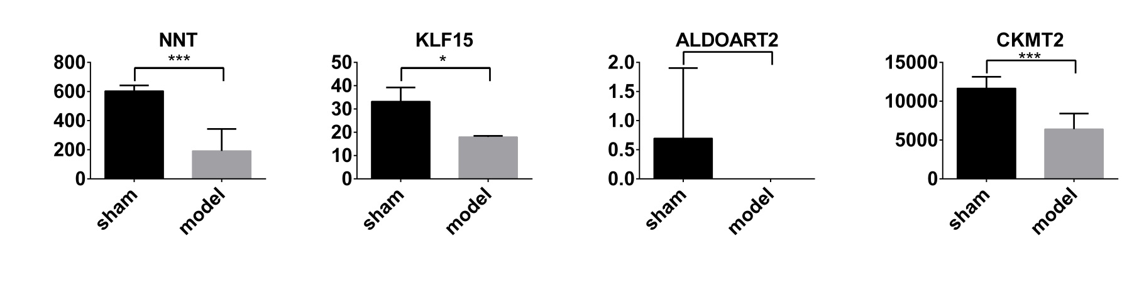
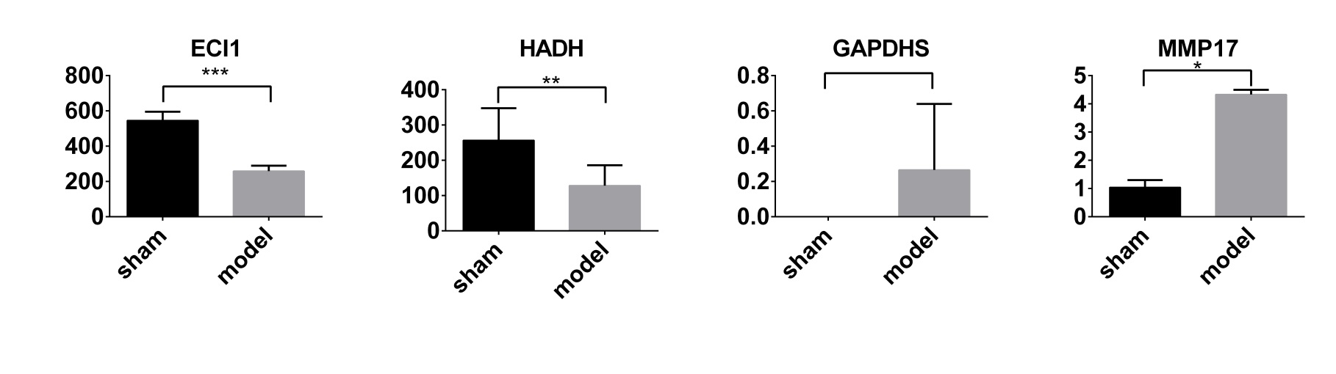
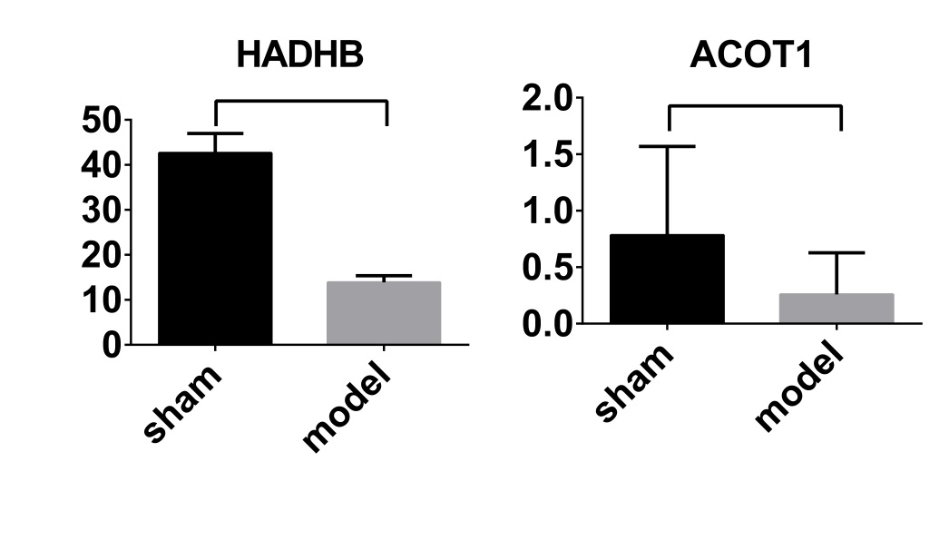
Pathogenesis of AMI Revealed by Integrative Global Transcriptomics and Proteomics Analysis
Yong Wang^{1,$}, Weili Lin^{2,$}, Colleen A. Nugent³, Sheng Gao⁴, Zhiyuan Ma⁴, Ruixin Zhu⁴, Chun Li¹, Lixin Zhu^{3, 5, *}, Wei Wang^{1,*}
¹ Basic Medical College, Beijing University of Chinese Medicine, Beijing 100029, P.R.China
² Key Lab of Computational Biology, CAS-MPG Partner Institute for Computational Biology, Shanghai Institutes for Biological Sciences, Chinese Academy of Sciences, Shanghai 200031, P.R. China
³ Digestive Diseases and Nutrition Center, Department of Pediatrics, The State University of New York at Buffalo, Buffalo, New York 14214, United States.
⁴ Department of Bioinformatics, School of Life Sciences and Technology, Tongji University, Shanghai 200092, P.R.China.
⁵ Genome, Environment and Microbiome Community of Excellence, The State University of New York at Buffalo, Buffalo, New York 14214, United States.
⁶ Institute of Digestive Diseases, Longhua Hospital, Shanghai University of Traditional Chinese Medicine, Shanghai 200032, P.R. China
$Contributed equally
* Correspondence authors: Lixin Zhu (lixinzhu@buffalo.edu) , Wei Wang(wangwei@bucm.edu.cn)
Abstract
Method
Feature gene expression on protein level
Discussion
Background: Acute myocardial infarction (AMI) is a common cardiovascular event which becomes an important cause of mortality and morbidity worldwide. The molecular pathological mechanism of AMI can exhibit across multiple layers of gene regulation including gene expression and protein translation. Integrative analysis of multiple layers (transcriptome and proteome) of genetics information provides new insights into pathogenesis of AMI.
Methods: Sprague-Dawley (SD) rats were randomly divided into 2 groups (3 rats in each group): Sham-operated group and AMI model group. AMI model was induced by ligation of left anterior descending coronary artery. Twenty eight days after surgery, cardiac tissue was harvested for digital gene expression (DGE) sequencing and two-dimensional electrophoresis coupled mass spectrometric (MS) analysis. To integrate transcriptome and proteome data, we performed multiple co-inertia analysis (MCIA) to detect feature genes of AMI on both mRNA and protein levels. Feature genes were ranked with PageRank score in gene co-expression network (GCN). Pathway enrichment analysis and functional module analysis were further performed on feature genes. Moreover, significance of functional module was evaluated with priority of feature genes.
Results: At the gene level, MCIA integrative analysis revealed 2313 feature genes of AMI, with 2264 mRNAs and 63 proteins. Among them, 14 feature genes were detected on both mRNA and protein levels, and most of them were the top-ranked genes in GCN (NDUFA10, SIGLEC1, SUCLA2, ACAA2, NNT, KLF15, ALDOART2, CKMT2, ECIL1, HADH, GAPDHS, MMP17 and HADHB). These genes can be candidate biomarkers of AMI. At pathway level, pathway enrichment analysis indicated dysregulation of fatty acid degradation and its upstream signalling pathways, including both PPAR and AMPK signalling pathways. Additionally some other pathways related to cardiovascular diseases were enriched, including hypertrophic cardiomyopathy, dilated cardiomyopathy and renin secretion. At functional module level, significant functional modules were relevant to upstream signalling pathways of important metabolism, including AMPK and glucagon signalling pathways. These significant functional modules play pivotal roles in the control of energy metabolism, including fatty acid oxidation and glycolysis. Meanwhile, significant functional modules were involved in cardiac function pathways, including adrenergic signalling in cardiomyocytes and calcium signalling pathway.
Conclusion: Integrative analysis of transcriptome and proteome provides new insights into pathogenesis of AMI. Top-ranked feature genes can be candidate biomarkers of AMI. Our study identified significant functional modules that regulate important energy metabolism and cardiac function in AMI development.
Sham-operated group
AMI model group
Integrative transcriptomics and proteomics analysis makes the results more comprehensive
After 28 days
ENTREZ ID | Gene symbol | mRNA level mean expression |  | Protein level mean expression
89803 | Sfrp4 | Yes | 4.262587 | NA | NA
296358 | Matn4 | Yes | 3.681324 | NA | NA
25471 | Kcne1 | Yes | 3.462478 | NA | NA
24367 | Fgg | Yes | 8.355622 | NA | NA
314654 | Myo1f | Yes | 3.049494 | NA | NA
282821 | Has1 | Yes | 4.027679 | NA | NA
83575 | Cpz | Yes | 5.89138 | NA | NA
24213 | Atp1a3 | Yes | 3.935509 | NA | NA
289780 | Ddx56 | Yes | 2.955882 | NA | NA
310552 | Sfrp2 | Yes | 6.743997 | NA | NA
113931 | Prrx2 | Yes | 3.754717 | NA | NA
83467 | Slit3 | Yes | 3.646652 | NA | NA
304581 | Tmem119 | Yes | 3.608598 | NA | NA
296616 | Cercam | Yes | 4.386547 | NA | NA
304960 | Olfml2b | Yes | 4.356032 | NA | NA
689108 | Slc25a31 | NA | NA | Yes | 8.970983
29213 | Tubb4a | NA | NA | Yes | 8.821194
315324 | Krt78 | NA | NA | Yes | 5.325644
685672 | Krt78 | NA | NA | Yes | 5.325644
259233 | Gpx6 | NA | NA | Yes | 11.76463
290721 | LOC290721 | NA | NA | Yes | 9.196546
291065 | RGD1564781 | NA | NA | Yes | 9.196546
297826 | LOC297826 | NA | NA | Yes | 9.196546
501727 | LOC501727 | NA | NA | Yes | 9.196546
688456 | LOC688456 | NA | NA | Yes | 9.196546
688509 | Eno1-ps1 | NA | NA | Yes | 9.196546
24587 | Nefh | NA | NA | Yes | 6.83678
365654 | LOC365654 | NA | NA | Yes | 15.26386
302948 | Srl | NA | NA | Yes | 10.92162
26198 | COX2 | NA | NA | Yes | 9.948752
Cardiac tissues of ischemic marginal zone
RNA-seq
Protein Mass Spectrometry
mRNA expression profile
protein expression profile
Feature expression analysis
Differential expression analysis
(MCIA)
⇌
NOIseq
Feature genes (mRNA/protein)
DEGs
⇌
DEPs
1. Protein mapping to gene
2. Gene co-expression analysis
Complementary
Complementary
Figure 2. Feature gene expression on protein level. Mean values ±SD are plotted. Asterisks indicate significant differences (*, FDR<0.05).
Co-expression network
1.gene ranking (PageRank)
2.Pathway enrichment (ClusterProfiler,FDR<0.05)
3.Pathway merging(KEGGgraph)
4.modularization(igraph)
Result — Differential expression analysis
Differential expression analysis on mRNA level
Significant functions
ENTREZ ID | Gene symbol | Sham mean expression | Model mean expression | FDR | Fold change | Feature gene or not
24795 | Serpina3n | 0.375075 | 19.51121 | 0.003266 | 52.01944 | Yes
29576 | Wisp2 | 1.034994 | 28.82009 | 1.37E-09 | 27.84566 | Yes
29469 | Lbp | 3.493309 | 75.04319 | 0.001679 | 21.48198 | Yes
89803 | Sfrp4 | 0.281143 | 4.262587 | 0.035512 | 15.16162 | Yes
24618 | Reg3b | 2.072791 | 30.44778 | 0.045711 | 14.68927 | Yes
294312 | Pi16 | 2.070984 | 30.40392 | 4.00E-15 | 14.68091 | Yes
59106 | Ltbp2 | 0.751891 | 10.79045 | 0.044044 | 14.35108 | Yes
296358 | Matn4 | 0.281143 | 3.681324 | 0.017695 | 13.09413 | Yes
361945 | Postn | 1.503914 | 19.62071 | 0.02086 | 13.04643 | Yes
25471 | Kcne1 | 0.281143 | 3.462478 | 0.020393 | 12.31571 | Yes
25353 | Spp1 | 2.82712 | 33.80796 | 0.017795 | 11.95844 | Yes
257642 | LOC257642 | 8.118816 | 92.26228 | 0.046351 | 11.36401 | Yes
24367 | Fgg | 0.753851 | 8.355622 | 0.040388 | 11.08392 | Yes
314654 | Myo1f | 0.281143 | 3.049494 | 2.44E-15 | 10.84676 | Yes
282821 | Has1 | 0.373813 | 4.027679 | 0.036356 | 10.77459 | Yes
83575 | Cpz | 0.559151 | 5.89138 | 0.037934 | 10.53629 | Yes
Result — Feature expression analysis
Both transcriptome and proteome data are incomplete. Some genes are detected only on mRNA level, while some only on protein level.
Feature genes (including mRNA and protein)
The combination of feature expression analysis and differential expression analysis provides more solid results for exploring pathological mechanisms
Entrez ID | Gene symbol | Molecular type | Sham mean expression | Model mean expression | Fold change | FDR | PageRank
678759 | Ndufa10 | mRNA | 103.0966667 | 55.15 | 0.534934851 | 0.018460 | 0.000745793
678759 | Ndufa10 | protein | 8.982249853 | 8.698827809 | 0.968446431 | 0.072452 | 0.000745793
311426 | Siglec1 | mRNA | 0.346666667 | 3.415 | 9.850961538 | 0.060081 | 0.000713749
311426 | Siglec1 | protein | 9.551479867 | 9.305396046 | 0.974236053 | 0.102289 | 0.000713749
361071 | Sucla2 | mRNA | 142.26 | 60.65 | 0.426332068 | 0.175272 | 0.000648736
361071 | Sucla2 | protein | 6.617665308 | 6.163080233 | 0.931307334 | 0.078239 | 0.000648736
170465 | Acaa2 | mRNA | 669.9566667 | 243.905 | 0.364060860 | 1.21E-06 | 0.000621028
170465 | Acaa2 | protein | 12.74067182 | 12.4255502 | 0.975266483 | 0.102289 | 0.000621028
310378 | Nnt | mRNA | 603.55 | 192.275 | 0.318573440 | 4.87E-14 | 0.000596385
310378 | Nnt | protein | 12.76700094 | 12.45031161 | 0.975194696 | 0.039273 | 0.000596385
85497 | Klf15 | mRNA | 33.23333333 | 17.985 | 0.541173521 | 0.041393 | 0.000575740
85497 | Klf15 | protein | 8.158812666 | 7.241065043 | 0.887514561 | 0.065727 | 0.000575740
299052 | Aldoart2 | mRNA | 0.696666667 | 0 | 0 | 0.050170 | 0.000570288
299052 | Aldoart2 | protein | 5.867218053 | 5.387731469 | 0.918277013 | 0.081611 | 0.000570288
688698 | Ckmt2 | mRNA | 11664.31667 | 6404.13 | 0.549036020 | 7.66E-15 | 0.000567980
688698 | Ckmt2 | protein | 12.25998879 | 11.96701046 | 0.976102888 | 0.074769 | 0.000567980
29740 | Eci1 | mRNA | 545.8133333 | 258.02 | 0.472725718 | 0 | 0.000565242
29740 | Eci1 | protein | 10.18426513 | 9.85969485 | 0.968130221 | 0.103684 | 0.000565242
113965 | Hadh | mRNA | 256.34 | 128.025 | 0.499434345 | 0.009719 | 0.000549845
113965 | Hadh | protein | 10.77545197 | 10.37276122 | 0.962628875 | 0.051585 | 0.000549845
66020 | Gapdhs | mRNA | 0 | 0.265 | Inf | 0.385309 | 0.000515878
66020 | Gapdhs | protein | 6.286459341 | 6.067573426 | 0.965181368 | 0.240023 | 0.000515878
288626 | Mmp17 | mRNA | 1.04 | 4.33 | 4.163461538 | 0.036107 | 0.000507204
288626 | Mmp17 | protein | 7.947038099 | 7.660112503 | 0.963895279 | 0.100670 | 0.000507204
171155 | Hadhb | mRNA | 42.62666667 | 13.91 | 0.326321551 | 0.136150 | 0.000501835
171155 | Hadhb | protein | 11.43476231 | 11.11196311 | 0.971770362 | 0.035323 | 0.000501835
50559 | Acot1 | mRNA | 0.783333333 | 0.26 | 0.331914894 | 0.072447 | 0.000352744
50559 | Acot1 | protein | 5.787465135 | 5.468160239 | 0.944828195 | 0.039273 | 0.000352744
Differentially expressed mRNA and proteins
Feature genes (mRNA and proteins)
Background
813
668
Differential expression analysis on protein level
1659
ENTREZ ID | Gene symbol | Sham mean expression | Model mean expression | FDR | Fold change | Feature gene or not
362377 | Herc3 | 5.711208894 | 6.822641534 | 0.039127346 | 1.194605496 | Yes
117505 | Csrp3 | 9.359941176 | 9.962447623 | 0.039273289 | 1.064370751 | Yes
689108 | Slc25a31 | 8.482948305 | 8.970983083 | 0.039273289 | 1.057531269 | Yes
259233 | Gpx6 | 11.3111931 | 11.76462781 | 0.035323133 | 1.040087257 | No
24333 | Eno1 | 8.938631522 | 9.196546348 | 0.039127346 | 1.028853950 | No
290721 | LOC290721 | 8.938631522 | 9.196546348 | 0.039127346 | 1.028853950 | No
291065 | RGD1564781 | 8.938631522 | 9.196546348 | 0.039127346 | 1.028853950 | No
297826 | LOC297826 | 8.938631522 | 9.196546348 | 0.039127346 | 1.028853950 | No
501727 | LOC501727 | 8.938631522 | 9.196546348 | 0.039127346 | 1.028853950 | No
688456 | LOC688456 | 8.938631522 | 9.196546348 | 0.039127346 | 1.028853950 | No
688509 | Eno1-ps1 | 8.938631522 | 9.196546348 | 0.039127346 | 1.028853950 | No
24440 | Hbb | 13.27336339 | 13.57696645 | 0.003057570 | 1.022873106 | No
360971 | Nipsnap1 | 10.57540882 | 10.7908428 | 0.035323133 | 1.020371220 | No
361596 | Idh2 | 13.93829272 | 13.82005125 | 0.035728788 | 0.991516790 | No
24551 | Mdh1 | 11.89360404 | 11.78971679 | 0.035323133 | 0.991265284 | No
24587 | Nefh | 6.902129927 | 6.83678042 | 0.039273289 | 0.990531980 | No
171374 | Atp5b | 15.42064446 | 15.26386254 | 0.039273289 | 0.989832985 | No
365654 | LOC365654 | 15.42064446 | 15.26386254 | 0.039273289 | 0.989832985 | No
293448 | Uqcrc2 | 12.56109878 | 12.40720147 | 0.039273289 | 0.987748101 | No
29556 | Myh6 | 9.401138145 | 9.27780408 | 0.035323133 | 0.986880943 | No
25438 | Eno3 | 10.46586431 | 10.30929543 | 0.039127346 | 0.985040043 | No
302948 | Srl | 11.13489521 | 10.9216229 | 0.039273289 | 0.980846491 | No
26198 | COX2 | 10.14584804 | 9.948751748 | 0.039127346 | 0.980573699 | No
25288 | Acsl1 | 10.40041691 | 10.17141404 | 0.039273289 | 0.977981375 | No
301073 | Hhatl | 8.830180845 | 8.63271584 | 0.039127346 | 0.97763749 | Yes
310378 | Nnt | 12.76700094 | 12.45031161 | 0.039273289 | 0.975194696 | Yes
60460 | Hspa2 | 8.052134086 | 7.846107306 | 0.035323133 | 0.974413394 | Yes
29213 | Tubb4a | 9.063671986 | 8.821193687 | 0.039127346 | 0.973247234 | Yes
171155 | Hadhb | 11.43476231 | 11.11196311 | 0.035323133 | 0.971770362 | Yes
50559 | Acot1 | 5.787465135 | 5.468160239 | 0.039273289 | 0.944828195 | Yes
315324 | Krt78 | 5.863392932 | 5.325644285 | 0.039273289 | 0.908287121 | Yes
685672 | Krt78 | 5.863392932 | 5.325644285 | 0.039273289 | 0.908287121 | Yes
The yellow circle represents the differentially expressed mRNA and protein, and the blue circle represents feature genes (including RNA and protein levels). The overlap of two circles represents the intersection of the feature genes and differentially expressed mRNA and proteins. The number represents the number of mRNA and proteins.
Conclusion
FFA
-2ATP
ACOT1
O
Feature gene expression on mRNA level
Cytoplasm
Acyl-CoA
☓
Fatty Acids + CoA-SH
O
☓
Transcriptome data
Proteome data
CPT-1
Multiple co-inertia analysis
ACAA2
β -oxidation
Feature protein
PC2
Feature gene
Mitochondrion
PC1
NDUFA10
TCA
AMI
Mitochondrial Damage
Acute myocardial infarction (AMI) is a common cardiovascular event which becomes an important cause of mortality and morbidity worldwide.
The molecular pathological mechanism of AMI can exhibit across multiple layers of gene regulation including gene expression and protein translation. Integrative analysis of multiple layers (transcriptome and proteome) of genetics information provides new insights into pathogenesis of AMI.
In our study, the down regulation of ACOT1 is closely related with AMI. The acyl-CoA thioesterase gene (ACOT) family encodes enzymes that catalyse the hydrolysis of acyl-CoA thioester compounds, also known as activated fatty acids, to their corresponding non-esterified (free) fatty acid and coenzyme A (CoASH). The down regulation of ACOT1, CPT-1, ACCA2 and NDUFA10 leads to the impaired fatty acid oxidation in mitochondrion. This may cause myocardial energy failure and AMI.
Figure 1. Feature gene expression on mRNA level. Mean values ±SD are plotted. Asterisks indicate significant differences (*, FDR<0.05; **, FDR<0.01; ***, FDR<0.001).

