Slide 1
Identifying Backup Generator Usage During Power Outages
Nighttime Light–Based Evidence from Texas Case Studies
Zhiyuan Zhao · Qiushi Yu

Slide 2
Project Background
Governments promote electrification to support economic development and energy transition.
Electricity supply remains unreliable during extreme weather events.
Households and critical facilities increasingly rely on backup generators.
Backup generators introduce localized air pollution and equity concerns.
A key limitation: backup generator usage is largely unobserved.

Slide 3
Research Objective
Develop an indirect method to identify backup generator usage during power outages.
Leverage satellite-based nighttime light observations and outage records.
Provide spatially explicit evidence to support environmental and policy analysis.

Slide 4
Study Areas and Data
Case studies: Dallas County and Harris County (Houston).
VIIRS daily nighttime light data (usable observations only).
Severe weather–related outage events.
Critical facilities: hospitals, airports, police, and fire stations.

Slide 5
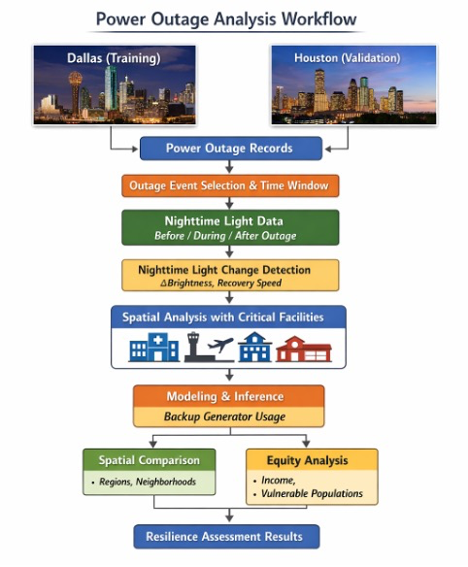
Analytical Workflow
Identify major outage events using outage records.
Define pre-, during-, and post-outage periods.
Extract nighttime light intensity from VIIRS Black Marble data.
Measure changes in light intensity during outages.
Link patterns to critical facility locations and infrastructure resilience.

Slide 6
Current Progress: Data Availability
Outage events screened with corresponding VIIRS nighttime light coverage.
Total outage events evaluated: 23.
Usable images are filtered for cloud cover and data quality flags.
Remaining gaps motivate event-level and window-level robustness checks.

Slide 7
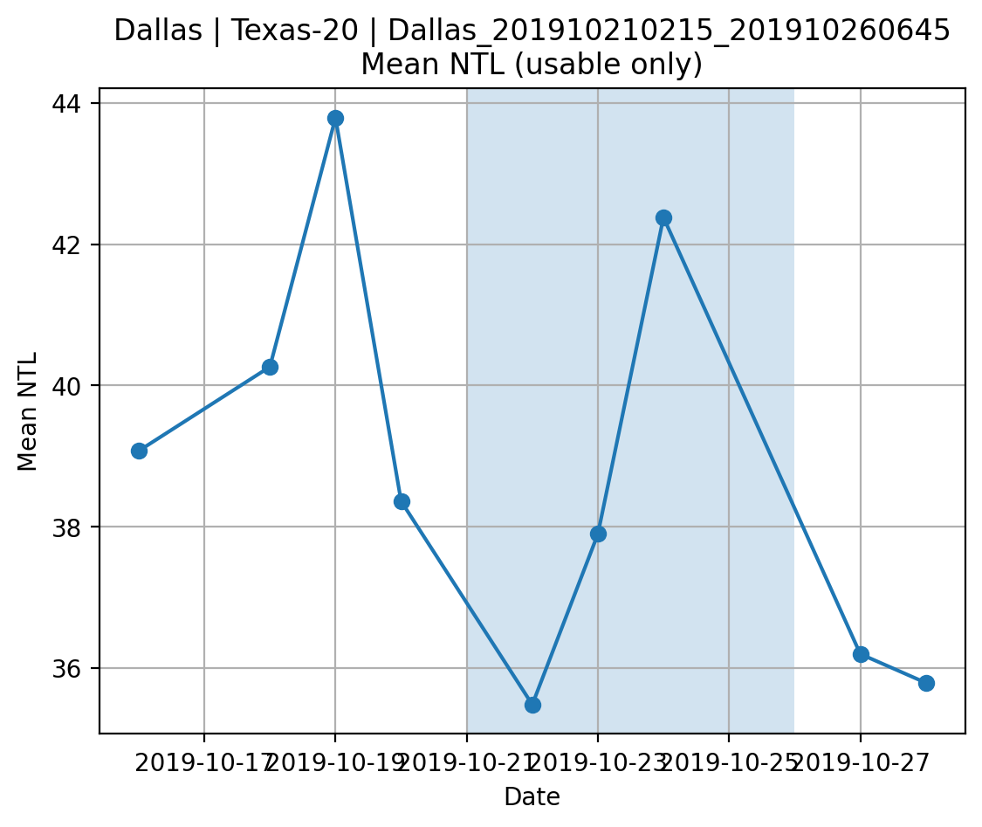
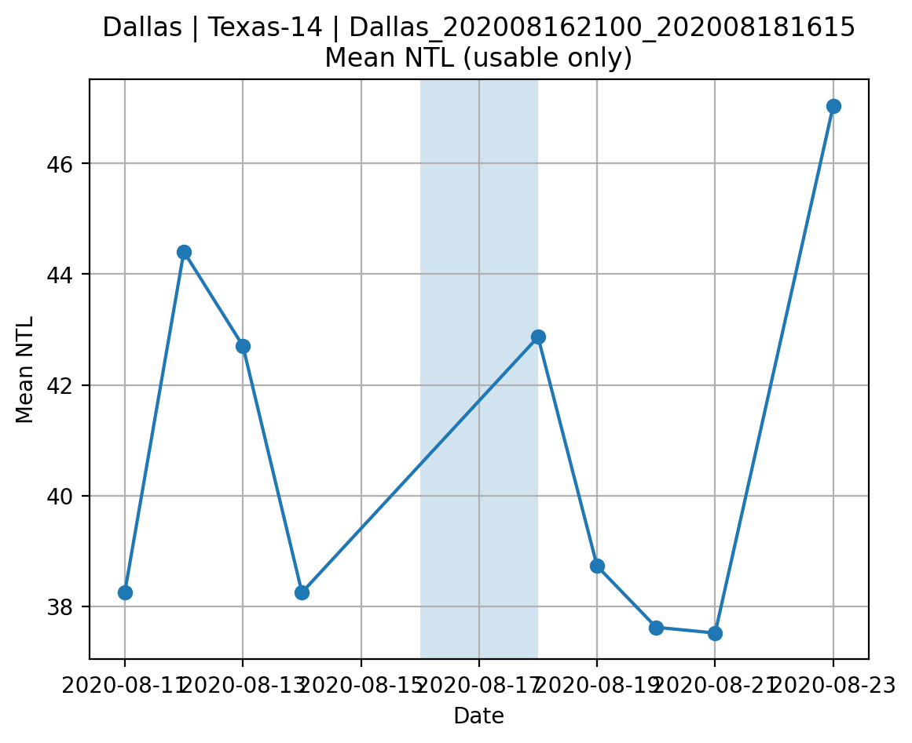
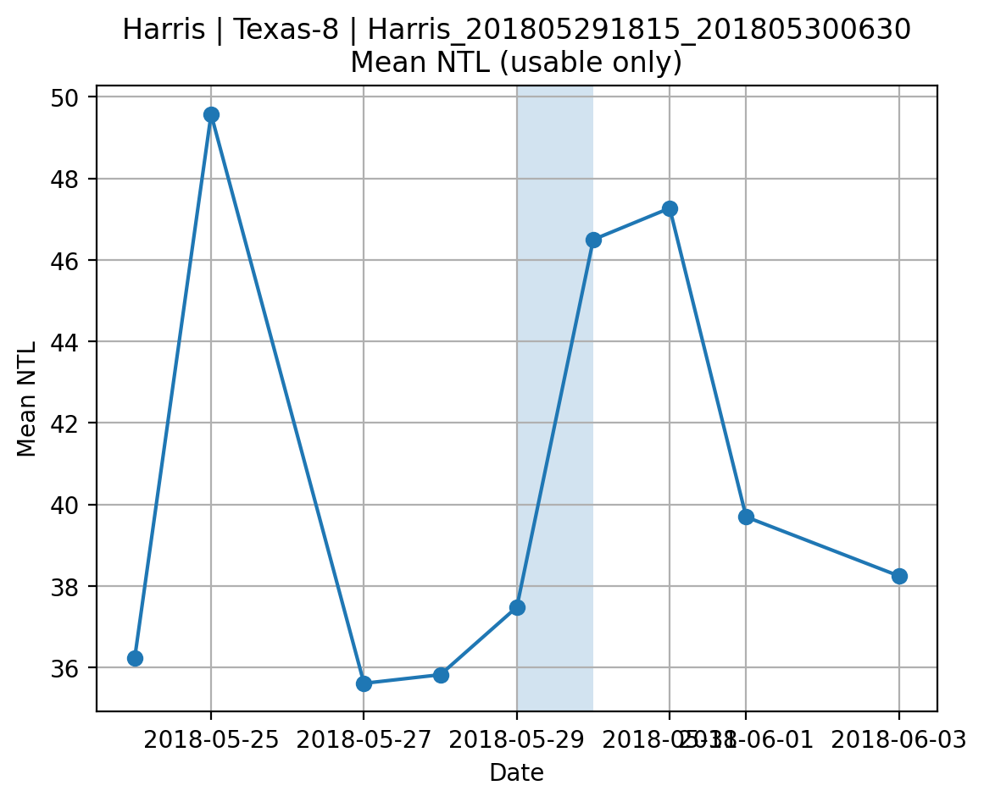
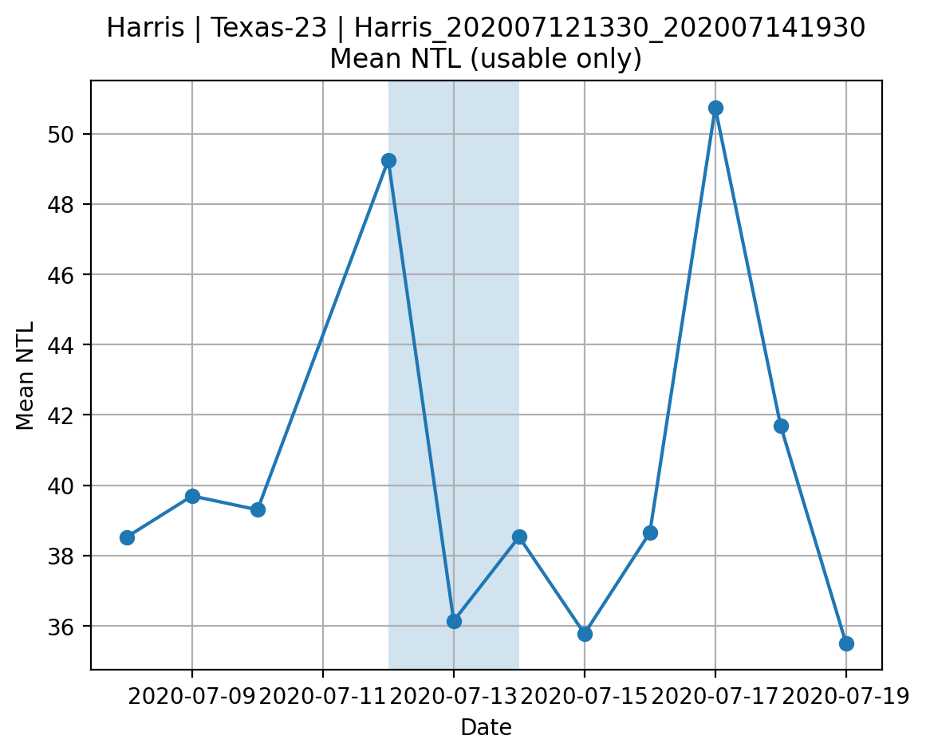
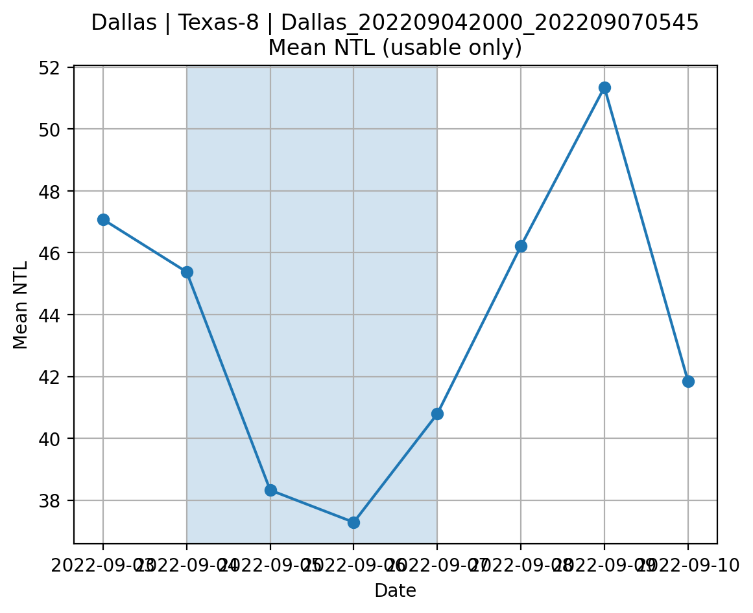
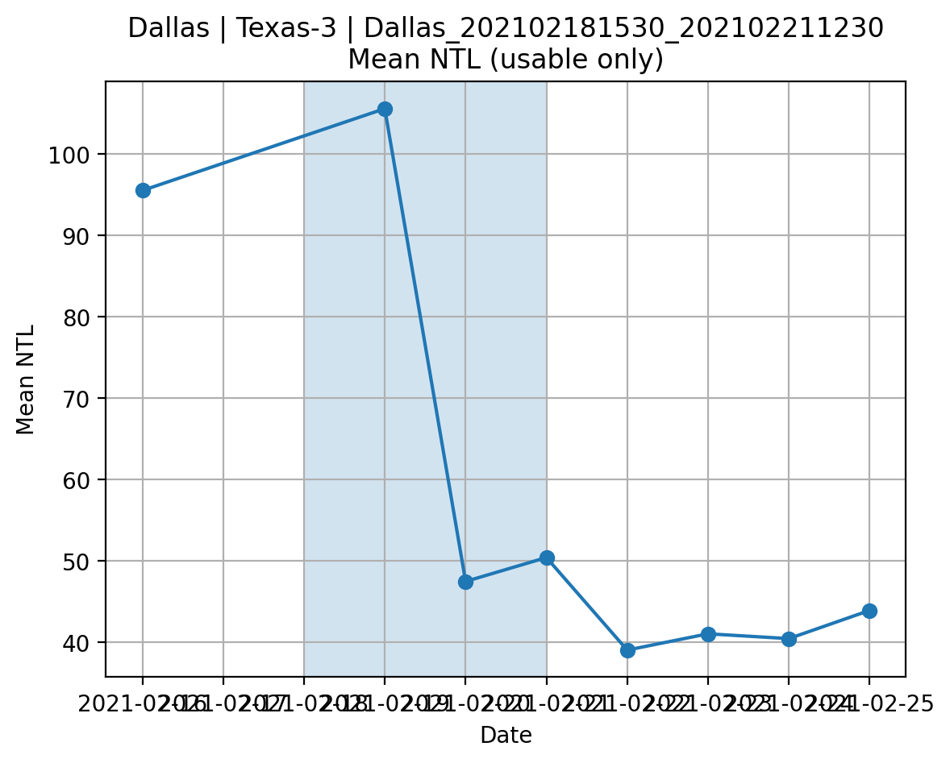
Current Progress: Nighttime Light Responses to Outage Events

