Slide 1
Identifying Backup Generator Usage During Power Outages
Nighttime Light–Based Evidence from Texas Case Studies
Zhiyuan Zhao · Qiushi Yu

Slide 2
Project Background
Global electrification expansion is central to sustainable development, yet grid vulnerability persists in extreme weather events.
Power outages during natural disasters disproportionately impact critical infrastructure and vulnerable populations.
Backup generators serve as essential resilience infrastructure, yet their deployment and operational patterns remain largely unquantified.
Diesel-powered generators contribute to localized air pollution emissions, raising environmental justice and public health concerns.
A critical research gap: systematic methods for detecting and quantifying backup generator usage at scale are lacking.

Slide 3
Research Objective
Develop an indirect method to identify backup generator usage during power outages.
Use satellite-based nighttime light observations and outage records.
Provide spatially explicit evidence to support environmental and policy analysis.

Slide 4
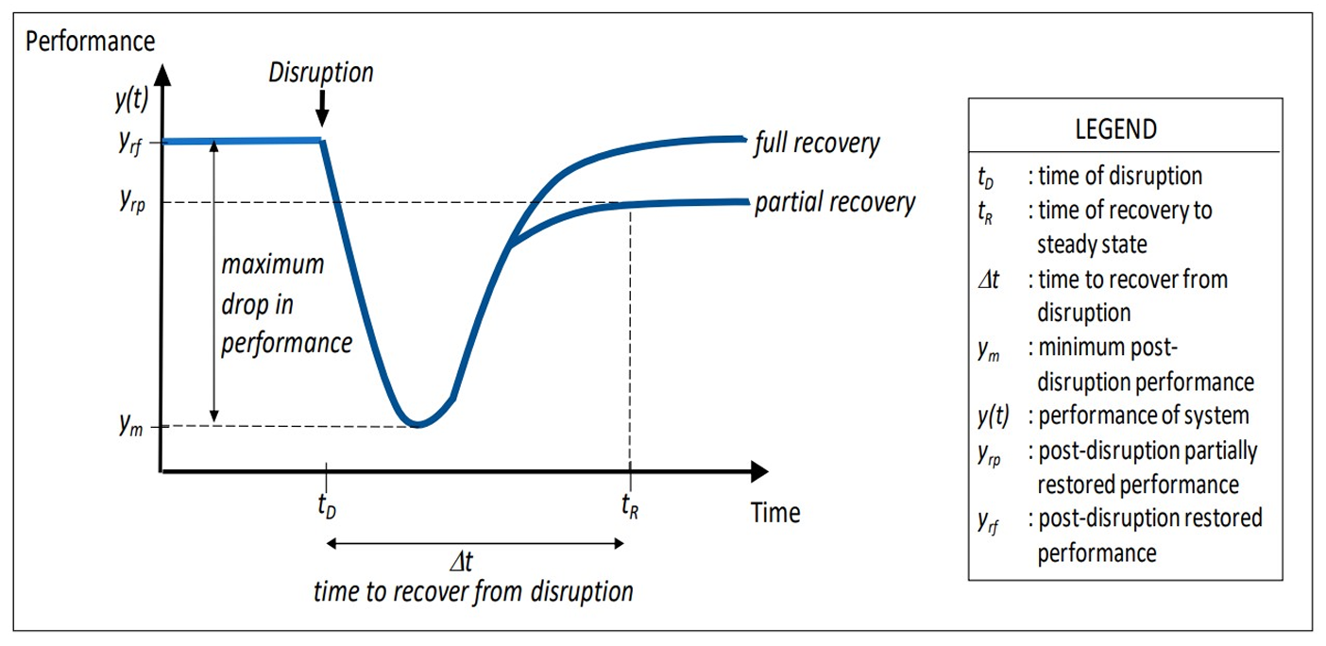
Resilience Curve Framework
Before, during, and after a disaster occurs, the performance of a system is represented by the resilience curve. At the time of disruption, the system’s performance experiences a sudden drop. As time progresses, the performance gradually increases, leading to either partial or full recovery, depending on the recovery efforts.
During power outages, the nighttime light curves of facilities equipped with backup generators show significant differences compared to other areas. We use this contrast to identify the presence of backup generators.
Because precise generator locations are unavailable and only postcode-level information exists, we combine this with the fact that critical public facilities generally have backup generators to generate labels for our model.

Slide 5
Study Areas and Data
Study Areas:
Dallas County and Harris County (Houston),
Texas – selected for frequent outage events and data availability.
Nighttime Light:
NASA VIIRS Black Marble (VNP46A2),
500m resolution, daily imagery with quality flags for cloud/noise filtering.
Outage Records:
OpenEI EAGLE-I dataset providing county-level hourly outage customer counts (2014-present).
POI Data:
OpenStreetMap critical facilities (hospitals, airports, police, fire stations…);
Air Permit database for post-code level generator registrations.

Slide 6
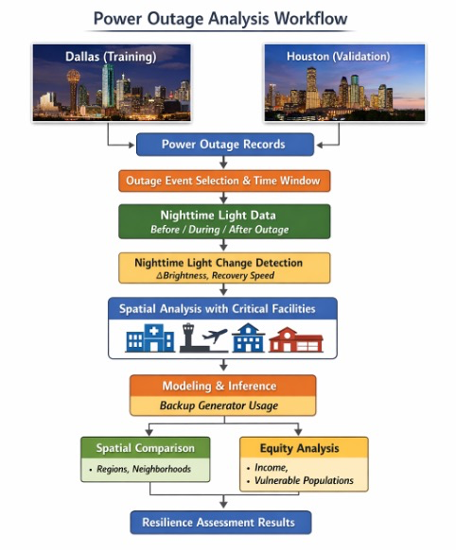
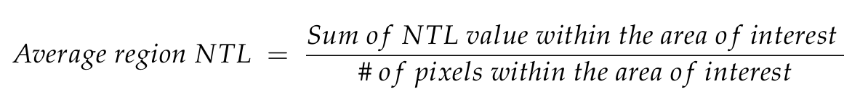
Analytical Workflow
Step 1: Screen outage events from EAGLE-I records based on severity (>10,000 affected customers) and duration (>8 hours).
Step 2: Define temporal windows: pre-outage baseline (5 days), during-outage period, and post-outage recovery (5 days).
Step 3: Extract pixel-level NTL radiance from VIIRS VNP46A2, applying QA flags to exclude cloud-contaminated observations.
Step 4: Extract NTL anomaly features (intensity change, recovery rate, spatial patterns) for model input.
Step 5: Apply deep learning models to classify backup generator usage patterns based on NTL anomaly features.
Step 6: Validate predictions against Air Permit generator records and critical facility POI data.

Slide 7
Current Progress: Data Availability
Event Data Summary
Event Data Coverage
Metric | Value
Total Outage Events | 23
Events with During-Outage Images | 18
Events with High Snow Cover (>10%) | 2
Usable Events for Analysis | 16
County | Event | Pre | Dur | Post | Snow%
Dallas | Texas-2 | 1 | 1 | 2 | 0.0
Dallas | Texas-20 | 4 | 3 | 2 | 0.0
Dallas | Texas-14 | 4 | 1 | 4 | 0.0
Dallas | Texas-1 | 0 | 1 | 5 | 79.5
Dallas | Texas-1 | 1 | 3 | 4 | 79.5
Dallas | Texas-8 | 1 | 4 | 3 | 0.1
Dallas | Texas-10 | 1 | 2 | 2 | 0.1
Harris | Texas-3 | 1 | 1 | 2 | 0.5
Harris | Texas-1 | 3 | 1 | 2 | 1.5
Harris | Texas-1 | 4 | 1 | 1 | 1.5
Harris | Texas-1 | 4 | 1 | 0 | 1.5
Harris | Texas-4 | 3 | 2 | 0 | 0.0
Harris | Texas-8 | 3 | 3 | 4 | 1.0
Harris | Texas-8 | 4 | 2 | 3 | 1.0
Harris | Texas-10 | 3 | 1 | 0 | 0.0
Harris | Texas-2 | 2 | 1 | 2 | 0.3
Harris | Texas-23 | 3 | 3 | 5 | 0.3
Harris | Texas-0 | 1 | 3 | 0 | 0.4

Slide 8
Current Progress: NTL Change Analysis
County-Level NTL Change During Outages
Critical Facility vs Non- Critical Facility NTL Change
County | Event | Pre | During | Chg% | Snow
Dallas | 201504 | 3.1 | 4.4 | 41.3 | 0.00
Dallas | 201910 | 4.0 | 3.9 | -4.4 | 0.00
Dallas | 202008 | 4.1 | 4.3 | 4.8 | 0.00
Dallas | 202102 | 7.8 | 6.2 | -20.2 | 0.00
Dallas | 202209 | 4.7 | 4.0 | -14.1 | 0.00
Dallas | 202303 | 5.0 | 4.8 | -4.1 | 0.00
Harris | 201708 | 3.3 | 4.6 | 40.1 | 0.00
Harris | 201801 | 3.9 | 3.5 | -11.6 | 0.00
Harris | 201801 | 3.8 | 4.7 | 24.0 | 0.00
Harris | 201801 | 3.8 | 4.0 | 3.9 | 0.00
Harris | 201804 | 3.8 | 3.7 | -4.2 | 0.00
Harris | 201805 | 3.9 | 3.6 | -7.6 | 0.00
Harris | 201805 | 3.9 | 4.2 | 6.9 | 0.00
Harris | 201811 | 3.5 | 3.5 | -2.5 | 0.00
Harris | 202005 | 3.7 | 4.6 | 24.7 | 0.00
Harris | 202007 | 3.9 | 4.1 | 5.4 | 0.00
Harris | 202301 | 4.3 | 5.0 | 15.6 | 0.00
County | Event | Buf% | Non% | Diff
Dallas | 201504 | 35.3 | 42.1 | -6.9
Dallas | 201910 | 4.5 | -4.3 | 8.8
Dallas | 202008 | 5.7 | 4.9 | 0.8
Dallas | 202102 | -21.4 | -20.2 | -1.2
Dallas | 202209 | -7.1 | -14.4 | 7.3
Dallas | 202303 | 13.3 | -3.7 | 17.0
Harris | 201708 | 49.6 | 40.5 | 9.1
Harris | 201801 | -10.7 | -11.7 | 1.0
Harris | 201801 | 21.8 | 24.1 | -2.2
Harris | 201801 | 2.3 | 3.9 | -1.6
Harris | 201804 | -5.7 | -4.1 | -1.6
Harris | 201805 | -6.5 | -7.6 | 1.1
Harris | 201805 | 7.2 | 6.9 | 0.3
Harris | 201811 | -2.5 | -2.5 | 0.0
Harris | 202005 | 48.5 | 24.7 | 23.8
Harris | 202007 | 3.3 | 5.6 | -2.3
Harris | 202301 | -3.6 | 15.7 | -19.3
Key Finding: Buffer regions (500m around critical facilities) show +2.4% higher NTL resilience on average.

Slide 9
Current Progress: Data Availability
Data Coverage:
23 outage events identified; 44% show NTL decrease during outages (excluding high-snow events).
Buffer Analysis:
500m buffer around critical facilities shows slightly higher NTL resilience than surrounding areas.
Signal Limitation:
500m spatial resolution constrains individual facility-level detection; statistical approaches required.
Next Steps:
Pixel-level anomaly detection methods and validation against permit-based ground truth data.

Slide 10
Thanks

