Slide 1
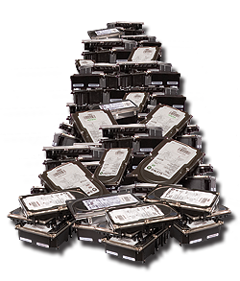

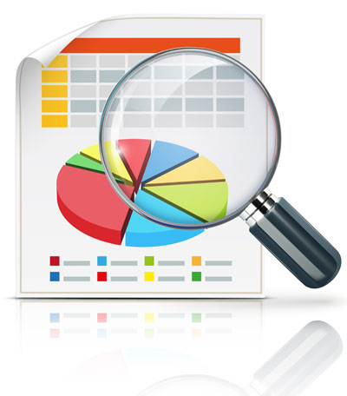
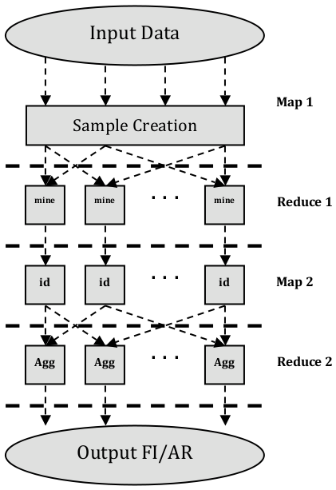
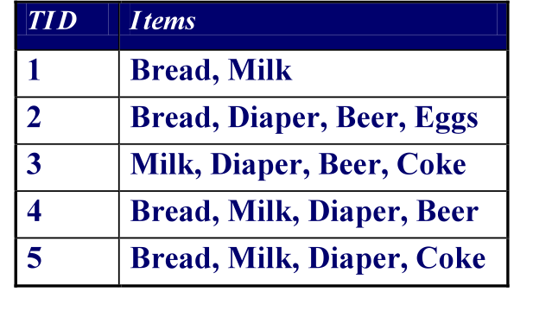
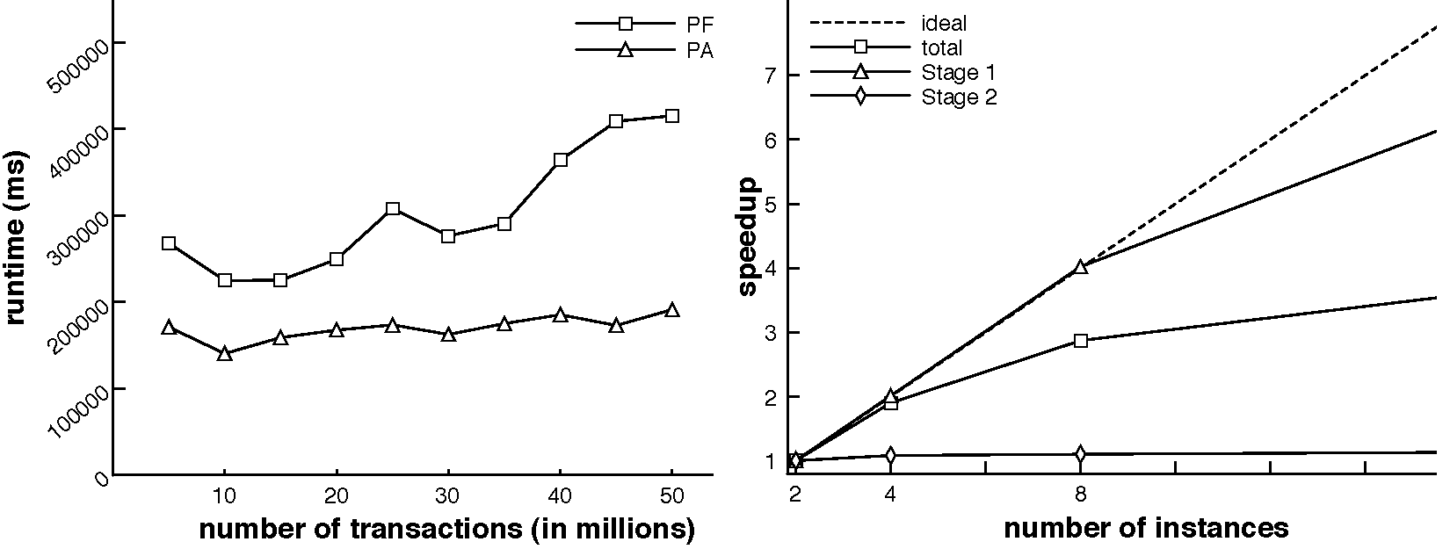
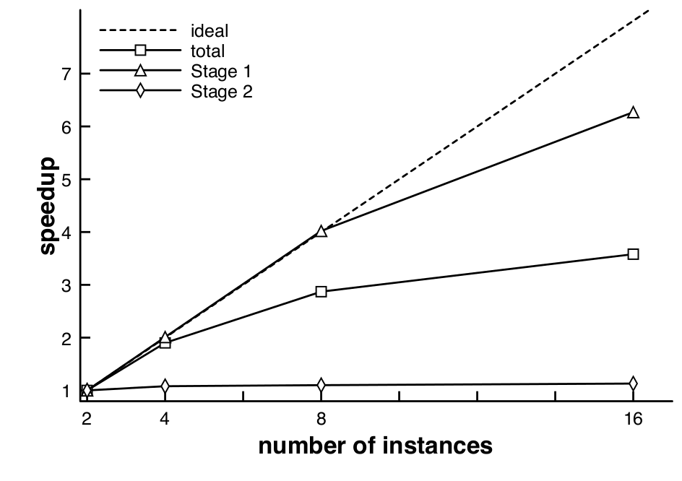
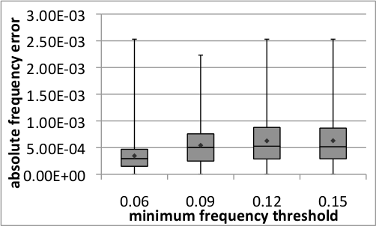
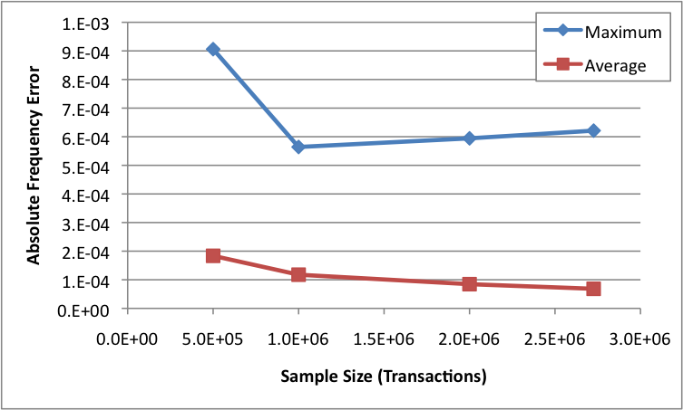
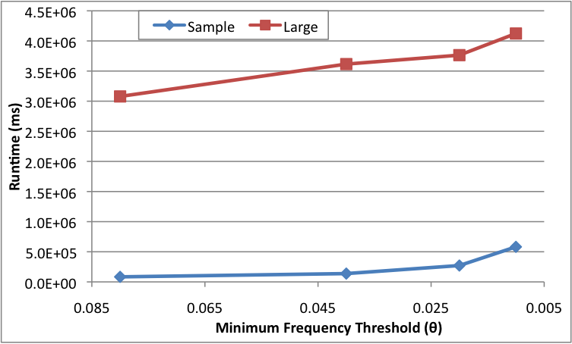
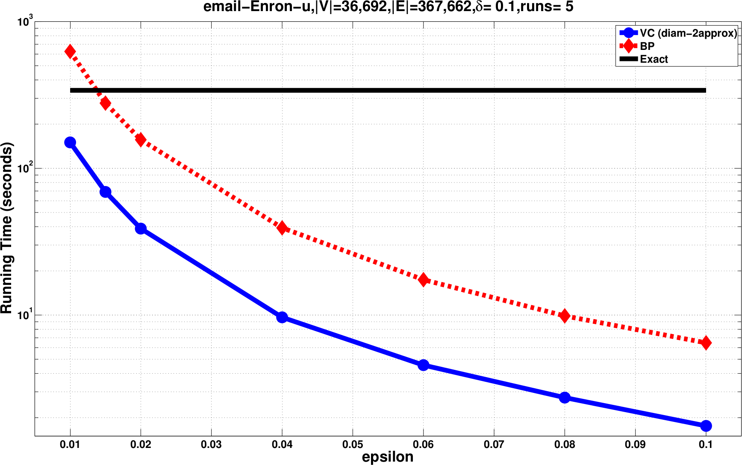
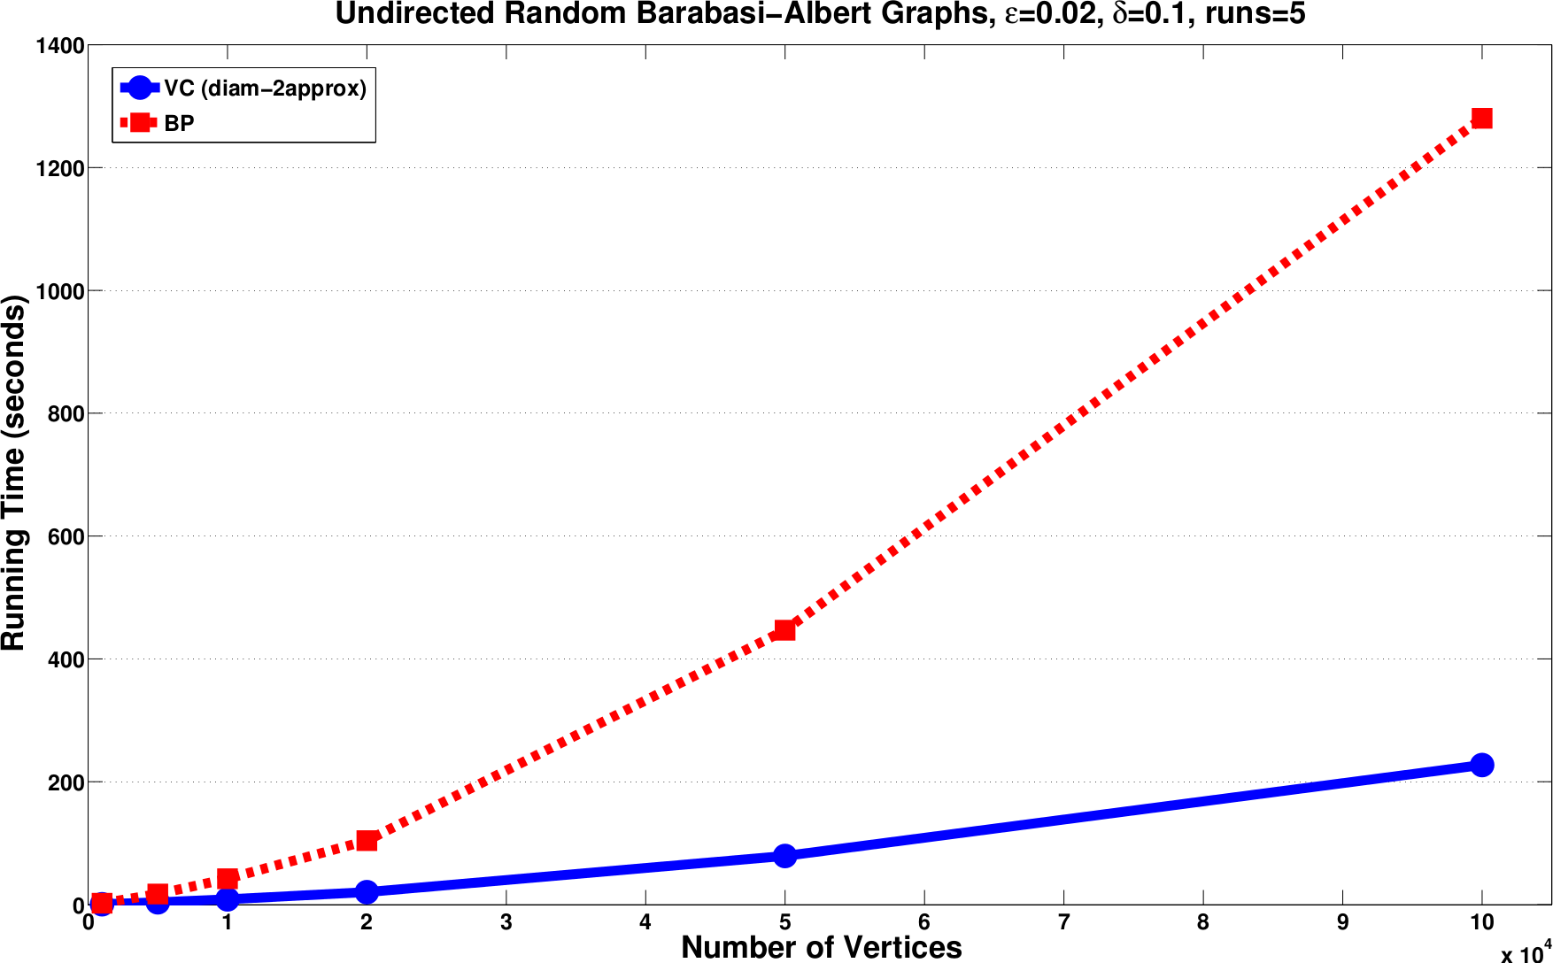
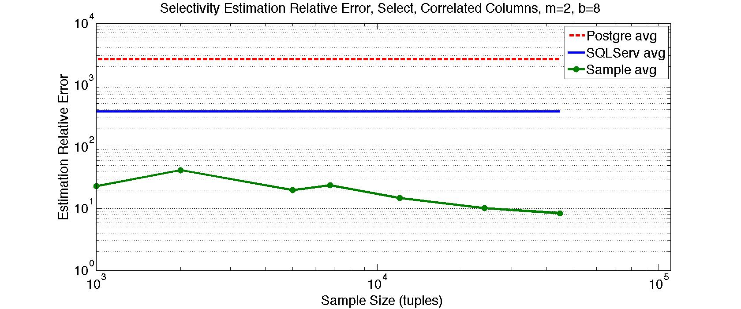
Sampling-based Randomized Algorithms for Big Data Analytics
Matteo Riondato (matteo@cs.brown.edu, http://cs.brown.edu/~matteo) – Advisor: Prof. Eli Upfal, Dept. of Computer Science, Brown University, Providence, RI
1. Motivation
2. Thesis Statement and Contributions
3. Approximations and Limitations of Classic Approach
4. Vapnik-Chervonenkis (VC)-Dimension
: set of points (domain)
}
We use VC-dimension to obtain (probabilistically-guaranteed) high-quality approximations for many data analytics tasks by processing only a small random sample of the data
Tradeoff between sample size and quality of approximation is well studied
Given , , is -approximation of if
Our goal: compute sample size to obtain -approximation
Classic bounds can not handle Big Data Variety (i.e., high values of )
E.g., with Chernoff bound + Union bound, sample size is
rangeset
: collection of subsets of (ranges)
Data analytics
=
cleaning, inspecting, transforming, modeling, ...
For any , let
If , is shattered by
Data
Information
Data Analytics Task | Contributions & Comparison with prev. work
Frequent Itemsets and Association Rules | Sampling algorithm – smaller sample size
 | (MapReduce+sampling) alg. – more scalable
 | Stat. test for false positives – more power
Betwenness Centrality | Sampling algorithm – smaller sample size
 | Tighter analysis of existing algorithm
Database Query Selectivity | Sampling algorithm – smaller sample size
{
Volume
Needs fast algorithms challenging due to Big Data
Variety
Theorem [VapnikChervonenkis'71, Li et al. '08]
Volume: data is large and grows fast
Variety: no. of “questions” to answer using data is large (e.g., itemsets)
Assume . Let , be a probabil. distrib. on , and
cost(analytics algorithm) = cost(Volume) + cost(Variety)
be a collection of samples from w.r.t. with
e.g., cost(APriori) = cost(size dataset) + cost(no. of patterns)
Dependency on is too much for typical data analytics tasks
E.g., in Frequent Itemsets mining, is number of items, can be O(10⁴).
VC-dimension overcomes this issue:
Smart algorithms may cut cost(Variety) but cost(Volume) always takes over
Then, with probability ,
Idea: cut cost(Volume) by analyzing only a subset of the dataset
i.e., can compute -approximation of
5. Mining Frequent Itemsets and Assoc. Rules (1)
6. Mining Frequent Itemsets and Assoc. Rules (2)
7. Estimating Betweenness Centrality
8. Estimating the Selectivity of Database Queries
R., Upfal, “Efficient Discovery of Association Rules and Frequent Itemsets through Sampling with Tight Performance Guarantees”, ECML PKDD'12, ACM TKDD'14
R., DeBrabant, Fonseca, Upfal, “PARMA: A Parallel Randomized Algorithm for Approximate Association Rules Mining in MapReduce”,
ACM CIKM'12
R., Vandin, “Finding the True Frequent Itemsets”, SIAM SDM'14
Idea: improve scalability and accuracy using MapReduce
Previous algorithm used in boosting-like approach
R., Kornaropoulos, “Fast Approximation of Betweenness Centrality through Sampling”, ACM WSDM'14
R., Akdere, Cetintemel, Zdonik, Upfal, “ The VC-Dimension of SQL Queries and Selectivity Estimation through Sampling”, ECML PKDD'11
Betweenness centrality: measure of vertex importance in graphs
Settings: Graph
: fraction of Shortest Paths in that pass through
Database queries are composed of elementary operations (selection, joins,...)
Operations can be organized in many ways with same output (query plans)
Settings: Transactional dataset
Algorithm
DBMS must choose plan with smallest execution time
NP-hard problem. Must use heuristics.
Frequency of itemset in :
: fraction of containing
e.g.,
Transaction
1st Map: Create many samples in parallel.
No. of samples and size to exploit resources
1st Reduce: Mine each sample on dedicated reducer
2nd Map: Identity function
2nd Reduce: Aggregate and filter mining results:
1) only itemsets that were frequent in many samples are considered frequent and sent to output
2) estimation of frequency is median of estimations
: all SPs in
Items from
: SPs from to ,
Common heuristic: perform small selectivity operations first
Selectivity of a query :
Exact value not available before execution, must approximate.
DBMSs use histograms: independence, uniformity assumption not true
Tan et al. - Introduction to Data Mining
Itemset
Exact algorithm for takes time [Brandes01]
Our goal: fast computation of -approximation using sampling
Task: Given , compute
Exact algorithms (APriori, ...) scan dataset multiple times: too slow
Our goal: compute approximation of with following properties:
Can achieve goal by computing -approximation of
Algorithm
0
1
Frequency
Must not be in
May be in
Must be in
Evaluation
Our goal: Given class of queries , compute sample size such that
is -approximation to
500
exact sample
for
random pair of vertices
Algorithm
runtime (seconds)
400
all SPs from to (BFS, Dijkstra, bidirectional search)
Rangeset for query selectivity:
max integer s.t. contains transactions of length
300
random SP from
200
Theorem: Let = max no. of join operations in a query from
= max no. of selection conditions in a query from
= max no. of columns in a table
Then,
return
random sample of of size
100
return
0
Theorem: has the required properties
Important issue: avoid false positives in mining results
Settings: : unknown process generating transactions,
: collection of i.i.d. samples from
Itemset , : true frequency of
Task: Given , compute
Can't be solved exactly with finite
Our goal: compute such that
At same time, try to maximize , i.e., minimize
Intuition: Variant of Knapsack to compute VC-Dim of Negative Border
NP but do not need exact solution
Results: Much more power (larger ) w.r.t. traditional methods
Theorem: is a -approximation for
Rangeset for :
Rangeset for betweenness centrality:
Evaluation:
Sample can fit into main memory estimation is fast
Estimate much closer to real value than guaranteed
Beat PostgreSQL and SQLServer by orders of magnitude
Theorem:
Theorem:
Evaluation: dataset from FIMI'04 repository
Evaluation: C implementation, patch for igraph, on SNAP graphs
Accuracy much better than
8x speedup (and more!)

