Slide 1
VC-dimension for faster computation and tighter analysis
Matteo Riondato
Thesis Defense
April 18, 2014

Slide 2
Outline
Introduction
  Problem
  Thesis statement
  Contributions
  VC-dimension
Estimating betweenness centrality
  Rangeset and bounds
  Algorithms
Conclusions
  Limitations of sampling
  Directions for further research

Slide 3
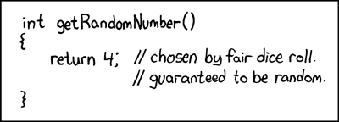
What am I talking about?
  Sampling-based Randomized Algorithms for Big Data Analytics
from xkcd.com

Slide 4
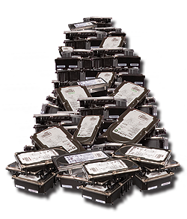


What is data analytics?
Needs fast algorithms
Data
Information
Data analytics
=
cleaning, inspecting, transforming, modeling, ...
challenging due to Big Data
(Volume + Variety)

Slide 5
Why is Big Data a challenge?
Volume: data size is large and grows
Variety: no. of “questions” is large
cost(analytics algorithm) = cost(Volume) + cost(Variety)
E.g., cost(APriori) = cost(size dataset) + cost(no. of patterns)
Smart algorithms may cut cost(Variety)
  cost(Volume) always takes over

Slide 6
Thesis statement
It is possible to obtain high-quality approximations of the results of many analytical tasks by processing a small random sample of the data
  Vapnik-Chervonenkis (VC) dimension to compute sample size
  Probabilistic guarantees on quality of approximations
  Tasks from data mining, graph analysis, database management

Slide 7
What did we get?
Frequent Itemsets / Association Rules mining
  sampling-based algorithm –smallest sample size
  MapReduce-based algorithm – fastest and most scalable
  statistical test – more statistical power than available solutions
Betweenness centrality
  sampling-based algorithm – fastest available
  tighter analysis of existing algorithm
Database query selectivity
  characterization of VC-dimension of SQL queries
  sampling-based algorithm – smallest sample size

Slide 8
Why sampling?
Natural solution to cut cost(Volume)
Implies approximations
  data analytics is exploratory, approximations are ok
Trade-off:
  larger sample = better approximation but slower algorithm
    quantified by probability theory (CLT, Chernoff, Azuma, VC-dimension, …)

Slide 9
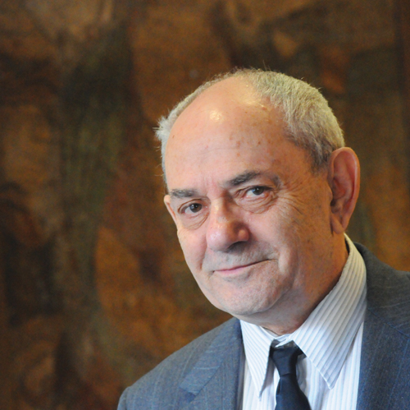
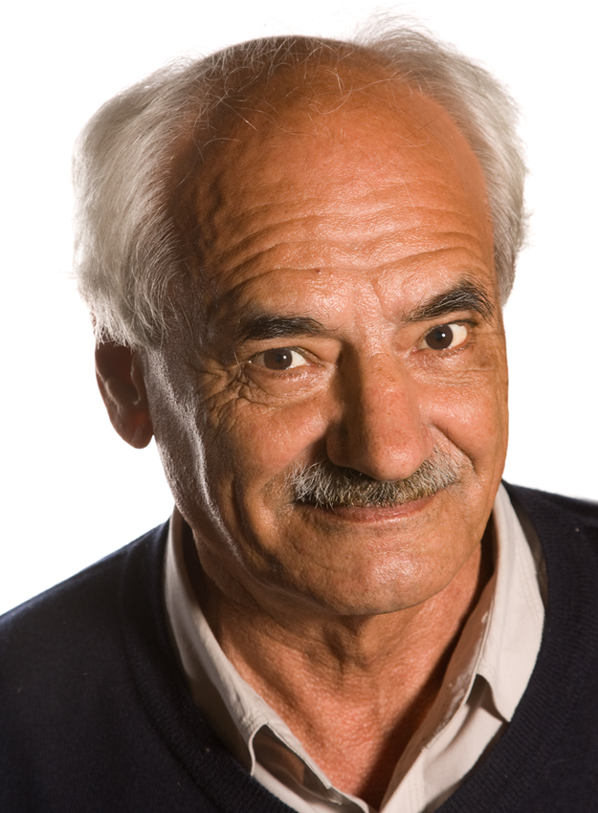
Why VC-dimension?
Chernoff+Union too weak for Big Data analytics
  Chernoff: guarantee on answer to single question
  Union: guarantee extended to all questions
  Sample size depends on no. of questions (Variety):
VC-dimension overcomes this issue:
Vladimir N. Vapnik
Aleksey J. Chervonenkis

Slide 10
VC-dimension
: set of points
: collection of subsets of (ranges)
VC-dimension of : measures richness, expressivity of
For any , let
If , then is shattered by
}
rangeset

Slide 11
VC-dimension – Example
y
x

Slide 12
VC-dimension – Example
y
= all axis-aligned rectangles
x

Slide 13
VC-dimension – Example
y
= all axis-aligned rectangles
Shattering 4 points?
x
y
y
x

Slide 14
VC-dimension – Example
y
= all axis-aligned rectangles
Shattering 4 points: easy
x
y
Need 16 rectangles
x

Slide 15
VC-dimension – Example
y
= all axis-aligned rectangles
Shattering 5 points?
x
y
x

Slide 16
VC-dimension – Example
y
= all axis-aligned rectangles
Shattering 5 points: impossible
  One point is contained in all rectangles containing the other four
x
y
x

Slide 17

VC-dimension and sampling
Theorem ([Vapnik and Chervonenkis '71] [Li et al. '08])
  Fix , and assume
  : probability distribution on
  : collection of samples from , according to , with
  Then, with probability

Slide 18
Necessary ingredients
To use the theorem we need:
  analytical task as probability estimation problem
  definition of and
  probability distribution on
  an efficient procedure to sample from
  an upper bound to
    must be efficient to compute

Slide 19
Outline
✓
Introduction
  Problem
  Thesis statement
  Contributions
  VC-dimension
Estimating betweenness centrality
  Rangeset and bounds
  Algorithms
Conclusions
  Limitations of sampling
  Directions for further research
✓
✓
✓
✓

Slide 20
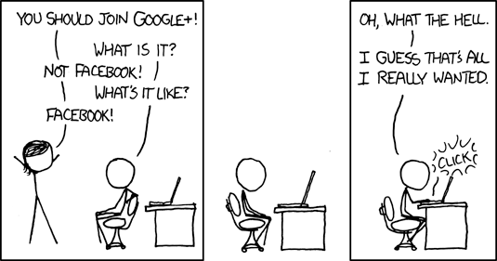
Social Network Analysis
Take a social network. Any. Even Google+.
What do you do with it? You analyze it.
  If the NSA does it, it must be useful to do it, right?
What are you analyzing about?
from xkcd.com

Slide 21
What vertices in a graph are important?
Betweenness centrality: measure of importance
  fraction of shortest paths that go through vertex
Graph
= all shortest paths in
= set of shortest paths from to ( )
Notes:
Graph directed, weighted
Internal vertices
There are many variants (e.g. edges)
We solve them too

Slide 22
Exact algorithms
Naïve algorithm: all pairs shortest paths + aggregation
  Aggregation part dominates. Complexity:
[Brandes '01]:
  aggregation after each Single Source Shortest Path computation
  Complexity: or
Too much for networks with billions of vertices
Solution: fewer SP computations using sampling!

Slide 23
Exact algorithms
Naïve algorithm: all pairs shortest paths + aggregation
  Aggregation part dominates. Complexity:
[Brandes '01]:
  aggregation after each Single Source Shortest Path computation
  Complexity: or
Too much for networks with billions of vertices
Solution: fewer SP computations using sampling!
what to sample?
how much?

Slide 24
What do we want to get?
Probabilistic guarantees on approximation
-approximation: values such that
Trade-off: smaller or , higher number of samples
accuracy
confidence

Slide 25
A first sampling algorithm
[BrandesPich '08] (inspired by [EppsteinWang '01]:
  for
    random vertex
    Perform SSSP from
    Perform partial aggregation for (like in exact algorithm)
  output

Slide 26
How to compute the sample size?
[Hoeffding '63] (bounded differences):
  for a single vertex
  Union bound over vertices: want
  Sample size for -approximation:

Slide 27
Drawbacks
Size depends on
  loose, obtained from union bound
  not the right quantity
  should be characteristic quantity of graph
At each iteration, perform SSSP
  full exploration of the graph (no locality)

Slide 28
What can we do?
Our algorithm
  uses VC-dimension, not union bound
  sample size depends on vertex-diameter of
  at each step, single s-t shortest path computation
    fewer edges touched
    more locality
    can use bidirectional search

Slide 29
The algorithm
  vertex-diameter of
  for
    random pair of vertices
    all SPs from to (Dijkstra, trunc. BFS, bidirect. Search)
    random element of
  output

Slide 30
What is the vertex-diameter?
: max no. of vertices in a SP
  small in social networks
not weighted:
  otherwise no relationship in general
Computation:
  unweighted, undirected: 2-approx via SSSP
  otherwise: size of largest WCC

Slide 31
What do we get?
  vertex-diameter of
  for
    random pair of vertices
    all SPs from to (Dijkstra, trunc. BFS, bidirect. Search)
    random element of
  output
Theorem: is a -approximation

Slide 32
How can we prove it?
Define rangeset
Define probability distribution
Define betweenness as probability estimation problem
Show upper bound to VC-dimension
  Bonus: show tightness + variants
Apply sampling theorem

Slide 33
Rangeset and probability
= all SPs in
Let
Probability distribution on :
  algorithm samples paths according to

Slide 34
How can we prove it?
✓
Define rangeset
Define probability distribution
Define betweenness as probability estimation problem
Show upper bound to VC-dimension
  Bonus: show tightness + variants
Apply sampling theorem
✓
✓

Slide 35
What is the VC-dimension of our rangeset?
Theorem:
Proof
  To shatter , ,
    need different ranges
    any must appear in different ranges
  Any appears only in the ranges such that
  i.e., it appears in ranges
  To shatter , must be

Slide 36
How can we prove it?
✓
Define rangeset
Define probability distribution
Define betweenness as probability estimation problem
Show upper bound to VC-dimension
  Bonus: show tightness + variants
Apply sampling theorem
✓
✓
✓

Slide 37
How to use this bound
}
is empirical average for
Sampling done according to
We know upper bound to
If
then is an -approximation:
We can apply the
sample theorem

Slide 38
How can we prove it?
✓
Define rangeset
Define probability distribution
Define betweenness as probability estimation problem
Show upper bound to VC-dimension
  Bonus: show tightness + variants
Apply sampling theorem
✓
✓
✓
✓

Slide 39
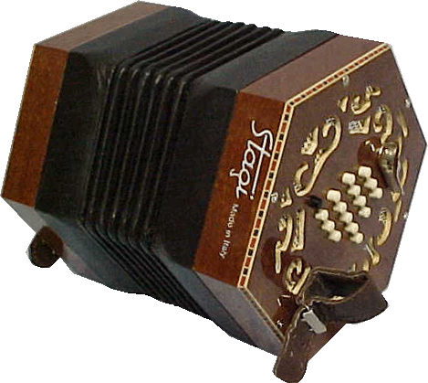
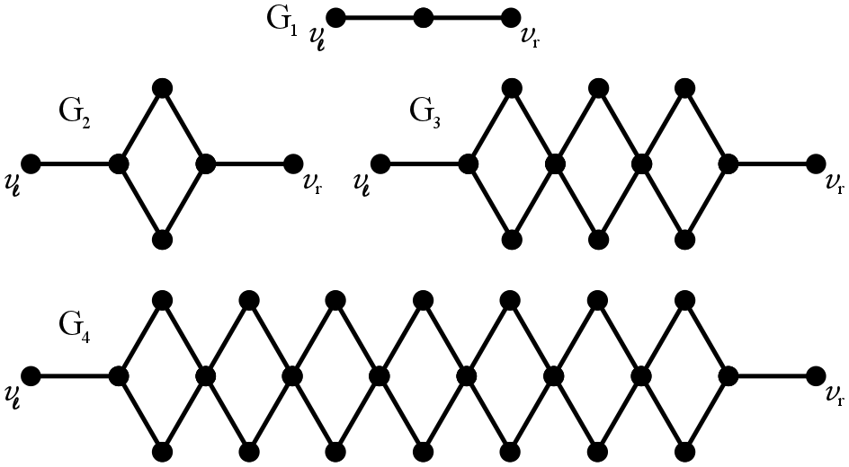
Is the bound tight?
Concertina graphs
Theorem:
Concertina, a musical instrument

Slide 40
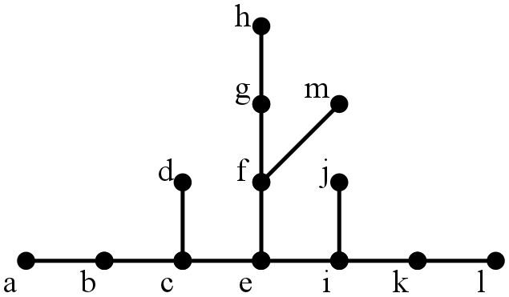
Is the vertex diameter the right quantity?
No.
If
  G is undirected
  for every connected pair there is a unique SP, then
Proof: two SPs that meet and separate can't meet again
    + case analysis
Tight? Yes
Notes:
It's not true just for trees!

Slide 41
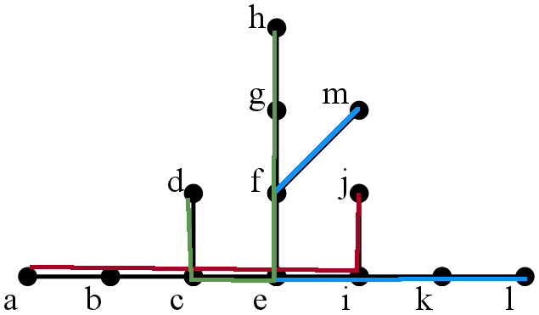
Is the vertex diameter the right quantity?
No.
If
  G is undirected
  for every connected pair there is a unique SP, then
Proof: two SPs that meet and separate can't meet again
    + case analysis
Tight? Yes
Notes:
It's not true just for trees!

Slide 42
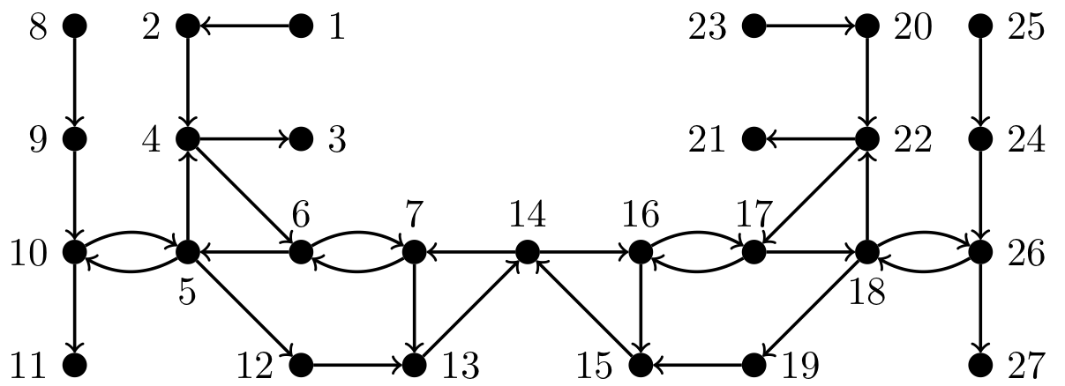
Is this true for directed graphs?
No.
Notes:
The fact on which we based the proof for the undirected case is not true on directed graphs.
In this graph each pair of connected nodes has a unique shortest path.

Slide 43
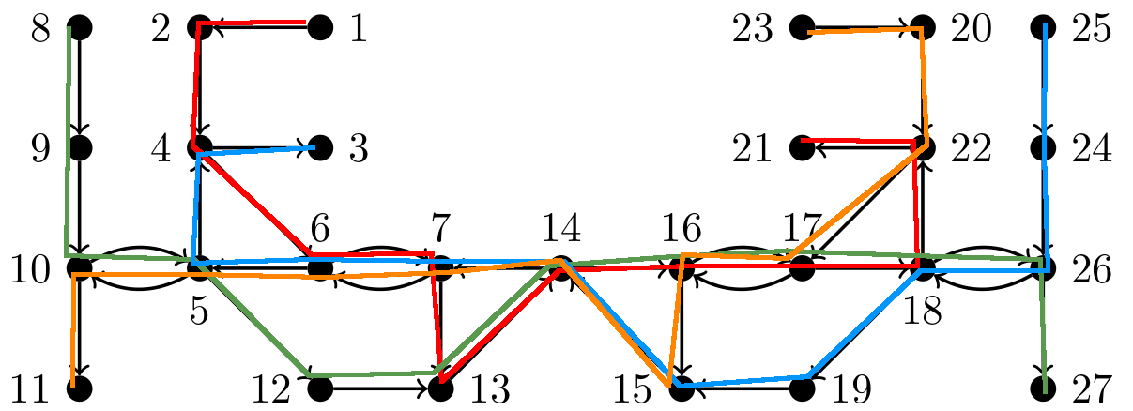
Is this true for directed graphs?
No.
Open question: still a constant for directed graphs? (6?)

Slide 44
How can we prove it?
✓
Define rangeset
Define probability distribution
Define betweenness as probability estimation problem
Show upper bound to VC-dimension
  Bonus: show tightness + variants
Apply sampling theorem
✓
✓
✓
✓
✓

Slide 45
What about relative guarantees?
: ^{th} highest betweenness, ties broken arbitrarily
Top-K vertices:
Relative approximation: s.t.
Algorithm:
  run additive approximation algorithm
  lower bound to
  use and relative-guarantees version of VC sample theorem to compute sample size for relative approximation for

Slide 46
How good is the algorithm in practice?
C implementation as patch to igraph (igraph.sf.net)
Graphs: real (snap.stanford.edu) + artificial BarabasiAlbert
  social networks, road networks, …
Goals: evaluate
{
accuracy
speed
scalability

Slide 47
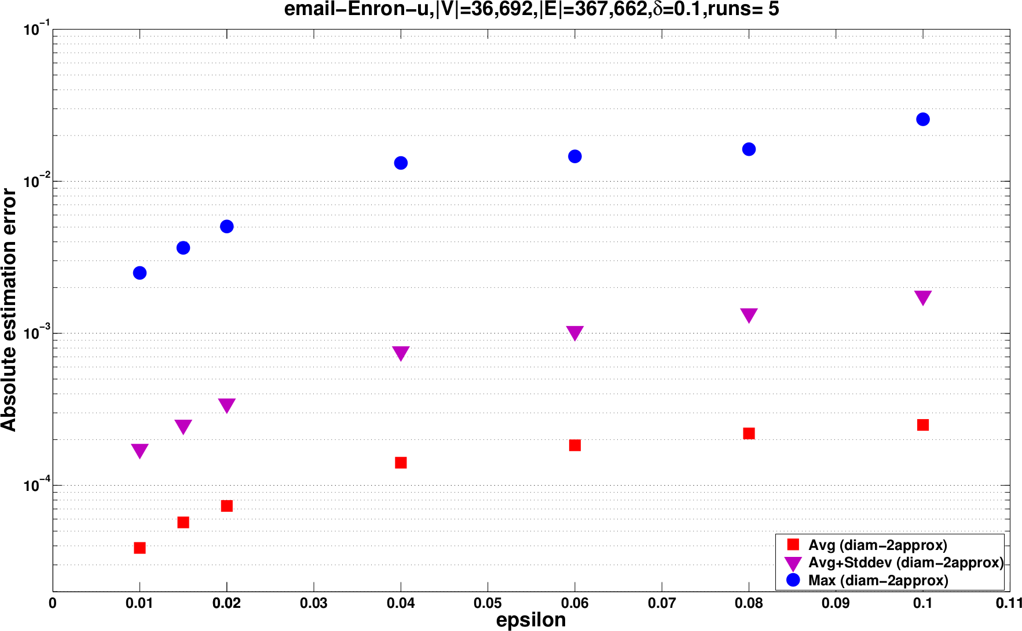
How accurate is our algorithm?
always ( O(10^3) runs on different graphs)
Accuracy ~8x better than guaranteed.

Slide 48
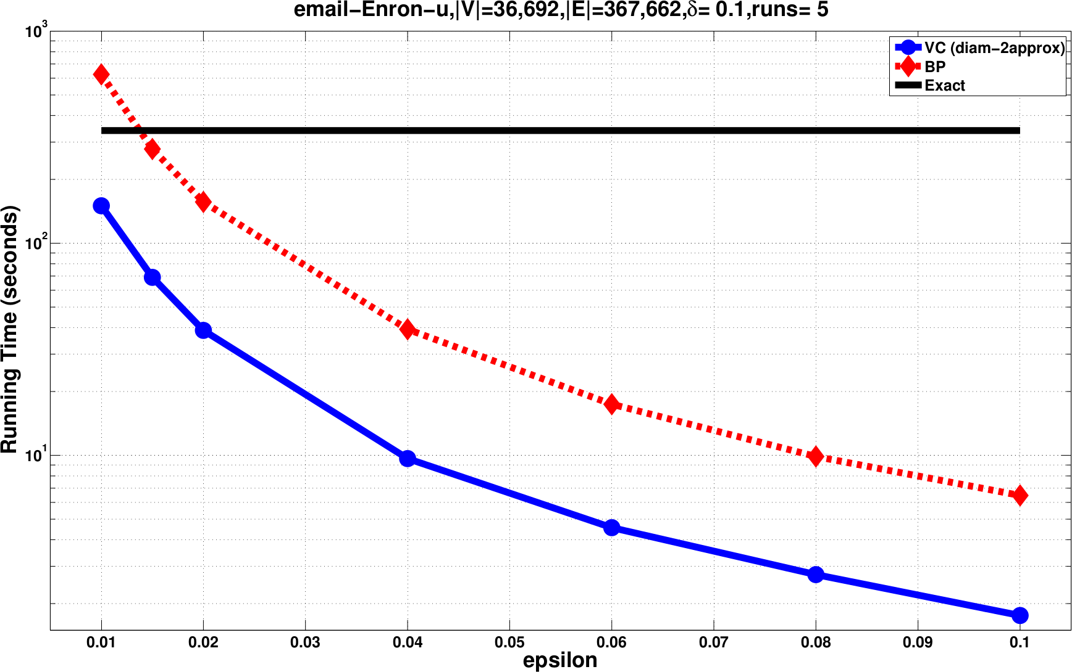
How fast is our algorithm?
~10x faster than simple sampling algorithm

Slide 49
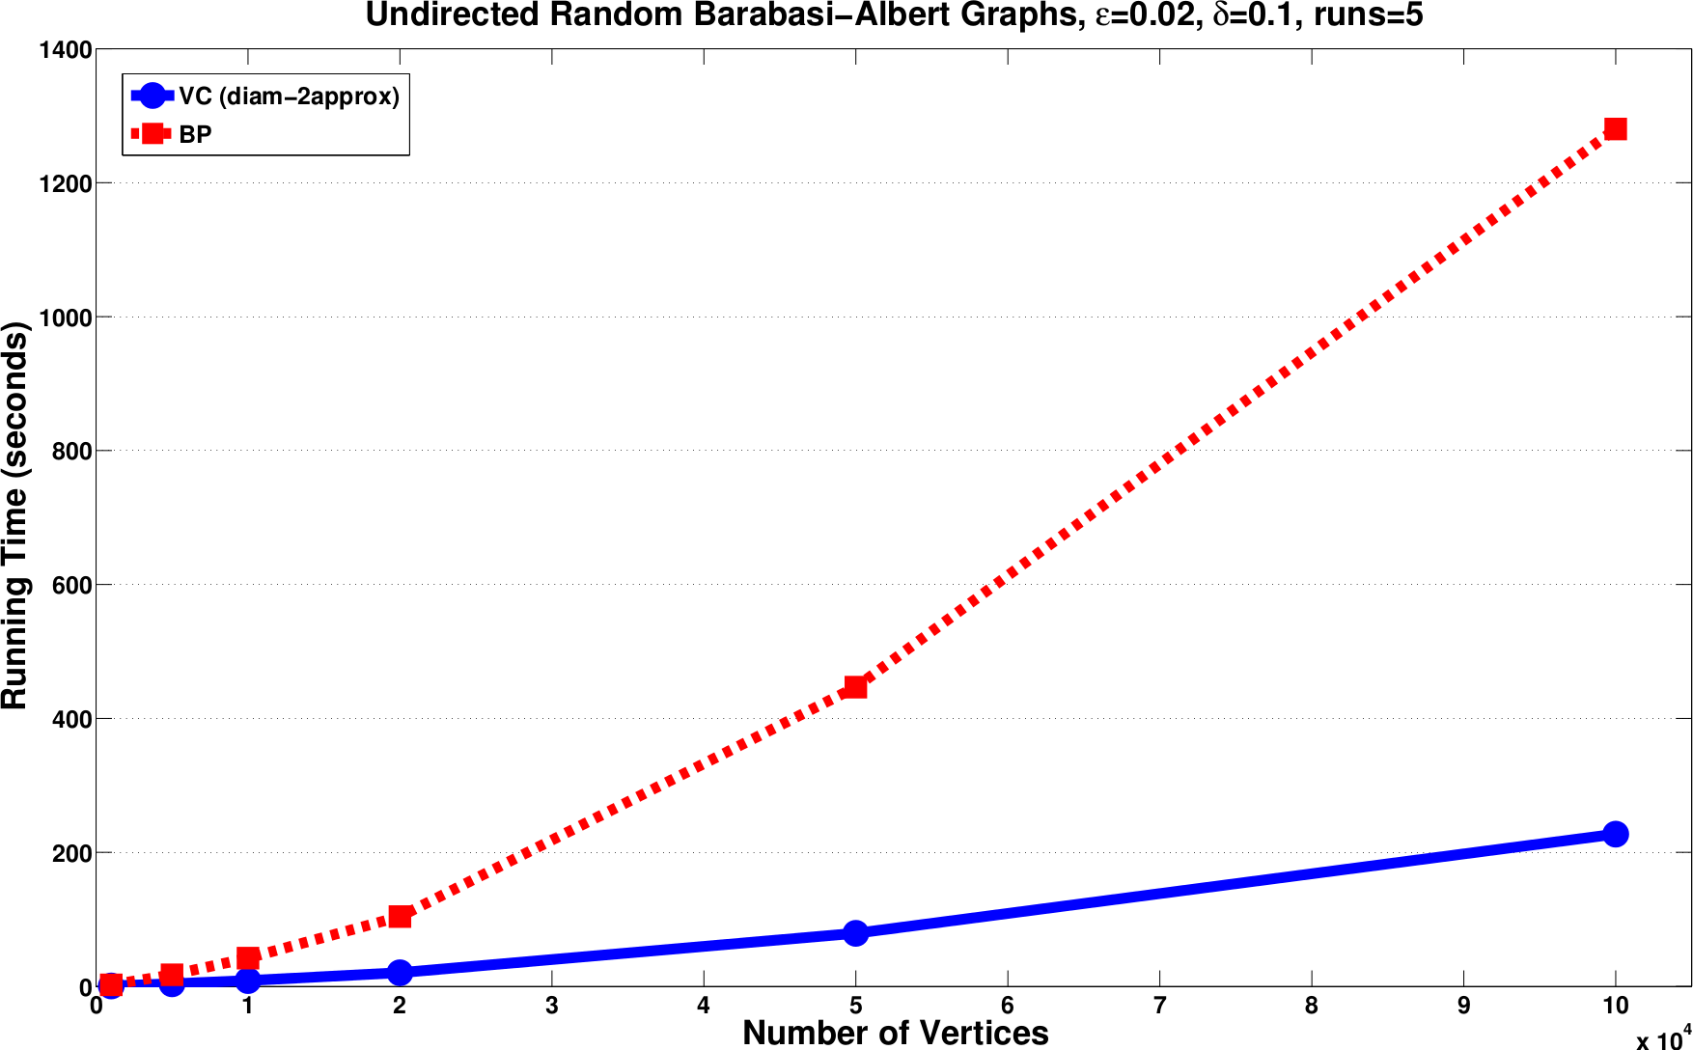
How well does it scale?

Slide 50
Am I telling the truth?
Yes, but.
  : estimator computed by simple sampling algorithm using same number of samples as ours
  Theorem:
    does not imply that it computes a -approximation
  The two algorithms put emphasis on different aspects:
    Ours: speed
    Theirs: accuracy

Slide 51
Recap
Two sampling based algorithms for betweenness estimation
  Top-K algo is first to achieve high relative guarantees
  Much smaller sample size than previously known
  Fewer computations than existing work = faster
Characterizing graph problems through VC-dimension is challenging, but interesting
  and rewarding
Published at ACM WSDM'14, journal subm. in preparation

Slide 52
Outline
✓
Introduction
  Problem
  Thesis statement
  Contributions
  VC-dimension
Estimating betweenness centrality
  Rangeset and bounds
  Algorithms
Conclusions
  Limitations of sampling
  Directions for further research
✓
✓
✓
✓
✓
✓
✓

Slide 53
Conclusions
We can compute sample sizes for approximating many data analytics tasks
  depend on bound to VC-dimension, not no. of questions (Variety)
    characteristic quantity of the dataset / problem
  lower cost(Volume)
  sample can fit into memory of single machine
    can use MapReduce for boosting-like approach (many samples in parallel)
  can use “backwards” to derive statistical tests for false positives

Slide 54
Limitations
Need efficient-to-compute bound on VC-dimension
Need efficient sampling procedure
Need for independent sampling
  some new developments here
Dependency on

Slide 55
Future work
Smaller bounds to sample size
  pseudodimension, shatter coefficients, covering numbers, …
Progressive sampling
  Rademacher averages bounds
Statistical testing
  False Discovery Rate rather than Family-Wide Error Rate
New technology / computational platforms
  Spark, Pregel, …

Slide 56
Publications
  R., Akdere, Cetintemel, Zdonik, Upfal. “The VC-dimension of SQL queries and selectivity estimation through sampling”. ECML-PKDD'11.
  R., Upfal. “Efficient discovery of Association Rules and Frequent Itemsets through sampling with tight performance guarantees”. ECML-PKDD'12, ACM TKDD'14.
  R., DeBrabant, Fonseca, Upfal. “PARMA: a parallel randomized algorithm for approximate association rule mining in MapReduce”. ACM CIKM'12.
  R., Vandin. “Finding the True Frequent Itemsets”. SIAM SDM'14.
  R., Kornaropoulos. “Fast approximation of betweenness centrality through sampling”. ACM WSDM'14
  Others:
    Pietracaprina, R., Upfal, Vandin. “Mining top-k Frequent Itemsets through progressive sampling”. ECML-PKDD'10, DMKD'10.
    Akdere, Cetintemel, R., Upfal, Zdonik.“The case for predictive database systems: opportunities and challenges”. CIDR'11
    Akdere, Cetintemel, R., Upfal, Zdonik. “Learning-based query performance modeling and prediction”. IEEE ICDE'10.
    Pietracaprina, Pucci, R., Silvestri, Upfal. “Space-round tradeoffs for MapReduce computations”. ACM ICS'12

Slide 57
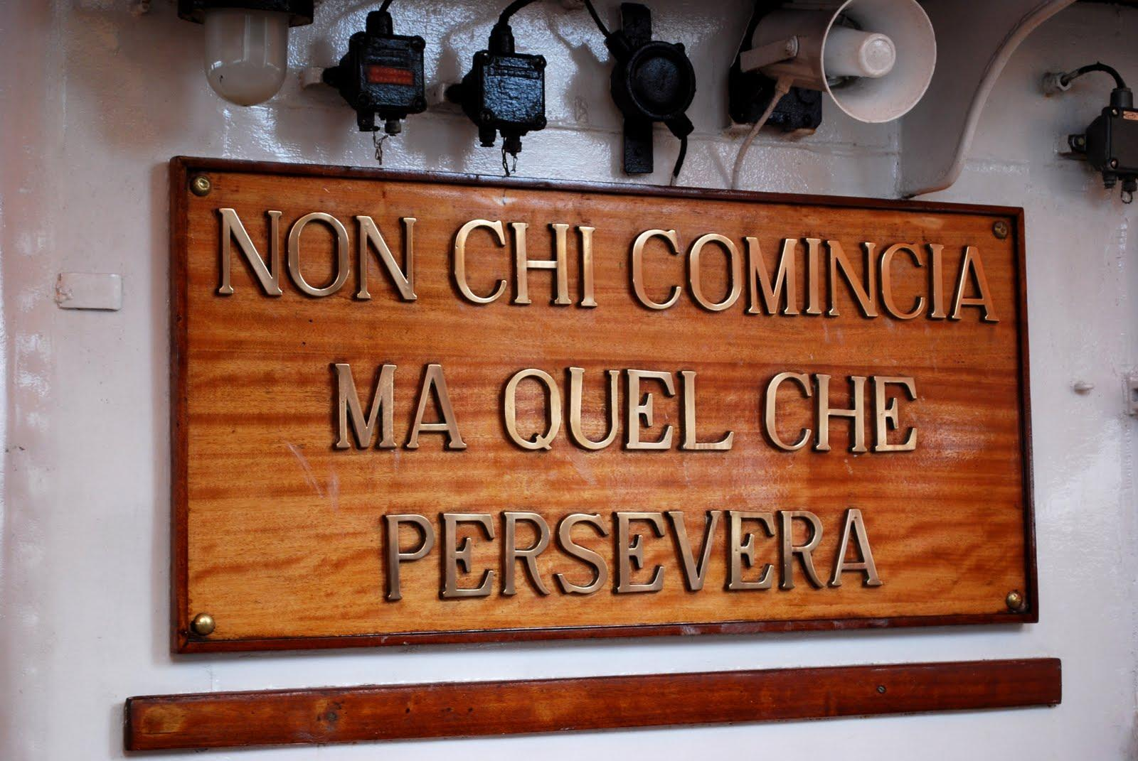
Acknowledgements
  Eli
  Ugur, Basilis
  Rodrigo, Stan, Fabio, Andrea, Geppino, Francesco, Aris, Luca
  Olya, Andy, Justin, Evgenios, Andrew, Foteini, Alexandra, Ahmad
    and all other PhDs
  Mackenzie, Michela, Marco, Cristina, Erica, Robyn, Andrew, …
  Lauren (especially for all the times I locked myself out...), Genie, and Saara
  tstaff for the grid + problems@

