Slide 1
VC-dimension for faster computation and tighter analysis
Matteo Riondato
Thesis Defense
April 18, 2014

Slide 2
Outline
Introduction
  Problem
  Thesis statement
  Contributions
  VC-dimension
Estimating betweenness centrality
  Rangeset and bounds
  Algorithms
Conclusions
  Limitations of sampling
  Directions for further research

Slide 3
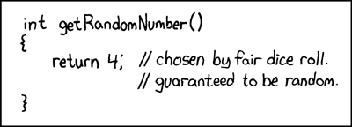
What am I talking about?
Dissertation title:
  Sampling-based Randomized Algorithms for Big Data Analytics
from xkcd.com

Slide 4
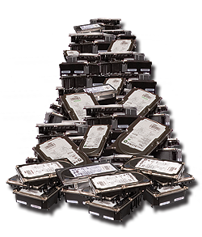


What is data analytics?
Needs fast algorithms
Data
Information
Data analytics
=
cleaning, inspecting, transforming, modeling, ...
challenging due to Big Data
(Volume + Variety)

Slide 5
Why is Big Data a challenge?
Volume: data size is large and grows
Variety: no. of “questions” is large
cost(analytics algorithm) = cost(Volume) + cost(Variety)
E.g., cost(APriori) = cost(size dataset) + cost(no. of patterns)
Smart algorithms may cut cost(Variety)
  but cost(Volume) always takes over

Slide 6
Thesis statement
It is possible to obtain high-quality approximations of the results of many analytical tasks by processing a small random sample of the data
  Vapnik-Chervonenkis (VC) dimension to compute sample size
  Probabilistic guarantees on quality of approximations
  Tasks from data mining, graph analysis, database management

Slide 7
What did we get?
Frequent Itemsets / Association Rules mining
  sampling-based algorithm –smallest sample size
  MapReduce-based algorithm – fastest and most scalable
  statistical test – more statistical power than available solutions
Betweenness centrality
  sampling-based algorithm – fastest available
  tighter analysis of existing algorithm
Database query selectivity
  characterization of VC-dimension of SQL queries
  sampling-based algorithm – smallest sample size

Slide 8
Why sampling?
Natural solution to cut cost(Volume)
Implies approximations
  data analytics is exploratory, approximations are ok
Trade-off:
  larger sample = better approximation but slower algorithm
    quantified by probability theory (CLT, Chernoff, Azuma, VC-dimension, …)

Slide 9
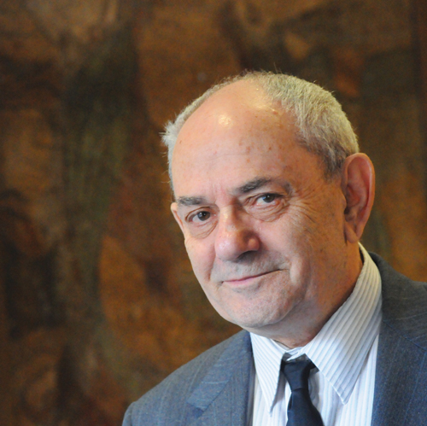
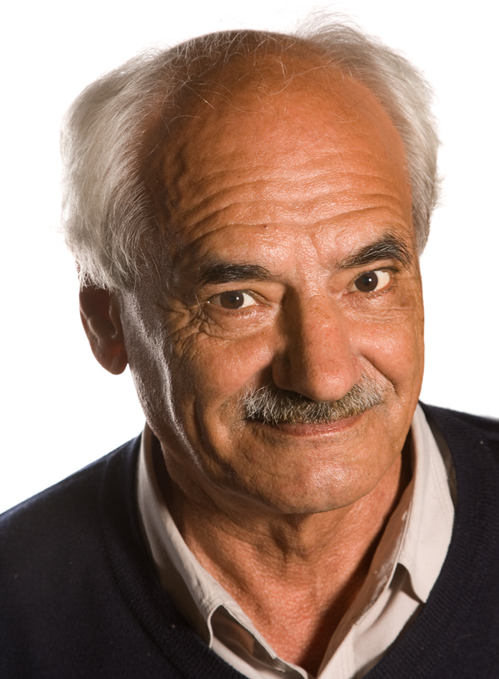
Why VC-dimension?
Chernoff+Union too weak for Big Data analytics
  Chernoff: guarantee on answer to single question
  Union: guarantee extended to all questions
  Sample size depends on no. of questions (Variety):
VC-dimension overcomes this issue:
Vladimir N. Vapnik
Aleksey J. Chervonenkis

Slide 10
VC-dimension
: set of points
: collection of subsets of (ranges)
VC-dimension of : measures richness, expressivity of
For any , let
If , then is shattered by
}
rangeset

Slide 11
VC-dimension – Example
y
x

Slide 12
VC-dimension – Example
y
= all axis-aligned rectangles
x

Slide 13
VC-dimension – Example
y
= all axis-aligned rectangles
Shattering 4 points?
x
y
y
x

Slide 14
VC-dimension – Example
y
= all axis-aligned rectangles
Shattering 4 points: easy
x
y
Need 16 rectangles
x

Slide 15
VC-dimension – Example
y
= all axis-aligned rectangles
Shattering 5 points?
x
y
x

Slide 16
VC-dimension – Example
y
= all axis-aligned rectangles
Shattering 5 points: impossible
  One point is contained in all rectangles containing the other four
x
y
x

Slide 17

VC-dimension and sampling
Theorem ([Vapnik and Chervonenkis '71] [Li et al. '08])
  Fix , and assume
  : probability distribution on
  : collection of samples from , according to , with
  Then, with probability

Slide 18
Necessary ingredients
To use the theorem we need:
  analytical task as probability estimation problem
  definition of and
  probability distribution on
  an efficient procedure to sample from
  an upper bound to
    must be efficient to compute

Slide 19
Outline
Introduction
  Problem
  Thesis statement
  Contributions
  VC-dimension
Estimating betweenness centrality
  Rangeset and bounds
  Algorithms
Conclusions
  Limitations of sampling
  Directions for further research

Slide 20
What vertices in a graph are important?
Betweenness centrality: measure of importance
  fraction of shortest paths that go through vertex
Graph
= all shortest paths in
= set of shortest paths from to ( )
Notes:
Graph directed, weighted
Internal vertices
There are many variants (e.g. edges)
We solve them too

Slide 21
Exact algorithms
Naïve algorithm: all pairs shortest paths + aggregation
  Aggregation part dominates. Complexity:
[Brandes '01]:
  aggregation after each Single Source Shortest Path computation
  Complexity: or
Too much for networks with billions of vertices
Solution: fewer SP computations using sampling!

Slide 22
Exact algorithms
Naïve algorithm: all pairs shortest paths + aggregation
  Aggregation part dominates. Complexity:
[Brandes '01]:
  aggregation after each Single Source Shortest Path computation
  Complexity: or
Too much for networks with billions of vertices
Solution: fewer SP computations using sampling!
what to sample?
how much?

Slide 23
What do we want to get?
Probabilistic guarantees on approximation
-approximation: values such that
Trade-off: smaller or , higher number of samples
accuracy
confidence

Slide 24
A first sampling algorithm
[BrandesPich '08] (inspired by [EppsteinWang '01]:
  for
    random vertex
    Perform SSSP from
    Perform partial aggregation for (like in exact algorithm)
At each step, one SSSP computation
  Full exploration of the graph

Slide 25
How to compute the sample size?
[Hoeffding '63] (bounded differences):
  for a single vertex we have
  Union bound over vertices: want
  Sample size for -approximation:

Slide 26

Drawbacks
The sample size depends on
  Obtained from the union bound: loose!
  Is this the right quantity?
    We believe not
    It should be a characteristic quantity of the graph
At each sample, “heavy” computation (SSSP)
  Touch a lot of edges, has low “locality”
Riondato et al. – Fast Approximation of Betweenness Centrality Through Sampling

Slide 27
Fast Sampling Algorithm
Our algorithm solves the drawbacks:
  Does not use the union bound
      use VC-dimension
  Its sample size depends on a characteristic quantity of the graph (the vertex-diameter)
      Not on number of vertices
  Performs a single s-t shortest path computation per sample
    Fewer edges touched, better locality
Riondato et al. – Fast Approximation of Betweenness Centrality Through Sampling

Slide 28
Fast Sampling Algorithm
The algorithm:
For times do
    Sample a random pair of vertices
    Compute ,all shortest paths from to
    Select a path uniformly at random from
    For each
Riondato et al. – Fast Approximation of Betweenness Centrality Through Sampling

Slide 29
Vertex Diameter
The vertex diameter of is the maximum size of a shortest path between a pair of vertices of :
If the graph is not weighted:
No relationship in general if is weighted
Riondato et al. – Fast Approximation of Betweenness Centrality Through Sampling

Slide 30
Analysis
Theorem:
Given , if
then
We have an -approximation
Riondato et al. – Fast Approximation of Betweenness Centrality Through Sampling

Slide 31
Analysis
Theorem:
Given , if
then
We have an -approximation
Always less than n
Riondato et al. – Fast Approximation of Betweenness Centrality Through Sampling

Slide 32
Analysis
Theorem:
Given , if
then
We have an -approximation
For the proof, we use VC-Dimension
Always less than n
Riondato et al. – Fast Approximation of Betweenness Centrality Through Sampling

Slide 33
Roadmap
We are going to build a range set for the problem and show an upper bound to its VC-dimension
We define a probability distribution and use it to sample elements of the domain
The sample theorem gives us the amount of samples we need to draw to obtain a good approximation of the betweenness of all vertices
Riondato et al. – Fast Approximation of Betweenness Centrality Through Sampling

Slide 34
Shortest Path Range Set
Range set associated to shortest paths
Domain: , all shortest paths in
Contains one range per vertex
Sampling probability distribution on
The algorithm samples paths according to
All shortest paths v
is internal to
Riondato et al. – Fast Approximation of Betweenness Centrality Through Sampling

Slide 35
Bounding the VC-Dimension
Theorem:
Proof: To shatter a set of paths, , we need different ranges
  Any must appear in different ranges
  appears only in the 's of the
  appears in ranges
  For to be shattered, must be
  Implies the thesis
Riondato et al. – Fast Approximation of Betweenness Centrality Through Sampling

Slide 36
Back to the algorithm
Recall the algorithm:
For times do
    Sample a random pair of vertices
    Compute ,all shortest paths from to
    Select a path uniformly at random from
    For each
Sampling from π
Empirical
Average
Riondato et al. – Fast Approximation of Betweenness Centrality Through Sampling

Slide 37
Correctness
From the sample theorem we get that if
then the returned collection of is an
-approximation:
In real world social networks,
the diameter is usually very small
(small world phenomenon)
Definitively smaller than n
Riondato et al. – Fast Approximation of Betweenness Centrality Through Sampling

Slide 38
Corollaries
If there is a unique shortest path for each pair of vertices then
  This “collapse” of the VC-dimension to a constant is somewhat surprising
  Suggests that there may be other characteristic quantities of the graph that control the VC-Dimension
k-betweenness: if we only consider shortest paths of size up to k, then
Riondato et al. – Fast Approximation of Betweenness Centrality Through Sampling

Slide 39
Diameter Approximation
Computing exactly would require APSP
  Defeat the purpose of sampling
We need an approximation of
Can be constant approx, we use log anyway!
Undirected && unweighted:2-approx using BFS
All other cases: ???
  Return the size of the largest WCC (<= n)
Riondato et al. – Fast Approximation of Betweenness Centrality Through Sampling

Slide 40
Top-K Betweenness
Often interest is top-K players in the network, and in their ranking
Let be the ^{th} highest betweenness (ties broken arbitrarily)
Goal:
  find the set :
Similar to definition of
top-K Frequent Itemsets
Riondato et al. – Fast Approximation of Betweenness Centrality Through Sampling

Slide 41
Top-K Betweenness
“Two phases” sampling algorithm for high-quality approximation of the betweenness of the top-K vertices
  1st phase: compute lower bound to using “standard” sample theorem
  2nd phase: Use relative variant of the sample theorem to compute superset of
For all vertices in output we have
  with probability at least
Multiplicative factor
(rather than addictive)
Riondato et al. – Fast Approximation of Betweenness Centrality Through Sampling

Slide 42
Tightness
We proved the upper bound
Is it tight?
YES!
There are graphs with
Example:
Riondato et al. – Fast Approximation of Betweenness Centrality Through Sampling

Slide 43
Experimental Evaluation
Goals:
  Evaluate accuracy of our algorithms
  Compare running time, accuracy, and locality with exact and simple sampling algorithms
Implementation:
  C extension of igraph (igraph.sf.net)
  Exposed through Python3 API
  Available from GitHub (not yet)
Datasets:
  Real networks (social, road, citation, …) from SNAP (snap.stanford.edu)
Riondato et al. – Fast Approximation of Betweenness Centrality Through Sampling

Slide 44
Accuracy Results
Always within from real value
Accuracy even better than guaranteed
Riondato et al. – Fast Approximation of Betweenness Centrality Through Sampling

Slide 45
Speedup Results
Almost 1 order of magnitude faster than simple sampling algorithm
Riondato et al. – Fast Approximation of Betweenness Centrality Through Sampling

Slide 46
Scalability Results
Scales much better than simple sampling algorithm
Riondato et al. – Fast Approximation of Betweenness Centrality Through Sampling

Slide 47
Conclusions
We presented two sampling-based randomized algorithms to approximate the betweenness of (top-K) vertices in huge graphs
The algorithms offer probabilistic guarantees on the accuracy of the approximations, using much fewer samples and performing fewer computations than previous available algorithms
Experimental evaluation shows that the algorithm outperforms previous works in terms of execution time and accuracy
Riondato et al. – Fast Approximation of Betweenness Centrality Through Sampling

Slide 48
Outline
Introduction
  Problem
  Thesis statement
  Contributions
  VC-dimension
Estimating betweenness centrality
  Rangeset and bounds
  Algorithms
Conclusions
  Limitations of sampling
  Directions for further research

Slide 49
Conclusions
We can compute sample sizes for approximating many data analytics tasks
  depend on bound to VC-dimension, not no. of questions (Variety)
    characteristic quantity of the dataset / problem
  lower cost(Volume)
  sample can fit into memory of single machine
    can use MapReduce for boosting-like approach (many samples in parallel)
  can use “backwards” to derive statistical tests for false positives

Slide 50
Limitations
Need efficient-to-compute bound on VC-dimension
Need efficient sampling procedure
Need for independent sampling
  some new developments here
Dependency on

Slide 51
Future work
Obtain even better bounds to sample size
  pseudodimension, shatter coefficients, covering numbers, …
Progressive sampling vs fixed-size sampling
  Rademacher averages bounds
Statistical testing
  False Discovery Rate rather than Family-Wide Error Rate
Use new technology / computational platforms
  Spark, Pregel, ...

Slide 52
Publications
  R., Akdere, Cetintemel, Zdonik, Upfal. “The VC-dimension of SQL queries and selectivity estimation through sampling”. ECML-PKDD'11.
  R., Upfal. “Efficient discovery of Association Rules and Frequent Itemsets through sampling with tight performance guarantees”. ECML-PKDD'12, ACM TKDD'14.
  R., DeBrabant, Fonseca, Upfal. “PARMA: a parallel randomized algorithm for approximate association rule mining in MapReduce”. ACM CIKM'12.
  R., Vandin. “Finding the True Frequent Itemsets”. SIAM SDM'14.
  R., Kornaropoulos. “Fast approximation of betweenness centrality through sampling”. ACM WSDM'14
  Others:
    Pietracaprina, R., Upfal, Vandin. “Mining top-k Frequent Itemsets through progressive sampling”. ECML-PKDD'10, DMKD'10.
    Akdere, Cetintemel, R., Upfal, Zdonik.“The case for predictive database systems: opportunities and challenges”. CIDR'11
    Akdere, Cetintemel, R., Upfal, Zdonik. “Learning-based query performance modeling and prediction”. IEEE ICDE'10.
    Pietracaprina, Pucci, R., Silvestri, Upfal. “Space-round tradeoffs for MapReduce computations”. ACM ICS'12

Slide 53
Acknowledgements
  Eli
  Ugur, Basilis
  Rodrigo, Stan, Fabio, Andrea, Geppino
  Olya, Andy, Justin, Evgenios, Andrew, Foteini, Alexandra, Ahmad,
    and all other PhDs
  Mackenzie, Michela, Marco, Cristina, Erica, Robyn, Andrew, …
  Lauren (especially for all the times I locked myself out...),Genie, and Saara
  tstaff for the grid + problems@

