Slide 1

Final Database Project
Group Members-
Zhoha Damani
YashKumar Patel
VipulKumar Gupta
AdityaKumar Galiara
NeelKumar Patel

Slide 2

INTRODUCTION
The aim of this project is the development of a Music store database for the company named ‘Soul Sound Co.’. Our group was hired to design, develop and test the database for the store. This database has to store information of customers, their orders and singers along with their albums.

Slide 3
Topics of discussion.
Aim of the project.
Database for a Music store Application.
Problems and their solutions.

Slide 4
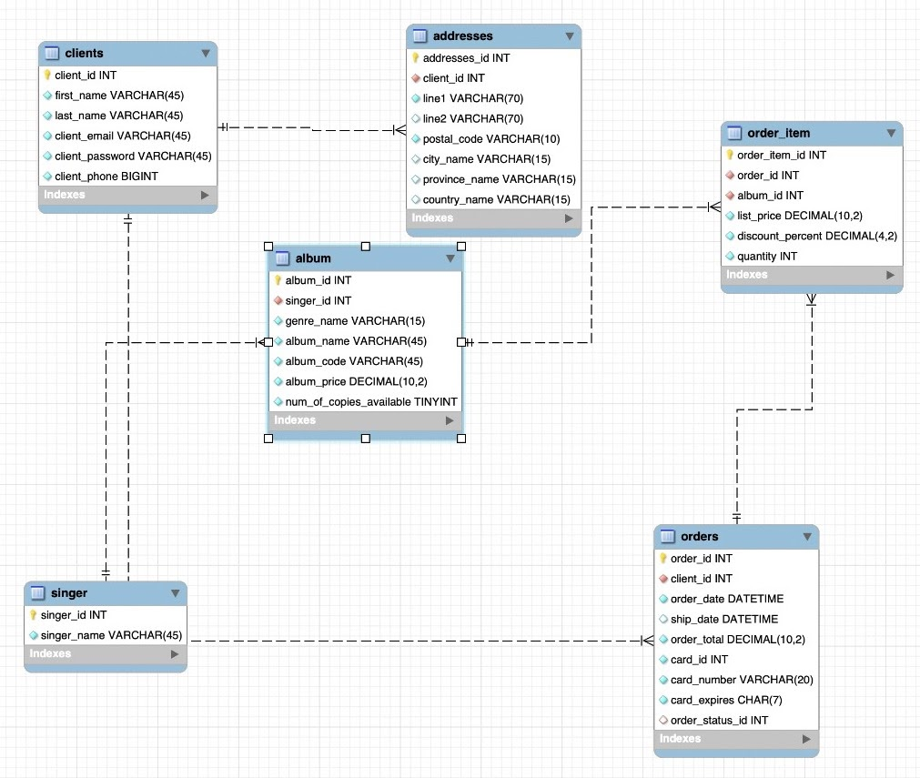
Comparison and explanation between the original database with the 3NF database
- Original Database

Slide 5
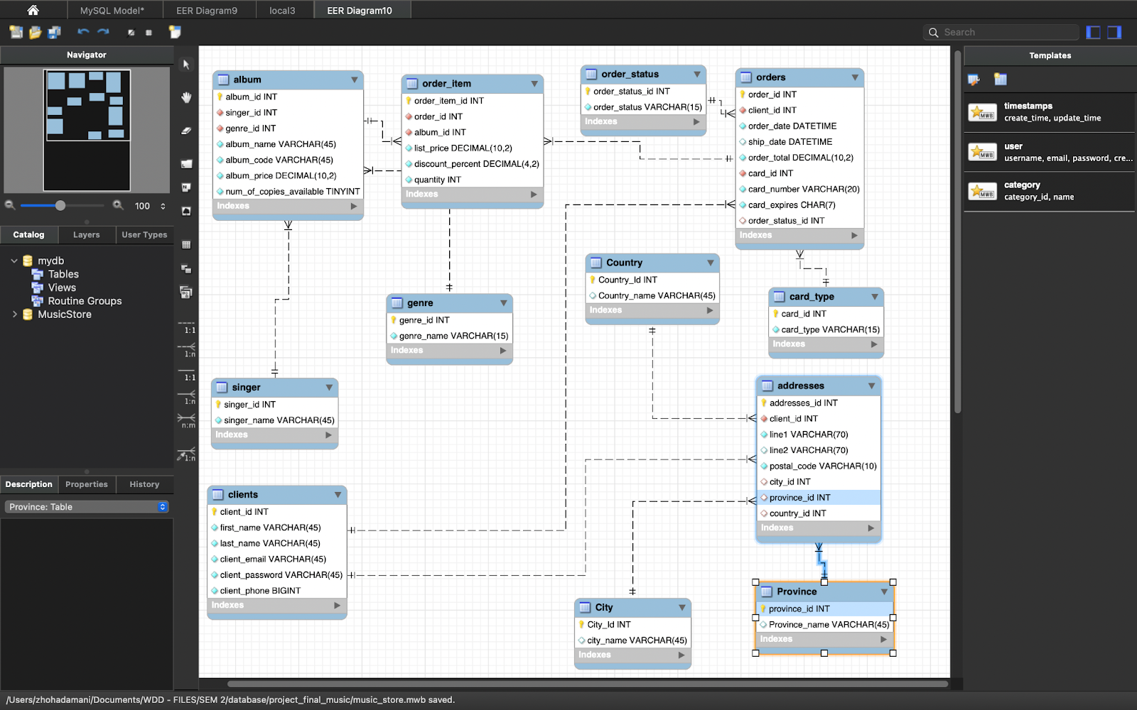
Comparison and explanation between the original database with the 3NF database
- 3NF

Slide 6
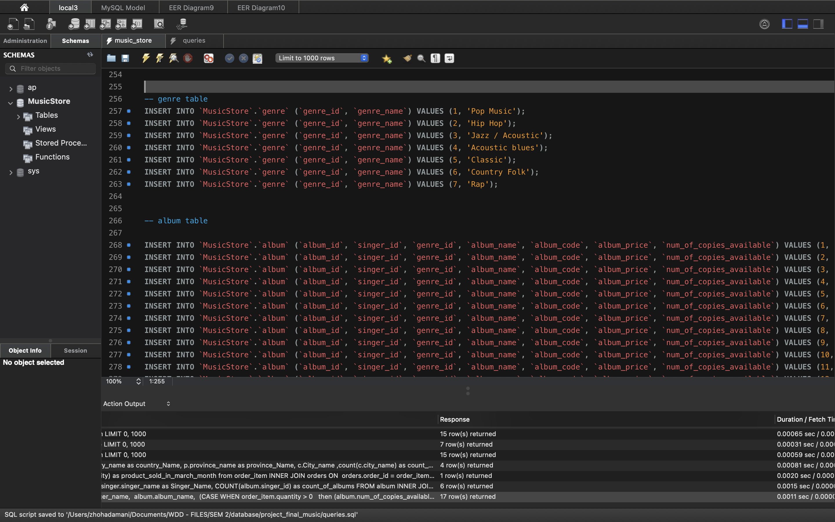
Populate the database in order to present your final-results working in class as you run your queries (next requirement).

Slide 7
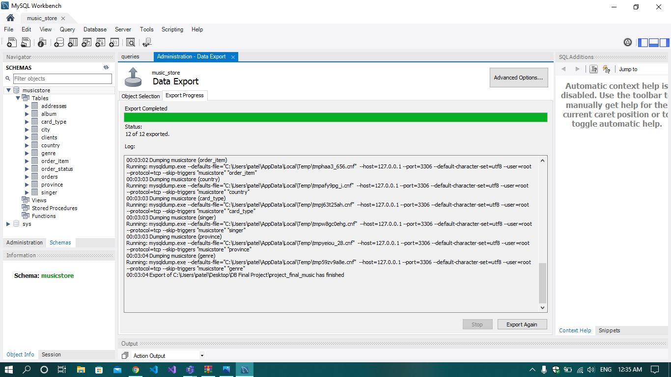
Create a script and backup of the database, data, and queries in order to run then during the presentation.

Slide 8
Assigned Queries
Display a list of clients that spent more than the average spent by client in the past month.
The top sold products and least sold products over a week.
The maximum price of products in the same genre (for example, rock, pop, country, hip-hop). Use GROUP BY to list all the genres and their maximum price.
List how many customers the system has by location (Country, Province, and City), and then sort them.
List how many products the store has sold for a particular month.
List how many distinct albums each singer has.
List how many copies of an album are available of a particular singer.

Slide 9
Custom Queries
Find out whether delivery is on time or late, and display number of days taken to ship product from the time of order
Find the trend of music by the genre sold till now.

Slide 10

Any questions?

