Slide 1
Applied Data Science L10. Support vector Machines
Irina Mohorianu
Head of Bioinformatics/ Scientific Computing @CSCI

Slide 2
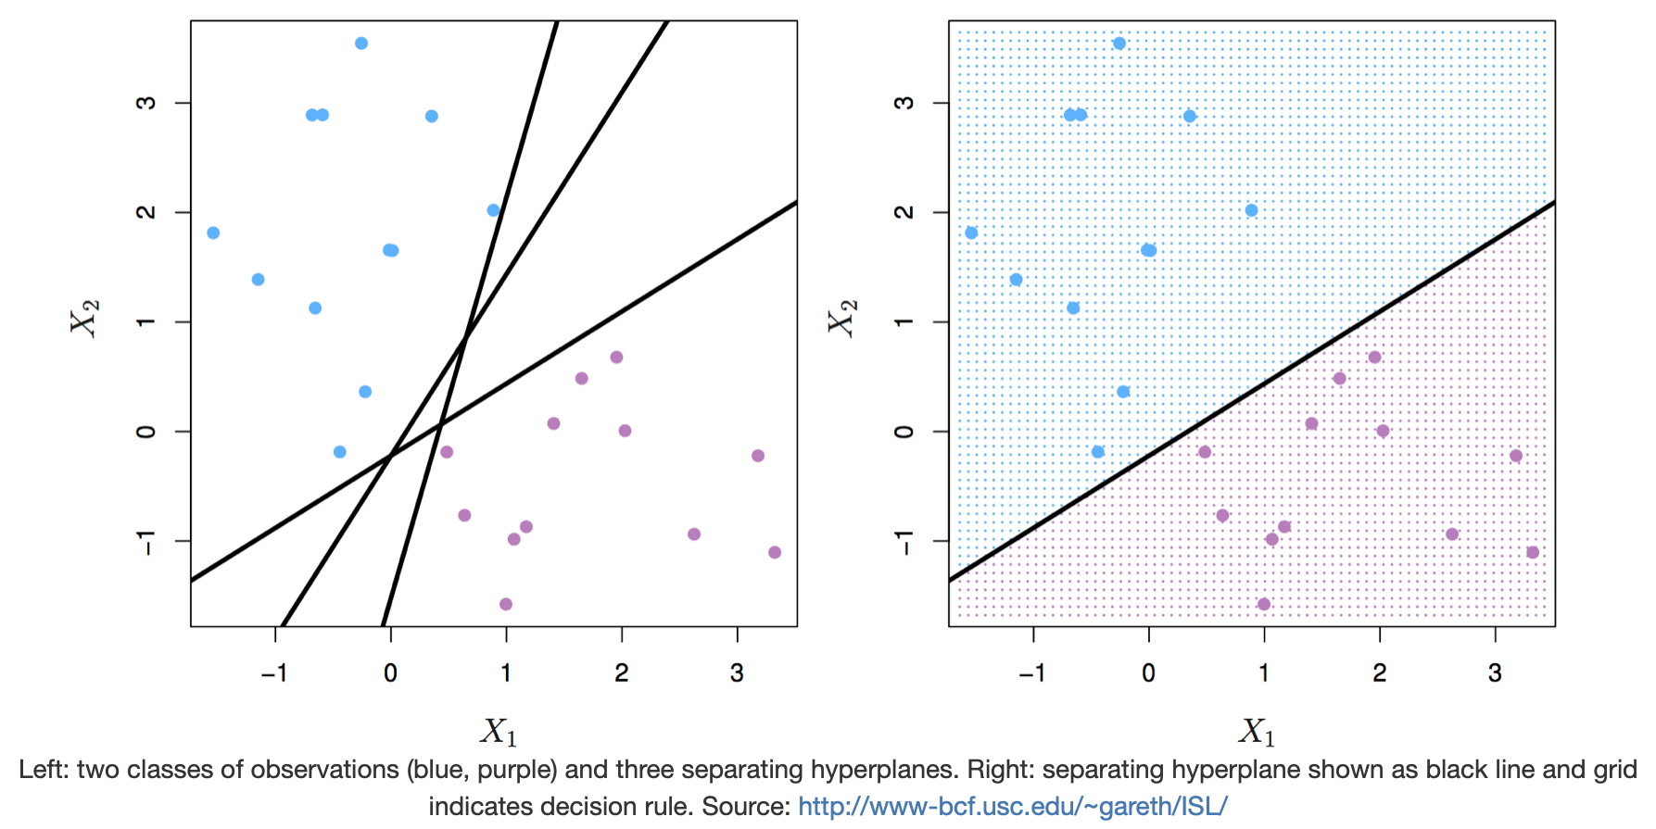
Support Vector Machines. Maximum margin classifier
Support vector machines (SVMs) are models of supervised learning, applicable to both classification and regression problems. The SVM is an extension of the support vector classifier (SVC), which is turn is an extension of the maximum margin classifier.
Let’s start by defining a hyperplane. In p-dimensional space, a hyperplane is an affine subspace of p-1. The figure below shows three separating hyperplanes and objects of two different classes. A separating hyperplane forms a natural linear decision boundary, classifying new objects according to which side of the line they are located.

Slide 3
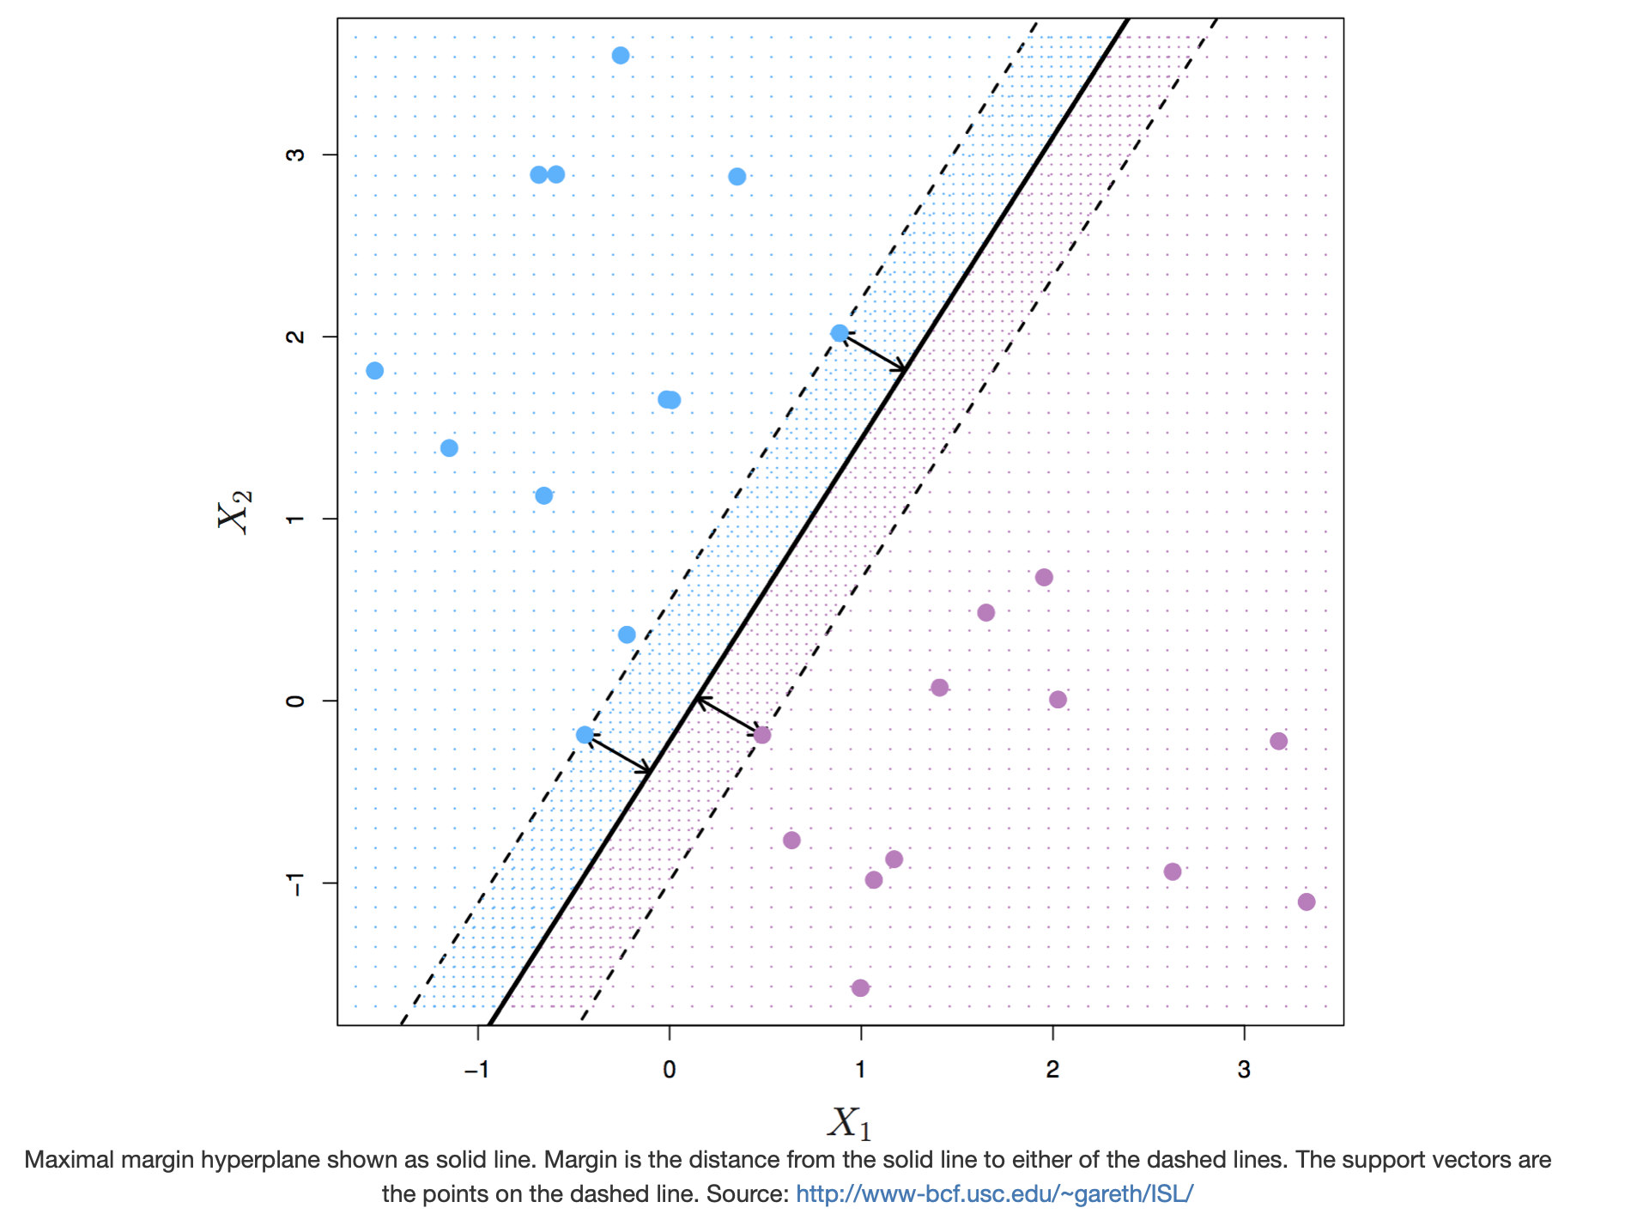
Support Vector Machines. Maximum margin classifier
The maximal margin hyperplane is the separating hyperplane that is farthest from the training observations. The perpendicular distance from a given hyperplane to the nearest training observation is known as the margin. The maximal margin hyperplane is the separating hyperplane for which the margin is largest.
The figure above shows three training observations that are equidistant from the maximal margin hyperplane and lie on the dashed lines indicating the margin. These are the support vectors. If these points were moved slightly, the maximal margin hyperplane would also move, hence the term support. The maximal margin hyperplane is set by the support vectors alone; it is not influenced by any other observations.

Slide 4
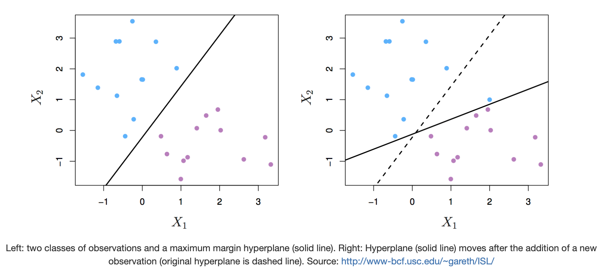
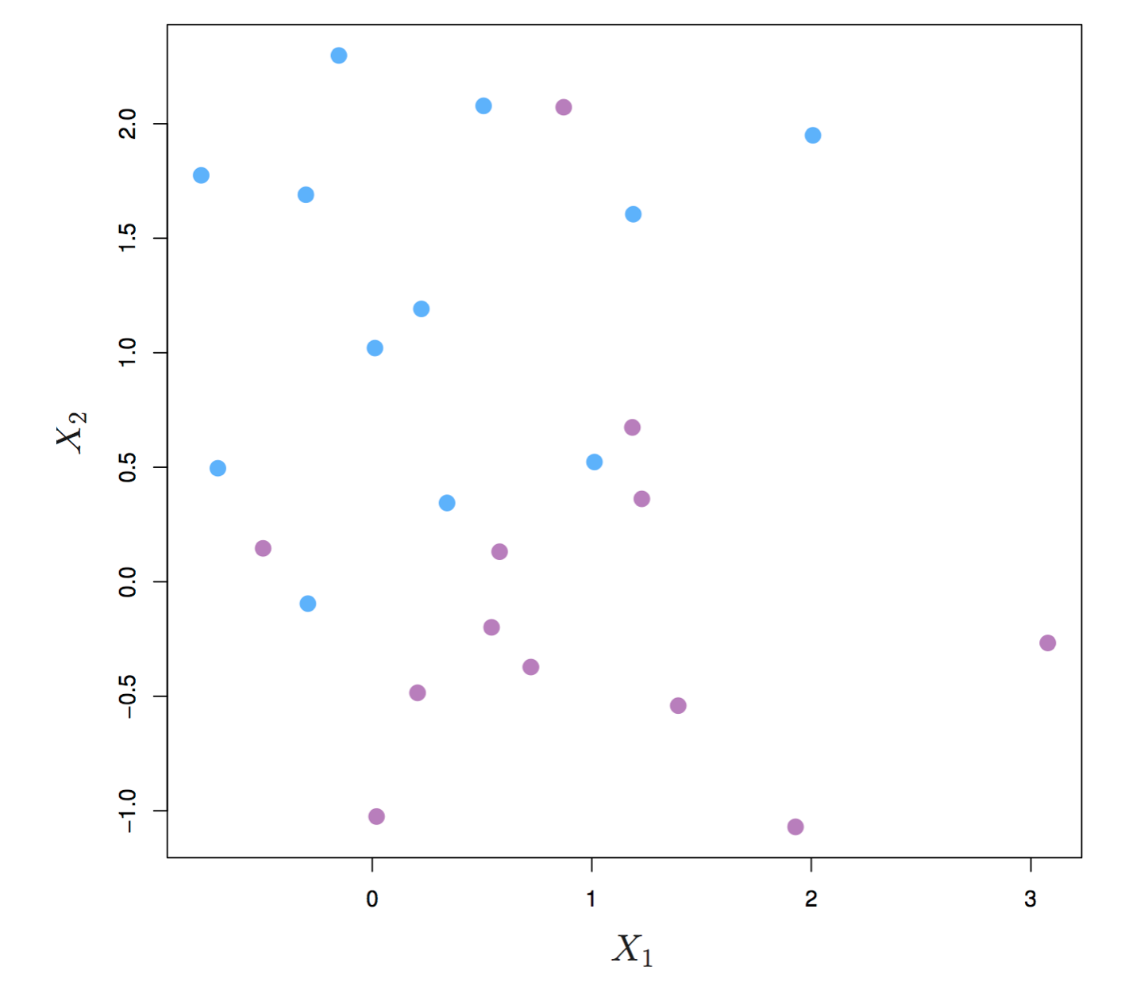
Support Vector Machines. Support vector classifier
It would be better to choose a classifier based on a hyperplane that:
is more robust to individual observations
provides better classification of most of the training variables

Slide 5
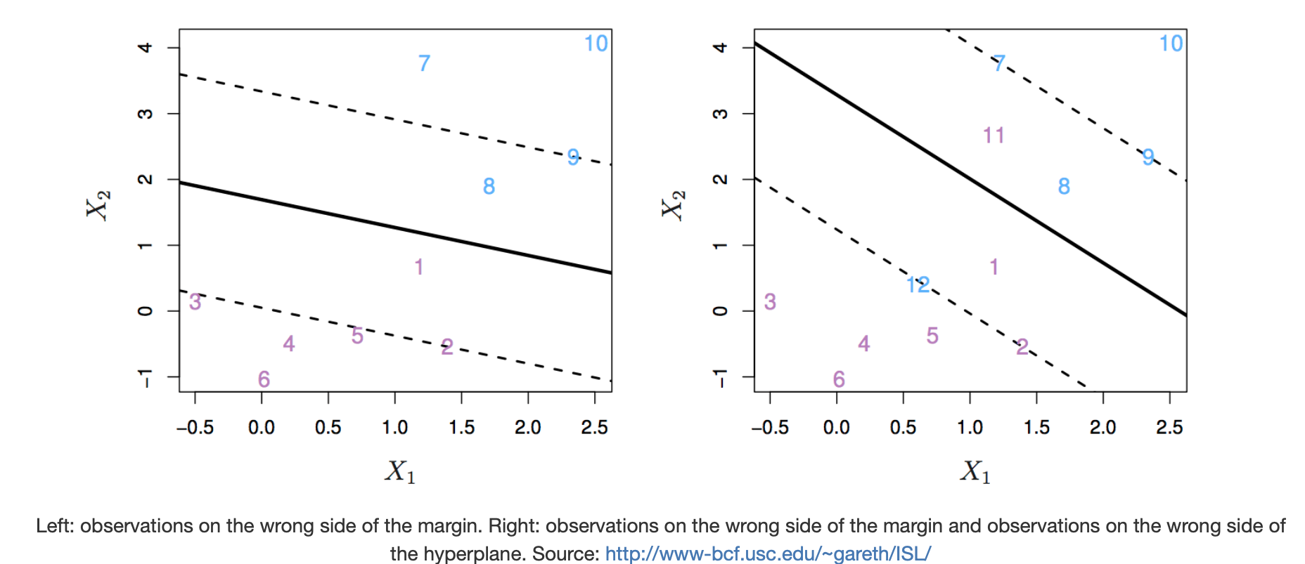
Support Vector Machines. Support vector classifier
In other words, we might tolerate some misclassifications if the prediction of the remaining observations is more reliable. The support vector classifier does this by allowing some observations to be on the wrong side of the margin or even on the wrong side of the hyperplane. Observations on the wrong side of the hyperplane are misclassifications.

Slide 6
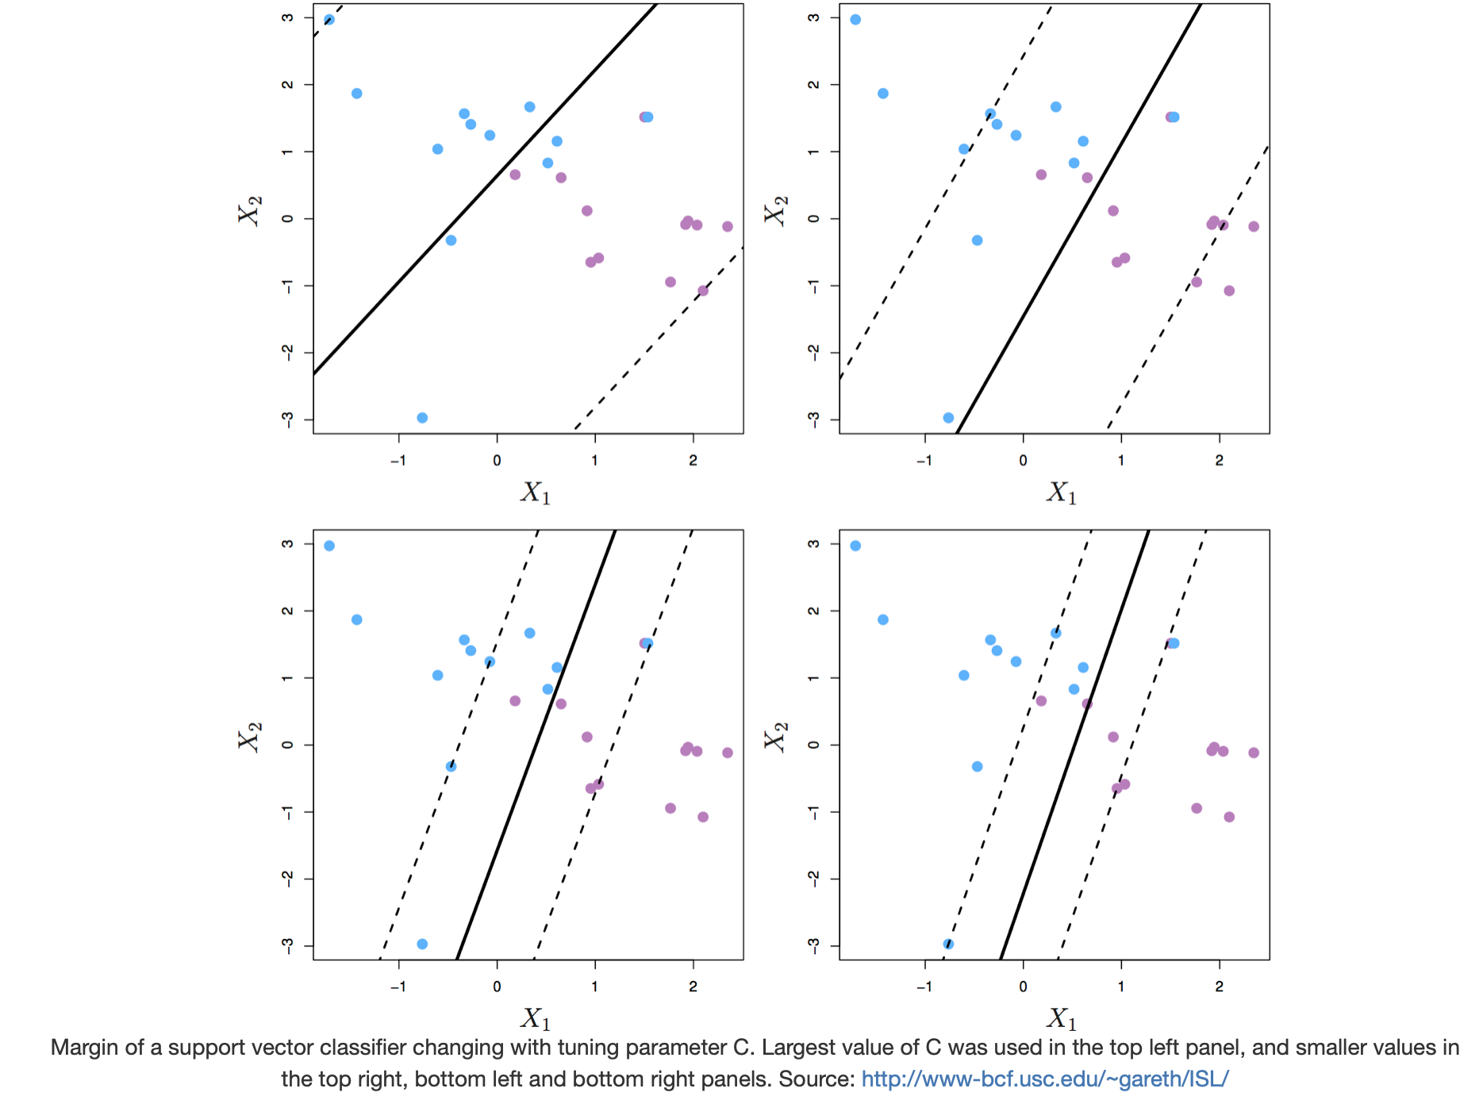
Support Vector Machines. Maximum margin classifier
The support vector classifier has a tuning parameter, C, that determines the number/ severity of the margin violations
If C = 0, then no violations to the margin will be tolerated, which is equivalent to the maximal margin classifier.
As C increases, the classifier becomes more tolerant of violations to the margin, and so the margin widens.
The optimal value of C is chosen through cross-validation.
C is described as a tuning parameter, because it controls the bias-variance trade-off:
[a] a small C results in narrow margins that are rarely violated; the model will have low bias, but high variance.
[b] as C increases the margins widen allowing more violations; the bias of the model will increase, but its variance will decrease.

Slide 7
Support Vector Machines. Maximum margin classifier
The support vectors are the observations that lie directly on the margin, or on the wrong side of the margin for their class. The only observations that affect the classifier are the support vectors. As C increases, the margin widens and the number of support vectors increases. In other words, when C increases more observations are involved in determining the decision boundary of the classifier.

Slide 8
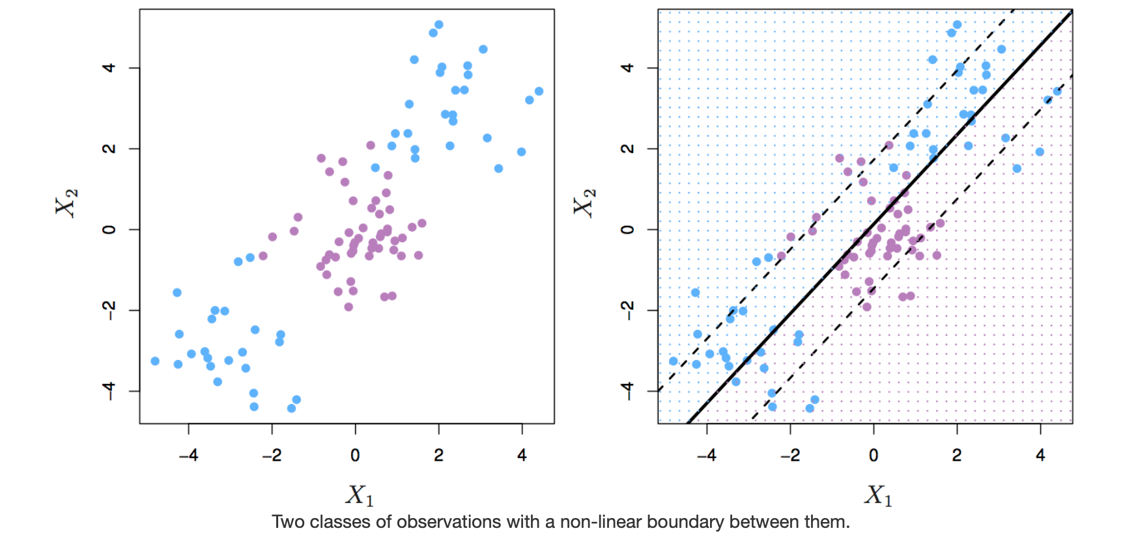
Support Vector Machines. Non linearly separable classes.

Slide 9
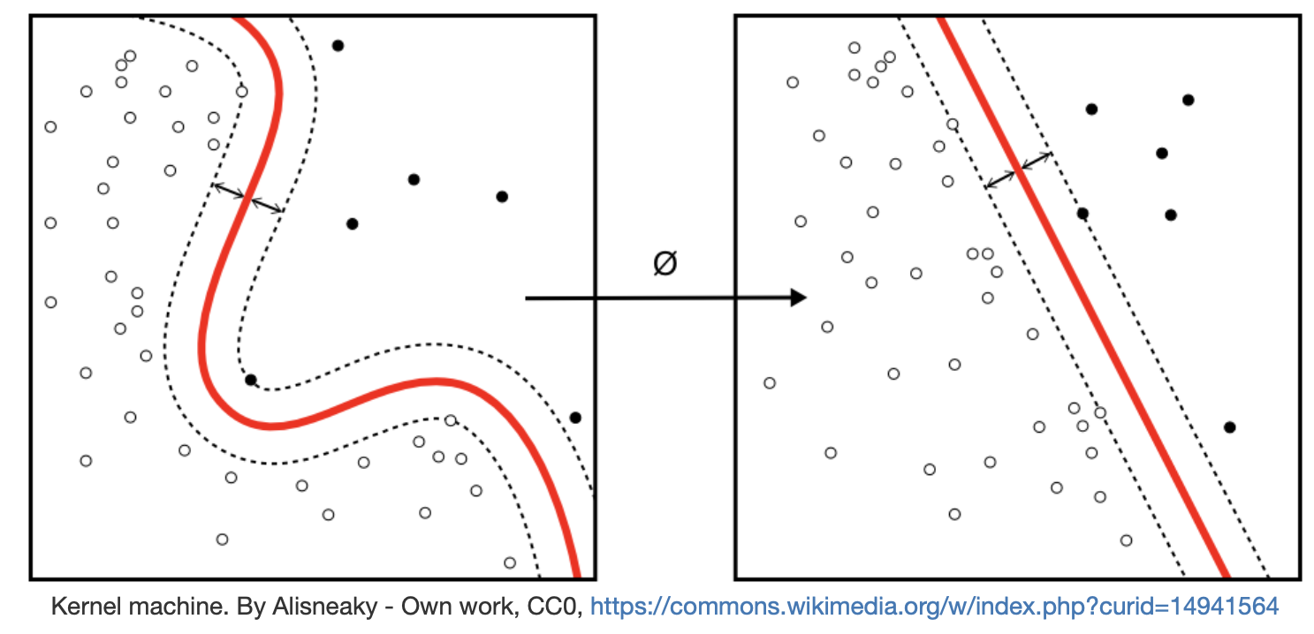
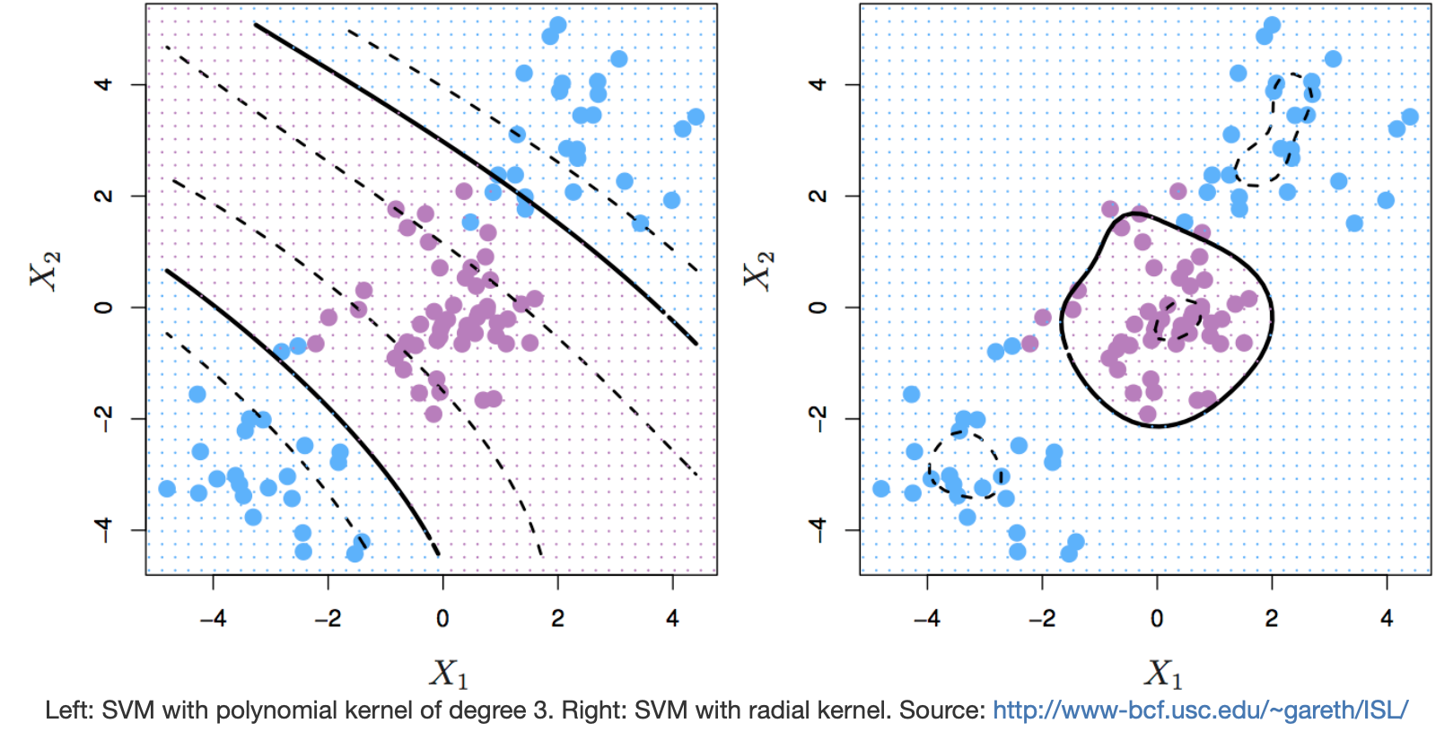
Support Vector Machines.

Slide 10
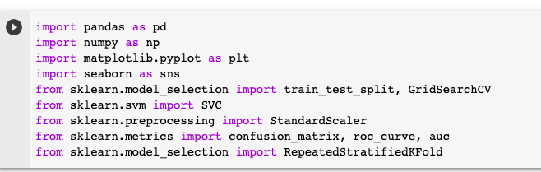
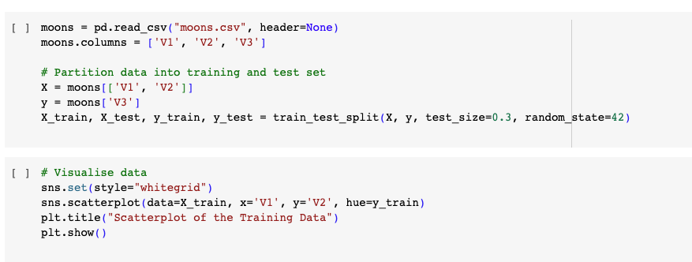
Support Vector Machines. Moons example.

Slide 11
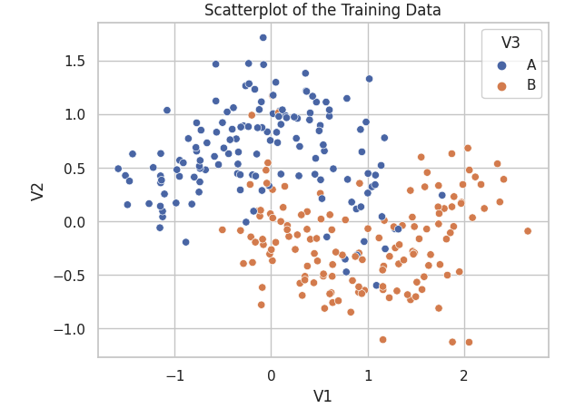
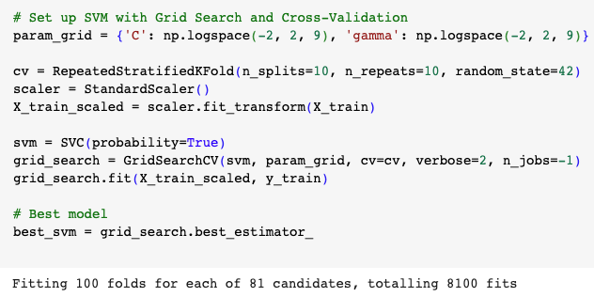
Support Vector Machines. Moons example.

Slide 12
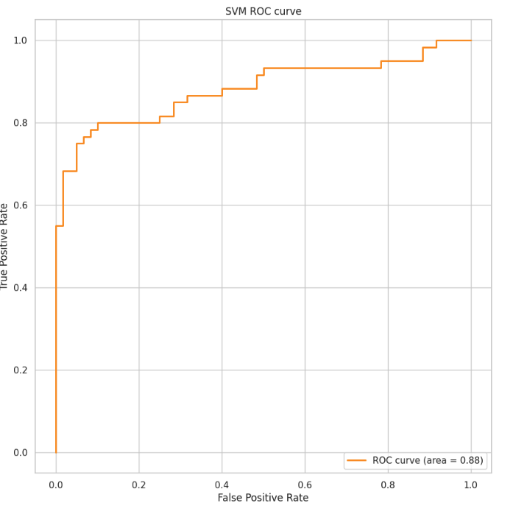
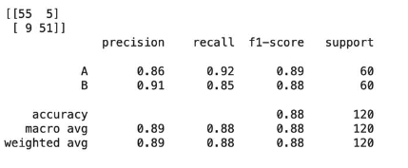
Support Vector Machines. Moons example.

Slide 13
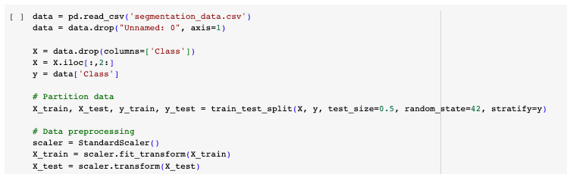
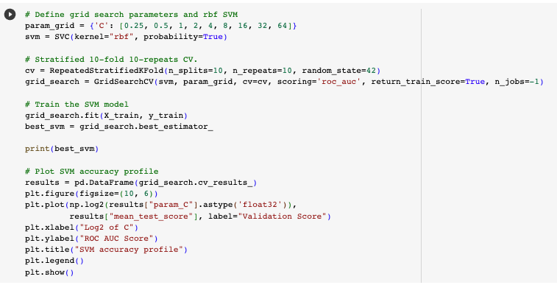
Support Vector Machines. Cell Segmentation example

Slide 14
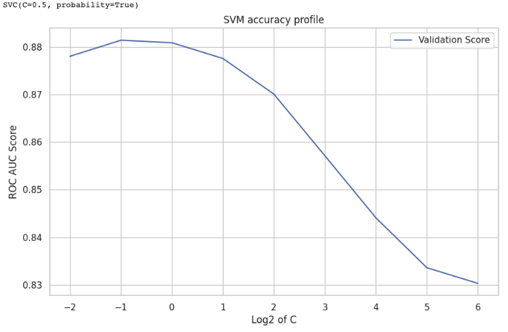
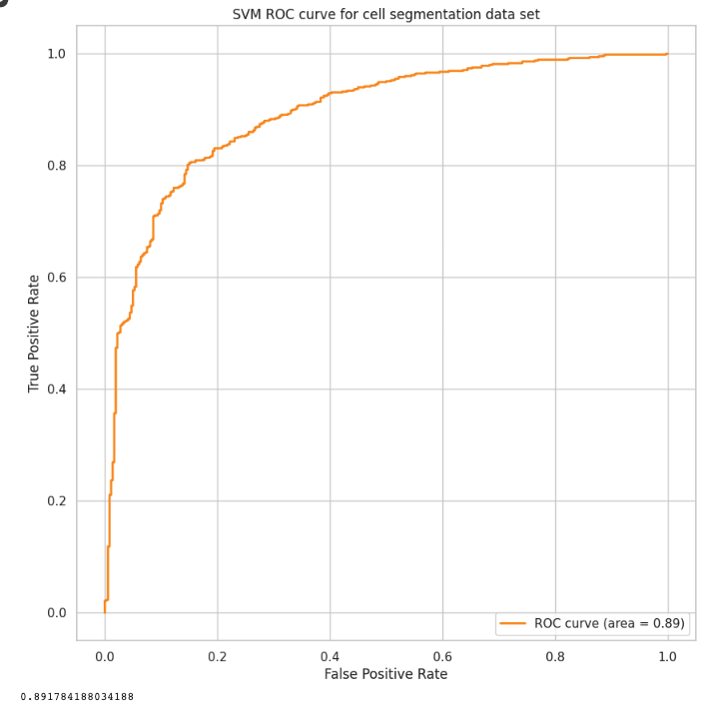
Support Vector Machines. Cell Segmentation example
Acc on the test data: 0.89

Slide 15
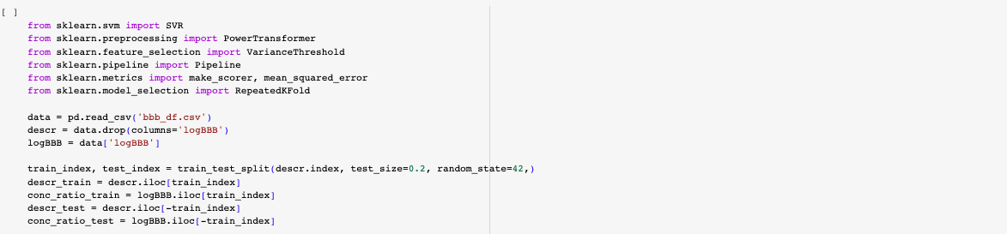
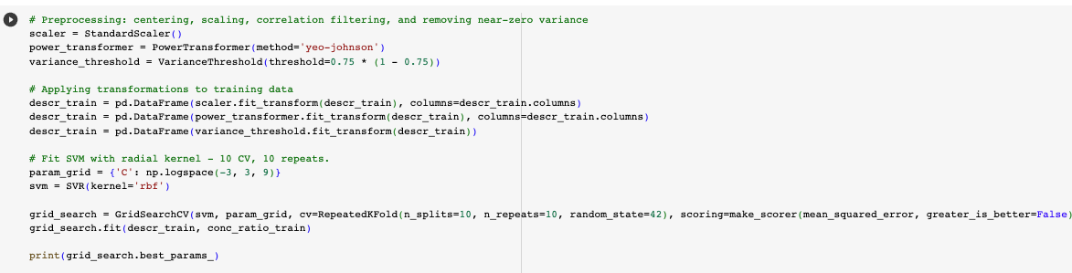
Support Vector Machines. Blood brain barrier example
Optimal value for the C parameter: C = 31.62

Slide 16
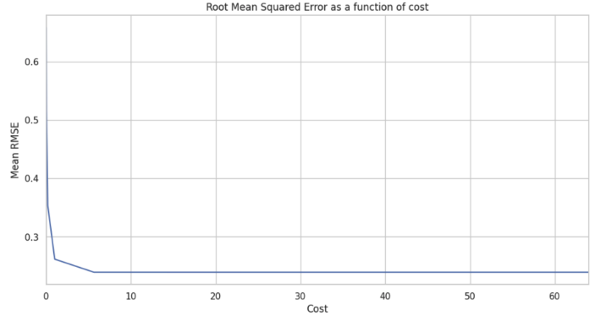
Support Vector Machines. Blood brain barrier example

Slide 17
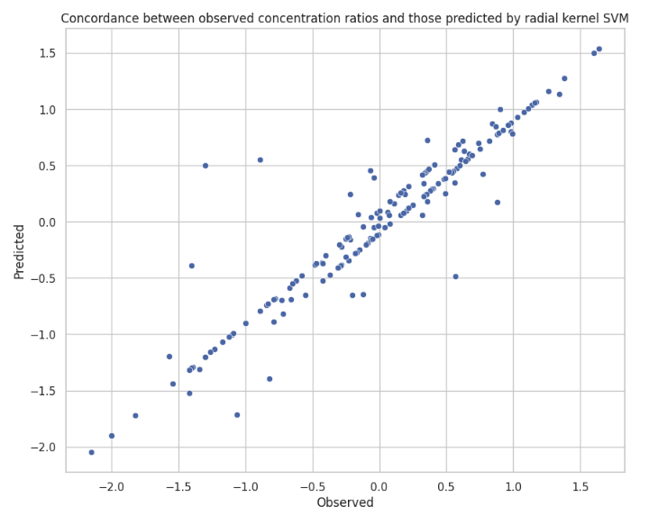
Support Vector Machines. Blood brain barrier example
Correlation between observed and predicted: 0.937

