Slide 1
AlphaZero on Gomoku
6.882 Final Project
Zhongxia “Zee” Yan

Slide 2
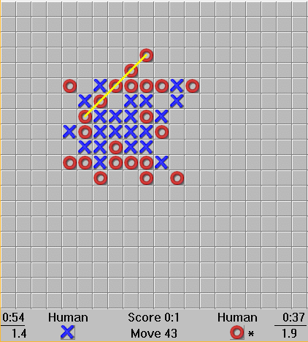
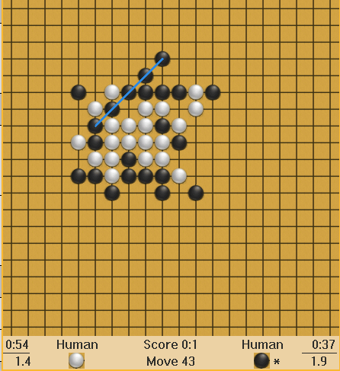
Gomoku / Connect 5
Two player competitive game
Similar to Tic Tac Toe but connect 5 pieces on 20x20 board

Slide 3
(Modified) AlphaZero: Neural Network
Input: 5x20x20 binary board state
2x20x20 for binary player state
2x20x20 for past two move coordinates
1x20x20 for which player moved first
Output: scalar value v_{s}, 20x20 prior move probability P(s, ·)
Tried two architectures:
ResNet with 2 heads
Fully convolutional network

Slide 4
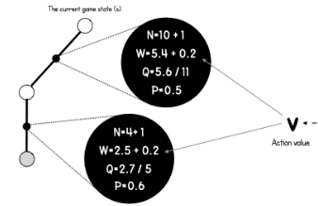
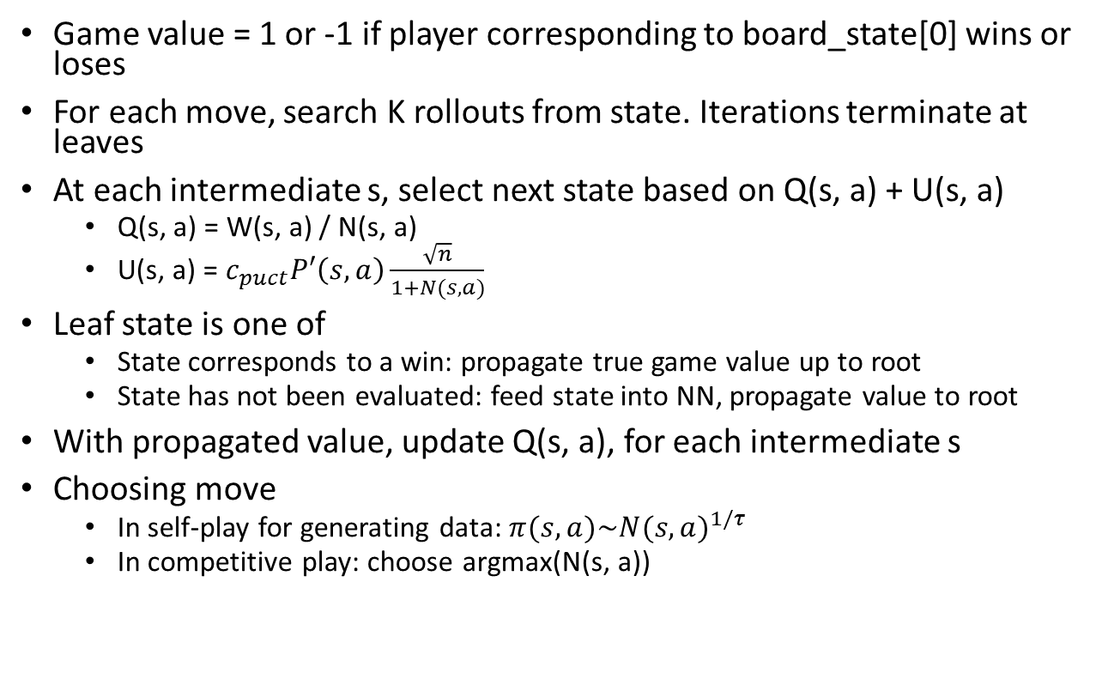
AlphaZero: Monte Carlo Tree Search (MCTS)
Game value = 1 or -1 if player corresponding to board_state[0] wins or loses
For each move, search K rollouts from state. Iterations terminate at leaves
At each intermediate s, select next state based on Q(s, a) + U(s, a)
Q(s, a) = W(s, a) / N(s, a)
U(s, a) = $c_{puct}P′\left(s, a\right)\frac{\sqrt{n}}{1+N(s, a)}$
Leaf state is one of
State corresponds to a win: propagate true game value up to root
State has not been evaluated: feed state into NN, propagate value to root
With propagated value, update Q(s, a), for each intermediate s
Choosing move
In self-play for generating data: $π(s, a)\sim {N(s, a)}^{1/τ}$
In competitive play: choose argmax(N(s, a))

Slide 5
Implementation – Multiprocessing
Processes
48 - 60 MCTS processes
1 eval process – runs evaluations with NN for MCTS
1 train process – trains NN weights
Resources: CPUs, 2 GPUs (Titan X Pascal, GTX 1080)
Flow
MCTS processes send states to eval process to evaluate
MCTS processes send full games (multiple states, values, policies) to train process
Train process trains on game states, send network weights to eval process

Slide 6
Experiments
Connect 3 pieces on 3x3 board (Tic-Tac-Toe)
3-block ResNet for shared layers, conv –> FC for value and policy heads
Connect 4 pieces on 6x6 board
3-layer conv net for shared layers
Connect 5 pieces on 20x20 board (attempt 1)
6-layer conv net for shared layers
Connect 5 pieces on 8x8 board
9-layer conv net for shared layer, conv –> FC for value, conv for policy
Connect 5 pieces on 12x12 board
Curriculum learning from 8x8
Connect 5 pieces on 20x20 board (attempt 2)
Curriculum learning from 12x12

Slide 7
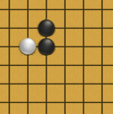
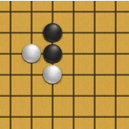
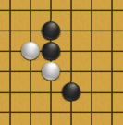
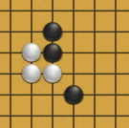
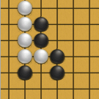
3x3 Board (Connect 3), 6x6 Board (Connect 4)
Model achieves good performance
Actually had a bug in the value function code for 3x3, but didn’t matter
Model achieves good reflex to crucial moves and winning moves
Crucial move
Winning move
Final state
Black: Zee, White: model (policy only, no MCTS rollouts)

Slide 8
20x20 Board (Connect 5), attempt 1
Didn’t work with 40k epochs

Slide 9
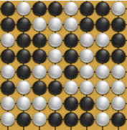
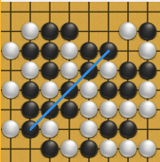
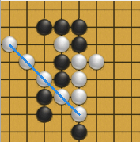
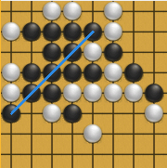
8x8 Board (Connect 5)
60k epochs, ~ 1 day
Self-play Training
Zee-play
White: model
White: model

Slide 10
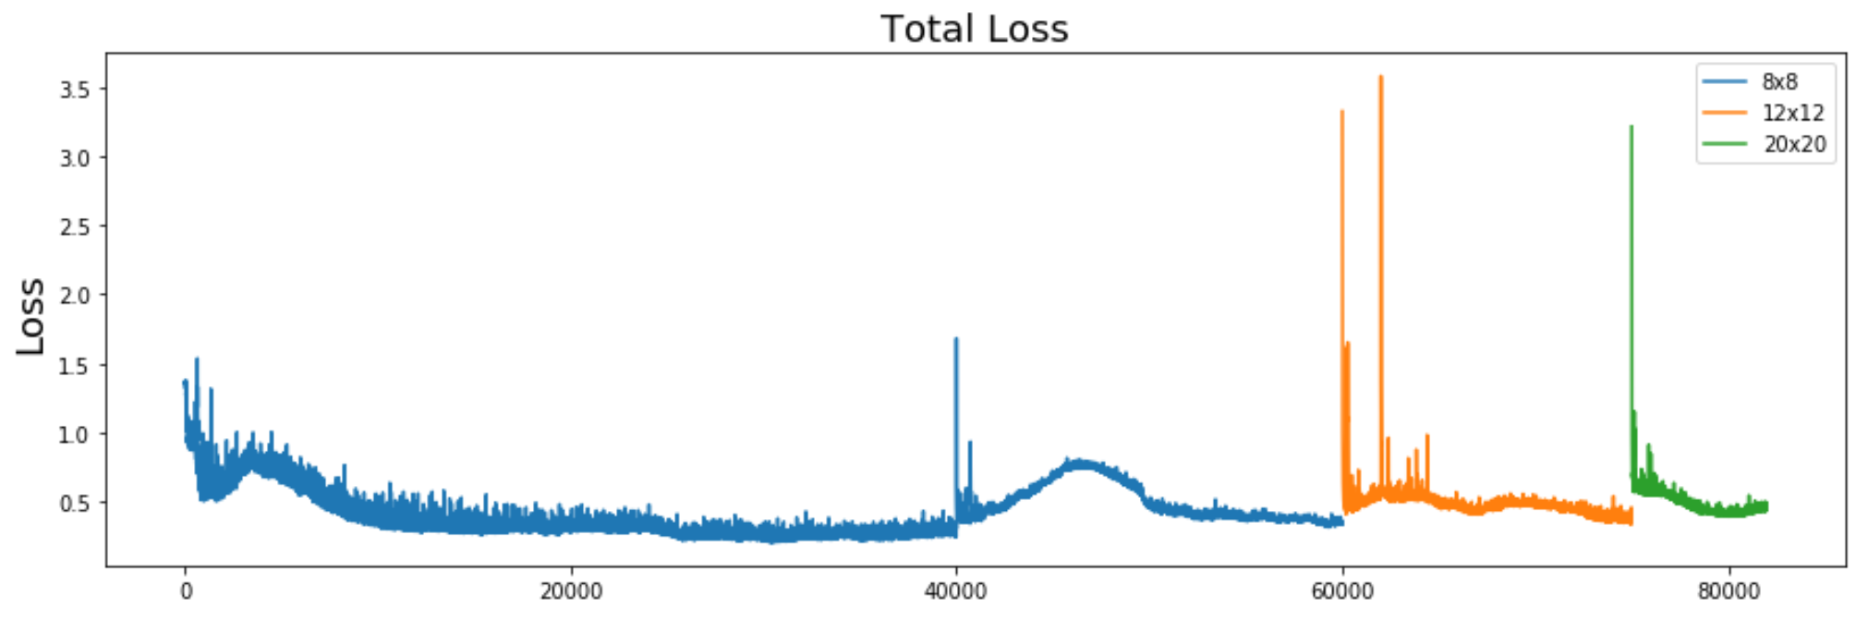
8x8 Board (Connect 5)

Slide 11
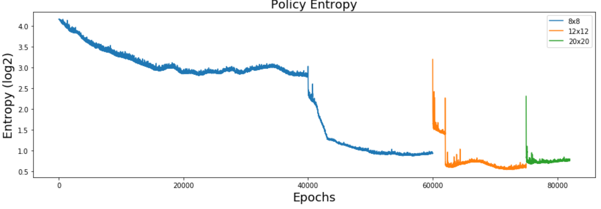
8x8 Board (Connect 5)

Slide 12
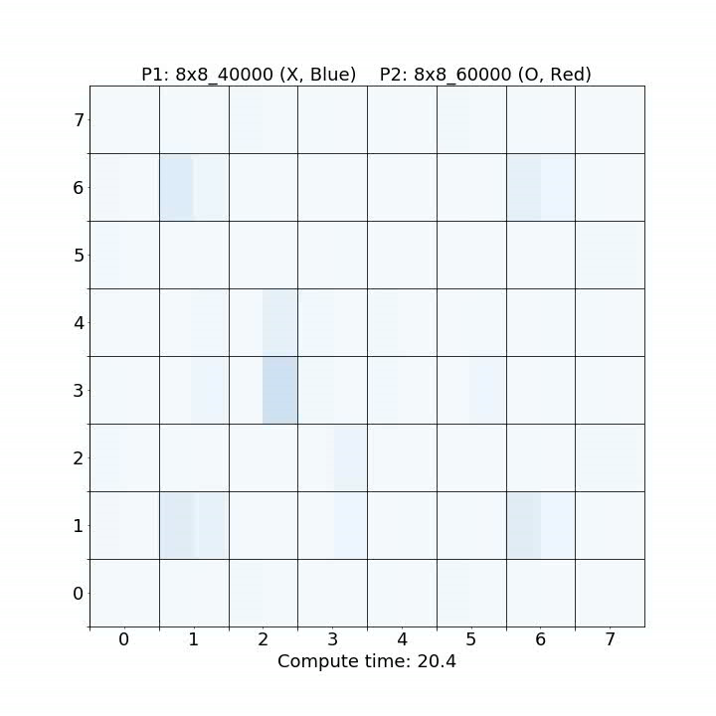
8x8 Board (Connect 5)
Competitive play
Left half: prior policy at state
Right half: MCTS rollout distribution

Slide 13
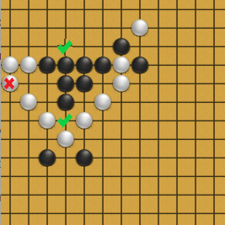
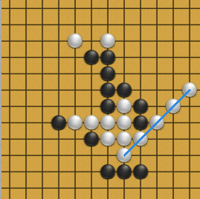
12x12 Board (Connect 5)
White: model (policy only) Black: Zee
White: model (full)
Black: Zee

Slide 14
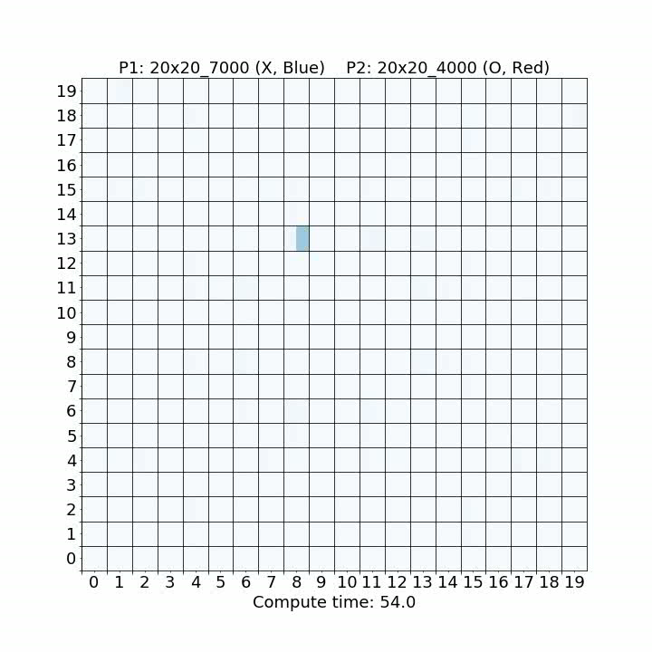
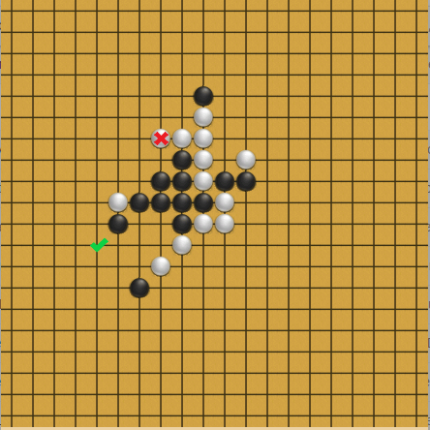
20x20 Board (Connect 5)
White: model (full) Black: Zee

Slide 15
Model Competitive Play Results
Connect 5, 8x8 board
Epoch 40k beat epoch 0: 20-0-0
Epoch 60k beat epoch 40k: 11-4-5
Connect 5, 12x12 board
Epoch 8k beat epoch 0: 19-0-1
Connect 5, 20x20 board
Epoch 2k beat epoch 0: 17-0-3
Epoch 4k beat epoch 2k: 18-0-2
Epoch 7k beat epoch 4k: 14-0-6
Epoch 7k beat epoch 2k: 18-0-2

