Slide 1

Variable-Point FFT Design
Zhongyuan Ji
June 19 2023

Slide 2
Outline
Circuit Architecture
FFT Algorithm
Discussion
Working Principle and Timing Diagram

Slide 3
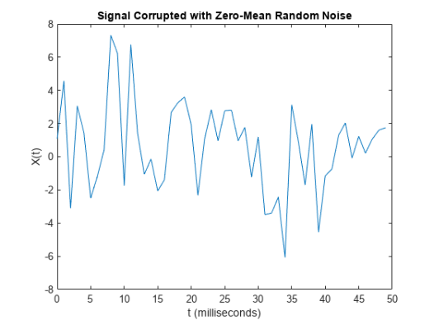
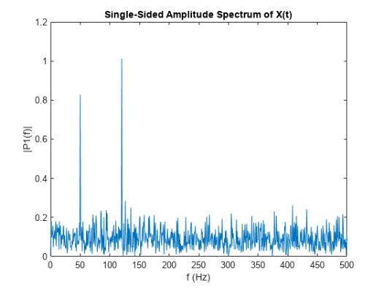
FFT Algorithm: WHY DFT/FFT?
The Fourier transform yields the spectral density function
ZhongyuanJi@ Ravsense

Slide 4
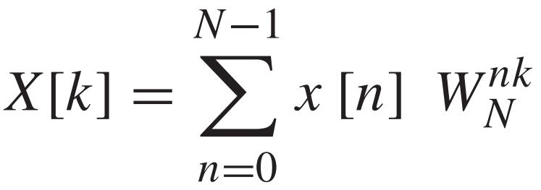
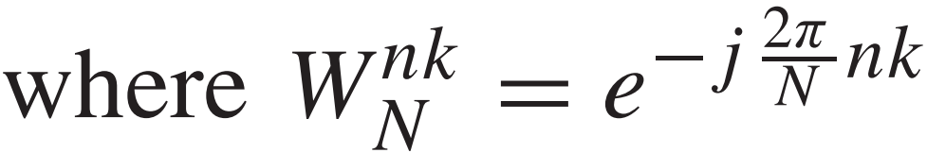

FFT Algorithm: WHY DFT/FFT?
DFT: Discrete-time Fourier transform
Specific X[k] needs: N multiplication operations and N-1 addition operations
Complexity:
$$O\left(N^{2}\right)$$
ZhongyuanJi@ Ravsense

Slide 5
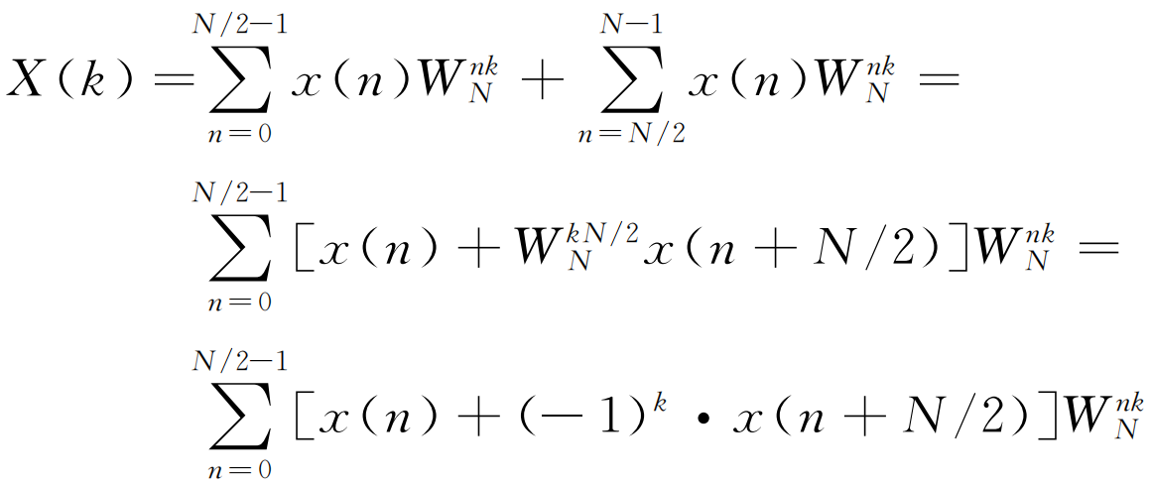
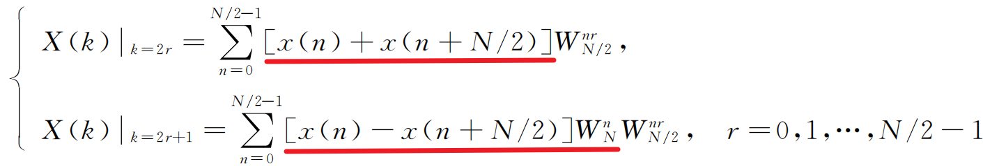
FFT Algorithm
Radix-2 Decimation in Frequency Fast Fourier Transform(DIF FFT)
The input x(n) is divided into two parts before and after in the order of n inputs
1）DFT:
2）Divided into two parts:
3）The original DFT splits into two new DFT:
ZhongyuanJi@ Ravsense

Slide 6
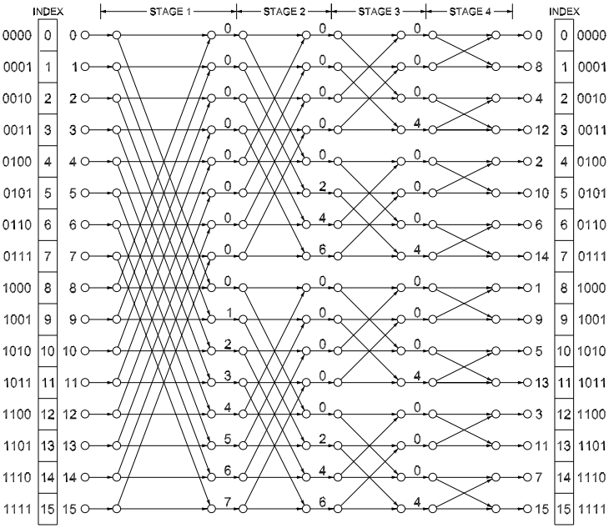
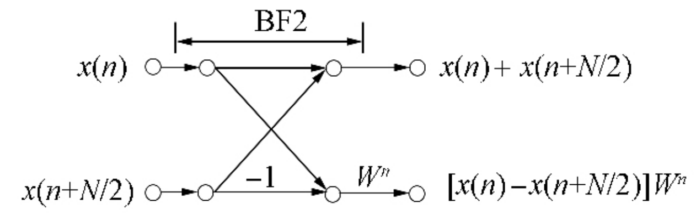
FFT Algorithm
The original DFT splits into two new DFT:
Radix-2 DIF butterfly operation unit：
DIF – FFT(Radix-2)
ZhongyuanJi@ Ravsense

Slide 7
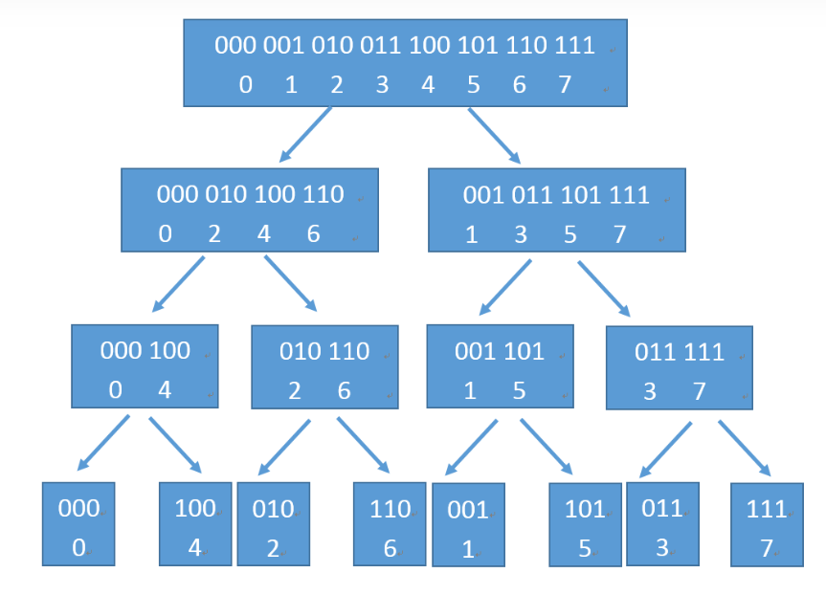
FFT Algorithm
DIT – FFT(Radix-2)
DIF – FFT(Radix-2)
DIT – FFT(Radix-2)
INPUT:
Binary order
OUTPUT:
Binary reverse order
INPUT:
Binary reverse order
OUTPUT:
Binary order
ZhongyuanJi@ Ravsense

Slide 8
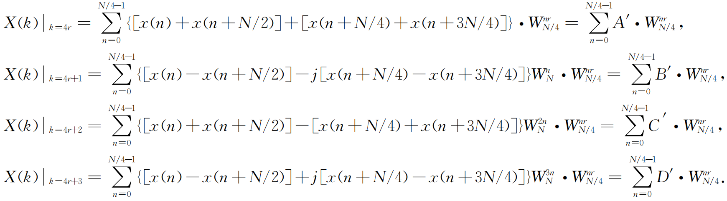
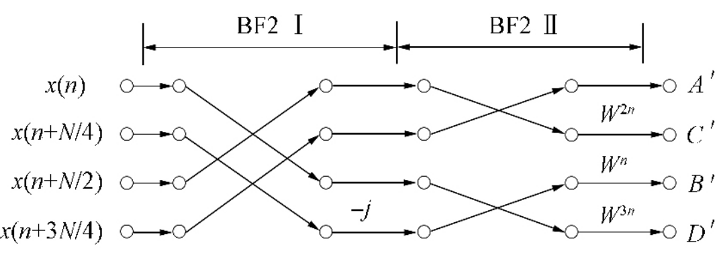
FFT Algorithm
Optimized Radix-4 Algorithm:
Optimized Radix-4 Computing Unit:
ZhongyuanJi@ Ravsense

Slide 9
Outline
Circuit Architecture
FFT Algorithm
Discussion
Working Principle and Timing Diagram

Slide 10
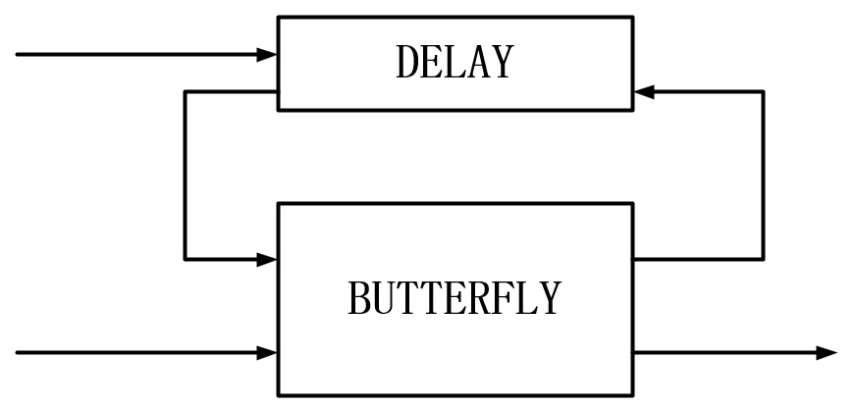
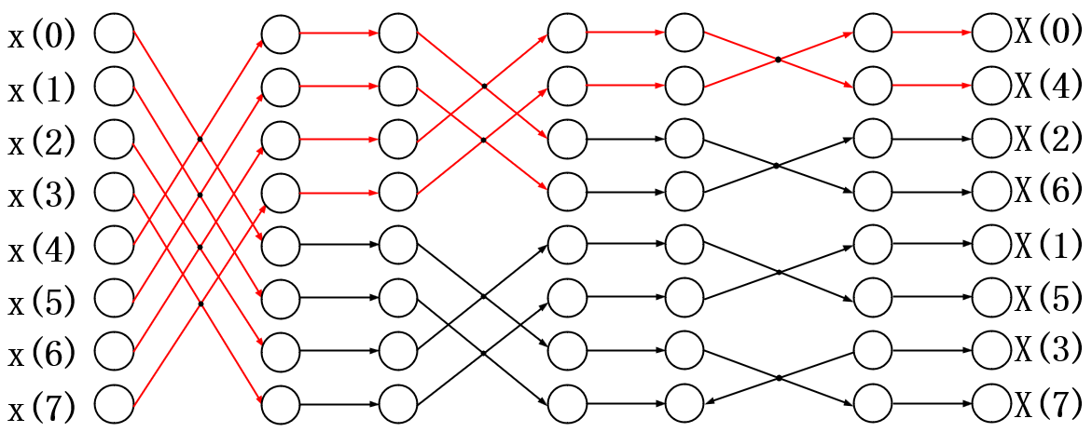
Circuit Architecture
Implementation:
Save the first half of the data first, then execute the butterfly operation with the last data
Fig.Circuit Implementation
Fig.Data Calculation Flow
ZhongyuanJi@ Ravsense

Slide 11
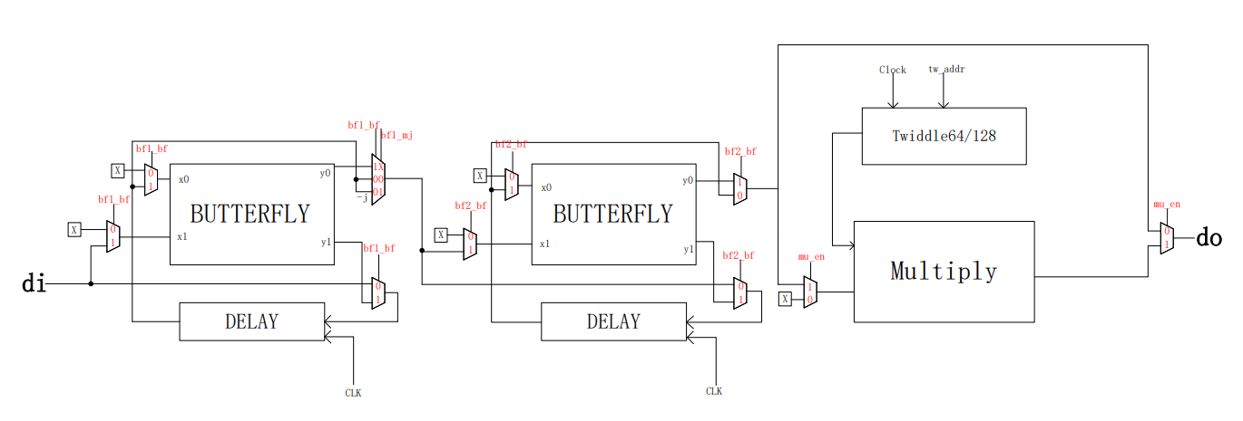

Circuit Architecture
Fig.R22SDF Circuit Architecture
ZhongyuanJi@ Ravsense

Slide 12
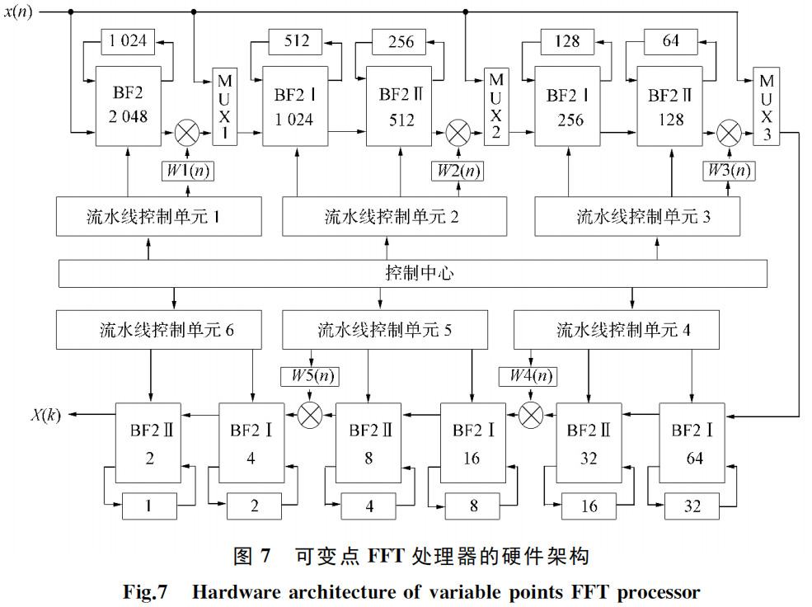
Circuit Architecture
ZhongyuanJi@ Ravsense

Slide 13
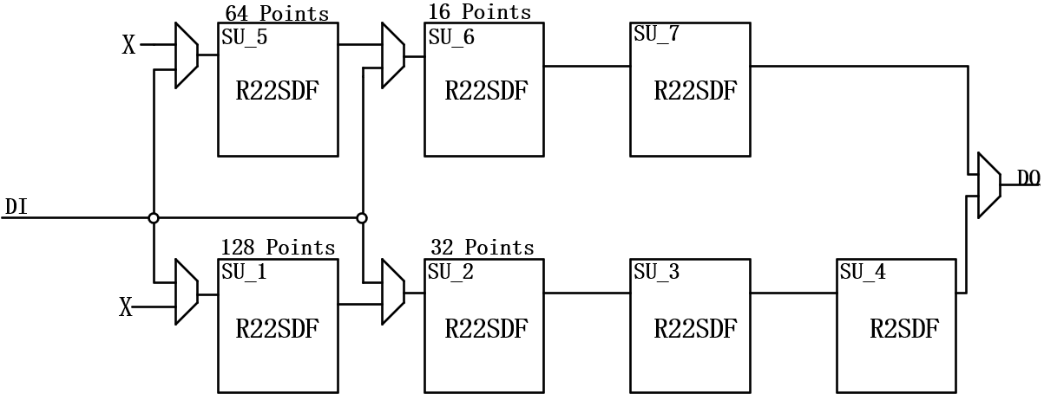
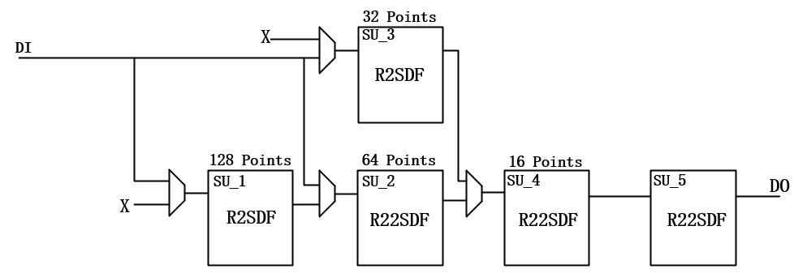
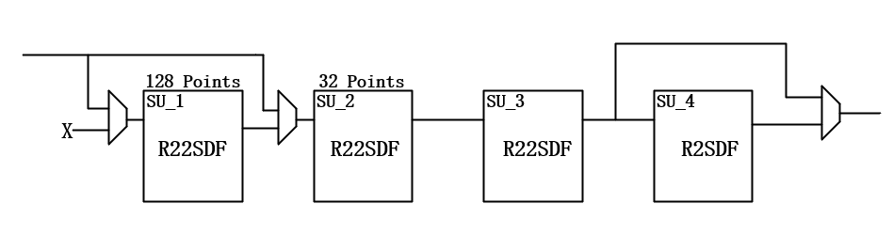
Circuit Architecture
Our Architectures:
Why not other Architectures?
ZhongyuanJi@ Ravsense

Slide 14
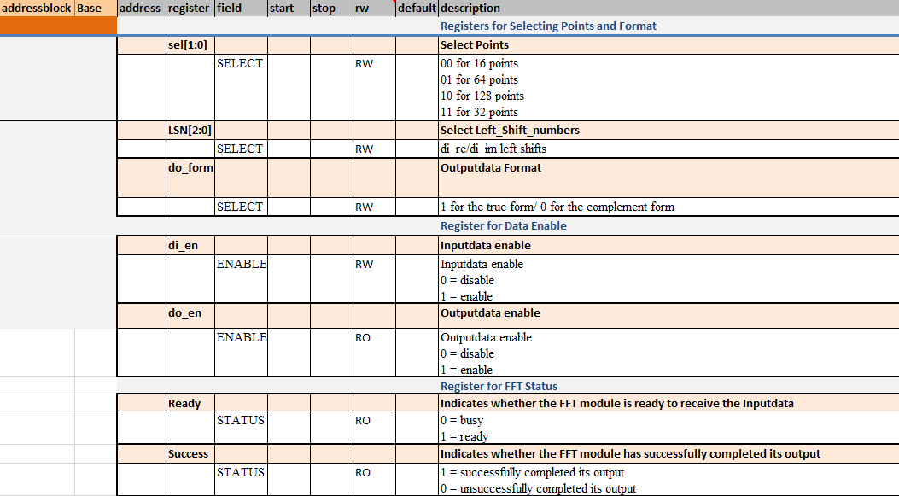
Circuit Architecture
Our Circuit Architecture:
Points Selecting: sel[1:0]
00: 16 points
01: 64 points
10: 128 points
11: 32 points
ZhongyuanJi@ Ravsense

Slide 15

Outline
Circuit Architecture
FFT Algorithm
Discussion
Timing Diagram and Results

Slide 16
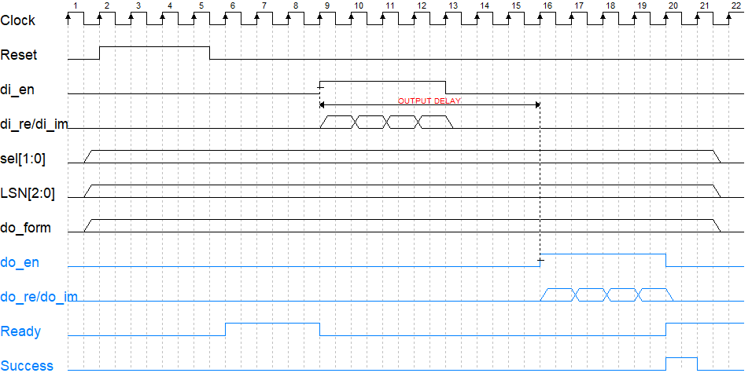
Timing Diagram and Results
Binary Reverse Order
16 points: 20 cycles 50MHz: 0.4us
32 points: 38 cycles 50MHz: 0.76us
64 points: 71 cycles 50MHz: 1.42us
128 points:137 cycles 50MHz: 2.74us
Output Delay:
ZhongyuanJi@ Ravsense

Slide 17
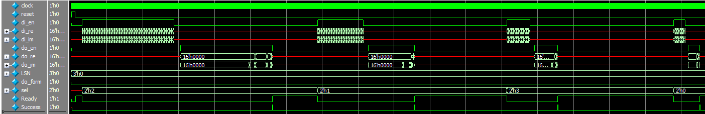
Timing Diagram and Results
Fig. Ideal Timing Diagram
Fig. Modelsim Simulate Timing Diagram
ZhongyuanJi@ Ravsense

Slide 18
Outline
Circuit Architecture
FFT Algorithm
Discussion
Working Principle and Timing Diagram

Slide 19

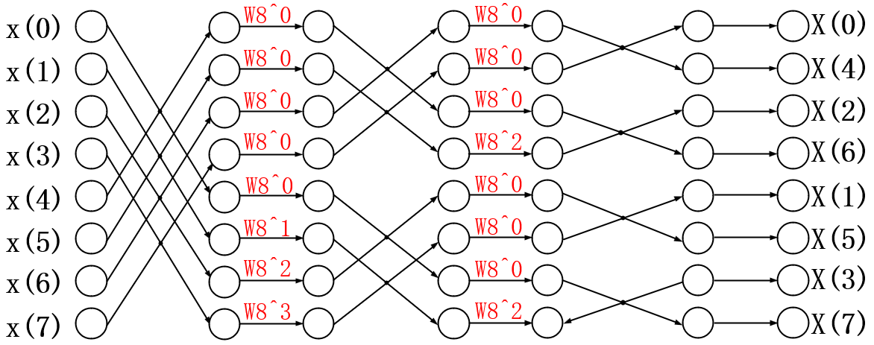
Discussion: Twiddle Work Principle
Twiddle:
All Twiddle = 1 (W8^0)
Binary Reverse Order
ZhongyuanJi@ Ravsense

Slide 20
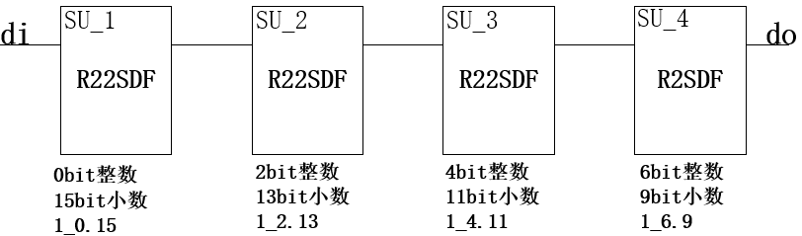
Discussion: Outputdata Scale
With adding and subtracting in the butterfly unit, shifting the result of all additions and subtractions one bit to the right to prevent overflow
Scale: “Outputdata Scale” = “Inputdata Scale”/2^“Numbers of Butterfly”
Fig. 128 Points Output Scale
ZhongyuanJi@ Ravsense

Slide 21
Discussion:Multiplier optimization
Directly using multiplication will take up a lot of resources, you can use shift sum to achieve multiplication, this design uses shift sum to design a 16bit*16bit multiplier and complete the complex multiplication operation
110 * 011 = (110<<1) + (110<<0)
Core Code:
for(index = 0; index < (WIDTH-1); index = index + 1)begin
multi1_temp = multi1_temp + ({(2*WIDTH-2){tw_re_trans[index]}}&({a_re_ex << index}));//a_re*tw_re
multi2_temp = multi2_temp + ({(2*WIDTH-2){tw_im_trans[index]}}&({a_im_ex << index}));//a_im*tw_im
multi3_temp = multi3_temp + ({(2*WIDTH-2){tw_im_trans[index]}}&({a_re_ex << index}));//a_re*tw_im
multi4_temp = multi4_temp + ({(2*WIDTH-2){tw_re_trans[index]}}&({a_im_ex << index}));//a_im*tw_re
end
ZhongyuanJi@ Ravsense

Slide 22
Discussion:Multiplier optimization
always@(*)begin
// multi1
if((a_re == 16'h0)||(tw_re == 16'h0))begin
multi10 = 16'b0;
end
else begin
if((a_re == 16'h8000)||(tw_re == 16'h8000))begin
if((a_re == 16'h8000)&&(tw_re == 16'h8000))begin
multi10 = 16'h7fff;
end
else begin
if((a_re == 16'h8000))begin
multi10 = {~tw_re +1'b1};
end
else begin
multi10 = {~a_re + 1'b1};
end
end
end
else begin
multi10 = multi1;
end
end
end
***When the shift sum multiplier meets “8000”, it is incorrectly assumed to be negative 0***
If both equal“8000”, then directly
assign as 7fff
If just one equals “8000”, then rollover and add 1
If no one equals “8000”, then equal shift sum
ZhongyuanJi@ Ravsense

Slide 23
Discussion:Script and self-checking
Script: Determine the input waveform using Matab Software, and sample and convert to complement
for i = 1:length
if(data_before_fft(i)>=0)
temp= dec2bin(data_before_fft(i),16);
else
temp= dec2bin(data_before_fft(i)+2^16,16);
end
for j=1:16
fprintf(fp,'%s',temp(j));
end
fprintf(fp,'0000000000000000'); %虚部补0
fprintf(fp,'\r\n');
end
ZhongyuanJi@ Ravsense

Slide 24
Discussion:Script and self-checking
task compare;
integer j;
begin
for(j = 0; j<128 ; j = j + 1)begin
inst_re[j] = matlabmem_re[j] - naromen_re[j] + 16'b0000_1000_0000_0000;
inst_im[j] = matlabmem_im[j] - naromen_im[j] + 16'b0000_1000_0000_0000;
end
end
endtask
integer l = 0;
task jiaoyan;
begin
for(l = 0; l<128 ; l = l + 1)begin
if(inst_re[l]>16'b0000_1000_0000_0010||inst_re[l]<16'b0000_0111_1111_1110) begin
error = error + 1;
end
if(inst_im[l]>16'b0000_1000_0000_0010||inst_im[l]<16'b0000_0111_1111_1110) begin
error = error + 1;
end
end
end
endtask
ZhongyuanJi@ Ravsense

Slide 25
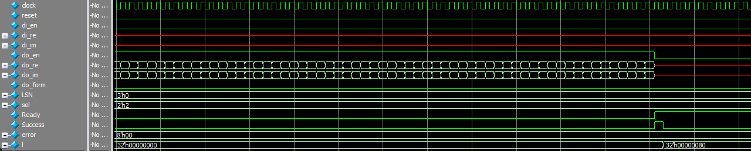
Discussion:Script and self-checking
When l is equal to 32'h00000080 (128), it means that the 128 output data have been compared, at this time, error is still 0, which means that all data are within the specified error range
ZhongyuanJi@ Ravsense

Slide 26
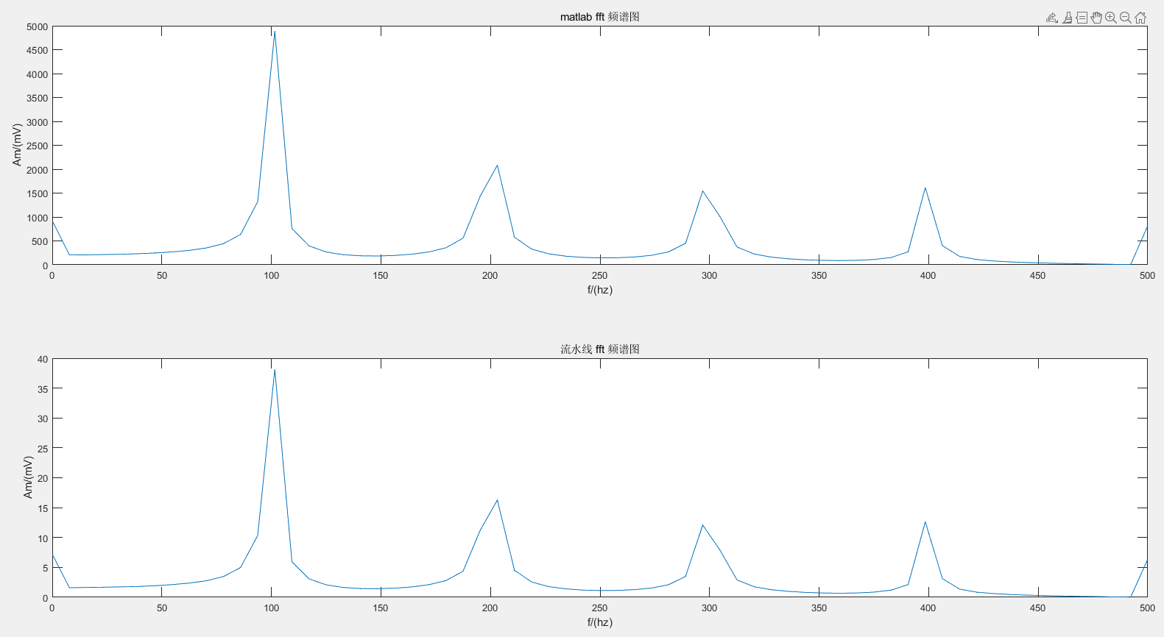
Discussion:Script and self-checking
Order | Matab | Modelsim
0 | 1111110001100110 | 1111110001100111
1 | 1111111110011001 | 1111111110011010
2 | 1111111110011000 | 1111111110011000
3 | 1111111110010111 | 1111111110010111
4 | 1111111110010110 | 1111111110010110
5 | 1111111110010100 | 1111111110010101
6 | 1111111110010001 | 1111111110010010
7 | 1111111110001101 | 1111111110001101
8 | 1111111110000111 | 1111111110000111
9 | 1111111101111110 | 1111111101111111
10 | 1111111101101111 | 1111111101110000
11 | 1111111101010000 | 1111111101010000
12 | 1111111011100100 | 1111111011100100
…
Signal = sawtooth(2*pi*100*t)
ZhongyuanJi@ Ravsense

Slide 27
Discussion:Script and self-checking
Order | Matlab | Modelsim – 16 bit | Modelsim – 11 bit
0 | 0000000000000000 | 0000000000000000 | 0000000000000000
1 | 1111111111111001 | 1111111111111010 | 1111111111111001
2 | 1111111111110011 | 1111111111110011 | 1111111111110011
3 | 1111111111101100 | 1111111111101101 | 1111111111101101
4 | 1111111111100110 | 1111111111100110 | 1111111111100110
5 | 1111111111011111 | 1111111111100000 | 1111111111100000
6 | 1111111111011000 | 1111111111011001 | 1111111111011001
7 | 1111111111010001 | 1111111111010001 | 1111111111010001
8 | 1111111111001010 | 1111111111001010 | 1111111111001010
9 | 1111111111000010 | 1111111111000010 | 1111111111000010
10 | 1111111110111001 | 1111111110111001 | 1111111110111001
11 | 1111111110110000 | 1111111110110000 | 1111111110110000
12 | 1111111110100110 | 1111111110100110 | 1111111110100110
…
signal = cos(2*pi*200*t)*i + cos(2*pi*300*t)*i
ZhongyuanJi@ Ravsense

Slide 28
THANK YOU
ZhongyuanJi@ Ravsense

Slide 29

FFT Algorithm: WHY DFT/FFT?
Radix-2 Decimation in Frequency Fast Fourier Transform
Ruler Formula:
ZhongyuanJi@ Ravsense

