Slide 1
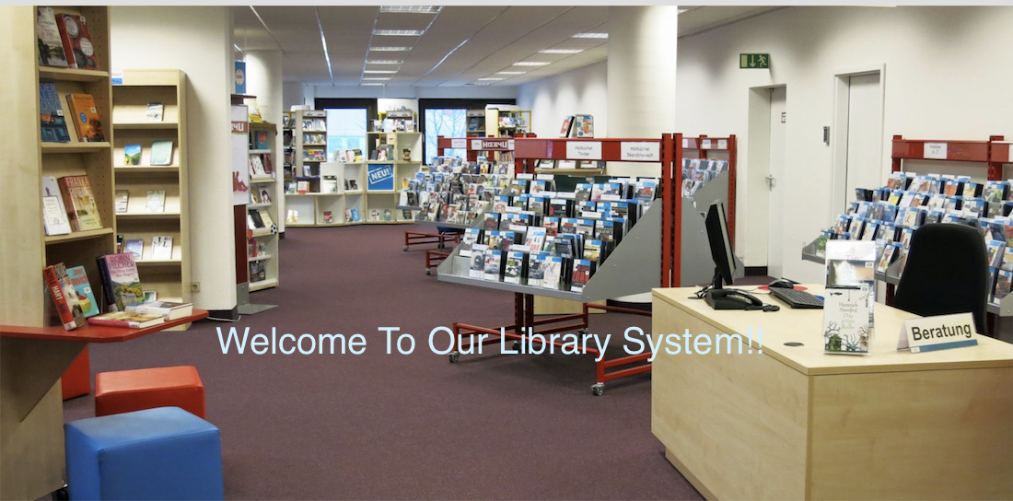

Welcome to Our Library System
Group：Winning Pig
PRESENTED BY
Runyang Zhou
Yuan Chai

Slide 2

Problem Statement
For student
How to make an appointment with tutors without looking for them in person?
How to view and borrow library books without checking in library ?
How to order coffee in the library?
For librarian
How to manage the library books on the system?
How to check and make actions for students’ borrowing request?
How to check analysis records of the library resource?
For tutor
How to check and make actions for students’ appointment request?
For coffee shop worker
How to check and make actions for students’ coffee orders?
How to manage the coffee menu?

Slide 3
Approach
For student
If students want to make an appointment with tutor, they can select the appointment detailed time and send request to tutors.
If students want to view and borrow library books, they can search, view and send the borrowing requests and return.
If students want to order coffee, they can read the menu and checkout the coffee order.
For librarian
Librarian can add, delete and update the library book.
Librarian can check the books borrowed requests from students and send the accept or decline reply.
Librarian can check the library resource records such as top 5 active students, top 5 popular books and top 5 popular coffee.
For tutor
Tutors can check the appointment requests from students and send the accept or decline reply.
For coffee shop worker
Workers can check the coffee order from students and complete them.
Workers can add and delete the coffee menu.

Slide 4
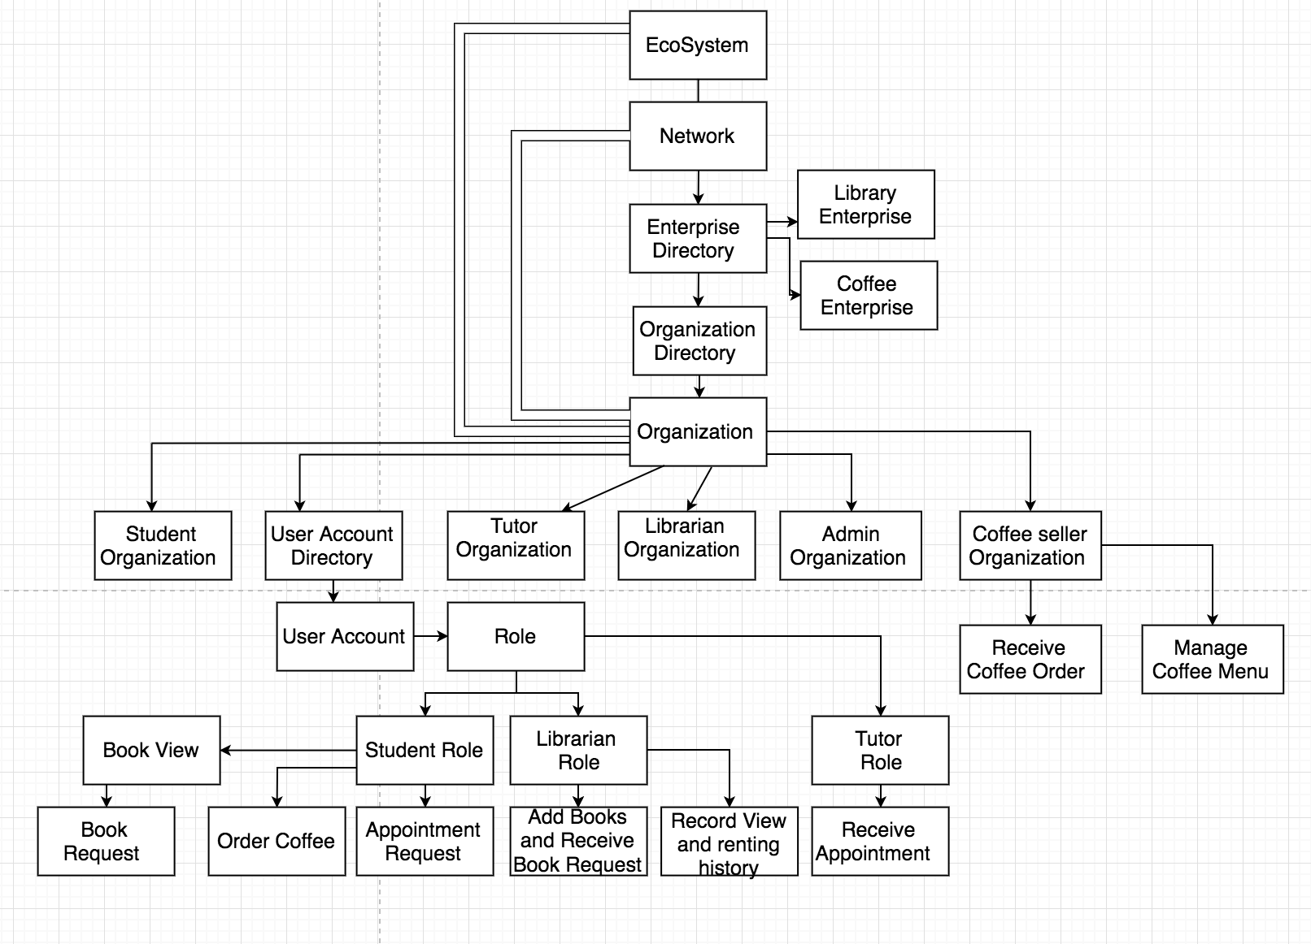
Object Model

Slide 5
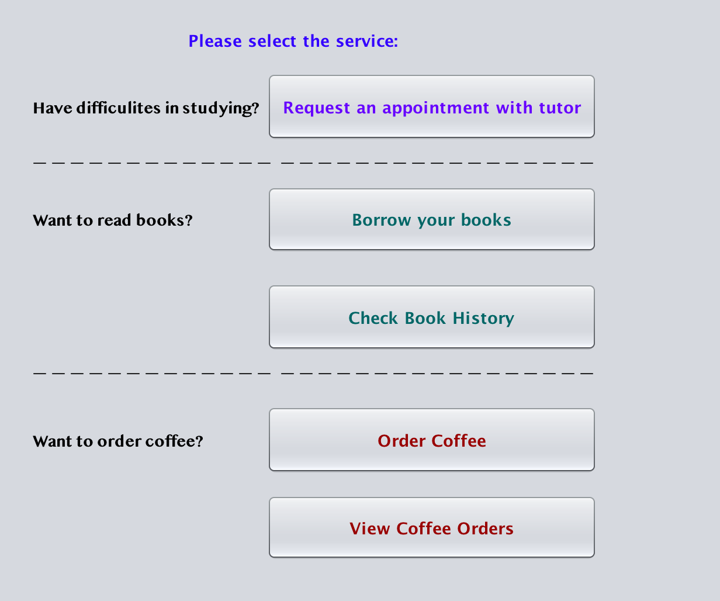
Functionalities ＆ Screenshots
Network: Neu
Enterprise：Library
Organization： Student

Slide 6
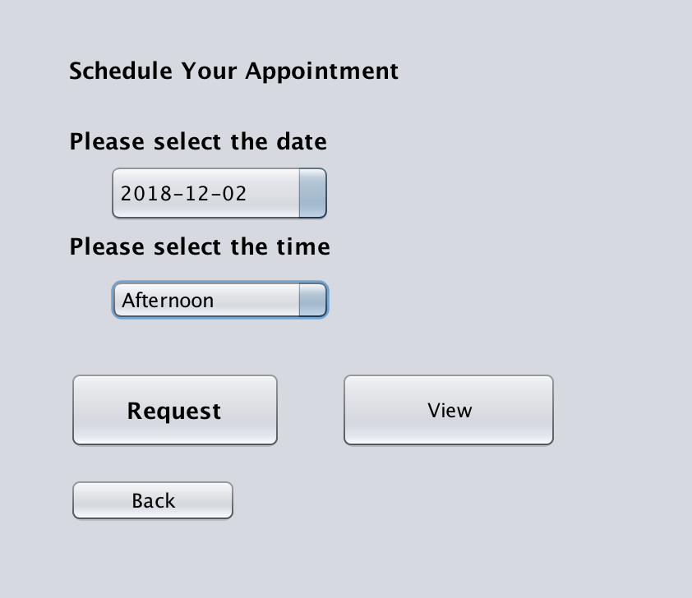
Functionalities ＆ Screenshots
Enterprise：Library
Organization： Student
Function：Make an appointment request with tutor

Slide 7
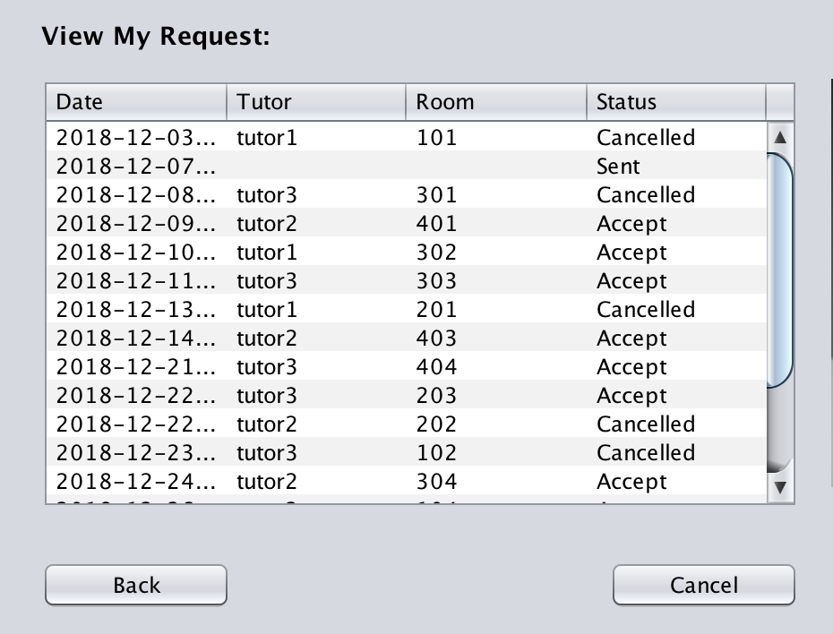
Functionalities ＆ Screenshots
Enterprise：Library
Organization： Student
Function：Check your request

Slide 8
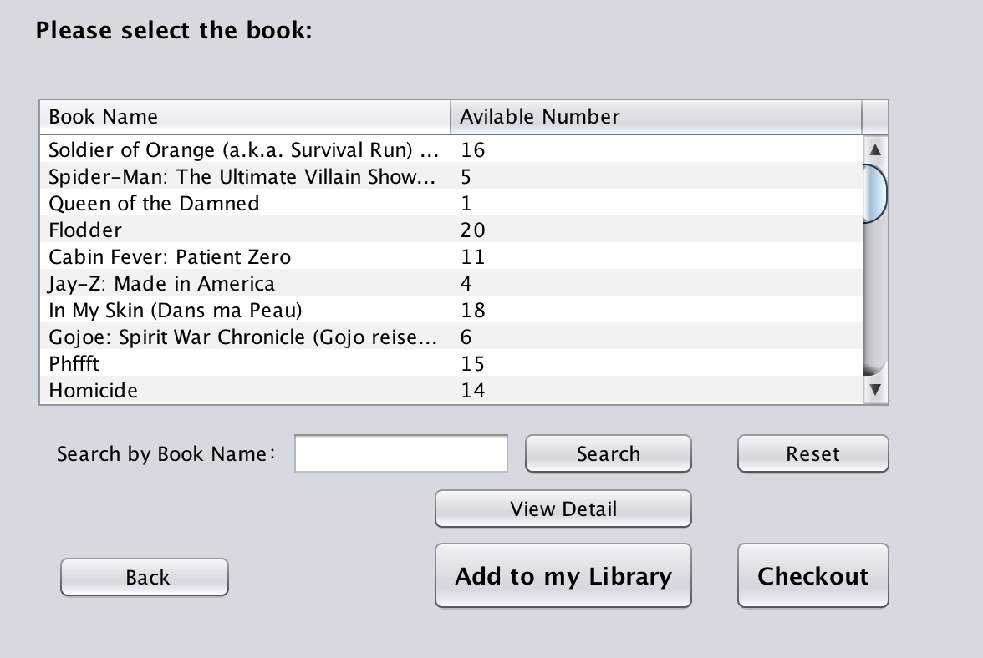
Functionalities ＆ Screenshots
Enterprise：Library
Organization： Student
Function：Search and add books to my
library

Slide 9
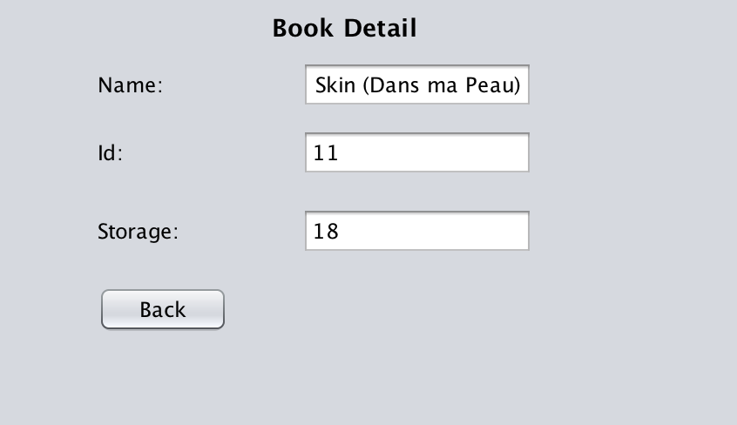
Functionalities ＆ Screenshots
Enterprise：Library
Organization： Student
Function：View book details

Slide 10
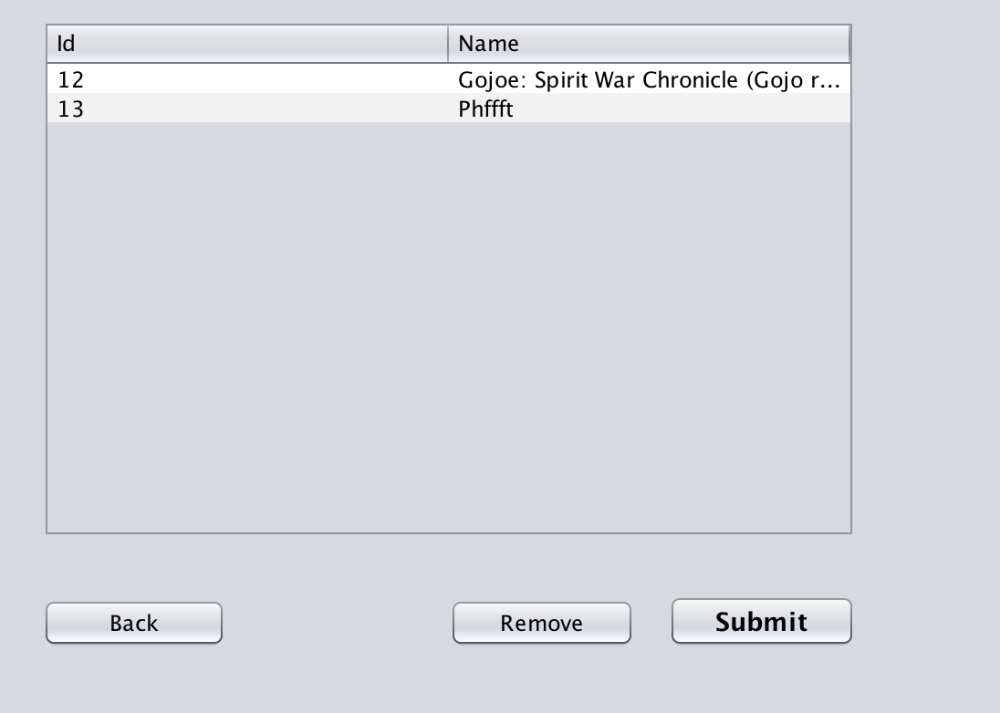
Functionalities ＆ Screenshots
Enterprise：Library
Organization： Student
Function：View book borrowing request

Slide 11
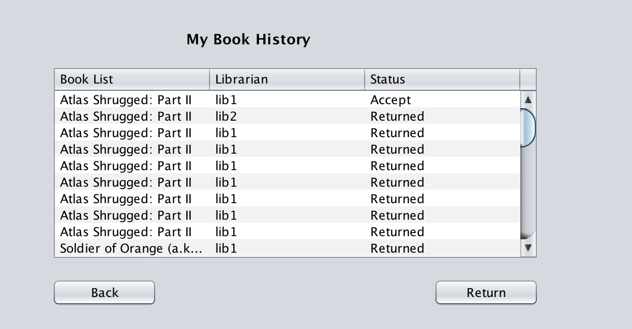
Functionalities ＆ Screenshots
Enterprise：Library
Organization： Student
Function：View book borrowing history

Slide 12
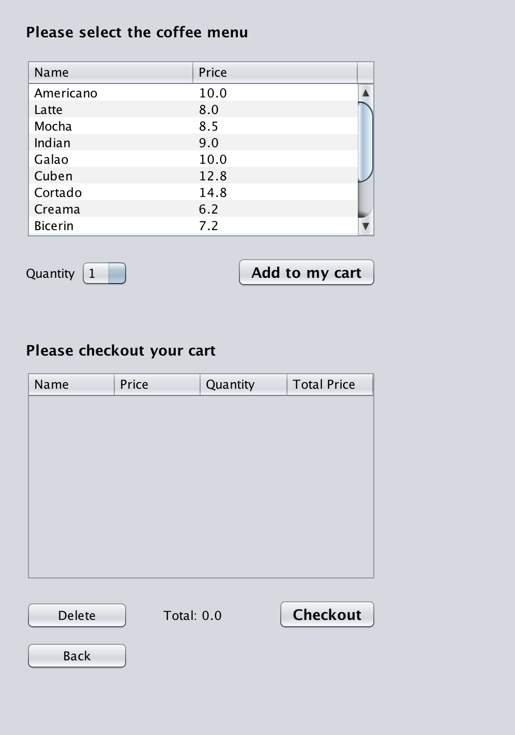
Functionalities ＆ Screenshots
Enterprise：Library
Organization： Student
Function：Order coffee and checkout

Slide 13
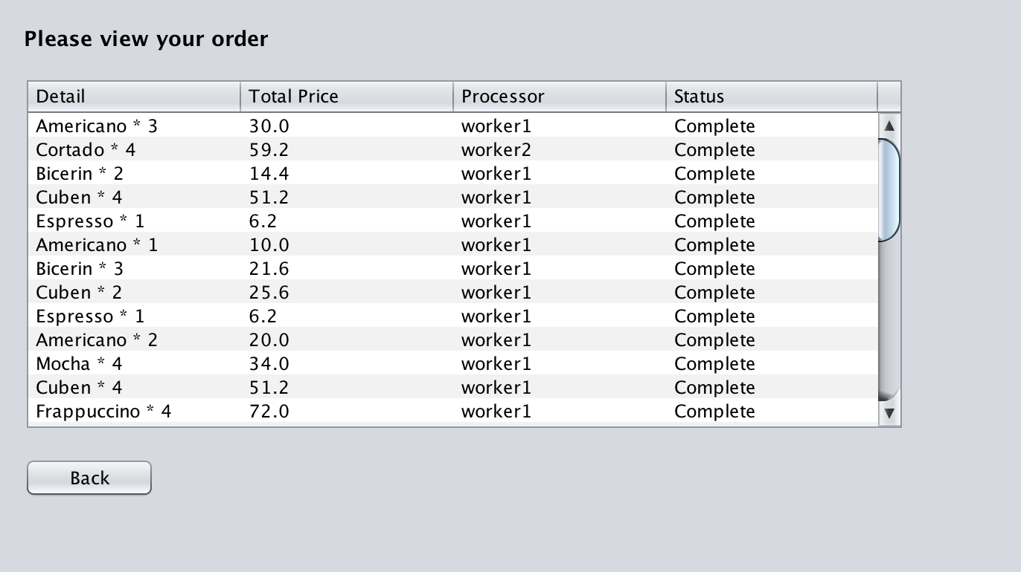
Functionalities ＆ Screenshots
Enterprise：Library
Organization： Student
Function：View coffee orders

Slide 14
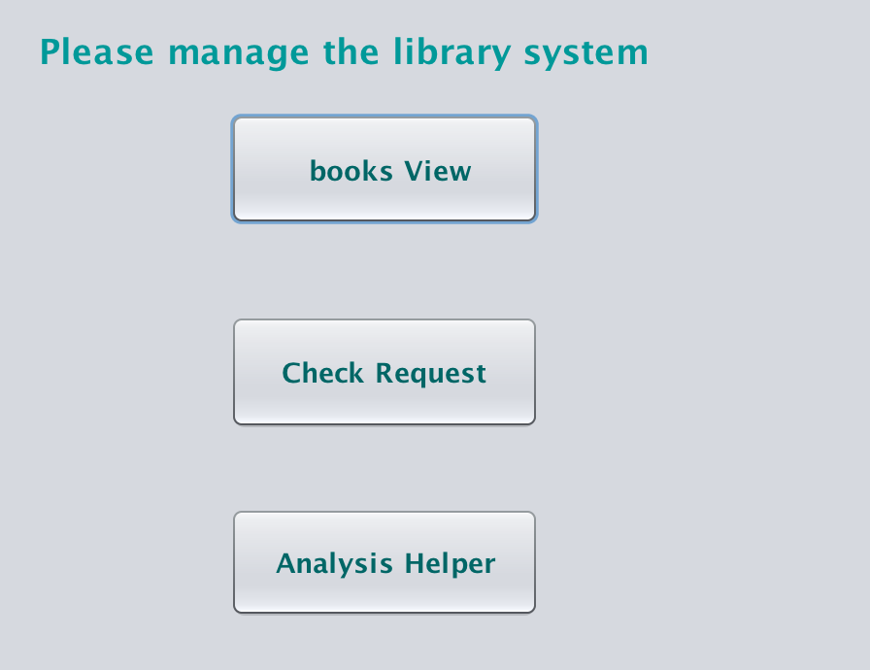
Functionalities ＆ Screenshots
Network: Neu
Enterprise：Library
Organization： Librarian

Slide 15
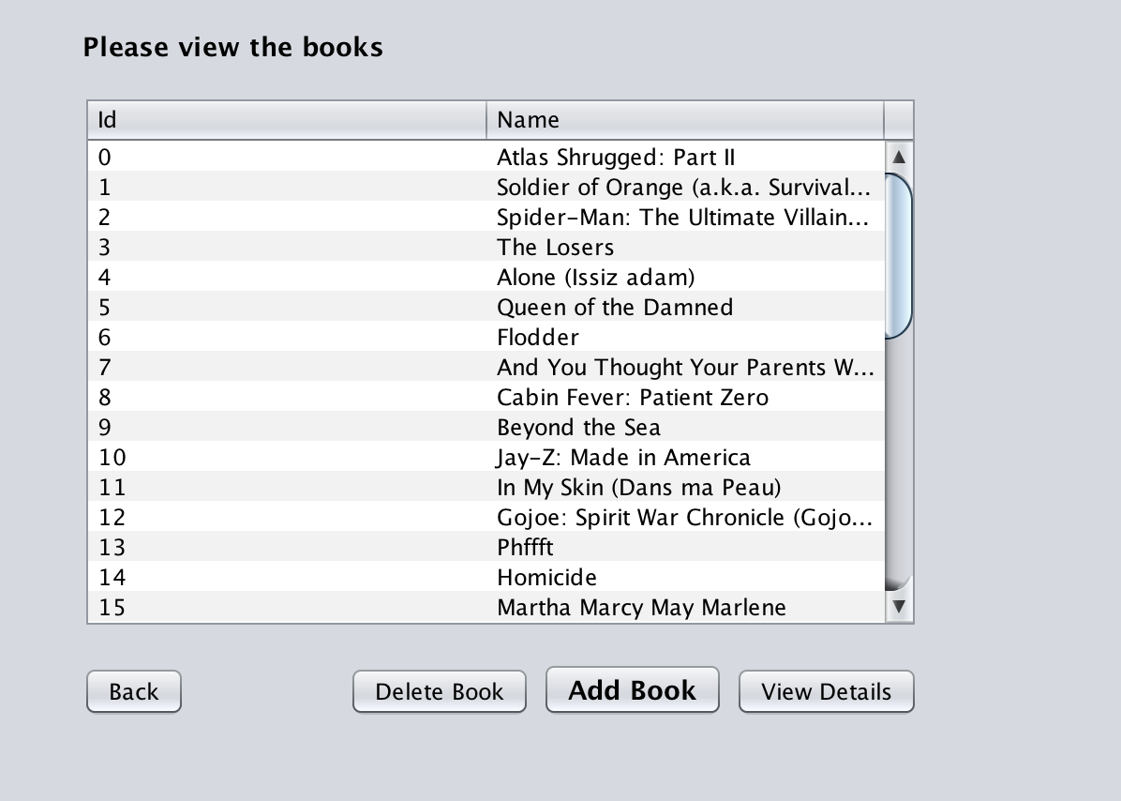
Functionalities ＆ Screenshots
Enterprise：Library
Organization： Librarian
Function：Add, delete and update books

Slide 16
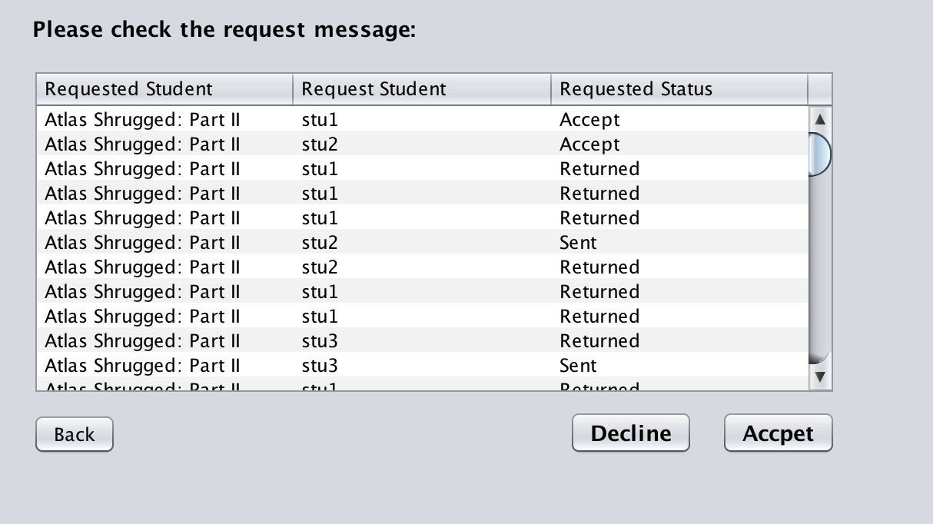
Functionalities ＆ Screenshots
Enterprise：Library
Organization： Librarian
Function：Accept or decline the books borrowed request from students

Slide 17
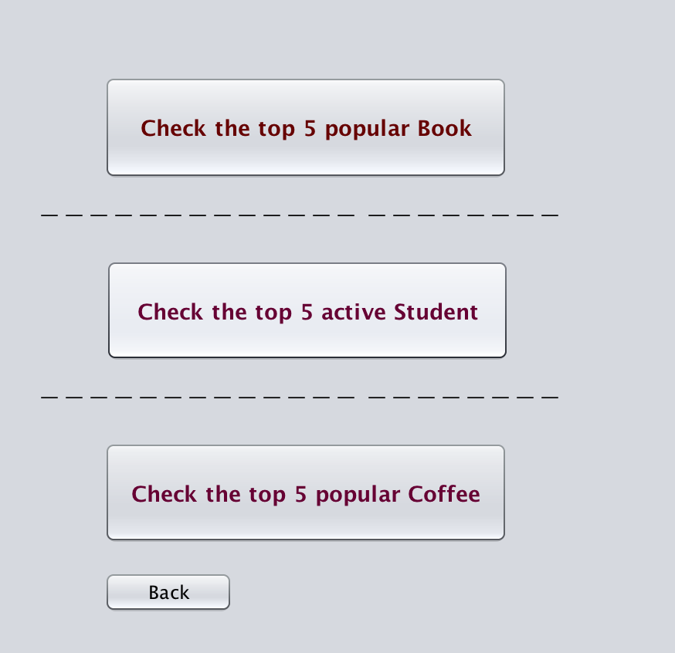
Functionalities ＆ Screenshots
Enterprise：Library
Organization： Librarian
Function：Check the data analysis records chart

Slide 18
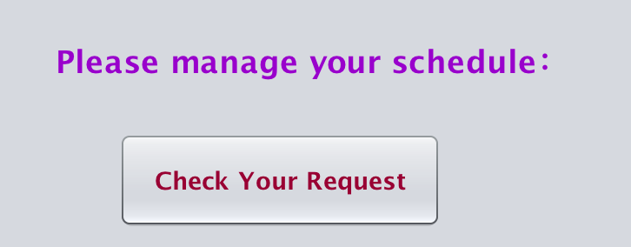
Functionalities ＆ Screenshots
Network: Neu
Enterprise：Library
Organization： Tutor

Slide 19
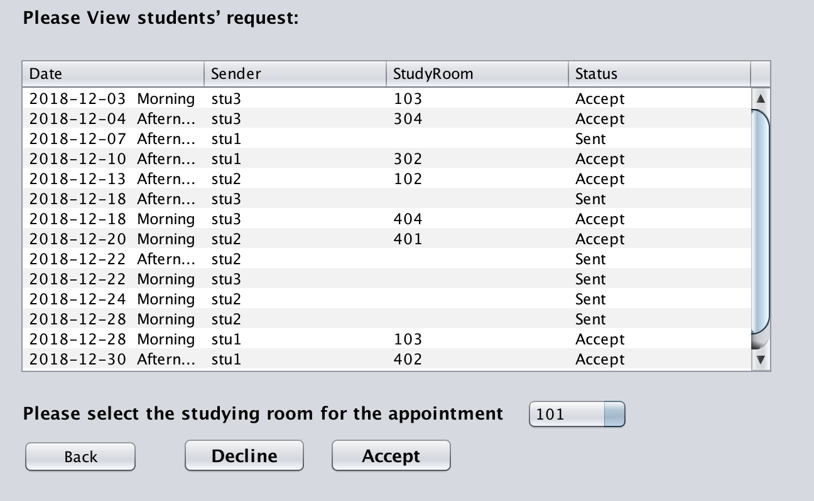
Functionalities ＆ Screenshots
Enterprise：Library
Organization： Tutor
Function：Accept or decline the appointment request from students

Slide 20
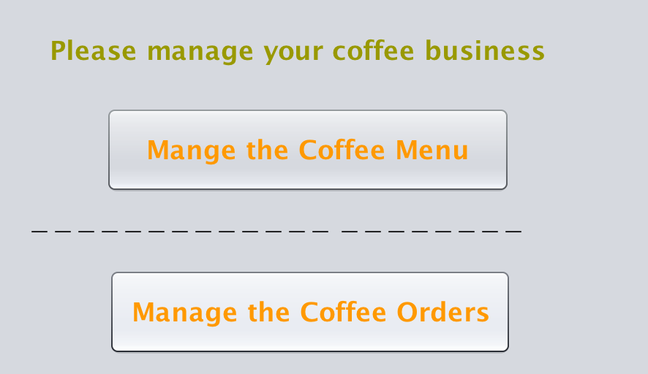
Functionalities ＆ Screenshots
Network: Neu
Enterprise：Cafe
Organization： Worker

Slide 21
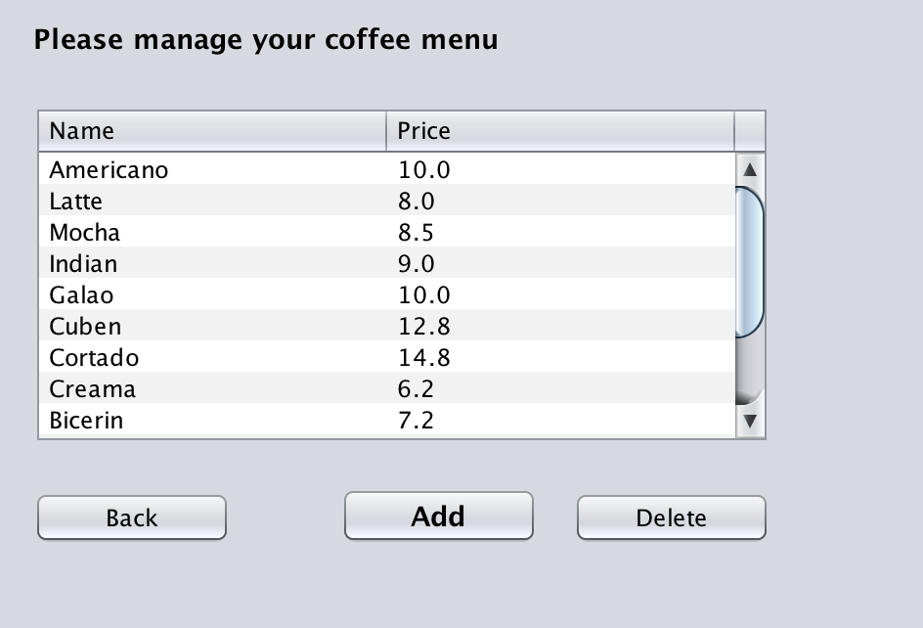
Functionalities ＆ Screenshots
Enterprise：Cafe
Organization： Worker
Function：Add or delete the coffee item

Slide 22
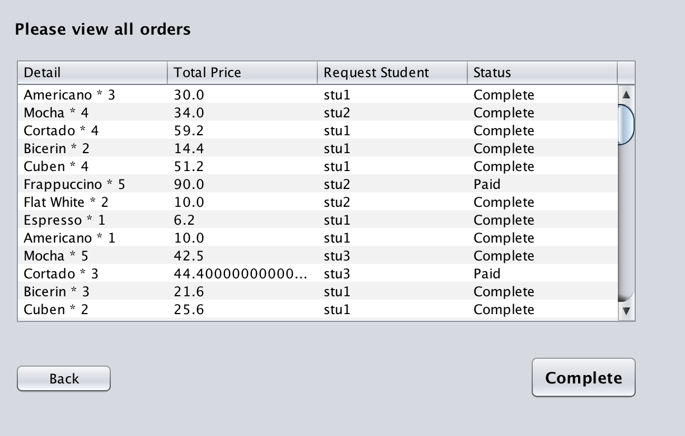
Functionalities ＆ Screenshots
Enterprise：Cafe
Organization： Worker
Function：Complete the coffee order from students

Slide 23
THANK YOU!
PRESENTED Winning pig

