Slide 1
Capstone: Find the best neighborhood in new York to open a Restaurant
Applied Data Science Capstone
IBM Data Science Professional Certificate

Slide 2

Introduction
New York is the one of the populous cities in United States
Largest metropolitan area in United States
Rapid growth of consumer market
International and multicultural city
Large Russian community due to heavy immigration in 1900s
https://www.pods.com/blog/2019/03/nyc-moving-guide-the-new-york-city-boroughs-explained/

Slide 3

Problem Statement
What is the best location for Russian cuisine in New York?
https://www.forbes.com/sites/jarretjackson/2020/08/12/as-a-leader-are-you-asking-the-right-questions/?sh=7c3c4bb26e7d

Slide 4
Data
New York data containing the neighborhoods and boroughs, latitudes, and longitudes will be obtained from the data source: https://cocl.us/new_york_dataset
All data related to locations and quality of Russian restaurants will be obtained via the FourSquare API utilized via the Request library in Python.

Slide 5
Methodology
Data will be collected from https://cocl.us/new_york_dataset and cleaned and processed into a dataframe.
FourSquare be used to locate all venues and then filtered by Russian restaurants. Ratings, tips, and likes by users will be counted and added to the dataframe.
Data will be sorted based on rankings.
Finally, the data will be visually assessed using graphing from Python libraries.

Slide 6
Results
Data will be collected from https://cocl.us/new_york_dataset and cleaned and processed into a dataframe.
FourSquare be used to locate all venues and then filtered by Russian restaurants. Ratings, tips, and likes by users will be counted and added to the dataframe.
Data will be sorted based on rankings.
Finally, the data will be visually assessed using graphing from Python libraries.

Slide 7
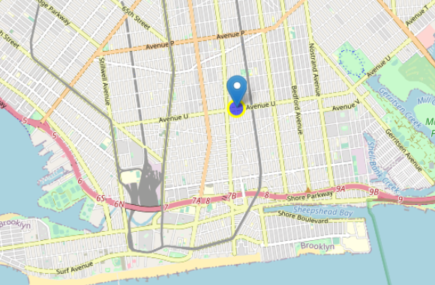
Results cont’d
Map plot of the best location of the Russian restaurant

Slide 8
Discussion
To have the successful business, I would open a Russian restaurant in Brooklyn. Brooklyn has multiple neighborhoods with approximate rating of 8.0. Moreover, since the Brooklyn neighborhood is known for high population of Russian-speaking immigrants, opening the restaurant in that area would attract many Russians locals as well as other visitors interested in Russian cuisine.

Slide 9
Conclusion
In conclusion, I would say that Brooklyn would be the best location to open the restaurant for the Russian cuisine in NYC based on the number of restaurants, ratings and immigration history of Russians.

