Slide 1
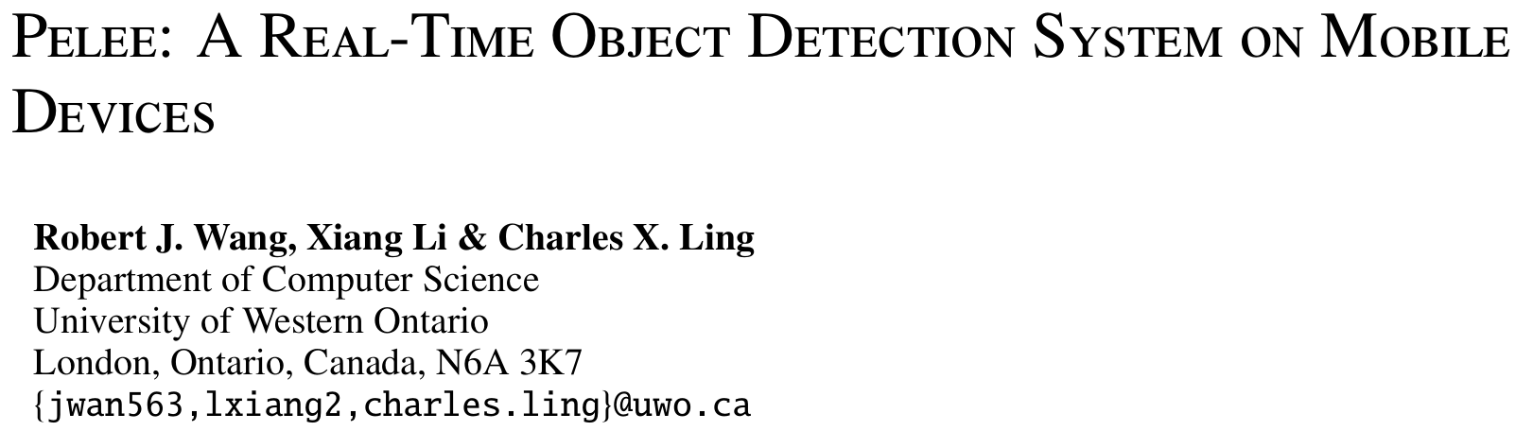
NIPS 2018

Slide 2
Motivation
Strict constraints on memory and computational budget on mobile devices
MobileNets，ShuffleNet，MobileNetV2 etc. heavily dependent on depthwise separable convolution which lacks efficient implementation
Propose a variant of DenseNet architecture

Slide 3
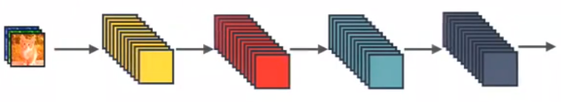
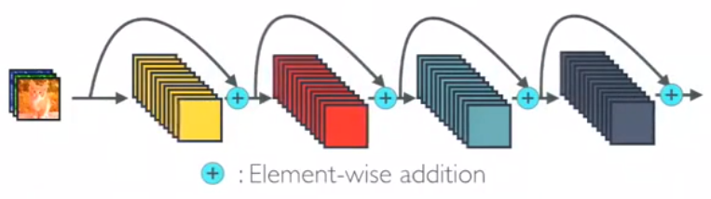
ResNet
Standard ConvNet

Slide 4
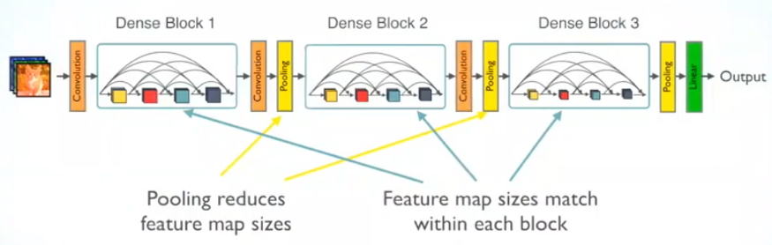
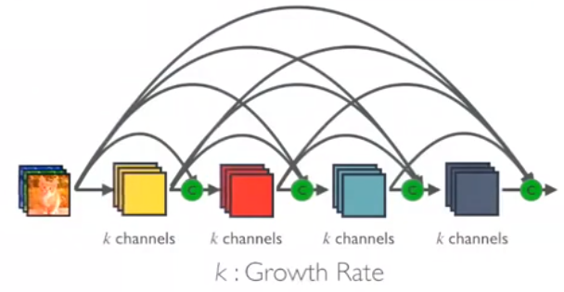
DenseNet
DenseNet
Dense Block in DenseNet with Growth Rate k
Stem Convolution
Dense Block with Growth Rate k

Slide 5
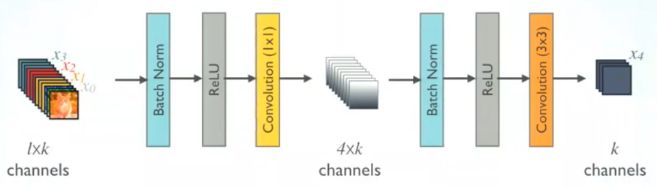
DenseNet
DenseBlock
DenseLayer（first）

Slide 6
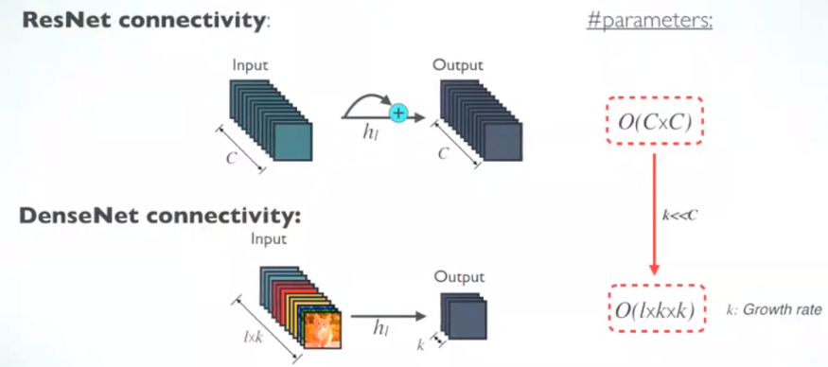
DenseNet
Advantages:
Strong Gradient Flow, “Deep Supervision”
Parameter & Computational Efficiency
More Diversified Features

Slide 7
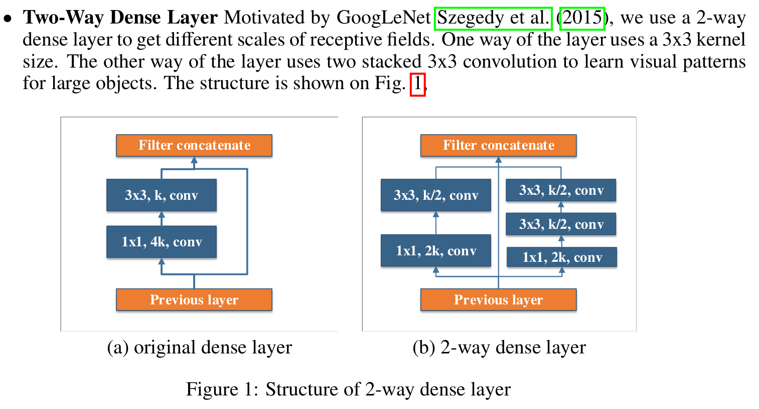


PeleeNet
$$4k*k=4kk$$
$$2k*k/2+2k*k/2+k/2*k/2=2.25kk$$

Slide 8
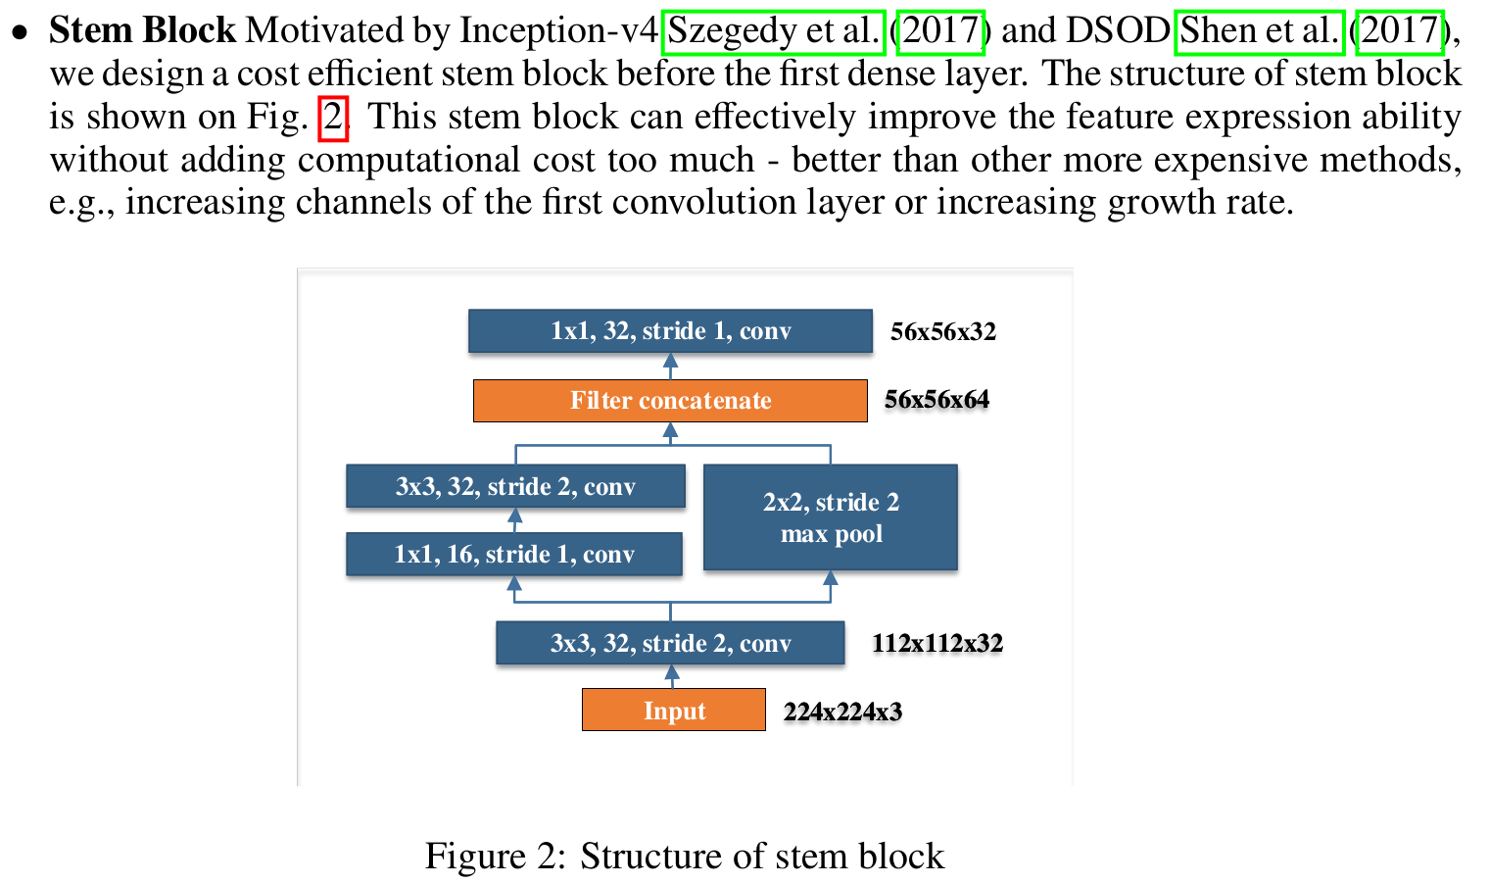
PeleeNet

Slide 9
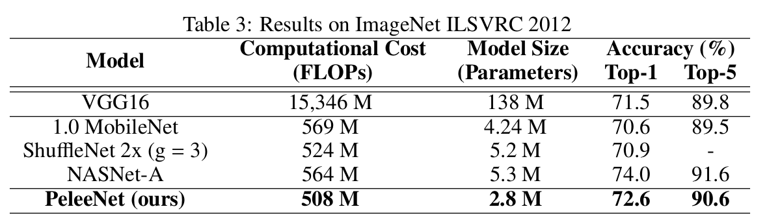
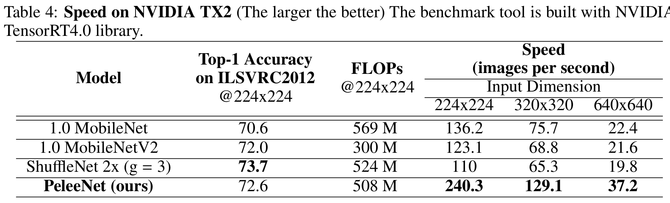
Performance

