Slide 1
An Unsupervised-Learning-Based Approach for
Automated Defect Inspection on Textured Surfaces
Shuang Mei, Hua Yang , Member, IEEE, and Zhouping Yin, Member, IEEE

Slide 2
Main Contribution
An unsupervised novel defect inspection method which can be trained with only defect-free samples is proposed.
This method is implemented in a multimodal form. (Pyramid layers with various resolutions contain different textural information and can be viewed as multiple modalities.) This strategy is able to enhance robustness and accuracy of the method.

Slide 3
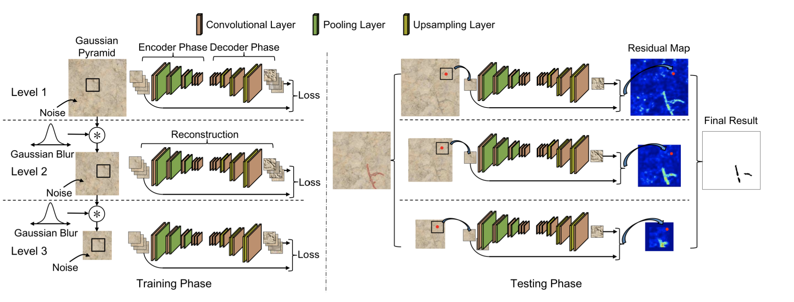
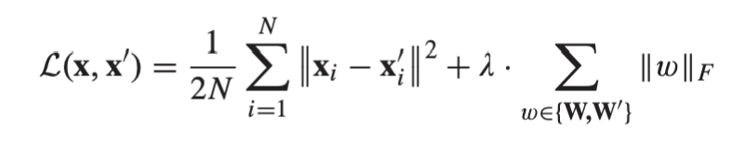
Method
Multiscale convolutional denoising Auto Encoder (MSCDAE)

Slide 4
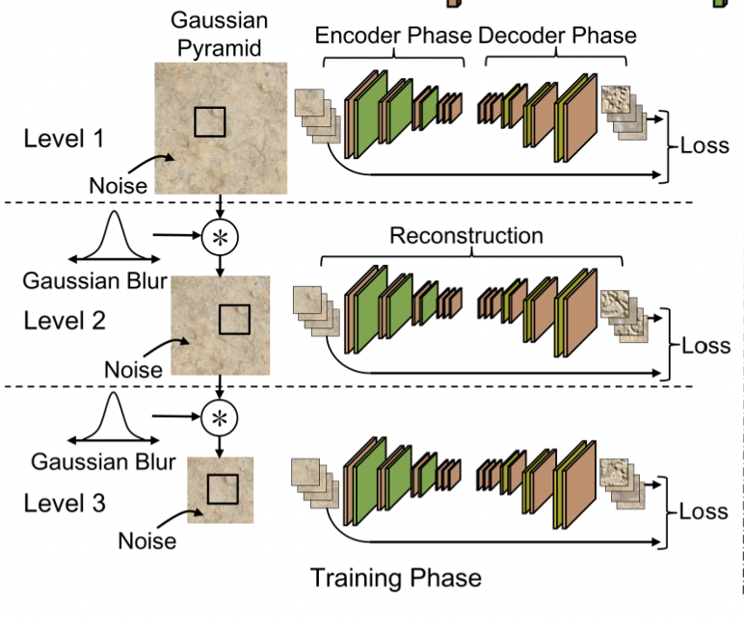
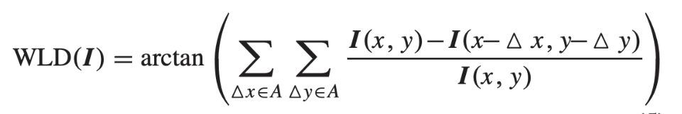
MSCDAE Model Training
Image Preprocessing:
a) Illumination normalization
b) Gaussian pyramid downsampling
c) Noise corruption

Slide 5
MSCDAE Model Training
Patch Extraction
For pixelwise prediction, characterizing a pixel based on local neighborhood information can be more robust than using only a single pixel.

Slide 6
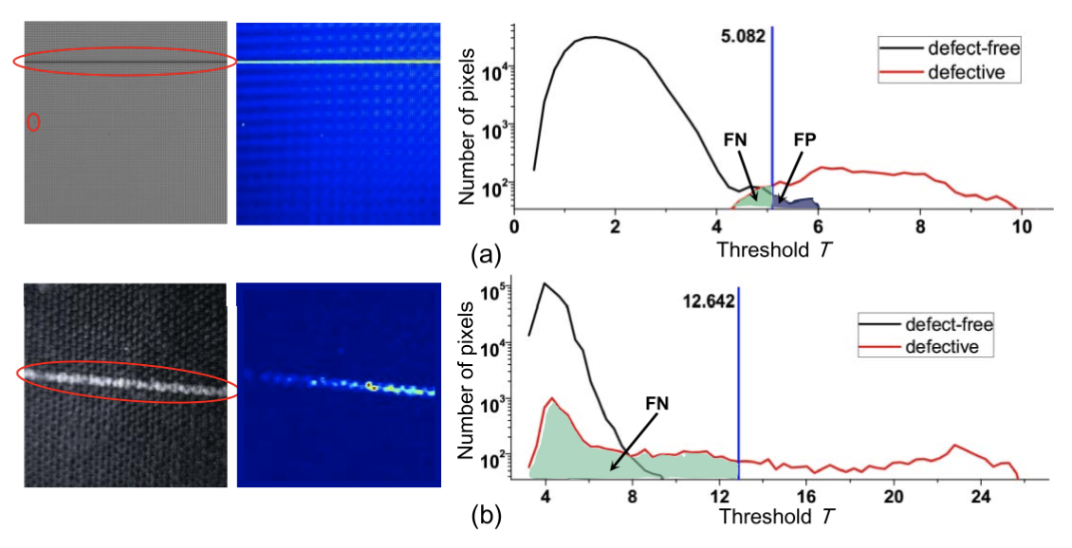
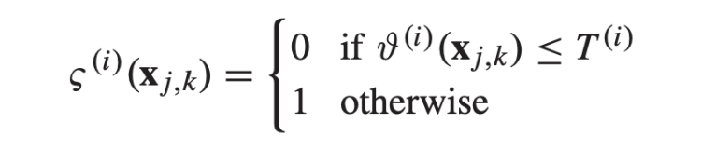
MSCDAE Model Training
Training and Threshold Determination

Slide 7
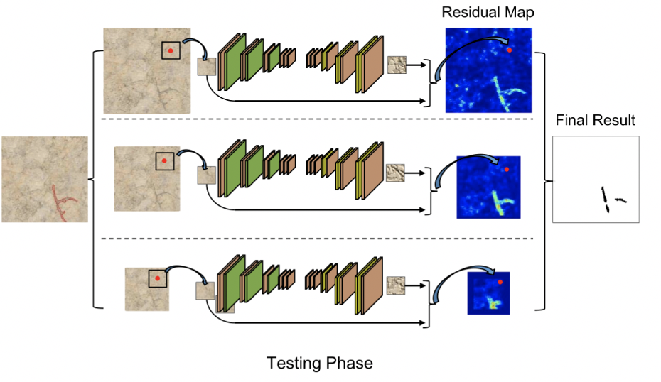
MSCDAE Model Testing
—Image Preprocessing
a) Illumination normalization
b) Gaussian pyramid downsampling
—Patch Extraction

Slide 8
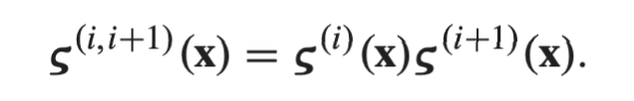

MSCDAE Model Testing
—Residual Map Construction
—Defect Segmentation
—Result Synthesization

Slide 9
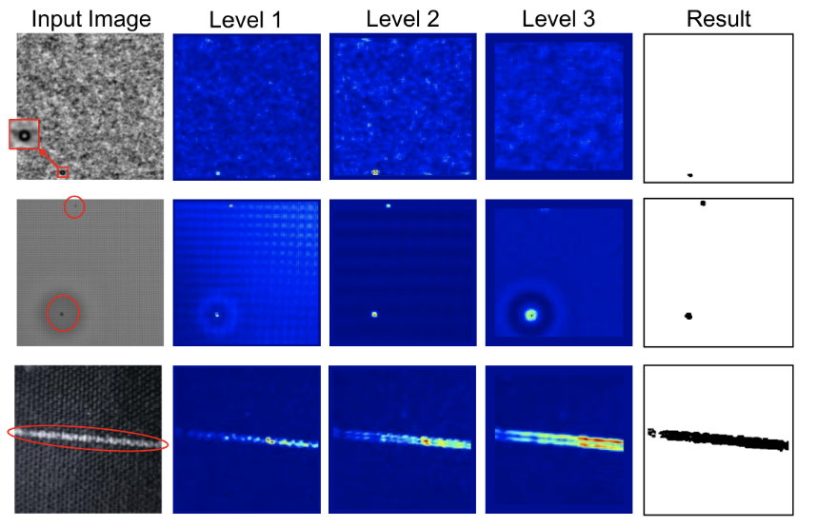
Results

Slide 10
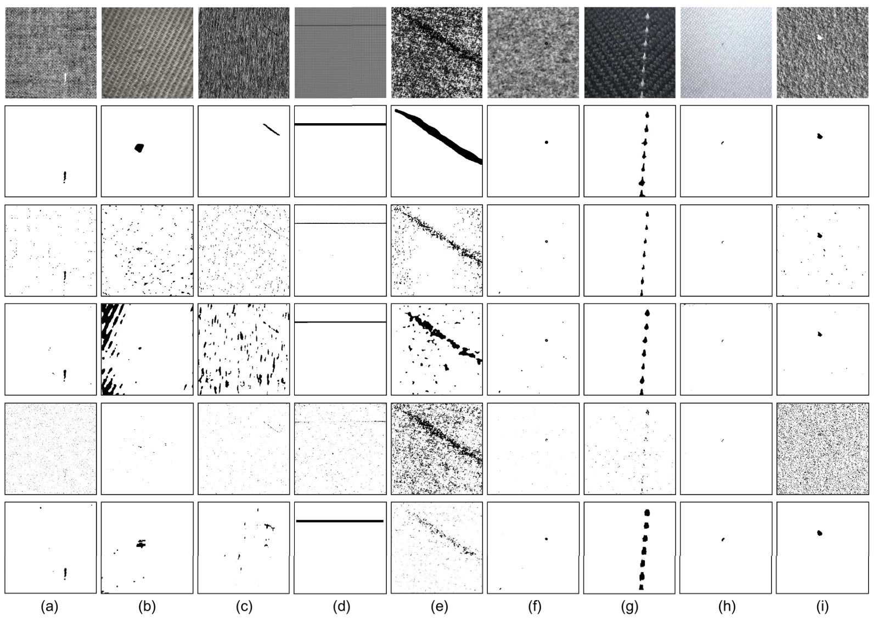
Results

Slide 11
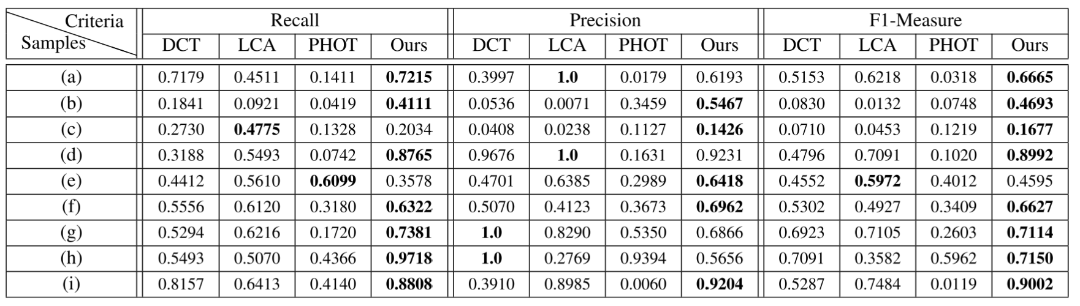
Results

