Slide 1
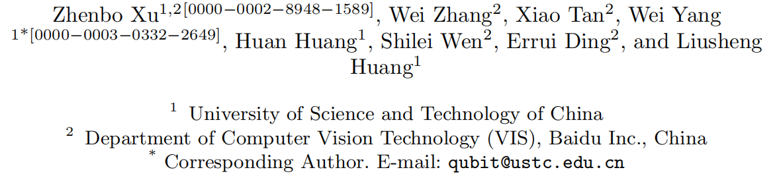
Segment as Points for Efficient Online Multi-Object Tracking and Segmentation

Slide 2
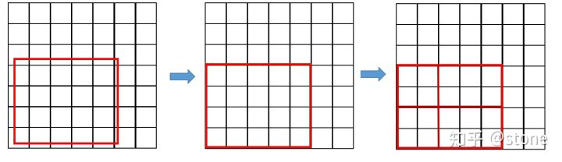
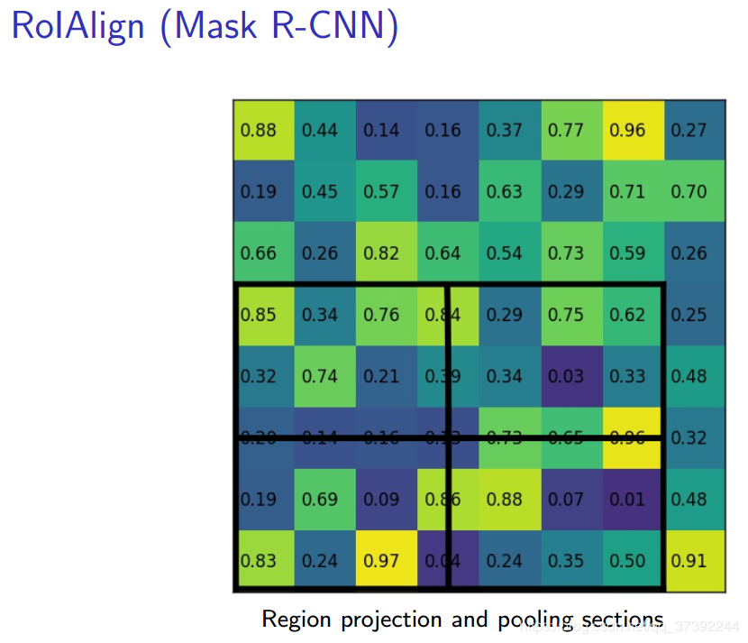
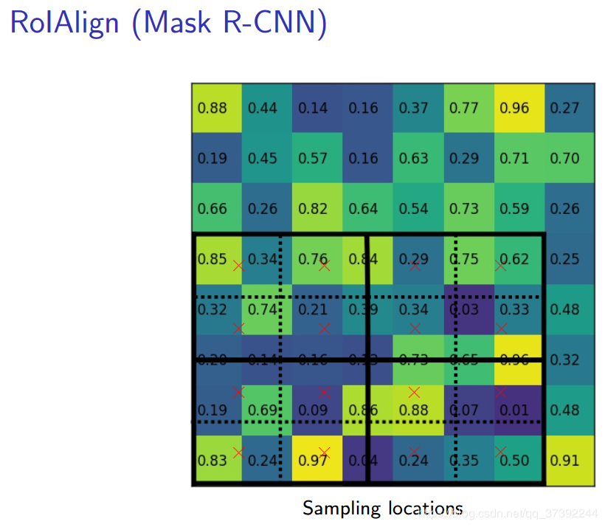
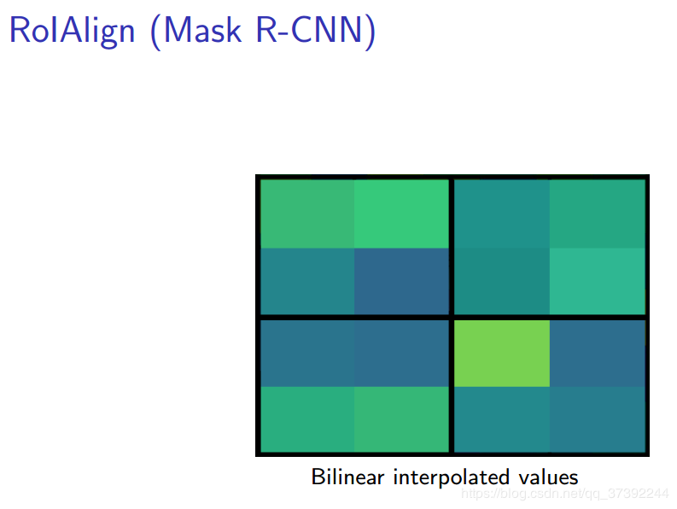
tracking-by-detection
RoIPool
RoIAlign

Slide 3
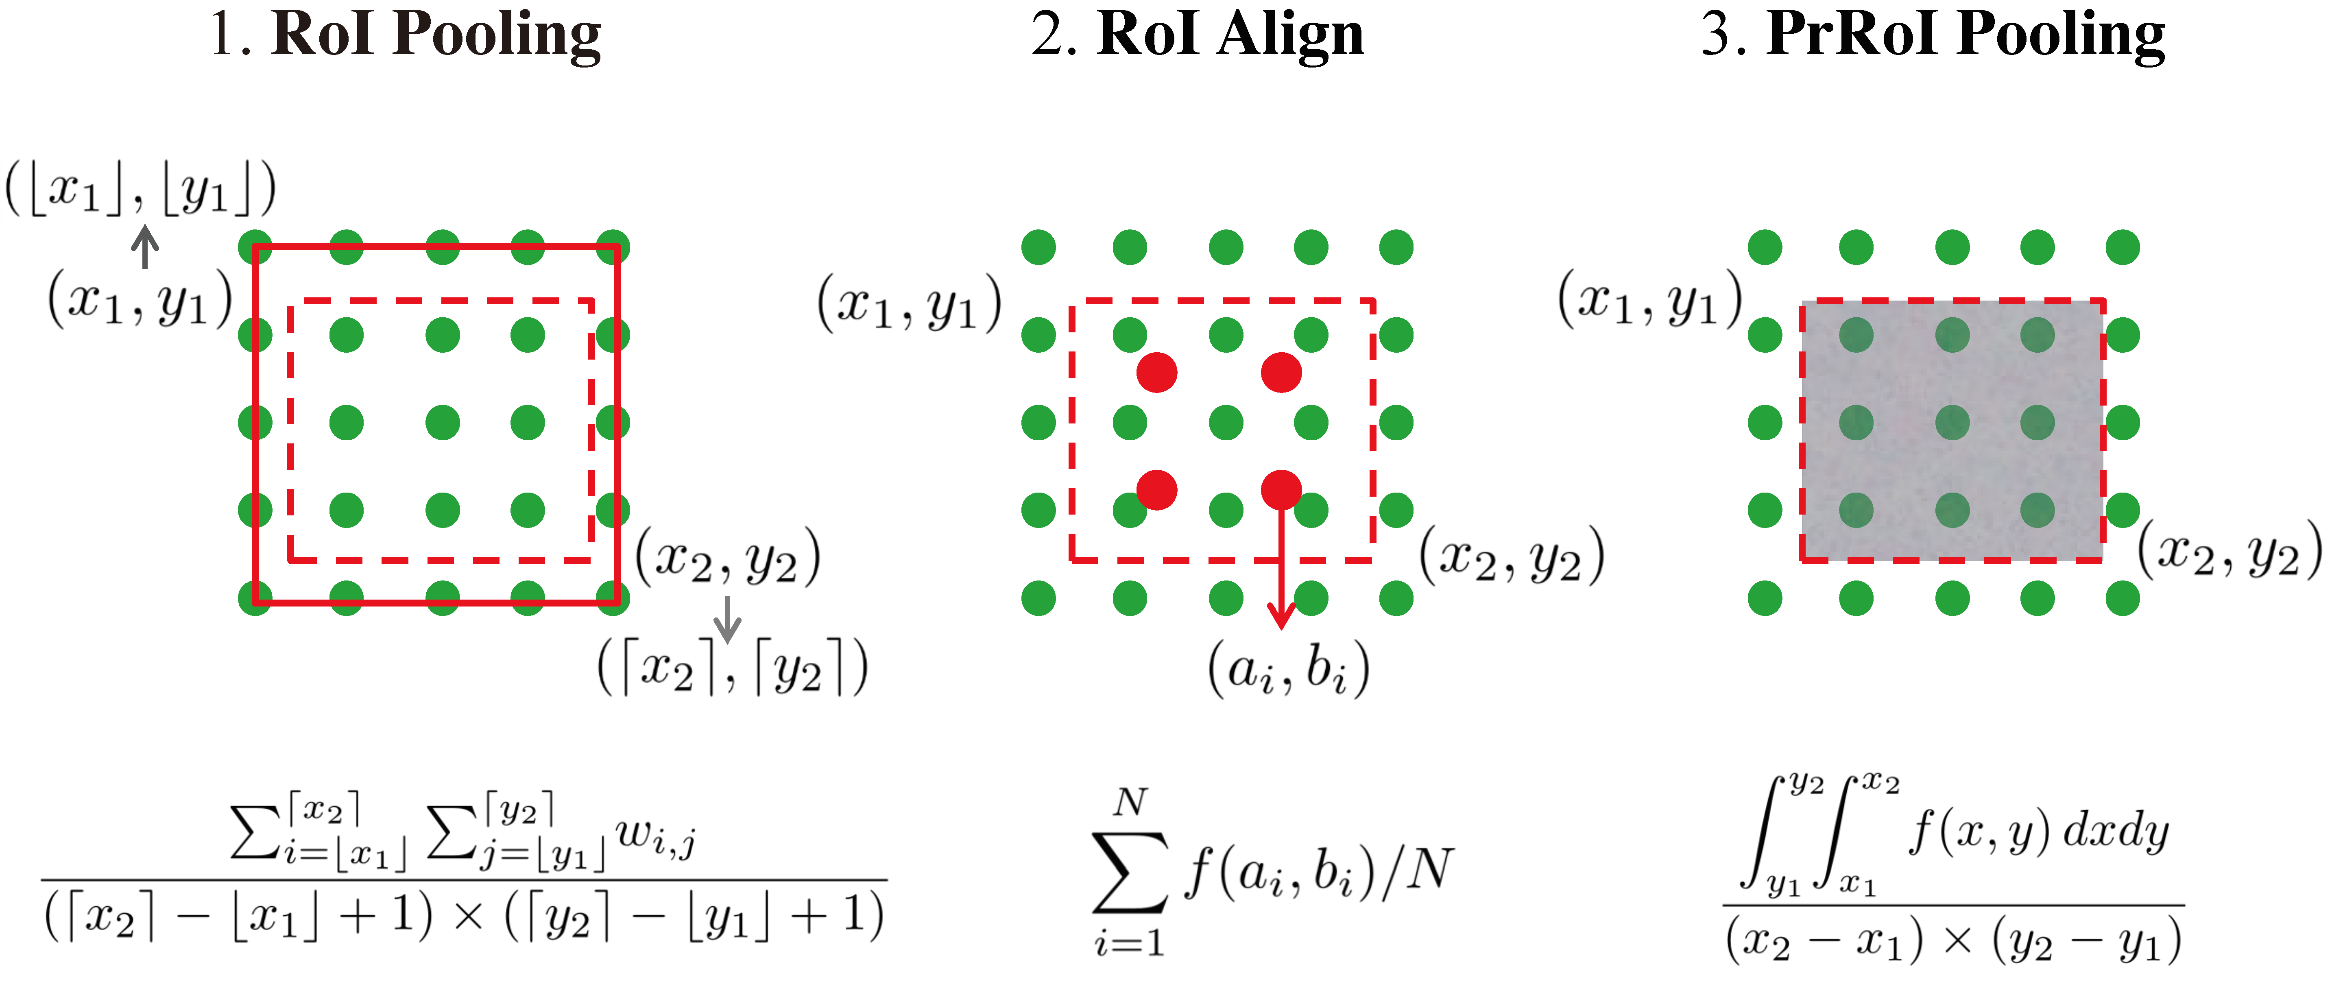

tracking-by-detection
4. Mask Pooling

Slide 4
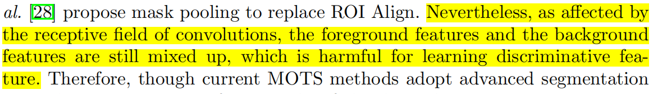
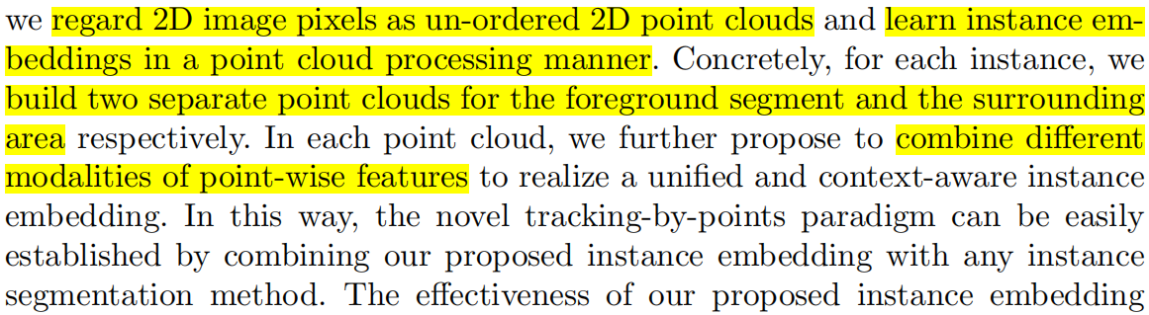
tracking-by-points

Slide 5
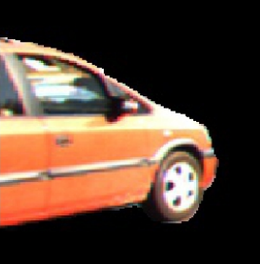
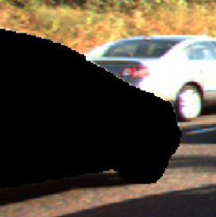
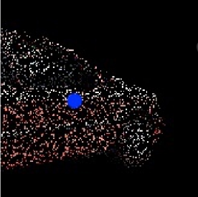

tracking-by-points
前景图像
背景图像
前景点+中心点（1000）
环境点（500）

Slide 6


tracking-by-points
Offset: Scale+Shape
Color: Appearance
Category: Nearby objects
Position: Position

Slide 7
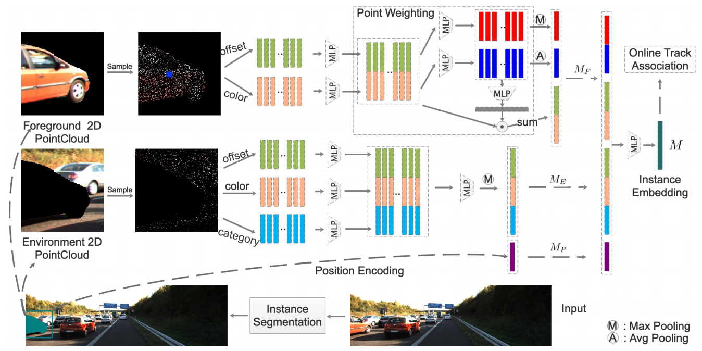
tracking-by-points

Slide 8
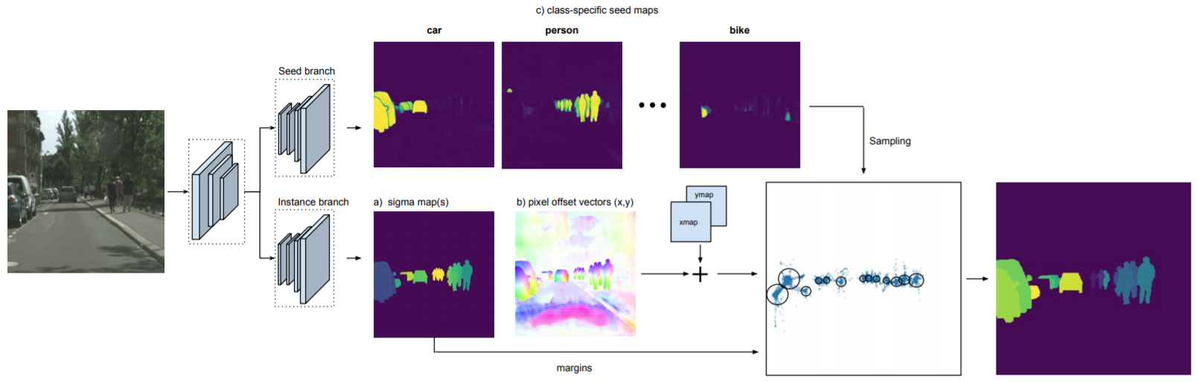
tracking-by-points
Instance Segmentation by Jointly Optimizing Spatial Embeddings and Clustering Bandwidth

Slide 9
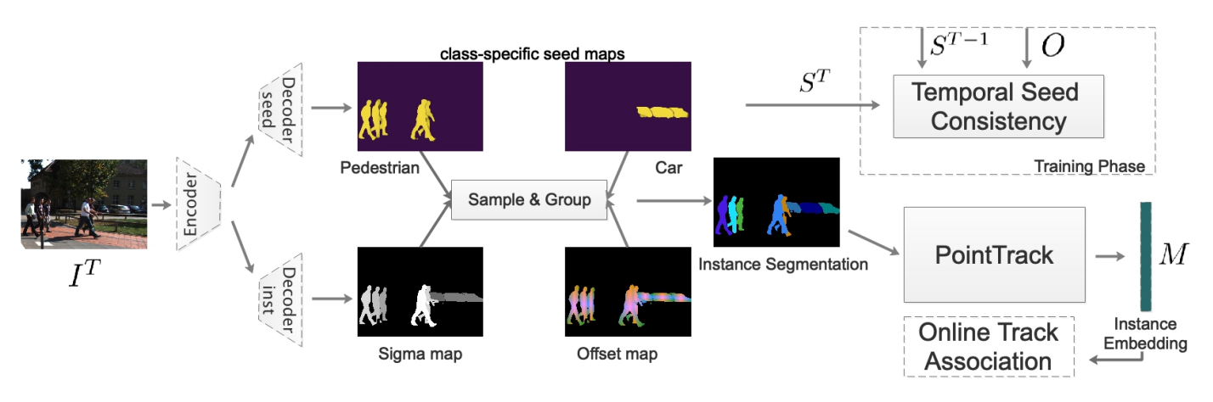
tracking-by-points

Slide 10
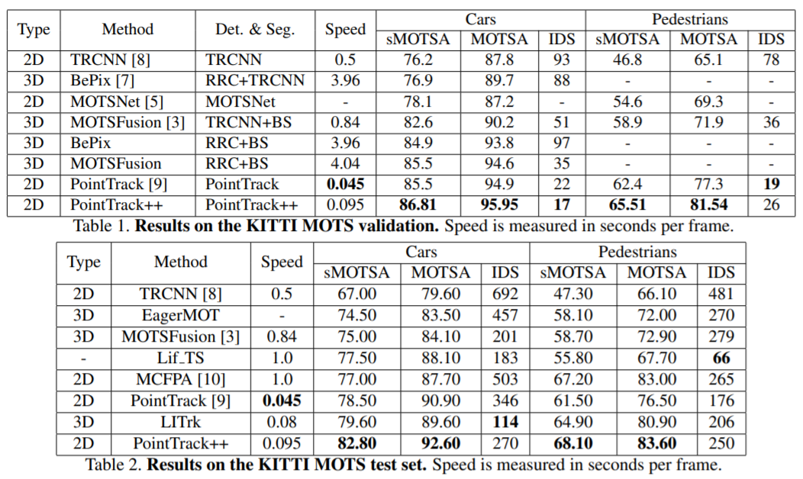
tracking-by-points

