Slide 1
Momentum Contrast for Unsupervised Visual Representation Learning
Kaiming He Haoqi Fan Yuxin Wu Saining Xie Ross Girshick
Facebook AI Research (FAIR)
Code: https://github.com/facebookresearch/moco

Slide 2
Background
Several recent studies present promising results on unsupervised visual representation learning using approaches related to the contrastive loss. Though driven by various motivations, these methods can be thought of as building dynamic dictionaries. The “keys” (tokens) in the dictionary are sampled from data (e.g., images or patches) and are represented by an encoder network. Unsupervised learning trains encoders to perform dictionary look-up: an encoded “query” should be similar to its matching key and dissimilar to others. Learning is formulated as minimizing a contrastive loss.

Slide 3
Motivation
Two key elements of dictionary:
Large:
Intuitively, a larger dictionary may better sample the underlying continuous, high dimensional visual space.
Consistent:
the keys in the dictionary should be represented by the same or similar encoder so that their comparisons to the query are consistent.
However, existing methods that use contrastive losses can be limited in one of these two aspects.

Slide 4
Contributions
Based on above problems, author presents MoCo as a way of building large and consistent dictionaries for unsupervised learning with a contrastive loss.

Slide 5
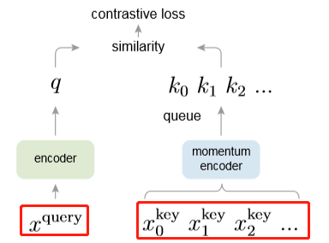
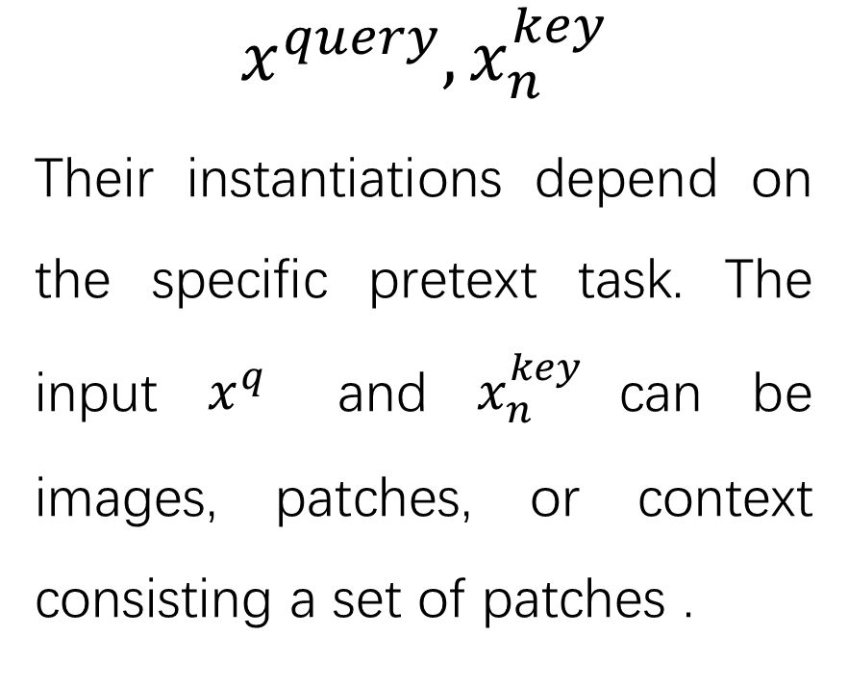
Method
$$x^{query},x_{n}^{key}$$
Their instantiations depend on the specific pretext task. The input $x^{q}$ and $x_{n}^{key}$can be images, patches, or context consisting a set of patches .

Slide 6


$$x^{query},x_{n}^{key}$$
aug
set
aug
$$x^{query}$$
set

Slide 7
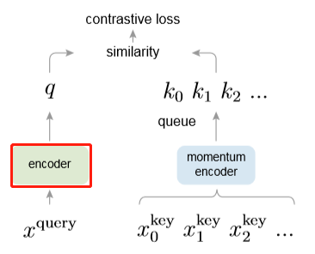
Method
encoder
Their instantiations depend on the specific pretext task.
e.g.
In corruption image recover
encoder means the network to
filter out flaws.

Slide 8
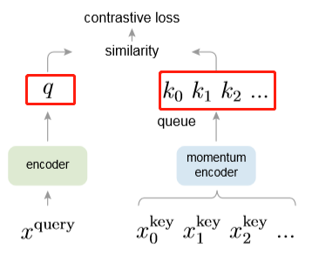

Method
query, keys
The representation(e.g. features) of $x^{query}$ and $x_{n}^{key}$.

Slide 9
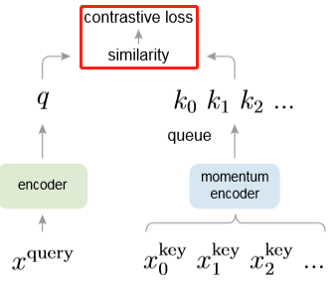

Method
contrastive loss
A contrastive loss is a function whose value is low when q is similar to its positive key k+ and dissimilar to all other keys.

Slide 10
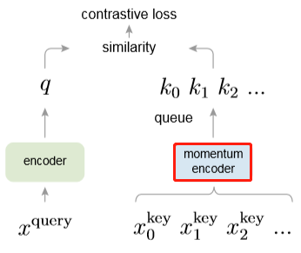
Method
momentum encoder
Why momentum?
Using a queue can make the dictionary large, but it also makes it intractable to update the key encoder by back-propagation (the gradient should propagate to all samples in the queue). A naive solution is to copy the key encoder fk from the query encoder fq, ignoring this gradient. But this solution yields poor results in experiments. We hypothesize that such failure is caused by the rapidly changing encoder that reduces the key representations’ consistency.

Slide 11
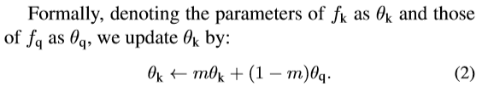

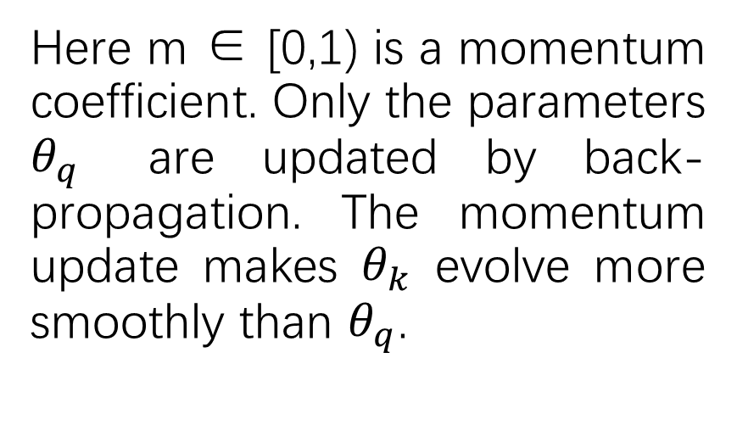
Method
Here m ∈ [0,1) is a momentum coefficient. Only the parameters $θ_{q}$ are updated by back-propagation. The momentum update makes $θ_{k}$ evolve more smoothly than $θ_{q}$.

Slide 12
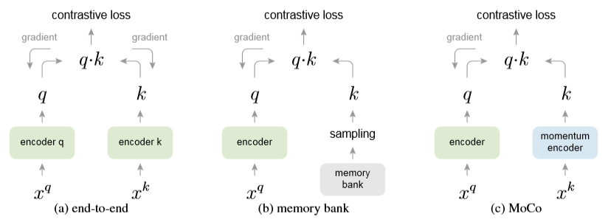
comparison
v
Limited Dictionary size
Inconsistency of keys

Slide 13
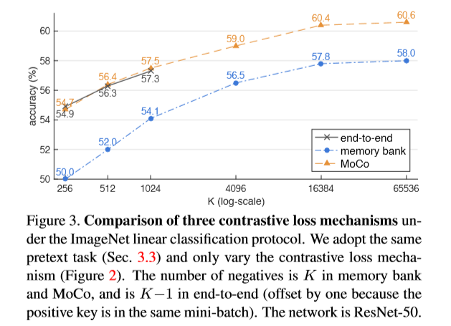
Experiments on different contrastive loss mechanism

Slide 14
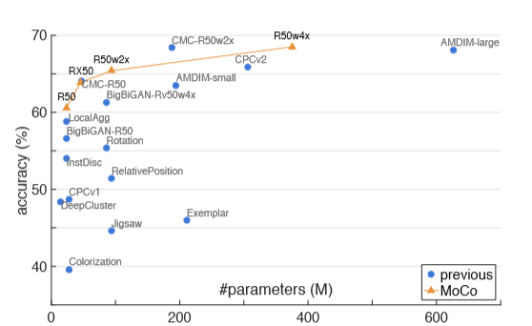
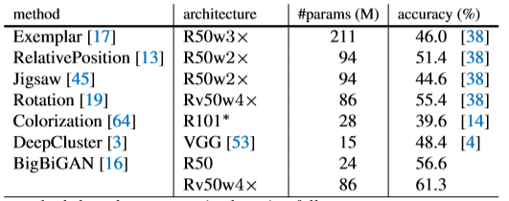
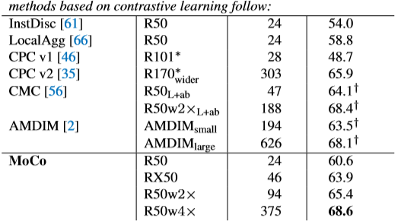
Experiments on Linear classification

Slide 15
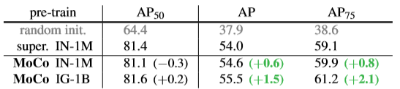
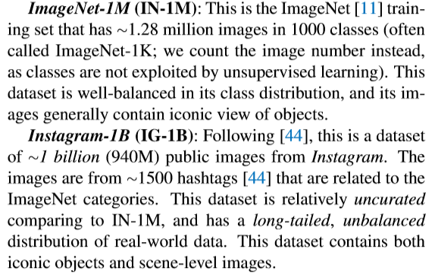
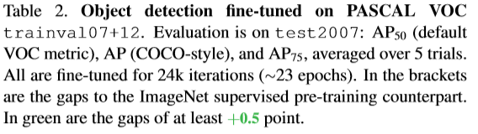
Experiments on Object detection

