Slide 1
Unsupervised Anomaly Detetion(UAD)
龚石
2020.8.15

Slide 2
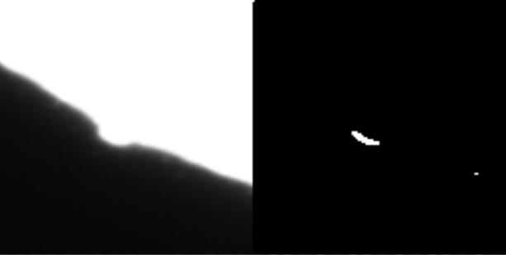
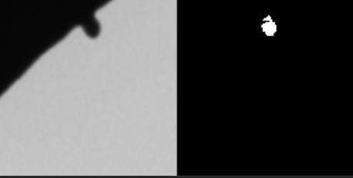
Background
任务: 确定是否为缺陷图像以及缺陷的位置
UDA: 训练数据只包含正常图像 or 未标记的正常和缺陷图像

Slide 3
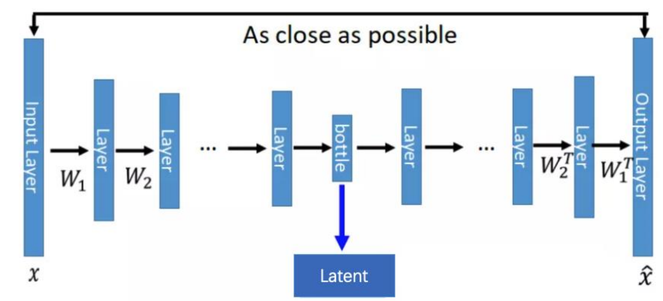
基于自编码器的方法
用正样本的数据集训练一个Variational Autoencoder
用训练出的Variational Autoencoder计算异常数据的重建误差，重建误差大于某个阀值α，则为异常

Slide 4
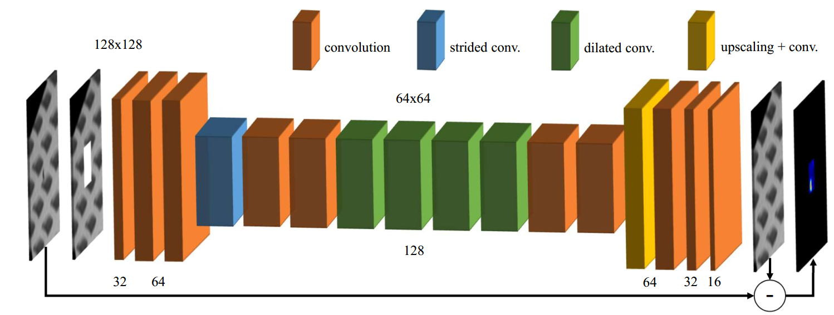
基于图像恢复的方法
对正样本添加窗口噪声, 训练一个网络恢复出窗口中的像素值
测试时通过滑动窗口,重建出整张图, 重建误差大于某个阀值α，则为异常

Slide 5
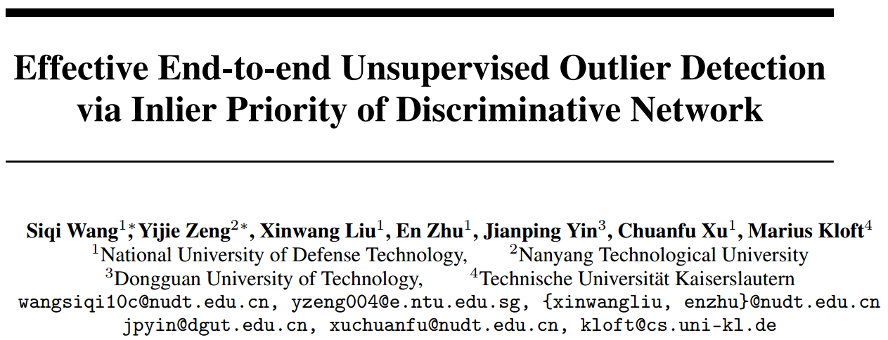
Effective End-to-end Unsupervised Outlier Detection via Inlier Priority of Discriminative Network, NIPS 2018

Slide 6
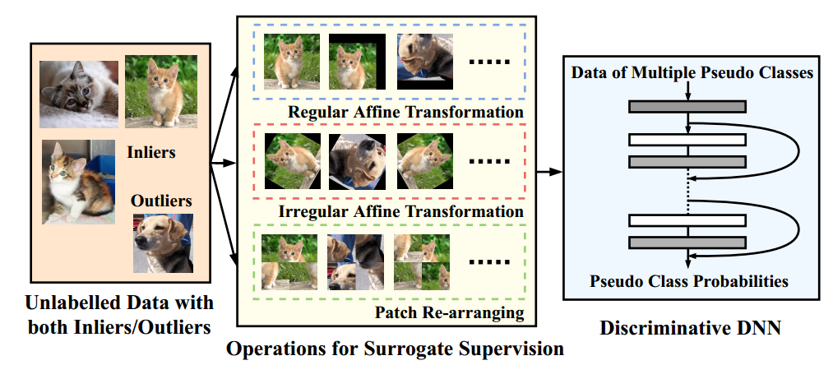
Surrogate Supervision
Existing DNN based UDAmethods rely on auto-encoder(AE)
AE focus on reducing low-level pixel-wise error that is not sensitive to human perception, rather than learning high-level semantic features.
Pseudo label: a combination of one or more basic transformations
Rotation
Flip
Shifting
Patch re-arranging
Effective End-to-end Unsupervised Outlier Detection via Inlier Priority of Discriminative Network, NIPS 2018

Slide 7
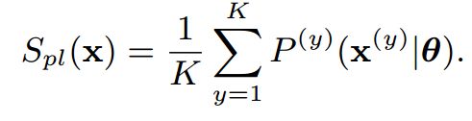
Inlier Priority
Due to inliers is much more than outliers during training, model will prioritize the minimization of inliers’ loss.
Scoring:
Effective End-to-end Unsupervised Outlier Detection via Inlier Priority of Discriminative Network, NIPS 2018

Slide 8
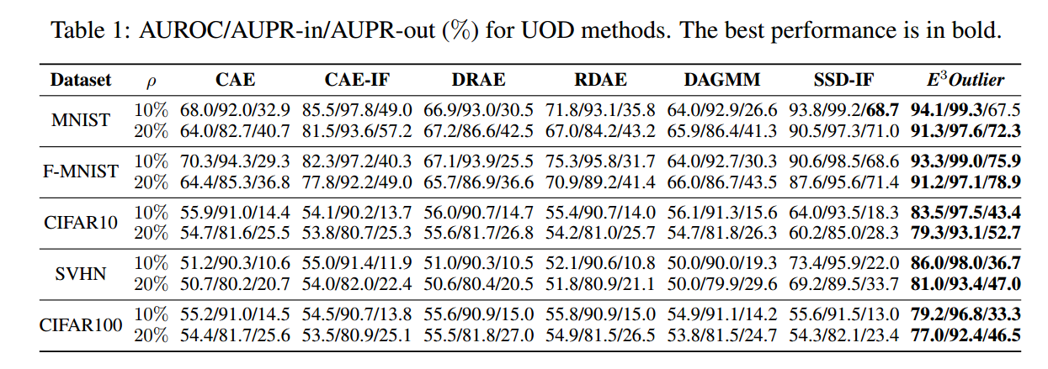
Performance

