Slide 1

CVPR 2020
Speaker: XingLi

Slide 2
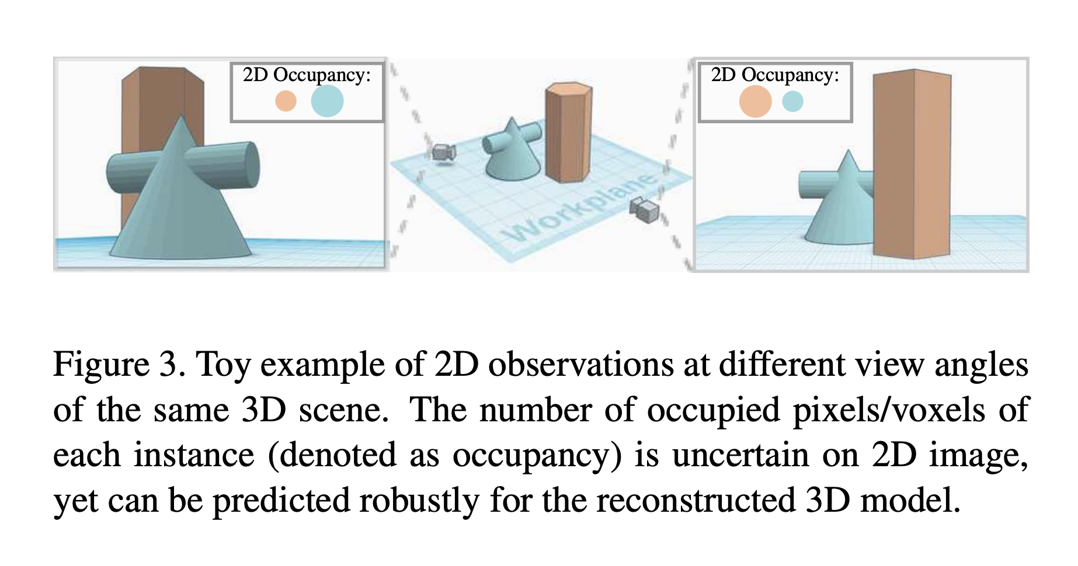
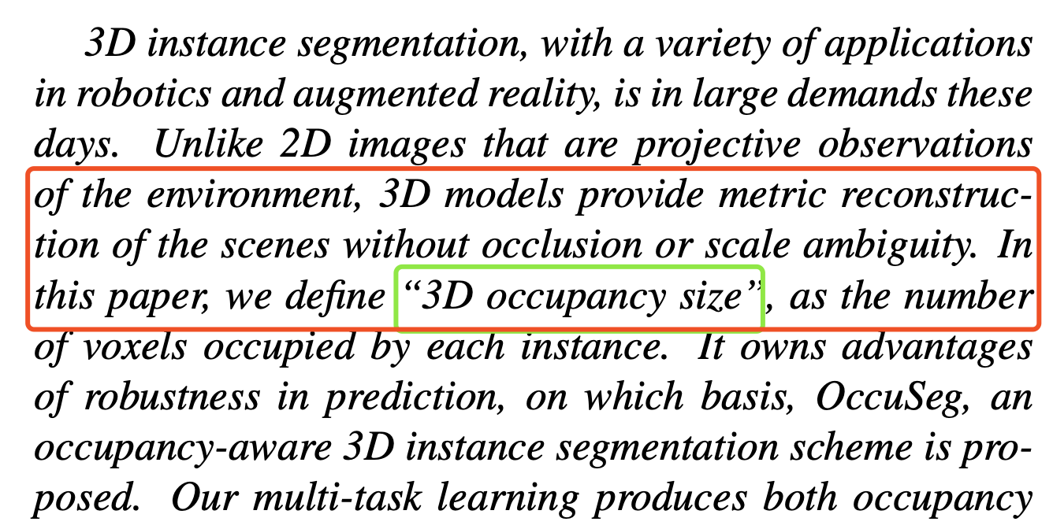
motivation

Slide 3
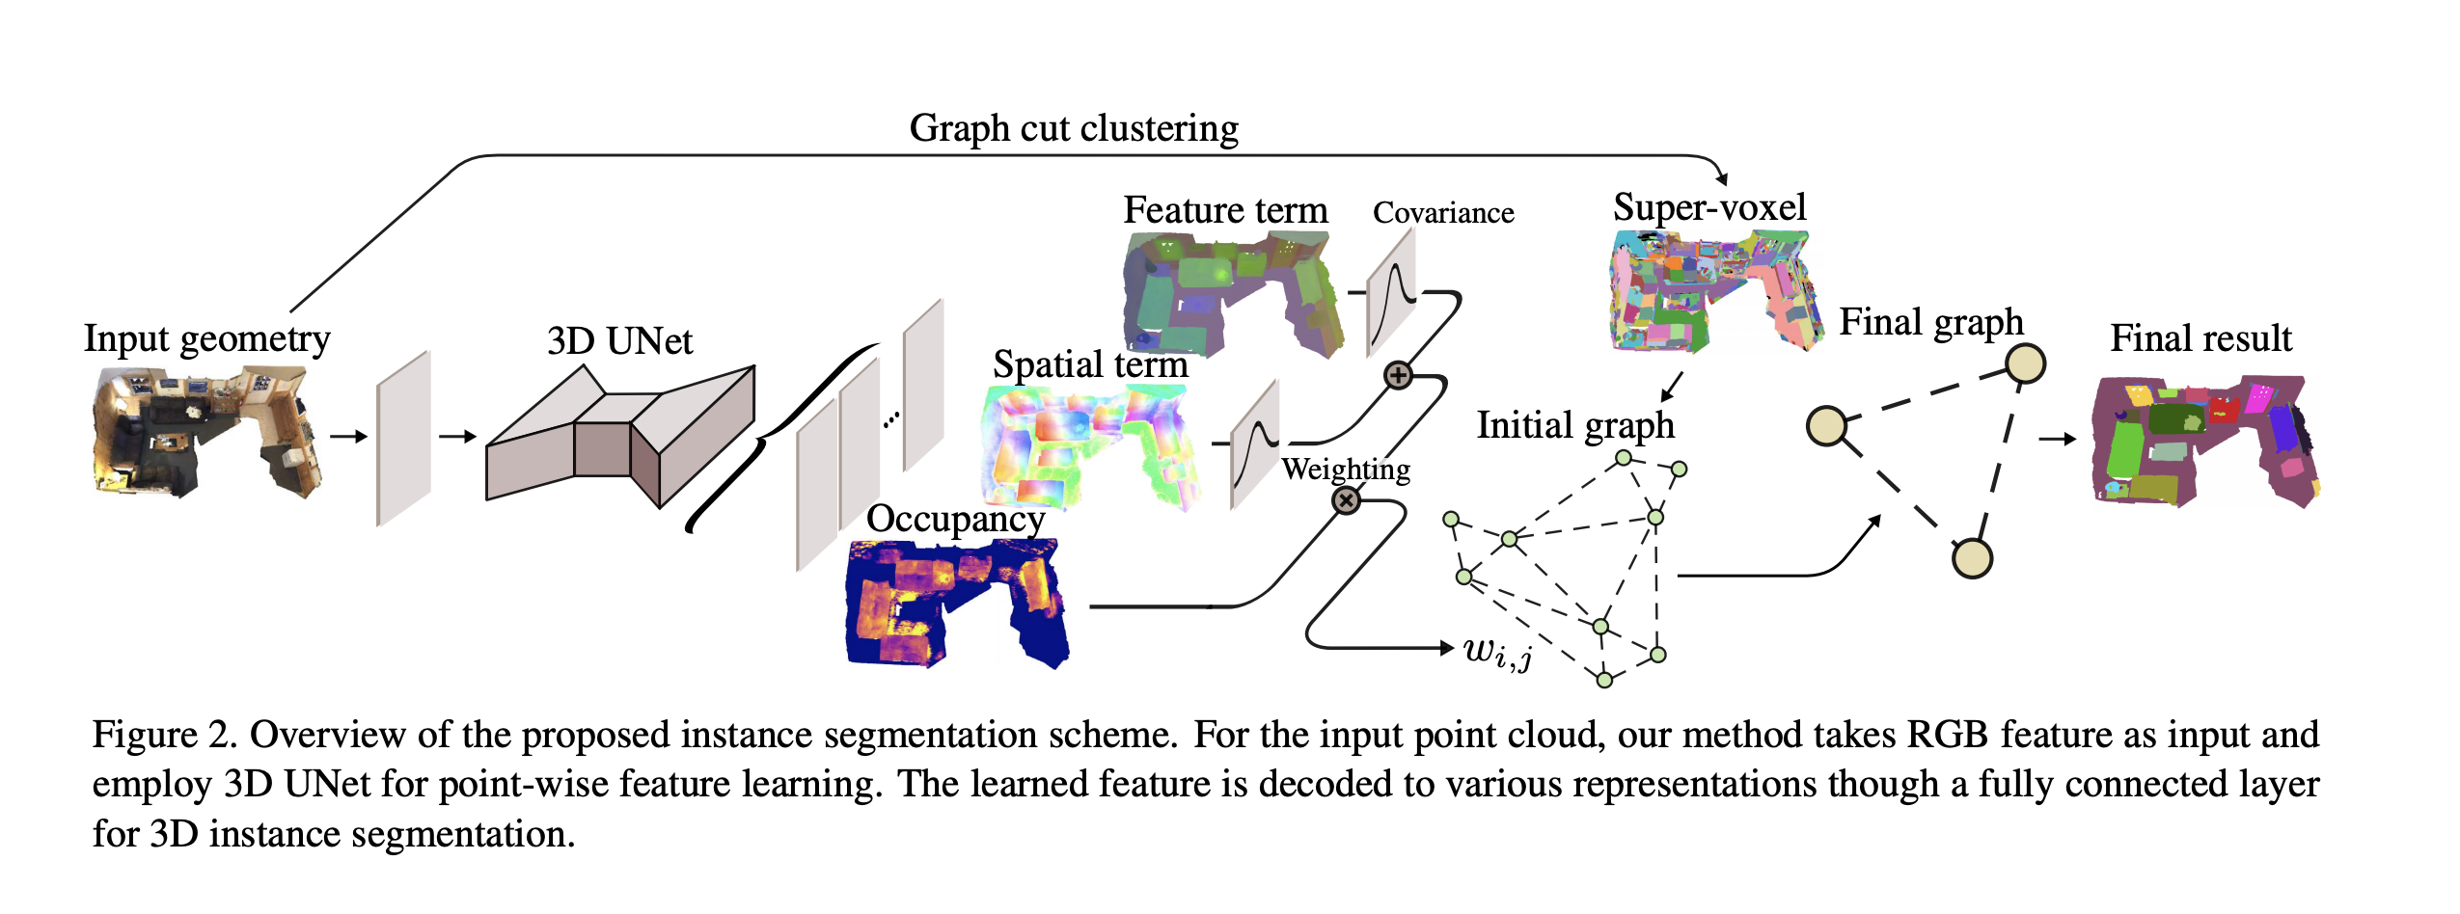
pipeline

Slide 4




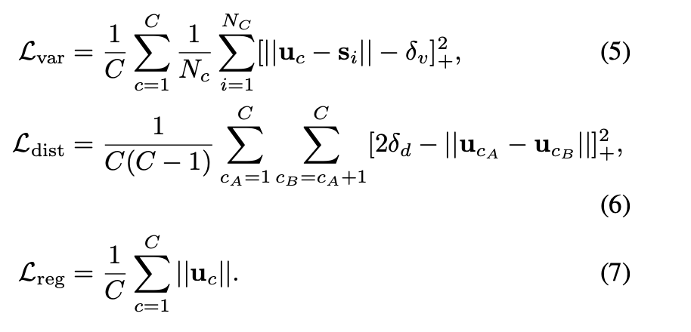

embedding learning & Occupancy Regression

Slide 5
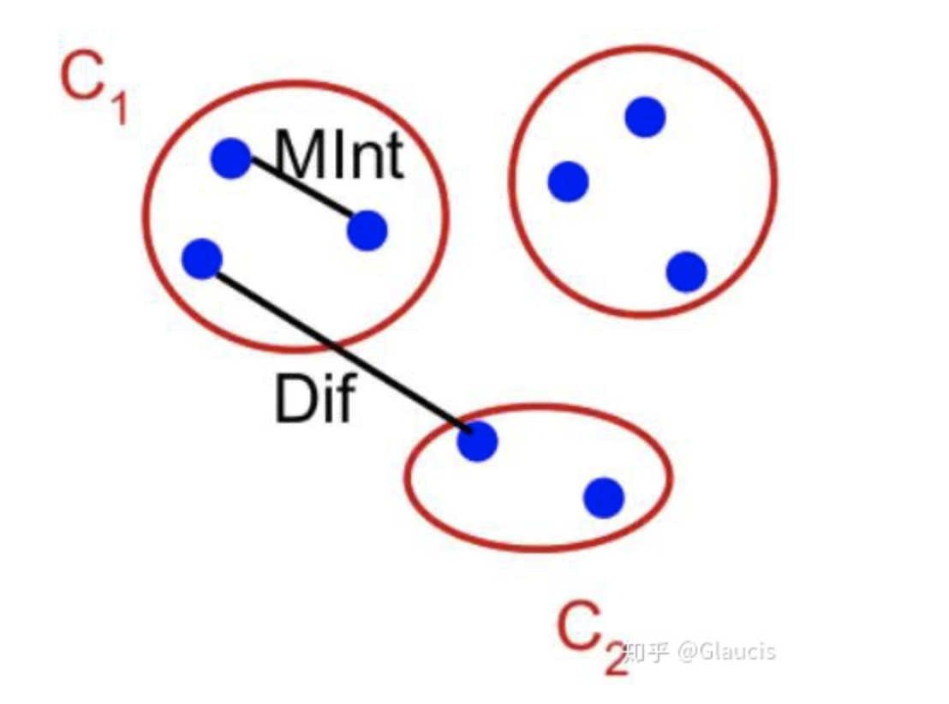



instance clustering
voxel-->super-voxel
super-voxel-->无向图

Slide 6

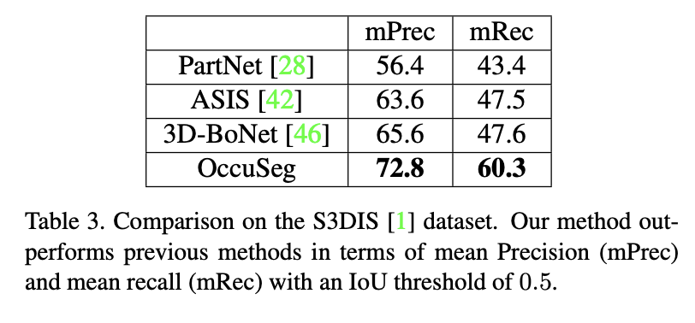

results

Slide 7
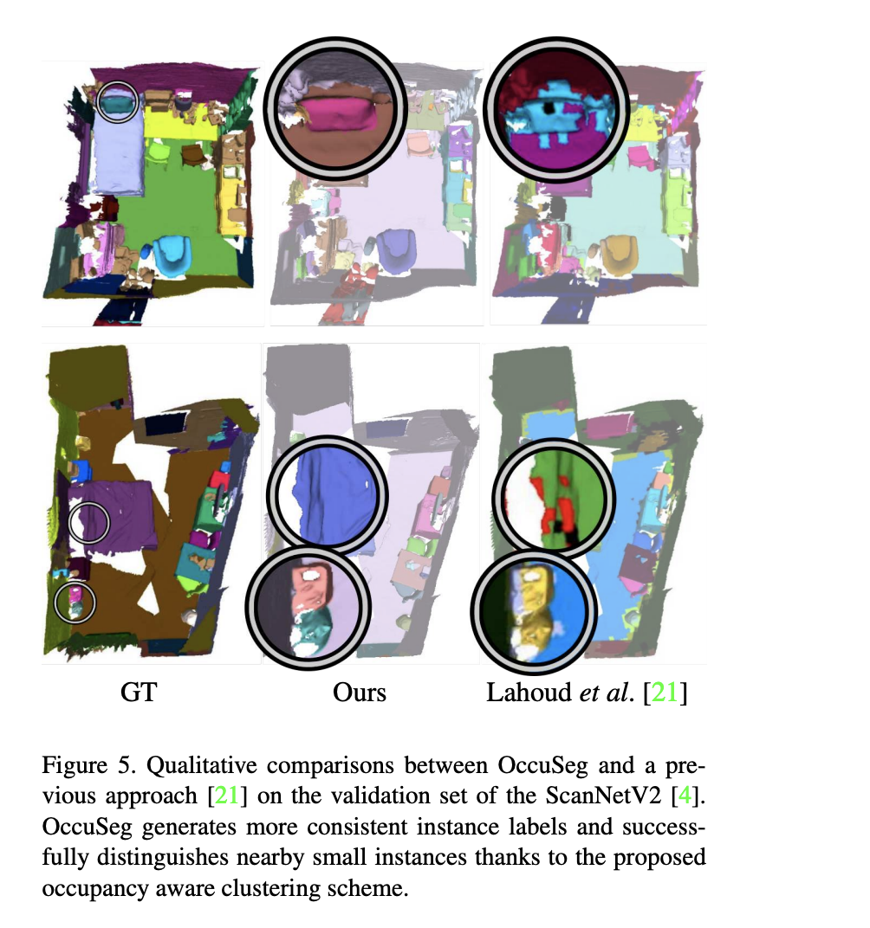
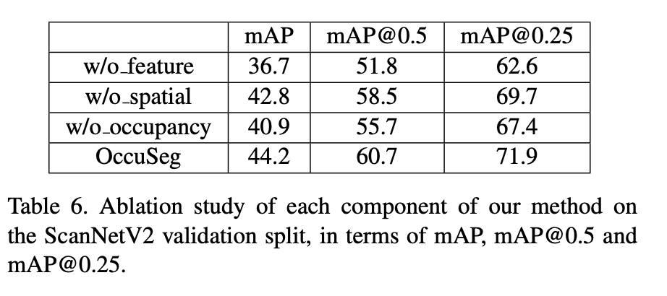
Ablation study

