Slide 1
Uninformed Students: Student–Teacher Anomaly Detection with Discriminative Latent Embeddings
Paul Bergmann Michael Fauser David Sattlegger Carsten Steger
MVTec Software GmbH
www.mvtec.com
{paul.bergmann, fauser, sattleger, steger}@mvtec.com

Slide 2
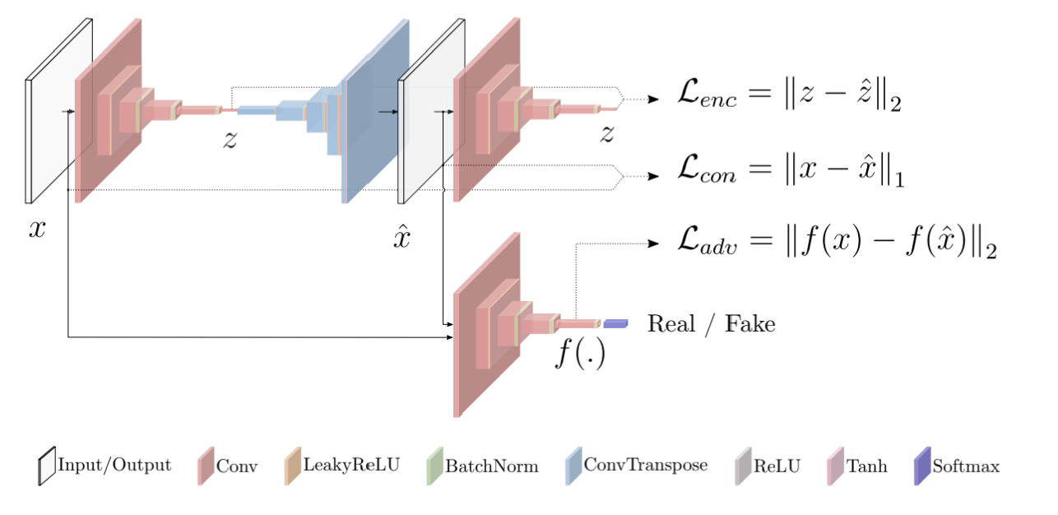
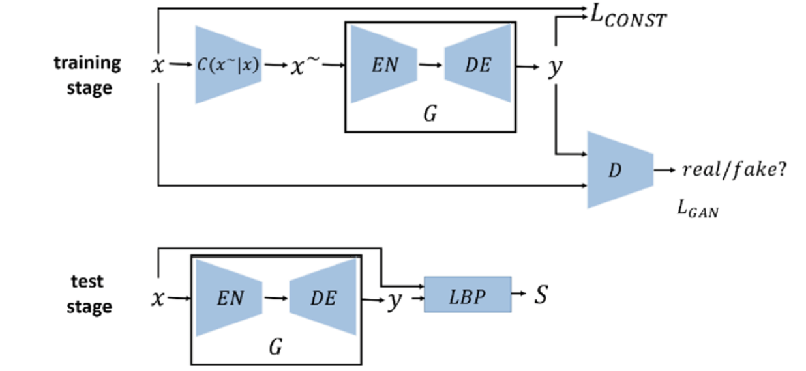
Related Work

Slide 3
Contribution
1、We propose a novel framework for unsupervised anomaly detection based on student–teacher learning.
2、We introduce scoring functions based on the students' predictive variance and regression error to obtain dense anomaly maps for the segmentation of anomalous regions in natural images.
3、We demonstrate state-of-the-art performance on three real-world computer vision datasets.

Slide 4
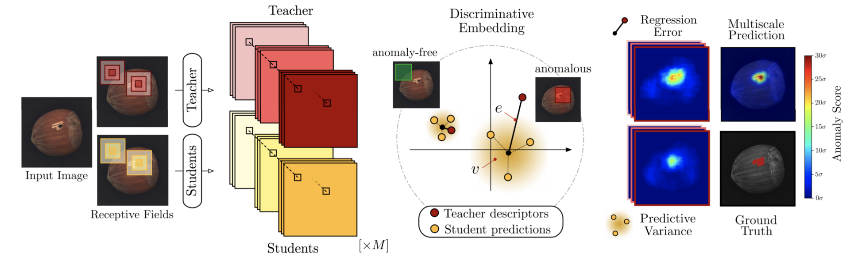
Method

Slide 5
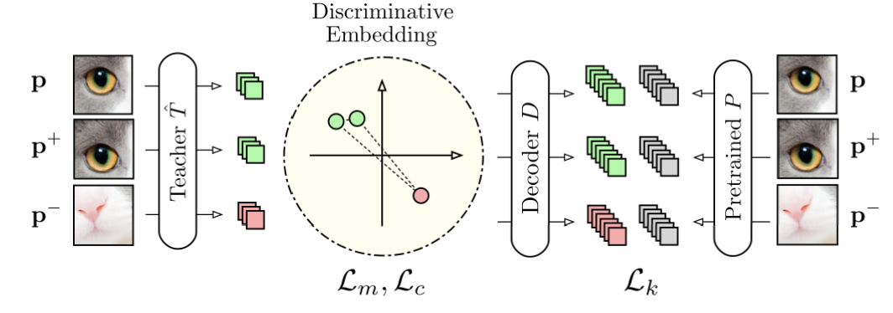
Method
知识蒸馏（Knowledge Distillation）先准备好一个在其他任意数据集上预训练好的pretrained model P，把patch P输入到Resnet18里去，得到patch descriptor，论文分别给出了patch边长为17/33/65的T hat的网络结构，同样的把patch输入到T hat里，得到patch descriptor ，这里的decoder就是让Resnet输出的descriptor和T hat输出的descriptor维度相匹配，我们通过计算两个descriptor的L2距离来达到迁移学习的目的

Slide 6

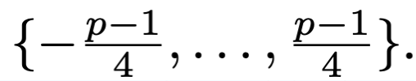
Method
Triplet Learning : 把原始图片缩放到
再在这些图片上随机截取边长为p的patch（作为p），p+是
在patch p的基础上进行在
随机选择一个偏移量进行偏移得到的，此外在patch p+上还随机添加了高斯
噪声，p-是在其他类别的图像中随机crop得到的，用resnet18和p=33/17/65的网络结构在{p , p+, p-}上训练即可。

Slide 7
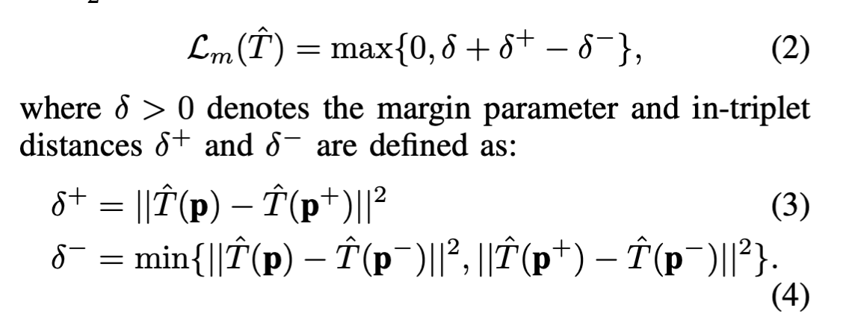
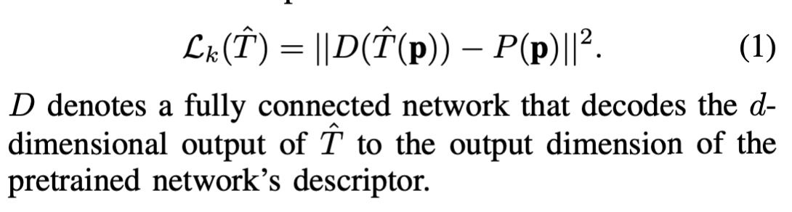
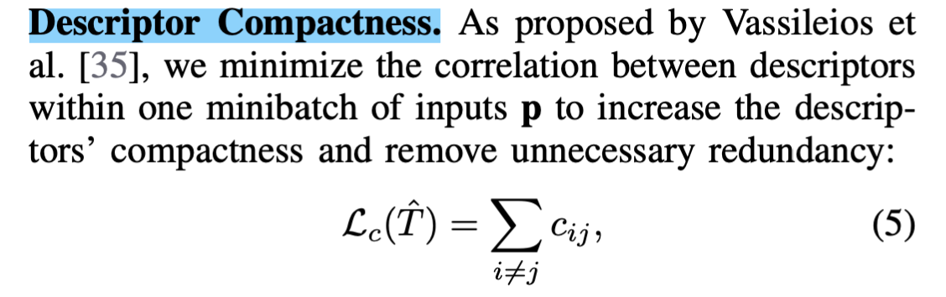
Method

Slide 8
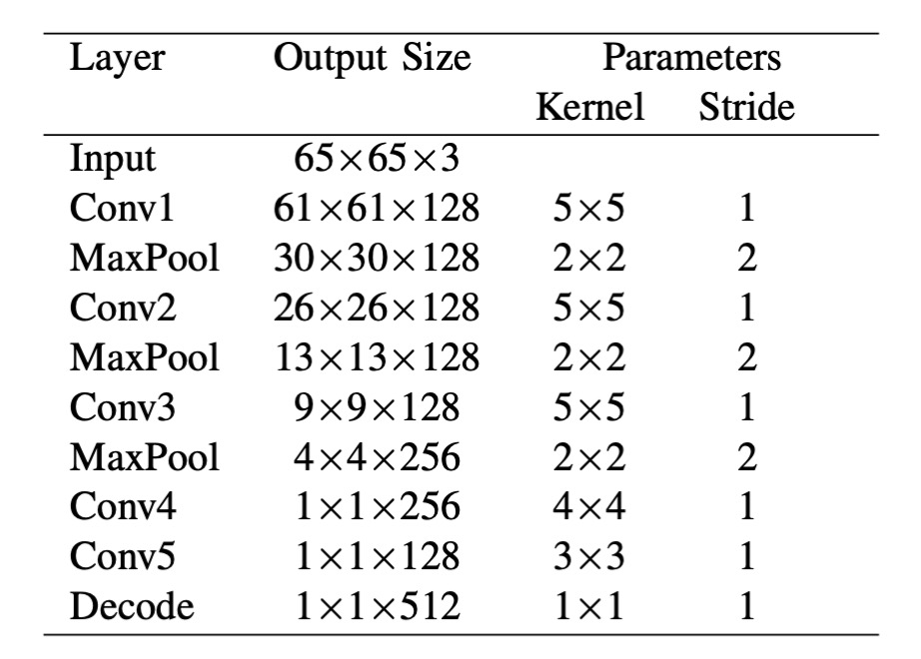
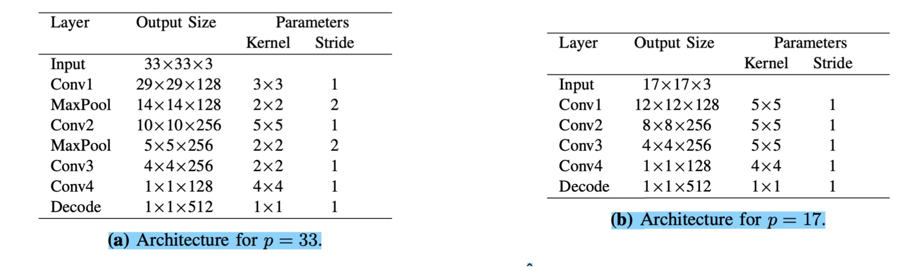
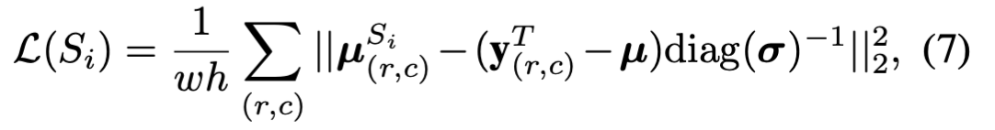
Method

Slide 9
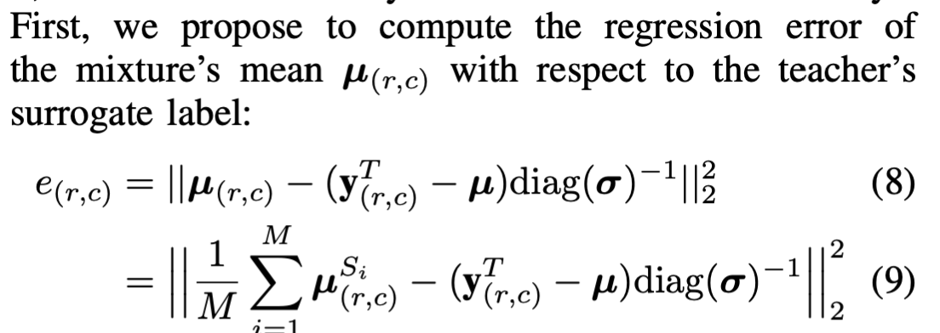
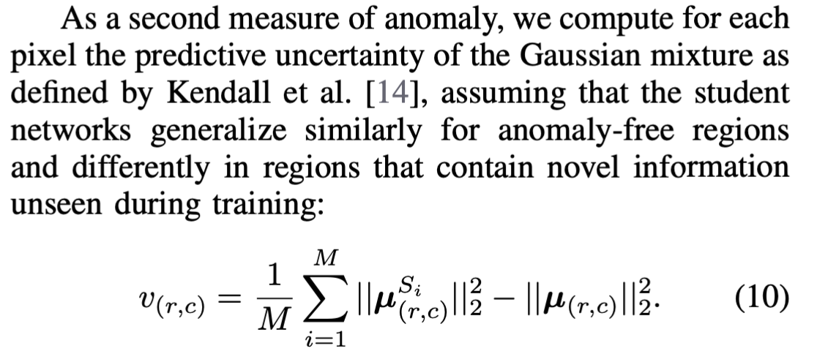
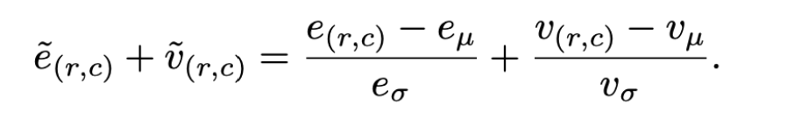
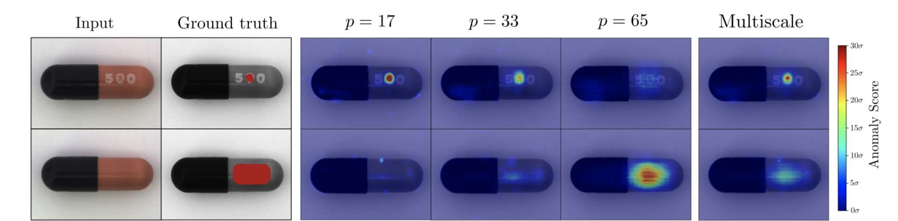
Method

Slide 10
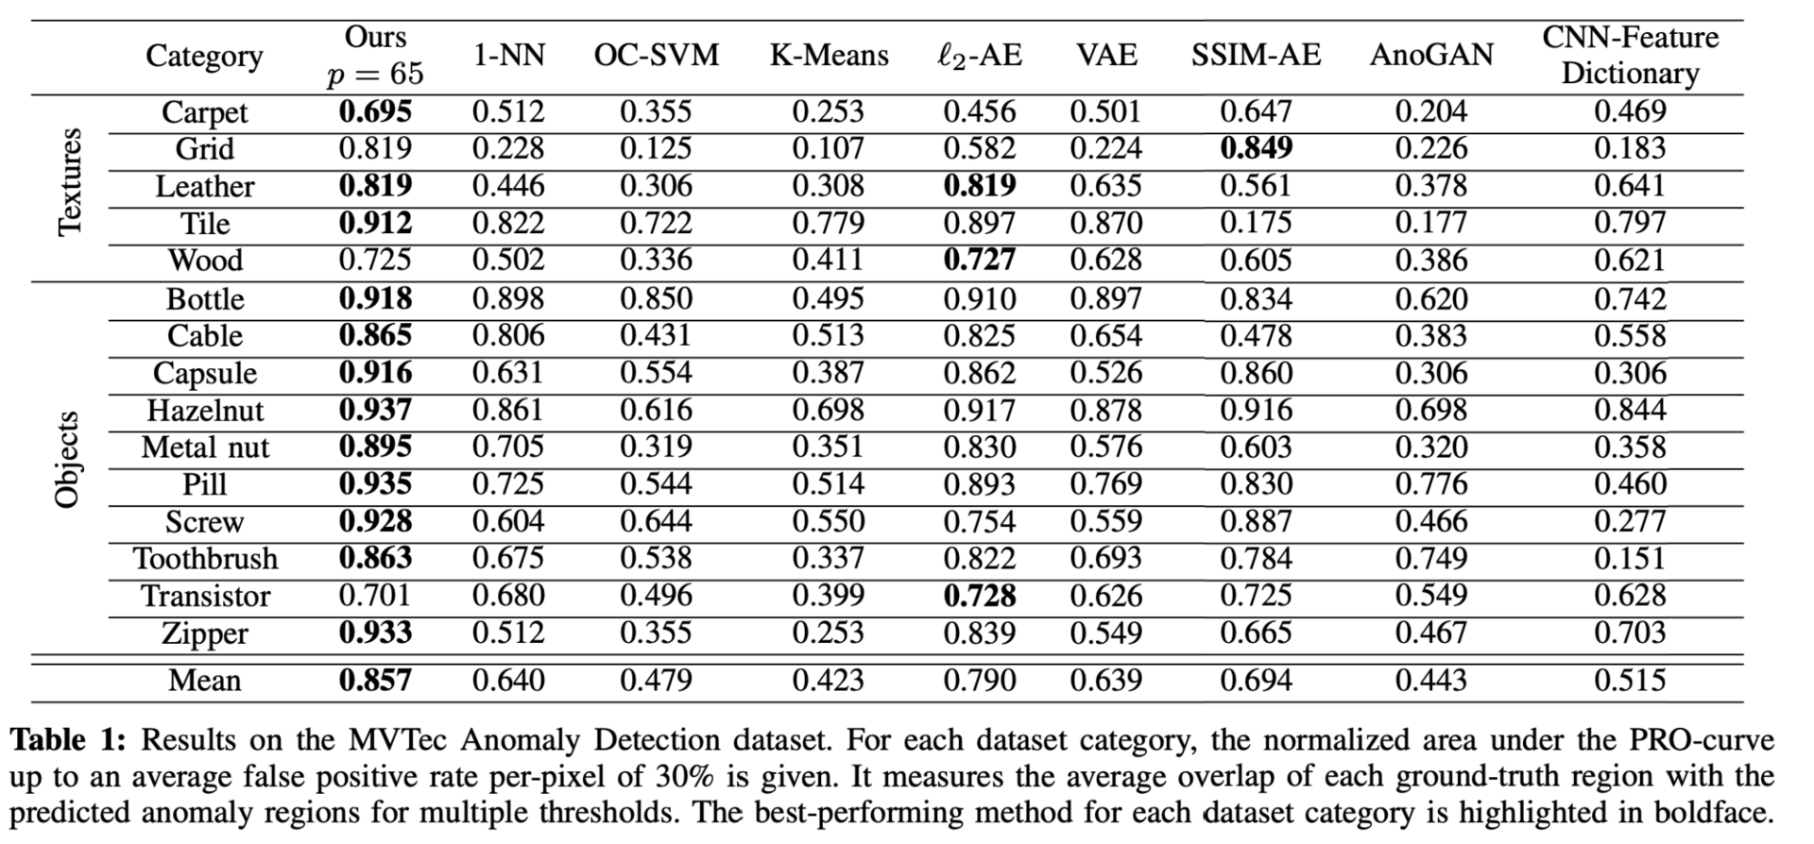
Experiment

Slide 11
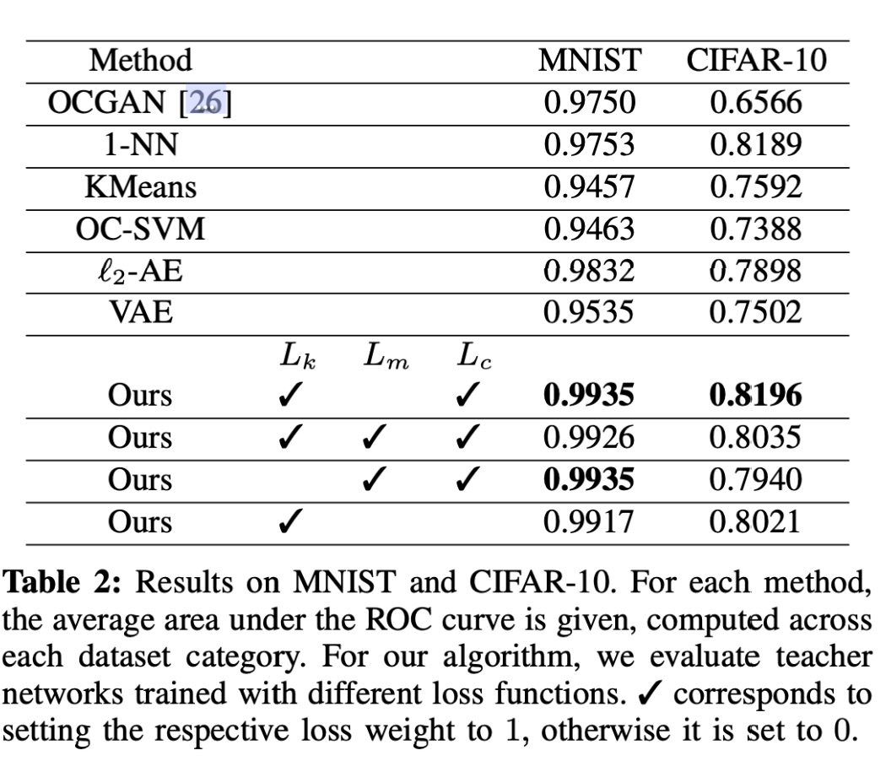
Experiment

