Slide 1
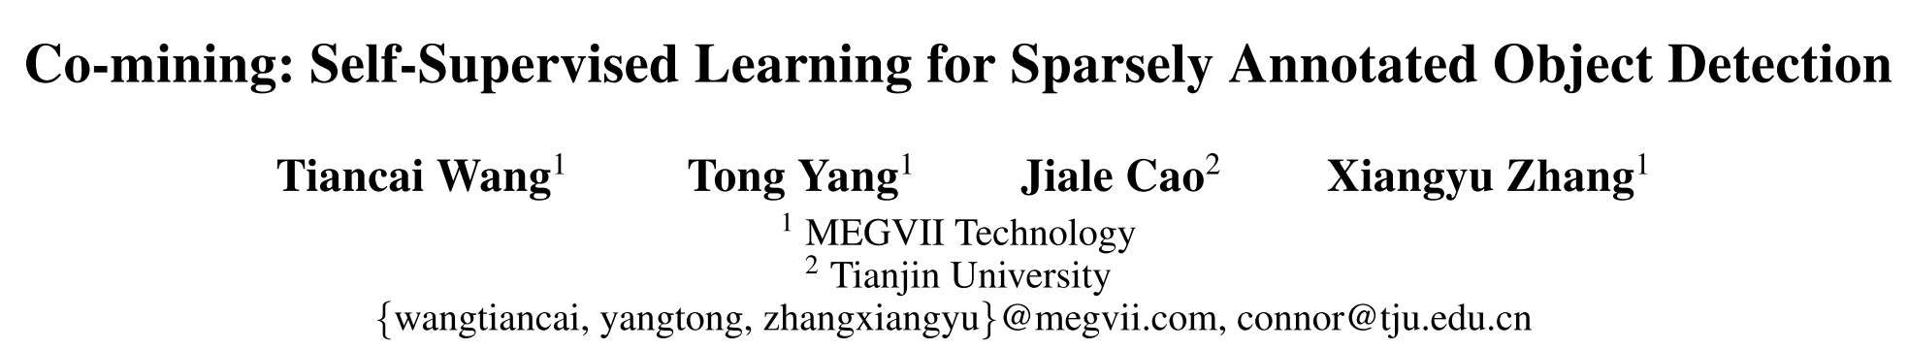
AAAI 2021

Slide 2


Motivation
complete annotations
Object detectors
sparse annotations
Task-sparsely annotated object detection
Existing methods:
re-weight the loss of hard negative samples
convert the unlabeled instances into ignored regions
Drawback:
fail to make full use of the useful information mined from unlabeled instances
Notes:
之前的方法主要有两类，一类是对hard negative sample的loss重加权，之前未被标注的instance会直接被当做背景，从而影响网络的训练，现在对于不确定的背景区域，也就是网络认为可能是未标注的instance，给与其loss一个比较小的权重，从而减轻未标注目标带来的副作用。
另一类也很直观，就是直接忽略不确定的区域，不计算其loss，也就不会因为错误的梯度导致的网络训练不稳定。
但是，重新加权的策略和忽略的策略都是次优策略，因为这两种策略在很大程度上缓解了未标记实例造成的负面影响，但是同样不能充分利用未标记实例的信息。
从而引出这篇文章的motivation，为什么不能充分地挖掘未标记实例的信息，将其转化为正向的监督信号来提升网络的performance。

Slide 3
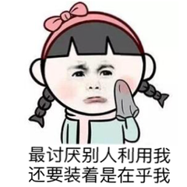
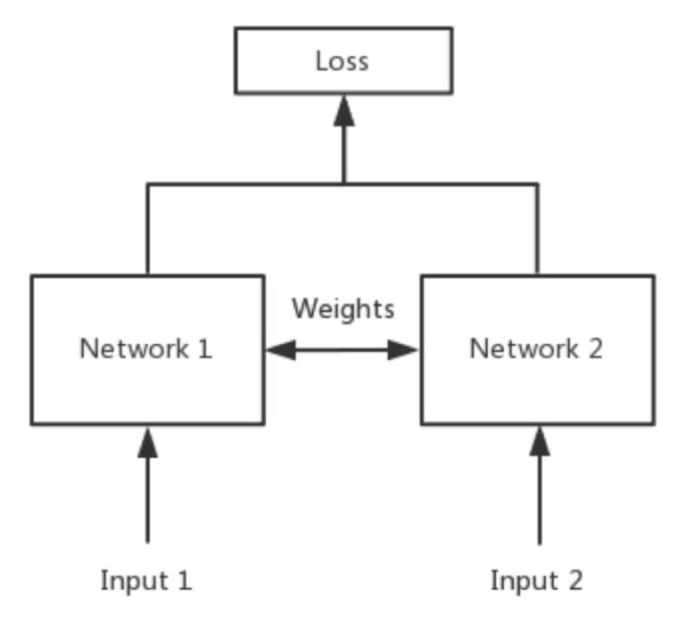
Overview
Why not convert the category of unlabeled instance into the positive category to help improve detection performance during training?
Co-mining
two branches of a Siamese network predict the pseudo-label sets for each other
Siamese network
Notes:
Siamese network就是“连体的神经网络”，神经网络的“连体”是通过共享权值来实现的，因为共享权值，实际上两个网络是同一个，但是两个网络的输入是不同的，Siamese network最开始被提出也正是要去衡量两个输入的相似程度。不过在这项工作中，作者利用siamese的网络结构来learn different and multi-view feature patterns，从而提升pseudo-label learning.

Slide 4
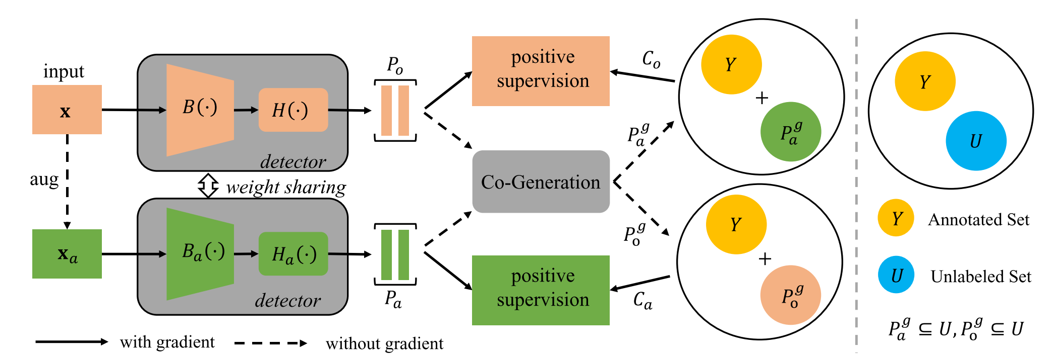
Method
Structure: Siamese-style detection network
Input: original images and corresponding augmented images
Co-Generation: generate two different pseudo-label sets
The pseudo-label set generated from one branch will merge with the sparsely annotated-label set as the supervision signal of another branch.

Slide 5
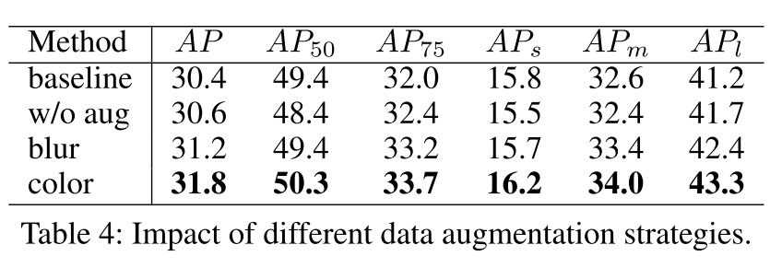
Data Augmentation
Why?
To generate two rich but diverse pseudo-label sets. With these diverse pseudo-labels, the two branches help each other to avoid the incorrect interference of unlabeled instances as much as possible.
How?
Gaussian blur and color-jitter

Slide 6
Co-Generation
Purpose
Co-generation module is employed to convert the predictions of one branch into the pseudo-labels for another branch.
Steps
Step1: Filter the bounding boxes with lower scores.
The predicted bounding box with a lower confidence score has a little chance of detecting unlabeled instances.
Step2: Remove redundant boxes by Non-Maximum Suppression (NMS).
Keep the bounding box with highest confidence score to represent each instance by NMS.
Step3: Drop the bounding boxes representing annotated instances.
To avoid generating duplicated labels for the annotated instances, we remove the bounding boxes representing the annotated instances according to their overlaps with annotated instances.

Slide 7
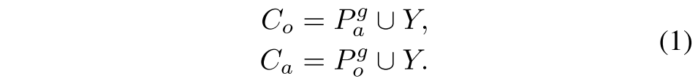
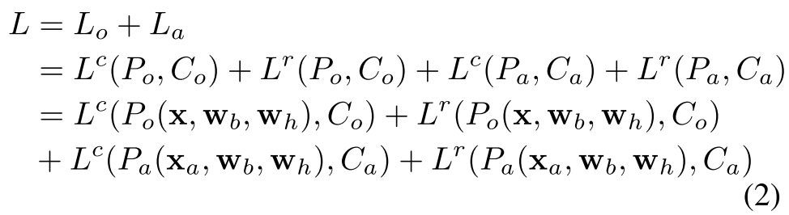
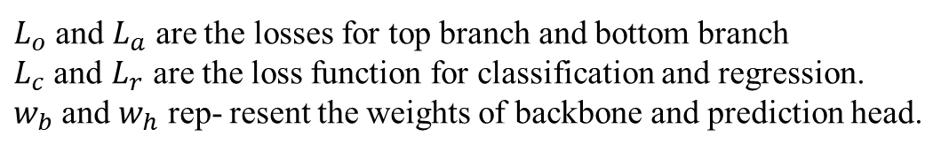
Complementary Supervision
New complete annotations
Overall loss
$L_{o}$ and $L_{a}$ are the losses for top branch and bottom branch
$L_{c}$ and $L_{r}$ are the loss function for classification and regression.
$w_{b}$ and $w_{h}$ rep- resent the weights of backbone and prediction head.

Slide 8
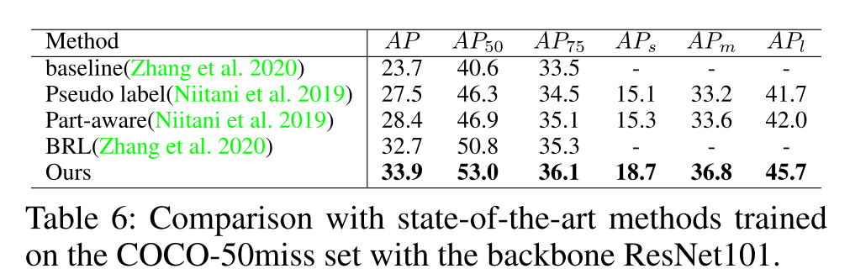
Result
Comparison with Other Methods

Slide 9
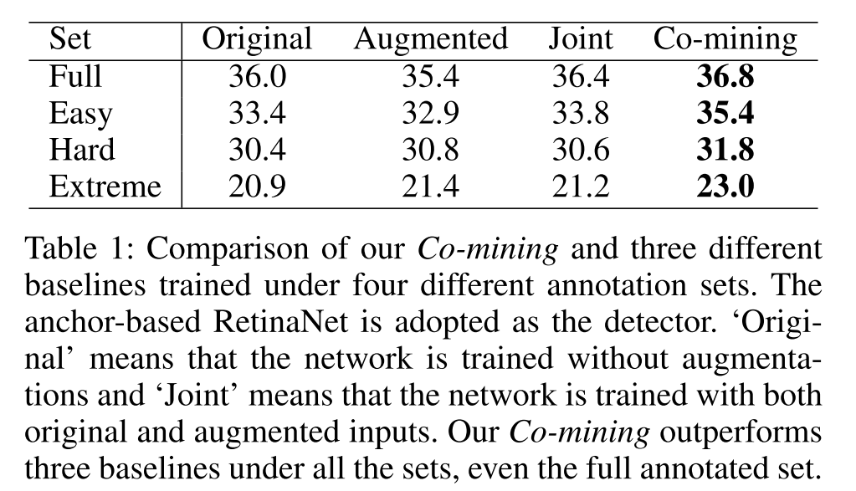
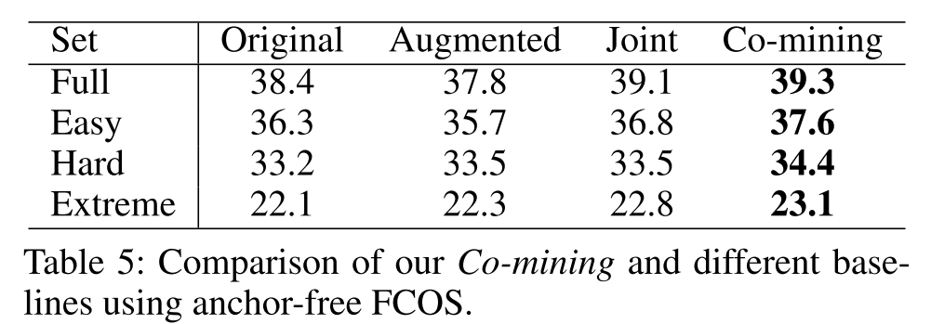
Result
Generalization on Anchor-based and Anchor-free Detectors
Anchor-based--RetinaNet
Anchor-free--FCOS

Slide 10
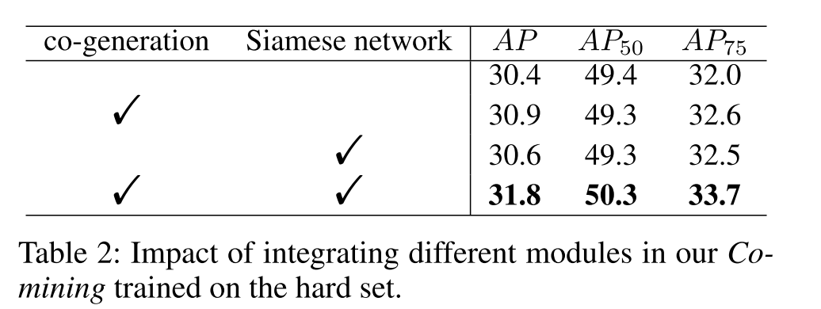
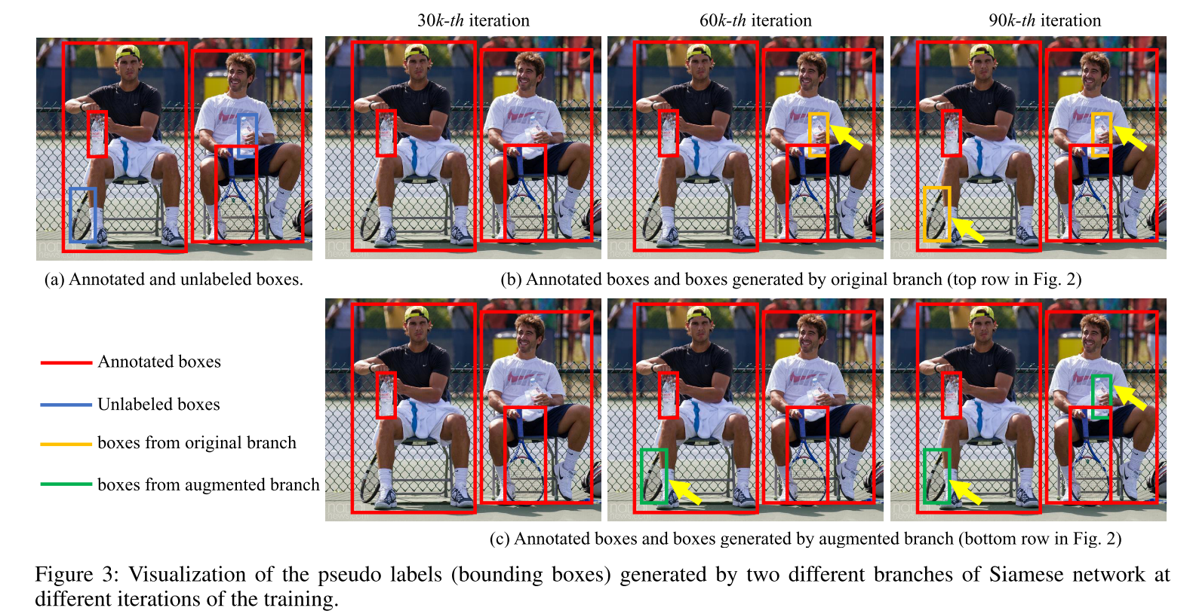
Ablation Study
Notes:
good angle 问题切入的一个好的角度
新颖的解决方式

