Slide 1
Sub-Image Anomaly Detection with Deep Pyramid Correspondences
Niv Cohen and Yedid Hoshen
School of Computer Science and Engineering
The Hebrew University of Jerusalem, Israel.
{niv.cohen2,yedid.hoshen}@mail.huji.ac.il

Slide 2
Introduction
目标：
利用Pre-trained Model，做Sub-Image Anomaly Detection
问题：
正常样本多，标注少
K Nearest Neighbor 具有对整图强大的异常检测能力，但难以用于异常区域的分割
贡献：
<1> SPADE ---- Semantic Pyramid Anomaly Detection
<2> Fast, Robust, SOTA performance
<3> No training Time
Main Idea：
Pretrain Model + KNN + 特征金字塔匹配

Slide 3
Why KNN?
Reconstruction-based method
1）如何正确选择重建损失的度量函数
2）模型性能对重建损失的度量非常敏感
How to use KNN？
1）feature extraction
2）KNN normal image retrieval
3）pixel alignment
Notes:
先做 image-level的KNN，再做 pixel-level的KNN

Slide 4
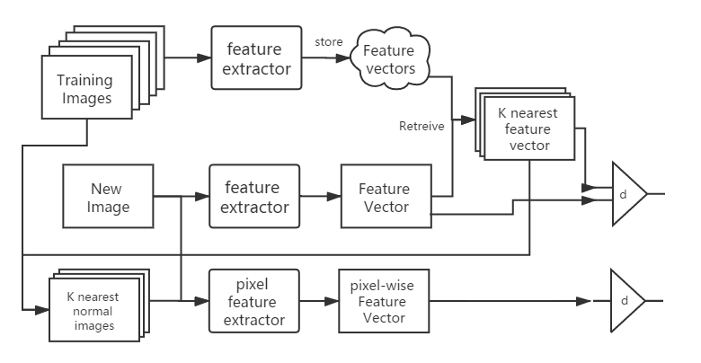
Main Pipeline

Slide 5
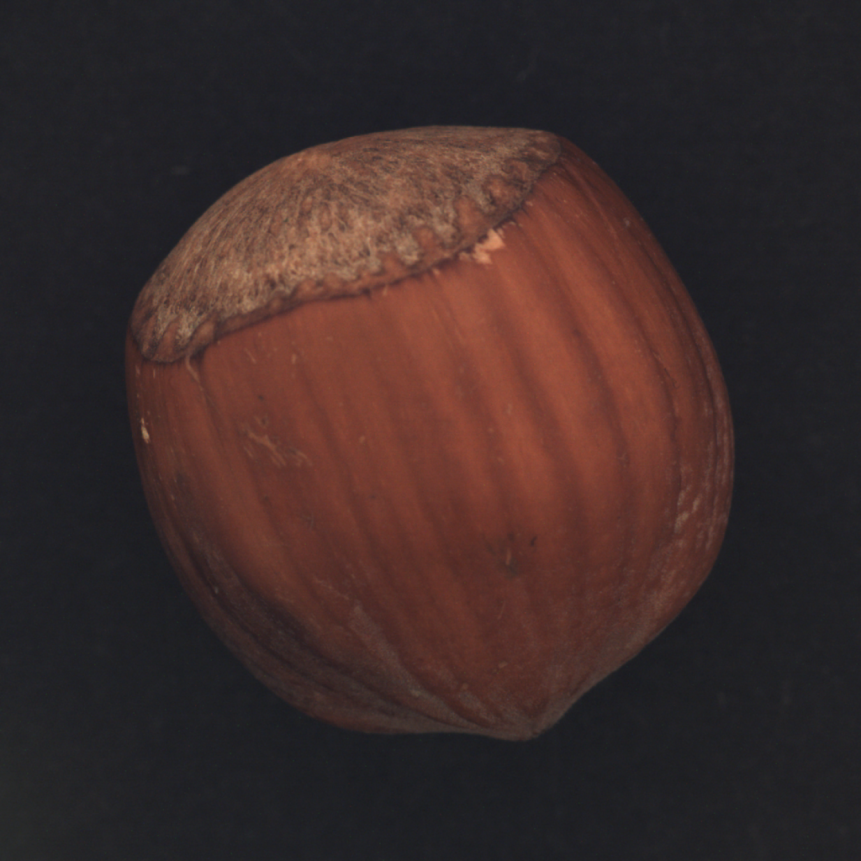


SPADE Feature Extraction at Initialization
Pretrained on ImageNet
Normal
features
DB
Store
Wide-Resnet 50
Global pooling
$$x_{i}$$
k = 2
$$f_{i}=F(x_{i})$$
At Initialization, apply to all training images (Normal)
Store their feature vectors
Notes:
Global Pooling after last conv-layer
作为图像级特征，使用全局合并最后一个卷积层后获得的特征向量。

Slide 6
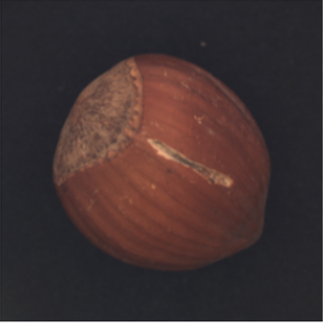
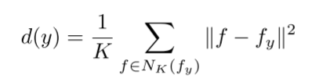


SPADE KNN Normal Image Retrieval
Pretrained on ImageNet
Normal
features
DB
Retrieve
Wide-Resnet 50
Global pooling
$$f_{y}$$
y
×K
$$N_{K}(f_{y})$$
计算特征向量的KNN距离，欧氏距离度量
设置阈值τ，判断Image-level有无缺陷：若d > τ，则有缺陷

Slide 7
SPADE Image Alignment & Feature Pyramid Matching
目的：
对于判断为异常的图像，进一步分割异常区域
对于被误检为异常的图片，希望分割结果为无异常像素点
问题：
简单的显式图像对应，无法完全对齐
各个图像像素间的差距可能较大（尤其对变化较大的物体或小数据集）
像素层面的差异对损失函数非常敏感

Slide 8

SPADE Image Alignment & Feature Pyramid Matching
Normal
image
b1
concat
b2
Apply KNN
Test images
b3
b4
$G=\left\{F\left(x_{1},p\right) | p∈P\right\}∪$ $\left\{F\left(x_{2},p\right) | p∈P\right\}∪…∪\left\{F\left(x_{k},p\right) | p∈P\right\}$
特征金字塔提取每个像素特征，密集特征对应
比较特征距离，若d大于阈值θ，则为缺陷像素

Slide 9
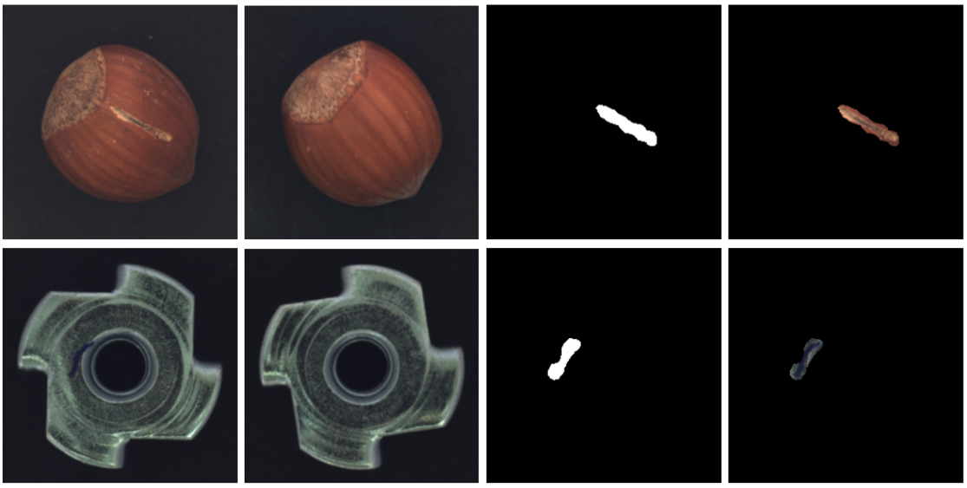
SPADE Detection Visualization Example
Raw image
Top normal neighbor image
Detected Mask
Anomalous image pixels

Slide 10
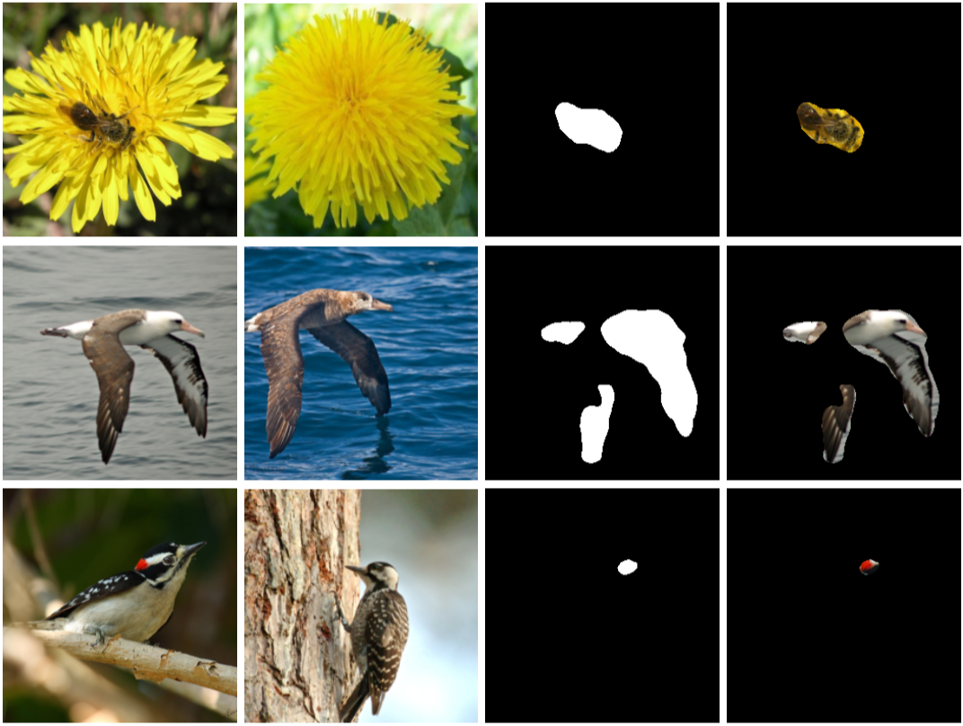
SPADE Detection Visualization Example
Raw image
Top normal neighbor image
Detected Mask
Anomalous image pixels

Slide 11
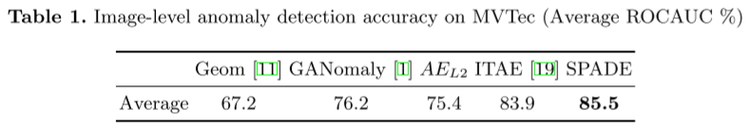
SPADE Benchmark Evaluation

Slide 12
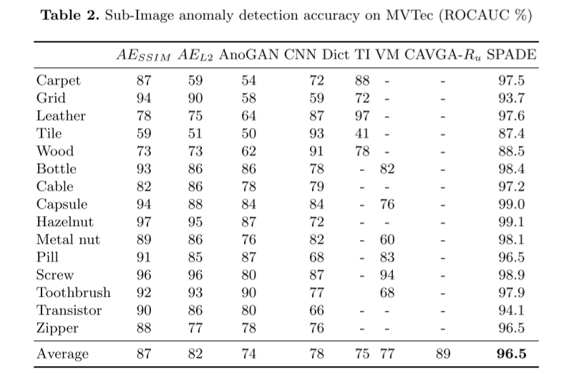
SPADE Benchmark Evaluation

Slide 13
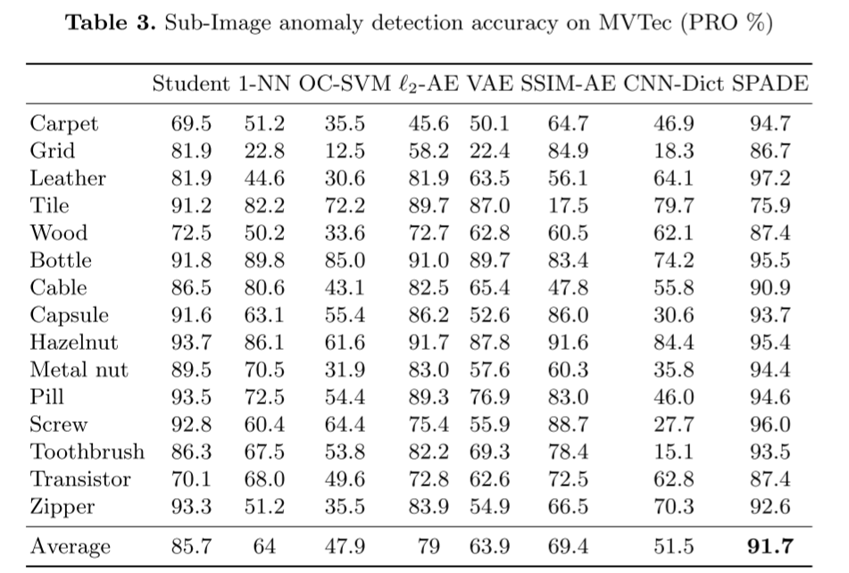
SPADE Benchmark Evaluation

Slide 14
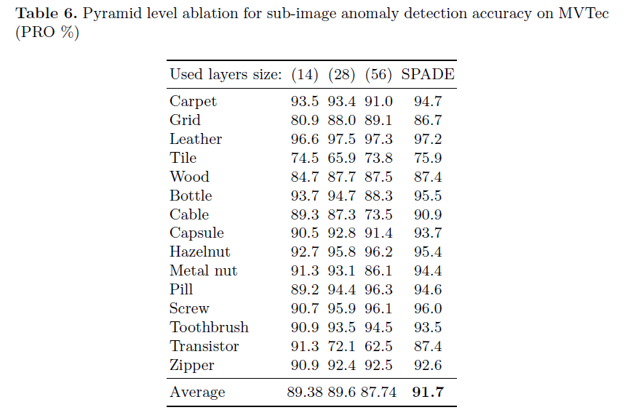
SPADE Ablation

Slide 15
SPADE Discussion
KNN method ：better than single alignment
Low-level feature + context information
Optimizing runtime performance：limited search number & speedup techniques
Pre-trained vs. learned features：high performance; small dataset

