Slide 1
QATM: Quality-Aware Template Matching For Deep Learning
Jiaxin Cheng, Yue Wu, Wael Abd-Almageed, Premkumar Natarajan, USC Information Sciences Institute, Marina del Rey, CA, USA
CVPR2019

Slide 2
Motivation
Problem
All pixels within a template and a candidate window are taken into account when measuring similarity.
Traditional Method
Exclude background pixels for matching.
Proposed Method
Consider multiple matching scenarios to exclude the possibility of mismatch resulted from background information.

Slide 3
Contribution
Propose a standalone template matching method.
Above-mentioned method can be embedded into any deep neural network as a trainable layer.

Slide 4
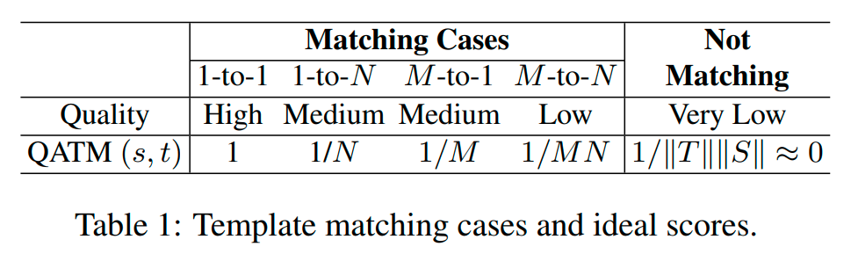
Method
t and s are patches in the template T and search S images

Slide 5
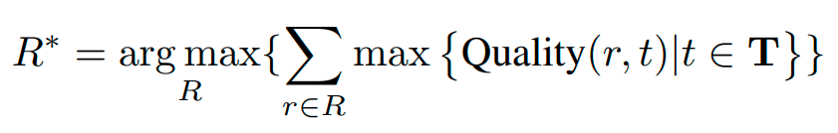

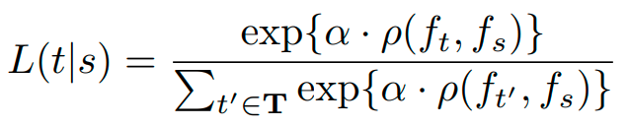
Method

Slide 6
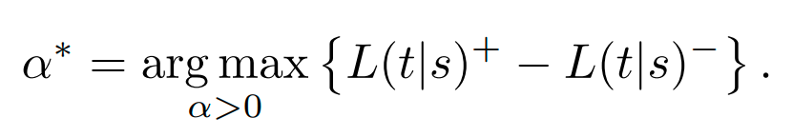
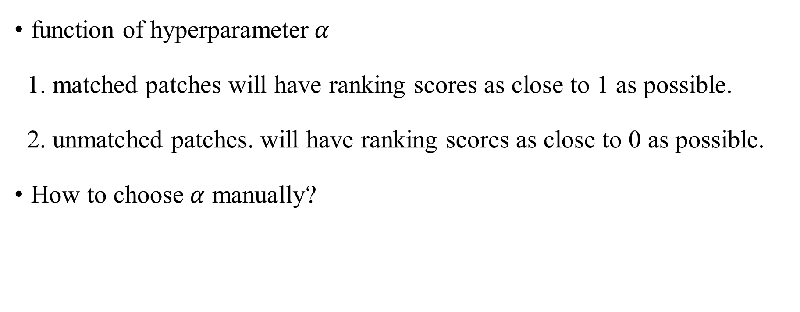
Method
function of hyperparameter$α$
1. matched patches will have ranking scores as close to 1 as possible.
2. unmatched patches. will have ranking scores as close to 0 as possible.
How to choose$α$ manually?

Slide 7
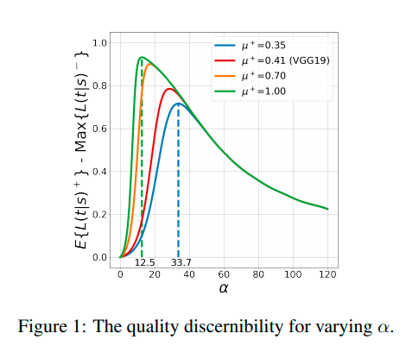
Method
Previous work provides the theoretical cosine similarity score distribution for both matched pairs and unmatched pairs.

Slide 8
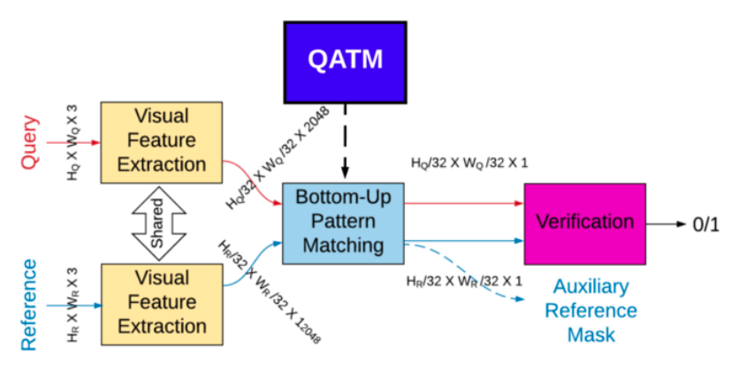

Method
Trainable $α$
Depend on specific application themes

Slide 9

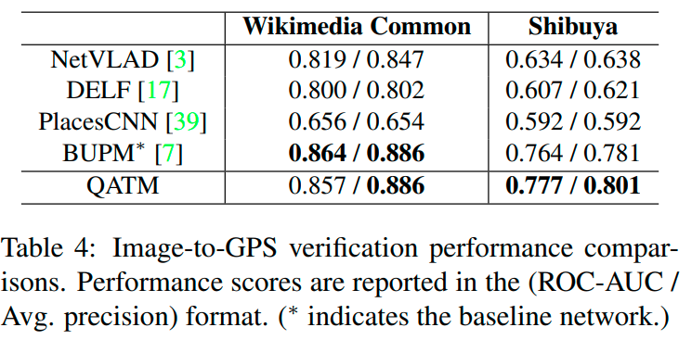
Performance

Slide 10
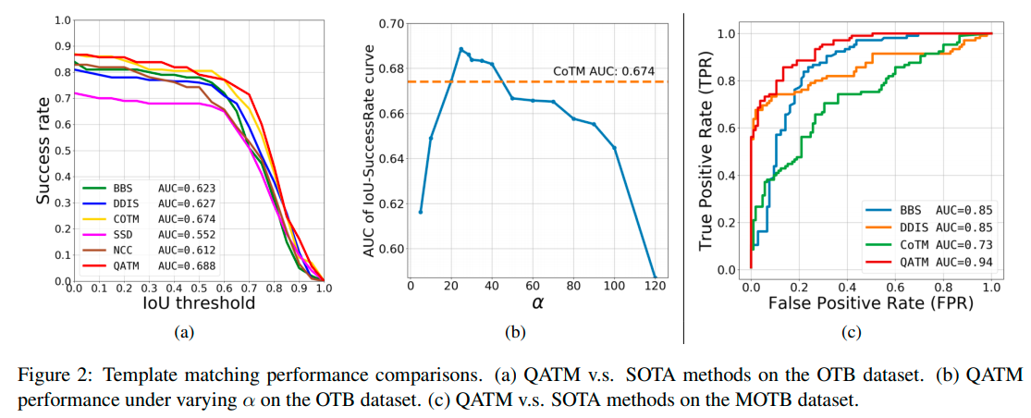
Performance

Slide 11
Thanks for listening!

