Slide 1
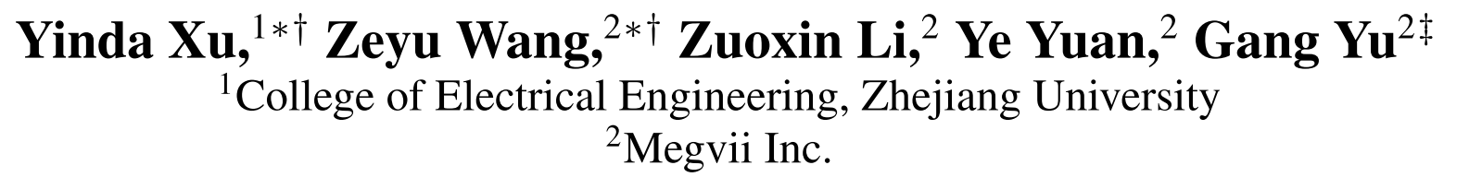
SiamFC++: Towards Robust and Accurate Visual Tracking with Target Estimation Guidelines
AAAI2020
Notes:
主要亮点是清晰地阐明了之前的孪生网络追踪器存在的不合理性问题，以及定义了一套基于anchor-free的目标估计的回归线路

Slide 2
Introduction
Generic Visual Tracking aims at locating a moving object sequentially in a video, given very limited information, often only the annotation of the first frame.
Tracking problem can be treated as the combination of a classification task and an estimation task. The first task aims at providing a robust coarse location of the target via classification. The second task is then to estimate an accurate target state, often represented by a bounding box.
Notes:
当前的一些tracking方法，虽然利用各种trick挖掘到了目标状态的潜在可能性，但是很少考虑到视觉跟踪问题本身存在的特性。

Slide 3
Introduction
methods for the second task (i.e. target state estimation) largely differ.
The first category: DCF, SiamFC
Employs brutal multi-scale test which is inaccurate 多尺度划分
The second category:ATOM
Iteratively refines multiple initial bounding boxes via gradient ascending to estimate the target bounding box
IOU-NET迭代训练的方式多重随机初始化帧与背面边框的数量
The third category:SiamRPN tracker family
performs an accurate and efficient target state estimation by introducing the Region Proposal Network (RPN) , the pre-defined anchor settings not only introduce ambiguous similarity scoring that severely hinders the robustness
PN回归的思想，预先定义锚点之间的位移偏移与大小的差异

Slide 4
Motivation
G1: decomposition of classification and state estimation
tracker should perform two sub-tasks: classification and state estimation
G2: non-ambiguous scoring 使分类分支取消歧义性
classification score should represent the confidence score of target existence directly
G3: prior knowledge-free不再依赖于类似于长宽比等先验知识
be free of prior knowledge like scale/ratio distribution
G4: estimation quality assessment增加了估计质量分数分支
using classification confidence for bounding box selection directly will result in degenerated performance
Notes:
G2 : 得分无歧义 直接对相应的图像块进行分类，并在该位置回归目标边框，即直接将位置视为训练样本。而基于锚点的目标（将输入图像上的位置视为多个锚框的中心）在相同位置会输出多个分类得分，并根据锚点回归目标边界框，这导致了每个位置的歧义性。

Slide 5
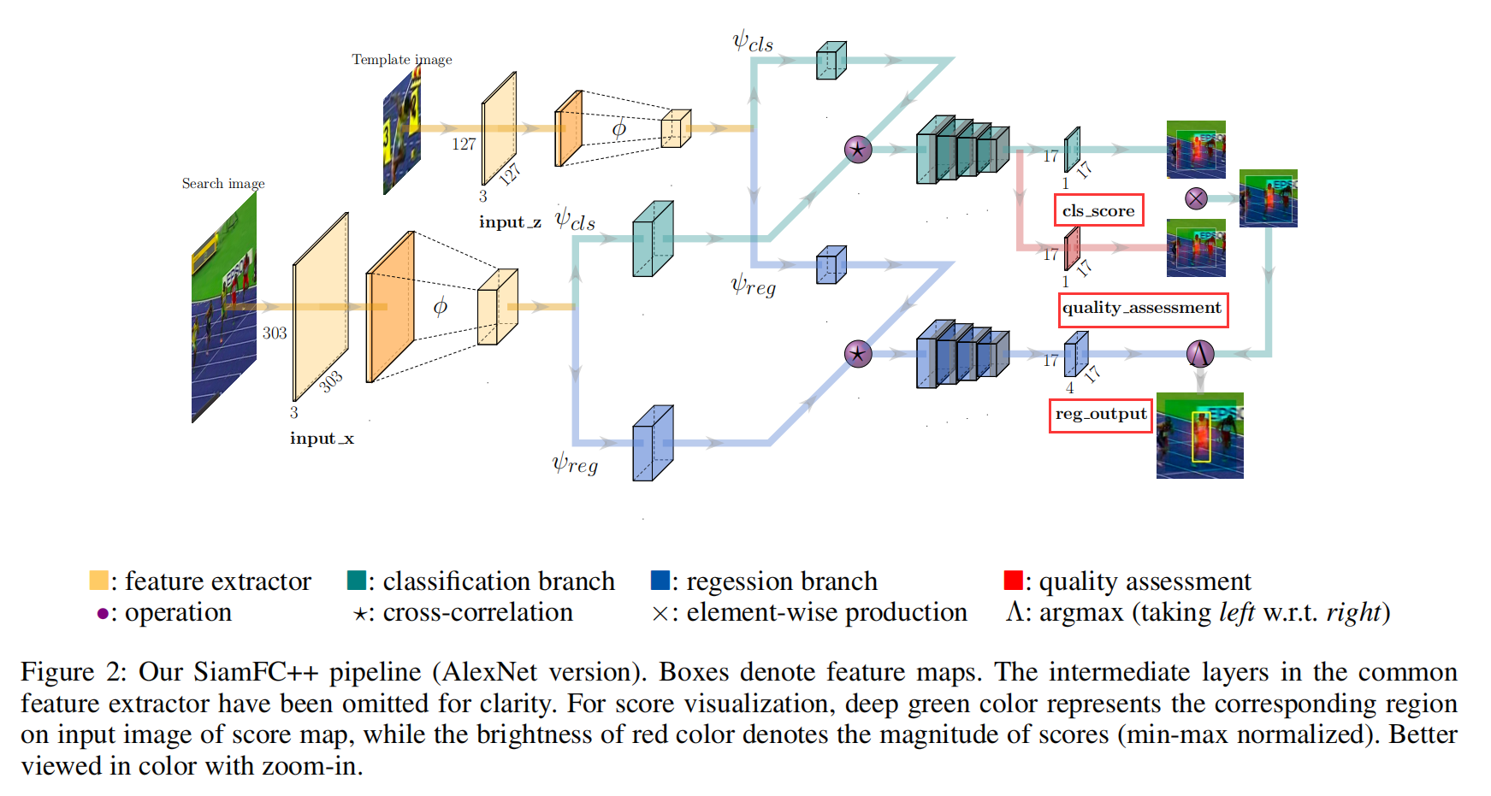
Method

Slide 6
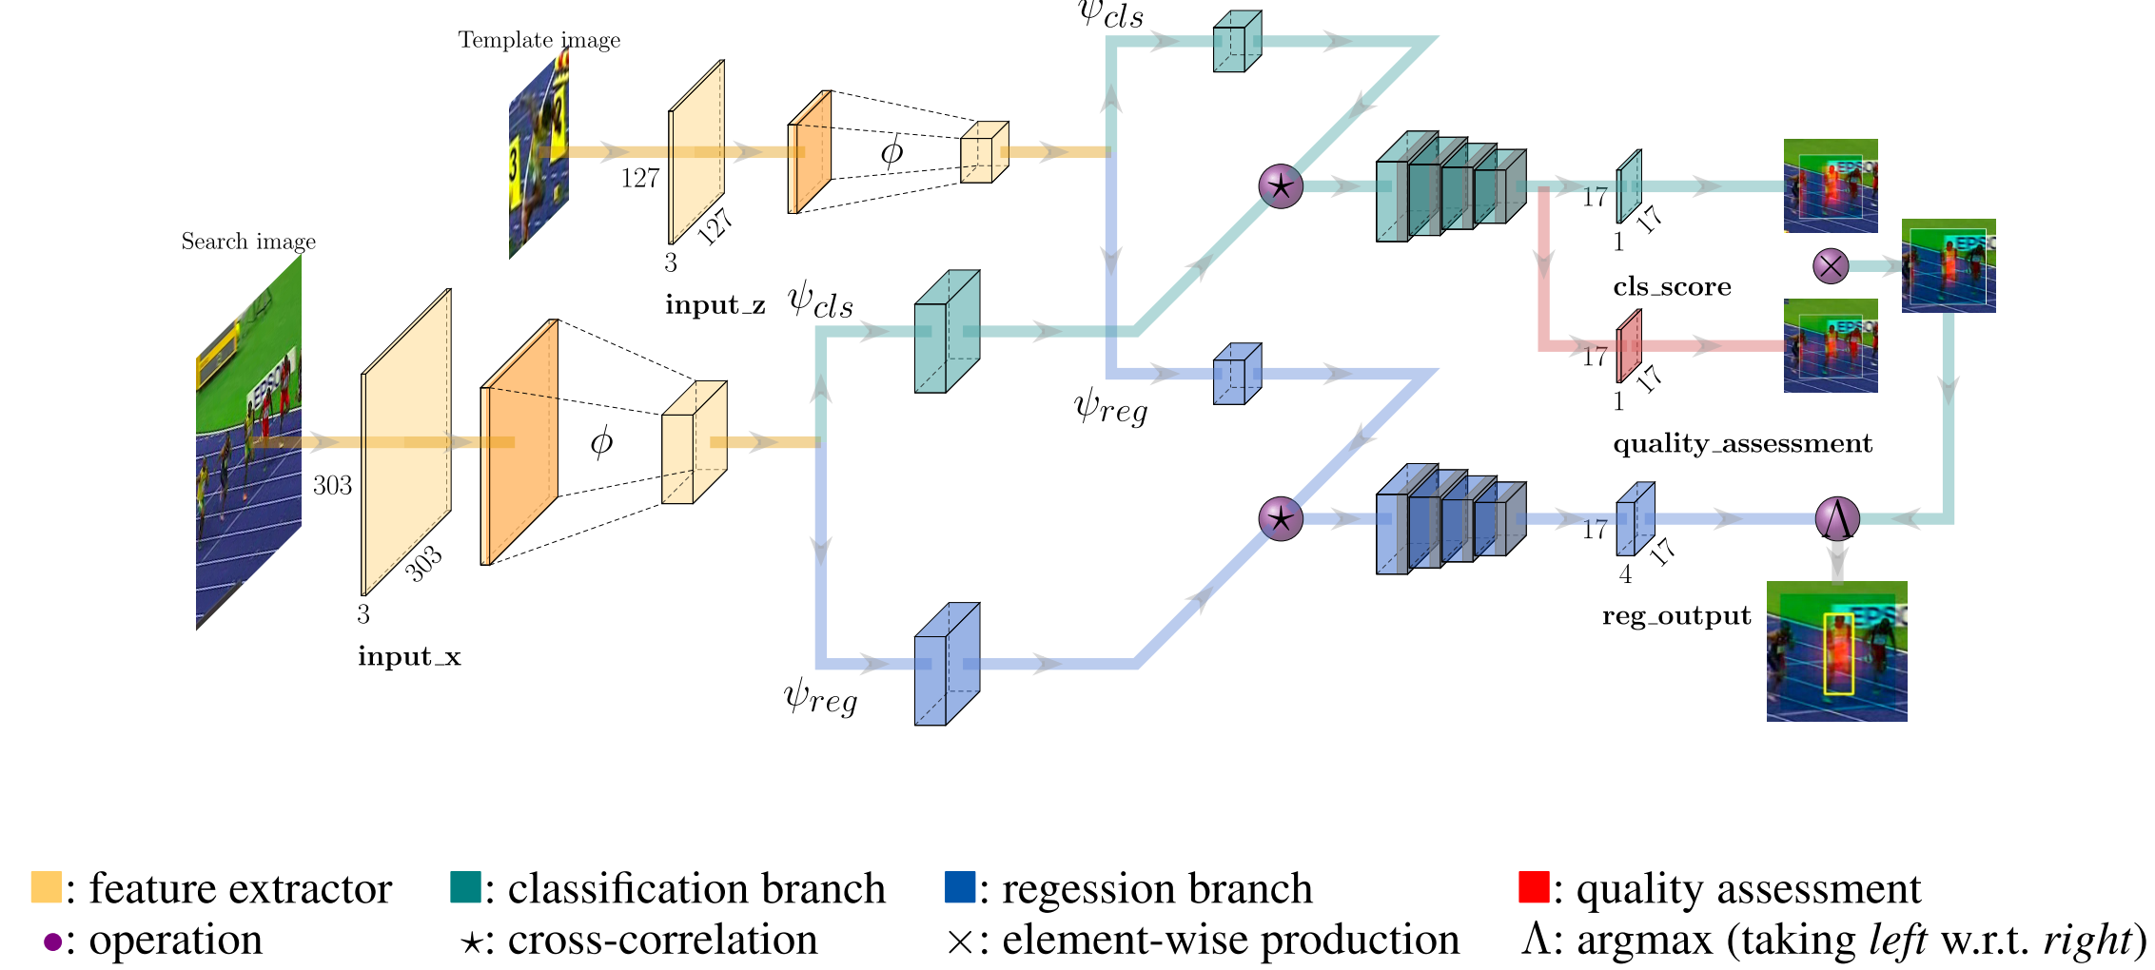
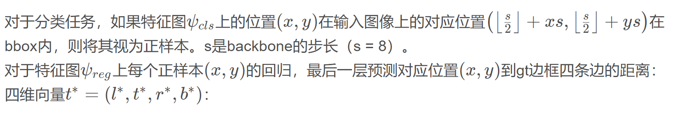
Classification 分支是用于大致定位，而 Regression 分支则是为了得到更加准确地 BBox 位置信息。这部分网络的设计借鉴 FCOS 物体检测方法。

Slide 7
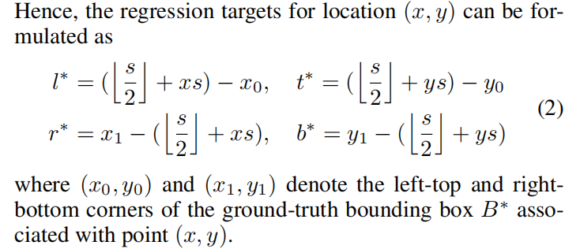
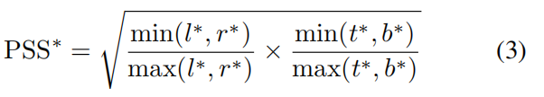

分类的得分并没有和定位的准确度很好地对应。作者采用了这种中心先验的做法，并且服从 G4，添加了一个简单但是有效的 quality assessment branch 来进行跟踪效果评估。该输出可以去预测先验空间得分（the Prior Spatial Score, PSS）
PSS评分代表了在滑动窗中心的像素点具有高评分，远离中心点像素的评分会降低，做了一个像素级的加权

Slide 8
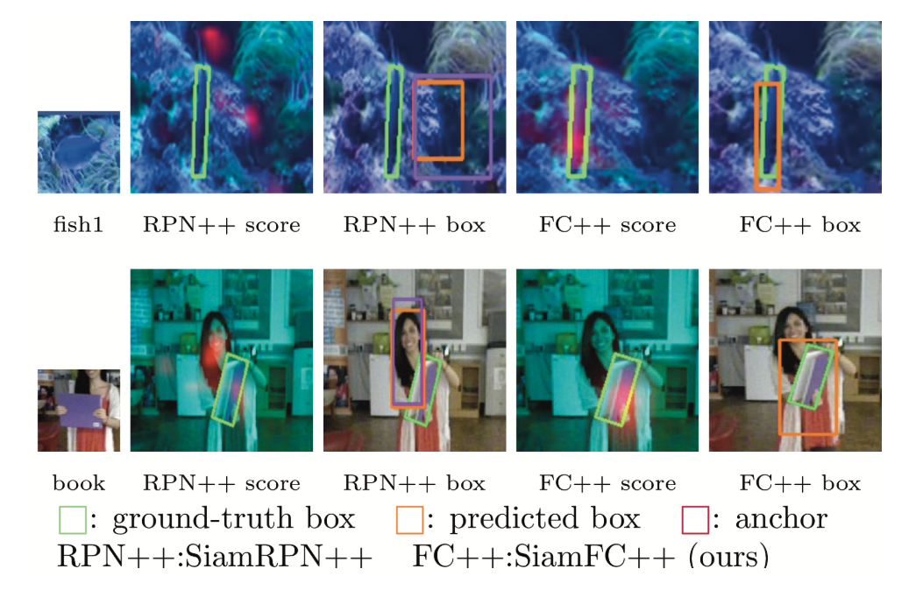
Result

Slide 9
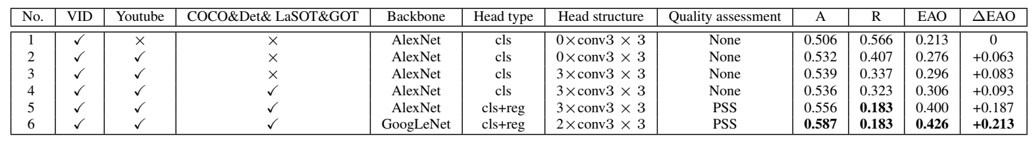
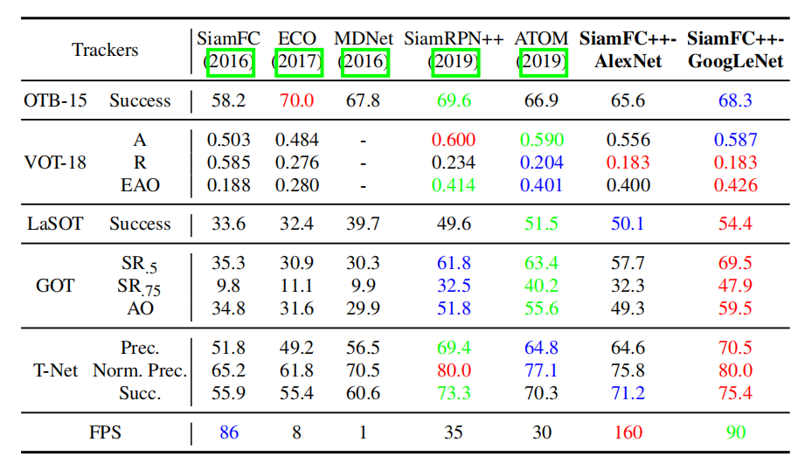
Experiment

