Slide 1
INTRODUCTION
-----Zhou Ziyu
周子瑜

Slide 2

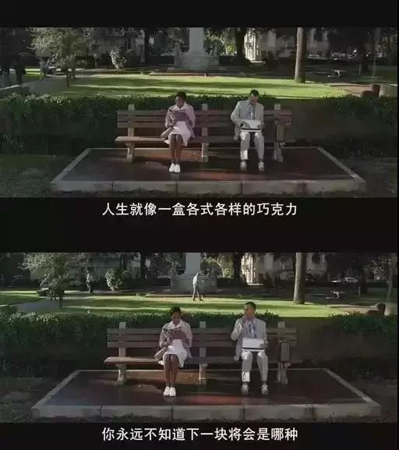
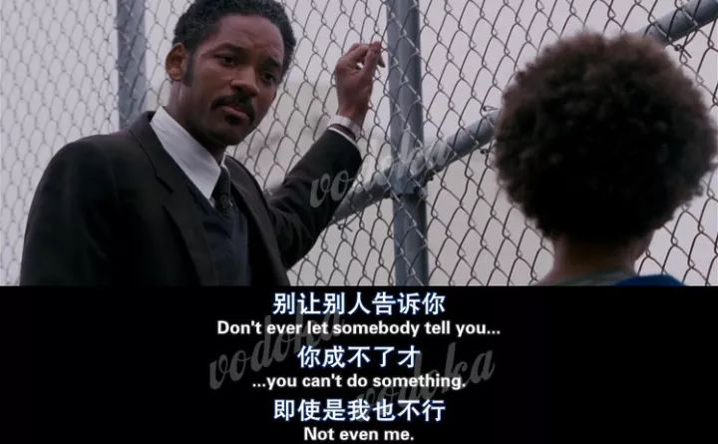
Personal Information:
you can know about it in my word
Hobbies:
1
Movies
I like movies which are energetic
Which can make me have a good mood

Slide 3

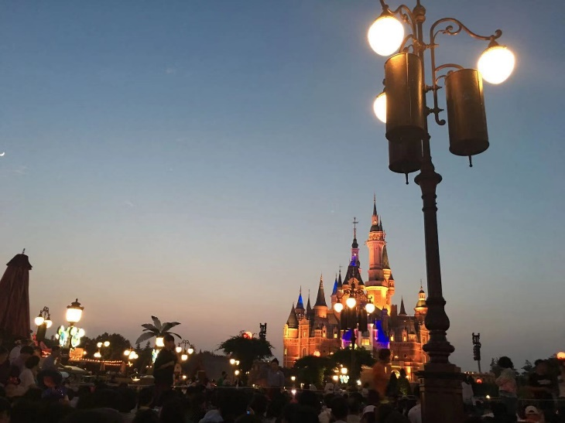
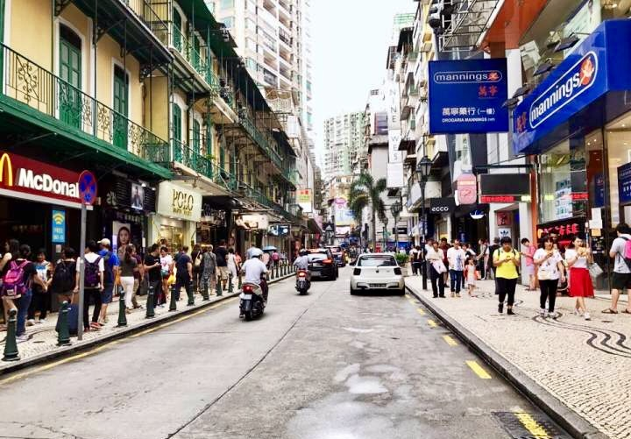
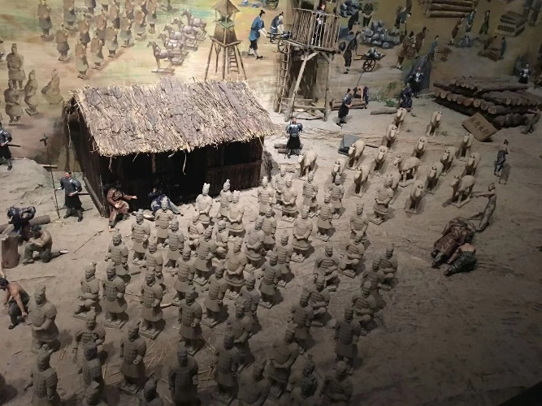
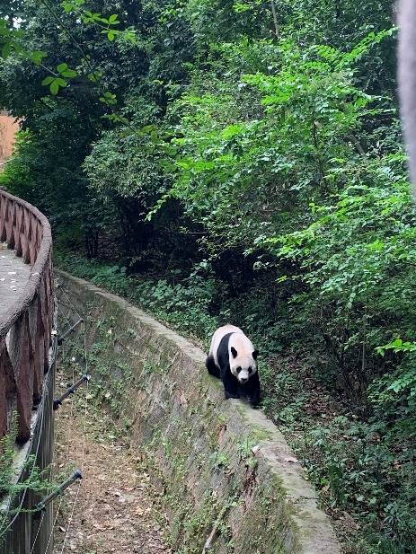
Travel
2
I also like traveling
I been to many places during this summer vocation
Shanghai
Chengdu
Macao
Xi’an

Slide 4
More information about me is in my word
Thank you

