Slide 1
Admin Console Backend
Jinming Lv
2018-08-29

Slide 2
Backgroud
Based on the new Admin console, we need automatic capture video from camera, admin already assign camera capture job to different host. Backend should launch capture app based on the camera and monitor capture status

Slide 3
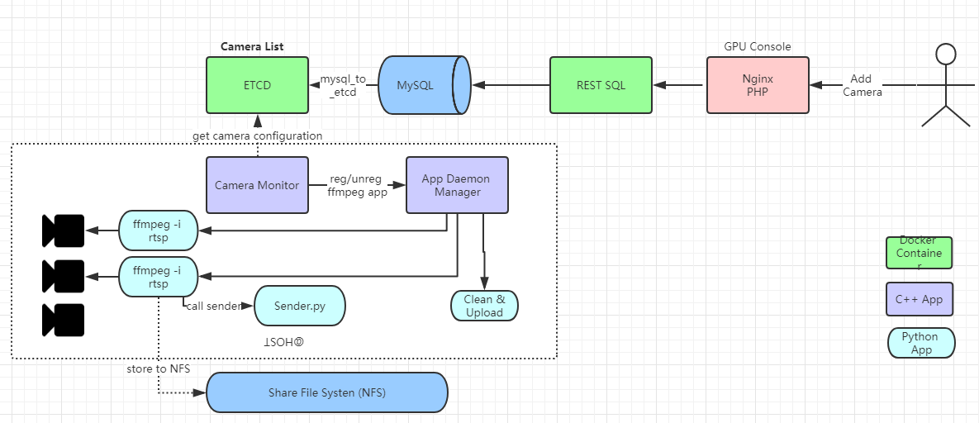
Artitecture

Slide 4
Scope [Camera Monitor Service]
Get camera list from ETCD.
Register video capture application to capture videos.
Write service status to ETCD with TTL when this app started
/db/deepnorth/capturehost/hostA
/db/deepnorth/capturehost/hostB
Update Capture status to ETCD (with ttl)
/db/deepnorth/capturehost/hostA/$camera_id/status
Unreg application when un-assigned
Update current capture status to ETCD (with ttl)
/db/deepnorth/capturehost/hostA
Update capture app when parameter changed
Capture host support HA
Notes:
Auto start: https://blog.csdn.net/jjwen/article/details/51453431

Slide 5
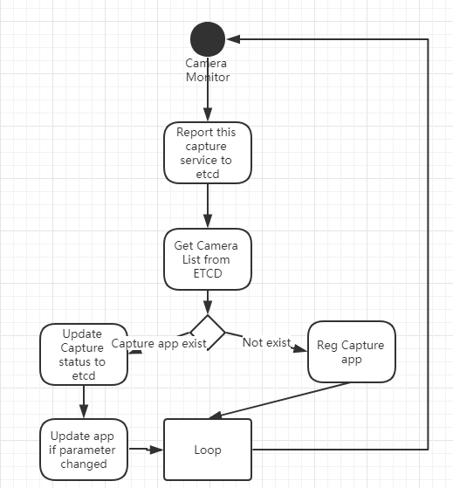
Active Diagram

Slide 6
Deployment
cameramonitor (binary implemented by C++ with cmd line parameter –etcdip & --etcdport)
Parameter
-p capture interface ffmpeg/vlc/ffmpegapi/vlcapi default is vlc
Application definition segment for App Daemon Manager:
{ "name": "cameramonitor", "run_as": “vmaxx", "command_line": “/opt/cameramonitor –etcdip=192.168.1.151 –etcdport=2379 –p vlc", "working_dir": "/opt", }

