Slide 1
Admin Console Backend
Jinming Lv
2018-08-29

Slide 2
Backgroud
The new video capture will take charge of video and picture capture from camera RTSP stream. The capture parameter is defined in Database, video capture application is managed by camera monitor service and launched by App Daemon Manger.

Slide 3
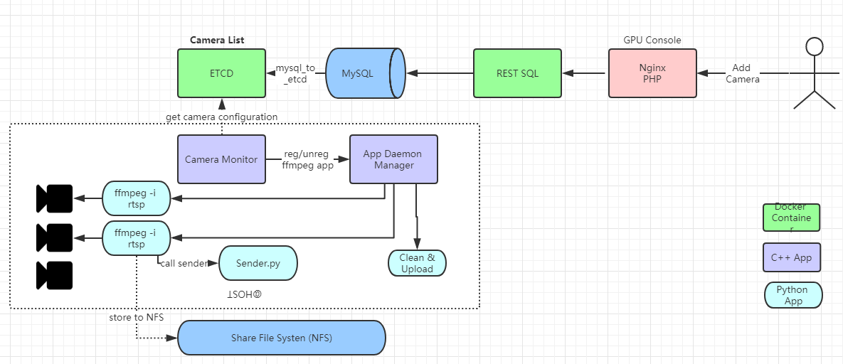
Artitecture

Slide 4
Scope [Camera Monitor Service]
Capture video from RTSP stream.
Send capture result to Message Queue.
Return exit code in different error case.
Notes:
Auto start: https://blog.csdn.net/jjwen/article/details/51453431

Slide 5
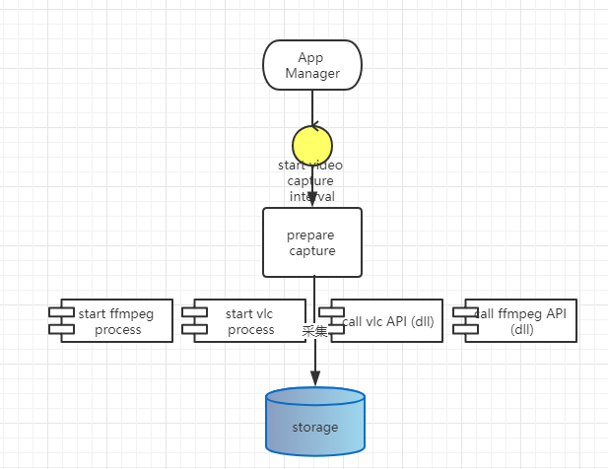
Interface
Capture component is defined in camera monitor

Slide 6
Parameter
-c camera rtsp address
-u camera id
-q message queue address 192.168.1.151:5672
-t capture type : video/picture
-i interval seconds
-d media store directory, default is /opt/deepnorth/ （如果目录不存在需要新创建）
-p capture interface ffmpeg/vlc/ffmpegapi/vlcapi default is vlc

Slide 7
File name format
Directory:
$base_dir/$camera_id/YYYY-MM-DD/
File name:
Picture:
Yyyyy-MM-dd _HH.mm.ss_120.jpg
Video
YYYY-MM-dd_HH.mm.ss_120.mp4 120表示视频长度2分钟

Slide 8
Message
Message Body send to RabbitMQ:
{
camera_id:123,
capture_time:”2018-08-30 10:00:00”,
capture_duration_seconds:50*60,
file_path:”/opt/deepnorth/$camera_id/$day/xxxx.mp4”
}

Slide 9
Error code
201: camera unavailable
202: no enough disk
203: no permission to write file
204:
205:

Slide 10
Deployment
videocapture (binary implemented by C++)
All dependency should be include in one package, no need install 3rd party on customer site.
Application definition segment for App Daemon Manager:
{ "name": capture camera $camera_name", "run_as": “vmaxx", "command_line": “/opt/videocapture –i rtsp:127.0.0.1 …", "working_dir": "/opt", }

