Slide 1
维视科技
Camera Status Design
Jinming Lv
2019-03

Slide 2
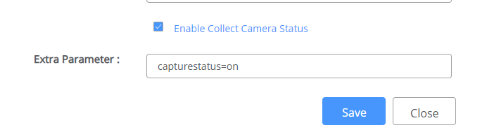
Components
AdminConsole
Add a check of camera status to camera settings
Notes:
The switch is added to top of “Extra Parameter” edit box , check it means add a sting “camerastatus=on” to the edit box, uncheck to delete.

Slide 3
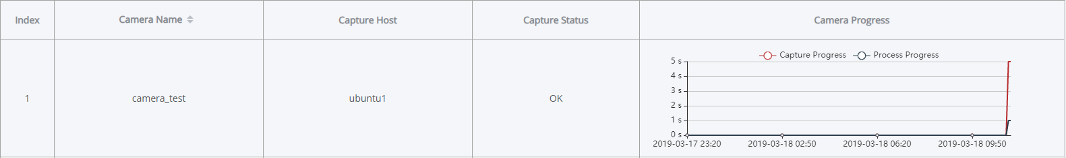
Components
AdminConsole
Change menu “capture status“ to “camera status”
Camera Status use a new column to show status of each camera
X-coordinate shows the time 3hours/72hours(user changeable) to current
Y-coordinate shows the time used by both capture and process
Graph is showed at the end of each column, and can be maximized by click

Slide 4
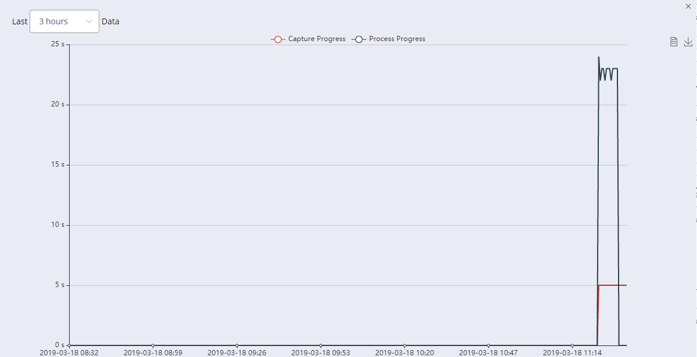
Components
Notes:
The maximized graph

Slide 5
Components
VideoCapture
Generate a json file after capture is done.
DB_rest_agent
Support “update” operation
Scheduler
Use newly added “update” interface to update processed status
Notes:
These modules don`t have any GUIs.

Slide 6
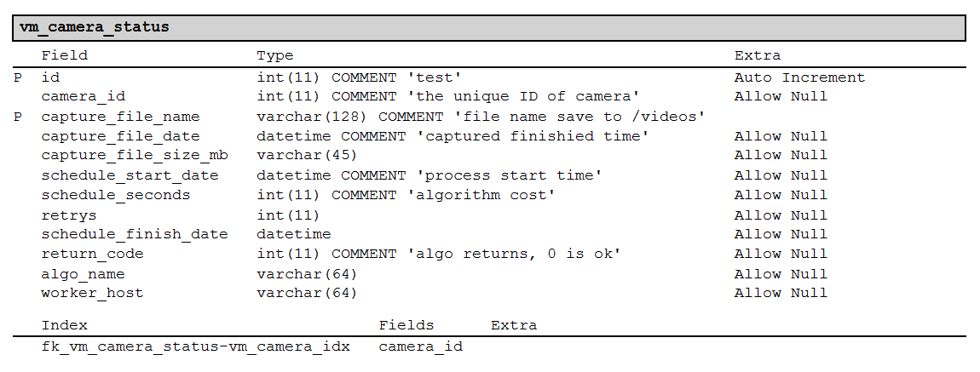
DB Table design

Slide 7
Components
Algorithm Status
Dimension(set boundary)
Algorithm--all algorithms installed on all hosts
Host--all hosts
Type(status type)
Statics
Algorithm--shows each algorithm`s pending/finished/error MQs
Host-shows each host`s pending/finished/erros MQs
Allocation
Algorithm--shows the number of workers allocated to each algorithm
Hosts--shows the number of workers(algorithm) runs on each host
Throughput
Algorithm—shows the throughput of each algorithm
Hosts—shows the throughput of each host

Slide 8
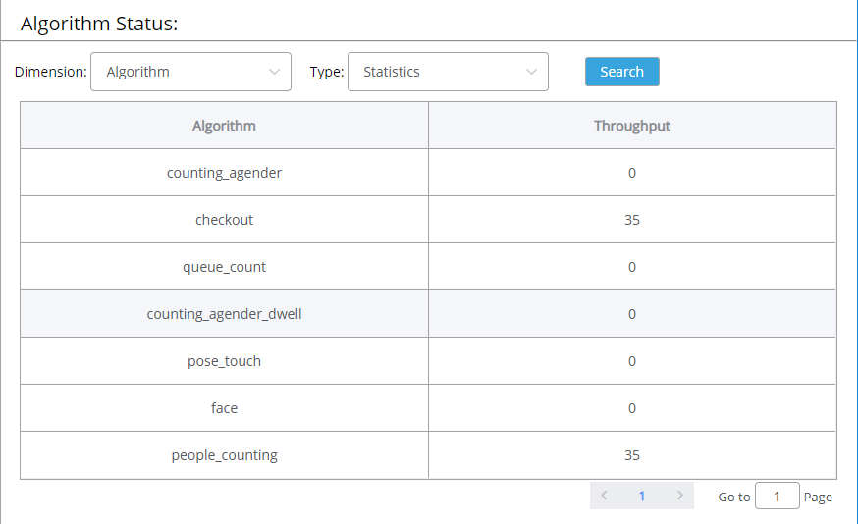
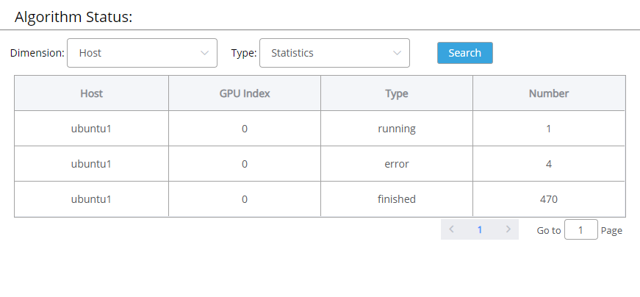
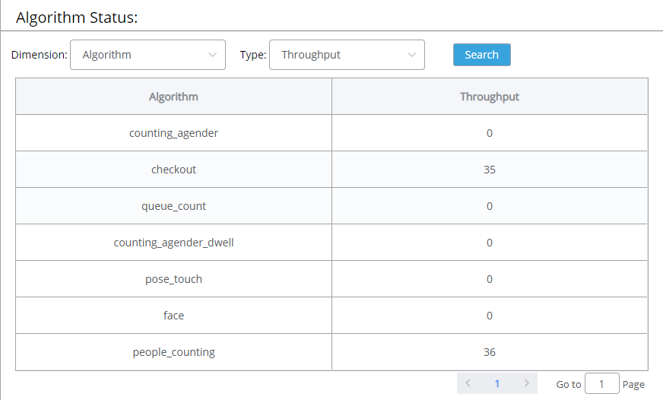
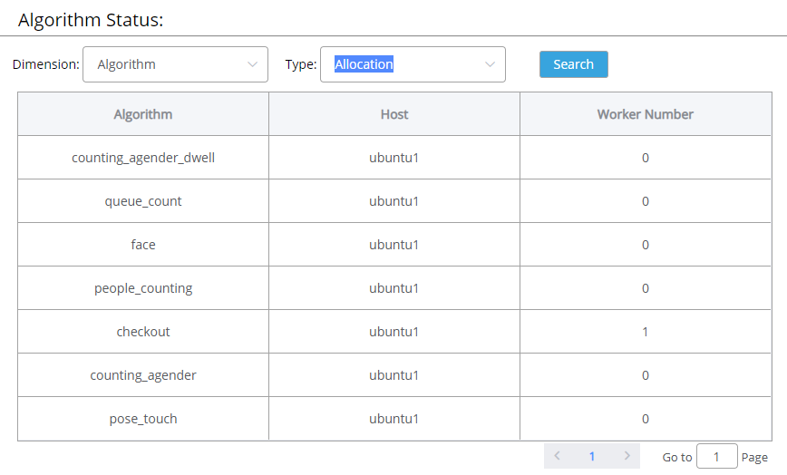
Components

Slide 9
DB Table design
vm_etcd designs
Statics
Algorithm
Host
key | value
/db/deepnorth/scheduler/statistics/algorithoms/${algo-name}/pending | pending number
/db/deepnorth/scheduler/statistics/algorithoms/${algo-name}/error | error number
/db/deepnorth/scheduler/statistics/algorithoms/${algo-name}/${type} | finished number
key | value
/db/deepnorth/capturehost/${host-name}/${camera-id}/status | status str

Slide 10
DB Table design
vm_etcd designs
Allocation
Both algorithm and host share one dataset
Throughput
Algorithm
Host
key | value
/db/deepnorth/scheduler/allocation/${algo-name}/${host-name}/workers | worker number
key | value
/db/deepnorth/scheduler/throughput/algorithoms/${algo-name} | Algo throughput value
key | value
/db/deepnorth/scheduler/throughput/hosts/${host-name} | Algo throughput value

