Slide 1
Camera picture upload
Jianhao Hou
Notes:
1

Slide 2
Backgroud
Camera_pic_upload periodically scans the table vm_camera_picture_collect in the database through the rest interface, obtains the code stream url in the vm_camera table according to the camera_id in the read record, grabs a picture from the code stream, uploads azure according to the configuration or saves it to a local directory, and Update the record status of the vm_camera_picture_collect table in the database and the screen_capture field in the vm_camera table
Notes:
1

Slide 3
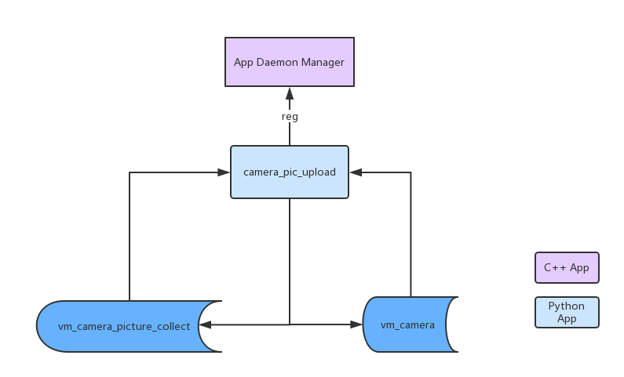
Artitecture

Slide 4
Scope [Camera picture upload]
Scan table vm_camera_picture_collect in database.
Process all records, capture a picture, send to azure or save to local dir, update table vm_camera_picture_collect and vm_camera.
Only one camera_pic_upload can be installed in the same environment.
Notes:
Auto start:
https://blog.csdn.net/jjwen/article/details/51453431
<number>

Slide 5
Parameter
--timeout set upload timeout time .
--cloudpath set uplaod file path on Azure .
--interval scan sleep interval
--loopnum scan loop number
--local picture save directory on location
–-urlpref url prefix

Slide 6
Deployment
camera-pic-upload (binary implemented by c++)
Application definition segment for App Daemon Manager:
{
"active" : 1,
"command_line" : "/opt/deepnorth/camera_pic_upload/camera_pic_upload --timeout 10 --cloudpath \"dashboardv1_01/adminconsole/\" --interval 2 --loopnum 1800 --local \"\" --urlpref \"\"",
"index" : 2,
"keep_running" : true,
"name" : "camera-pic-upload",
"pid" : 10358,
"posix_timezone" : "",
"return" : 0,
"run_as" : "root",
"start_interval_seconds" : 3600,
"start_interval_timeout" : 0,
"start_time" : "2019-04-26 01:55:46",
"working_dir" : "/opt/deepnorth/camera_pic_upload"
}

