Slide 1
Fine-grained deep-learning algorithm scheduling
Jinming Lv
2018-09-20

Slide 2
Backgroud
Currently, one customer may have many kinds of algo to process, different algo have different resource cost, it’s hard to balance those video/pic data and GPU resources.

Slide 3
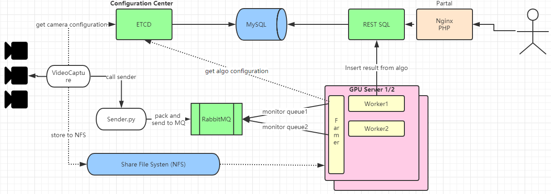
Architecture
1. Each GPU host deploy one Scheduler
2. Scheduler monitor MQ to consumer data

Slide 4
Pain point
Algo number is not fixed (2-10)
Each algo have different GPU/CPU cost
GPU host and GPU card number is not fixed
GPU host and GPU card might down
Algo load and unload cost much time
Algo cost might different for different time range (based on video scene) (collect running cost?)
Each algo process should run more than one task
Notes:
Auto start: https://blog.csdn.net/jjwen/article/details/51453431

Slide 5
Schedule
Input: Define the <worker number> for each queue and the queue resource cost
Output: Those worker should be balanced on different GPU card
E.g:
queue1 => 6
queue2 => 12
GPU card = 6, each card run <1> queue1 worker and <2> queue2 worker.
To sum up: scheduler will balance those worker inner one host

Slide 6
Schedule
Each queue resource cost was defined in table “vm_algo_parameter” include GPU/CPU/MEM
The predefined worker number is also defined in table “vm_algo_parameter”
Two level schedule:
1st level:
Balance all the pre-defined worker number on each host and GPU card.
2nd level:
If one host still have free resource, check all other queues and pickup job from most pending queues, until the queue is not most pending queue. (the dynamic worker number should not cost all the resource) (and also dynamic resource should handle more satisfied queue, e.g mem intensive)

Slide 7
Schedule
ETCD integration:
Each scheduler will update schedule status to ETCD:
/deepnorth/scheduler/${QUEUE_1}/${GPU_HOST_1}/static = queue1 1st level schedule result [a number value] on gpu-host-1
/deepnorth/scheduler/${QUEUE_1}/${GPU_HOST_1}/dynamic = queue1 2nd level schedule result [a number value] on gpu-host-1
When each scheduler do the calculation, need hold queue level lock (distribute lock)
/deepnorth/scheduler/${QUEUE_1}

Slide 8
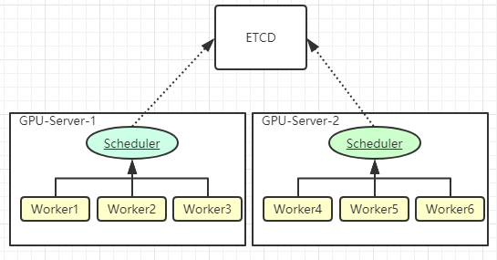
Architecture
Each GPU host will run one Scheduler which is share to others.
Scheduler will publish status to ETCD so that other Scheduler can known all scheduler number.
When one Scheduler down or add a new one, all Scheduler will be updated.
Each scheduler will start same number of workers for each queue.

Slide 9
Configuration
Draft resource usage for a specific queue (parameter is defined from deploy web console):
people_count:
Memory: 1228 [ = 1.2G]
CPU: 0.6 [ = 60%]
GPU: 0.3 [ = 30%]
RESERVED_WORKERS: 6
Other configuration
enable_dynamic_schedule = true [dynamic_schedule means the 2nd level schedule]

Slide 10
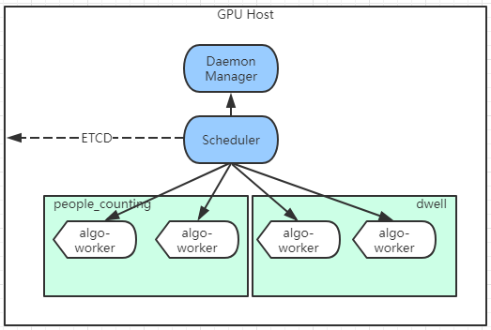
Deployment
Scheduler is started by application manager

