Slide 1
Start with R for Survey Analysis

Slide 2
1. Download R

Slide 3
2. Download RStudio

Slide 4
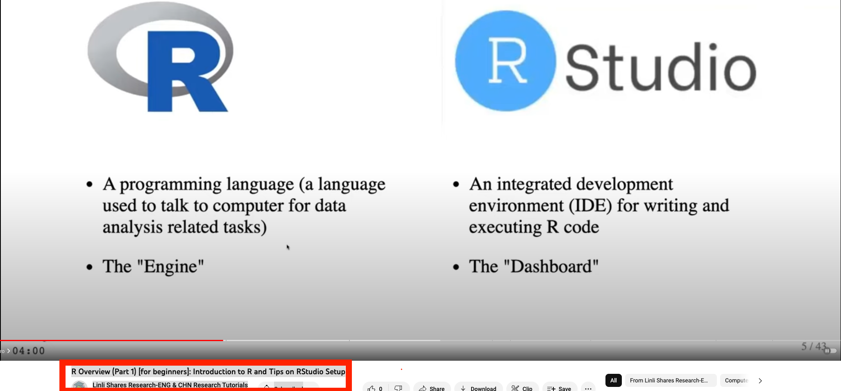
R Overview (Part 1) [for beginners]: Introduction to R and Tips on RStudio Setup

Slide 5
3. Download sample files
1. theme_source.R
2. FirstImpSurvey.Rmd

Slide 6
4. Open FirstImpSurvey.Rmd using R

Slide 7
5. Run through the file
Find the file path of the following files
1) theme_source.R
2) Data file

