Slide 1
Distance Distribution with Simulated BSD

Slide 2
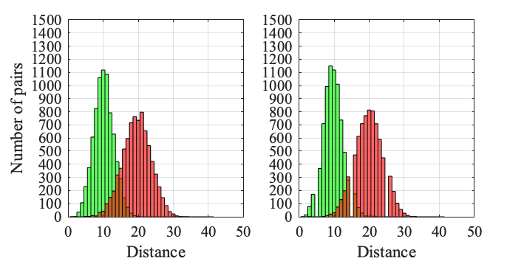
Route length = 10, Accuracy = 75%
Union Square (12%)
Wall Street (19%)

Slide 3
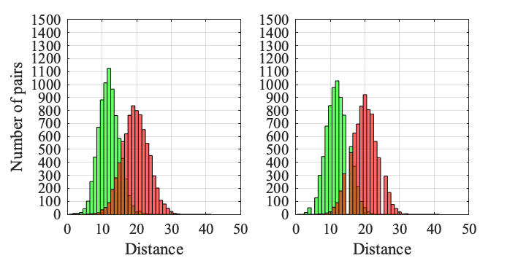
Route length = 10, Accuracy = 70%
Union Square (3.6%)
Wall Street (5.4%)

Slide 4
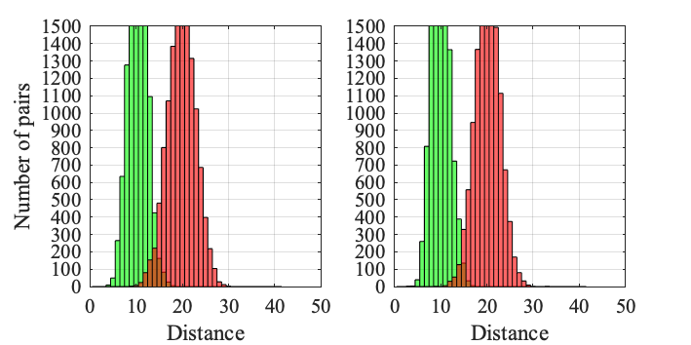
Route length = 20, Accuracy = 75%
Union Square (41.4%)
Wall Street (66%)

Slide 5
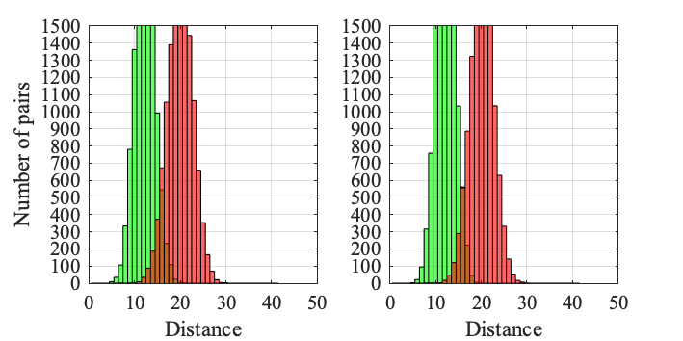
Route length = 20, Accuracy = 70%
Union Square (19.4%)
Wall Street (26.4%)

Slide 6
Distance Distribution with Real BSD

Slide 7
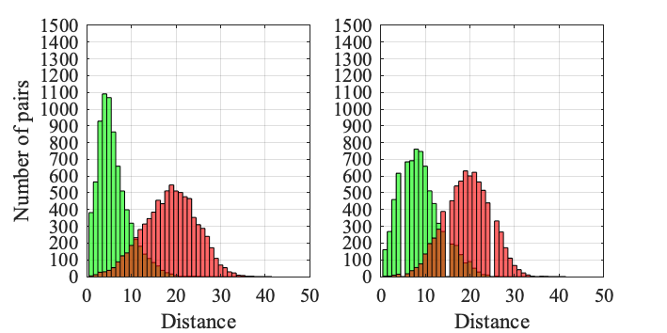
Route length = 10
Union Square (7.4%)
Wall Street (11.2%)

Slide 8
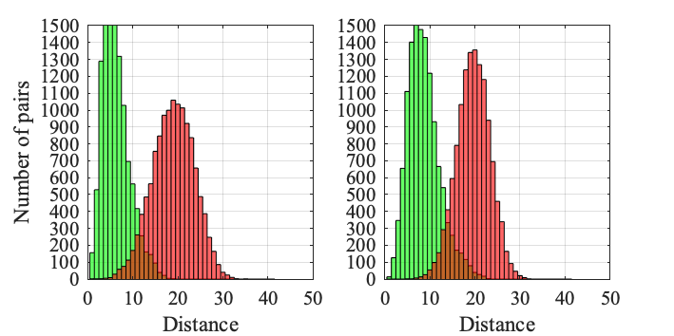
Route length = 20
Union Square (20.2%)
Wall Street (34.5%)

Slide 9
BSD Distribution for Different Areas

Slide 10
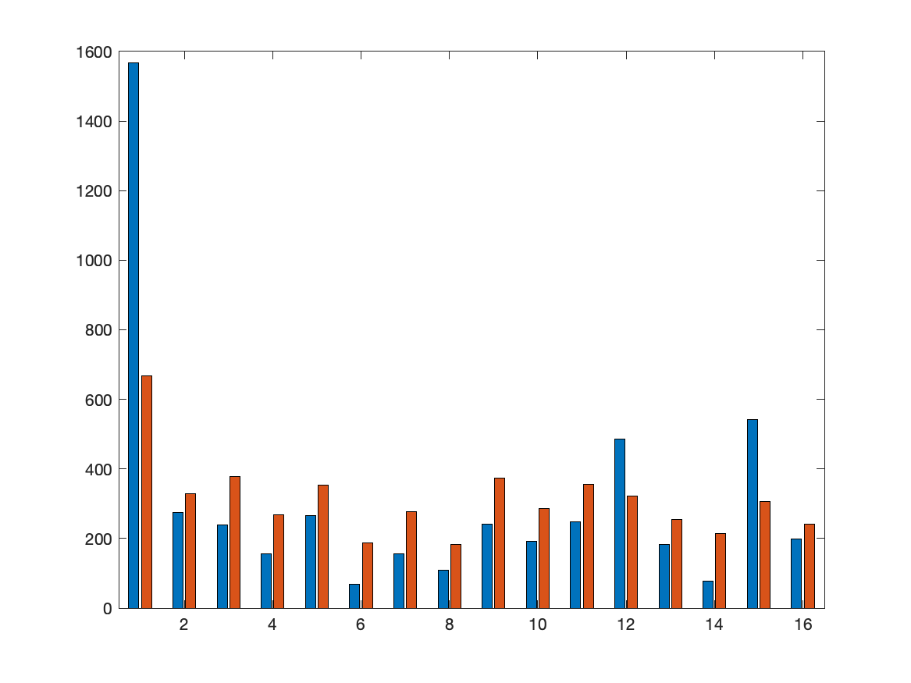
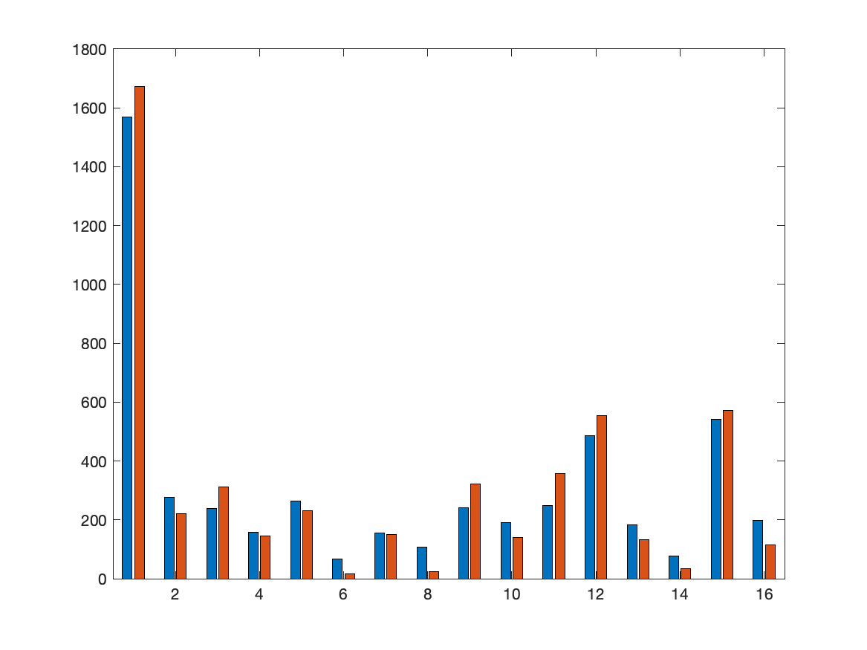
Union Square
Simulated Classifier
Real Classifier

Slide 11
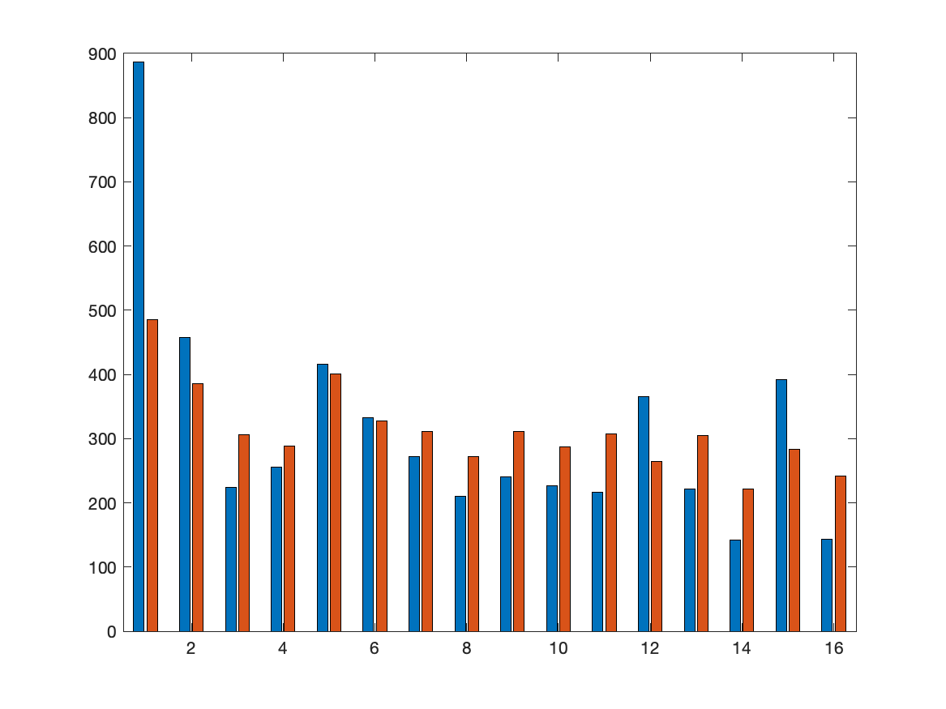
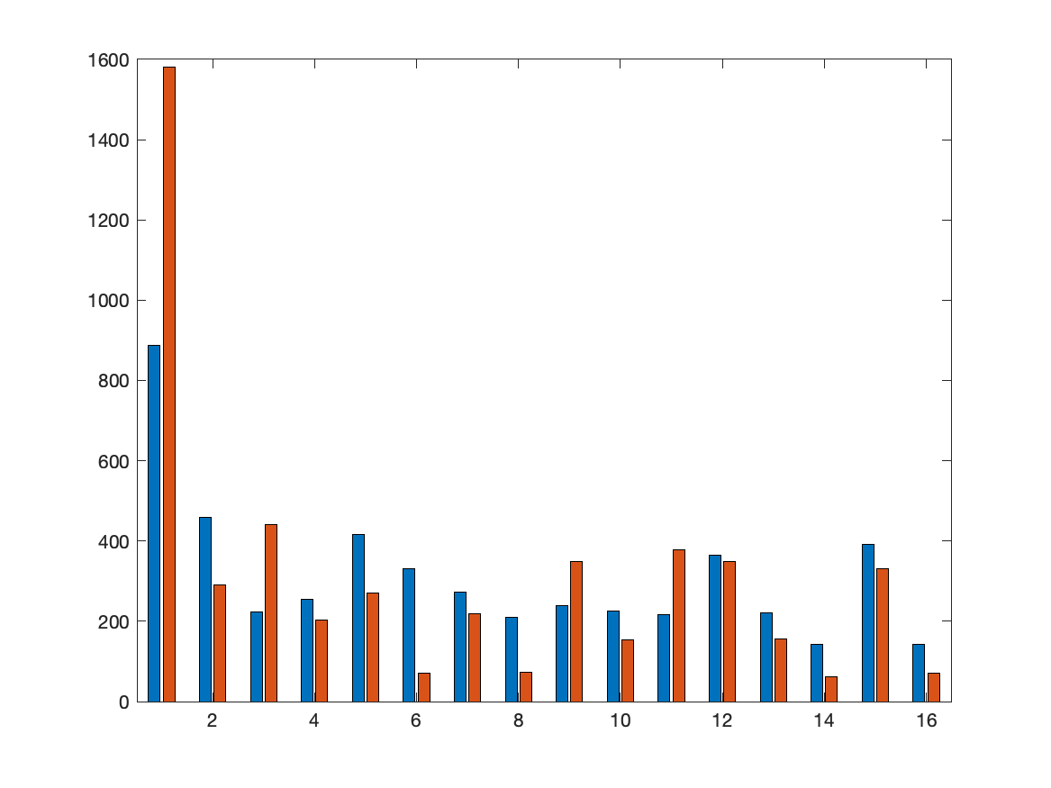
Wall Street
Simulated Classifier
Real Classifier

Slide 12
Dataset Statisctic for Training, Validation and Testing

Slide 13
Training Set
Num of junctions | Num of non_junctions | Num of gaps | Num of non_gaps
63404 | 124130 | 88272 | 99262
187534 |  | 187534
375068
Validation Set (Hudson River)
Num of junctions | Num of non_junctions | Num of gaps | Num of non_gaps
2989 | 7011 | 3372 | 6628
62.395% | 92.619% | 79.982% | 87.251%
83.27% |  | 84.8%

Slide 14
Testing Set (Wall Street)
Num of junctions | Num of non_junctions | Num of gaps | Num of non_gaps
4260 | 5740 | 4023 | 5977
48.099% | 91.725% | 75.367% | 85.16%
73.14% |  | 81.22%
Testing Set (Union Square)
Num of junctions | Num of non_junctions | Num of gaps | Num of non_gaps
3156 | 6844 | 4297 | 5703
66.635% | 93.834% | 85.641% | 86.358%
85.25% |  | 86.05%

Slide 15
Classification Accuracy for Each Bit

Slide 16
Statistic accuracy for each bit
 |  | Bit 1 | Bit 2 | Bit 3 | Bit 4
Wall Street | Whole area | 73.64% | 81.7% | 72.64% | 80.74%
 | test routes | 78.89% | 83.05% | 77.32% | 84.49%
Union Square | Whole area | 84.92% | 86.32% | 85.58% | 85.78%
 | test routes | 84.87% | 87.36% | 85.51% | 86.31%

Slide 17
Statistic accuracy for each category
 |  | junction | Non_junction | gap | Non_gap
Wall Street | Whole area | 48.1% | 91.72% | 75.37% | 85.16%
 | test routes | 56.3% | 92.06% | 81.89% | 85.5%
Union Square | Whole area | 66.64% | 93.83% | 85.64% | 86.36%
 | test routes | 65.03% | 93.89% | 87.09% | 86.65%

Slide 18
Localisation Accuracy with different classifiers

Slide 19
Localisation Accuracy With Real Classifier (with Turns)
 | 5 | 10 | 15 | 20 | 25 | 30 | 35 | 40
Wall street | 0.042 | 0.31 | 0.58 | 0.778 | 0.864 | 0.932 | 0.958 | 0.96
v2 | 0.114 | 0.522 | 0.846 | 0.95 | 0.974 | 0.982 | 0.986 | 0.978
v3 | 0.09 | 0.442 | 0.776 | 0.91 | 0.96 | 0.98 | 0.982 | 0.968
Union square | 0.046 | 0.164 | 0.31 | 0.478 | 0.662 | 0.824 | 0.898 | 0.942
v2 | 0.18 | 0.592 | 0.834 | 0.926 | 0.974 | 0.992 | 0.992 | 0.982
v3 | 0.144 | 0.5 | 0.756 | 0.906 | 0.972 | 0.988 | 0.99 | 0.986

Slide 20
Localisation Accuracy With Real Classifier (without Turns)
 | 5 | 10 | 15 | 20 | 25 | 30 | 35 | 40
Wall street | 0.03 | 0.112 | 0.226 | 0.345 | 0.458 | 0.568 | 0.63 | 0.678
v2 | 0.052 | 0.224 | 0.506 | 0.682 | 0.84 | 0.872 | 0.902 | 0.894
v3 | 0.034 | 0.164 | 0.388 | 0.534 | 0.672 | 0.738 | 0.79 | 0.798
Union square | 0.018 | 0.074 | 0.152 | 0.202 | 0.314 | 0.44 | 0.532 | 0.598
v2 | 0.122 | 0.428 | 0.702 | 0.85 | 0.894 | 0.946 | 0.956 | 0.934
v3 | 0.094 | 0.328 | 0.546 | 0.772 | 0.85 | 0.89 | 0.938 | 0.902

Slide 21
 | Accuray | Precision | Recall | F1 - score | Loss
Junction | 83.3% | 77.3% | 62.4% | 69 | 0.3891
Building gap | 84.8% | 76.1% | 80% | 78 | 0.3909

Slide 22
