Slide 1
Distance Distribution with Simulated BSD

Slide 2
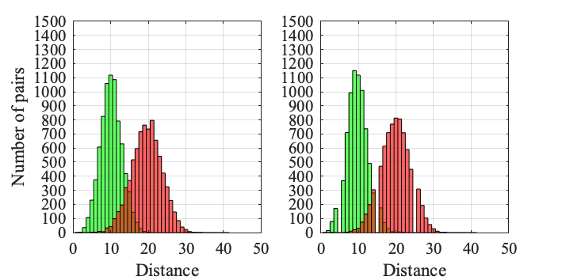
Route length = 10, Accuracy = 75%
Union Square (12%)
Wall Street (19%)

Slide 3
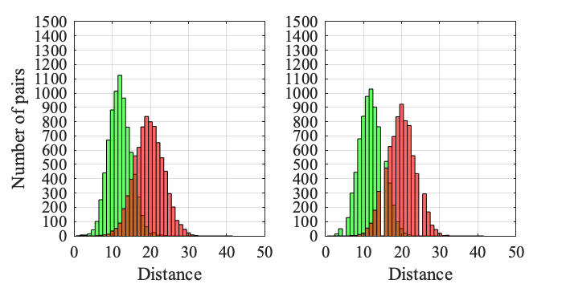
Route length = 10, Accuracy = 70%
Union Square (3.6%)
Wall Street (5.4%)

Slide 4
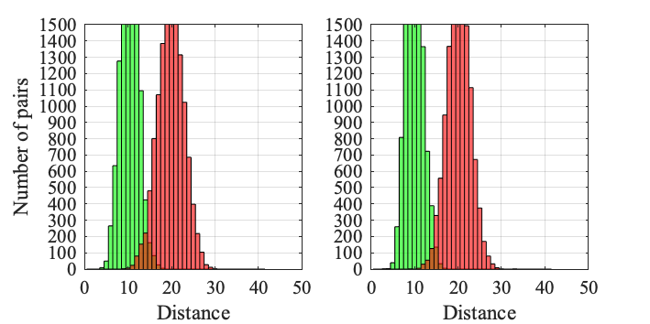
Route length = 20, Accuracy = 75%
Union Square (41.4%)
Wall Street (66%)

Slide 5
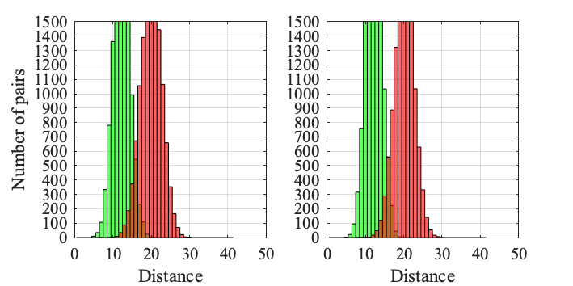
Route length = 20, Accuracy = 70%
Union Square (19.4%)
Wall Street (26.4%)

Slide 6
Distance Distribution with Real BSD

Slide 7
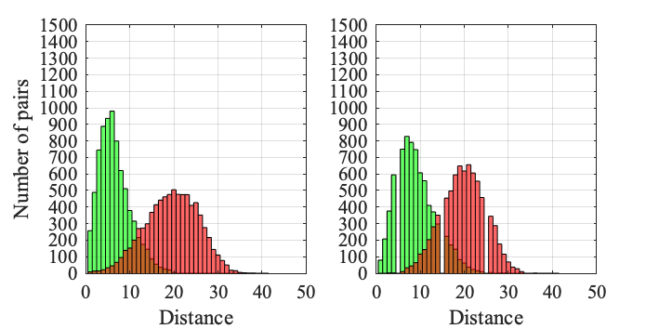
Route length = 10
Union Square (7.8%)
Wall Street (8.4%)

Slide 8
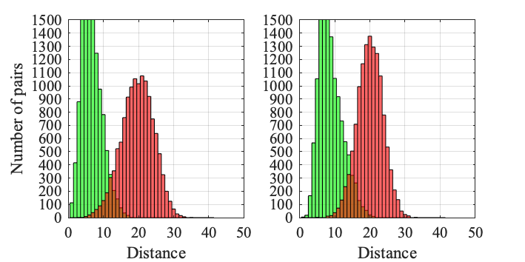
Route length = 20
Union Square (26.2%)
Wall Street (37.4%)

Slide 9
BSD Distribution for Different Areas

Slide 10
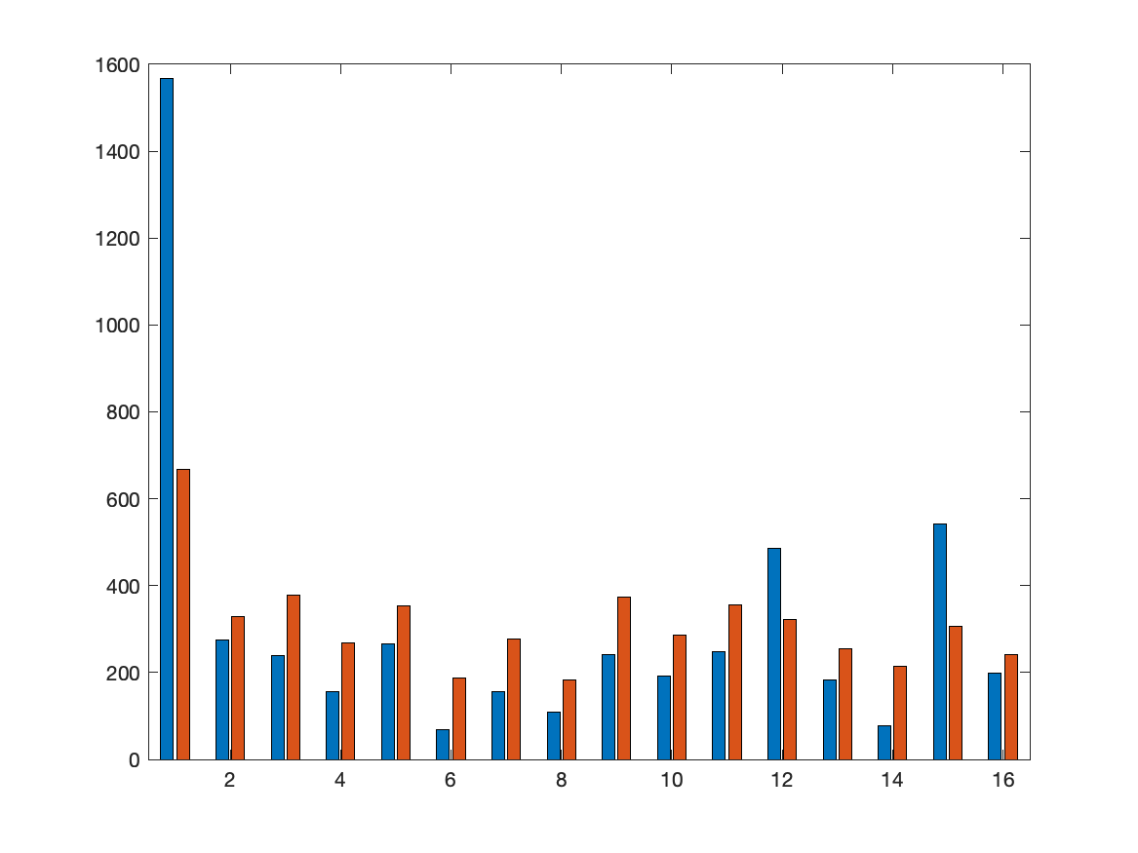
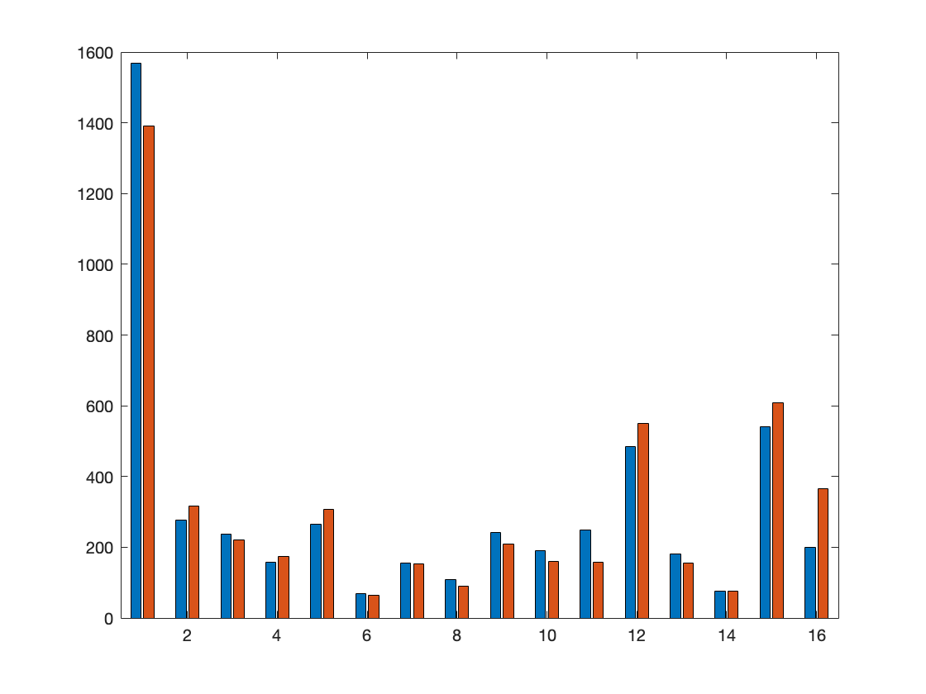
Union Square
Simulated Classifier
Real Classifier

Slide 11
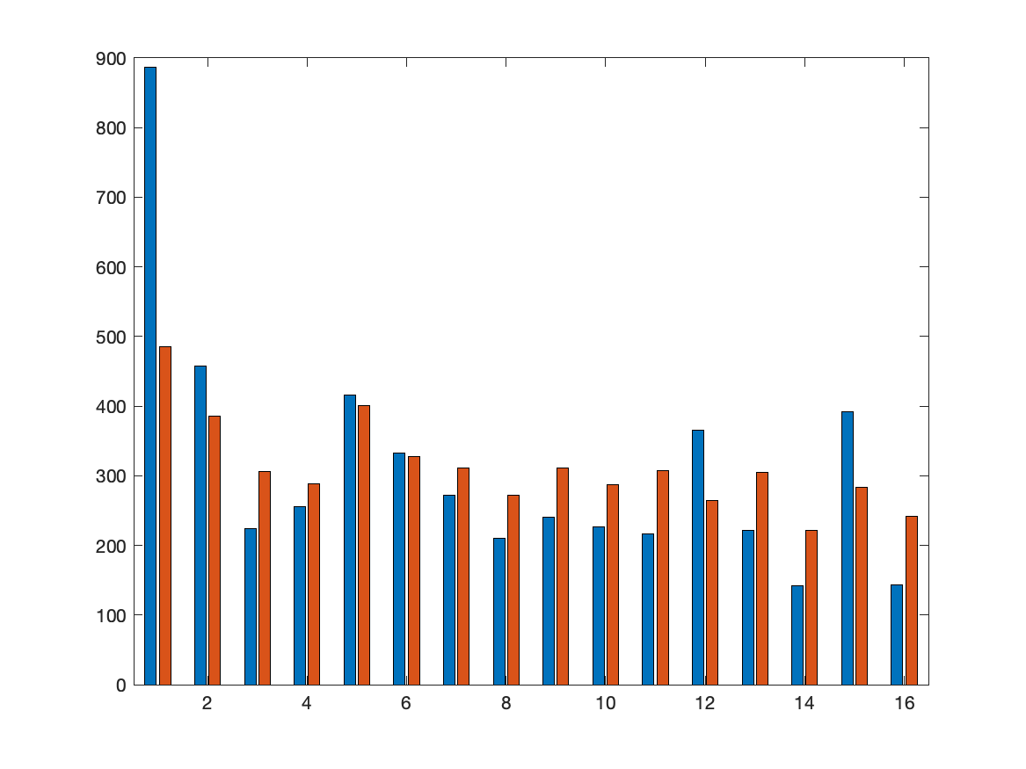
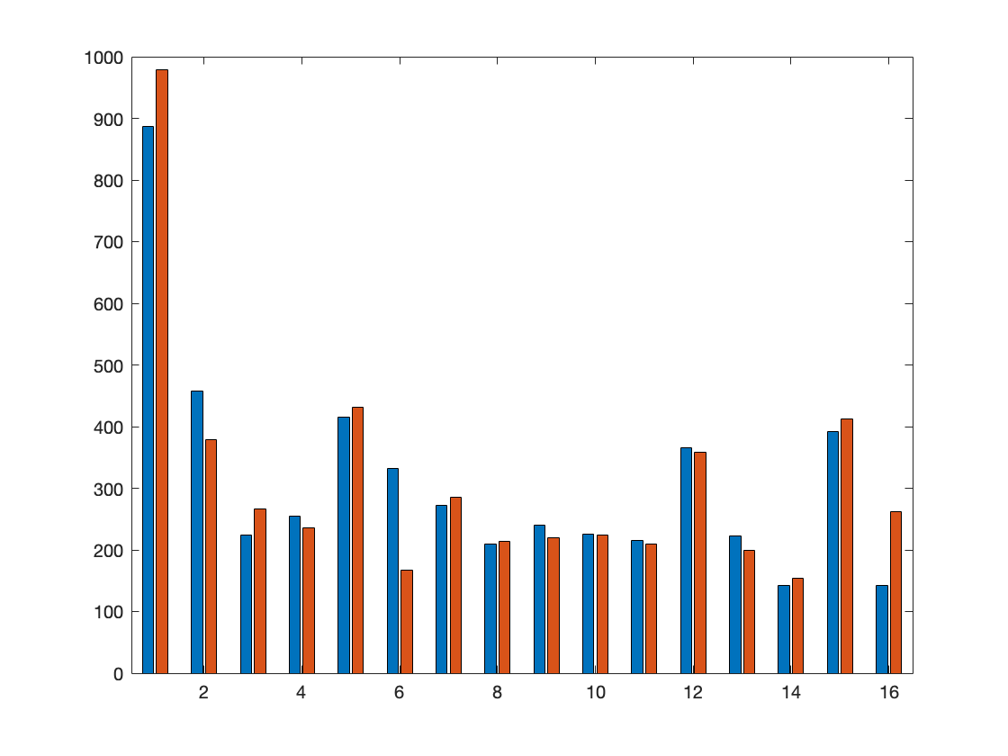
Wall Street
Simulated Classifier
Real Classifier

Slide 12
Dataset Statisctic for Training, Validation and Testing

Slide 13
Training Set
Num of junctions | Num of non_junctions | Num of gaps | Num of non_gaps
63404 | 124130 | 88272 | 99262
187534 |  | 187534
375068
Validation Set (Hudson River)
Num of junctions | Num of non_junctions | Num of gaps | Num of non_gaps
2989 | 7011 | 3372 | 6628
10000 |  | 10000
20000

Slide 14
Testing Set (Wall Street)
Num of junctions | Num of non_junctions | Num of gaps | Num of non_gaps
4260 | 5740 | 4023 | 5977
10000 |  | 10000
20000
Testing Set (Union Square)
Num of junctions | Num of non_junctions | Num of gaps | Num of non_gaps
3156 | 6844 | 4297 | 5703
10000 |  | 10000
20000

Slide 15
Hudson River

Slide 16
Junction | Accuracy | precision | recall | specificity | F1 | loss
Resnet18_accuracy | 83.8% | 79.4% | 61.7% | 93.2% | 69.4 | 0.3911
Resnet18_precision | 83.7% | 82.2% | 58.2% | 94.6% | 68.1 | 0.3897
Resnet18_recall | 78.2% | 60.8% | 75.9% | 79.1% | 67.5 | 1.0985
Resnet18_F1 | 82.7% | 72.8% | 67.4% | 89.3% | 70 | 0.4226
Resnet18_loss | 83.7% | 82.2% | 58.2% | 94.6% | 68.1 | 0.3897

Slide 17
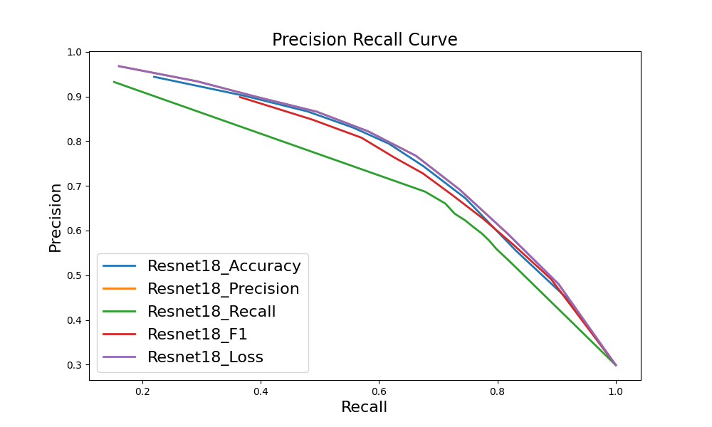

Slide 18
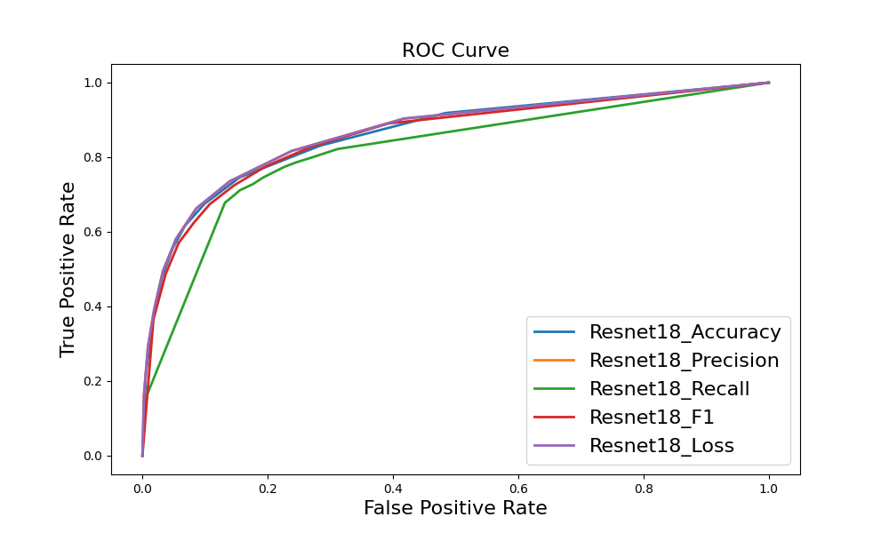

Slide 19
Junction ghmc | Accuracy | precision | recall | specificity | F1 | loss
Resnet18_accuracy | 82.1% | 74.8% | 60.5% | 91.3% | 66.9 | 0.8138
Resnet18_precision | 80.9% | 84.3% | 44.3% | 96.5% | 58.1 | 0.6627
Resnet18_recall | 72.8% | 53.1% | 79.3% | 70.1% | 63.6 | 0.5092
Resnet18_F1 | 79.4% | 64.2% | 70.8% | 83.1% | 67.3 | 1.2639
Resnet18_loss | 74.3% | 56.3% | 62.1% | 79.5% | 59.1 | 0.4993

Slide 20
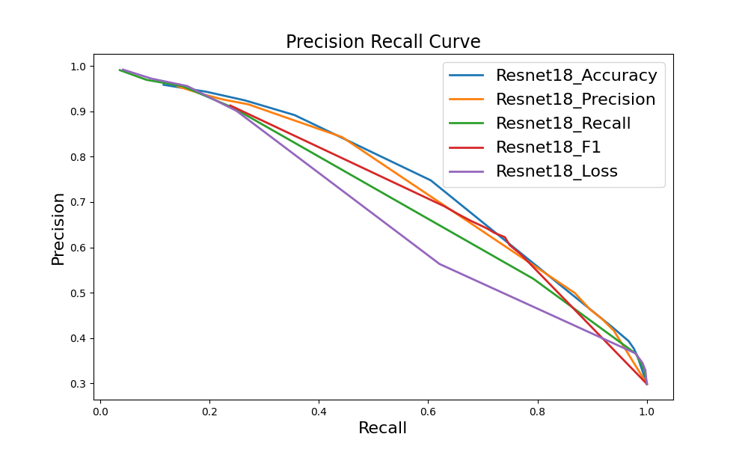

Slide 21
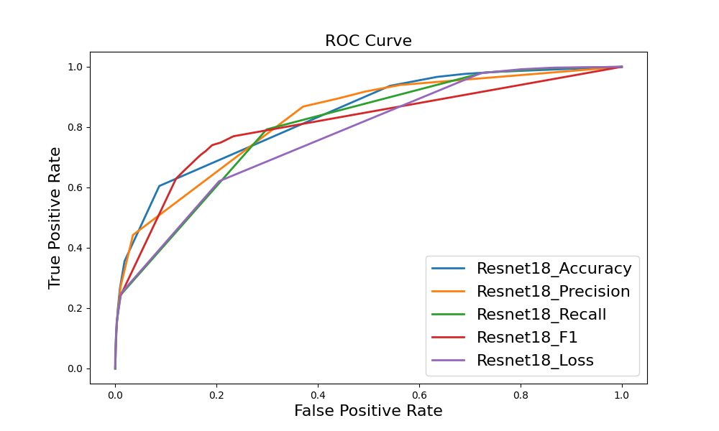

Slide 22
Gap | Accuracy | precision | recall | specificity | F1 | loss
Resnet18_accuracy | 84.2% | 78.1% | 73.9% | 89.5% | 76 | 0.4246
Resnet18_precision | 83.6% | 80.7% | 67.3% | 91.8% | 73.4 | 0.4074
Resnet18_recall | 84.2% | 74.5% | 80.9% | 85.9% | 77.6 | 0.4023
Resnet18_F1 | 84.2% | 74.5% | 80.9% | 85.9% | 77.6 | 0.4023
Resnet18_loss | 84.2% | 74.5% | 80.9% | 85.9% | 77.6 | 0.4023

Slide 23
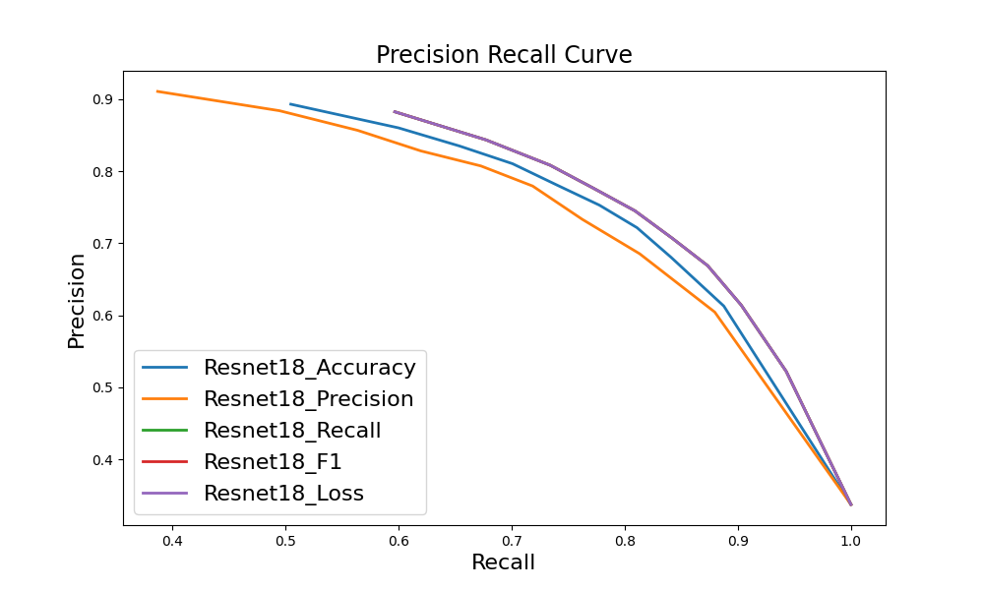

Slide 24
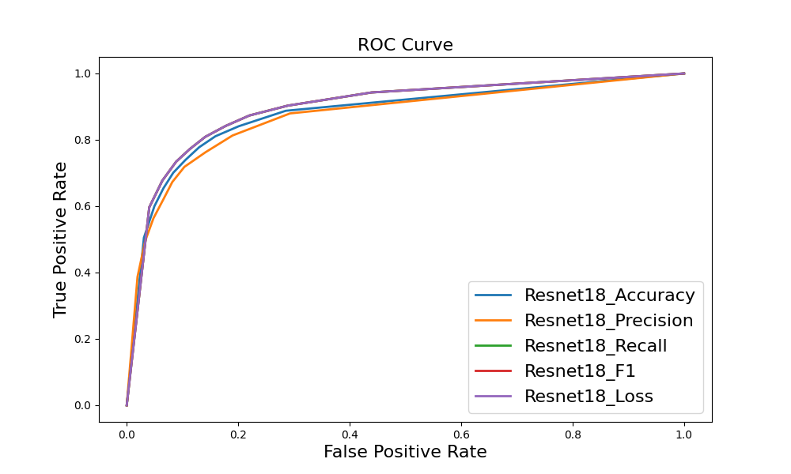

Slide 25
Gap ghmc | Accuracy | precision | recall | specificity | F1 | loss
Resnet18_accuracy | 73.7% | 79.1% | 69% | 90.8% | 73.7 | 1.0063
Resnet18_precision | 71.5% | 79.2% | 65.2% | 91.3% | 71.5 | 0.8318
Resnet18_recall | 73.5% | 67.3% | 81% | 79.9% | 73.5 | 0.9043
Resnet18_F1 | 74.7% | 69.8% | 80.3% | 82.3% | 74.7 | 0.9152
Resnet18_loss | 79.4% | 77.1% | 55.2% | 91.7% | 64.4 | 0.5495

Slide 26
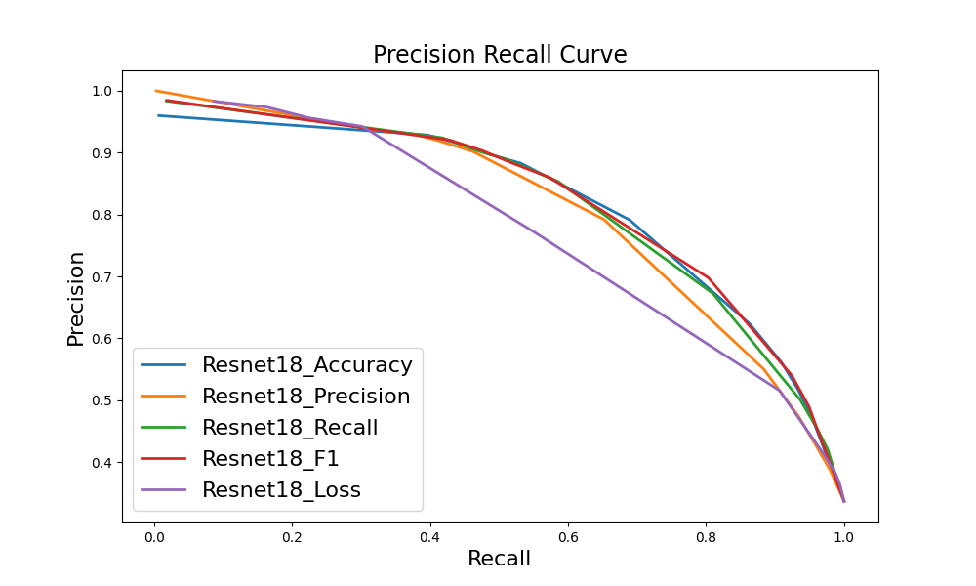

Slide 27
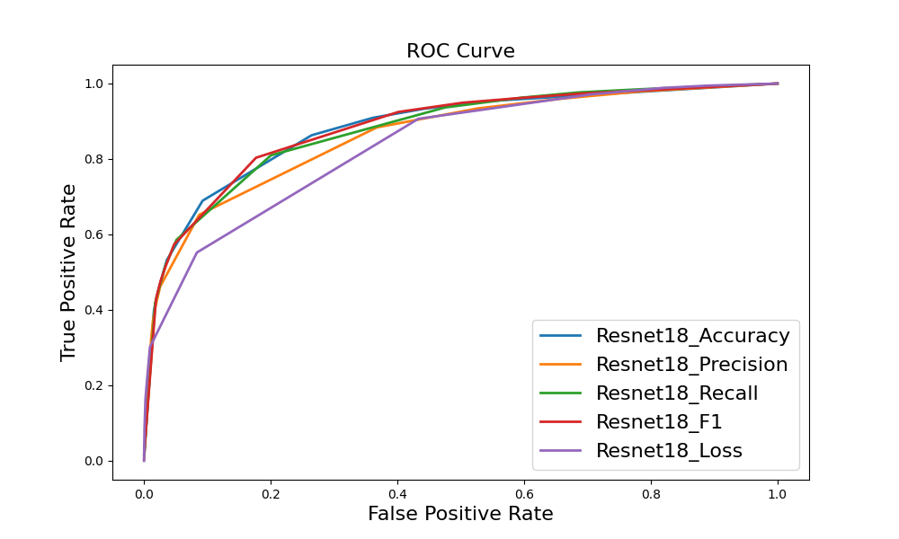

Slide 28
Wall Street

Slide 29
Junction | Accuracy | precision | recall | specificity | F1 | loss
Resnet18_accuracy | 73.2% | 82.8% | 46.9% | 92.8% | 59.9 | 0.5575
Resnet18_precision | 72.3% | 86.8% | 41.2% | 95.3% | 55.9 | 0.5903
Resnet18_recall | 71.6% | 67.3% | 65.1% | 76.5% | 66.2 | 1.3463
Resnet18_F1 | 73.1% | 77.7% | 51.5% | 89% | 62 | 0.5974
Resnet18_loss | 72.3% | 86.8% | 41.2% | 95.3% | 55.9 | 0.5903

Slide 30
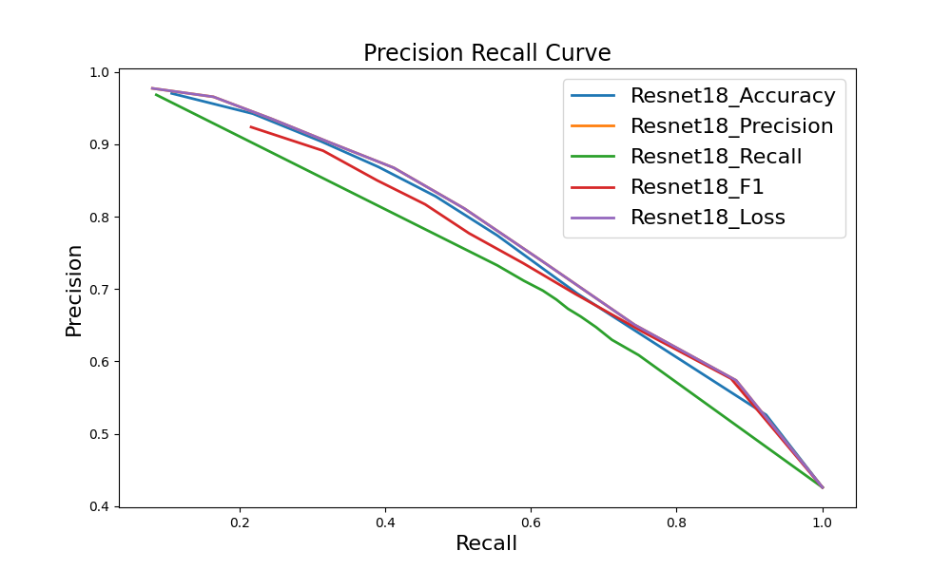

Slide 31
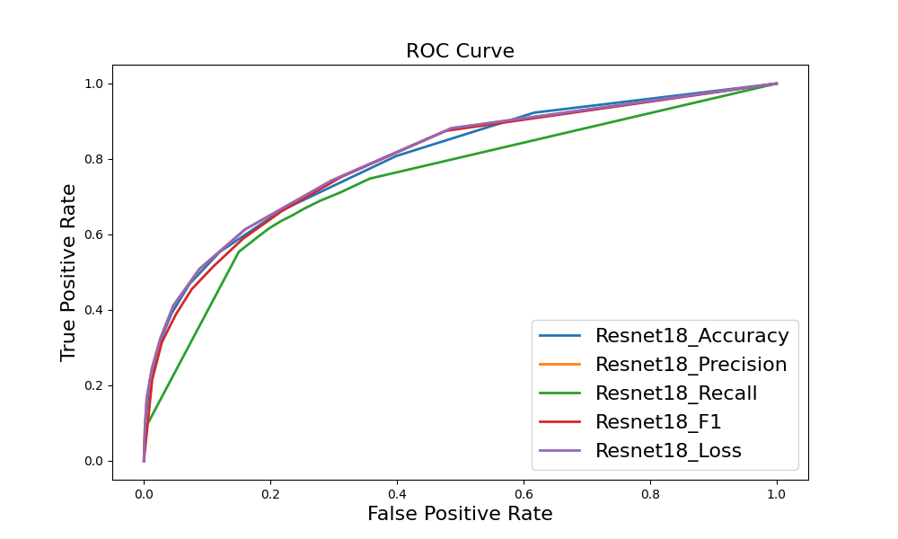

Slide 32
Junction ghmc | Accuracy | precision | recall | specificity | F1 | loss
Resnet18_accuracy | 72.4% | 78.7% | 48.3% | 90.3% | 59.9 | 0.8267
Resnet18_precision | 69.1% | 87.2% | 32.2% | 96.5% | 47 | 0.6982
Resnet18_recall | 68.8% | 62.1% | 68.7% | 68.9% | 65.2 | 0.5053
Resnet18_F1 | 71.5% | 69.1% | 59.7% | 80.2% | 64.1 | 1.1880
Resnet18_loss | 69.4% | 69.2% | 50.7% | 83.2% | 58.5 | 0.5351

Slide 33
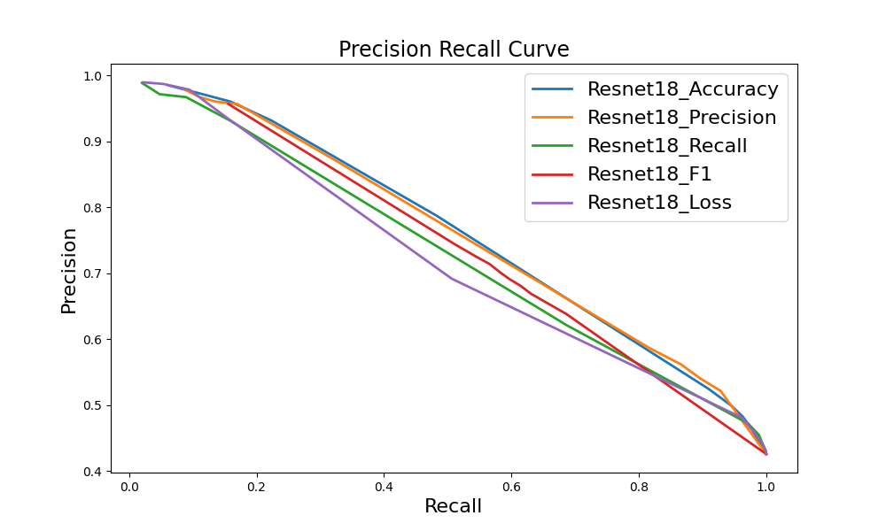

Slide 34
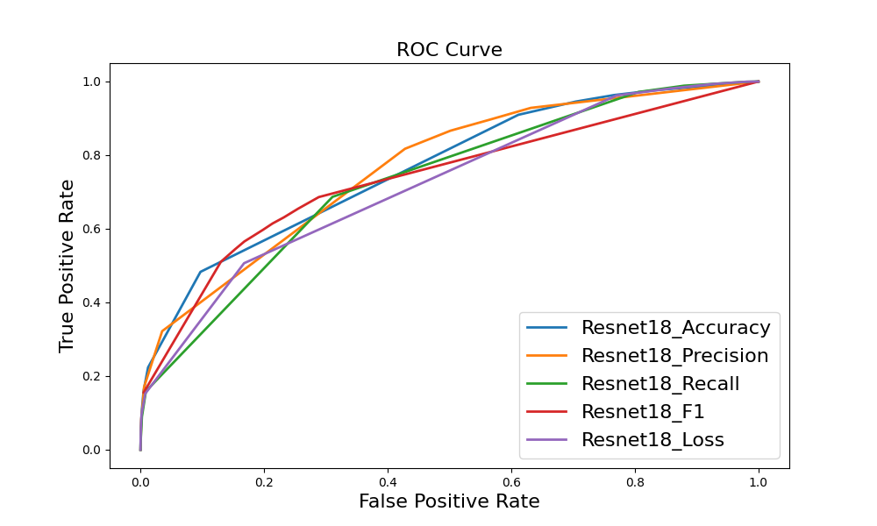

Slide 35
Gap | Accuracy | precision | recall | specificity | F1 | loss
Resnet18_accuracy | 79% | 74.3% | 73.2% | 83% | 73.7 | 0.4974
Resnet18_precision | 77.1% | 76% | 62.8% | 86.7% | 68.8 | 0.502
Resnet18_recall | 81.3% | 75.1% | 80.1% | 82.2% | 77.5 | 04655
Resnet18_F1 | 81.3% | 75.1% | 80.1% | 82.2% | 77.5 | 0.4655
Resnet18_loss | 81.3% | 75.1% | 80.1% | 82.2% | 77.5 | 0.4655

Slide 36
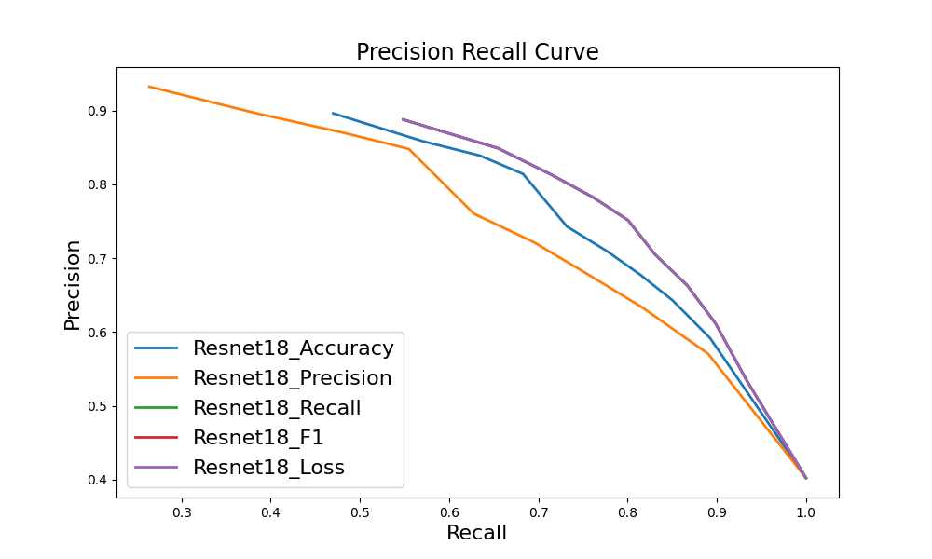

Slide 37
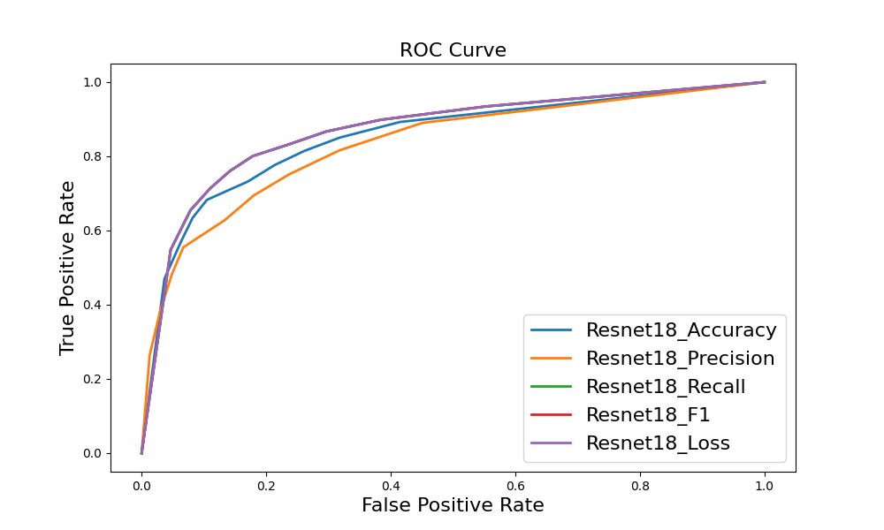

Slide 38
Gap ghmc | Accuracy | precision | recall | specificity | F1 | loss
Resnet18_accuracy | 78.4% | 77.6% | 65.1% | 87.3% | 70.8 | 1.0286
Resnet18_precision | 77.4% | 76.2% | 63.9% | 86.6% | 69.5 | 0.7702
Resnet18_recall | 75.5% | 67% | 77.3% | 74.4% | 71.8 | 0.9117
Resnet18_F1 | 75.4% | 66.4% | 78.8% | 73.1% | 72.1 | 0.9030
Resnet18_loss | 76.7% | 83% | 53.1% | 92.7% | 64.7 | 0.5324

Slide 39
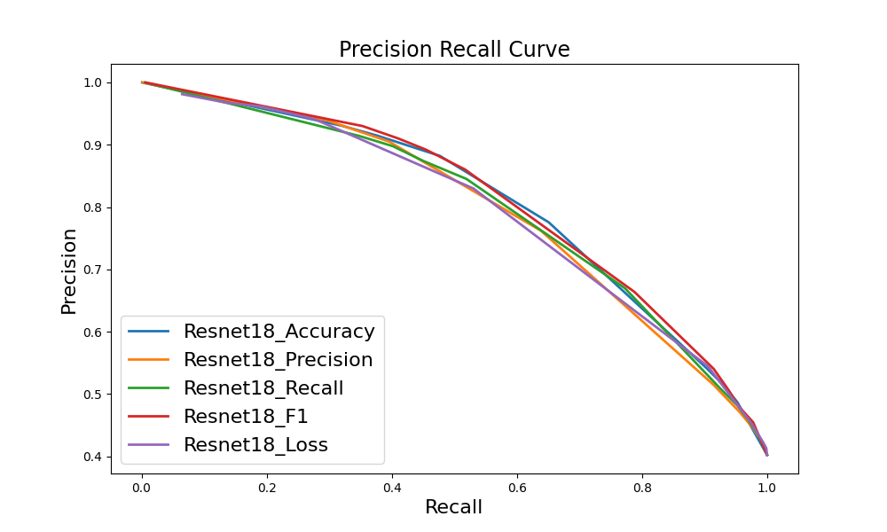

Slide 40
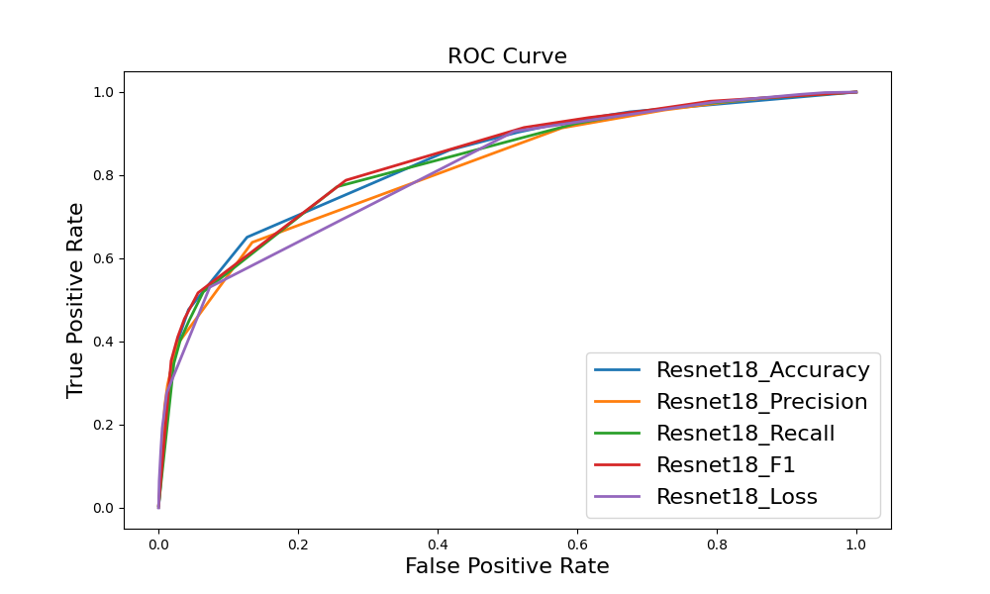

Slide 41
Union Square

Slide 42
Junction | Accuracy | precision | recall | specificity | F1 | loss
Resnet18_accuracy | 85.6% | 83.1% | 68.1% | 93.6% | 74.9 | 0.3546
Resnet18_precision | 85% | 86.9% | 61.7% | 95.7% | 72.2 | 0.3708
Resnet18_recall | 82% | 68.7% | 78.8% | 83.5% | 73.4 | 0.9276
Resnet18_F1 | 85.5% | 83% | 67.9% | 93.6% | 74.7 | 0.3916
Resnet18_loss | 85% | 86.9% | 61.7% | 95.7% | 72.2 | 0.3708

Slide 43
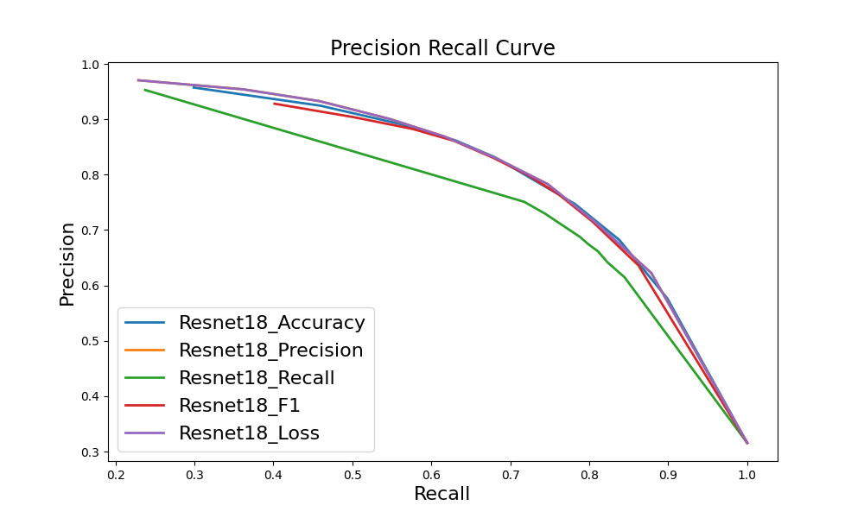

Slide 44
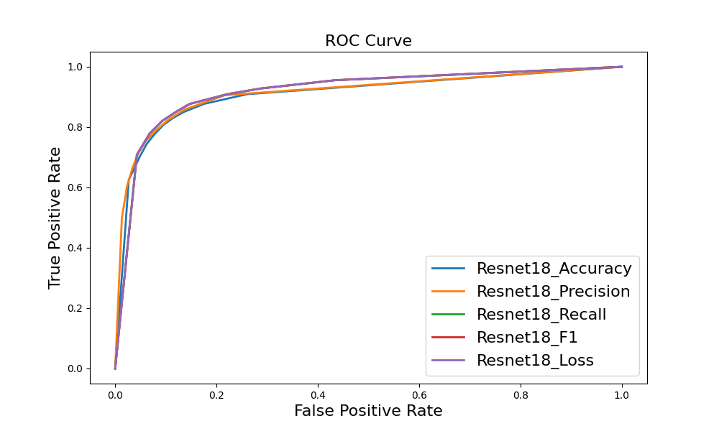

Slide 45
Junction ghmc | Accuracy | precision | recall | specificity | F1 | loss
Resnet18_accuracy | 83.9% | 81.5% | 63.1% | 93.4% | 71.2 | 0.7885
Resnet18_precision | 82.7% | 89.5% | 51.1% | 97.2% | 65 | 0.6606
Resnet18_recall | 79.7% | 63.8% | 82.6% | 78.4% | 72 | 0.5558
Resnet18_F1 | 84% | 75.4% | 72.9% | 89% | 74.2 | 1.3542
Resnet18_loss | 78.4% | 64.2% | 71.1% | 81.7% | 67.5 | 0.5655

Slide 46
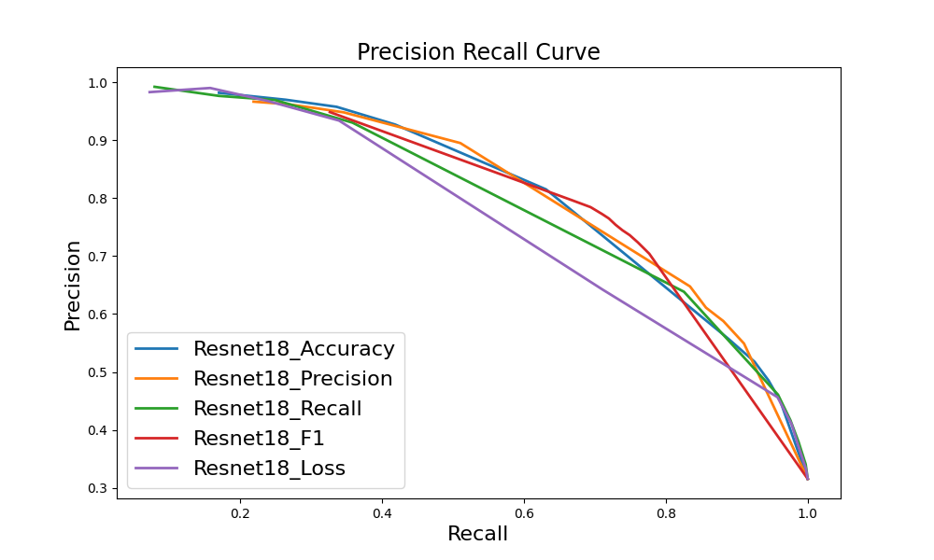

Slide 47
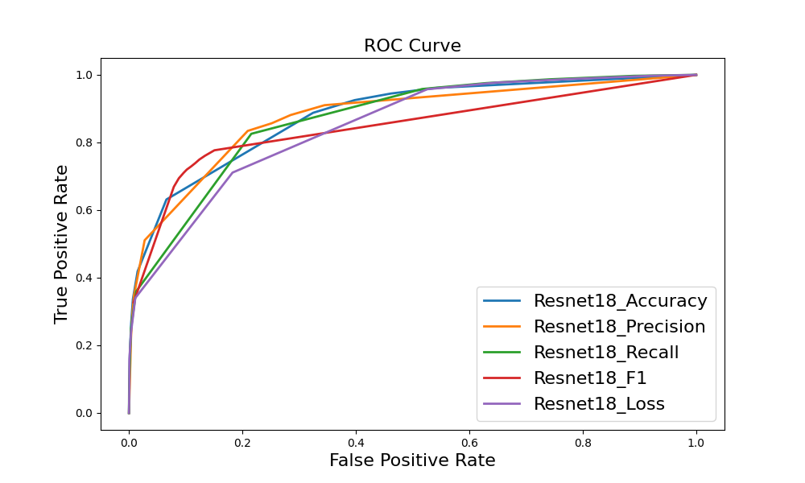

Slide 48
Gap | Accuracy | precision | recall | specificity | F1 | loss
Resnet18_accuracy | 86.3% | 86.4% | 80.8% | 90.4% | 83.5 | 0.3696
Resnet18_precision | 86% | 90.3% | 75.6% | 93.9% | 82.3 | 0.3572
Resnet18_recall | 86.3% | 81.8% | 87.7% | 85.3% | 84.6 | 0.3592
Resnet18_F1 | 86.3% | 81.8% | 87.7% | 85.3% | 84.6 | 0.3592
Resnet18_loss | 86.3% | 81.8% | 87.7% | 85.3% | 84.6 | 0.3592

Slide 49
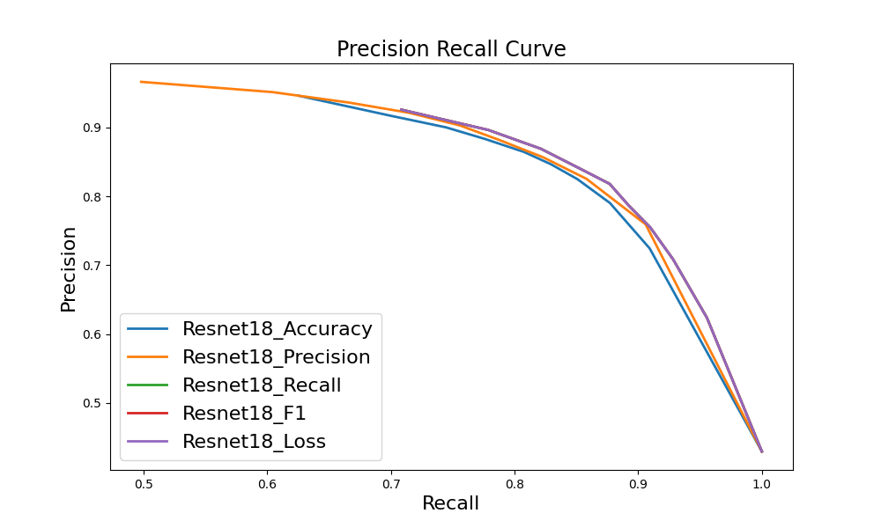

Slide 51
Gap ghmc | Accuracy | precision | recall | specificity | F1 | loss
Resnet18_accuracy | 85.4% | 86.8% | 77.8% | 91.1% | 82.1 | 1.0331
Resnet18_precision | 83.9% | 86.8% | 73.7% | 91.5% | 79.7 | 0.7982
Resnet18_recall | 83.6% | 77.8% | 86.5% | 81.4% | 81.9 | 0.8665
Resnet18_F1 | 82.7% | 76.2% | 86.6% | 79.7% | 81.1 | 0.9013
Resnet18_loss | 80.1% | 85.2% | 65% | 91.5% | 73.7 | 0.6012

Slide 52
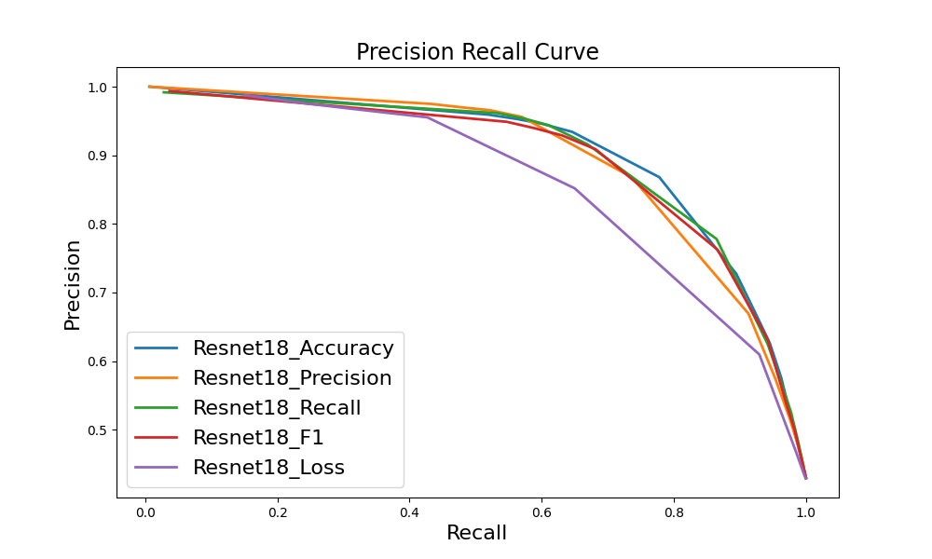

Slide 53
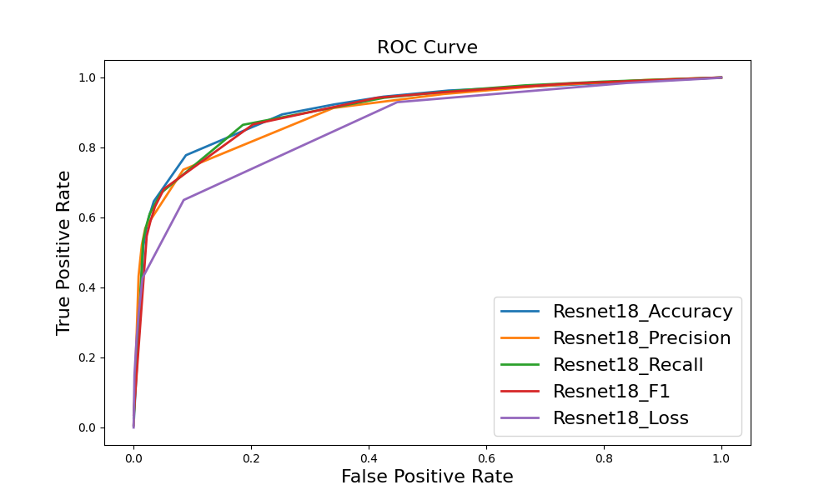

Slide 54
Classification Accuracy for Each Bit

Slide 55
Statistic accuracy for each bit
 |  | Bit 1 | Bit 2 | Bit 3 | Bit 4
Wall Street | Whole area | 71.72% | 81.08% | 71.56% | 81.56%
 | test routes | 75.27% | 83.45% | 76.19% | 85.15%
Union Square | Whole area | 81.5% | 86.58% | 82.52% | 86.08%
 | test routes | 81.39% | 87.55% | 82.28% | 86.61%
Hudson River | Whole area | 78.12% | 84.2% | 78.24% | 84.24%
 | test routes | 79.52% | 84.86% | 80.65% | 85.54%

Slide 56
Statistic accuracy for each category
 |  | junction | Non_junction | gap | Non_gap
Wall Street | Whole area | 65.09% | 76.5% | 80.06% | 82.17%
 | test routes | 72.19% | 77.99% | 85.07% | 83.59%
Union Square | Whole area | 78.83% | 83.47% | 87.69% | 85.31%
 | test routes | 77.12% | 83.88% | 89.11% | 85.57%
Hudson River | Whole area | 75.91% | 79.15% | 80.9% | 85.9%
 | test routes | 79.29% | 80.38% | 83.49% | 86.27%

Slide 57
Bit Flipping v2

Slide 58
Statistic accuracy for each bit
 |  | Bit 1 | Bit 2 | Bit 3 | Bit 4
Wall Street | Whole area | 72.06% | 80.56% | 70.54% | 81.82%
 | test routes | 72.42% | 81.65% | 71.4% | 81.34%
Union Square | Whole area | 81.5% | 86.2% | 82.2% | 86.58%
 | test routes | 80.84% | 86.19% | 82.04% | 86.67%

Slide 59
Statistic accuracy for each category
 |  | junction | Non_junction | gap | Non_gap
Wall Street | Whole area | 71.50% | 71.15% | 81.56% | 80.93%
 | test routes | 72.48% | 71.54% | 81.92% | 81.11%
Union Square | Whole area | 82.45% | 81.58% | 86.92% | 85.99%
 | test routes | 82.3% | 81.06% | 87.08% | 85.94%

Slide 60
Bit Flipping v3

Slide 61
Statistic accuracy for each bit
 |  | Bit 1 | Bit 2 | Bit 3 | Bit 4
Wall Street | Whole area | 71% | 81.64% | 71.68% | 81.46%
 | test routes | 70.32% | 81.81% | 72.96% | 80.75%
Union Square | Whole area | 81.96% | 85.82% | 82.54% | 85.62%
 | test routes | 82.24% | 85.62% | 82.4% | 85.69%

Slide 62
Statistic accuracy for each category
 |  | junction | Non_junction | gap | Non_gap
Wall Street | Whole area | 65.52% | 75.66% | 80.19% | 82.46%
 | test routes | 65.41% | 75.63% | 79.95% | 82.5%
Union Square | Whole area | 80.51% | 83.05% | 87.36% | 84.48%
 | test routes | 81.18% | 82.81% | 87.11% | 84.57%

Slide 63
Localisation Accuracy with different classifiers

Slide 64
Localisation Accuracy With Real Classifier (with Turns)
 | 5 | 10 | 15 | 20 | 25 | 30 | 35 | 40
Wall street | 0.038 | 0.352 | 0.662 | 0.82 | 0.898 | 0.942 | 0.96 | 0.952
v2 | 0.118 | 0.522 | 0.85 | 0.946 | 0.978 | 0.978 | 0.988 | 0.972
v3 | 0.072 | 0.488 | 0.834 | 0.948 | 0.974 | 0.98 | 0.992 | 0.968
Union square | 0.036 | 0.172 | 0.352 | 0.522 | 0.718 | 0.836 | 0.898 | 0.928
v2 | 0.136 | 0.496 | 0.794 | 0.916 | 0.982 | 0.992 | 0.994 | 0.986
v3 | 0.136 | 0.532 | 0.806 | 0.92 | 0.978 | 0.988 | 0.992 | 0.982

Slide 65
Localisation Accuracy With Real Classifier (without Turns)
 | 5 | 10 | 15 | 20 | 25 | 30 | 35 | 40
Wall street | 0.018 | 0.084 | 0.252 | 0.374 | 0.546 | 0.604 | 0.662 | 0.67
v2 | 0.052 | 0.218 | 0.458 | 0.652 | 0.85 | 0.86 | 0.876 | 0.886
v3 | 0.018 | 0.182 | 0.444 | 0.614 | 0.794 | 0.846 | 0.87 | 0.882
Union square | 0.02 | 0.078 | 0.146 | 0.262 | 0.35 | 0.472 | 0.558 | 0.644
v2 | 0.082 | 0.34 | 0.6 | 0.804 | 0.896 | 0.924 | 0.95 | 0.922
v3 | 0.08 | 0.368 | 0.656 | 0.79 | 0.898 | 0.92 | 0.936 | 0.91

Slide 66
BSD Distribution for Different Versions

Slide 67
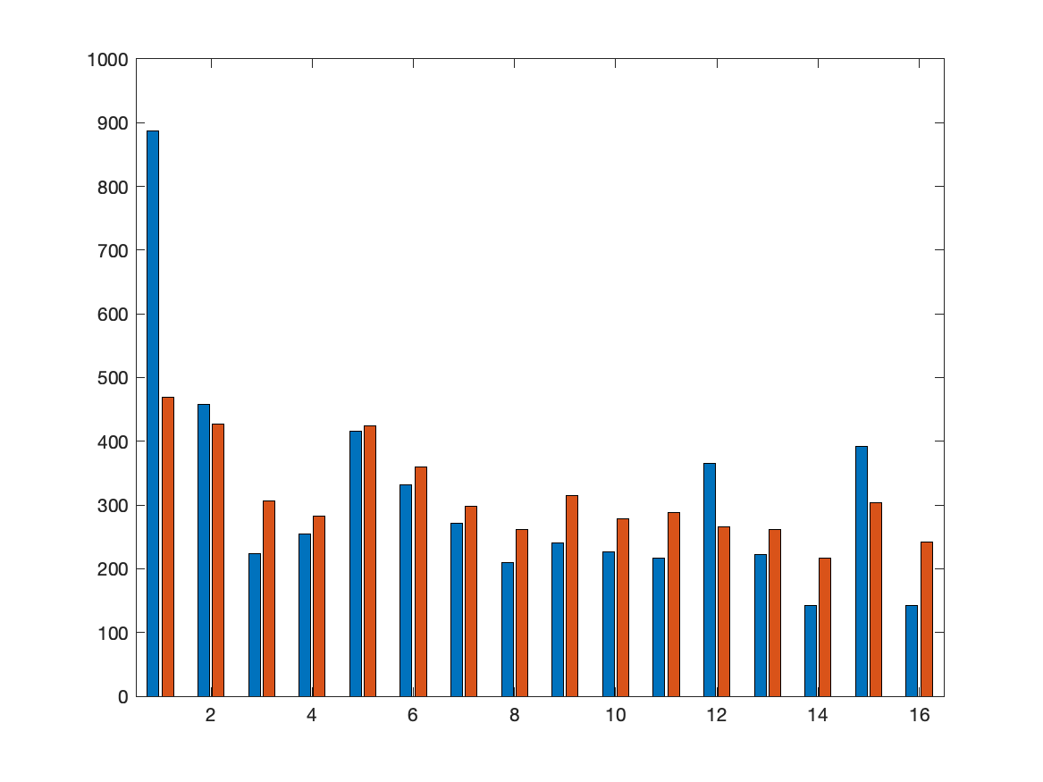
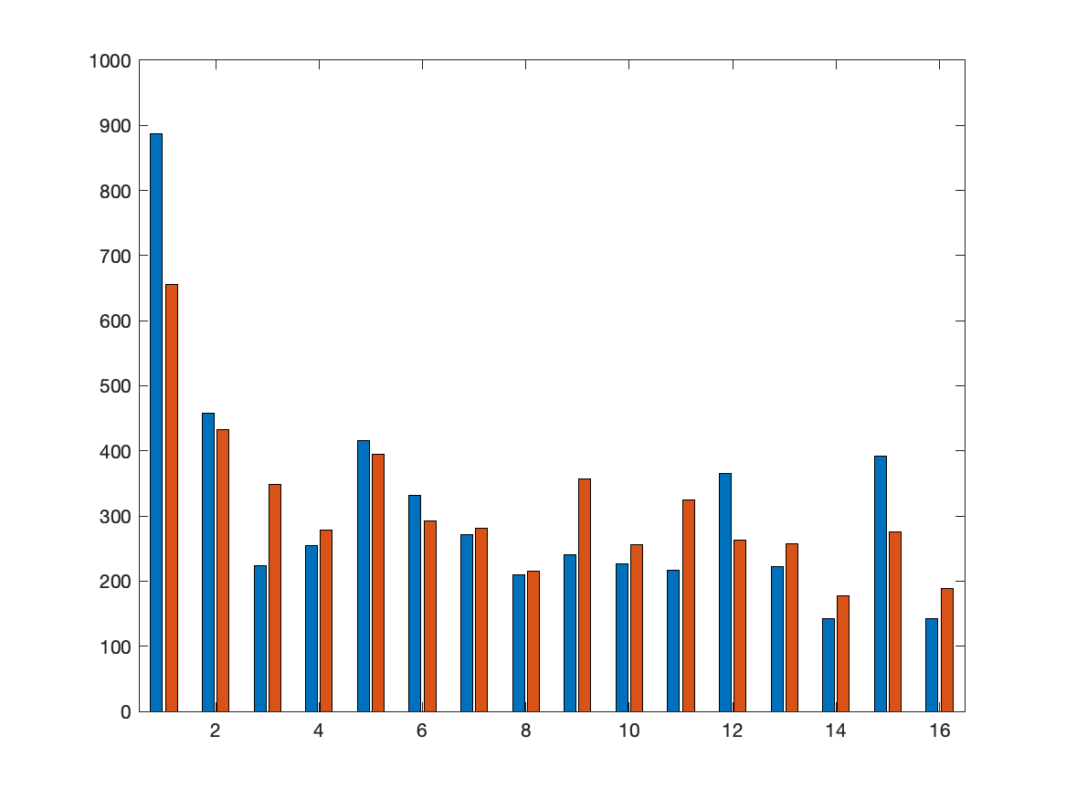
Wall Street
real
v2
v3

Slide 68
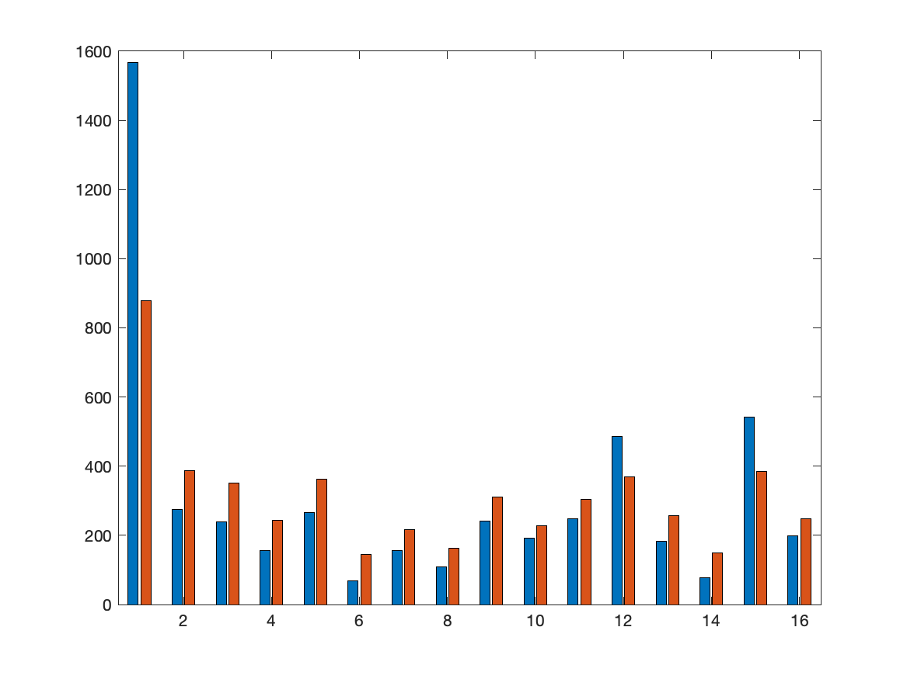

Union Square
real
v2
v3

Slide 69
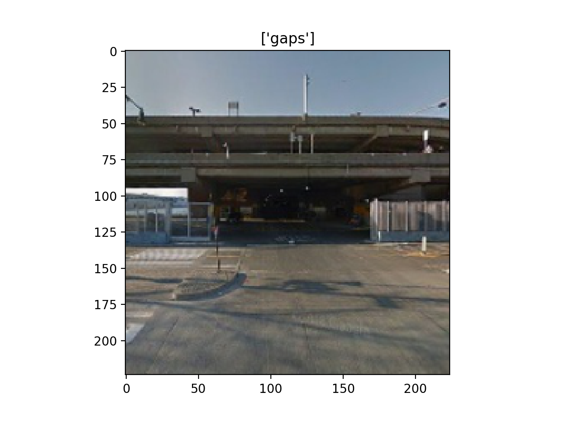
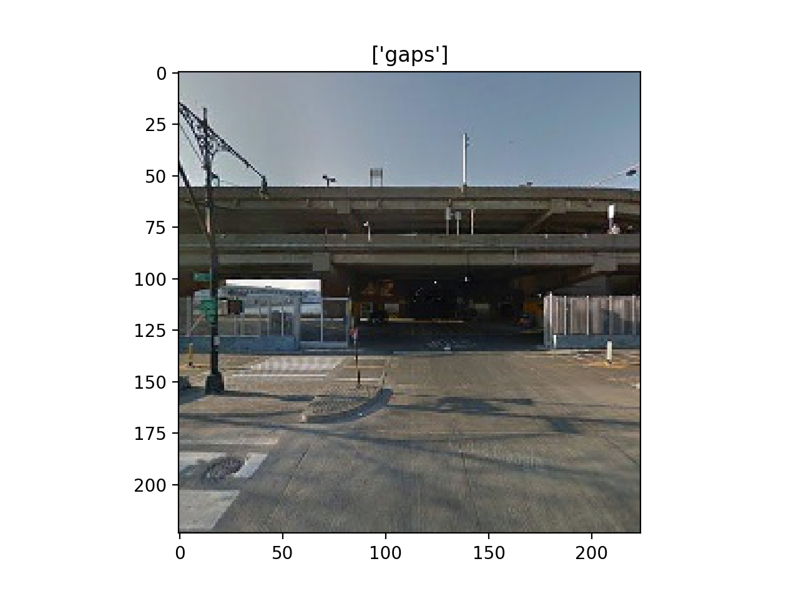
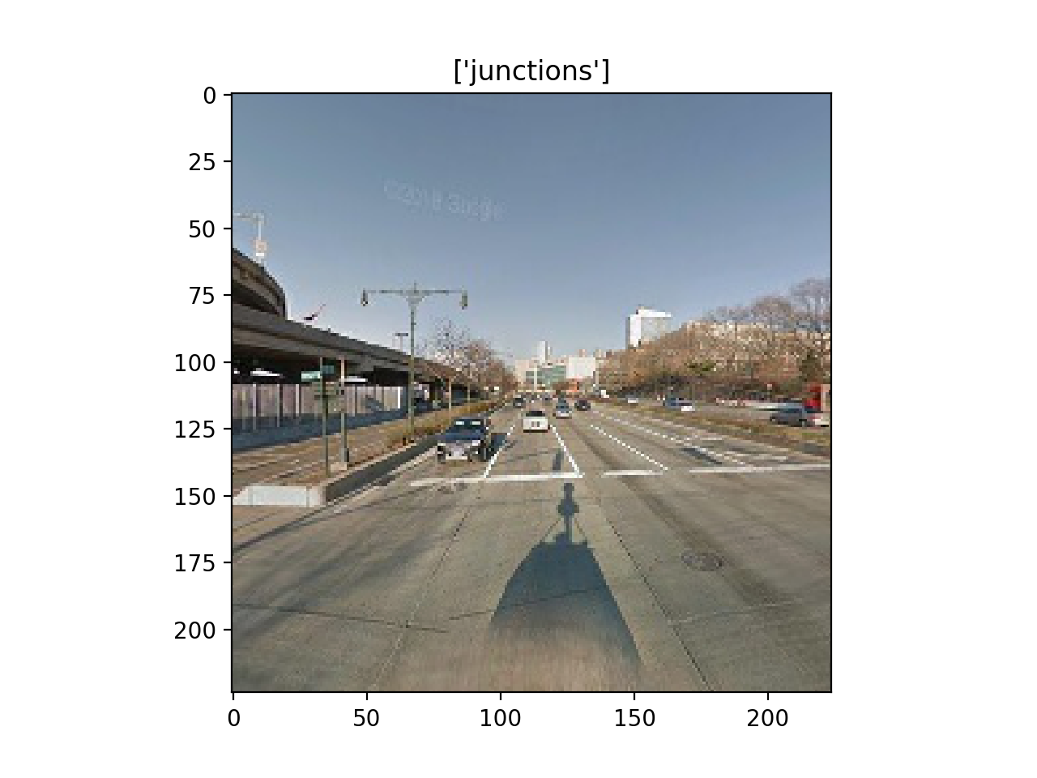
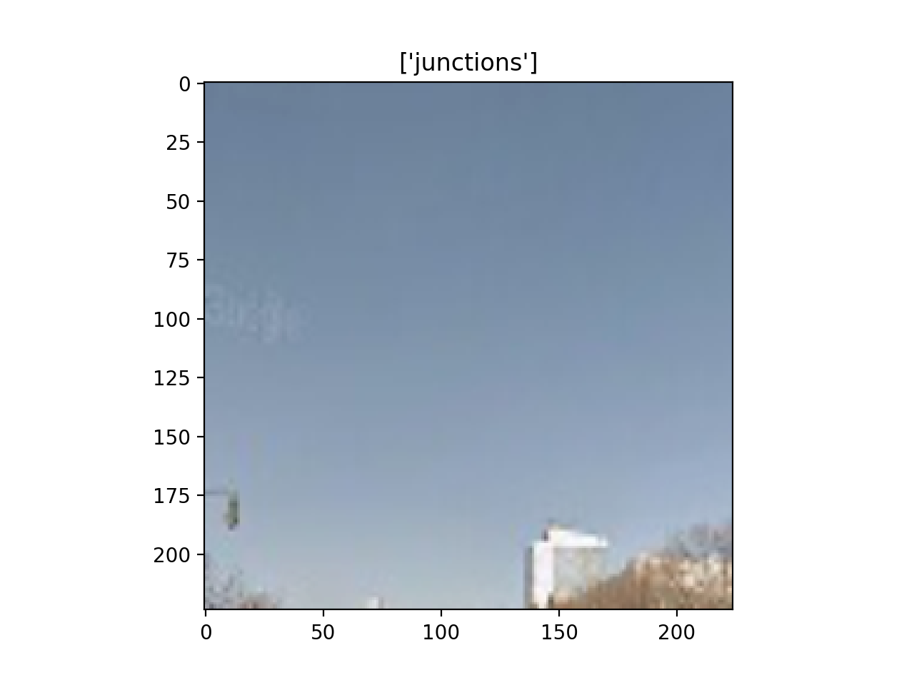
Some Errors

Slide 70
Route Distribution for Different Versions

Slide 71
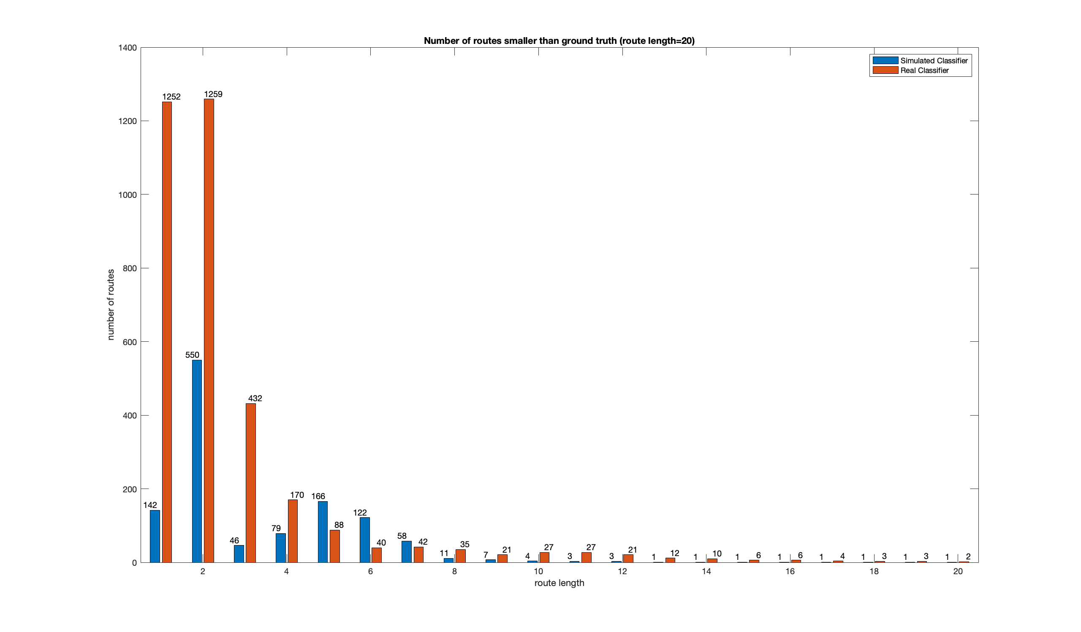
Route 1

Slide 72
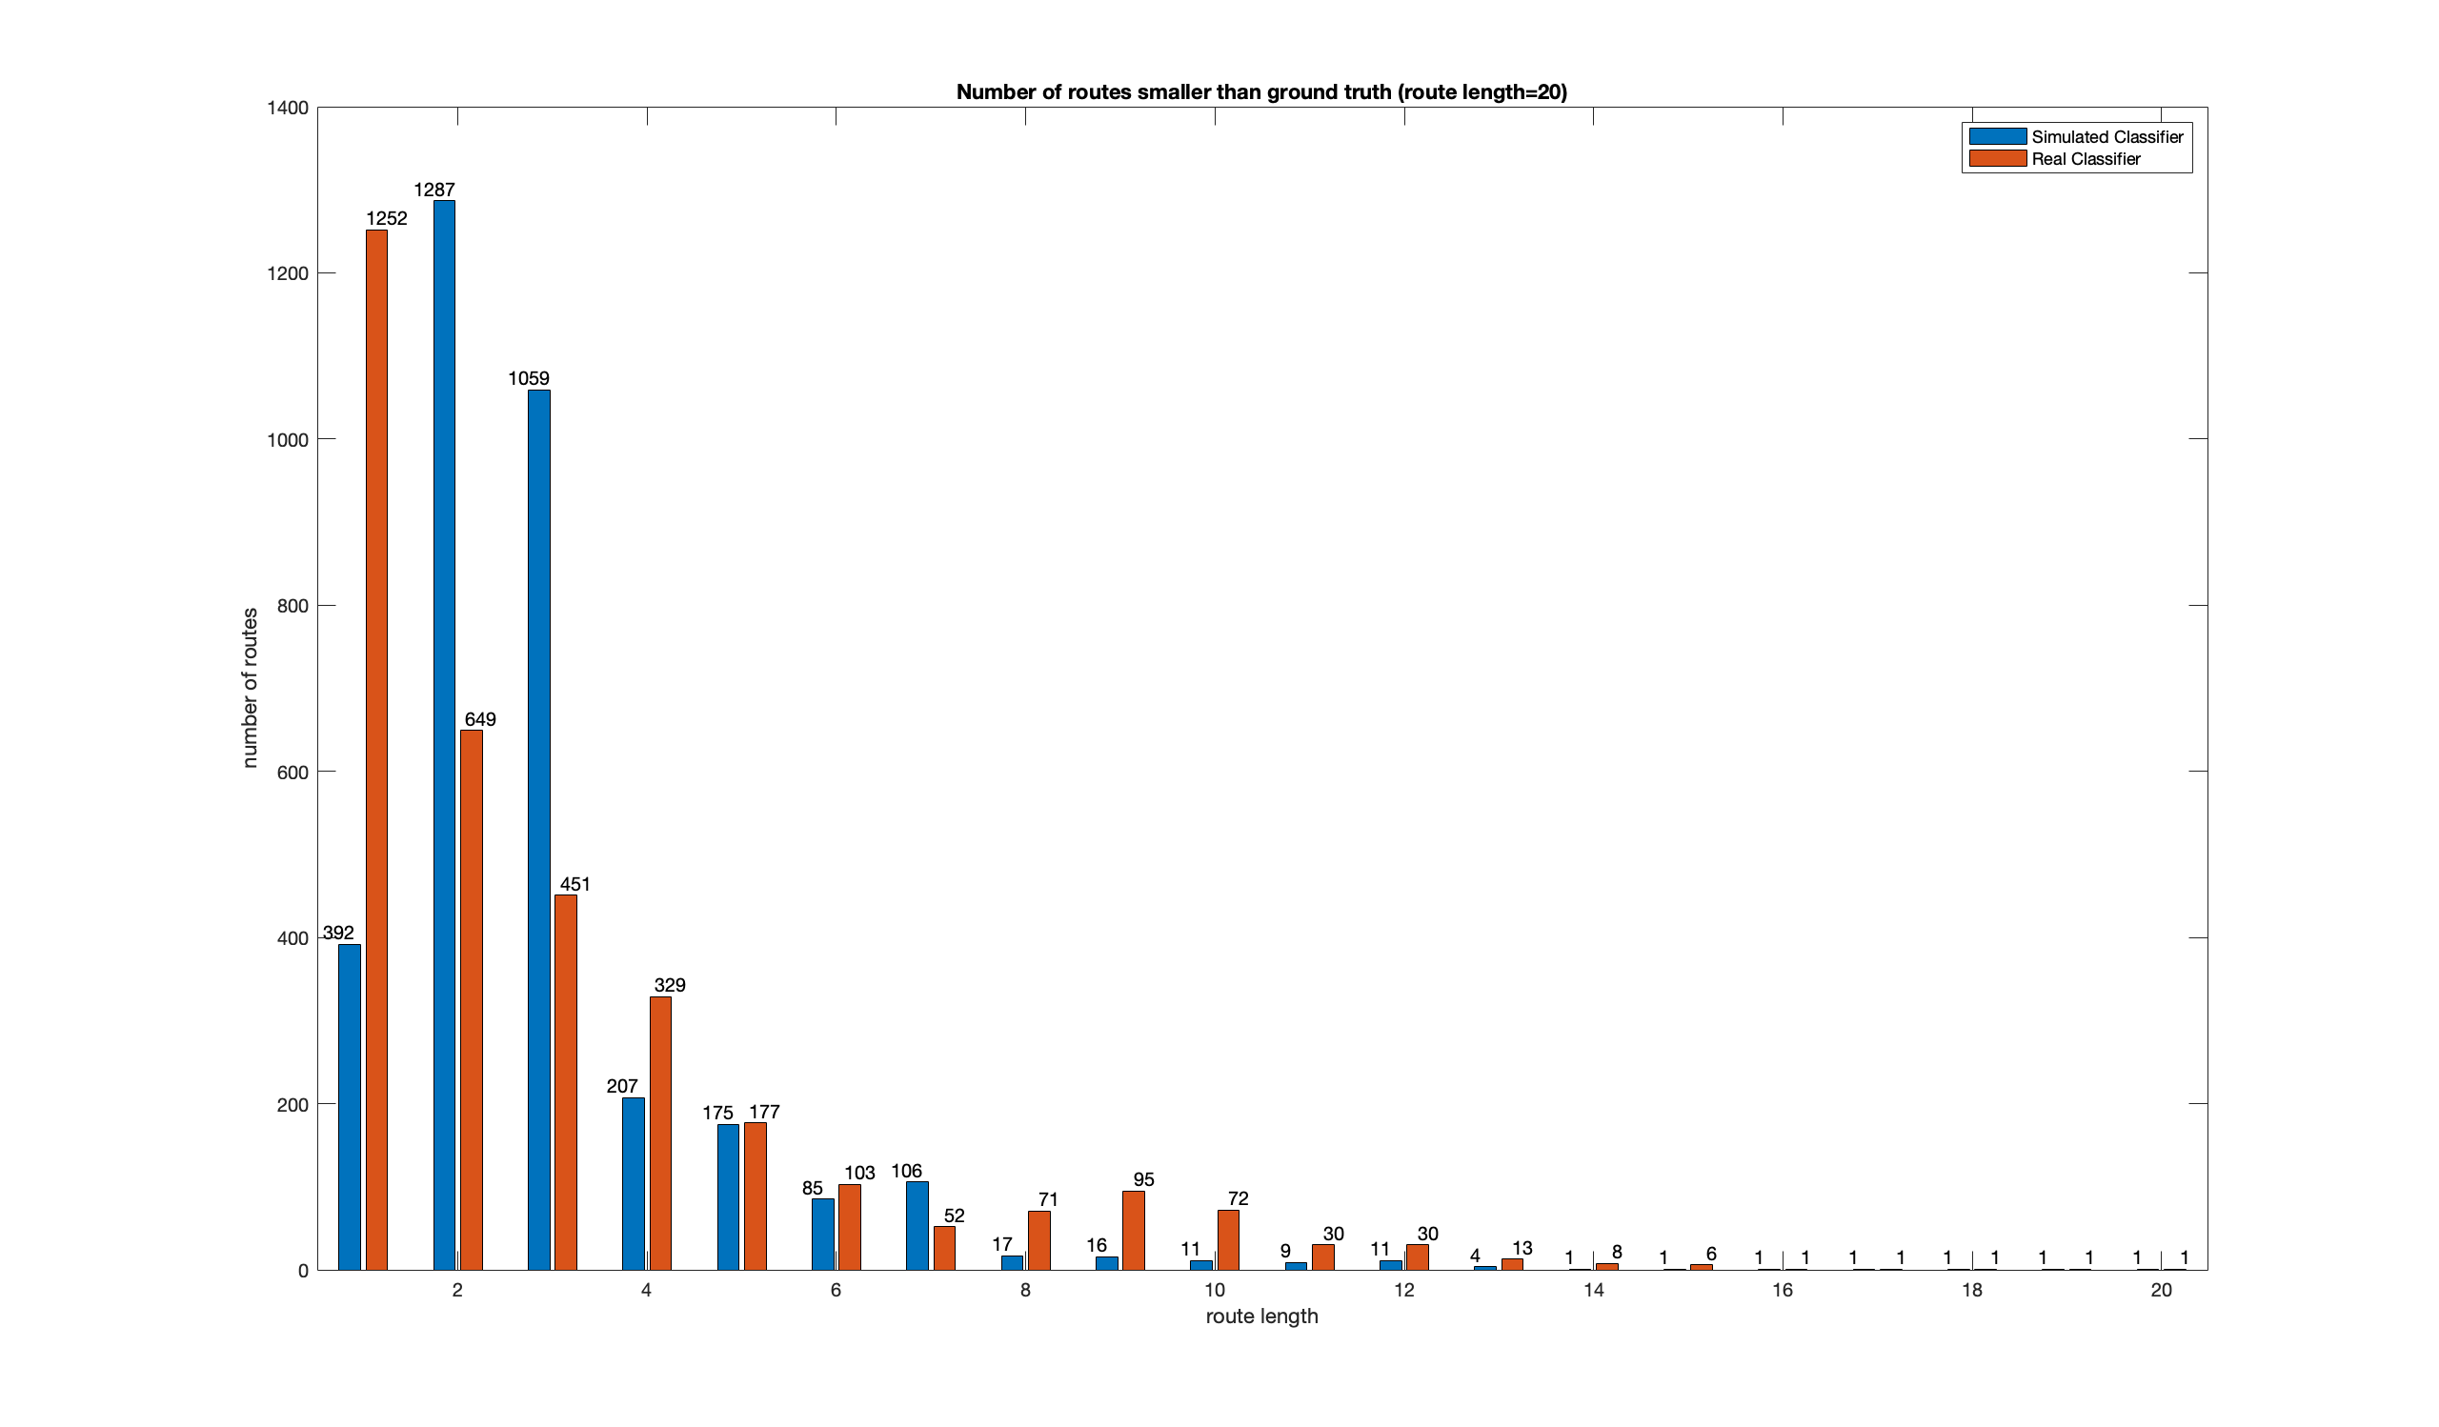
Route 60

Slide 73
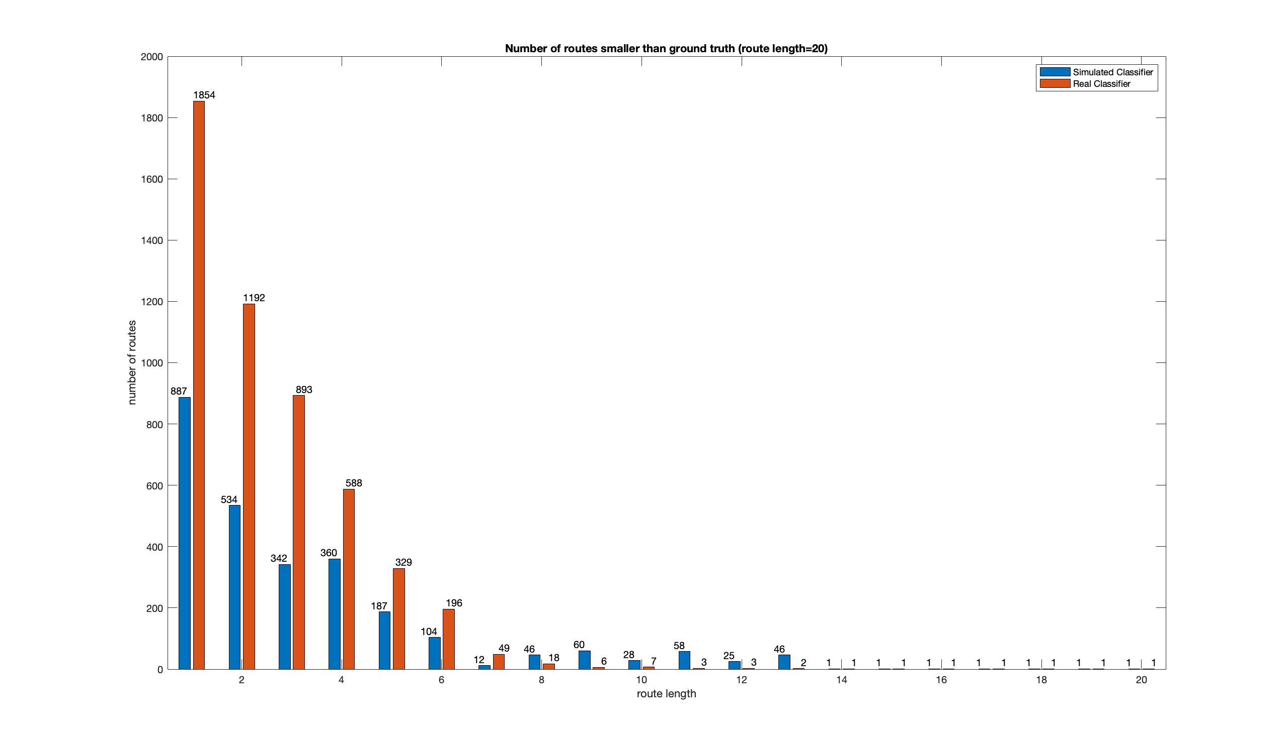
Route 120

Slide 74
Different Models

Slide 75
Hudson River

Slide 76
Junction | Accuracy | precision | recall | specificity | F1 | loss
Alexnet_accuracy | 0.804 | 0.699 | 0.607 | 0.888 | 0.650 | 0.4562
Alexnet_precision | 0.779 | 0.734 | 0.410 | 0.937 | 0.526 | 0.5238
Alexnet_recall | 0.722 | 0.524 | 0.756 | 0.707 | 0.619 | 0.5376
Alexnet_F1 | 0.795 | 0.662 | 0.646 | 0.859 | 0.654 | 0.4848
Alexnet_loss | 0.80 | 0.700 | 0.578 | 0.895 | 0.633 | 0.4555

Slide 77
Gap | Accuracy | precision | recall | specificity | F1 | loss
Alexnet_accuracy | 0.826 | 0.773 | 0.683 | 0.898 | 0.725 | 0.4196
Alexnet_precision | 0.808 | 0.797 | 0.577 | 0.925 | 0.670 | 0.4401
Alexnet_recall | 0.337 | 0.337 | 1.000 | 0.000 | 0.504 | 0.7061
Alexnet_F1 | 0.823 | 0.760 | 0.695 | 0.889 | 0.726 | 0.4435
Alexnet_loss | 0.826 | 0.773 | 0.683 | 0.898 | 0.725 | 0.4196

Slide 78
Junction | Accuracy | precision | recall | specificity | F1 | loss
resnet50_accuracy | 0.832 | 0.764 | 0.633 | 0.917 | 0.692 | 0.4048
resnet50_precision | 0.826 | 0.808 | 0.548 | 0.944 | 0.653 | 0.4004
resnet50_recall | 0.746 | 0.552 | 0.799 | 0.723 | 0.653 | 1.1484
resnet50_F1 | 0.825 | 0.700 | 0.725 | 0.867 | 0.712 | 0.4099
resnet50_loss | 0.826 | 0.808 | 0.548 | 0.944 | 0.653 | 0.4004

Slide 79
Gap | Accuracy | precision | recall | specificity | F1 | loss
resnet50_accuracy | 0.852 | 0.835 | 0.700 | 0.930 | 0.761 | 0.3591
resnet50_precision | 0.843 | 0.853 | 0.647 | 0.943 | 0.736 | 0.3769
resnet50_recall | 0.819 | 0.697 | 0.822 | 0.818 | 0.754 | 0.5043
resnet50_F1 | 0.848 | 0.781 | 0.765 | 0.891 | 0.773 | 0.3773
resnet50_loss | 0.852 | 0.835 | 0.700 | 0.930 | 0.761 | 0.3591

Slide 80
Junction | Accuracy | precision | recall | specificity | F1 | loss
vgg_accuracy | 0.84 | 0.785 | 0.638 | 0.925 | 0.704 | 0.3840
vgg_precision | 0.833 | 0.817 | 0.567 | 0.946 | 0.670 | 0.3952
vgg_recall | 0.770 | 0.582 | 0.817 | 0.750 | 0.680 | 0.5029
vgg_F1 | 0.831 | 0.712 | 0.729 | 0.874 | 0.720 | 0.4053
vgg_loss | 0.840 | 0.785 | 0.638 | 0.925 | 0.704 | 0.3840

Slide 81
Gap | Accuracy | precision | recall | specificity | F1 | loss
vgg_accuracy | 0.853 | 0.786 | 0.774 | 0.893 | 0.780 | 0.4101
vgg_precision | 0.826 | 0.856 | 0.580 | 0.950 | 0.692 | 0.4142
vgg_recall | 0.833 | 0.724 | 0.815 | 0.842 | 0.766 | 0.4144
vgg_F1 | 0.853 | 0.786 | 0.774 | 0.893 | 0.780 | 0.4101
vgg_loss | 0.843 | 0.776 | 0.751 | 0.890 | 0.763 | 0.3945

Slide 82
Junction | Accuracy | precision | recall | specificity | F1 | loss
googlenet_accuracy | 0.837 | 0.755 | 0.673 | 0.907 | 0.712 | 0.3867
googlenet_precision | 0.837 | 0.755 | 0.673 | 0.907 | 0.712 | 0.3867
googlenet_recall | 0.759 | 0.572 | 0.771 | 0.754 | 0.657 | 1.4077
googlenet_F1 | 0.837 | 0.755 | 0.673 | 0.907 | 0.712 | 0.3867
googlenet_loss | 0.837 | 0.755 | 0.673 | 0.907 | 0.712 | 0.3867

Slide 83
Gap | Accuracy | precision | recall | specificity | F1 | loss
googlenet_accuracy | 0.853 | 0.790 | 0.767 | 0.896 | 0.779 | 0.3744
googlenet_precision | 0.847 | 0.839 | 0.677 | 0.934 | 0.749 | 0.3744
googlenet_recall | 0.819 | 0.697 | 0.816 | 0.820 | 0.752 | 0.9594
googlenet_F1 | 0.853 | 0.790 | 0.767 | 0.896 | 0.779 | 0.3744
googlenet_loss | 0.849 | 0.804 | 0.732 | 0.909 | 0.766 | 0.3541

Slide 84
Wall Street

Slide 85
Junction | Accuracy | precision | recall | specificity | F1 | loss
Alexnet_accuracy | 0.716 | 0.781 | 0.465 | 0.903 | 0.583 | 0.5634
Alexnet_precision | 0.670 | 0.809 | 0.294 | 0.948 | 0.432 | 0.6087
Alexnet_recall | 0.687 | 0.633 | 0.628 | 0.730 | 0.631 | 0.5961
Alexnet_F1 | 0.710 | 0.759 | 0.469 | 0.890 | 0.580 | 0.5622
Alexnet_loss | 0.698 | 0.779 | 0.405 | 0.915 | 0.533 | 0.5894

Slide 86
Gap | Accuracy | precision | recall | specificity | F1 | loss
Alexnet_accuracy | 0.753 | 0.729 | 0.617 | 0.845 | 0.668 | 0.5339
Alexnet_precision | 0.742 | 0.779 | 0.502 | 0.904 | 0.610 | 0.5527
Alexnet_recall | 0.402 | 0.402 | 1.000 | 0.000 | 0.574 | 0.7015
Alexnet_F1 | 0.755 | 0.5633 | 0.720 | 0.642 | 0.679 | 0.832
Alexnet_loss | 0.753 | 0.5339 | 0.729 | 0.617 | 0.668 | 0.845

Slide 87
Junction | Accuracy | precision | recall | specificity | F1 | loss
resnet50_accuracy | 0.738 | 0.826 | 0.487 | 0.924 | 0.613 | 0.5908
resnet50_precision | 0.717 | 0.873 | 0.392 | 0.958 | 0.541 | 0.5967
resnet50_recall | 0.694 | 0.621 | 0.721 | 0.673 | 0.667 | 1.2624
resnet50_F1 | 0.741 | 0.773 | 0.554 | 0.879 | 0.646 | 0.5312
resnet50_loss | 0.717 | 0.873 | 0.392 | 0.958 | 0.541 | 0.5967

Slide 88
Gap | Accuracy | precision | recall | specificity | F1 | loss
resnet50_accuracy | 0.814 | 0.843 | 0.661 | 0.917 | 0.741 | 0.4384
resnet50_precision | 0.793 | 0.828 | 0.612 | 0.914 | 0.704 | 0.4541
resnet50_recall | 0.778 | 0.697 | 0.795 | 0.767 | 0.743 | 0.5829
resnet50_F1 | 0.798 | 0.748 | 0.752 | 0.829 | 0.750 | 0.4616
resnet50_loss | 0.814 | 0.843 | 0.661 | 0.917 | 0.741 | 0.4384

Slide 89
Junction | Accuracy | precision | recall | specificity | F1 | loss
googlenet_accuracy | 0.745 | 0.805 | 0.528 | 0.905 | 0.638 | 0.5208
googlenet_precision | 0.745 | 0.805 | 0.528 | 0.905 | 0.638 | 0.5208
googlenet_recall | 0.703 | 0.636 | 0.709 | 0.699 | 0.670 | 1.6266
googlenet_F1 | 0.745 | 0.805 | 0.528 | 0.905 | 0.638 | 0.5208
googlenet_loss | 0.745 | 0.805 | 0.528 | 0.905 | 0.638 | 0.5208

Slide 90
Gap | Accuracy | precision | recall | specificity | F1 | loss
googlenet_accuracy | 0.804 | 0.759 | 0.754 | 0.839 | 0.756 | 0.4504
googlenet_precision | 0.799 | 0.808 | 0.656 | 0.895 | 0.724 | 0.4493
googlenet_recall | 0.777 | 0.701 | 0.777 | 0.777 | 0.737 | 1.0550
googlenet_F1 | 0.804 | 0.759 | 0.754 | 0.839 | 0.756 | 0.4504
googlenet_loss | 0.803 | 0.785 | 0.702 | 0.871 | 0.741 | 0.4566

Slide 91
Junction | Accuracy | precision | recall | specificity | F1 | loss
vgg_accuracy | 0.746 | 0.833 | 0.504 | 0.925 | 0.628 | 0.5254
vgg_precision | 0.728 | 0.868 | 0.427 | 0.952 | 0.572 | 0.5608
vgg_recall | 0.731 | 0.681 | 0.693 | 0.759 | 0.687 | 0.5395
vgg_F1 | 0.748 | 0.767 | 0.586 | 0.868 | 0.664 | 0.5223
vgg_loss | 0.746 | 0.833 | 0.504 | 0.925 | 0.628 | 0.5254

Slide 92
Gap | Accuracy | precision | recall | specificity | F1 | loss
vgg_accuracy | 0.806 | 0.760 | 0.758 | 0.839 | 0.759 | 0.4755
vgg_precision | 0.768 | 0.820 | 0.543 | 0.920 | 0.654 | 0.5010
vgg_recall | 0.782 | 0.706 | 0.785 | 0.780 | 0.743 | 0.4916
vgg_F1 | 0.806 | 0.760 | 0.758 | 0.839 | 0.759 | 0.4755
vgg_loss | 0.788 | 0.753 | 0.705 | 0.844 | 0.729 | 0.4869

Slide 93
Union Square

Slide 94
Junction | Accuracy | precision | recall | specificity | F1 | loss
Alexnet_accuracy | 0.836 | 0.800 | 0.642 | 0.926 | 0.712 | 0.3978
Alexnet_precision | 0.786 | 0.795 | 0.433 | 0.949 | 0.561 | 0.5008
Alexnet_recall | 0.795 | 0.655 | 0.743 | 0.819 | 0.696 | 0.4601
Alexnet_F1 | 0.830 | 0.770 | 0.658 | 0.909 | 0.710 | 0.4212
Alexnet_loss | 0.824 | 0.802 | 0.588 | 0.933 | 0.679 | 0.4071

Slide 95
Gap | Accuracy | precision | recall | specificity | F1 | loss
Alexnet_accuracy | 0.842 | 0.870 | 0.744 | 0.916 | 0.802 | 0.3901
Alexnet_precision | 0.825 | 0.891 | 0.674 | 0.938 | 0.768 | 0.4023
Alexnet_recall | 0.430 | 0.430 | 1.000 | 0.000 | 0.601 | 0.6991
Alexnet_F1 | 0.842 | 0.848 | 0.771 | 0.896 | 0.808 | 0.3852
Alexnet_loss | 0.842 | 0.870 | 0.744 | 0.916 | 0.802 | 0.3901

Slide 96
Junction | Accuracy | precision | recall | specificity | F1 | loss
resnet50_accuracy | 0.854 | 0.811 | 0.699 | 0.925 | 0.751 | 0.3687
resnet50_precision | 0.848 | 0.871 | 0.607 | 0.959 | 0.716 | 0.3666
resnet50_recall | 0.806 | 0.655 | 0.814 | 0.802 | 0.726 | 0.9444
resnet50_F1 | 0.852 | 0.791 | 0.723 | 0.912 | 0.756 | 0.3535
resnet50_loss | 0.848 | 0.871 | 0.607 | 0.959 | 0.716 | 0.3666

Slide 97
Gap | Accuracy | precision | recall | specificity | F1 | loss
resnet50_accuracy | 0.860 | 0.863 | 0.801 | 0.905 | 0.831 | 0.3473
resnet50_precision | 0.857 | 0.878 | 0.774 | 0.919 | 0.823 | 0.3545
resnet50_recall | 0.851 | 0.799 | 0.872 | 0.835 | 0.834 | 0.4189
resnet50_F1 | 0.866 | 0.846 | 0.840 | 0.885 | 0.843 | 0.3408
resnet50_loss | 0.860 | 0.863 | 0.801 | 0.831 | 0.905 | 0.3473

Slide 98
Junction | Accuracy | precision | recall | specificity | F1 | loss
googlenet_accuracy | 0.859 | 0.817 | 0.713 | 0.926 | 0.762 | 0.3374
googlenet_precision | 0.859 | 0.817 | 0.713 | 0.926 | 0.762 | 0.3374
googlenet_recall | 0.809 | 0.663 | 0.803 | 0.812 | 0.726 | 1.1526
googlenet_F1 | 0.859 | 0.817 | 0.713 | 0.926 | 0.762 | 0.3374
googlenet_loss | 0.859 | 0.817 | 0.713 | 0.926 | 0.762 | 0.3374

Slide 99
Gap | Accuracy | precision | recall | specificity | F1 | loss
googlenet_accuracy | 0.869 | 0.858 | 0.834 | 0.896 | 0.846 | 0.3363
googlenet_precision | 0.868 | 0.901 | 0.779 | 0.935 | 0.835 | 0.3289
googlenet_recall | 0.838 | 0.780 | 0.866 | 0.816 | 0.821 | 0.8072
googlenet_F1 | 0.869 | 0.858 | 0.834 | 0.896 | 0.846 | 0.3363
googlenet_loss | 0.867 | 0.875 | 0.806 | 0.913 | 0.839 | 0.3305

Slide 100
Junction | Accuracy | precision | recall | specificity | F1 | loss
vgg_accuracy | 0.856 | 0.825 | 0.689 | 0.932 | 0.751 | 0.3391
vgg_precision | 0.852 | 0.854 | 0.639 | 0.950 | 0.731 | 0.3583
vgg_recall | 0.806 | 0.645 | 0.859 | 0.782 | 0.737 | 0.4399
vgg_F1 | 0.860 | 0.794 | 0.753 | 0.910 | 0.772 | 0.3415
vgg_loss | 0.856 | 0.825 | 0.689 | 0.932 | 0.751 | 0.3391

Slide 101
Gap | Accuracy | precision | recall | specificity | F1 | loss
vgg_accuracy | 0.860 | 0.827 | 0.854 | 0.865 | 0.840 | 0.3755
vgg_precision | 0.840 | 0.916 | 0.690 | 0.953 | 0.787 | 0.3845
vgg_recall | 0.857 | 0.814 | 0.863 | 0.852 | 0.838 | 0.3560
vgg_F1 | 0.860 | 0.827 | 0.854 | 0.865 | 0.840 | 0.3755
vgg_loss | 0.867 | 0.866 | 0.817 | 0.905 | 0.840 | 0.3456

