Slide 1

DineIntel
ML-Powered Dining Intelligence
Machine Learning Final Project

Slide 2


The Problem
Two underserved groups navigating the food industry
Tourists & Diners
Entrepreneurs
Don't know where to eat. Generic search results miss intent — a quick lunch vs. a special occasion need different answers.
Don't know where or what to open. No accessible, data-driven tools to evaluate if a restaurant concept will succeed.
150K+
5M+
$20B+
Businesses
Reviews
Location Intelligence Market
Yelp Open Dataset • Real businesses, real reviews

Slide 3
System Architecture
Diner / Tourist Side
Merchant / Owner Side
Search Query
Location + Category Input
▼
▼
TF-IDF Retrieval (50K features)
Spatial Features (BallTree) + Semantic Features (KNN)
▼
▼
UCB Re-Ranker (intent-aware)
HistGradientBoosting Models
▼
▼
Vue Frontend /search
Vue Frontend /merchant
Shared: FastAPI Backend • Yelp CSV → Cleaning → Spatial Features → Model Artifacts

Slide 4
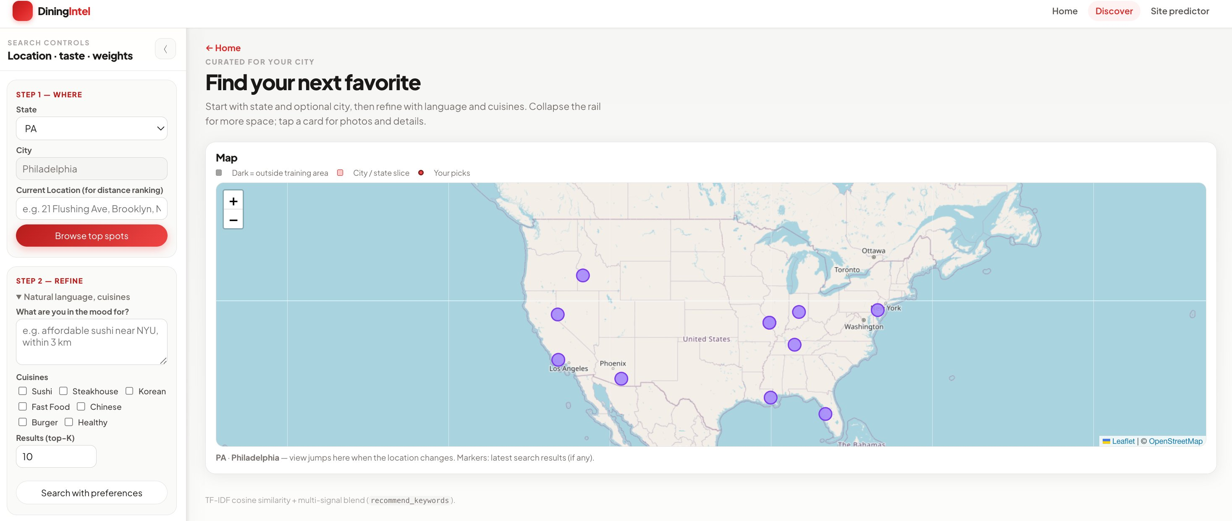
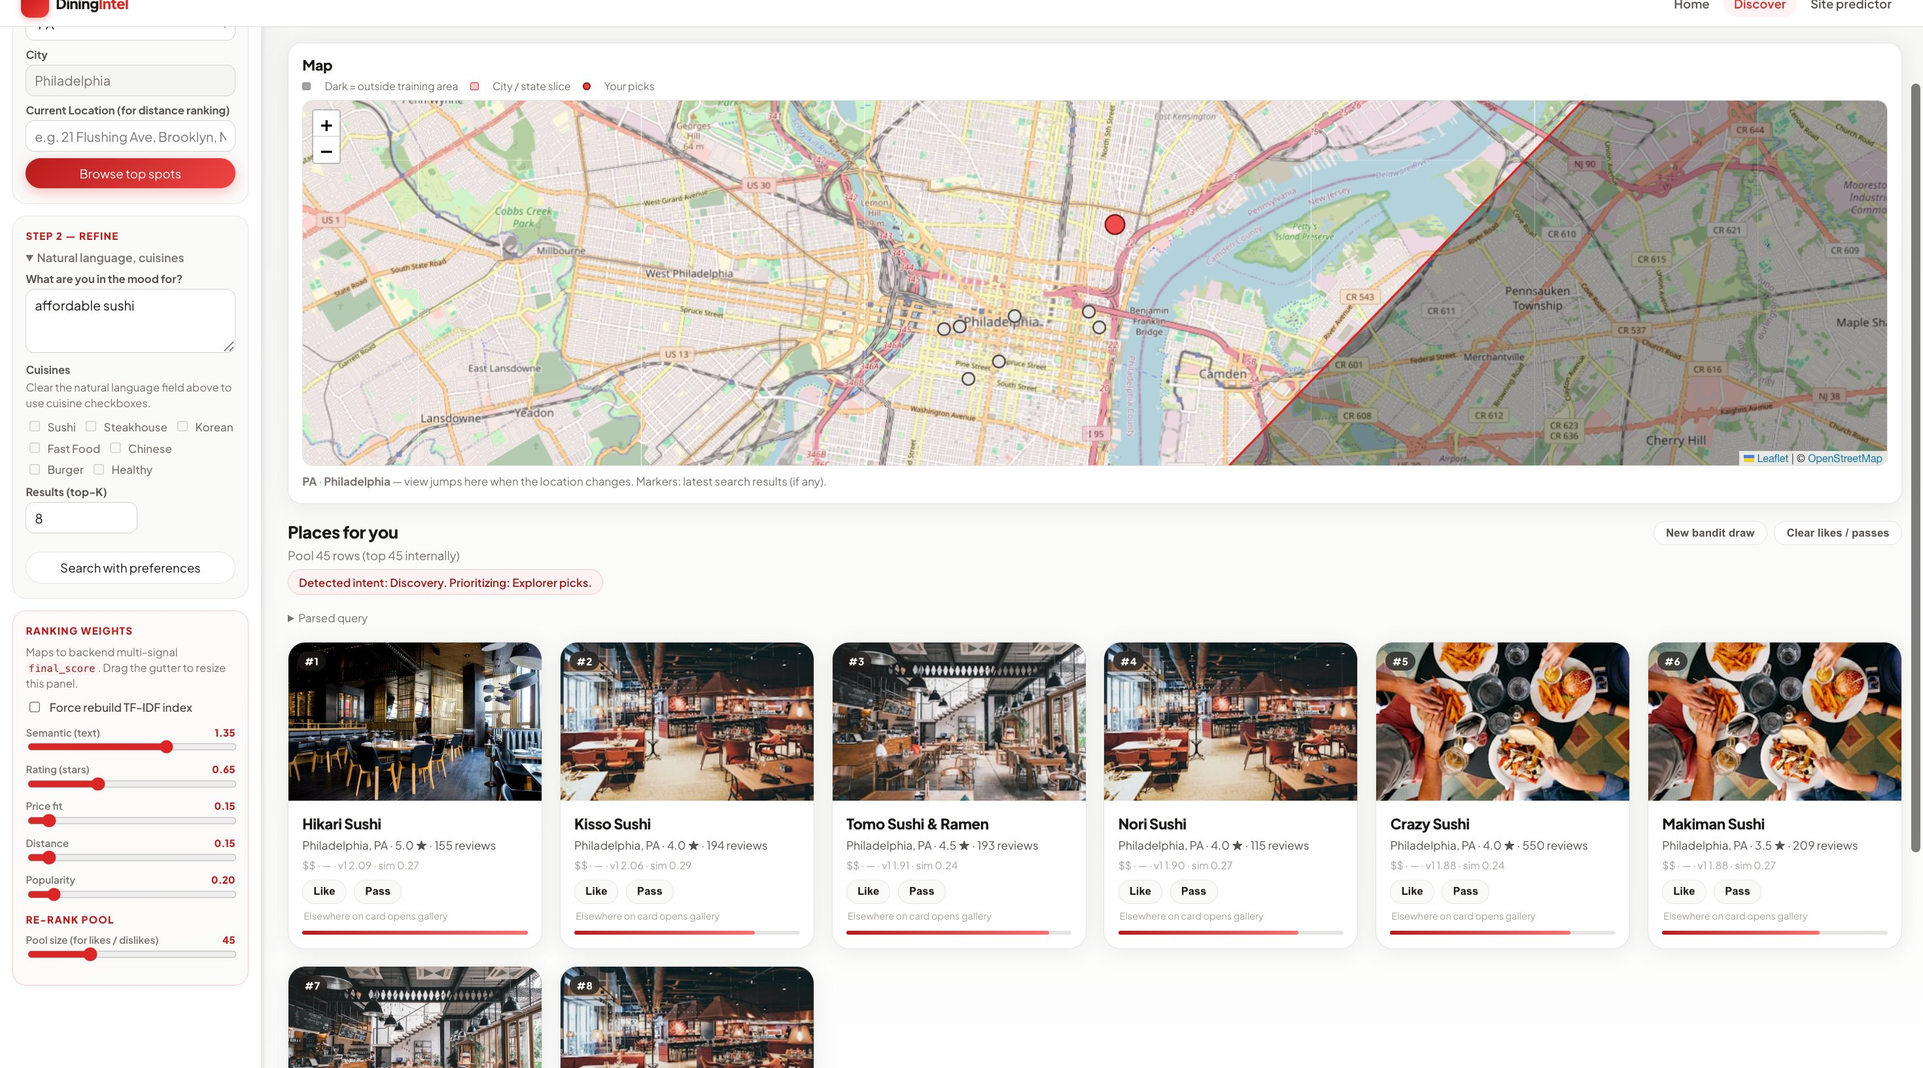
Diner Experience
1. Select state & city, set search preferences
2. Intent-aware ranked results with Like/Pass feedback
Natural language queries ("affordable sushi") • Cuisine filters • Adjustable ranking weights (semantic, rating, price, distance, popularity) • UCB bandit detects intent and adapts

Slide 5
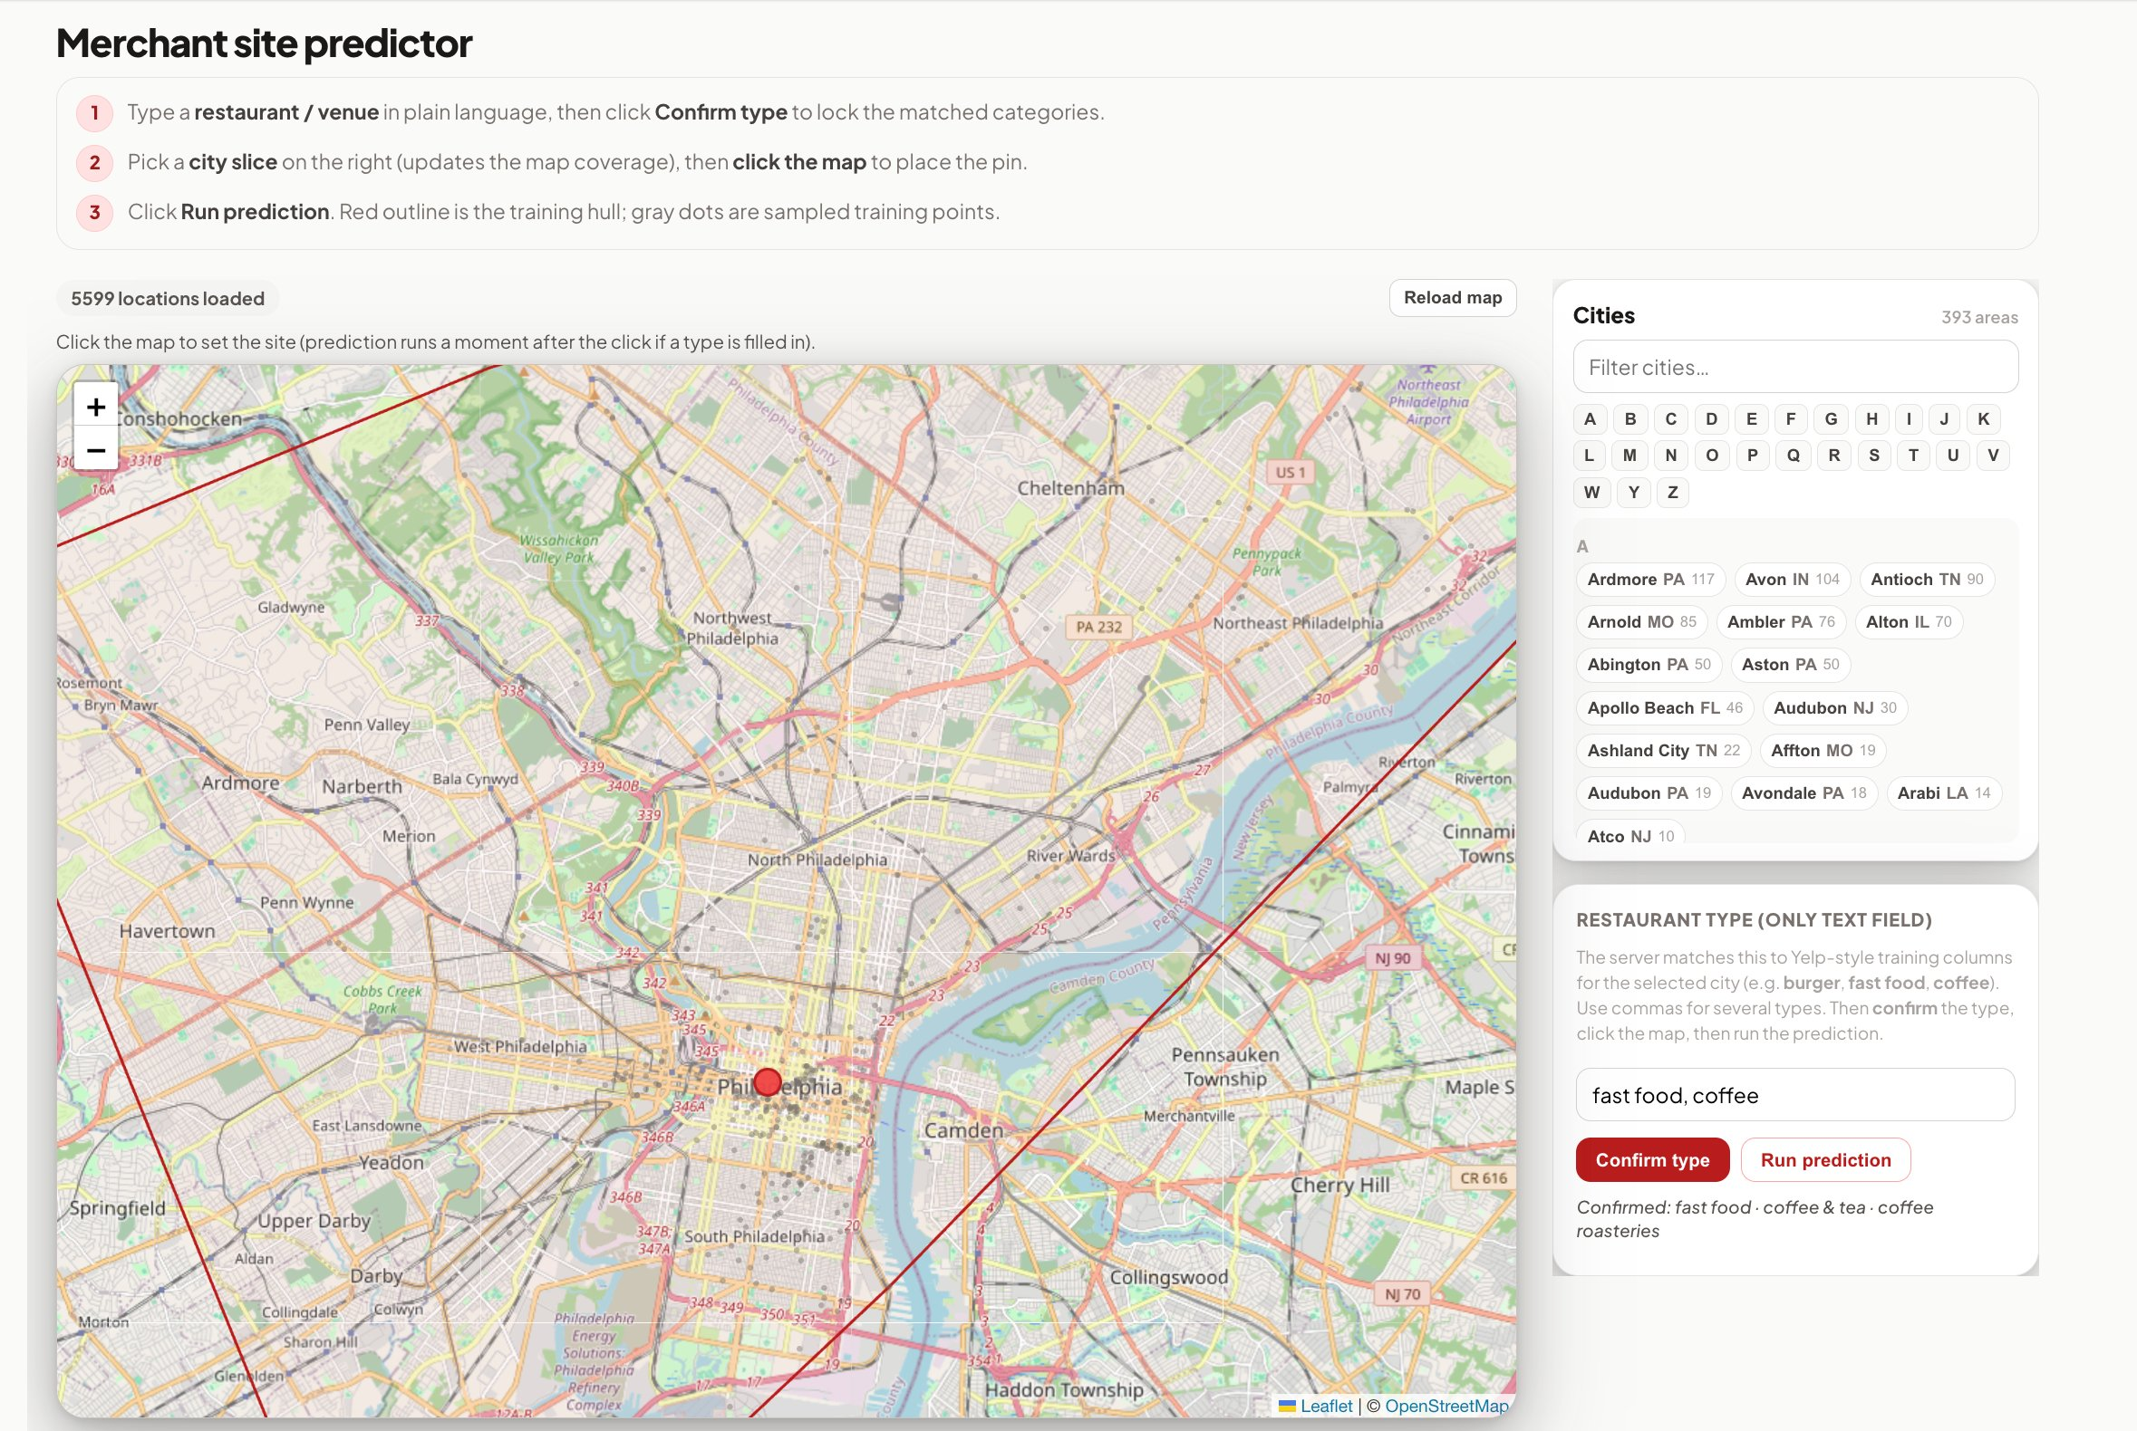
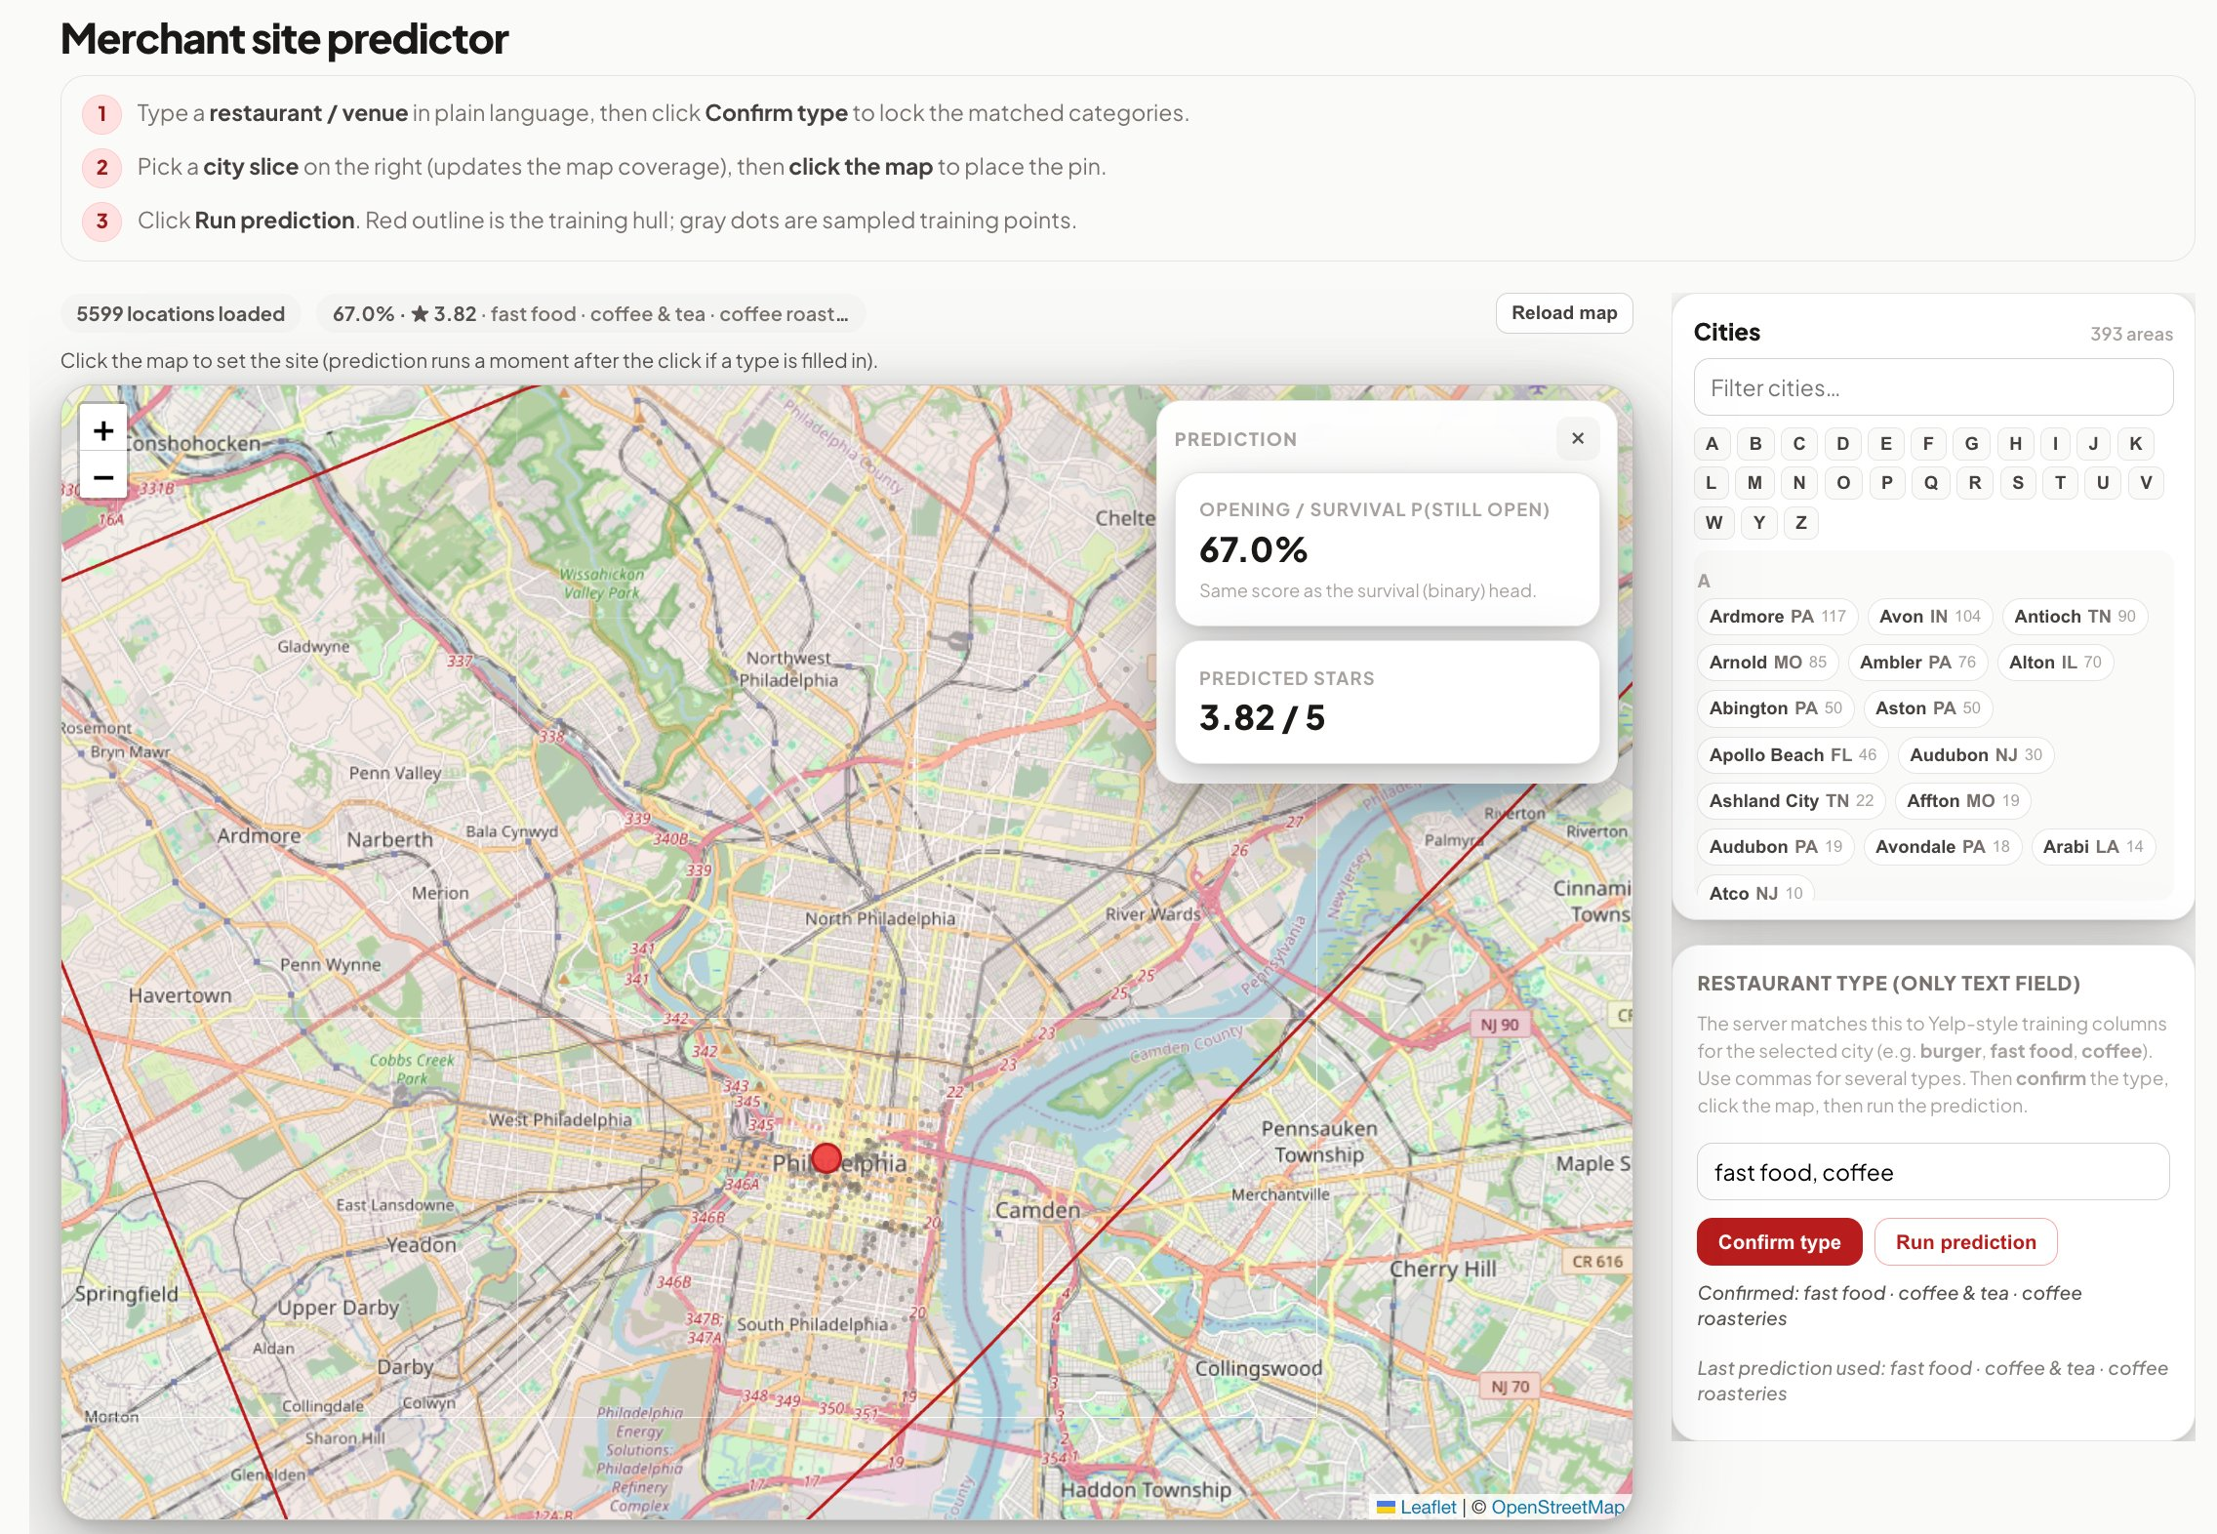
Merchant Experience
1. Choose city, enter restaurant type, click map
2. Instant prediction: survival probability + star rating
Training hull boundary shown on map • Real-time spatial feature computation • Feature preview for transparency

Slide 6


Technical Deep Dive — Diner Side
TF-IDF Retrieval (Built from Scratch)
Aggregated review text (up to 20 reviews per restaurant)
50K TF-IDF features across ~5K businesses
Manual cosine similarity + Bayesian-style star prior (trust-scaled by review count)
Bucketed Contextual UCB Bandit (Reinforcement Learning)
Convenience
Reputation
Explorer
3 Arms
×
Quick Meal
Romantic / Special
Default
3 Intents
UCB balances explore/exploit per intent • Click = reward signal • Regex-based query bucketing feeds bandit context

Slide 7
Technical Deep Dive — Merchant Side
OFFLINE PIPELINE
REAL-TIME INFERENCE
Clean raw Yelp data — parse hours, flatten attributes, one-hot categories
Merchant clicks map location + inputs category
BallTree spatial index — query neighbors at 0.5km, 1km, 3km radii
Rebuild spatial index on the fly for new location
Compute: competition density, survival rates, avg ratings per radius
Compute full feature vector (865 features)
KNN cosine similarity — how similar restaurants perform globally
Pass through both trained models instantly
Greedy forward ablation → select features that improve AUC/MAE
Survival Prob.
Star Rating
Train two HistGradientBoosting models
Ablation Study — Feature Family Impact on Survival Classifier
0.7572
0.7581
0.7680
0.7537
0.7553
0.7189
Base
+Dist
+Counts
+Gap
+Divers.
+Semantic

Slide 8
Evaluation & Results
Merchant Models (Test Set)
UCB Bandit — Offline Replay (1,687 matches)
Survival Classifier (is_open)
CTR Comparison
0.768
AUC-ROC
0.741
Accuracy
0.756
Precision
Random Baseline
0.3444
UCB Agent
0.6621
0.920
Recall
0.830
F1
Theoretical Optimal
0.6968
Rating Regressor (stars)
Learned Policy — Each intent found its best arm
Intent
Best Arm
Pulls
Q-Value
0.523
0.664
17.6%
MAE
RMSE
MAPE
Quick Meal
Convenience
538 / 550
0.939
Predicts within ~0.5 stars • Pred mean/std matches true distribution
Romantic
Explorer
493 / 551
0.692
Default
Reputation
473 / 586
0.548
All assertions passed: each intent bucket learned the expected best arm
UCB agent reaches 95% of optimal CTR (0.66 vs 0.70) • Survival model catches 92% of closures • Rating within ~0.5 stars

Slide 9


Strengths & Limitations
What Works Well
Limitations & Future Work
Survival model generalizes well
Dataset geographic coverage
Near-identical train vs. test metrics (AUC 0.768 vs 0.768, F1 0.833 vs 0.830) — no overfitting despite 865 features. The model reliably catches 92% of restaurant closures.
The Yelp Open Dataset doesn't include major cities like New York, Chicago, or San Francisco. Predictions outside the training hull are extrapolated and less reliable.
UCB bandit reaches 95% of optimal CTR
Star rating model lacks key features
Agent CTR of 0.66 vs. random baseline of 0.34 — nearly 2x improvement. Each intent bucket converged to its expected best arm with clear Q-value separation.
R² of 0.38 reflects that star ratings depend heavily on factors we can't observe from location data alone — service quality, food quality, management, ambiance. Spatial features explain where to open, not how to run it.
End-to-end full-stack app
Tourist side lacks granular data
Both modes run live with real-time inference — no pre-computed results. From-scratch TF-IDF, custom spatial features, and two distinct ML paradigms (retrieval + supervised prediction) in one deployable app.
No access to menus, prices per dish, wait times, or real-time availability. The retrieval relies on review text, which can be noisy and doesn't capture what a restaurant currently offers.

Slide 10

Live Demo
Thank you — Questions?

