Slide 1
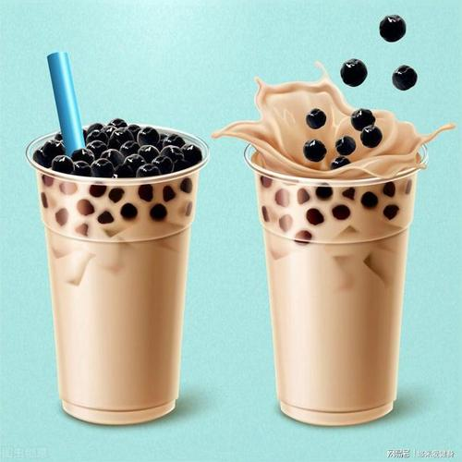
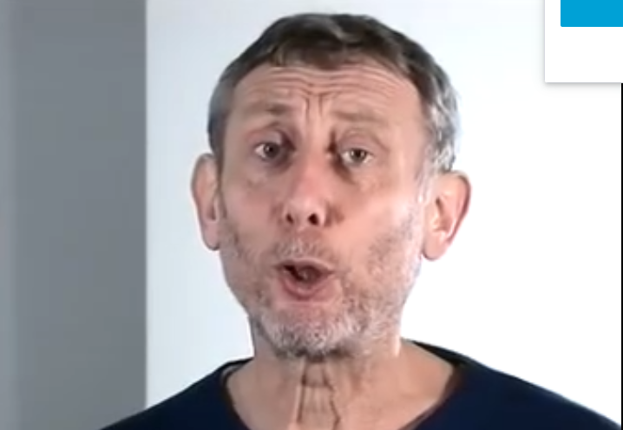

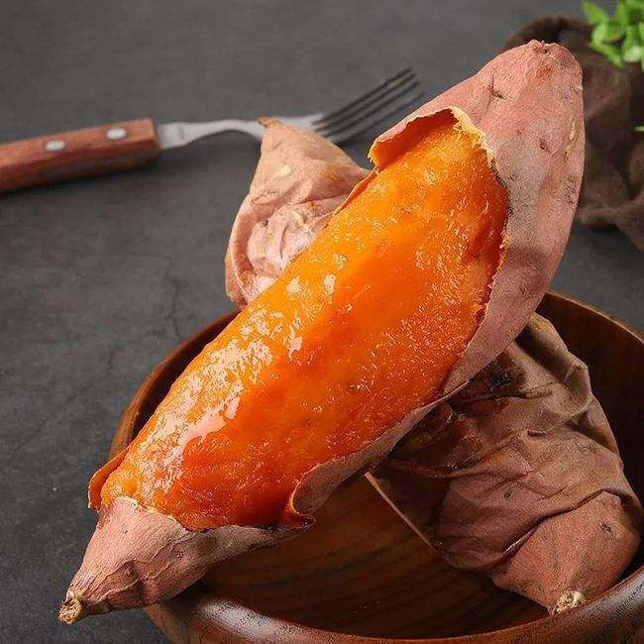
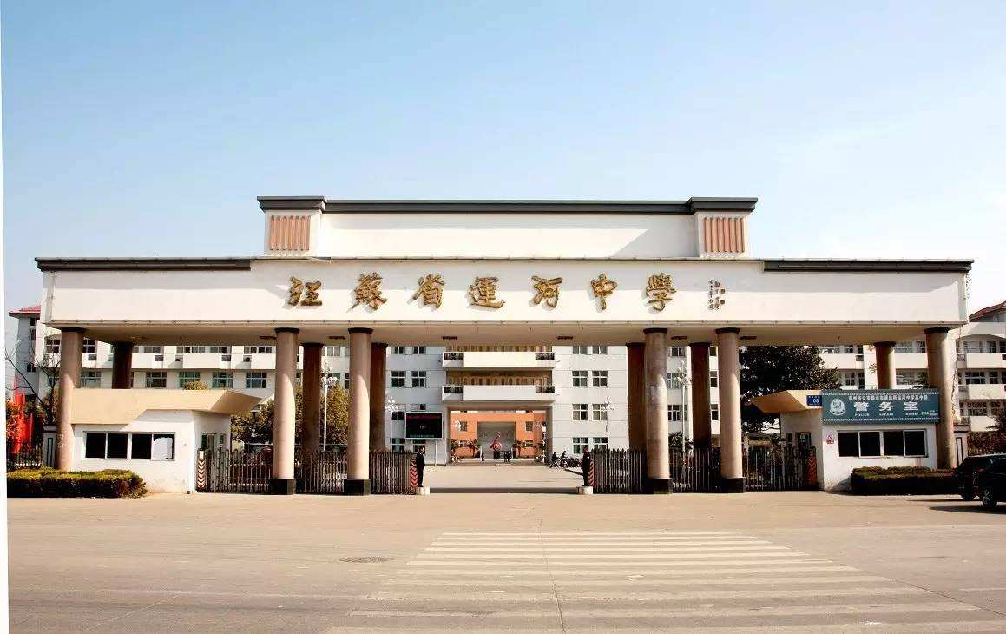
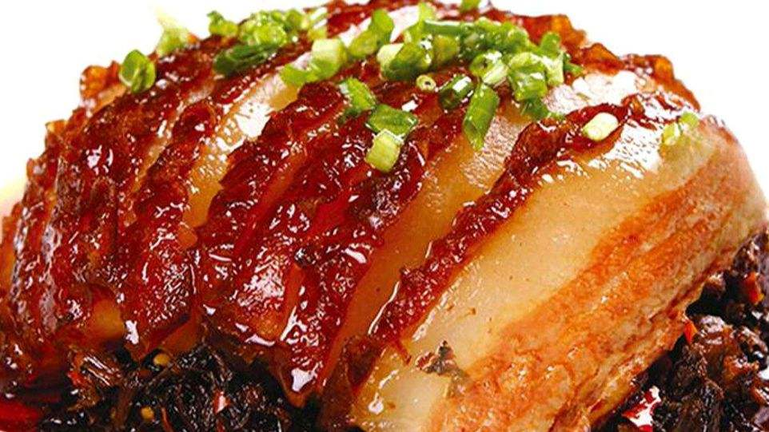
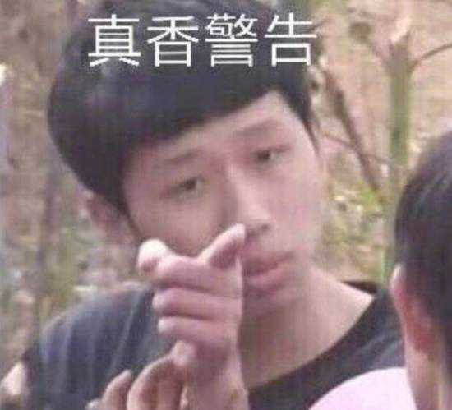
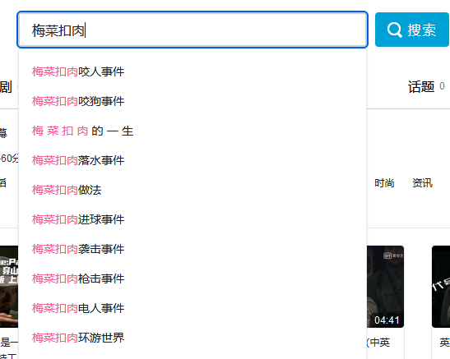
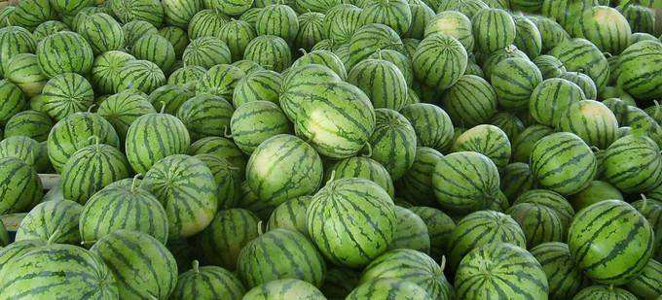



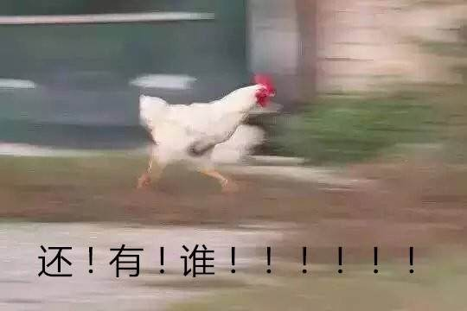
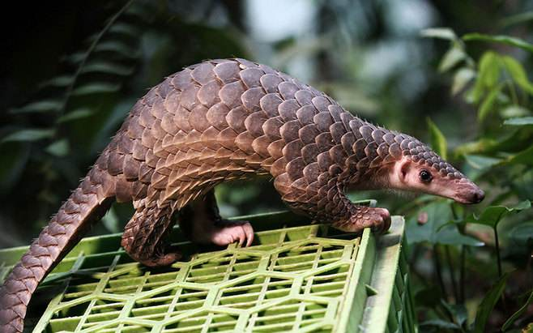

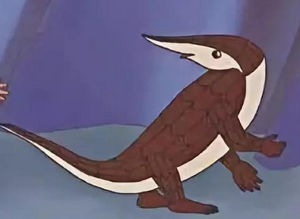
translate
Eat through the Internet
Eat through the Internet
我一开水果摊的
能卖你生瓜蛋子
Thanks for listening
TO GET MORE INFORMATION
watermelon
A GREAT COOKER
1:50/2:57
面筋
More than 70
生异形啊哥俩
撒日朗
你这瓜多少钱一斤啊
你**劈我瓜是吧
你**故意找猹是吧
Fly in, fly out

