Slide 1

Resume Filter And Cover Letter Generator Research
Group Member:
Pengyu Tao pt2649, Zhou Zhou zz3237

Slide 2
Introduction
Research Topic: Challenges in resume and cover letter writing
Research Purpose: Enhance resume and cover letter content using LLMs
Approach: Fine-tune a transformer model to generate content based on job descriptions
Objective & Ideal Outcome: Develop AI-powered generator for custom, ATS-optimized resumes and cover letters
Target Users: Job seekers across industries

Slide 3
Project Step-by-Step Overview
Data Collection: Kaggle dataset of resumes and job descriptions
User Interactions and Data Preprocessing: Text cleaning, tokenization, and formatting
Model Training: GPT4o, Fine-tuning GPT-2 and google T5-base for personalized content generation
Model Comparison: Comparison Methods by Bleu Score, Rouge-L and Bert Score testing

Slide 4
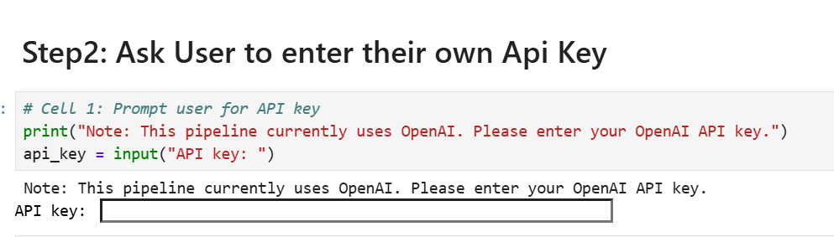
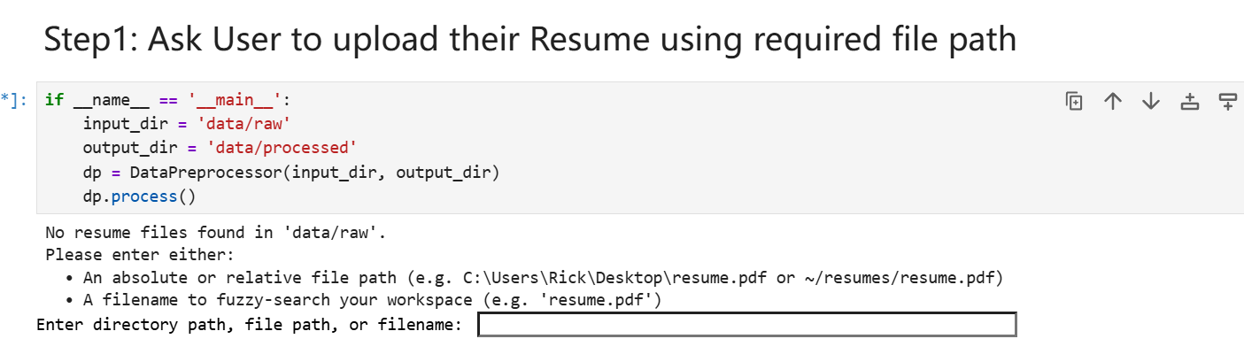
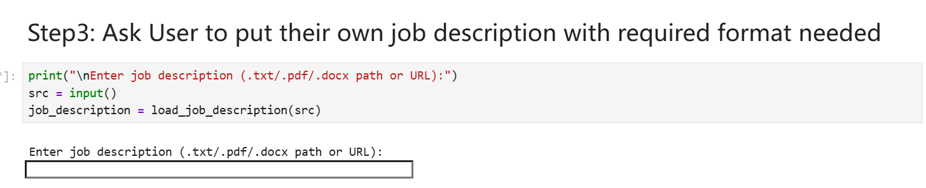
Data Preprocessing and User Interactions
What user has to do: Job description, Resume content, and Api keys(if required for the chosen models)
Data Processing: Extracting key sections, identifying keywords, Convert to json files
Output Generation: Clean text resume and cover letter in .txt format

Slide 5
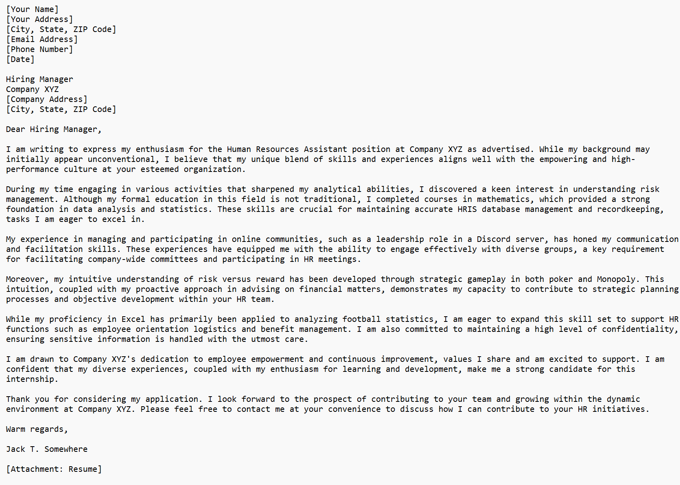
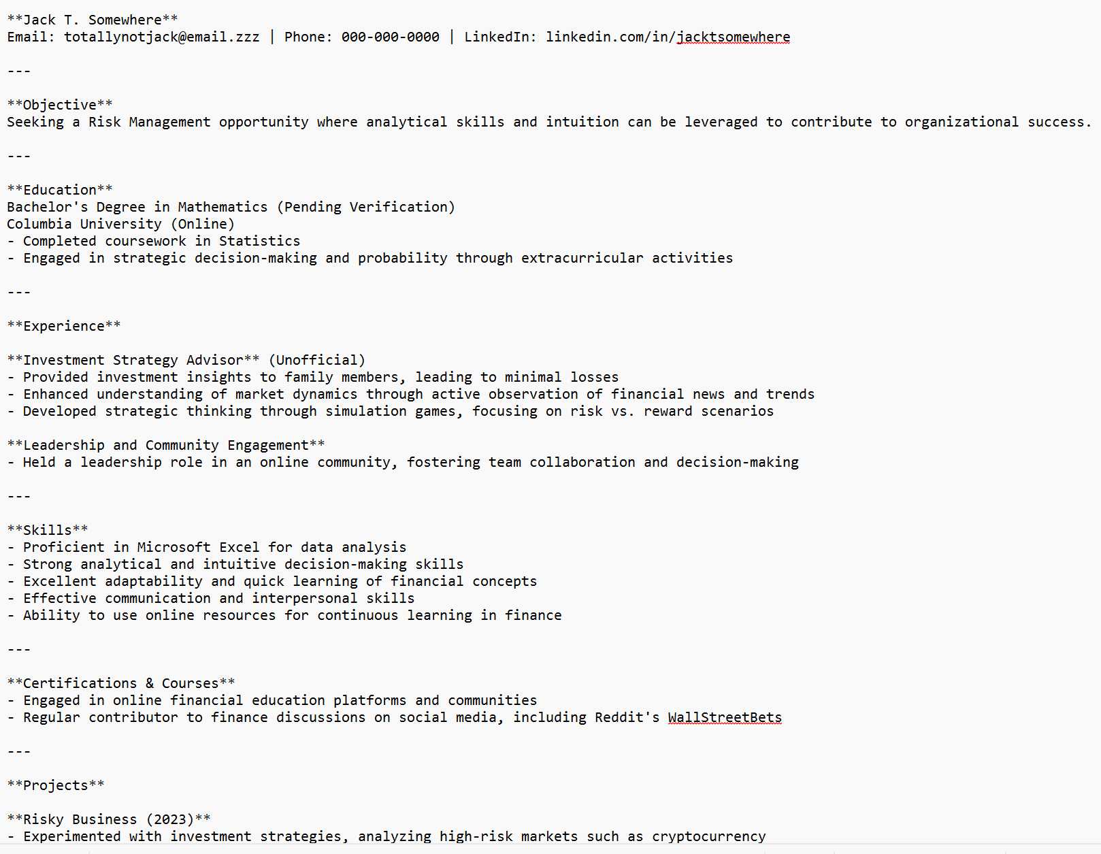
GPT-4o-mini Model
A complete and mature model, few training required
Instead, we alter and managing prompt for this model
Results:
Generate clean and accurate text result
Changing input prompt won’t changing its accuracy
More
Pros: adding prompt length will limit its creativity but provide more accurate results
Cons: short prompt will fake user’s actual skills to fulfill the job requirements

Slide 6
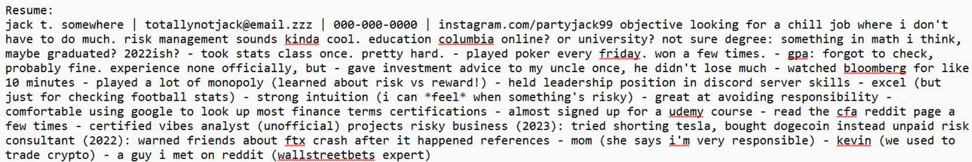
Fine-tuned GPT-2 Model
Steps: Data preprocessing same as done in GPT-4o-mini version
Difference in training steps:
Adding a Fine Tuning Approach, altering Prompts for ai to reconsider the outputs
Customized training of GPT-2 model using collected resume and job description dataset from chosen kaggle dataset
Comparing the difference in results when we changing prompts
During training, the model learns to align the user’s experiences and skills with the targeted job requirements.

Slide 7
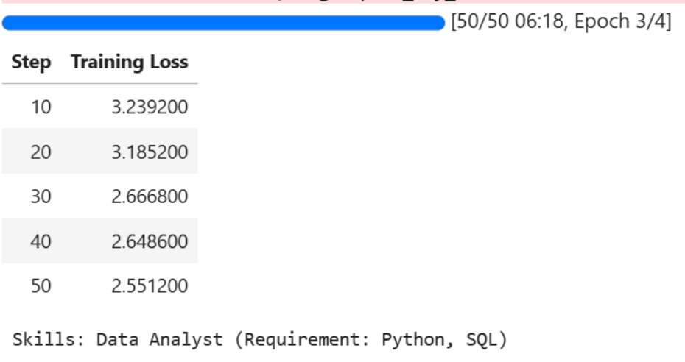
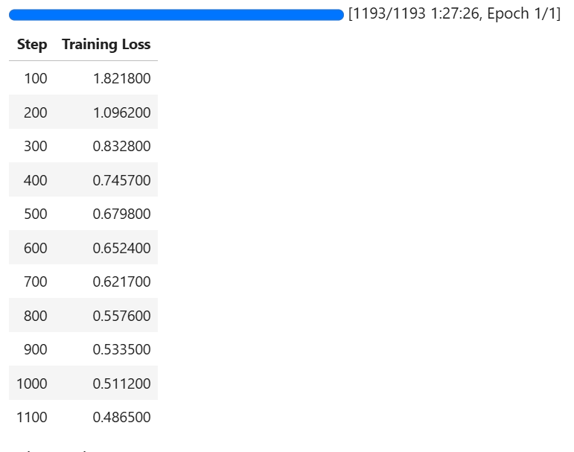
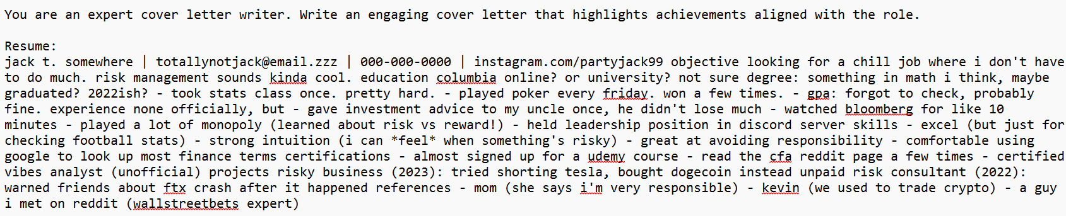
Fine-tuned GPT-2 Model
Pros: able to do personalization for resumes, no fake skills, strictly following prompts for text alignments
Cons: Less creativity, some garbled characters, and miss accuracy in required skill and positions; training loss increase and learning-rate decrease due to desired fast training time.

Slide 8
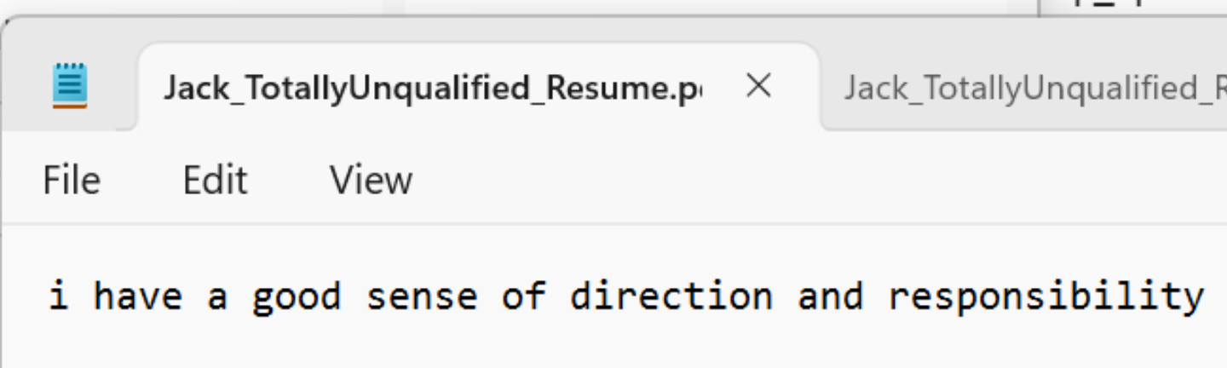
Fine-tuned google T5-base/small Model
Change(tried two methods): By precomputing embeddings for our resume pairs and using FAISS to retrieve just three examples for a few-shot prompt to flan-t5-small, we eliminated all fine-tuning and achieve CPU-only, sub-second resume and cover letter generation.
However, the result is bad: just a sentence

Slide 9
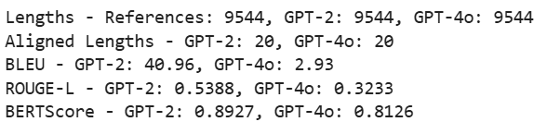
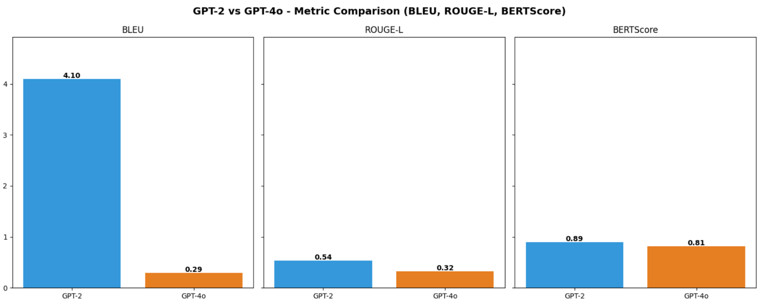
Evaluation Methods And Comparison Results
Testing Methods: Bleu Score, Rouge-L and Bert Score testing
Bleu Score:
GPT-2 has higher score of 40.96 compared to GPT-4o’s 2.93, indicating that GPT-2 closely follows the reference text in terms of word-level and n-gram overlaps, making its output more aligned with the original content, whereas GPT-4o adopts a more creative generation strategy, resulting in lower lexical overlap but potentially more varied expression.

Slide 10
Evaluation Methods And Comparison Results
ROUGE-L and BERT Score:
Despite scoring lower in ROUGE-L (0.3233 vs. 0.5388), GPT-4o maintains a comparable BERTScore (0.8126 vs. 0.8927) to GPT-2, suggesting that while GPT-4o exhibits less structural and n-gram alignment with the reference text, it retains considerable semantic consistency, indicating that its output remains contextually relevant even when expressed differently.

Slide 11
Some Summaries of good side
Achievements in Research purpose:
verified that the more compute power the model needed, the more accurate context the model will be able to generate.(tested by length of training time for gpt2)
Faster training time brings accuracy loss.
Gpt4o is more good at creativity than semantic alignment
Achievements in Application purpose:
For application purpose, we achieve using a cheaper price for creating accurate context for resumes.
We also utilize the existing gpt4o model to create a shortcut use for one step generation of user’s resume

Slide 12
Some Challenges and Foresights
Current Issues:
Model Complexity: Hard to simplifying architecture for faster training. Faster training time causes accuracy loss.
Model Accuracy?
Data Quality?
User Experience: hard to use without coding knowledge
Future Adjustments:
Model Complexity: better algorithm & training logic
Model Accuracy: ask user to provide fixed context for gpt2 model & use gpt4o model for creativity
Data Quality: Ensuring diverse and representative dataset
User Experience: enhancing UI for easy interaction
Notes:
Tested by gpt2 model, one training use less parameters

Slide 13
Q&A Session
Summary: AI-driven solution to enhance job application effectiveness
Next Steps: Further testing, refinement, and deployment
Q&A: Open for questions

