Slide 1
堆优化Dijkstra动画演示
蚊子的个人博客
提示：1.请使用幻灯片播放
2.请结合代码观看动画演示，代码在文末。
制作：蚊子 时间：2019-11-7 仅供学习交流

Slide 2
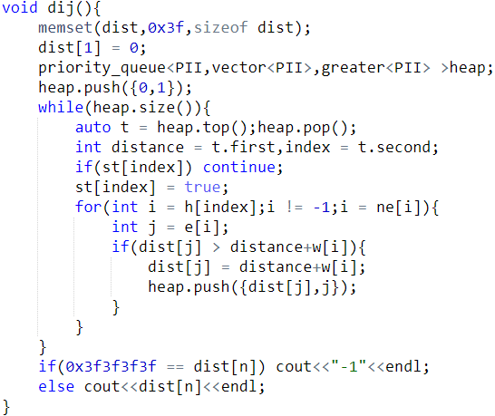
0
1
2
3
4
5
6
7
8
9
10
H
-1
9
3
8
4
5
-1
-1
-1
-1
Distance= 0
Index
= 1
E
2
3
1
4
5
2
4
2
2
2
I = 9
w
2
3
8
3
7
3
1
9
3
8
I = 7
I = 0
I = -1
ne
-1
-1
-1
-1
2
1
-1
0
6
7
J = 2
0
2
F
F
F
F
F
dist
8
Distance+w[i] = 2
Distance+w[i] = 9
Distance+w[i] = 8
st
1
2
1
2
3
3
8
1
{0,1}
3
3
{8,2}
3
4
5
7

Slide 3
0
1
2
3
4
5
6
7
8
9
10
H
-1
9
3
8
4
5
-1
-1
-1
-1
Distance= 5
Distance= 2
Index
= 4
Index
= 2
E
2
3
1
4
5
2
4
2
2
2
I = 2
w
2
3
8
3
7
3
1
9
3
8
I = 4
I = -1
I = -1
I = -1
I = 0
I = 3
ne
-1
-1
-1
-1
2
1
-1
0
6
7
J = 5
J = 4
J = 1
J = 2
5
12
dist
0
2
F
F
F
Distance+w[i] = 5
Distance+w[i] = 2
Distance+w[i] = 13
Distance+w[i] = 12
st
1
2
4
2
1
2
3
3
8
1
{5,4}
3
3
{2,2}
{8,2}
{12,5}
3
4
5
7

Slide 4
0
1
2
3
4
5
6
7
8
9
10
H
-1
9
3
8
4
5
-1
-1
-1
-1
Distance= 15
Distance= 12
Distance= 8
Distance= 5
Index
= 3
Index
= 5
Index
= 2
Index
= 4
E
2
3
1
4
5
2
4
2
2
2
I = -1
I = -1
w
2
3
8
3
7
3
1
9
3
8
I = 6
I = 2
I = 1
I = 8
I = 4
I = 5
I = -1
I = -1
I = -1
I = 0
I = 3
ne
-1
-1
-1
-1
2
1
-1
0
6
7
J = 4
J = 2
J = 5
J = 3
J = 4
J = 2
J = 1
J = 2
15
5
12
dist
0
2
F
F
F
Distance+w[i] = 15
Distance+w[i] = 16
Distance+w[i] = 18
Distance+w[i] = 13
st
1
2
3
4
5
完成
Dist[n] = 12
2
1
2
3
3
8
1
{8,2}
{12,5}
{15,3}
3
3
3
4
5
7

Slide 5
5 10
1 2 2
5 3 3
4 1 8
2 4 3
4 5 7
5 2 3
3 4 1
1 2 9
3 2 3
1 2 8

