Slide 1
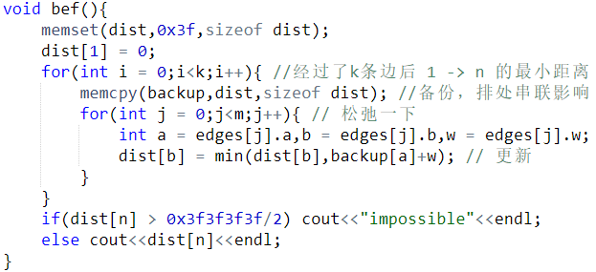
1
K = 3
2
2
7
3
2
3
9
5
2
1
4
5
6
j = 5
j = 3
j = 1
I = 0
j = 2
j = 0
j = 6
j = 4
j = 7
F
2
0
F
F
F
dist
2
F
F
a = 2、b = 4、w = 3
a = 3、b = 2、w = 7
a = 1、b = 3、w = 2
a = 1、b = 2、w = 2
a = 4、b = 6、w = 5
a = 5、b = 6、w = 1
a = 4、b = 5、w = 2
a = 3、b = 5、w = 9
backup
0
F
F
F
F
F
Backup[a] + w = 2
Backup[a] + w = F

Slide 2
1
K = 3
2
2
7
3
2
3
9
5
2
1
4
5
6
I = 1
j = 5
j = 0
j = 1
j = 6
j = 2
j = 7
j = 3
j = 4
0
2
2
5
11
dist
F
F
F
a = 3、b = 2、w = 7
a = 2、b = 4、w = 3
a = 1、b = 3、w = 2
a = 1、b = 2、w = 2
a = 5、b = 6、w = 1
a = 4、b = 5、w = 2
a = 3、b = 5、w = 9
a = 4、b = 6、w = 5
backup
0
2
2
F
F
F
Backup[a] + w = 2
Backup[a] + w = 9
Backup[a] + w = 11
Backup[a] + w = 5
Backup[a] + w = F

Slide 3
1
K = 3
2
2
7
3
2
3
9
5
2
1
4
5
6
完成
Dsit[n] = 10
j = 5
I = 2
j = 6
j = 0
j = 7
j = 4
j = 1
j = 2
j = 3
0
2
2
5
7
10
dist
11
F
a = 1、b = 2、w = 2
a = 3、b = 2、w = 7
a = 2、b = 4、w = 3
a = 3、b = 5、w = 9
a = 4、b = 5、w = 2
a = 4、b = 6、w = 5
a = 5、b = 6、w = 1
a = 1、b = 3、w = 2
backup
0
2
2
5
11
F
Backup[a] + w = 11
Backup[a] + w = 5
Backup[a] + w = 2
Backup[a] + w = 10
Backup[a] + w = 12
Backup[a] + w = 9
Backup[a] + w = 7

Slide 4
6 8 3
1 2 2
1 3 2
3 2 7
2 4 3
3 5 9
4 5 2
4 6 5
5 6 1

