Slide 2
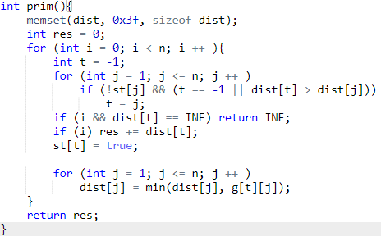
1
t = -1
t = -1
t = 1
t = 2
1
3
4
4
2
2
3
2
3
1
5
F
1
F
3
F
1
F
2
F
5
F
2
F
4
2
3
F
4
F
3
dist
F
F
F
F
F
I = 1
1
1
3
I = 0
F
1
2
3
F
Res = 0
st
0
1
Res = 1
1
0
0
0
0
2
1

Slide 4
5 8
1 2 1
1 3 2
1 4 3
2 3 2
3 4 4
4 5 3
5 3 2
5 2 1

