Slide 2
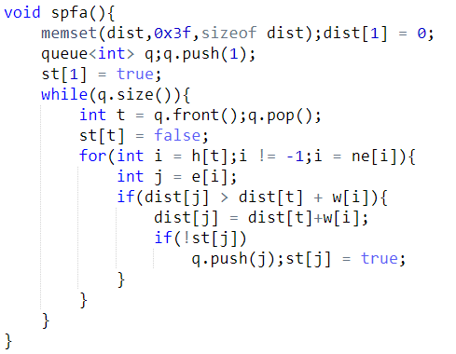
1
2
2
7
3
2
3
9
2
5
4
1
J = 5
J = 2
J = 4
J = 6
J = 2
J = 3
5
6
Dist[t] + w[i] = 7
Dist[t] + w[i] = 11
Dist[t] + w[i] = 8
Dist[t] + w[i] = 10
Dist[t] + w[i] = 9
Dist[t] + w[i] = 5
Dist[t] + w[i] = 2
st
1
0
0
0
0
1
1
0
0
0
1
0
1
0
0
0
1
完成
Dist[n] = 8
1
2
3
4
5
6
dsit
F
F
F
F
F
0
7
2
2
5
11
10
8
Q
1
3
4
5
6
2

